Slide 1
Graphics – Part 3
HRP223 – 2013
December 2, 2013
Copyright © 1999-2013 Leland Stanford Junior University. All rights reserved.
Warning: This presentation is protected by copyright law and international treaties. Unauthorized reproduction of this presentation, or any portion of it, may result in severe civil and criminal penalties and will be prosecuted to maximum extent possible under the law.

Slide 2
Statistical Graphics Procs
proc sgPlot
general plotting procedure that replaces gplot
proc sgScatter
lots of tools for scatterplots and scatter matrices
proc sgPanel
quick and easy trellis/lattice/matrix/panel of plots
Proc sgRender
used with proc template to make totally custom plots
It replaces proc greplay

Slide 3
What is a good graphic?
Don’t make your audience think unnecessarily!
The point of the graphic should stand out instantly.
Plot the quantity (inference) that you want people to notice.
Show the central tendency and the variability.
Minimize the amount of ink on the page.
Be sure colorblind people can understand it.
Use a black and white photocopier and make sure you can distinguish all groups.

Slide 4
Avoid Thinking
Put labels on the graphic directly instead of using a key.
If you want people to compare the difference between two lines, plot the difference, not the two lines.
Don’t include graphics that your audience will not understand.

Slide 5
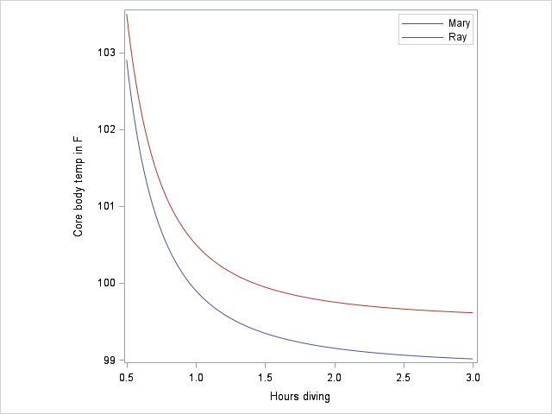
Bivariate Comparisons with Lines
People are extremely bad at judging the distance between two curves. Never ask people to judge up and down (vertical) distances between curves.
Based on: Robbins Creating More Effective Graphs, 2005
Notes:
data hypothermia;
label time = "Hours spent diving";
do time = .5 to 3 by .001;
Ray = 99.5 - .6 + 1/time**2;
Mary = Ray + .6;
label Difference = "00"x;
Difference = Ray-Mary;
output;
end;
run;
proc sgplot data = hypothermia aspect=1 tmplout="c:\blah\t1.sas";
series x=time y=Ray / name="Ray";
series x=time y=Mary / name="Mary";
keylegend "Mary" "Ray" / down=2 location=inside;
yaxis label="Core body temperature in (*ESC*){unicode '00B0'x}F";
xaxis label="Hours diving";
run;
proc sgplot data = hypothermia aspect=1 tmplout="c:\blah\t2.sas";
series x=time y=Difference;
inset "Difference between Mary and Ray" /position=bottomleft;
run;
proc template;
define statgraph paired;
begingraph / subpixel=on;
layout lattice / rowweights=(.85 .15) columndatarange=union rowgutter=5px;
columnaxes;
columnaxis / display=(ticks tickvalues label);
endcolumnaxes;
layout overlay / cycleattrs=true aspectRatio=1.00 xaxisopts=( Label="Hours diving" type=linear )
y2axisopts=(labelFitPolicy=Split)
yaxisopts=( Label="Core body temperature in (*ESC*){unicode '00B0'x}F" labelFitPolicy=Split type=linear )
y2axisopts=(labelFitPolicy=Split);
SeriesPlot X='time'n Y='Ray'n / primary=true LegendLabel="Ray" NAME="Ray";
SeriesPlot X='time'n Y='Mary'n / LegendLabel="Mary" NAME="Mary";
DiscreteLegend "Mary" "Ray" / Location=Inside down=2 order=columnMajor
autoAlign=(TopLeft TopRight BottomRight BottomLeft Bottom Top Right Left);
endlayout;
layout overlay / aspectRatio=1.00 yaxisopts=(labelFitPolicy=Split) y2axisopts=(labelFitPolicy=Split);
SeriesPlot X='time'n Y='Difference'n / primary=true LegendLabel=" " NAME="SERIES";
Layout Gridded / Border=false halign=left valign=bottom;
Layout Gridded;
Entry halign=left "Difference in (*ESC*){unicode '00B0'x}F between Mary and Ray" / textattrs=GraphValueText;
endlayout;
endlayout;
endlayout;
endlayout;
endgraph;
end;
run;
proc sgrender data=hypothermia template=paired;
run;

Slide 6
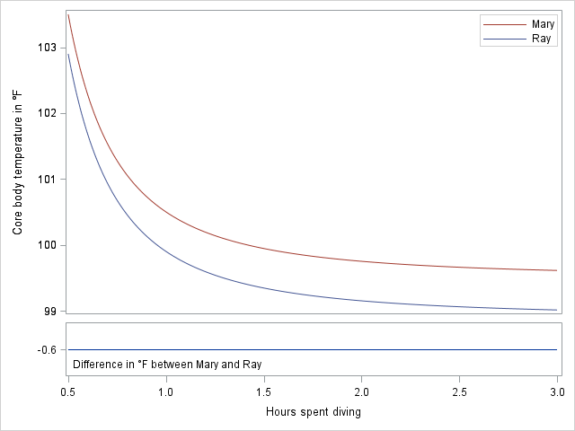
If the point is to show a consistent difference between the two lines... Plot the difference!
Notes:
data hypothermia;
label time = "Hours spent diving";
do time = .5 to 3 by .001;
Ray = 99.5 - .6 + 1/time**2;
Mary = Ray + .6;
label Difference = "00"x;
Difference = Ray-Mary;
output;
end;
run;
proc sgplot data = hypothermia aspect=1 tmplout="c:\blah\t1.sas";
series x=time y=Ray / name="Ray";
series x=time y=Mary / name="Mary";
keylegend "Mary" "Ray" / down=2 location=inside;
yaxis label="Core body temperature in (*ESC*){unicode '00B0'x}F";
xaxis label="Hours diving";
run;
proc sgplot data = hypothermia aspect=1 tmplout="c:\blah\t2.sas";
series x=time y=Difference;
inset "Difference between Mary and Ray" /position=bottomleft;
run;
proc template;
define statgraph paired;
begingraph / subpixel=on;
layout lattice / rowweights=(.85 .15) columndatarange=union rowgutter=5px;
columnaxes;
columnaxis / display=(ticks tickvalues label);
endcolumnaxes;
layout overlay / cycleattrs=true aspectRatio=1.00 xaxisopts=( Label="Hours diving" type=linear )
y2axisopts=(labelFitPolicy=Split)
yaxisopts=( Label="Core body temperature in (*ESC*){unicode '00B0'x}F" labelFitPolicy=Split type=linear )
y2axisopts=(labelFitPolicy=Split);
SeriesPlot X='time'n Y='Ray'n / primary=true LegendLabel="Ray" NAME="Ray";
SeriesPlot X='time'n Y='Mary'n / LegendLabel="Mary" NAME="Mary";
DiscreteLegend "Mary" "Ray" / Location=Inside down=2 order=columnMajor
autoAlign=(TopLeft TopRight BottomRight BottomLeft Bottom Top Right Left);
endlayout;
layout overlay / aspectRatio=1.00 yaxisopts=(labelFitPolicy=Split) y2axisopts=(labelFitPolicy=Split);
SeriesPlot X='time'n Y='Difference'n / primary=true LegendLabel=" " NAME="SERIES";
Layout Gridded / Border=false halign=left valign=bottom;
Layout Gridded;
Entry halign=left "Difference in (*ESC*){unicode '00B0'x}F between Mary and Ray" / textattrs=GraphValueText;
endlayout;
endlayout;
endlayout;
endlayout;
endgraph;
end;
run;
proc sgrender data=hypothermia template=paired;
run;

Slide 7
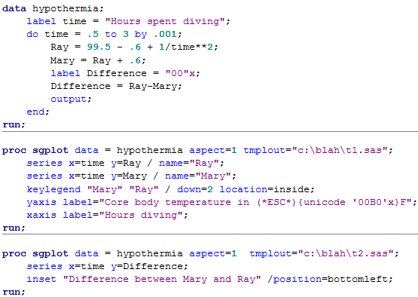
Making a two panel plot

Slide 8
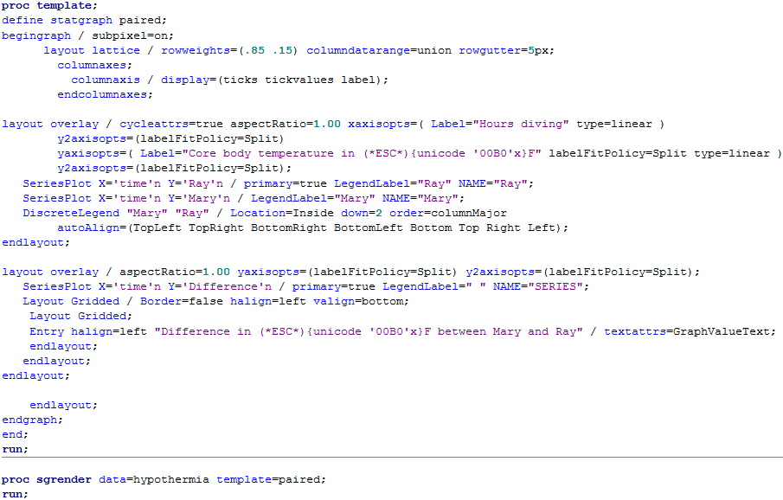
Say I have lattice with a the top cell taking up 85% of the graphic.
From t1.sas
From t2.sas

Slide 9
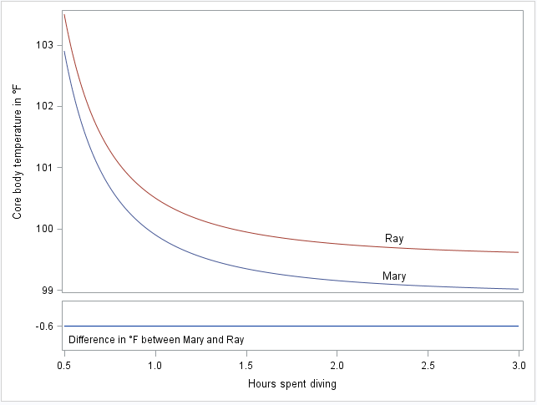
Notes:
data hypothermia;
label time = "Hours spent diving";
do time = .5 to 3 by .001;
Ray = 99.5 - .6 + 1/time**2;
Mary = Ray + .6;
label Difference = "00"x;
Difference = Ray-Mary;
output;
end;
run;
data who;
function = "text"; x1=75; y1 = 26; label = "Ray "; output;
function = "text"; x1=75; y1 = 15; label = "Mary"; output;
run;
proc sgplot data = hypothermia aspect=1 tmplout="c:\blah\t1.sas" sganno=who noautolegend;
series x=time y=Ray / name="Ray";
series x=time y=Mary / name="Mary";
*keylegend "Mary" "Ray" / down=2 location=inside;
yaxis label="Core body temperature in (*ESC*){unicode '00B0'x}F";
xaxis label="Hours diving";
run;
proc sgplot data = hypothermia aspect=1 tmplout="c:\blah\t2.sas";
series x=time y=Difference;
inset "Difference between Mary and Ray" /position=bottomleft;
run;
proc template;
define statgraph paired;
begingraph / subpixel=on;
layout lattice / rowweights=(.85 .15) columndatarange=union rowgutter=5px;
columnaxes;
columnaxis / display=(ticks tickvalues label);
endcolumnaxes;
layout overlay / cycleattrs=true aspectRatio=1.00 xaxisopts=( Label="Hours diving" type=linear ) y2axisopts=(labelFitPolicy=Split) yaxisopts=( Label="Core body temperature in (*ESC*){unicode '00B0'x}F" labelFitPolicy=Split type=linear ) y2axisopts=(labelFitPolicy=Split);
SeriesPlot X='time'n Y='Ray'n / primary=true LegendLabel="Ray" NAME="Ray";
SeriesPlot X='time'n Y='Mary'n / LegendLabel="Mary" NAME="Mary";
DrawText "Ray" / X=75 Y=20;
DrawText "Mary" / X=75 Y=07;
endlayout;
layout overlay / aspectRatio=1.00 yaxisopts=(labelFitPolicy=Split) y2axisopts=(labelFitPolicy=Split);
SeriesPlot X='time'n Y='Difference'n / primary=true LegendLabel=" " NAME="SERIES";
Layout Gridded / Border=false halign=left valign=bottom;
Layout Gridded;
Entry halign=left "Difference in (*ESC*){unicode '00B0'x}F between Mary and Ray" / textattrs=GraphValueText;
endlayout;
endlayout;
endlayout;
endlayout;
endgraph;
end;
run;
proc sgrender data=hypothermia template=paired;
run;

Slide 10
Plot Types
Categorical variables
Descriptive
Bar charts
Dot plots
Inferential
Continuous variables
Histogram
Box plot
Violin plots
Quantile and QQ plots

Slide 11
Frequency Plots
EG for frequency plots
Custom code

Slide 12
Bar Charts
The ink-to-information ratio is lousy.
A one dimensional quantity is being “expanded” into two dimensions.
Doubling of the amount corresponds to how much of an increase in area?

Slide 13
Examples of Statistical Graphics
From the authors of your book:
http://support.sas.com/resources/papers/proceedings10/154-2010.pdf
SAS Tech support:
http://support.sas.com/sassamples/graphgallery/PROC_SGPLOT.html
The documentation:
http://support.sas.com/documentation/cdl/en/grstatproc/64978/HTML/default/viewer.htm#n06d3rt7nhhqq4n11xffmms8oj3z.htm
As you look in old documentation you will see many methods to specify group colors. Remember to use the styleattrs statement in 9.4 sgplot.

Slide 14
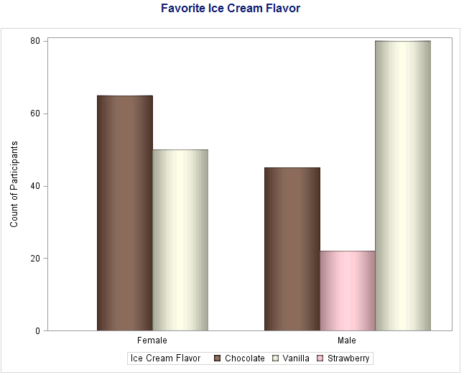
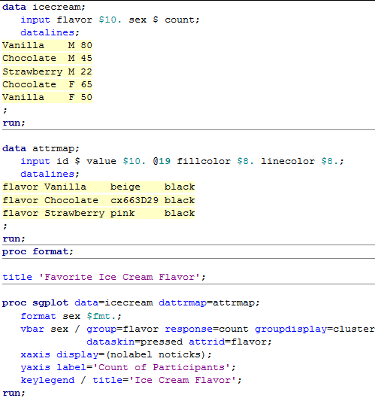
http://support.sas.com/kb/43/731.html
cx followed by the hex code for
Notice the bar order... vs the legend.
No longer needed in 9.4.

Slide 15
Picking Colors
SAS knows lots of common color names
The default color schemes are designed to NOT give extra emphasis to one group over another.
You can pick a color by typing cx followed by a 6 character hex color id.
Wikipedia is your friend...
Kuler is wonderful for picking schemes https://kuler.adobe.com/create/color-wheel/

Slide 16
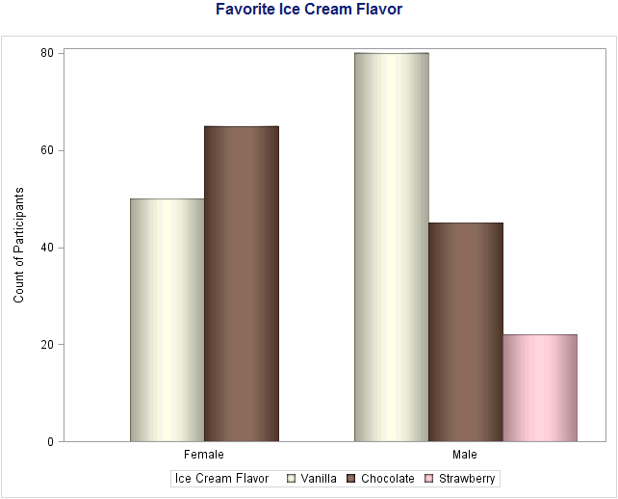
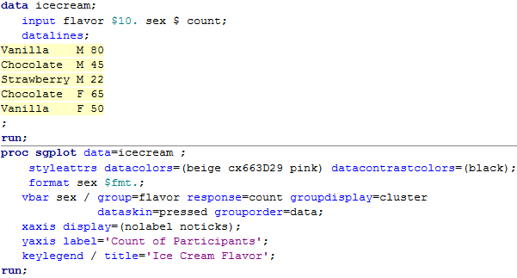
Use styleattrs!
Set the order.

Slide 17
Making a web page with art
Make a programming node in EG and paste in my SAS header file:
http://www.stanford.edu/class/hrp223/2013/ods/Header20130822.sas
Fix the path and date.
Paste in your analysis and graphic code
You can paste in SG code or EG generated code.
Fix the titles.
Run the code
Make a folder in your WWW space
Make and move a .htaccess file
Move all the files to the folder

Slide 18
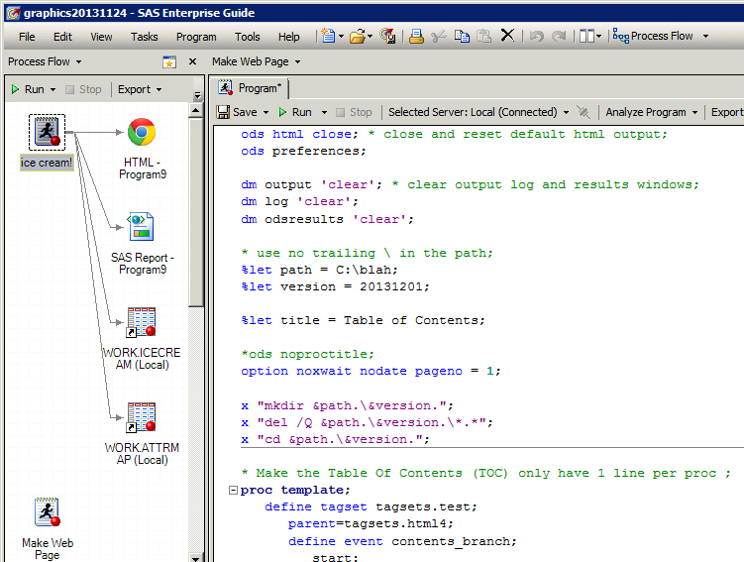
Use your own path and date.

Slide 19
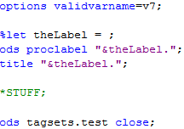
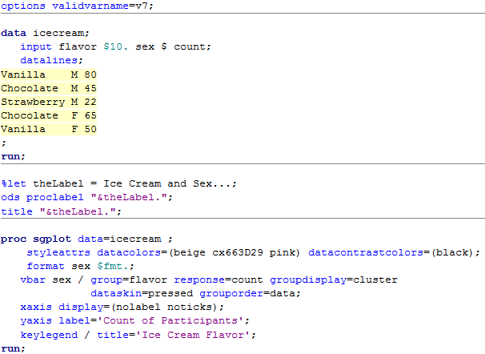
Copy and paste these three lines before each procedure that makes output. Add the label you want in the table of contents after the equal sign.
Your code goes here.

Slide 20
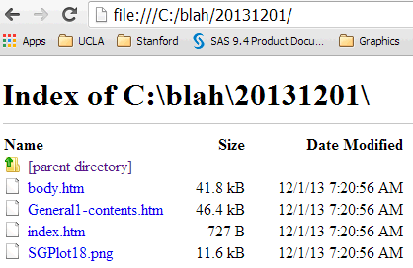
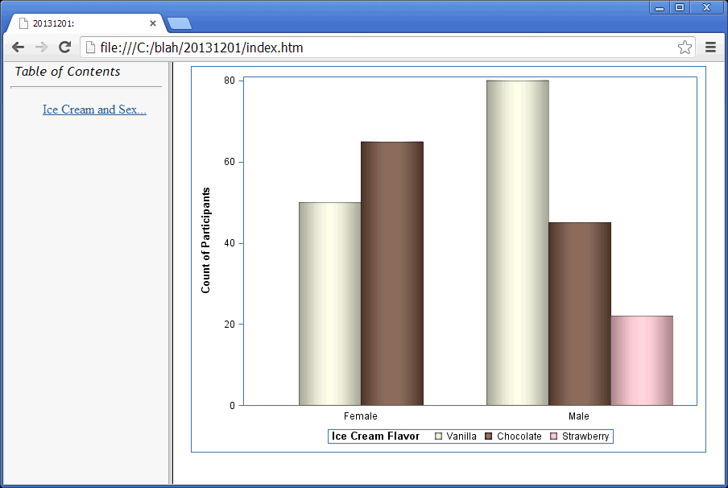
Body of the page
Table of contents
Frame holding TOC and body
The graphic
Look in the configuration slides if you see a hyperlink to the data values instead of the graphics. You are making an Active X control (which only shows in Microsoft Internet Explorer).

Slide 21
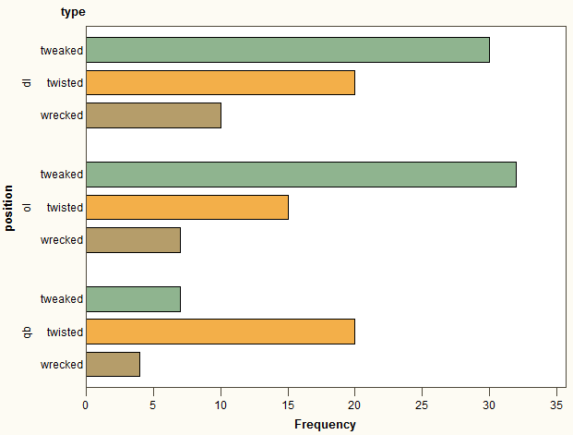
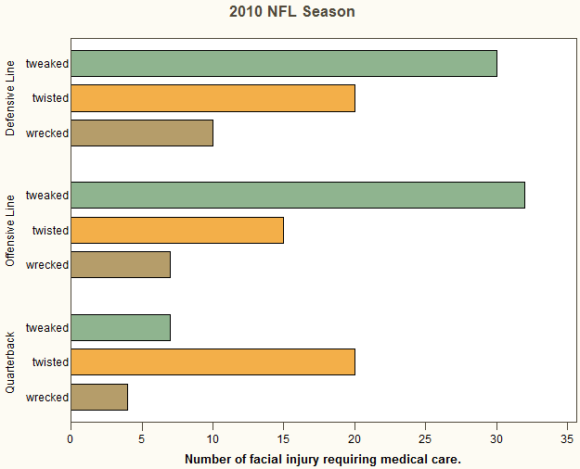
SAS Bar Charts
SAS makes the reader do extra work by rotating the axis labels in ActiveX images.
They pointlessly include variable labels by default.

Slide 22
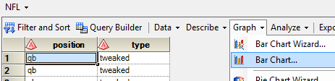
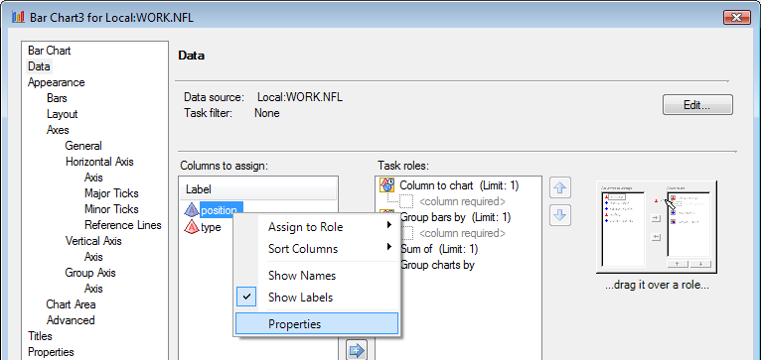
How to do it?
Notice you can Edit the data and apply filters.
You can right click on variables and apply user-defined formats off the Properties dialog.

Slide 23
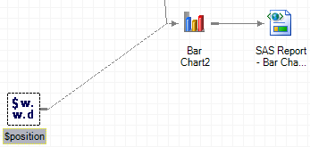
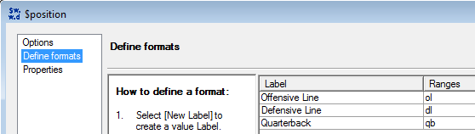
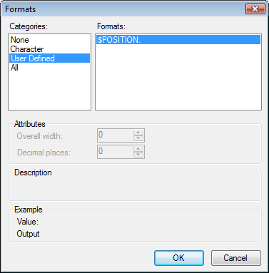
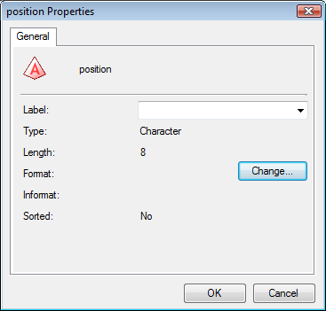
First create the format.
In the Data windowpane of the Bar Chart GUI, right click on the variable and change the format to the User Defined format you had created.

Slide 24
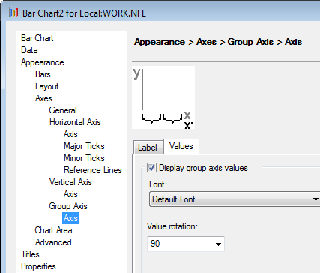
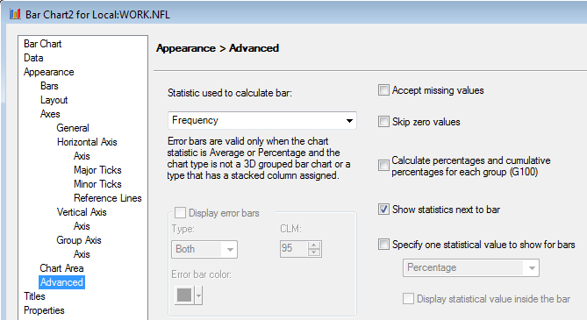
The GUI is Solid
My only complaints are that the rotate grouping values text does not work (position in this example) and the summary statistics do not show up when you request ActiveX images.

Slide 25
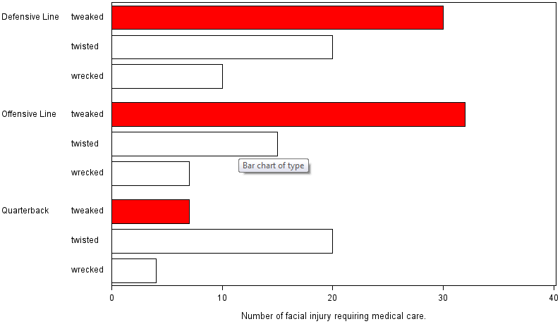
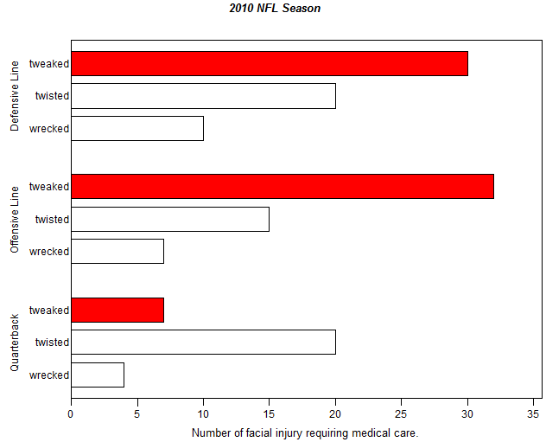
.PNG format
ActiveX image format

Slide 26
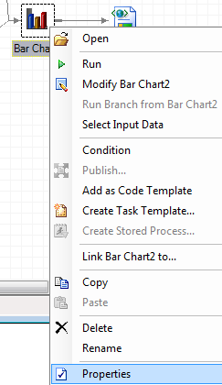
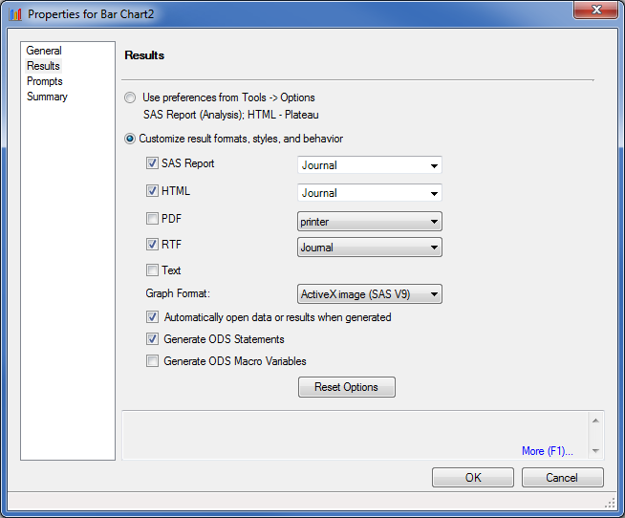
Saving the Graphic for Publication
The easiest way to get publication quality graphics is to set the output type to be RTF.

Slide 27
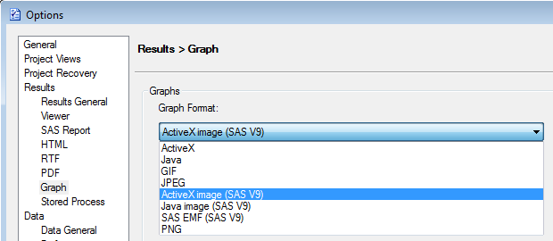
Default Output and Graphics
The default graphic format in EG is ActiveX. These images can be edited (even on the web) but they only display with Internet Explorer. I have set my graphics to display as ActiveX images. Tweak this with Tools> Options… > Graph.

Slide 28
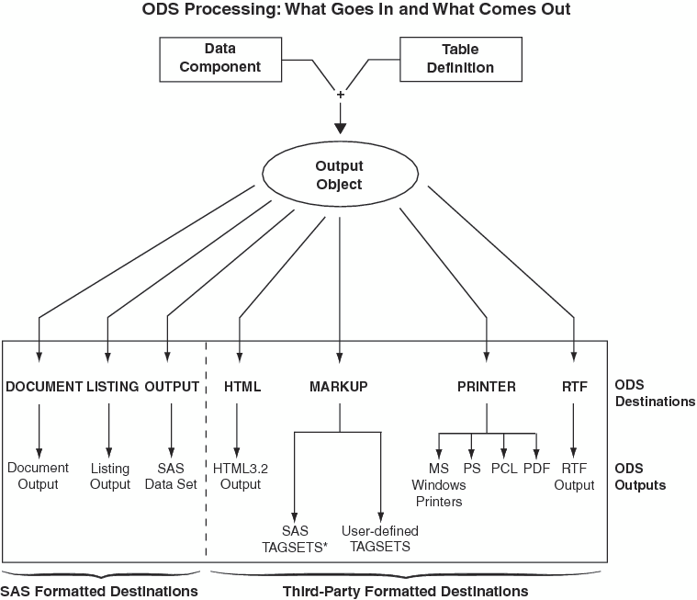

Slide 29
Types of Images
The default formats of the images are determined by the ODS destinations you are using:
LISTING: pgn visible in the Windows Image Fax Viewer
HTML: png, gif, jpg contained in web pages and visible in Internet Explorer, Firefox or Opera
LATEX: PostScrpt, epsi, gif, jpeg, pgn are visible in GhostView
PCL or PS: contained in Postscript file are visible in GhostView
PDF: contained in pdf, which is visible with Adobe Reader
RTF: visible in MS Word
RTF graphics are done at 300 dpi by default

Slide 30

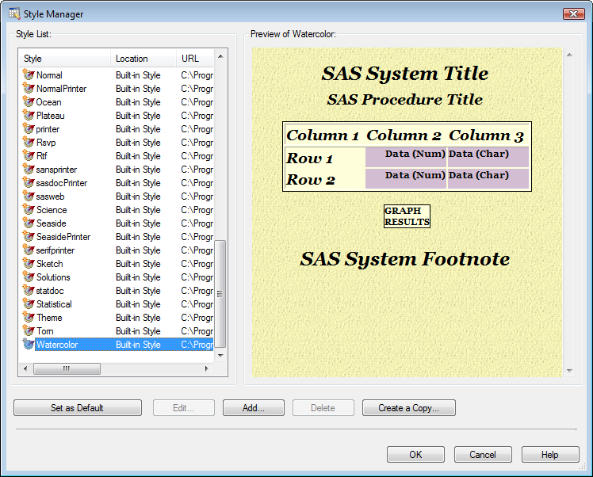
You can browse the ODS appearance templates from the Style Manager on the Tools menu.

Slide 31
Plot Types
Categorical variables
Bar charts
Dot plots
Continuous variables
Histogram
Box plot
Violin plots
Quantile and QQ plots

Slide 32
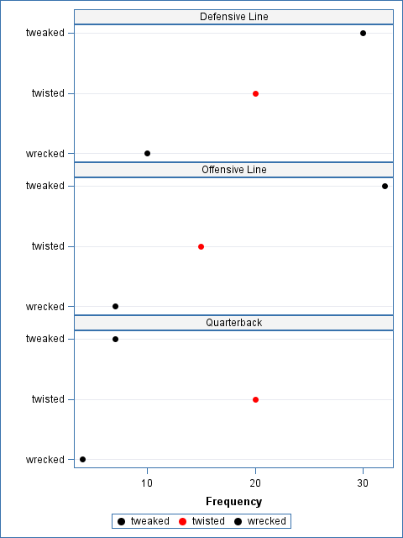
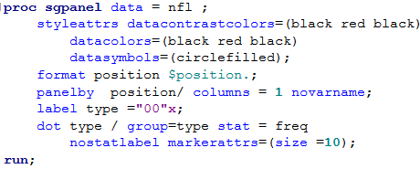
Categorical variables
Sets of dot charts

Slide 33
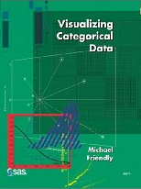
Grouped Categorical Variables
Grouped categorical variables
To graph categorical data in SAS you need to get Michael Friendly’s Visualizing Categorical Data. Unfortunately, his macros are copyrighted with the book… So I will show you the R versions.
Fourfold plots
Mosaic plots
Association plots

Slide 34
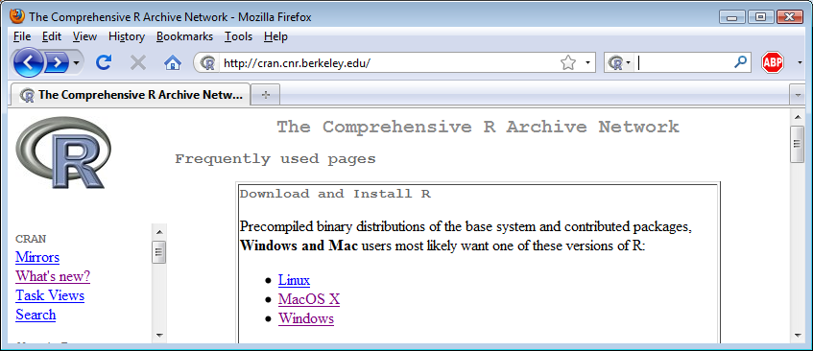
If you want to use R
Download R for Mac or PC cran.cnr.berkeley.edu/bin/macosx/ cran.cnr.berkeley.edu/bin/windows/base

Slide 35
How to learn R
I usually teach R classes in the summer.
www.stanford.edu/~balise/ has links to my slide decks for R classes.

Slide 36
Plots for Inference
Categorical plots
Confidence limits on odds ratios
Four-fold plots
Expectancy plots
Mosaic plots

Slide 37
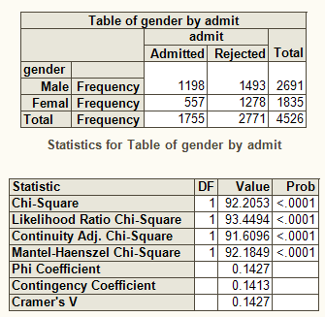
Fourfold Plots
Grouped categorical variables
45% male vs. 30% female admission
They draw 4 slices of pie with the area corresponding to the number of people in each cell of a 2x2 table and they have confidence bands such that if the confidence bounds overlap on adjacent pie pieces, they are not statistically significantly different.

Slide 38

Grouped categorical variables
More males were admitted than females.
There is clear evidence of sexist policies in admissions!
Notes:
values = c(1198, 557, 1493, 1278)
dim(values) = c(2,2)
rownames(values) = c("Male", "Female")
colnames(values) = c("Admissted", "Rejected")
fourfoldplot(values[,])

Slide 39

Grouped categorical variables
Department A admitted more females than males and every other department had no bias!
The joy of Simpsons paradox.
Notes:
data(UCBAdmissions)
x = aperm(UCBAdmissions, c(2,1,3))
dimnames(x)[[2]] <- c("Yes", "No")
names(dimnames(x)) <- c("Sex", "Admit?", "Department")
fourfoldplot(x[,,])

Slide 40
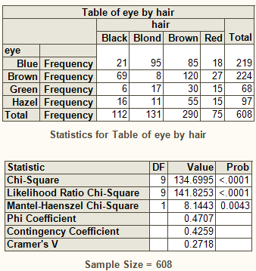
Mosaic Plots
Grouped categorical variables
So you have an contingency table and you want to know if there is as an association. You do a chi-square test and it says there are associations between the rows and columns. What next?

Slide 41

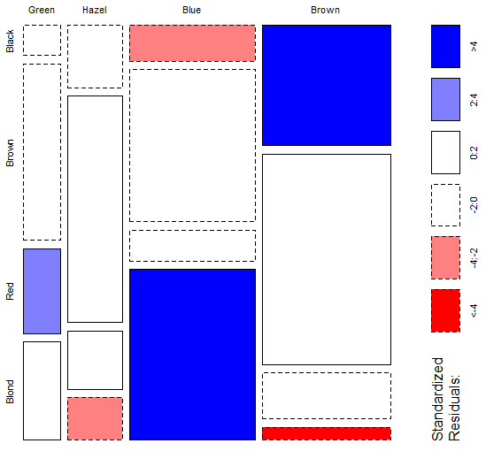
Grouped categorical variables
Some basic voodoo in R shows which combinations are over (in blue) or under represented (in red).
Notes:
values = c(5, 29, 14, 16, 15, 54, 14, 10, 20, 84, 17, 94, 68, 119, 26, 7);
values = matrix(values, nrow = 4, byrow=TRUE)
rownames(values) = c("Green", "Hazel", "Blue", "Brown")
colnames(values) = c("Black", "Brown", "Red", "Blond")
mosaicplot(values, shade = TRUE)

Slide 42

Grouped categorical variables
I prefer the simpler association plots.
Notes:
values = c(5, 29, 14, 16, 15, 54, 14, 10, 20, 84, 17, 94, 68, 119, 26, 7);
values = matrix(values, nrow = 4, byrow=TRUE)
rownames(values) = c("Green", "Hazel", "Blue", "Brown")
colnames(values) = c("Black", "Brown", "Red", "Blond")
marg <- margin.table(values, c(1, 2))
assocplot(marg, main = "Relation between hair and eye color")

Slide 43
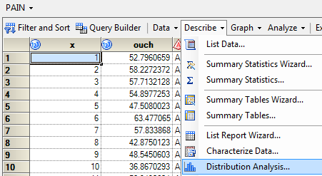
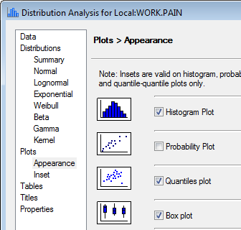
Continuous Outcomes
Continuous variables
The Distribution Analysis menu option can do basic plots.

Slide 44
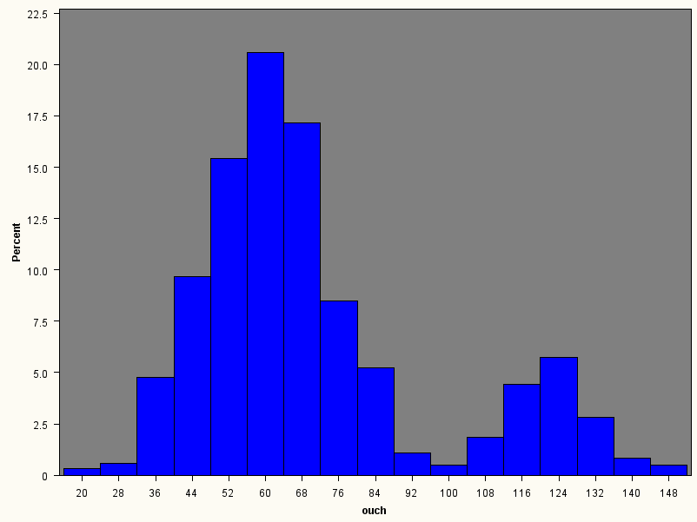
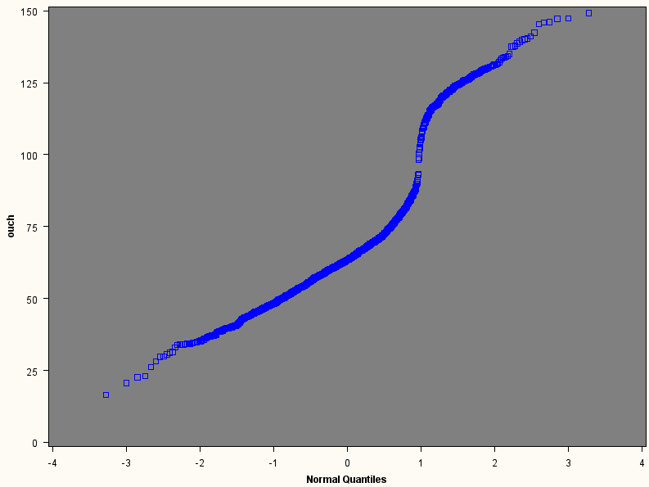
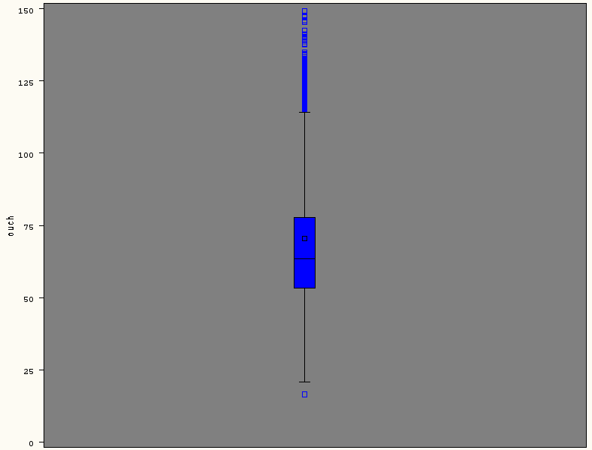
The resolution of the histogram is okay but the others are unacceptable.

Slide 45

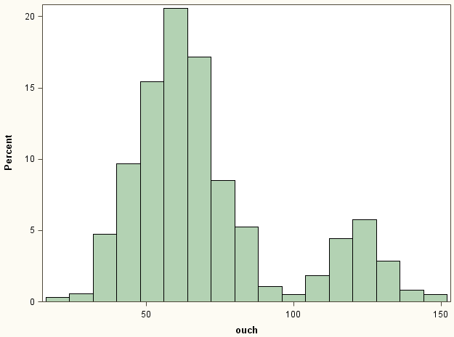
Continuous variables
Use sgplot for high resolution plots.

Slide 46
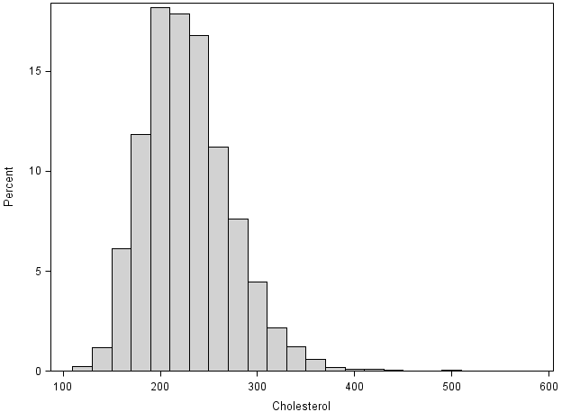

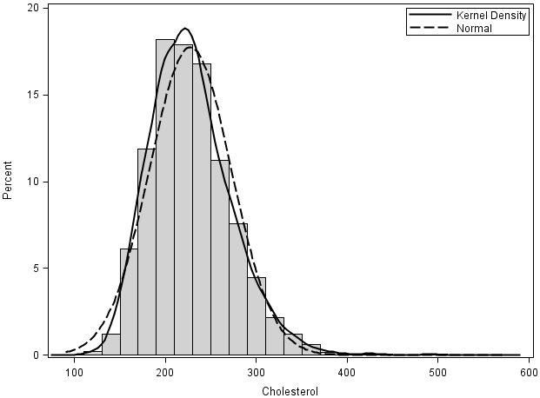
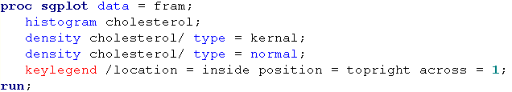
As you add more requests to the plot, it resizes and shifts things to make room. It draws them in the order you request them. It reads the requests from the first listed to the bottom. Change the order if you want to have an item appear layered on top of, or behind, another thing.
Some colors are not set yet in the enhanced editor. Use the menu Tools>Options>Enhanced Editor… then click User Defined Keywords to add the coloring.

Slide 47
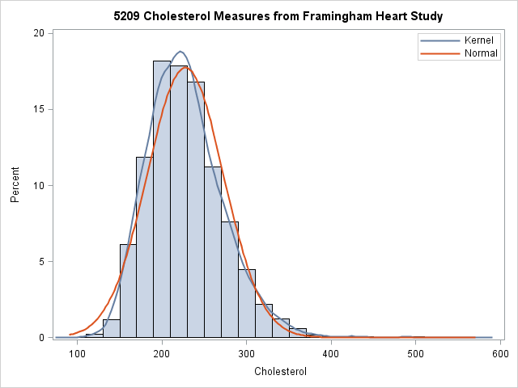
I want the title!

Slide 48
How is that made?
proc format library = work;
value $smoked
"Non-smoker" = "None "
missing = "Missing"
other = "Not none"
;
run;
data fram;
set sashelp.heart;
smokin = put(smoking_Status, $smoked.);
run;

Slide 49
How is that made?
Make a new graphics template
title "5209 Cholesterol Measures from Framingham Heart Study";
proc sgplot data = fram tmplout="c:\blah\plate.sas";
histogram cholesterol;
density cholesterol / type = kernel;
density cholesterol / type = normal;
keylegend /
location=inside position=topright across=1;
run;

Slide 50
Note I changed the name of this template.
proc template;
define statgraph sgplotFram;
begingraph /;
EntryTitle "5209 Cholesterol Measures from Framingham Heart Study" /;
layout overlay;
Histogram 'Cholesterol'n / primary=true binaxis=false LegendLabel="Cholesterol";
DensityPlot 'Cholesterol'n / Lineattrs=GraphFit kernel() LegendLabel="Kernel" NAME="DENSITY";
DensityPlot 'Cholesterol'n / Lineattrs=GraphFit2 normal() LegendLabel="Normal" NAME="DENSITY1";
DiscreteLegend "DENSITY" "DENSITY1" / Location=Inside across=1 halign=right valign=top;
endlayout;
endgraph;
end;
run;
proc sgrender data = work.fram template = template=sgplotFram;
run;
This was saved in plate.sas.
Render a graphic with the template and dataset specified.

Slide 51
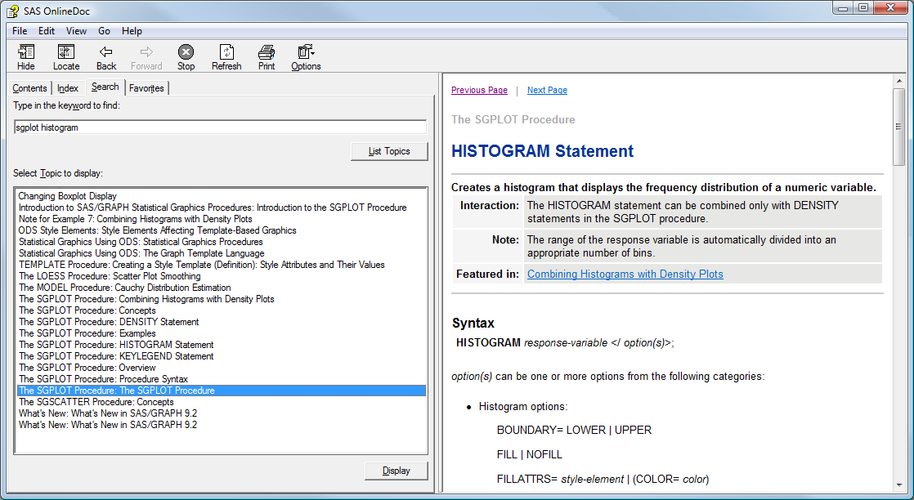
How to set the color for a histogram

Slide 52
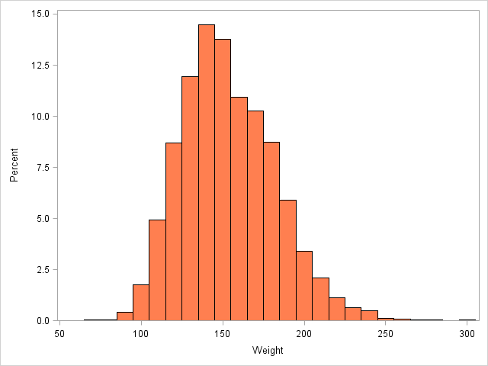
proc sgplot data = fram;
histogram weight / fillattrs = (color = coral);
run;

Slide 53

You can also tweak the style template

Slide 54


Continuous variables

Slide 55


Violin
Continuous variables
A violin plot mirrors the shape of the histogram (density). They can be done in R.
Notes:
ods select none;
proc kde data = pain;
univar ouch (gridl=0 gridu=200) /
NGRID=100 unistats percentiles plots=none
out = painDensity (rename=(value=ouch) drop=var);
run;
ods select all;
data painDensity2;
set painDensity;
mirror=-1*density;
zero=0;
run;
proc sgplot data=painDensity2 ;
band x=ouch upper=density lower=mirror /
fill outline;
xaxis label='Pain';
yaxis display=none;
run;

Slide 56
Grouped Continuous Variables
Grouped continuous variables
You can use the Distribution Analysis to get basic grouped plots.
For better looking plots you need to write sgplot and/or sgpanel code.

Slide 57




Grouped continuous variables
Request distinct graphics by subgroups.

Slide 58


Grouped continuous variables
Actually this took a bit of voodoo.

Slide 59

Grouped continuous variables
2nd
1st

Slide 60


Grouped continuous variables
Put details on the histogram tweaks here.
Double click here.
I use/tweak nrow ncol and endpoints often.
endpoints = 2 to 10 by 0.5
midpoints = 5.6 5.8 6.0 6.2 6.4

Slide 61


Grouped continuous variables

Slide 62


Grouped continuous variables

Slide 63




I want to add in a reference line showing what is normal and put the categories in order.

Slide 64


Slide 65


Side by Side Violin Plots
Grouped continuous variables
Notes:
proc kde data = pain;
by group;
univar ouch (gridl=0 gridu=200) / NGRID=100 unistats percentiles plots=none
out = painDensity (rename=(value=ouch) drop=var);
run;
data pain_dens_2;
set pain_dens;
mirror=-1*density;
zero=0;
run;
proc sgpanel data=pain_dens_2 nocycleattrs;
panelby group / layout=columnlattice onepanel
novarname noborder colheaderpos=bottom;
band y=ouch upper=density lower=mirror / fill outline;
rowaxis label='Pain' grid;
colaxis display=none;
run;

Slide 66

Paired Continuous Variables
Grouped continuous variables
People typically show paired data with scatterplots.
EG generate them:

Slide 67

Scatter Plot
Grouped continuous variables
Notes:
data hAndW;
set sashelp.heart;
rWeight = round(weight,10);
rHeight = round(height, 1);
if _N_ <= 200 then output;
run;

Slide 68


Jittered Plot
Notes:
Why bother

Slide 69

Jitter vs. Sunflowers
Grouped continuous variables
In R you can also do sunflower plots.

Slide 70

Ordinary Least Squares Regression
Grouped continuous variables
People typically plot a regression line to show a relationship between two continuous variables.

Slide 71

Regression line
You can easily add a regression line to the scatter plot.

Slide 72


proc sgplot data = fram;
scatter x = height y = weight;
run;
proc sgplot data = fram;
reg x = height y = weight;
run;

Slide 73

ods listing sge = on style = statistical;
proc sgplot data = fram;
reg x = height y = weight /
markerattrs = (color = green)
lineattrs = graphdata1 (color = lime);
run;

Slide 74

ods listing style = statistical;
proc sgplot data = fram;
reg x = height y = weight / group = sex ;
run;

Slide 75
Bisquare
Grouped continuous variables
Figure out what is an odd value and then put a weight on it to devalue it. There are many robust regression algorithms around. R and S-Plus software have them well implemented.

Slide 76
Loess and Splines
Grouped continuous variables
Loess is a technique essentially creates a rolling window and gets a weighted average across the values visible inside the window.
Splines are curved lines that allow different amounts of stiffness to the curves.

Slide 77




Smooth = 99
Smooth = 50
Smooth = 25

Slide 78




Proc phreg has a lot of new features but nothing major in the graphics. With phreg, if you specify ods graphics on you do not automatically get any plots. Here I request survival and cumulative hazard plots including the global confidence limits option (cl).
Once again the option names are not consistent with the table names.

Slide 79


This shows the number of people at risk after 20, 40 etc days.
Proc lifetest can show the number at risk but
the implementation is weak. It labels the groups with numbers even if the strata are character strings. You have to manually edit them and this affords ample opportunity for mistakes.
I don’t see a way to change the censoring symbol in the legend.

Slide 80
Beyond the Basic Univariate plots
There are 4 SG procedures that allow you to build up complex univariate plots and do multivariate (trellis/lattice) plots.

Slide 81
Statistical Graphics Procs
proc sgPlot
general plotting procedure that replaces gplot
Proc sgRender
used with proc template to make totally custom plots
It replaces proc greplay
proc sgScatter
lots of tools for scatterplots and scatter matrices
proc sgPanel
quick and easy trellis/lattice/matrix/panel of plots

Slide 82



Grids
You can produce lattices full of graphics with proc gpanel.

Slide 83



Slide 84



Spaghetti Plots
Data from Singer and Willett: www.ats.ucla.edu/stat/examples/alda.htm

Slide 85
SGPlot vs Template
You can replicate everything done with proc sgplot using the template language but don’t reinvent the wheel if you don’t need to.
You will want to use proc template to build custom graphics that use many panels.
Proc sgplot uses statements that start like reg but template uses names like regressionplot.
Similar but not identical names… boo.

Slide 86



Slide 87



Slide 88


Making your own graphic template
You can create your own graphic or combine several graphics that you make with sgplot.
Specify the details
Do the plot
Notes:
proc template;
define statgraph myGraphic;
begingraph;
*stuff*;
endgraph;
end;
run;
proc sgrender data=myData
template=myGraphic;
run;

Slide 89


layout gridded = ticks do not have to align
layout lattice = ticks must align

Slide 90


Slide 91



