Slide 1

TreeAge Pro 2-Day Healthcare Training Day 2
Using TreeAge Pro for Health Economic Modeling
© 2013 TreeAge Software, Inc.

Slide 2
Agenda – Day 2
Markov Models
Markov Modeling Exercise
Markov - Decisions Analysis
Markov - Time Dependence
Heterogeneity and Event Tracking (Microsimulation)
Sensitivity Analysis and Microsimulation
Advanced Modeling Techniques

Slide 3
Markov Models
Module 5: Markov Models
Goals:
Understand the concepts behind Markov models
Build a simple Markov model
Evaluate Markov models via cohort analysis
Integrate Markov model into decision tree for treatment comparison

Slide 4
Analyze Markov Models
Module 5: Analyze Markov Models
Goals:
Evaluate Markov models via cohort analysis
Study how cohort moves through a Markov model
Study how rewards (cost, eff) are accumulated
Integrate Markov model into decision tree for treatment comparison

Slide 5
Markov Models
Markov models:
Follow a cohort of patients into the future
Track disease progression over time
Breaks down overall progression into individual cycles that repeat
Model represents events within a cycle rather than entire scenarios
Also called state transition model
Without Markov model…
Would have to create model structure for all events over lifetime
Would lead to a gigantic model

Slide 6
Markov Models
Markov Model…
Health states indicate current status
Starting point for each cycle
Transition subtree for each health state
Includes all possible events occurring in a cycle
Terminal nodes return process to a health state (same or different) to start next cycle
Accumulate cost and effectiveness within each cycle (at state and transition nodes)
Continue until finished with analysis
Report accumulated cost and effectiveness

Slide 7
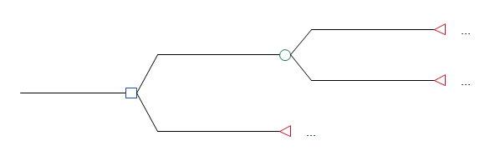
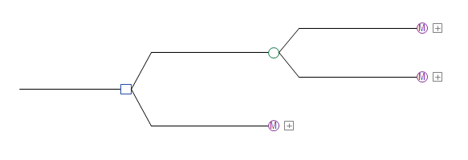
Markov Models
Markov Model:
Consists of the Markov node and everything to the right
Usually part of a larger decision tree for strategy selection
Evaluates to a single cost and effectiveness measure
Feeds back into decision analysis like a terminal node
Markov node cannot be placed within another Markov subtree

Slide 8
Markov Models
Cycle
Overall model is divided into smaller time periods
Cycle length
Almost always fixed
Known, but not entered into TP
All probabilities and rewards (cost, eff) must have values consistent with the cycle length
Model is usually run for a specific number of cycles (e.g., 20 1-year cycles)
Built-in keyword _stage is used as reference to the cycle count
_stage = 0 during first cycle

Slide 9
Markov Models
Cohort:
Markov models follow a hypothetical cohort as it progresses with time
Cohort is homogeneous
Cohort has total size 1, but split into portions that follow different paths through model
Provides expected value for a single person → Tx choice
Cohort starts each cycle split among the health states
For each state, cohort % is then split further to reflect the many events that can occur in a cycle
At end of cycle, cohort is returned to the health states (in different fractions) to start the next cycle

Slide 10
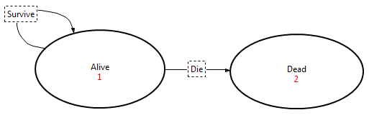
Markov Models
State Transition Diagram:
Provides simple representation of a Markov model
Details missing, cannot be used for analysis
Just shows health states and simple transitions with specific events
Good for communication of basic model flow

Slide 11
Markov Models
Instructions
Choose File > New State Diagram from the menu.
Select State from the palette.
Click and drag in the editor to create a state.
Label it Alive.
Repeat steps 2-4 to create a Dead state.
Select Arc from the palette.
Click on the Alive state and drag mouse to the Dead state. Label the arc Die.
Repeat steps 6-7 but drag mouse from Alive to blank space and back to Alive. Label the arc Survive.

Slide 12
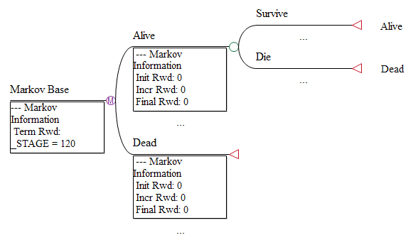
Markov Models
State Transition Diagram:
Right-click on blank space in diagram and choose Convert to Markov tree from context menu
Creates Markov model in decision tree format
Additional detail can then be added
Can copy/paste into a larger decision tree

Slide 13
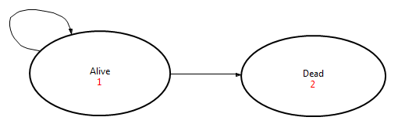
Markov Models
Markov model flow…
100% start Alive
10% die each cycle
_stage 0 100% 0%
_stage 1 90% 10%
_stage 2 81% 19%
_stage 3 73% 27%
Less cost/eff accumulated for subsequent cycles because less of cohort is alive

Slide 14
Markov Models
We will build a simple Markov model…
Markov node:
1-year cycles (implied)
Terminate model after 20 years
Markov health states:
Alive & Dead
Entire cohort starts in Alive state (initial probabilities)
For each Alive cycle, accumulate…
State rewards
Effectiveness of 1 LY
Cost of $50K
Transition subtree:
Alive – there is a 10% chance of death each cycle
Dead – no subtree needed

Slide 15
Markov Models
Markov node:
First node in the Markov model
Determines how long to run model via the Termination Condition
Evaluated before each cycle – analysis stops when true
Frequently a function of _stage
To run for 20 cycles: _stage = 20 (_stage = 0, 1, …, 18, 19)
Can run until entire cohort is dead (StateProb function)
Be careful if prob of death never reaches 100% (will run forever)
StateProb(stateIdx) >= 0.999 (not = 1)
Multiple conditions: “&” = AND, “|” = OR

Slide 16

Markov Models
Information:
Markov node:
1-year cycles (implied)
Terminate model after 20 years
Instructions:
Create new model from toolbar icon (blank tree).
Change root node to type Markov.
Enter node label text.
Open the Markov Info View.
Edit the default termination condition.

Slide 17
Markov Models
Health States:
Direct branches from Markov node
Starting point for each cycle
Track the changing distribution of the cohort among a number of mutually exclusive states
Initial probabilities divide the cohort among the health states before the first cycle
Proportion of cohort in health states will be different for next cycle based on events that occur within the cycle

Slide 18
Markov Models
Health States:
State rewards accumulate value (cost, eff) by cycle
Cost of treating person with that state’s condition
i.e., $10K/year to treat person with diabetes
Utility (for QALYs) associated with the health state
i.e., 0.80 rather than 1 for person in bad health
Rewards…
Initial: for first cycle (often same as incremental)
Incremental: for every subsequent cycle
Final: after the last cycle (usually 0)

Slide 19
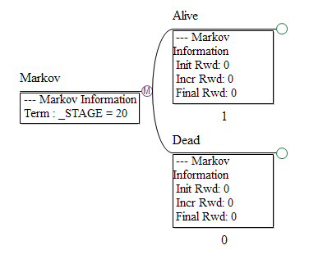
Markov Models
Information:
Markov states:
Alive & Dead
Entire cohort starts in Alive state
Instructions:
Double-click on the Markov node to add two branches (Markov health states).
Enter node label text for each Markov state.
Enter the initial probability beneath each state.

Slide 20
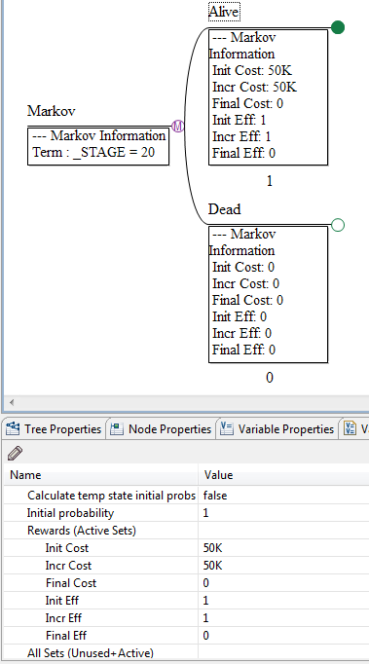
Markov Models
Information:
Markov states:
State rewards for Alive state
Effectiveness of 1 LY
Cost of $50K
In real model, use variables
Instructions:
Edit the Tree Preferences – set Calc Method to Cost-Effectiveness and set Numeric Formatting.
Select the Alive state node.
Open the Markov Info View.
Enter the State Rewards values… initial and incremental rewards.

Slide 21
Markov Models
Transition Subtrees:
Model structure for what can happen within a cycle
Each Markov state has its own transition subtree
Events (e.g., surgery, screening test, stroke, etc.)
Structure and transition probabilities drive the cohort through the transition subtree
Terminal nodes at end of subtree direct cohort to health states to start the next cycle
Changes the cohort split among health states by cycle
Absorbing states (usually Dead) do not have a transition subtree or jump states

Slide 22
Markov Models
Transition Subtrees:
Transition rewards (cost, eff) are associated with events in subtree
i.e., operation, adverse event, screening test cost and/or disutility
Allocated to cohort that passes through that node in the subtree (not everyone starting cycle in state)
Use extra payoff to count transitions to the dead state

Slide 23
Markov Models
Information:
Transition subtree:
At each annual cycle, there is a 10% chance of death
Instructions:
Double-click on the Alive node to add two branches in the transition subtree.
Enter the node label text for each branch.
Enter the probability for the Live (#) and Die (0.1) branches.

Slide 24
Markov Models
Information:
Count deaths via transition reward
Instructions:
Tree Preferences:
Select option to calculate extra payoffs.
Set enabled payoffs to 3.
Set custom payoff labels.
Cost, Eff, Deaths
Set transition reward for Die node to 1 for payoff set 3.

Slide 25
Markov Models
Need to terminate the transition subtrees
Instructions:
Right-click on the Live and change the node type to Terminal.
Select the jump state Alive when prompted.
Repeat for the Die branch and select the jump state Dead.
Repeat for the Dead state – no jump state needed for absorbing state.

Slide 26
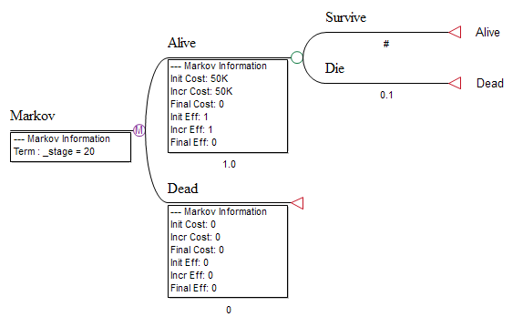
Markov Models
Model is now complete Example07a-MarkovSimple.trex
Transition subtree starts here
Markov state node
Jump state (for next cycle)
Markov node
Transition probability
Termination condition
Markov state rewards
Initial probability

Slide 27
Analyze Markov Models
In the last module, we created a Markov model
Now we need to analyze it
Two methods
Markov Cohort Analysis
Expected value calculation, preferred
Accumulate cost, eff for cohort as it passes through health states and transitions
Monte Carlo, patient-level simulation (Microsimulation)…
Run individual patients through the model, accumulating cost and effectiveness
Repeat for many patients and report mean values
Later module

Slide 28
Analyze Markov Models
Markov Cohort Analysis:
Start of cycle – state rewards:
Cohort split among health states
Accumulate state rewards (cost, eff) based on cohort % starting cycle in that state
StateProb * StateRwd
Within cycle – transition rewards:
Accumulate transition rewards based on cohort % starting cycle in that state AND passing through the specific transition node
StateProb * TransProb * TransRwd
Sum rewards from all states and transitions for total value for that cycle
Sum rewards from all cycles for total value of entire Markov model

Slide 29
Analyze Markov Models
Instructions:
Open Example07-MarkovSimple.trex.
Select the Markov node.
Choose Analysis > Markov Cohort > Markov Cohort (Quick).

Slide 30
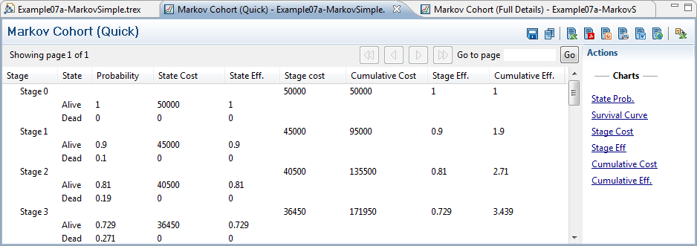
Markov Cohort Output
StateProb for each state
Reward product for each state/cycle
Sum of reward products for all states
Total EV (all states, all cycles)
Scroll to bottom

Slide 31
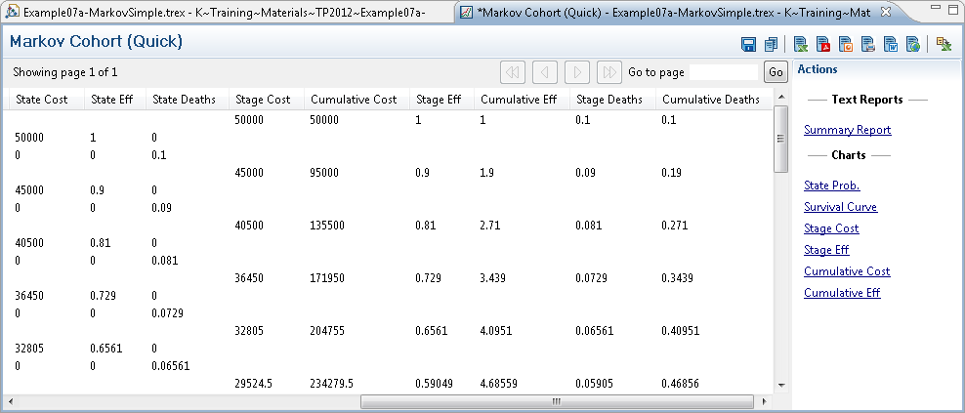
Markov Cohort Output
All payoffs displayed to right of active payoffs
Tree Prefs – Calculate Extra Payoffs on
Transition rewards reported in cycle’s end state not starting state

Slide 32
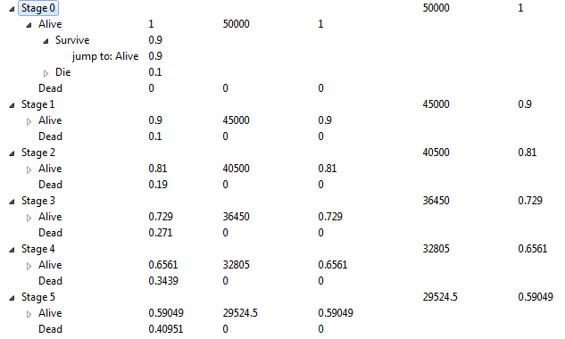
Markov Cohort Output
Full output follows entire transition subtree from the model for each cycle
Helpful for debugging models

Slide 33
Markov Cohort Output
Summary Report
Analysis data in simple grid
State Prob
Cohort split by cycle
Survival Curve
Combined state prob for non-dead states
Rewards
Active payoff accumulations by cycle or cumulative

Slide 34
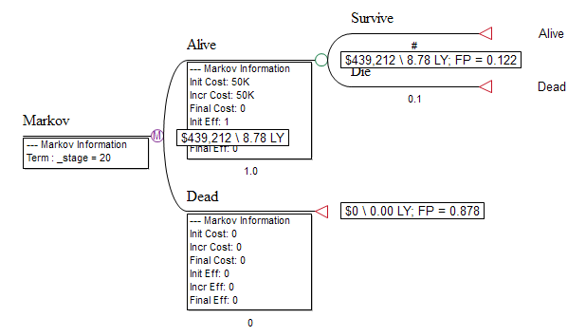
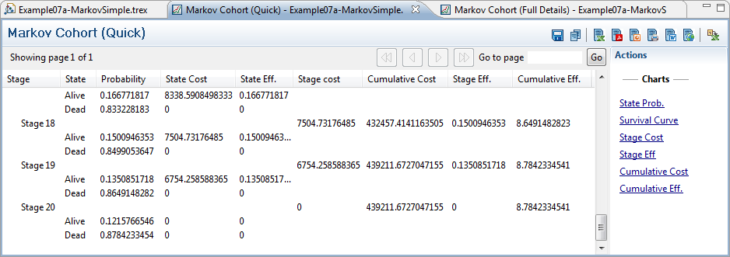
Markov Cohort Output
Total rewards (cost, eff) accumulated over all cycles is the total EV for Markov model
Roll back, cost-effective and other analyses use the overall EV for decision analysis

Slide 35
Markov Cohort Output
Half-cycle correction:
Markov state rewards provides full cycle’s reward at beginning of cycle
Transitions occur at end of cycle
Overestimates rewards (e.g., life expectancy)
Transitions at mid-point of cycle would be closer approximation to proper reward/survival
Apply consistently to all reward sets
Dies in Cycle… | Eff. Without Corr. | Eff. With Corr.
1 | 1 | 0.5
2 | 2 | 1.5
3 | 3 | 2.5
never | 3 | 3

Slide 36
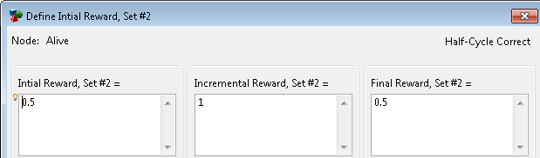
Markov Cohort Output
Half-cycle correction:
Implementation:
Apply half reward in initial reward
Apply full reward in incremental reward
Apply “missing” half reward in final reward
Instructions
Select reward set in Markov Info View.
Click pencil icon to open the Reward Set Dialog.
Click the Half-Cycle Correct button.

Slide 37
Markov Modeling Exercise
Cancer progression model
Start with Decision node with one strategy for Markov model
Local cancer state:
Annual mortality = 2%
Annual progression to Metastases = 15%
Annual cost = $20K
Annual effectiveness = 0.95 QALY
Metastases state:
Annual mortality = 10%
Annual cost = $50K
Annual effectiveness = 0.90 QALY
Dead state
No cost or effectiveness

Slide 38
Markov Modeling Exercise
Exercise: Cancer Progression Model
20 one-year cycles
Entire cohort starts in Local Cancer state
Create variables for all numeric quantities including probabilities and rewards
Parameters defined at root decision node
Perform half-cycle correction

Slide 39
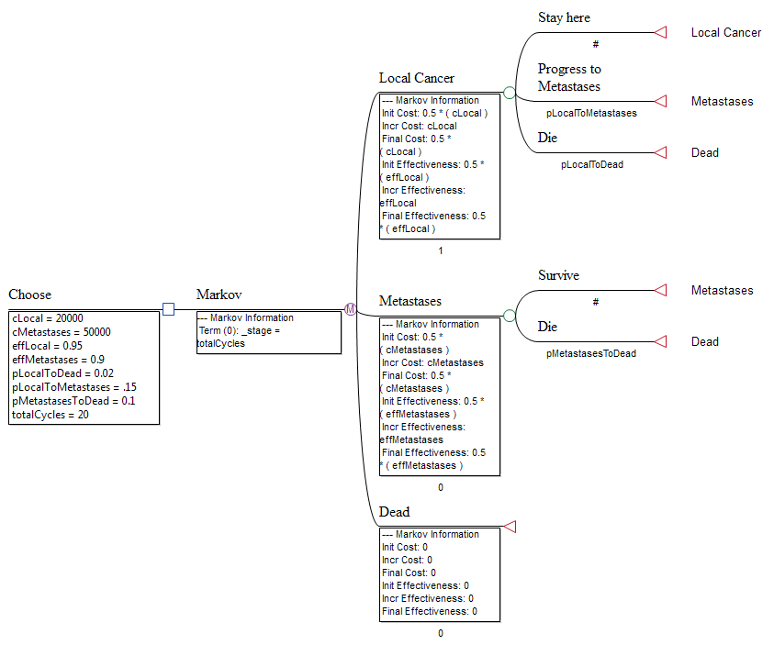
Markov Modeling Exercise
Example08-MarkovCancer.trex

Slide 40
Markov – Decision Analysis
Module 6: Markov – Decision Analysis
Goals:
Incorporate Markov models into a decision tree
Run cost-effectiveness on decision tree with Markov models

Slide 41
Markov – Decision Analysis
We have built and analyzed Markov models
Markov models can be portions of a larger decision tree in order to compare treatment strategies
Our cancer model has a decision node, but just one strategy
We will add a second strategy to our cancer model decision tree
Then run cost-effectiveness analysis to compare strategies

Slide 42
Markov – Decision Analysis
Steps…
Create another Markov node for the second strategy
Create clone master of original Markov model and place clone copy at new Markov node
Create treatment-specific parameter variables for each strategy at the root node
Use the appropriate treatment-specific parameters as “generic variable” values for each strategy
Analyze decision tree

Slide 43
Markov – Decision Analysis
Instructions:
Open Example08 Markov model.
Insert a new Markov node beneath the current Markov node via the palette.
Label the new node Tx 2.
Rename original Markov node Tx 1.

Slide 44
Markov – Decision Analysis
Instructions:
Create clone master at first Markov node.
Attach clone copy to new Markov node.
Set termination condition for new Markov node to _stage = totalCycles.
Run roll back to test.
Should get identical results
Have not yet integrated strategy-specific values

Slide 45
Markov – Decision Analysis
Instructions:
Define strategy-specific parameter variables at root node [best practice].
cLocal1 = 20000
cLocal2 = 22000
pLocalToDead1 = 0.02
pLocalToDead2 = 0.01
Set generic variables cLocal and pLocalToDead equal to the treatment-specific parameters above at each strategy node.
For example: at Tx 1 node, set cLocal = cLocal1
Delete the obsolete cLocal and pLocalToDead variable definitions at the root node [best practice].

Slide 46
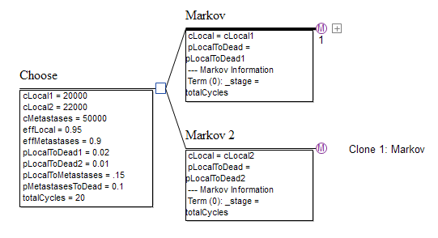
Markov – Decision Analysis
Model now has a separate Markov for each strategy
All parameters defined at root node
Strategy-specific parameters used at each Markov node

Slide 47
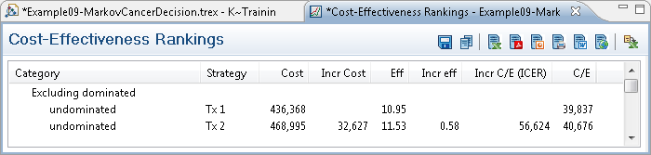
Markov – Decision Analysis
Can run Markov Cohort Analysis at either Markov node (including clone copy)
For details and/or debugging
Run CEA rankings to compare strategies
Only need overall cohort analysis EVs
EVs become basis for ICER calculations
ICER > $50K, choose Tx 1

Slide 48
Markov – Time Dependence
Module 7: Markov – Time Dependence
Goals:
Introduce time-dependent factors into Markov model
By cycle
By cycle within state

Slide 49
Markov – Time Dependence
So far, Markov model transition probabilities and rewards were fixed
However, these values often change with time
Frequently probabilities
TreeAge Pro supports time-dependent values
Time – f(_stage )
Age – f( _stage + startAge)
Time in state – f(_tunnel)

Slide 50
Markov – Time Dependence
Time-dependent values:
If only 2 or 3 possible values, use If or Choose functions
If(_stage<10; Val_1; Val_2)
_stage = 9, returns Val_1
_stage = 10, returns Val_2
Choose(whichVal; Val_1; Val_2; Val_3)
whichVal = 1, returns Val_1
whichVal = 2, returns Val_2
whichVal = 3, returns Val_3
Otherwise, use tables

Slide 51
Markov – Time Dependence
Tables allow you to enter a list of values that can be retrieved by an index
TableName[index]
Retrieve by _stage (directly or indirectly) to use different table value for each cycle

Slide 52
Tables
Tables have properties and data
Table properties:
Lookup method for missing index values
Off-edge – error or use closest index
Table data:
Organized by rows & columns
Index column is required
Multiple value columns allowed
Can rename value columns, but not “Index” column
Can attach to external data source via ODBC

Slide 53
Tables
Table lookups
Retrieve values by index and value column
If value column not provided,returns value from default column (usually 1)
Note the square brackets in table lookups
TableName[index; valueColumn]
TableName[30] = 300
TableName[20; 2] = 2000
Interpolation:
TableName[32] = 320
TableName[20; 1.5] = 1100
Index | Value | Value 2
10 | 100 | 1000
20 | 200 | 2000
30 | 300 | 3000
40 | 400 | 4000
50 | 500 | 5000

Slide 54
Markov – Time Dependence
We will now incorporate tables and time-dependent probabilities into our Cancer model
Changes to model:
Add transition before disease-related progression and/or death to account for background mortality
Use new mortality tables for probabilities of death from background mortality
Assume cohort starts at age 50

Slide 55
Markov – Time Dependence
Information:
Add transition before disease-related progression and/or death to account for background mortality
Instructions:
Open Example09-MarkovCancerDecision.trex and save as new document.
Hide Variables and Markov info via Tree Preferences (focus on structure).
Right-click on Local Cancer node and insert node to the right. Label the node.
Add a terminal node beneath the new node.
Select the jump state “Dead” and label the node.
Repeat steps 3-5 for the Metastases state.

Slide 56
Markov – Time Dependence
Information:
Use new mortality tables for probabilities of death from background mortality
First, create the table
Instructions:
Open the Tables View.
Click the “+” icon to create a new table.
Enter the table name “tMortBackground”.
Lookup Method – Interpolation.
Copy data from table in Example10 model and paste into current model’s table.

Slide 57
Markov – Time Dependence
Information:
Use new mortality tables for probabilities of death from background mortality
Incorporate the table into the model
Instructions:
Define three variables at the root node.
startAge = 50
age = startAge + _stage
pDeathBackground = tMortBackground[age]
Enter the probability of death from background mortality.
pDeathBackground
Use “#” for complement (survival).
Repeat step 2 for other background mortality nodes.

Slide 58
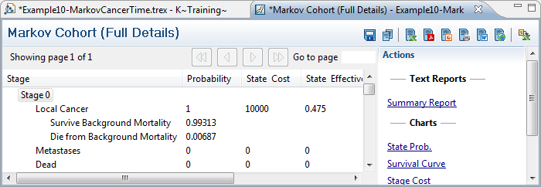
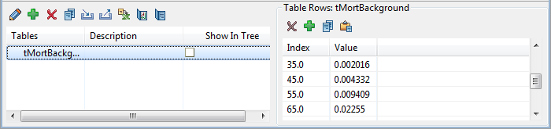
Markov – Time Dependence
Validate use of table via Markov Cohort (Full)
Table:
tMortBackground[50] = .5*.004332 + .5*.009409 = .0068705

Slide 59
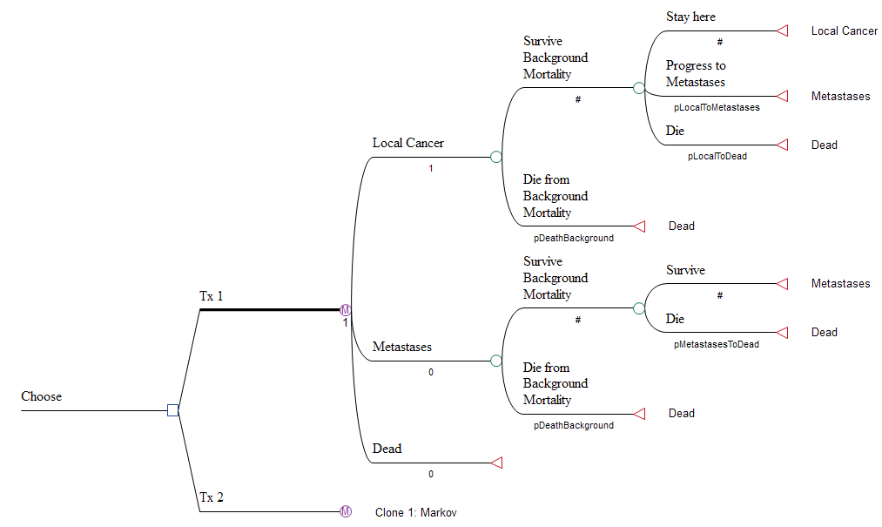
Markov – Time Dependence
Variable age increases with each cycle
Variable pDeathBackground will return a different value from table for each cycle
Example10-MarkovCancerTime.trex

Slide 60
Markov – Time Dependence
Discounting:
Standard practice for costs, life expectancy/QALYs in multi-year models
Apply consistently to all reward sets (debate)
Discount(value; rate; time) function:
value = base cost (or utility) for one cycle
rate = discount rate per period (usually annual rate)
time = number of periods to discount by (usually _stage)
Different cycle length:
Rewards:
Multiply/divide by conversion factor
Probabilities:
Cannot just multiply/divide probability
Annual to monthly: ProbToProb(annualProb; 1/12)

Slide 61
Markov – Time Dependence
We have looked at factors that depend on time
Time-dependent y = f( _stage )
Now we will look at factors that depend on time-in-state
Time-in-state dependent y = f( _tunnel )
How long a patient has been in a certain state can affect that patient’s transitions, etc.
Death from metastases depends on when the cancer metastasized
Survival from infection depends on when the infection occurred

Slide 62
Markov – Time Dependence
Setup tunnel state
Allows you to track how many continuous cycles the cohort has been in a state
Behind scenes, breaks single state into a number of temporary states
temporary state 1 (entry point)
temporary state 2 (next cycle)
… (more cycles)
temporary state N (N is max # of tunnels for state)
Model contains single state, but…
Probabilities, rewards, etc. can differ based on reference to the _tunnel counter

Slide 63
Markov – Time Dependence
Information:
Increase prob of death from metastases from 0.1 to 0.2 after first cycle in state.
Instructions:
Open Example10-MarkovCancerTime.trex and save to new file.
Select the Metastases state.
In the Markov Info View, change Tunnel max to 2.
Select root node.
Change variable definitions in Variable Definitions View.
pMetastasesToDead = if(_tunnel=1; 0.1; 0.2)

Slide 64
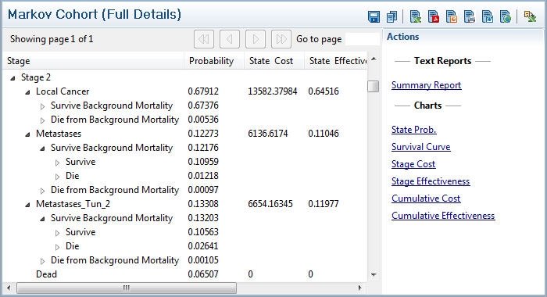
Markov – Time Dependence
Validate use of table via Markov Cohort (Full)
Metastases split into two states in output
_tunnel 1: 10% die
_tunnel 2: 20% die

Slide 65
Heterogeneity and Event Tracking
Module 8: Heterogeneity and Event Tracking
Goals:
Introduce a heterogeneous cohort into the model
Track events in the model
Analyze model using individual random walks (Microsimulation)

Slide 66
Heterogeneity and Event Tracking
We have analyzed Markov models using cohort analysis
We can also run individuals through the model via random walk (Microsimulation)
This allows us to introduce…
A heterogeneous cohort
Patient characteristics impact path through model
Event tracking
Memory of events can impact future cycles

Slide 67
Heterogeneity and Event Tracking
Microsimulation:
Generates individual outcomes (cost, eff) for individual patients (trials) based on each random walk
By analyzing the aggregate results for a set of trials, we can…
Estimate Expected Value (via mean)
Examine variability among individual outcomes
Also known as …
Random walk
1st-order simulation
1st-order trial

Slide 68
Heterogeneity and Event Tracking
By running individual trials, we can now study…
Individual patient characteristics (heterogeneity):
Age, gender, ethnicity, etc.
Tumor type, tumor size, etc.
Can sample from distributions by trial (characteristic, not parameter)
Individual patient events:
Adverse events (stroke, MI, etc.)
Use trackers to store values by trial

Slide 69
Heterogeneity and Event Tracking
Heterogeneity question?
Some could argue that it does not make sense to lump heterogeneous individuals into one cohort
Rather draw conclusions for each subgroup
Might not know which subgroups to isolate
Perhaps first run heterogeneous cohort and look at individual results to see differences in results by subgroup
Perhaps there are characteristics that are not easily identified
Will show the technique; use as deemed appropriate

Slide 70
Heterogeneity and Event Tracking
Microsimulation event-tracking expands modeling capabilities
Consider Markov model with 3 disease stages and 2 adverse events that affect future cycles
Would need 12 states – one for each stage and each of four combinations of adverse events (y/n)
Can cause way too many states in complex Markov model
Easier to use trackers and Microsimulation

Slide 71

Distributions
PSA used distributions for parameter uncertainty
One sample applied to entire cohort
Sampling rate: Once per EV or set of trials
Trials use distributions for individual variability
New sample for each trial at beginning of analysis
Use to assign patient characteristics
Sampling rate: Once per trial

Slide 72
Trackers
Store information for an individual trial
Unlike variables that have a single value for cohort
Start with an initial value (usually 0)
Tracker values can be retrieved and/or modified for the lifetime of the trial
Allows for memory from cycle to cycle
Tracker values can be used in any expression
Probabilities, rewards, etc.
Avoid using tunnels with microsimulation
Trackers can handle all _tunnel applications
Temporary states will slow down microsimulation

Slide 73

Trackers
Tracker modification can reference regular variables, functions, other trackers, etc.
Values in model can reference trackers
Be careful defining a tracker at node where it is used
Make sure the trackers are updated and used in the right sequence by separating via label node
Trackers are only evaluated during Microsimulation
Ignored in Expected Value-based analyses
If values are dependent on trackers → must run Microsimulation

Slide 74
Heterogeneity and Event Tracking
If model requires heterogeneity and/or event tracking…
Avoid Markov Cohort, Roll Back, CEA
Some sensitivity analyses
TreeAge Pro does not report Markov Cohort Analysis details (stage-by-stage state probability and rewards)
Advanced: Use Global( ) function to store/report
For Microsimulation to provide accurate EV estimates…
Need enough repetitions for stable mean/std dev values
Could require 10K or more trials
Computationally costly (computing time)
However, trackers may help keep model small…

Slide 75
Heterogeneity and Event Tracking
Incorporate heterogeneity into model…
Set individual patient starting age:
Generate starting age from uniform distribution (30–50)
Set tumor type for each trial:
Generate tumor type from a table distribution
Less aggressive (70%), prob. of metastases = 0.1
More aggressive (30%), prob. of metastases = 0.2

Slide 76
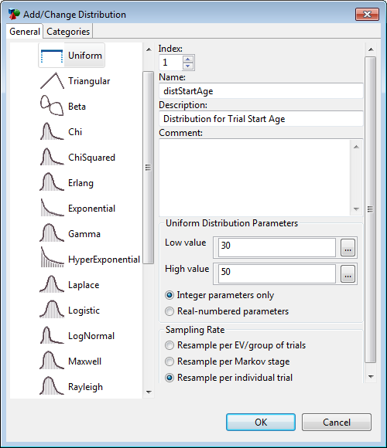
Heterogeneity and Event Tracking
Information:
Generate starting age from uniform distribution (30–50)
Instructions:
Open Example10-MarkovCancerTime.trex and save to new file.
Open the Distributions View.
Click the “+” icon to create a new distribution.
Select type Uniform.
Enter name distStartAge.
Select Integer parameters only.
Enter Low Value & High Value of 30 & 50.
Select Resample per individual trial.

Slide 77
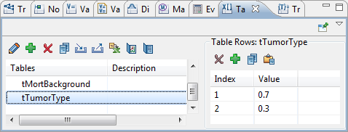
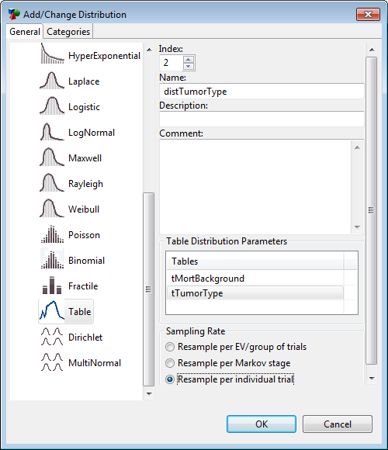
Heterogeneity and Event Tracking
Information:
Generate tumor type from a table distribution (30%, 70%)
Instructions:
Open the Tables View.
Click the “+” icon to create a new table.
Enter name tTumorType.
Enter rows 1, 0.7 and 2, 0.3.
Open the Distributions View.
Click the “+” icon to create a new dist.
Select type Table.
Enter name distTumorType.
Select the table tTumorType
Select Resample per individual trial.
Sum to 100%

Slide 78
Heterogeneity and Event Tracking
Information:
Generate starting age from uniform distribution (30–50)
Generate tumor type from a table distribution
Less aggressive (70%), prob. of metastases = 0.1
More aggressive (30%), prob. of metastases = 0.2
Instructions:
Select the root node.
Define the variable age as … distStartAge + _stage
Define the variable pLocalToMetastases as … if(distTumorType=1; 0.1; 0.2)
Delete the variable startAge.

Slide 79
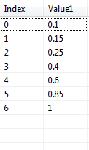
Heterogeneity and Event Tracking
Incorporate event tracking into model…
If patient survives in Metastases state, there is a 20% chance of having a stroke
Probability of death is dependent on the # of strokes
Use tracker to count strokes
Incorporate into probability of death in next cycle

Slide 80
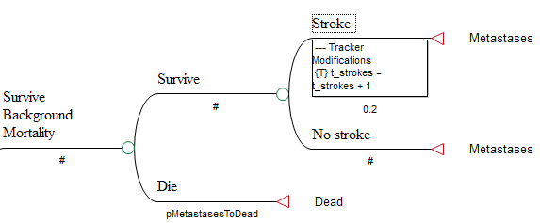
Heterogeneity and Event Tracking
Information:
If patient survives in Metastases state, there is a 20% chance of having a stroke
Use tracker to count strokes
Instructions:
Change the Metastases transition subtree to match this structure.
Define new variable pStroke = 0.2 at root node.
Right-click on the Stroke node and select Define Tracker > New.
Enter the name t_strokes and click OK.
Enter the tracker modification as … t_strokes + 1

Slide 81
Heterogeneity and Event Tracking
Information:
Probability of death is dependent on the # of strokes
Instructions:
Open the Tables View.
Create table tDeathMetastases, enter data above or copy from Example 12 model table data.
Select the root node.
Define the variable pMetastasesToDead as … tDeathMetastases[t_strokes]

Slide 82
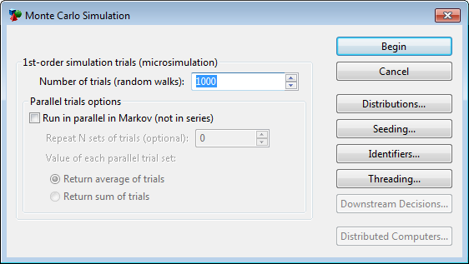
Heterogeneity and Event Tracking
Our model now…
Handles heterogeneity for start age and tumor type
Uses a tracker to count strokes
All three individual data elements affect analysis
Now we can run Microsimulation
Instructions
Select the root node.
Choose Analysis > Monte Carlo Simulation > Microsimulation from the menu.
Click Begin.

Slide 83
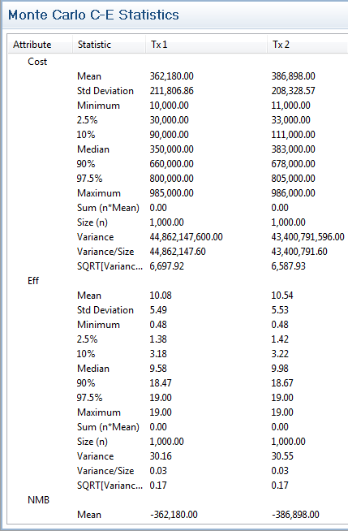
Heterogeneity and Event Tracking
Microsimulation output:
Shows aggregate values for each payoff, strategy
Mean values are EV estimates
Form the basis for CEA

Slide 84
Heterogeneity and Event Tracking
Microsimulation output:
See individual results via Values, Dists, Trackers
Cost, effectiveness for each strategy
Final tracker values for each strategy
Distribution samples (same for both strategies)
Identical cohort
Input and output distributions for variability within cohort
Do not use PSA-specific outputs
ICE scatterplot, Acceptability Curve, Dist of Incrementals
Need cohort-level results for PSA outputs

Slide 85
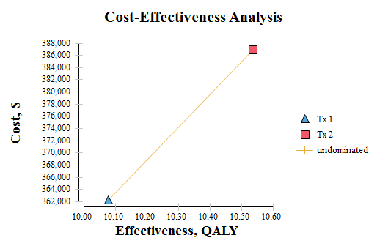
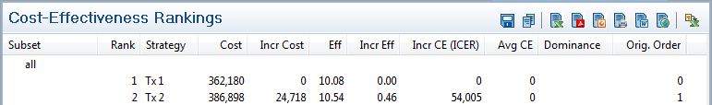
Heterogeneity and Event Tracking
Microsimulation output:
Still can look for optimal strategy via CEA, just run Microsimulation first
CEA/Rankings generated from mean EV estimates
ICER > $50K

Slide 86
Sensitivity Analysis & Microsimulation
Module 9: Sensitivity Analysis & Microsimulation
Goals:
Consider the effect of uncertainty on Microsimulation model
Deterministic and Probabilistic

Slide 87
Sensitivity Analysis & Microsimulation
We have incorporated heterogeneity and event tracking into a Microsimulation model
We have run CEA on the model
Still want to consider the impact of uncertainty on results

Slide 88
Sensitivity Analysis & Microsimulation
Deterministic:
Only one-way sensitivity analysis currently supported
Sensitivity analysis via variable, range, intervals
Instead of regular EV calcs…
Run Microsimulation and take mean values for EV

Slide 89
Sensitivity Analysis & Microsimulation
Analysis steps
Set variable to low value
Run Microsimulation and gather mean values
Change variable to next higher value
Run Microsimulation and gather mean values
Repeat steps 3-4 until high value reached
Return EVs in aggregated as sensitivity analysis output

Slide 90
Sensitivity Analysis & Microsimulation
Instructions
Select root node.
Choose Analysis > Sensitivity Analysis > 1-Way from menu.
Choose variable cLocal2.
Range 20K-24K, 4 intervals
Check box to run Microsimulation
Check box to Show Microsimulation results.

Slide 91
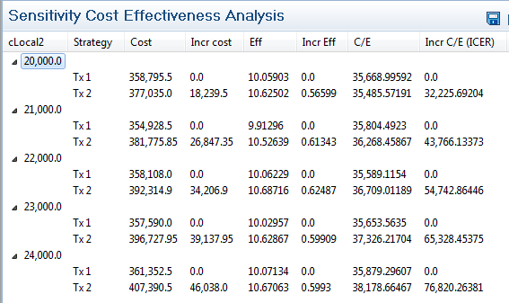
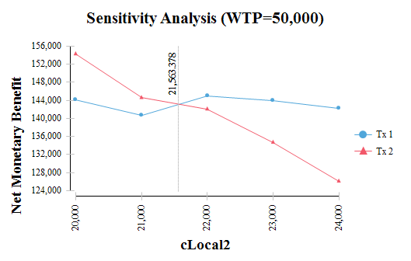
Sensitivity Analysis & Microsimulation
Regular sensitivity analysis output follows Microsimulation outputs
Net benefits to identify threshold

Slide 92
Sensitivity Analysis & Microsimulation
Probabilistic (PSA):
Still need cohort-level distributions
Run PSA on Microsimulation model via a 2-dimensional simulation
Outer loop for parameter uncertainty (samples, 2nd-order)
Inner loop for individual variability (trials, 1st-order)
Can take a long time…
Total iterations = samples * trials

Slide 93
Sensitivity Analysis & Microsimulation
Two-dimensional loop:
Sample parameter uncertainty distributions
Sample individual variability distributions
Run trial
Repeat 1.1 and 1.2 until set of trials is complete
Aggregate to mean values for the trial set
Repeat 1 until set of samples is complete
Aggregate values and present as PSA output
Results look the same as regular PSA without trial loop
Acceptability curve, distribution of incrementals, etc.
Lose information on trial-level data/variance (only means)

Slide 94
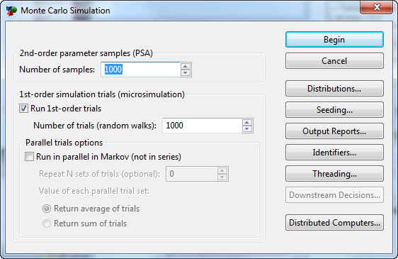
Sensitivity Analysis & Microsimulation
Instructions:
Open the Example13-MicrosimulationPSA.trex model.
Open Distributions View and check sampling rates.
Distributions 1, 2 are for individual variability.
Distributions 3, 4 are for parameter uncertainty.
Select root node.
Choose Analysis > Monte Carlo Simulation > Sampling & Trials from the menu.
Click Begin.

Slide 95
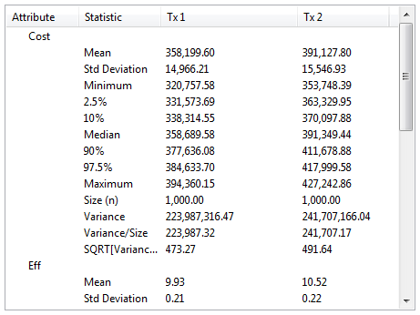
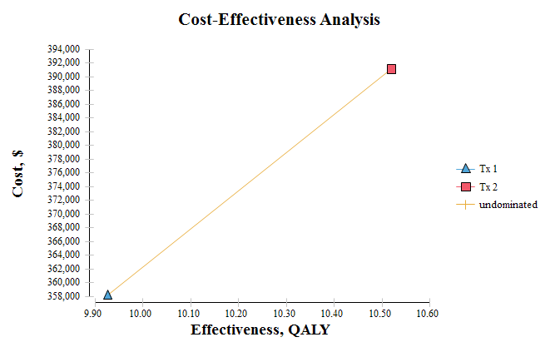
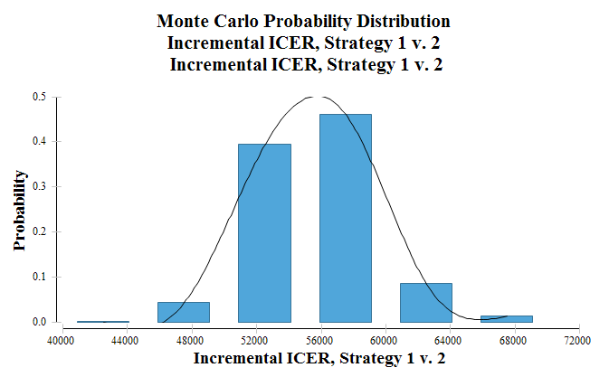
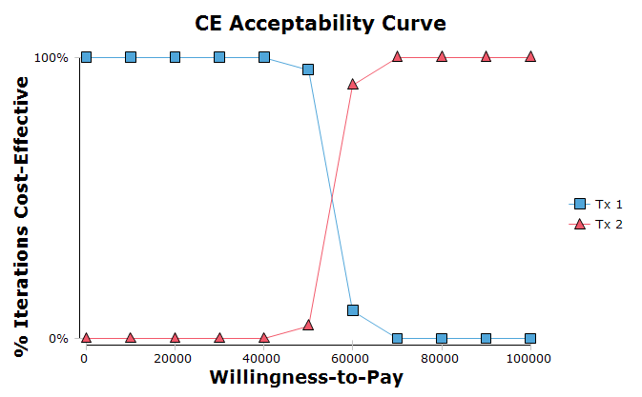
Sensitivity Analysis & Microsimulation
Results are the same as PSA without trials except that each iteration’s values are means from a set of trials rather than EV calcs
Other CEA and PSA outputs…

Slide 96
Advanced Modeling Techniques
Module 10: Advanced Modeling Techniques
Goals:
Introduce some advanced modeling techniques
Not in detail

Slide 97
Bayes’ Revision
Handle sensitivity/specificity of a test relative to…
True positives
False positivies
True negatives
False negatives

Slide 98
Player Models
Create a player model that restricts access to…
Change a subset of parameter values
Run a subset of analyses
Do not need a TP license to run player model

Slide 99
Exclude Strategies
Exclude a specific strategy from all analyses
Set a node property for a strategy to exclude the entire strategy
Analysis results will not include that strategy

Slide 100
Time-to-Event Simulation
Form of Discrete Event Simulation (DES) via Microsim.
Most Markov models have a fixed cycle length
Sometimes “time-to-event” more efficient or natural
Abandon _stage counter and fixed cycle length
Track time using a tracker
Increment time as it elapses
t_time = t_time + X
X may be distribution sampled by cycle
Time-dependent values are now a function of t_time
e.g., prob = Table[t_time]
Example model: Parallel Trials _CLOCK 1.trex
Published examples:
Barton, et al: BRAM arthritis model
LeLay, et al: Depression model

Slide 101
Parallel Trials
Trials can be run in parallel if there is interaction among trials
e.g., infectious disease, organ transplant availability
Data interaction:
StateProb can get % in each state for each cycle
Global matrix can store data by trial for reference by other trials
Synchronize trials by time rather than _stage, use special tracker name: _CLOCK
Sometimes need multiple trial sets to stabilize results
Example model: Parallel Trials _CLOCK 1.trex

Slide 102
Bootstrapping
Use real patient data as input to model
Create table with patient data
Each row is a patient
Each column is a different characteristic
Pull data from table for each patient characteristic
Draw each patient randomly from the table
Via uniform distribution – PatientData[ distUniform ]
Run for each patient in table (possibly more than once)
Via _trial keyword – PatientData[ _trial ]
PatientData[ Modulo(_trial; tableSize) ]

Slide 103
Dynamic Cohort
Add/subtract from cohort during analysis
Works for Markov Cohort Analysis and Microsimulation
Examples: infectious disease, population planning, budget analysis
Set Tree Preferences/Other Calc Settings to allow non-coherent probabilities (sum <> 100%)
Initial probabilities:
Number of patients starting in each state
Transition probabilities:
Can increase/decrease cohort size during any cycle (e.g., births, migration)
Example models:
Dynamic Population v2008.trex
Markov Dynamic Population 2.trex

Slide 104
EVPPI Simulation
Expected value of partial perfect information (EVPPI)
Isolate specific distribution(s) within PSA simulation in outer loop
Then sample other distributions in inner loop
Aggregated into means
Possibly also trials in “most inner” loop
Also aggregated into means
See isolated impact of specific distribution(s) within the overall PSA simulation
3-dimensional simulations can run slow……..

Slide 105
Testing & Debugging
You may want/need to verify that a model is calculating values as designed
Complex formulas, functions, non-root definitions
Time-dependent values: tables, functions
Markov transitions
Assumptions (calibration)
Temporarily change Markov assumptions …
Change probabilities to force cohort/trials to specific area in model to test a specific scenario

Slide 106
Testing & Debugging
Sensitivity analysis
Use extreme values
Look for unexpected changes in effects and costs
Evaluator View
Calculate variable/expression values at selected node
Output data
Add extra trackers for microsimulation to check events in iteration output
Use GlobalN function to store data during analysis
Dump global matrices at end of analysis

Slide 107
GlobalN Functions
Store and retrieve data at any time within a tree
Facilitates interaction among parallel trials
Store Markov transitions in a microsimulation
Store tracker at specific point in transition (microsimulation)
Output extra data from analyses not provided by TreeAge Pro
Commands
Store: GlobalN( index; row; column; data )
Retrieve: GlobalN( index; row; column )
Export to Text: GlobalN( index )
Export to Excel: Command( "EXCEL"; "ExportGlobalMatrixN"; index )
Example model: Global Function (simple).trex

Slide 108
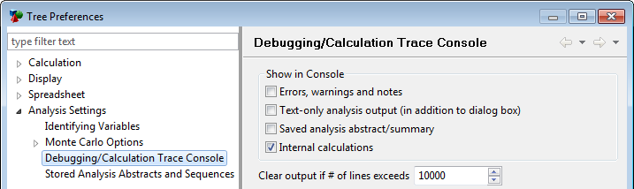
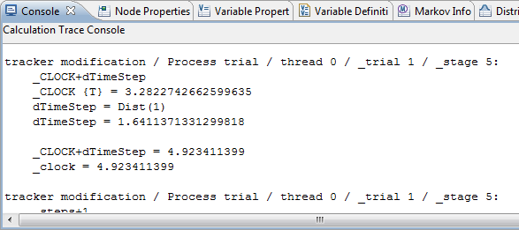
Testing & Debugging
Calculation Trace Console
Set Tree Preferences to output internal calculations
Calculations written to Calculation Trace Console
Slows down analyses
Test Microsimulation with just a few trials

Slide 109
Simulation Probabilities
Roll back may run fine, but simulations can still fail
Probability sampling can generate invalid probabilities
Single probability < 0 or > 1
Beta distributions bounded by 0 and 1
Sum of branch probabilities < 0 or > 1
Dirichlet distribution generates any number of coherent probabilities
Parameter: List(10; 20; 30; 40)
References: Dist(1; 1), Dist(1; 2), Dist(1; 3), Dist(1; 4)

Slide 110
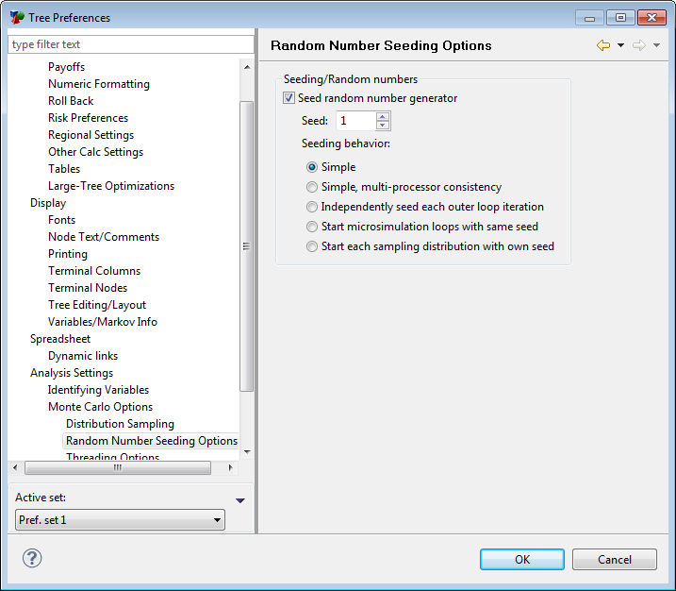
Seeding Simulations
Simulations will generate different results every time
Use seeding to get repeated results
Useful for testing, but do not overuse
Turn off when testing is done

Slide 111
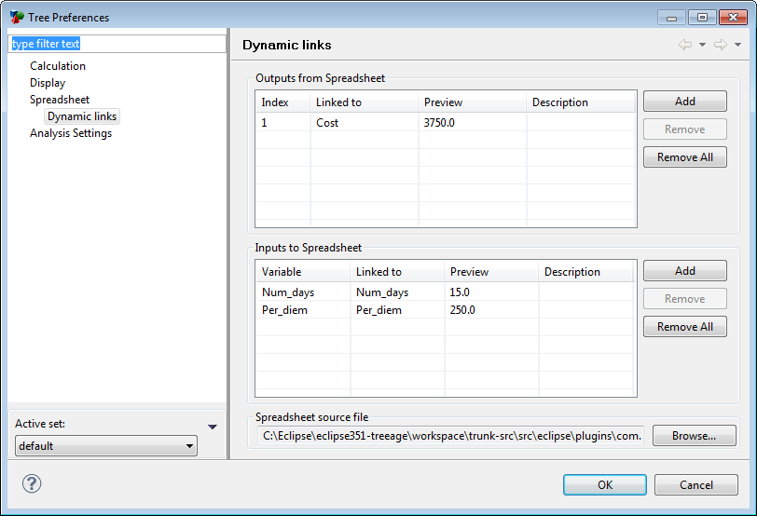
Bilinks
One direction:
Pull data from Excel into model
Both directions
Send data to specific Excel cells based on location in model
Calculate other cells in Excel
Pull calculated data back into TreeAge Pro
Allows complex calculations to be done in Excel
Slows model analysis, so use only when required

Slide 112
Getting Help
Context-sensitive help/manual
F1 or from Help menu
Complete description of most features
Technical support
Included with active license
Maintenance must be active for standard/perpetual license
support@treeage.com
413-458-0104, then 2 for support
Online training
For more extensive support than beyond that covered by Technical Support
Via GoToMeeting service

