Slide 1
Economic Value of Propeller Health System for Asthmatic Adults
Chong Hoon Kim, MPH
PhD Student
University of Colorado Anschutz Medical Campus,
Aurora, CO

Slide 2
Background
US estimated 24.6 million people (8.2%) currently have asthma
Current Asthma Management Approaches
Monitoring symptoms
Measuring lung function
Encouraging controller medication use
Reducing triggers of asthma
Educating patients
Maintaining collaborative patient-provider relationship
NAEPP recommendations not followed routinely[1]
1. Halterman JS, Aligne CA, Auinger P, McBride JT, Szilagyi PG: Inadequate therapy for asthma among children in the United States. Pediatrics 2000, 105(Supplement 2):272-276.

Slide 3
Background
American Thoracic Society recommends monitoring short acting β agonist (SABA) overuse
Propeller Health Platform
Monitoring Real-World Asthma Management Setting
SABA use
Asthma Control Test
Merchant RK, Inamdar R, Quade RC: Effectiveness of Population Health Management Using the Propeller Health Asthma Platform: A Randomized Clinical Trial. The Journal of Allergy and Clinical Immunology: In Practice 2016, 4(3):455-463.

Slide 4
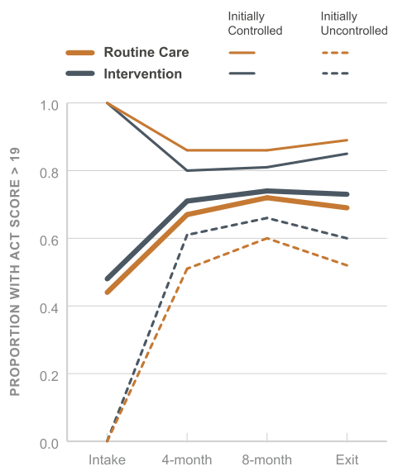
Proportion of participants with controlled asthma

Slide 5
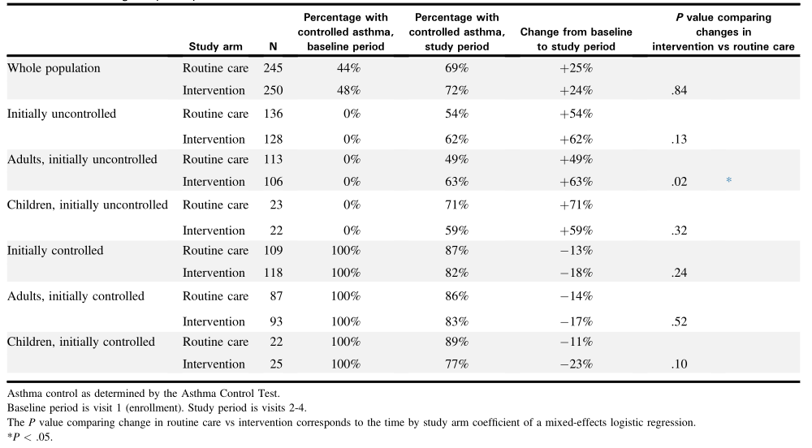
Percentage of Controlled Asthma

Slide 6
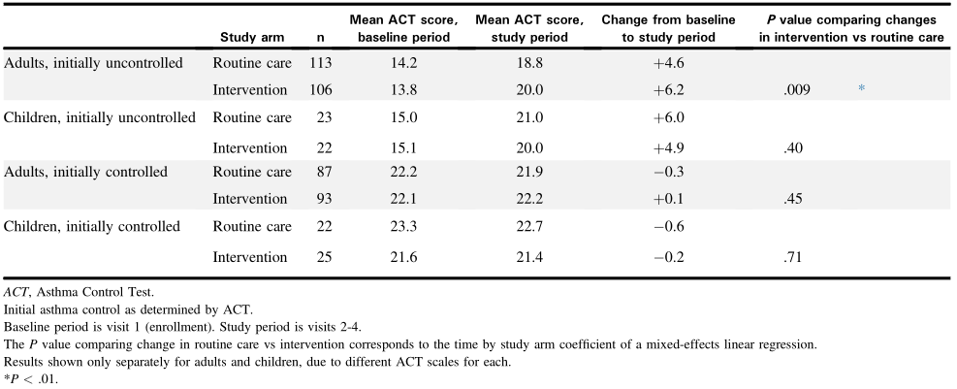
Change in ACT score

Slide 7
Objective
Estimate Cost-effectiveness of Propeller Health system vs. Usual care
Univariate Sensitivity Analysis
Probabilistic Sensitivity Analysis
CEAC

Slide 8
Model Framework: Level 1
PH + UC
UC
1-pCAPH
1-pCAPH
pCAPH
1-pUAPH
1-pCAUC
1-pCAUC
pCAUC
1-pUAUC
cUCA
cCA
cUCA
cCA
uUCA
uCA
uUCA
uCA
Uncontrolled
Controlled
Uncontrolled
Controlled
1-pUAPH
pUAUC
pCAPH
pCAUC

Slide 9
Model Framework: Level 2
uOSEX
uEREX
uHOEX
cOSEX
cEREX
cHOEX
Oral Steroid Burst Exacerbation
Emergency Room Exacerbation
Hospitalization Exacerbation
1-mr[age]
rrHOEX
rrOSEX
1-mr[age]
rrEREX
1-mr[age]-(amr+amrHosp)
Control or
Uncontrolled
mr[age]
mr[age]
mr[age]
amrHOEX
cNES
mr[age]
amr/amrc
uNES
Other-Cause mortality
Asthma-Related mortality

Slide 10
PH + UC
UC
A
Uncontrolled
Controlled
Uncontrolled
Controlled
Oral Steroid Burst Exacerbation
Emergency Room Exacerbation
Hospitalization Exacerbation
B
Control or
Uncontrolled
Other-Cause mortality
Asthma-Related mortality

Slide 11
Oral Steroid Burst Exacerbation
Emergency Room Exacerbation
Hospitalization Exacerbation
Control or
Uncontrolled
Other-Cause mortality
Asthma-Related mortality

Slide 12
Key Drivers of Economic Model
% of Controlled Asthma
Change in ACT score

Slide 13
Percentage of Controlled Asthma

Slide 14
Change in ACT score

Slide 15
Key Inputs
Cost of PH system per 2 weeks
$25
One time payment of $100
Exacerbation Probabilities/Proportions
OC Burst: 0.1005 vs. 0.0963 (UC vs Cont)
ER visit: 0.0025 vs. 0.0023 (UC vs. Cont)
Hospitalization: 0.0024 vs. 0.0022 (UC vs. Cont)

Slide 16
Cost
State/Event | Cost | Reference
Usual care pharmacotherapy per 2 weeks | $92 | Ayres et al.
Mild exacerbation unit cost | $120 | MarketScan
Emergency room unit cost | $548 | MarketScan
Hospitalization stay unit cost | $9,132 | MarketScan
One time cost of PH system registration | $100 | UC Denver Source
Cost of PH system per 2 weeks (recurrent) | $25 | UC Denver Source

Slide 17
Transitions
Transition | Probability | Reference
Probability of Asthma-related Mortality for 2 weeks for Uncontrolled Patients | 0.00238 | de Vries et al. 2010
Additional risk of death given asthma hospitalization | 0.01165 | Sullivan et al. 2009
Probability of Asthma-related Mortality for 2 weeks for Controlled Patients | 0.00015 | Sullivan et al. 2009
Probability of OC Burst per 2 week | 0.1005 | Sullivan et al 2014
Probability of OC Burst per 2 week for controlled asthma | 0.0963 | Sullivan et al 2014
Probability of Emergency Room Visit per 2 week | 0.0023 | Sullivan et al 2014
Probability of Asthma Hospitalization per 2 week | 0.0023 | Sullivan et al 2014
Probability of Controlled Asthma using PH system at 2 wks | 0.04 | Merchant et al.
Probability of Controlled Asthma under Usual Care at 2 wks | 0.03 | Merchant et al.
Probability of Uncontrolled Asthma using PH system at 2 wks as initially controlled | 0.01 | Merchant et al.
Probability of Uncontrolled Asthma under Usual Care at 2 wks as initially controlled | 0.01 | Merchant et al.

Slide 18
Utility Parameters
State/Event | Utility | Reference
Utility score for Non Exacerbation State (Chronic Asthma) | 0.67 | Chen
Utility score for OC Burst | 0.57 | Price et al.
Utility score for ER visit | 0.45 | Price et al.
Utility score for Hospitalization | 0.33 | Price et al.

Slide 19
Cost-Utility Results
 | Cost (USD) | QALYs | Lys | ICER
Usual Care | $57,042 | 13.57 | 20.58
Propeller Health + Usual Care | $59,675 | 14.04 | 21.30 | $5,581

Slide 20
Tornado Diagram
Notes:
Key Assumption/Input: Constant probability of UC and Controlled Asthma

Slide 21
Probabilistic Sensitivity Analyses

Slide 22
Cost Effectiveness Acceptability Curve

Slide 23
Subgroup Analysis

Slide 24
Limitations
Generalizable only to adults
Stochastic process from controlled to uncontrolled yet unclear
More research needs to be done
Transition probability from controlled/uncontrolled to exacerbation states needs meta analysis driven evidence
Currently only using one source for each transition probabilities
Utilities vary widely
Also need meta analysis source

Slide 25
Conclusions
Propeller Health System is highly cost effective given the willingness-to-pay threshold of $50,000.
Women compared to men have greater probability of PHS being cost effective for each age distribution.
Younger population compared to older population have greater probability of PHS being cost effective for each gender distribution.

