Slide 1

SRM Institute of Science and Technology College of Engineering and Technology School of Computing Major Project - VIVA VOCE Academic Year : 2025-2026 AUTOMATED NETWORK TOPOLOGY DISCOVERY AND ANALYSIS USING CISCO DNA CENTER Project Category: RESEARCH
Date: 7th May 2026
Guide Name : Student Name & Registration Number :
Dr. Rajaram V Vedant Pandey – (RA2211029010013)
ASSOCIATE PROFESSOR Chiranjeev Kumar – (RA2211029010019)
Networking and Communications

Slide 2

Introduction
Network topology maps are essential for troubleshooting, change management, capacity planning, and security validation.
This project studies topology discovery across three visibility tiers:
DNAC API for enterprise / managed networks
SNMP + LLDP for multi-vendor / vendor-neutral networks
ARP scanning for unmanaged / consumer networks
A unified Python framework converts every discovery output into a NetworkX DiGraph for analysis and visualization.
The comparative study highlights where each approach works best and where it breaks down.
Enterprise
DNAC API gives rich device, site, and link metadata.
Multi-vendor
SNMP/LLDP provides standards-based neighbor discovery.
Unmanaged
ARP reveals reachability, but topology is limited under Proxy ARP.
Goal
Make discovery method selection evidence-based, not guesswork.

Slide 3
Problem Statement
DNAC Scope Limit
Works only where Cisco DNA Center manages the devices. Outside that boundary, visibility is incomplete.
SNMP/LLDP Constraint
Depends on SNMP availability and LLDP/CDP configuration. It is often partial or disabled in secured networks.
ARP Limitation
Sees only IP reachability. Proxy ARP can collapse many hosts into one gateway MAC, making topology inference unreliable.
Research question
How accurate, comprehensive, and universally applicable are API-based, protocol-based, and reachability-based topology discovery techniques?
The project addresses the gap with controlled experiments and a unified scoring framework.

Slide 4
Literature Survey
Work | Technique | Key finding | Gap / Relevance to this project
Breitbart et al. SNMP/BRIDGE-MIB | SNMP/MIB | Reconstructs Layer 2 topology from forwarding tables and ARP caches. | Shows SNMP can infer adjacency, but coverage is incomplete.
Bejerano & Rastogi LLDP algorithms | LLDP | Bidirectional LLDP advertisement enables polynomial-time reconstruction. | Works only when LLDP is enabled end-to-end.
Cisco DNAC API Guide | API-driven | Provides managed-device inventory, links, and hierarchy through REST endpoints. | Richest metadata, but limited to Cisco-managed visibility.
Donnet & Friedman ARP topology survey | ARP / Proxy ARP | Proxy ARP is a major limitation for Internet topology discovery. | Motivates empirical testing of hotspot / consumer networks.

Slide 5
Existing System
Topology discovery is typically done with a single tool or a single protocol.
Manual mapping is slow, error-prone, and hard to keep current.
Vendor tools provide rich results only inside their own ecosystem.
SNMP-only approaches need access, credentials, and consistent MIB support.
ARP scanners are easy to deploy, but they do not reveal true Layer-2 structure in Proxy ARP networks.
Most existing workflows produce static screenshots rather than a reusable graph model.
Manual diagrams
Outdated soon after creation.
Vendor lock-in
Limited portability between environments.
Reachability only
No reliable adjacency inference.
Existing systems answer the question “Who is reachable?” better than “What is the actual topology?”

Slide 6
Proposed Work Objectives
Implement three separate discovery modules in Python: DNAC, SNMP/LLDP, and ARP.
Normalize every output into a common NetworkX DiGraph schema.
Measure discovery completeness, metadata richness, discovery time, and success rate.
Compare the methods side-by-side and generate charts, tables, and a decision tree.
Provide a dashboard for topology visualization and evidence-based method selection.
Outcome
A reproducible research framework for topology discovery.

Slide 7
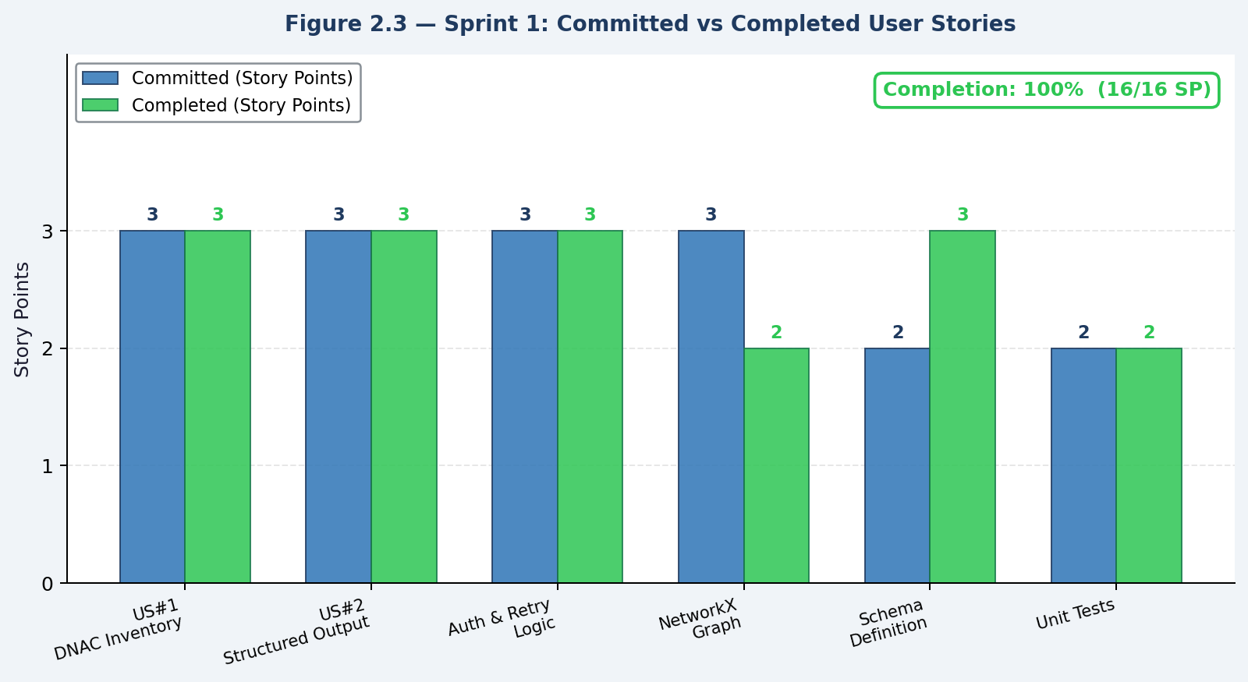
Sprint 1 – DNAC API Integration and Topology Discovery
Goal: log in to Cisco DNAC sandbox and extract device inventory plus physical links.
Implemented the DNAC module and constructed the initial NetworkX graph.
Generated PNG-based topology visualizations for the enterprise environment.
Blocker: sandbox maintenance / availability issues; a simulated fallback mode was used.
Result: committed stories were completed; discovery time recorded at about 5.2 seconds.
Key deliverable: DNAC discovery pipeline with usable structured topology output.

Slide 8
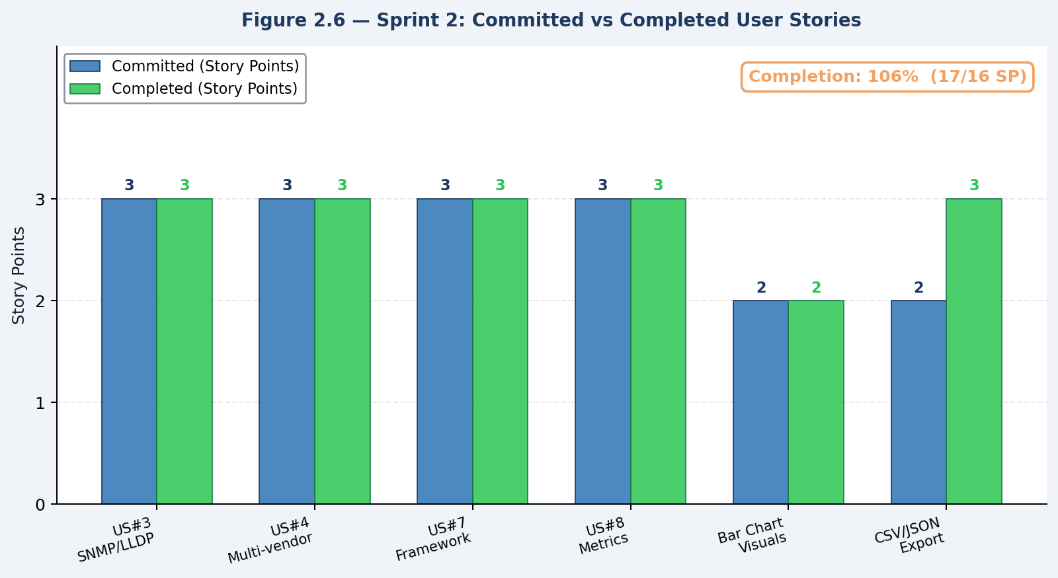
Sprint 2 – SNMP/LLDP Discovery and Comparative Analysis
Implemented the SNMP/LLDP discovery module for vendor-neutral topology extraction.
Built the comparison engine to evaluate methods on nodes, links, metadata richness, and performance.
Added CSV export and chart generation for side-by-side analysis.
Resolved an AttributeError discovered during review by tightening test coverage and method wiring.
Outcome: SNMP/LLDP correctly produced neighbor data; comparison framework became reusable.
Key deliverable: comparative analysis pipeline with standardized metrics and exportable results.

Slide 9
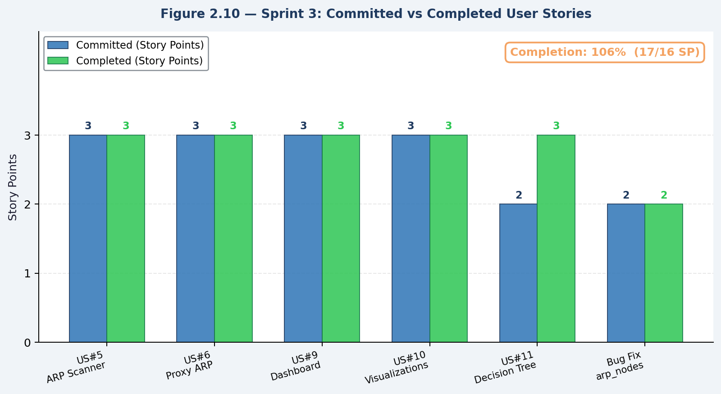
Sprint 3 – ARP Scanner, Dashboard, and Final Evaluation
Completed ARP scanning, Proxy ARP detection, dashboard, and final decision framework.
Integrated the Streamlit-based live view and the final chart set for presentation.
Fixed the arp_nodes scope issue that appeared when ARP responses were blank.
Verified Proxy ARP behavior on hotspot-style networks, where many IPs map to one MAC.
Result: all sprint stories were completed and the full framework reached final form.
Final sprint emphasis: operational completeness, dashboard presentation, and decision support for method selection.

Slide 10
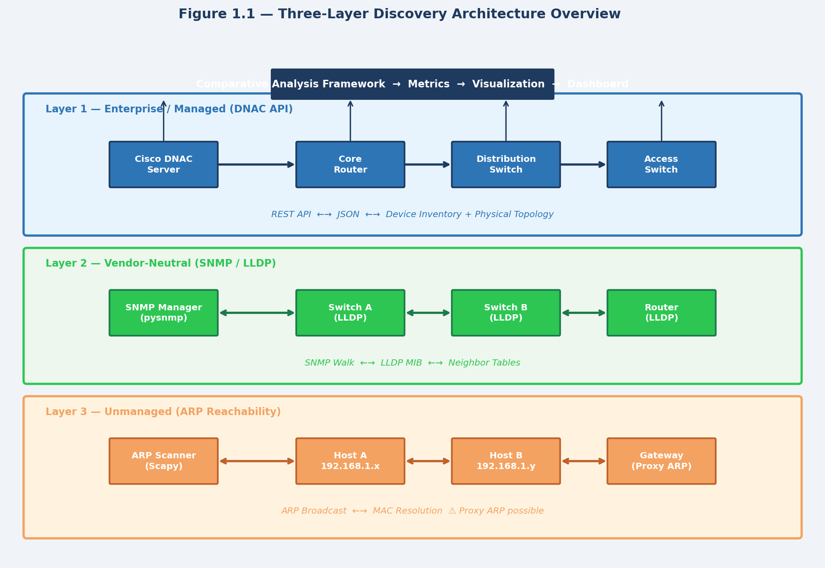
Proposed System Architecture
Layers: Discovery → Graph Model → Analytics & Intelligence → Presentation / Export

Slide 11
Algorithms Involved
DNAC API workflow
Authenticate → pull network-device and physical-topology data → build graph.
SNMP/LLDP workflow
SNMP walk / LLDP neighbor extraction → resolve links → enrich metadata.
ARP / Proxy ARP scan
Scan subnet → record replies → detect gateway MAC collapse.
Comparator / scoring
Normalize metrics, rank methods, and generate a decision tree.
Common output: a NetworkX DiGraph plus a comparison matrix for quantitative evaluation.

Slide 12
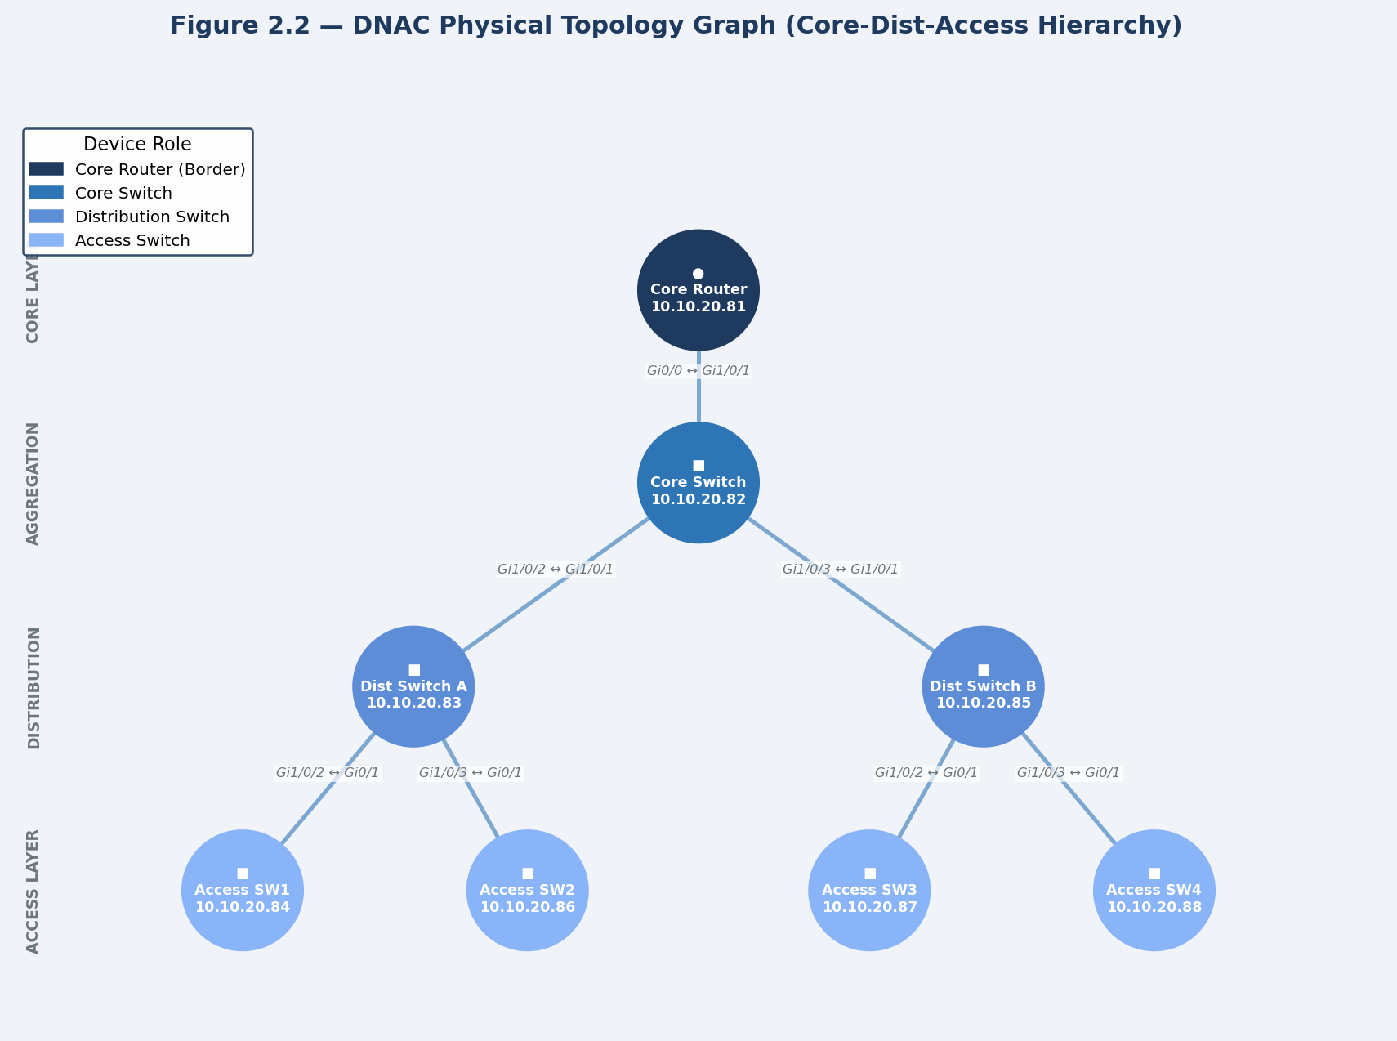
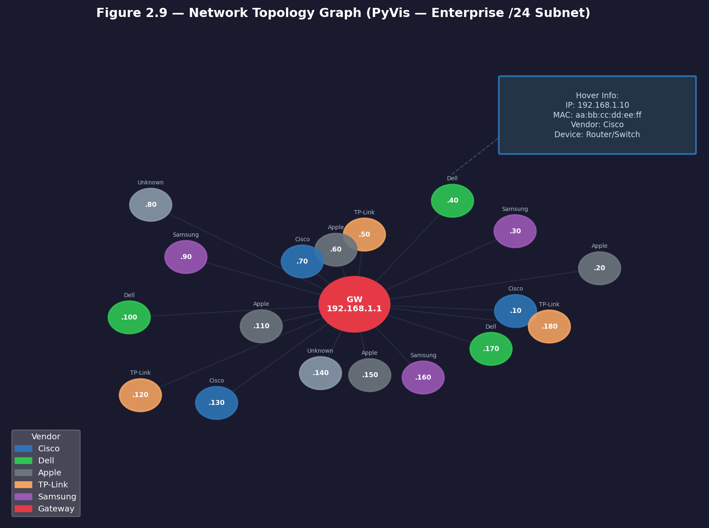
Implementation
Core code lives in the NW_Topology_Map and code/files folders.
Main modules include :
dnac_topology.py, network_topology.py, nw_map.py, wifi_device_discovery.py, comparative_analysis.py, dashboard.py, and main_research_framework.py.
Python libraries:
NetworkX, Matplotlib, PyVis, Streamlit/Flask style dashboarding, and protocol-specific networking libraries.
Outputs include topology graphs, comparison tables, radar/bar charts, and decision logic artifacts.

Slide 13
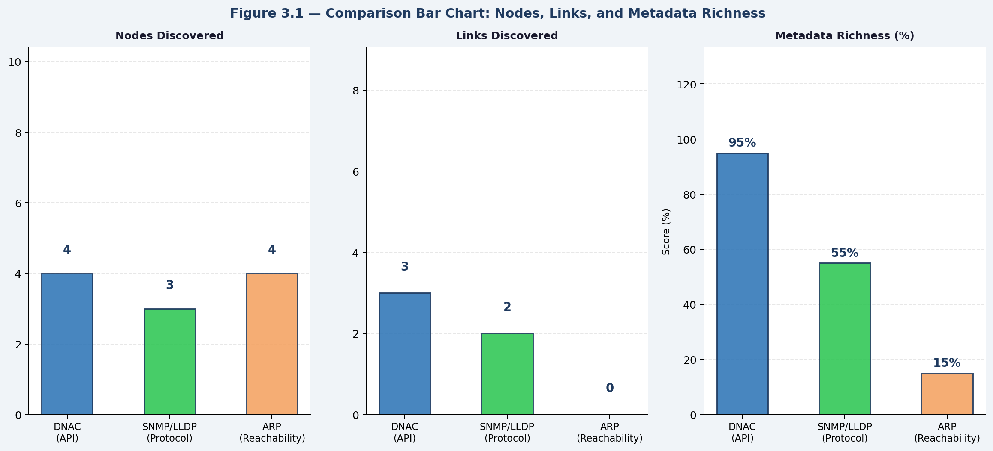
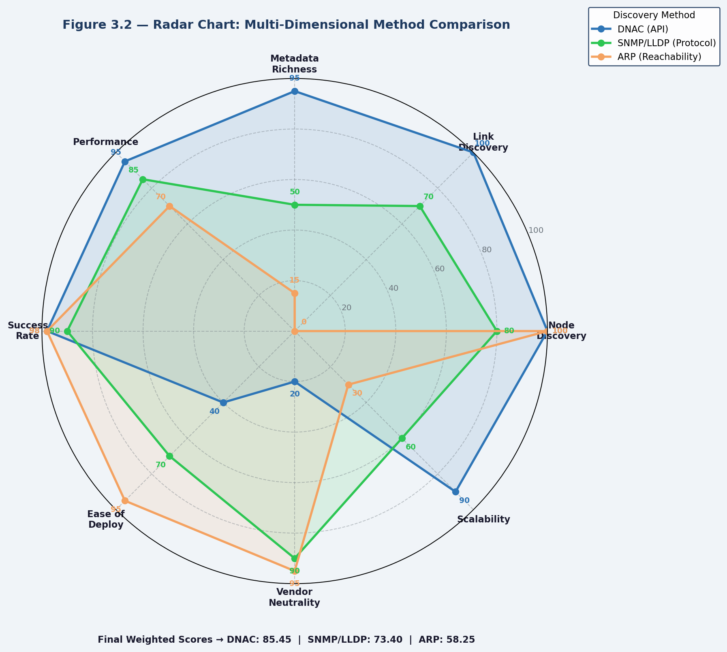
Results and Discussion
Method | Nodes | Links | Metadata Richness | Discovery Time (s)
DNAC | 2 | 1 | 60% | 5.20
SNMP_LLDP | 2 | 1 | 40% | 8.70
ARP | 2 | 0 | 30% | 4.21
Takeaway: DNAC is strongest for managed enterprise visibility, SNMP/LLDP is best for vendor-neutral connectivity, and ARP is fastest but topology-limited under Proxy ARP.

Slide 14
Conclusion
The framework demonstrates that no single discovery method is universally optimal.
DNAC gives the richest and most complete view where a management platform exists.
SNMP/LLDP provides a practical middle ground for heterogeneous enterprise networks.
ARP scanning is useful for quick reachability checks, but it does not recover true topology in Proxy ARP-heavy environments.
The common graph model and comparative metrics make method choice reproducible and explainable.
The project turns topology discovery into a measurable engineering decision.

Slide 15
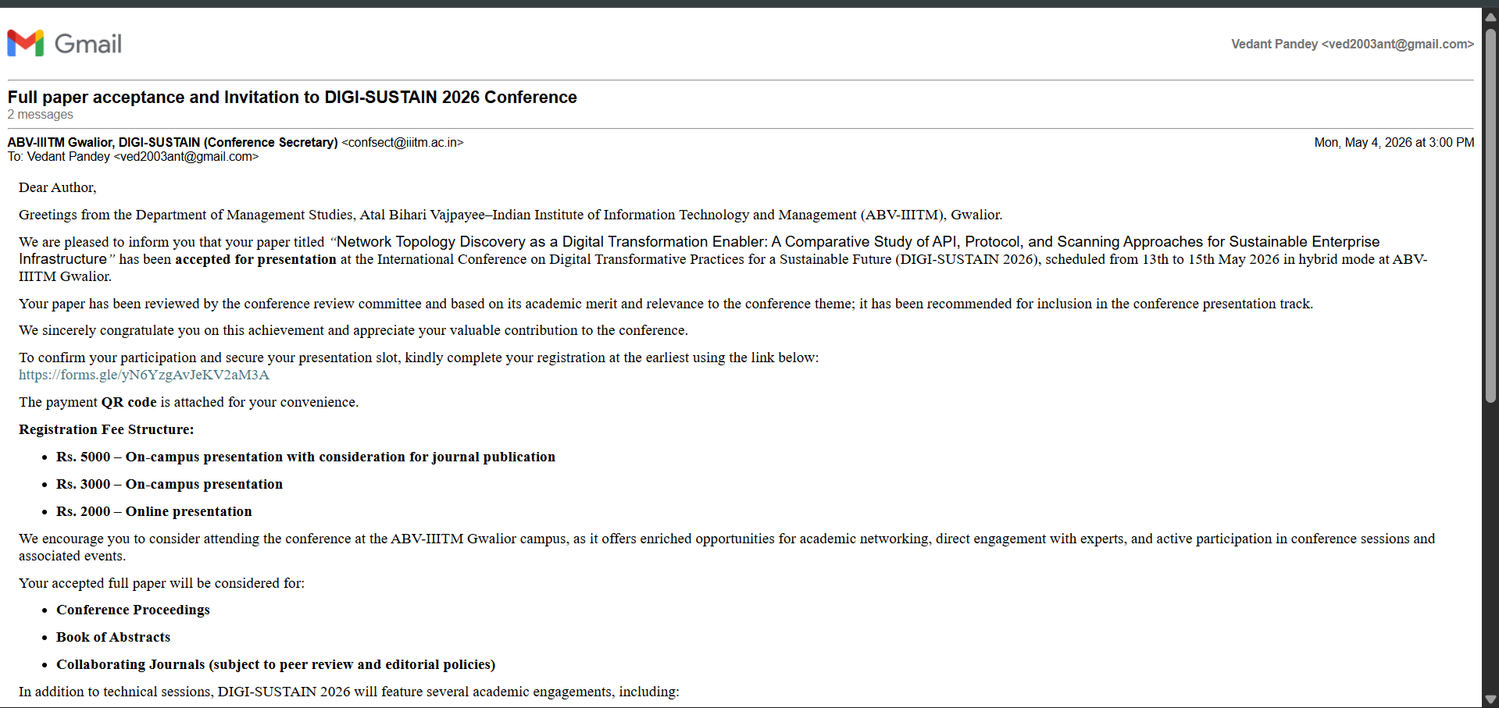
Project Outcome – Patent / Publication
Publication
Paper accepted for presentation at DIGI-SUSTAIN 2026.
Title: Network Topology Discovery as a Digital Transformation Enabler

Slide 16
References
Cisco Systems, Cisco DNA Center Platform API Reference Guide, Release 2.3, 2022.
A. Breitbart et al., SNMP / BRIDGE-MIB topology reconstruction for Layer-2 networks.
A. Bejerano and R. Rastogi, efficient LLDP-based topology inference algorithms.
B. Donnet and T. Friedman, Internet Topology Discovery: A Survey, 2007.
NetworkX documentation / Hagberg et al., graph modeling for topology analysis.
Project codebase and report figures from the uploaded major project archive.

Slide 17
Thank You!

