Slide 1
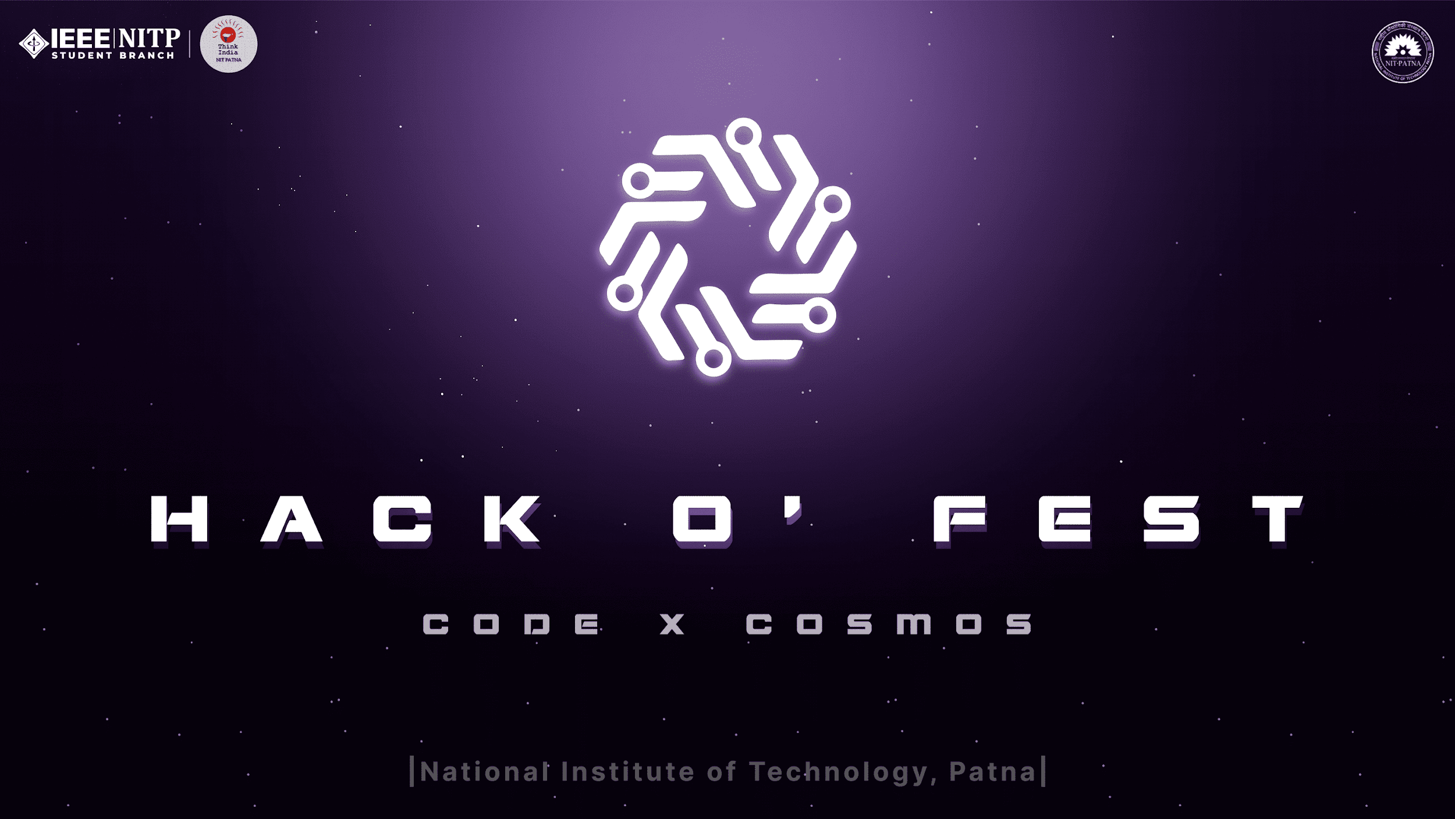

Slide 2

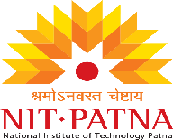

BRIEF DESCRIPTION OF YOUR IDEA
Hackathon Project: Project GreenBin - AI-powered Waste Management with Resource Recovery
Concept: Project GreenBin utilizes AI and Internet of Things (IoT) technology to optimize waste collection, improve sorting accuracy, and promote sustainable resource utilization within communities.
Components:
Smart Bins with AI Recognition:
Equipped with cameras and AI image recognition software.
Cameras capture images of waste items deposited in the bin.
AI software analyzes the images, identifying material types (plastic, metal, glass, organics, etc.).

Slide 3
Team DamageCTRL
Anitej Mishra
Prem Lohia
AADIT VINAYAK
CHIRANJEEV Kumar

Slide 4
CURRENT SOLUTIONS
Current Solutions in Waste Management
While Project GreenBin offers a comprehensive AI-powered approach, various existing solutions address aspects of waste management:
1. Sorting Technologies:
Optical Sorting Systems: These use cameras and sensors like near-infrared (NIR) to identify and separate materials based on their reflectance properties. They are effective for sorting plastics, metals, and paper.
Manual Sorting Facilities: Despite limitations, manual sorting by trained personnel remains prevalent, especially for mixed waste streams.

Slide 5
PROPOSED SOLUTION AND ITS BENEFITS
Benefits:
Increased Recycling Rates: Improved sorting accuracy through AI leads to higher quality recyclables.
Reduced Landfill Waste: Diversion of recyclables from landfills conserves valuable resources and reduces environmental impact.
Optimized Collection Efficiency: AI-powered route planning minimizes fuel consumption and emissions.
Resident Engagement: The mobile app fosters awareness and promotes responsible waste management practices.
Data-driven Decision Making: Real-time data provides insights for optimizing waste management strategies and resource recovery efforts.
Hackathon Focus:
Develop a functional prototype of the AI image recognition system for waste classification.
Design a user-friendly mobile app for resident interaction.
Showcase a proof-of-concept for data visualization and route optimization using simulated data.

Slide 6
PROPOSED SOLUTION ( Implementation And Technology Used )
Implementation Road Map:
Data Collection and Model Training:
Gather a large and diverse dataset of waste item images for various materials and waste streams.
Train the AI image recognition model using the collected data to achieve high accuracy in waste classification.
Smart Bin Prototype Development:
Integrate camera, sensors, and a secure communication module into a prototype bin.
Develop software to capture images, transmit data to the cloud platform, and interact with the central system.
Mobile App Development:
Design a user-friendly and informative app for residents.
Integrate features for waste sorting education, bin status updates, and gamification (optional).
Cloud Platform and Data Management:
Establish a secure cloud platform to handle data storage, processing, and communication between bins, mobile app, and waste management software.
Pilot Testing and Refinement:
Deploy the Project GreenBin system in a controlled environment for testing and evaluation.
Monitor system performance, including AI classification accuracy, data collection efficiency, and resident engagement through the mobile app.
Refine the system based on real-world data and user feedback.

Slide 7
FUTURE SCOPE AND SCALABILITY
Future Outlook:
Project GreenBin has the potential to become a global leader in AI-powered waste management. By continuously improving its technology, expanding its capabilities, and fostering collaboration, it can contribute significantly to a more sustainable future for our planet.
Scalability Advantages:
Project GreenBin's modular design allows for easy adaptation to different city layouts and waste management practices.
The cloud-based platform facilitates data management and scalability for deployment across larger regions.
The mobile app can be easily distributed and scaled to accommodate a growing user base.

