Slide 1
VIRTUAL TRY ON
Batch No:26
App Name: VTON- AI
Register Nos:RA2211028010206,RA2211029010019,RA2211003011495,RA2211026010333
Names: ROHAN, CHIRANJEEV , SHREYANSH, SWARNA
Department : CSE-NWC , CTECH, CINTEL
Dept of Networking and Communications
School of Computing
21CSE306P- Applied GenAI
Convenors: Dr. Vaishnavi Moorthy & Dr. R. Swathy

Slide 2
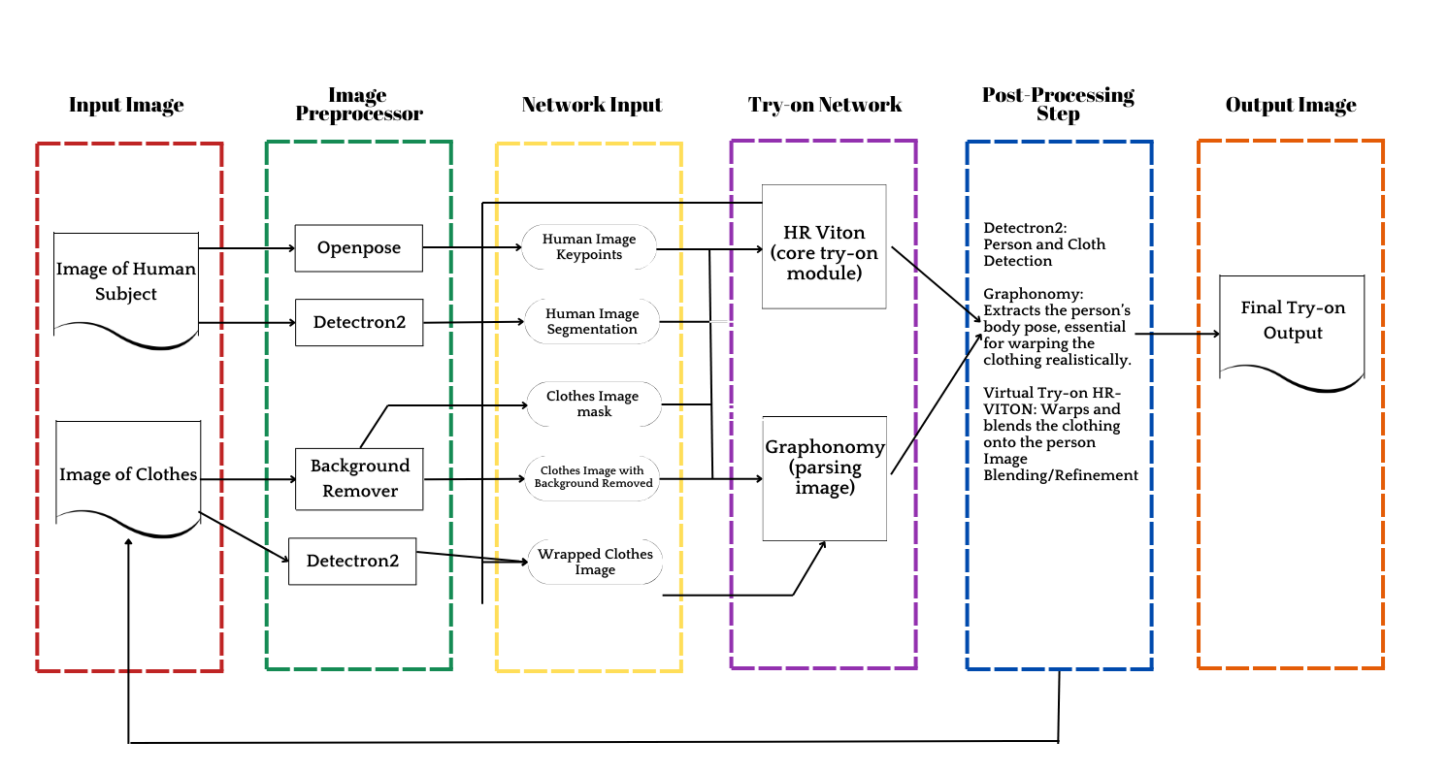


Problem statement : Provides virtual fashion trials and personalized recommendations based on body type and style preferences.
Gen AI Model – Proposed System Design
Model Design
Application Details: Enables fast, customizable fashion design with real-time style, color, and pattern options.
Smartness: Predicts preferences, suggests trends, and adapts designs
Target Users: Fashion designers, brands, and consumers seeking personalized fashion
Novelty: Combines generative AI with fashion for data-driven creativity.
AI Technique: Uses GANs and diffusion models for innovative, user-driven designs
Key features
Real-Time Customization: Instantly personalize colors, patterns, and styles.
Trend Prediction: AI suggests current trending designs.
User-Friendly Interface: Accessible for designers and casual users.
High-Quality Outputs: Realistic, high-res previews ready for production.
Fig. 1: Pipeline Diagram
Domain & Novelty
Domain: Focuses on digital fashion design and customization.
AI Integration: Uses AI for trend prediction and design generation.
User-Centric: Tailored for designers, brands, and fashion enthusiasts
Unique Approach: Combines AI with creative design for innovation.
Future Enhancement
Enhanced Personalization: Deeper customization based on individual style.
Sustainability Focus: Integrate eco-friendly design suggestions.
Improved Realism: Generate even more lifelike design previews.
Expanded Data Sources: Use broader trends for better accuracy
Challenges
Data Quality: Ensuring high-quality, diverse data for accurate designs
Computational Cost: Managing resource demands of AI models.
User Adaptability: Making AI tools accessible for all skill levels
Intellectual Property: Protecting originality and design ownership..

Slide 3
Literature Survey
Sl.No | Journal | Application/model name | Features | Shortcomings
1 | [5] Virtual Stylist Using IOT | Hybrid Matching-aware Virtual Try-On Framework (HMaVTON) | Clothing detection, Fashion technology, Image processing, Virtual try-on | Focusses only on image generation quality, Overlooks fashion item matching
2 | [6] GANs and Augmented Reality in Virtual Clothing Try-On | Arbitrary Virtual Try-On Network (AVTON) | Augmented Reality (AR) integration, real-time virtual clothing try-on | Focus on realism, Limited dataset diversity
3 | [7] Mobile 3D body scanning applications: a review of contact-free AI body measuring solutions for apparel | GARMENTO (B2B Virtual Try-On System) | Contactless scanning, virtual try-on, body tracking, and size recommendation | Needs refinement, future improvements, limited analysis
4 | [8] An interactive attribute-preserving fashion recommendation with 3D image-based virtual try-on | Generative Adversarial Networks (GANs) for virtual dress trials | Upload frontal image, virtual try-on, high accuracy, minimal memory usage | Limited accuracy in size suggestion
5 | [9] FashionTex: Controllable Virtual Try-on with Text and Texture | Virtual Stylist using IoT and Machine Learning | Multi-modal interactive setting, fashion editing module, loss functions, and ID recovery module | Inaccurate clothing detection

Slide 4
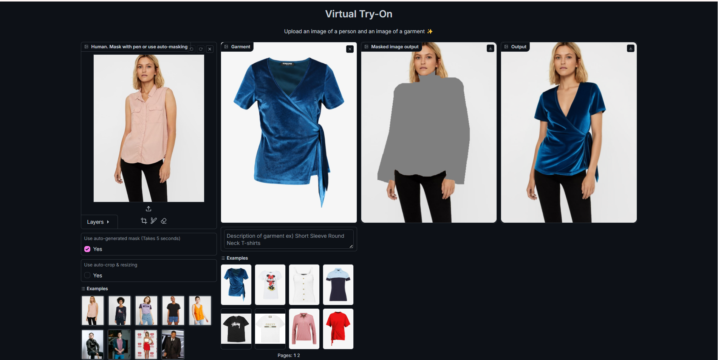


Screenshots + Results
Gen AI Model Outcome
Fig. 3: Application Input
Fig. 4: Application Output

