Slide 1
Rakuten Pay iOS MVVM + Clean Architecture Part 1 - Migration
August 22th , 2023
Chang Chih Hsiang
Rakuten Payment, Inc.

Slide 2
Practice resource
Gitpub :
https://gitpub.rakuten-it.com/scm/smartpayemv/01-ios-mvvmclean-sample.git
Gitlab :
https://gitlab-payment.intra.rakuten-it.com/rpay-ios/shopper/01-ios-mvvmclean-sample

Slide 3
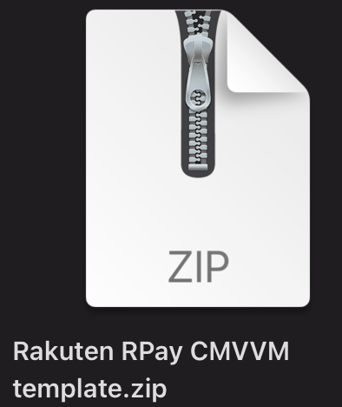
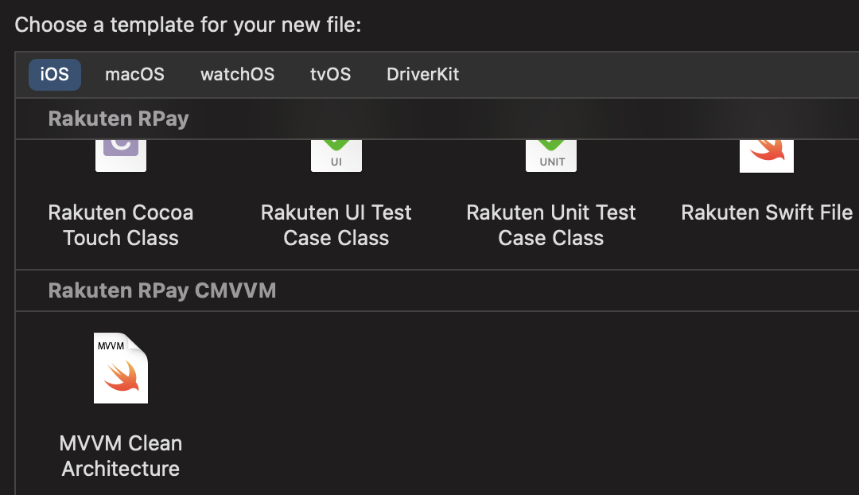
Copy template
~/Library/Developer/Xcode/

Slide 4
Preparation
Create Folders
Domain、Presentation、Data、Infrastructure、Application/Container、 Application/Container/MockData
Copy Materials
Container
Networks
Image Assets

Slide 5
Build feature - 1
Copy template
Create Feature
Create it in no matter what folder you want
Create feature by template
Input module name ( without ViewController or any suffix words)
Build anytime -> verify build status
Browse objects
Switch router path from AppDelegate to new class
Create container
Create one container for each flow
Register method by ViewModel type
Create necessary objects
Repository、UseCase、 ViewModel
Loader in repository is interface to switch to different network module in the future
Observe the mechanism in new ViewController > how to fetch dependency in container

Slide 6
Create a container
Feature tree
Rpoint Usage
PaymentMethod
OPBarcode
Charge Method
Selection
Rcash charge
Rakuten Cash
Charge Hostory
Balance refresh
Setting
Hamburger Menu
Re login

Slide 7
Build feature - 2
Handle UI
Copy properties from old class > next new line after “ViewModel” please
Copy UI from old class
Copy other codes from old class
Create Feature
Create it in no matter what folder you want
Create feature by template
Don’t forgot to BUILD again and again
Start to organize life cycle

Slide 8
Build feature - 3
Refactor UseCase
Refactor getUserInformation > new Method
Distinguish Business flow and Data flow
Copy logic from old method > Past it and Refactor it
Replace passing object , shopper > entity
Refactor initializer
Create Feature
Create it in no matter what folder you want
Create feature by template
Don’t forgot to BUILD again and again
Start to organize life cycle

Slide 9
Build feature - 4
Refactor Repository
Create a new method
Don’t forgot to write the method in "Protocol"
Copy perform API logic into repository
Network request is the same , so we just move logic from RakutenWalletApiManager and API Manager to Repository
Create new EndPoint
Refactor from the first line before invoke “Network request”
Copy parameters、API path、method
Make a new EndPoint
NetworkEndpoint<Generic(your response object)>
Refactor DTO (Data transfer object) > Data to Entity
Copy all properties to DTO > refactor toDomain method
Perform API call with Endpoint object by RemoteDataLoader

Slide 10
Build feature - 5
Refactor all the method to Combine objects (AnyPublisher<Success,Error>)
Repository
Success > Entity
Error > API Error
Wrap DTO publisher to Entity
UseCase
Success > Entity
Error > API Error
ViewModel
Refactor data handler and data flow in initialActions
Move properties into viewmodel
Add UI binding depend on dataFlow
Input > replace input trigger
Output > change UI status
Loading activities
UIPresent

Slide 11
Build feature - 6
Binding UIs
Add Published to ViewModel properties
Add $ in ViewController
Add weak self > retain cycle > unowend
Binding input and output
Handle the default value , because @Published will perform default value when sink
Drop first
Be care of life cycle orders , UI Setup > UI Biding > start trigger
Delete useless codes
Test by Mock objects

Slide 12
UseCase is the most important thing
Clean architecture

Slide 13
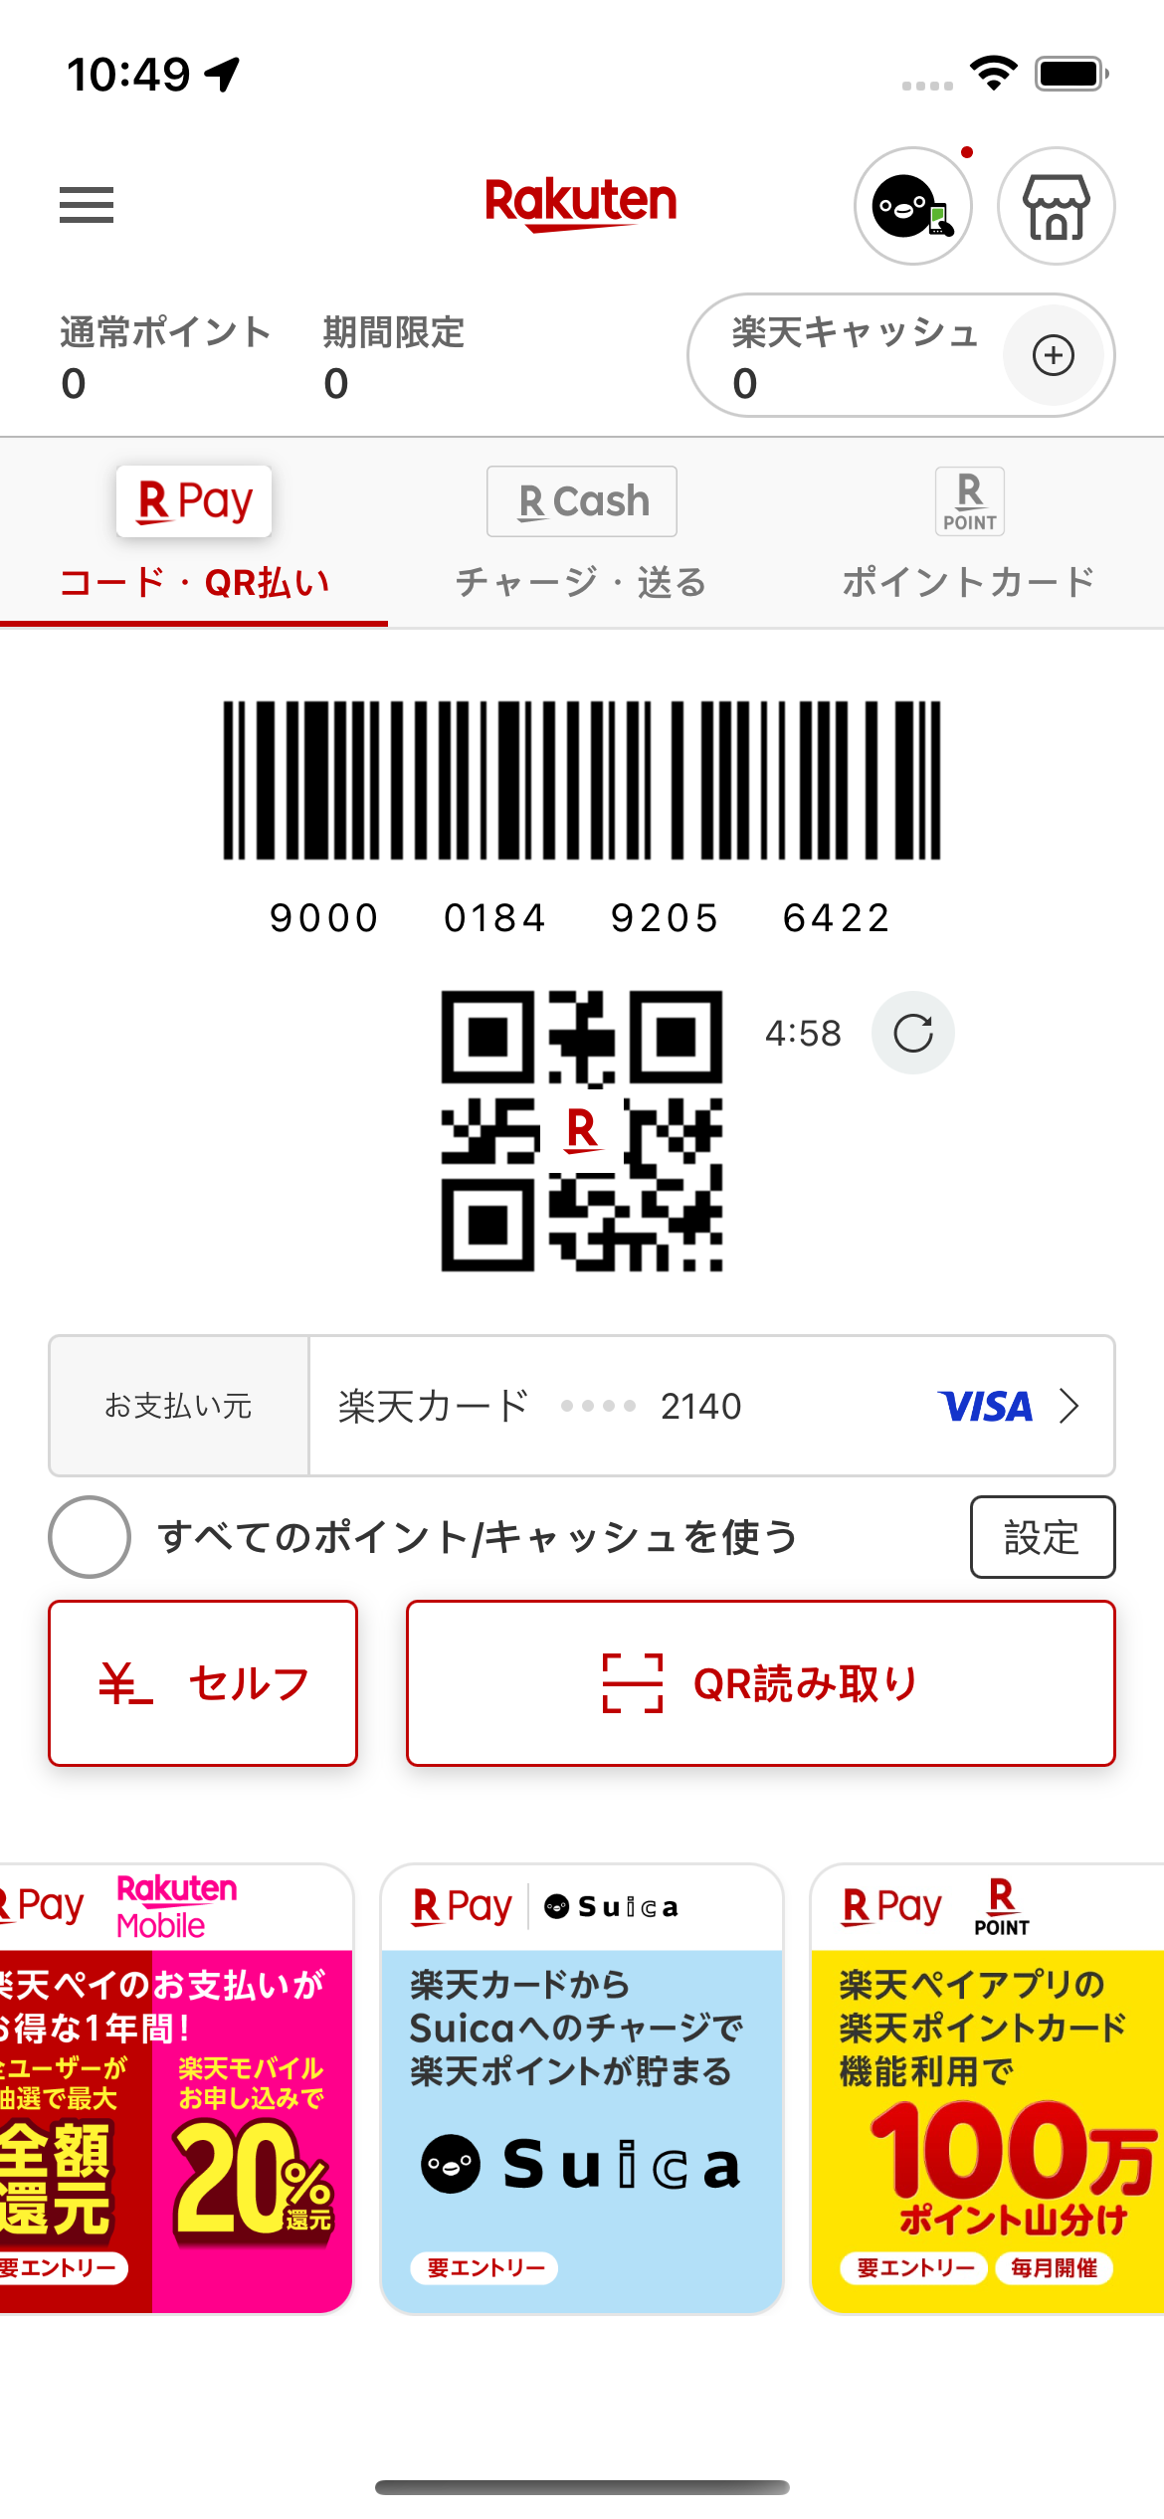
What is usecase?
※ A scenario on screen
Refresh barcode by user
User click refresh button
Check cache image is existing or not
Perform API to generate barcode
Parameters : EasyID
Retrieve new barcode from backend response
Validate the barcode format
Refresh barcode on screen
Happy path ( Success )
Display barcode on screen
Sad path ( Failure )
Handle error code
Alert message

Slide 14
Separate usecase into modules
ViewController
ViewModel
Model
UseCase
Entity
Core Module
Network
UI binding
Business logic
( Optional )
Scenario flow
Feature data object
Local persistent
UI、Transition
Repository
DTO
(Data Transfer Object )
Data source
Convert response

Slide 15
How to seperate
Refresh barcode by user UseCase
User click refresh button
Refresh button、Action
Refresh button Binding
Check cache image is existing or not
Perform API to generate barcode
Parameters EasyID
Retrieve new barcode from backend response
Convert response to entity
Validate barcode format
Refresh barcode on screen
Trigger data binding
Refresh barcode on screen
ViewController
ViewModel
UseCase
UseCase
UseCase
Repository
DTO
Entity
Model
ViewModel
ViewController

Slide 16
Snapshot Test
https://github.com/pointfreeco/swift-snapshot-testing

Slide 17
Unit Tests
Test_method_parameters_suceese
ViewModel for binding
UseCase for business flow
ViewModel + UseCase > Mock Repository

