Slide 1
Rakuten Pay iOS MVVM + Clean Architecture Part 1 - Migration
August 22th , 2023
Chang Chih Hsiang
Rakuten Payment, Inc.

Slide 2
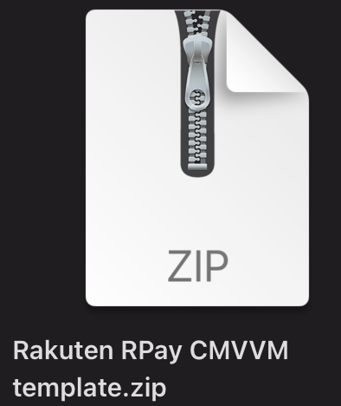
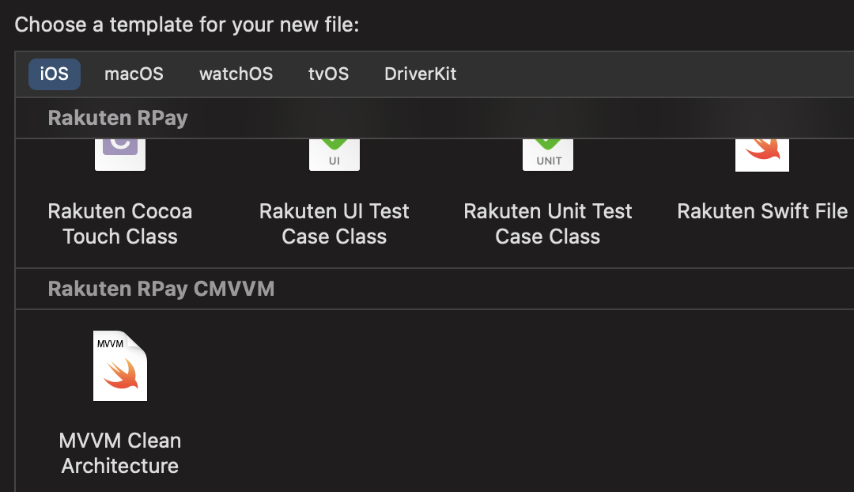
Copy template
~/Library/Developer/Xcode/

Slide 3
UseCase is the most important thing
Clean architecture

Slide 4
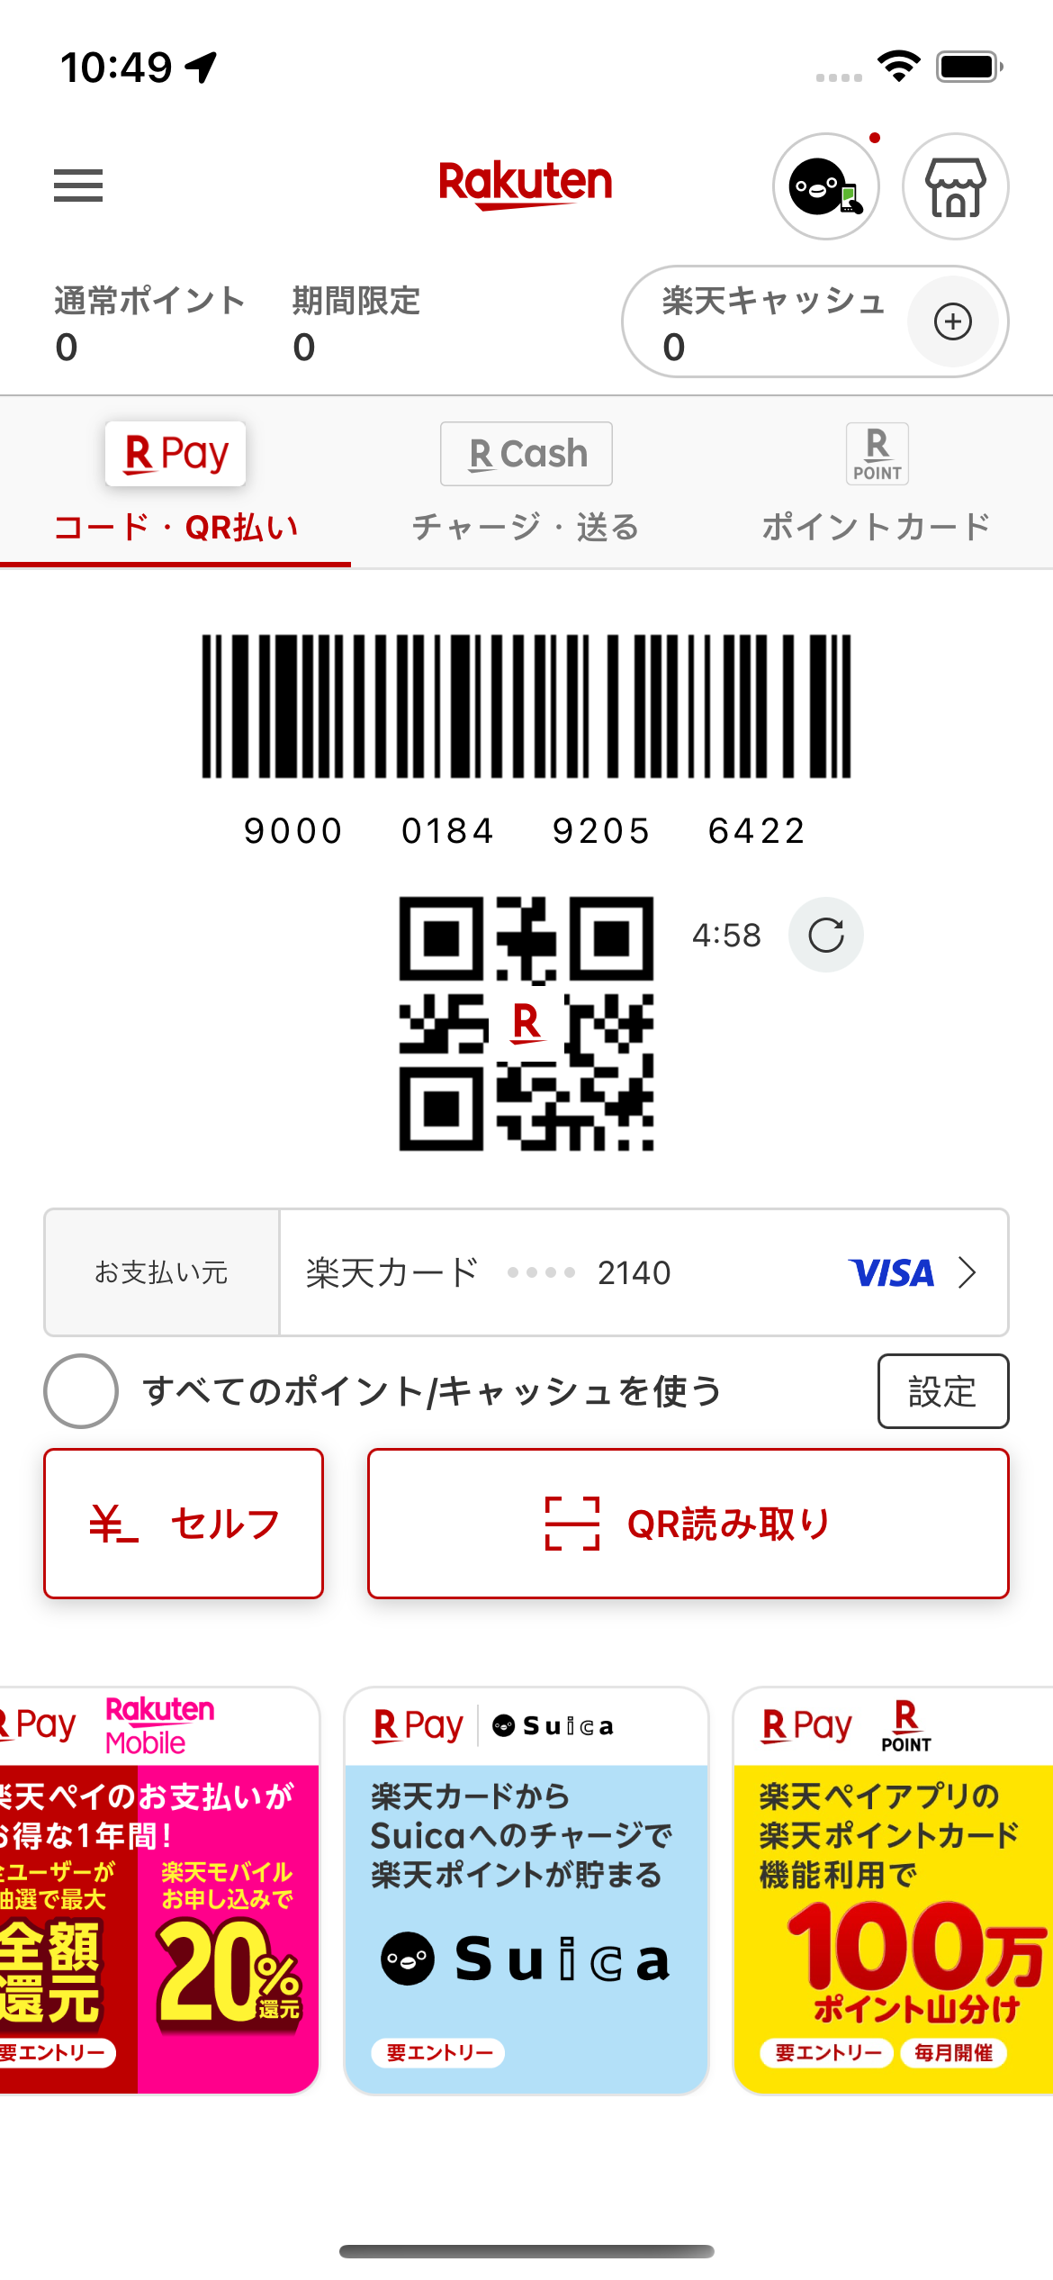
What is usecase?
※ A scenario on screen
Refresh barcode by user
User click refresh button
Check cache image is existing or not
Perform API to generate barcode
Parameters : EasyID
Retrieve new barcode from backend response
Validate the barcode format
Refresh barcode on screen
Happy path ( Success )
Display barcode on screen
Sad path ( Failure )
Handle error code
Alert message

Slide 5
Separate usecase into modules
ViewController
ViewModel
Model
UseCase
Entity
Core Module
Network
UI binding
Business logic
( Optional )
Scenario flow
Feature data object
Local persistent
UI、Transition
Repository
DTO
(Data Transfer Object )
Data source
Convert response

Slide 6
Create a container
Feature tree
Rpoint Usage
PaymentMethod
OPBarcode
Charge Method
Selection
Rcash charge
Rakuten Cash
Charge Hostory
Balance refresh
Setting
Hamburger Menu
Re login

Slide 7
How to seperate
Refresh barcode by user UseCase
User click refresh button
Refresh button、Action
Refresh button Binding
Check cache image is existing or not
Perform API to generate barcode
Parameters EasyID
Retrieve new barcode from backend response
Convert response to entity
Validate barcode format
Refresh barcode on screen
Trigger data binding
Refresh barcode on screen
ViewController
ViewModel
UseCase
UseCase
UseCase
Repository
DTO
Entity
Model
ViewModel
ViewController

