Slide 1
Assignment 1 Theory Problem Set DO NOT TAG
Name:
GT Email:

Slide 2
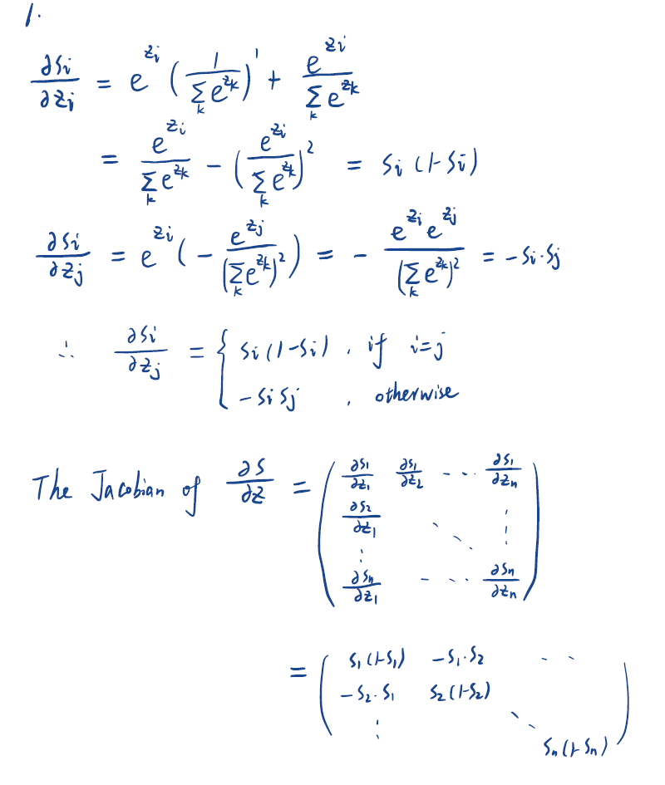
Theory PS Q1. Feel free to add extra slides if needed.

Slide 3
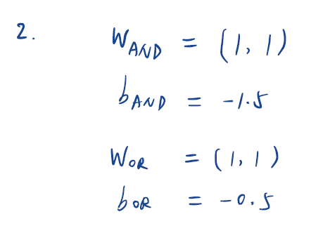
Theory PS Q2. Feel free to add extra slides if needed.

Slide 4
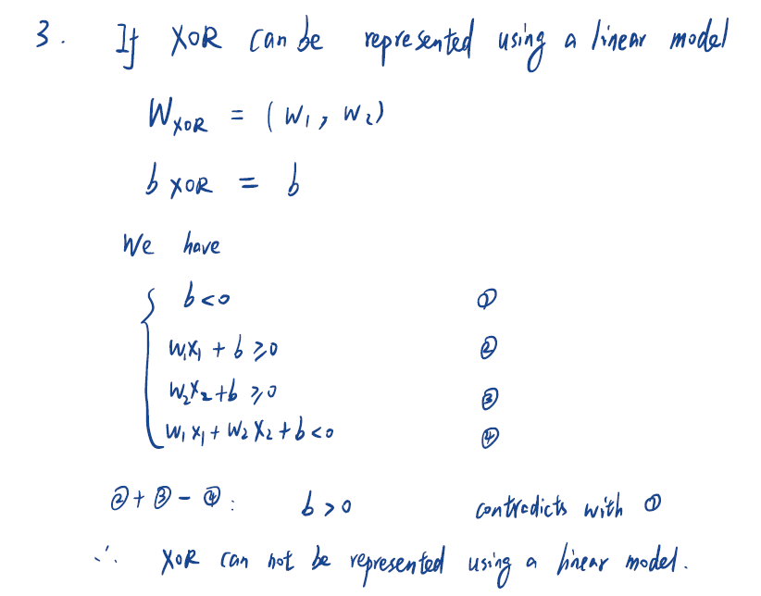
Theory PS Q3. Feel free to add extra slides if needed.

Slide 5
Assignment 1 Writeup DO NOT TAG
Name:
GT Email:

Slide 6
Two-Layer Neural Network
DO NOT TAG

Slide 7
Learning Rates
Tune the learning rate of the model with all other default hyper-parameters fixed. Fill in the table below:
 | lr=1 | lr=1e-1 | lr=5e-2 | lr=1e-2
Training Accuracy | 0.9420 | 0.9216 | 0.9090 | 0.7301
Test Accuracy | 0.9502 | 0.9281 | 0.9114 | 0.7581

Slide 8
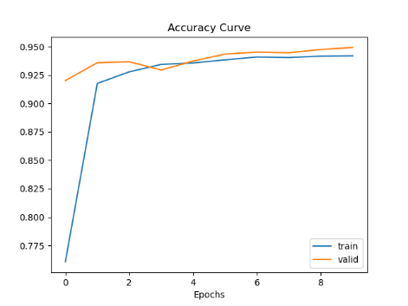
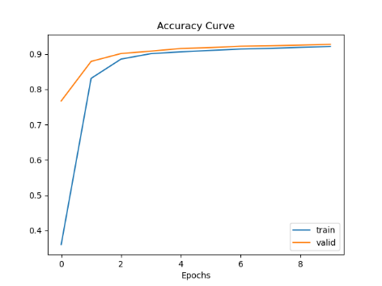
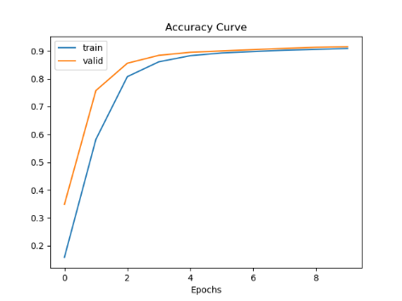
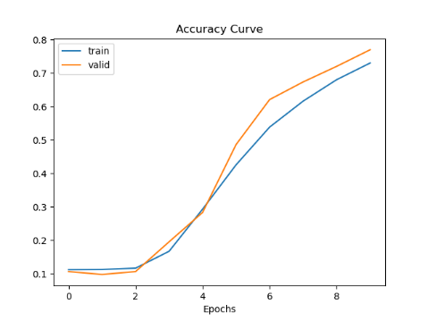
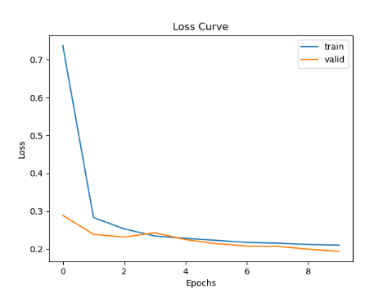
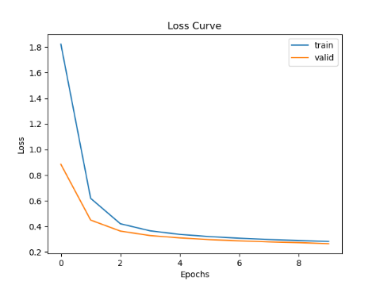
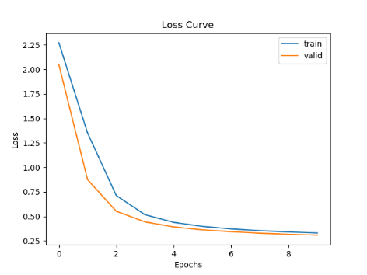
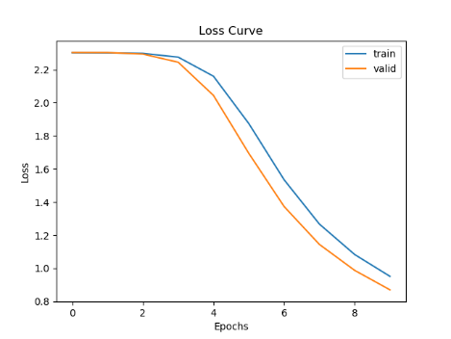
Learning Curve
Plot the learning curves using the learning rates from the previous slide and put them below (you may add additional slides if needed).
lr=1 | lr=1e-1 | lr=5e-2 | lr=1e-2

Slide 9
Learning Rates
Describe and Explain your findings: Explanation should go into WHY things work the way they do in the context of Machine Learning theory/intuition, along with justification for your experimentation methodology. DO NOT just describe the results, for example, you should explain why the learning rate has the observed effect. Also, be cognizant of the best way to organize and show the results that best emphasizes your key observations. If you need more than one slide to answer the question, you are free to create new slides.
Findings: For smaller learning rates, the accuracy is lower, and the loss is higher for both training and test data.
It is because as we are using smaller learning rate, the weight updates are smaller for each update step. It makes the models not fully optimized, and the model is under-fitting. Also training loss and validation loss are very close for large learning rate, which means the model is still under-fitting at large learning rate.

Slide 10
2. Regularization
Tune the regularization coefficient of the model with all other default hyper-parameters fixed. Fill in the table below:
 | alpha=1 | alpha=1e-1 | alpha=1e-2 | alpha=1e-3 | alpha=1e-4
Training Accuracy | 0.1042 | 0.3382 | 0.8831 | 0.9214 | 0.9299
Validation Accuracy | 0.1060 | 0.3732 | 0.8943 | 0.9266 | 0.9348
Test Accuracy | 0.1029 | 0.3896 | 0.8928 | 0.9232 | 0.9336

Slide 11
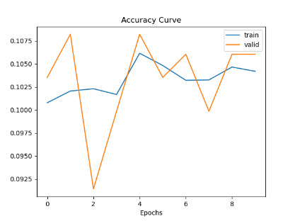
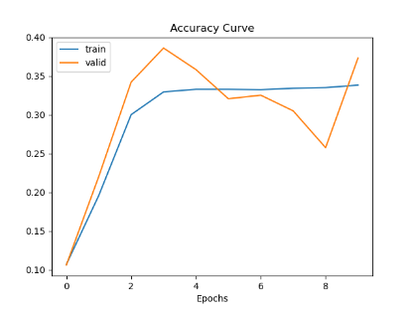
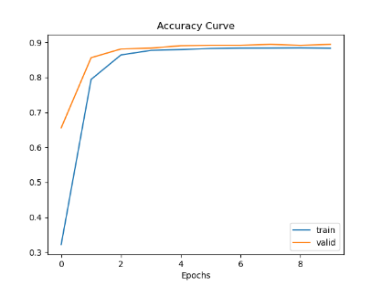

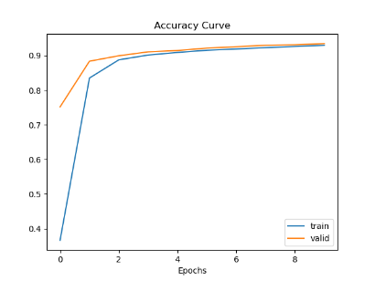
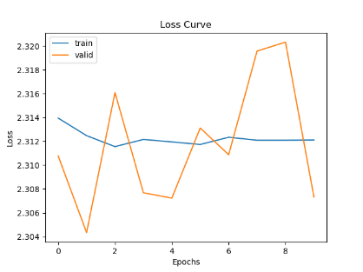
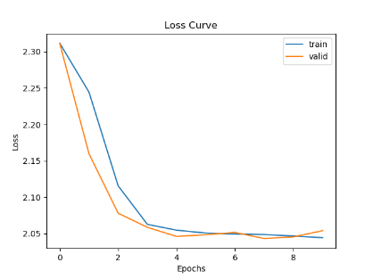
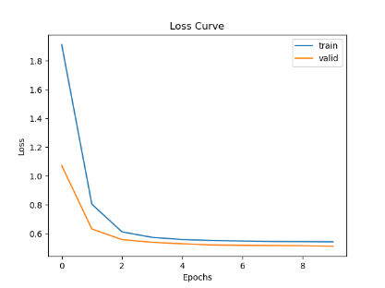
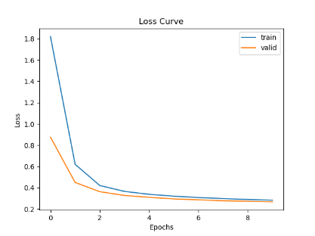
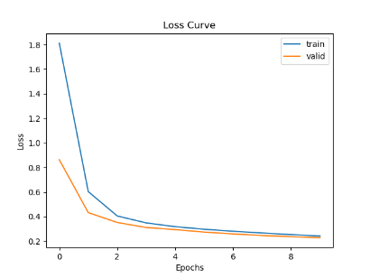
2. Regularization
Plot the learning curves using the regularization coefficients from the previous slide and put them below (you may add additional slides if needed).
alpha=1 | alpha=1e-1 | alpha=1e-2 | alpha=1e-3 | alpha=1e-4

Slide 12
2. Regularization
Describe and Explain your findings: Explanation should go into WHY things work the way they do in the context of Machine Learning theory/intuition, along with justification for your experimentation methodology. DO NOT just describe the results, for example, you should explain why the regularization value affects performance as well as model weights. Also, be mindful of the best way to organize and show the results that best emphasizes your key observations. If you need more than one slide to answer the question, you are free to create new slides.
Findings: For smaller regularization value alpha, the accuracy is lower, and the loss is higher for both training and test data.
It is because as we are using larger regularization, the weight are regularized and very similar to an average model, model complexity is sacrificed for generalization ability. It makes the models not fully optimized, and the model is under-fitting. Also training loss and validation loss are very close for large learning rate, which means the model is still under-fitting at large learning rate.

Slide 13
3. Hyper-parameter Tuning
You are now free to tune any hyper-parameters for better accuracy. Create a table below and put the configuration of your best model and accuracy into the table:
Explain why your choice works: Explanation should go into WHY things work the way they do in the context of Machine Learning theory/intuition, along with justification for your experimentation methodology. DO NOT just describe the results, you should explain the reasoning behind your choices and what behavior you expected. Also, be cognizant of the best way to mindful and show the results that best emphasizes your key observations. If you need more than one slide to answer the question, you are free to create new slides.
For learning rate: I choose lr=1, because we can see from the result (1) that the model is under-fitting with lower learning rate. So we should use large learning rate to adjust the update step to a higher one.
For regularization, I choose alpha=1e-4. We can see from the result (2) that the model performs better with lower regularization. Model complexity is sacrificed for generalization ability. But the model is still of good generalization ability, so we can use lower alpha to increase the model complexity.
For hidden_size and epochs, we have found that model is under-fitting with train/val loss still decreasing. We should increase the model complexity with higher hidden size and use higher epochs to optimized the models to get a minimum.
batch_size | learning_rate | reg | epochs | momentum | hidden_size | train accuracy | valid accuracy | test accuracy
64 | 1 | 1E-04 | 40 | 0.9 | 256 | 0.9907 | 0.9757 | 0.9789

