Slide 1
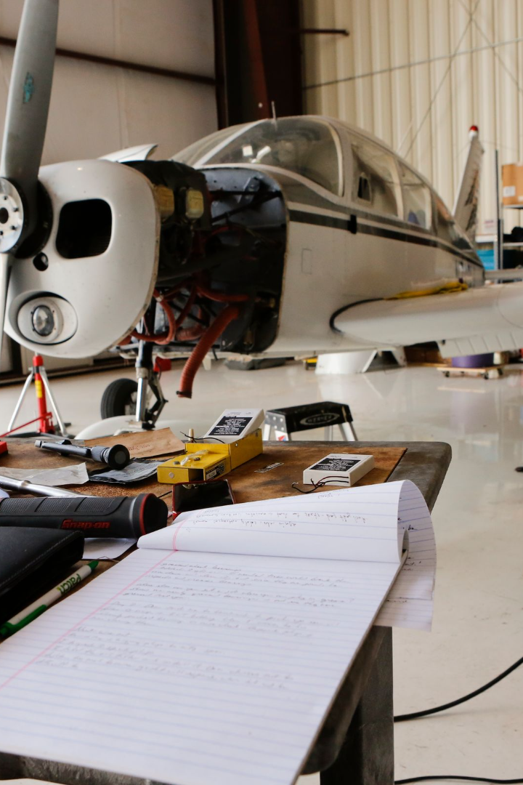
Blockchain in Aviation for Maintenance and Safety of Records
In aviation, the safety and maintenance of records is critical. Blockchain technology can revolutionize the way this is done, providing secure and auditable records that are accessible to all stakeholders.
Aditya Kumar
Branch: CSE(AIML)
Enrollment no.: 12020002016035

Slide 2

The Challenges in Maintenance and Safety Records
1
Complexity and Volume
2
Security and Privacy
Maintenance records are complex and voluminous, with different stakeholders and fragmented data sources making it difficult to ensure the accuracy of data and identify trends.
Current systems for storing records are vulnerable to hacking, and privacy laws require careful management of sensitive data.
3
Regulatory Compliance
Regulations require strict adherence to maintenance and safety records, with hefty fines and legal ramifications for non-compliance.

Slide 3
Introduction to Blockchain Technology
1
What is Blockchain?
Blockchain is a decentralized, distributed ledger technology that can be used to securely store and share data.
How Does it Work?
2
Data is stored in blocks, which are linked together in a chain. Blocks are added to the chain through a consensus mechanism that ensures all nodes agree on the validity of the transaction.
3
Why is it Revolutionary?
Blockchain provides a tamper-proof and auditable record of transactions that can be accessed by all parties, without the need for intermediaries.

Slide 4
Benefits of Blockchain in Aviation
Efficiency
Transparency
Security
Blockchain can streamline the maintenance and safety record-keeping process, reducing the time it takes to record and verify data and enabling real-time access to data across the supply chain.
Blockchain provides a single source of truth for all stakeholders, making it easier to identify and fix errors, track maintenance and safety trends, and prove compliance.
By design, blockchain is secure, providing protection against data tampering and cyber attacks.

Slide 5
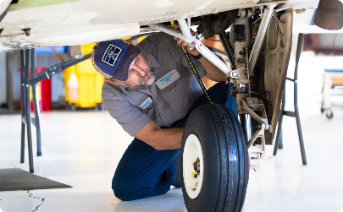
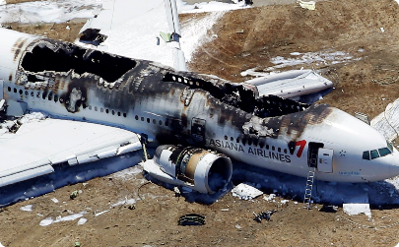
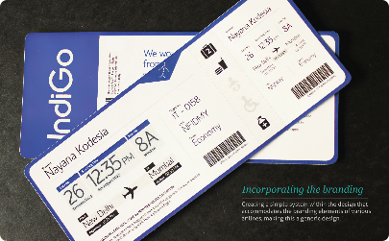
Use Cases of Blockchain in Maintenance and Safety Records
Maintenance Records
Accident Investigations
Security Checks
Blockchain can be used to store records related to inspections, repairs, and maintenance, enabling real-time access to data and reducing the risk of errors and omissions.
Blockchain can be used to store data related to accidents, providing a tamper-proof record that can be used to accurately identify the cause of the accident and prevent similar incidents.
Blockchain can be used to store data related to passenger screening, access control, and identity verification, providing a secure and auditable chain of custody record.

Slide 6
Implementation Considerations
Interoperability
Scalability
Governance
Blockchain solutions should be designed to work with existing systems and standards, enabling smooth integration and minimizing disruption to operations.
Blockchain solutions should be designed to handle large volumes of data, ensuring that the technology can keep up with the needs of the aviation industry.
Blockchain solutions should be developed with clear policies and guidelines to ensure that data is stored and accessed in a compliant and transparent manner.

Slide 7

Potential Future Developments
1
Smart Contracts
2
Internet of Things
Blockchain can be used to create self-executing contracts that can automatically trigger actions based on predefined rules and conditions.
Blockchain can be used to securely store data from IoT devices used in the aviation industry, providing valuable insights into performance and safety.
3
Tokenization
Blockchain can be used to create tokenized assets, which can be traded, transferred, and used to access services and incentives within the aviation industry.

Slide 8
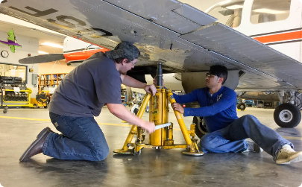
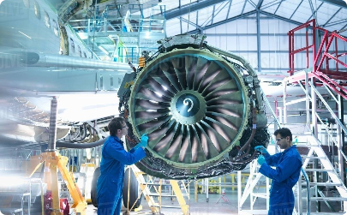

Conclusion and Key Takeaways
Blockchain is a Game-Changer
Improved Efficiencies
Enhanced Safety and Security
Blockchain can streamline the maintenance and safety record-keeping process, reducing the time it takes to record and verify data and enabling real-time access to data across the supply chain.
The aviation industry can benefit greatly from the implementation of blockchain technology in maintenance and safety records.
Blockchain provides a secure and auditable record of transactions that can be accessed by all parties, making it easier to identify and fix errors, track maintenance and safety trends, and prove compliance.

