Slide 1

Comprehensive Design and Analysis of IPMSM(Interior permanent magnet synchronous motor) for High Torque EV Applications Using FEA and Analytical Technique
M. Tech. Project Presentation- Mid-Semester
Department of Electrical Engineering
Under the supervision of: Dr Saifullah Payami
Presented by : Chandan Kumar
Entry no: 2023EEM1044

Slide 2
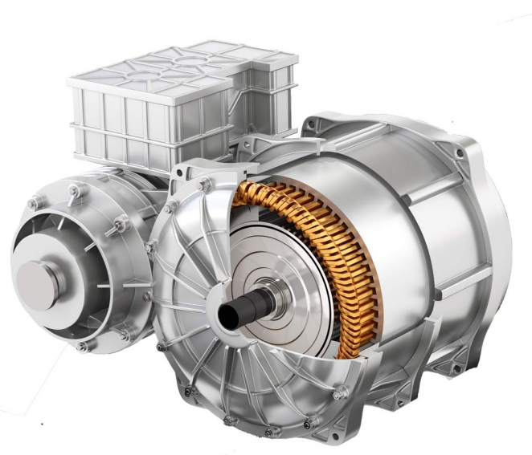
Outline
Introduction
Literature Survey
Work in progress
Future work
2

Slide 3
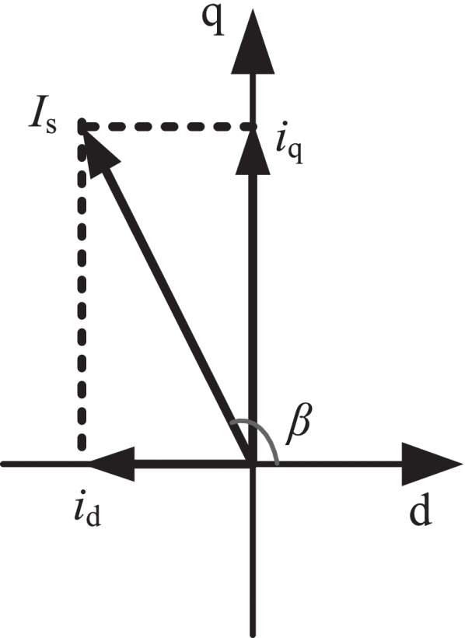
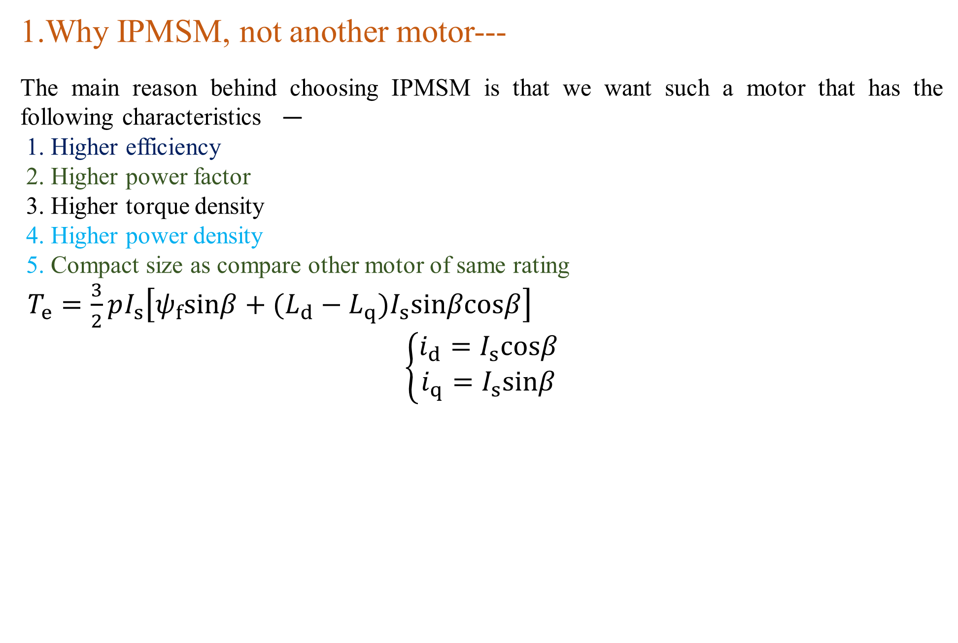
Introduction
1.Why IPMSM, not another motor---
The main reason behind choosing IPMSM is that we want such a motor that has the following characteristics —
1. Higher efficiency
2. Higher power factor 3. Higher torque density 4. Higher power density 5. Compact size as compare other motor of same rating $T_{e}=\frac{3}{2}pI_{s}\left[ψ_{f}sinβ+(L_{d}−L_{q})I_{s}sinβcosβ\right]$ $$\left\{\begin{matrix}i_{d}=I_{s}cosβ \\ i_{q}=I_{s}sinβ\end{matrix}\right.$$
Fig .a
Fig .1
3
Notes:
1. maintenance-free operation– since the rotor magnet is present we do not need winding
2. higher controllability- we can easily implement vector control here
3. robustness against the environment – here, there is no problem of the rotor short circuit.
4. Higher efficiency – The rotor contains a permanent magnet so flux density is higher so the stator draws less current and hence loss gets reduced also there is no loss in the rotor
5. Higher power factor – here, the power factor is high because the magnetization current requirement is less because of the permanent magnet in the rotor.
6. Higher torque density- Reluctance torque is included in electromagnetic torque.

Slide 4
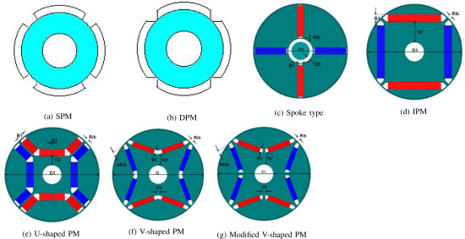
Literature survey
Paper number 1 :-Performance comparison between different rotor configurations of PMSM for EV application Here in this paper different type of IPMSM configuration is compare and comparison is done on the basis of common output power deliver by each motor-
Fig . 2
Reference paper - N. Murali, S. Ushakumari and M. V. P, "Performance comparison between different rotor configurations of PMSM for EV application," 2020 IEEE REGION 10 CONFERENCE (TENCON), Osaka, Japan, 2020, pp. 1334-1339, doi: 10.1109/TENCON50793.2020.9293844. keywords: {Rotors;Torque;Air gaps;Stator windings;Magnetic cores;Forging;Topology;E-rickshaw;PMSM;rotor topology;cogging torque;power;efficiency;air gap flux density;magnetic flux density;Maxwell},
4

Slide 5
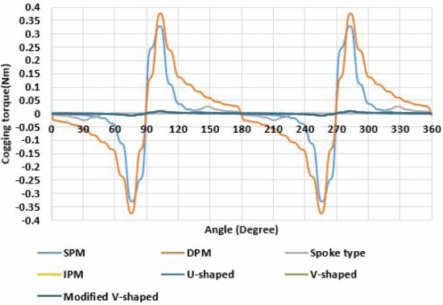
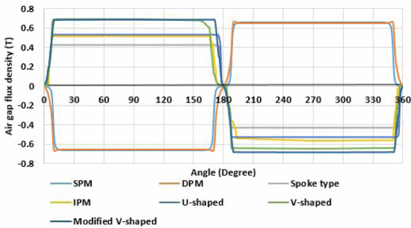
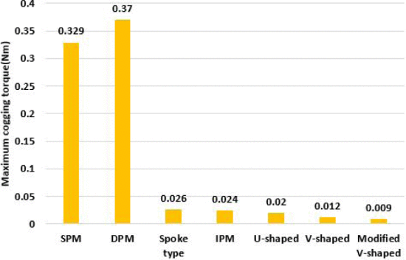
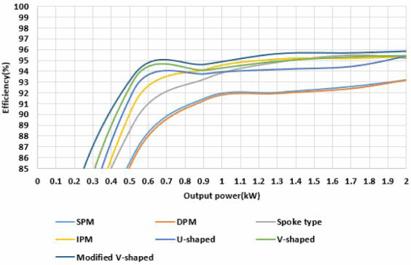
Contd..
These are the following result observe from the paper:--
Fig . 3
Reference paper - N. Murali, S. Ushakumari and M. V. P, "Performance comparison between different rotor configurations of PMSM for EV application," 2020 IEEE REGION 10 CONFERENCE (TENCON), Osaka, Japan, 2020, pp. 1334-1339, doi: 10.1109/TENCON50793.2020.9293844. keywords: {Rotors;Torque;Air gaps;Stator windings;Magnetic cores;Forging;Topology;E-rickshaw;PMSM;rotor topology;cogging torque;power;efficiency;air gap flux density;magnetic flux density;Maxwell},
5

Slide 6
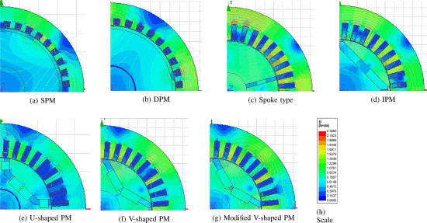
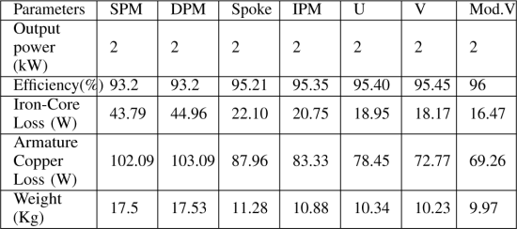
Contd..
Table 1. Comparison Table of different rotors
Fig .4
From this paper following observation are made :- a. Here virtual development of PMSM on ANSYS MAXWELL platform, considering seven different rotor topologies like surface- mounted, de-centred PM, spoke type, interior PM, U-shaped, V-shaped, modified V-shaped. A detailed comparative study based on performance characteristics like weight, cogging torque, power, efficiency, air gap flux density, magnetic flux density, etc. obtained from the Maxwell platform was done b. Among all PMSM the modified v and v shape IPMSM has batter performances in all aspect like efficiency , torque ripple , cogging torque and its power density are higher c. So we are going to consider v shape IPMSM for my motor designing process. d. Here in this paper it is not discuss how to improve saliency and how to improve torque.
e. And also motor performance like torque speed , power speed and power factor speed these are curical parameter for motor design these are not discuss in paper.
Reference paper - N. Murali, S. Ushakumari and M. V. P, "Performance comparison between different rotor configurations of PMSM for EV application," 2020 IEEE REGION 10 CONFERENCE (TENCON), Osaka, Japan, 2020, pp. 1334-1339, doi: 10.1109/TENCON50793.2020.9293844. keywords: {Rotors;Torque;Air gaps;Stator windings;Magnetic cores;Forging;Topology;E-rickshaw;PMSM;rotor topology;cogging torque;power;efficiency;air gap flux density;magnetic flux density;Maxwell},
6

Slide 7
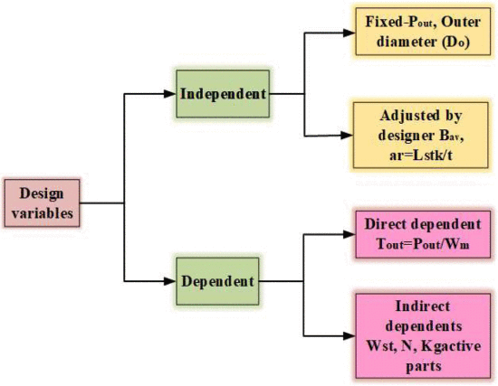
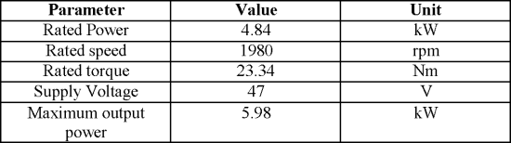
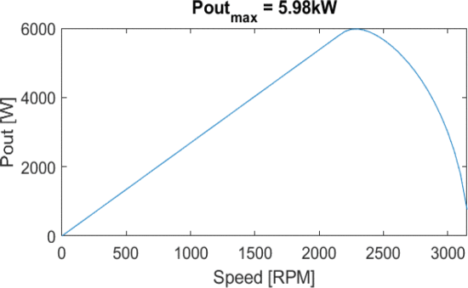
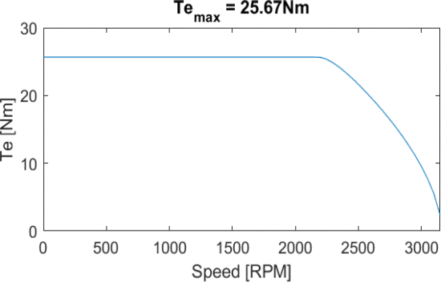
Contd..
Paper number 2:-Design of IPMSM using FEA in Ansys Maxwell Here in this paper 4.84 kw IPMSM is design and also different formulas for calculation of stator and rotor geometry is discussed
Table . 2
Fig . 7
Fig . 8
Observation from this paper – a. This paper presents the design and analysis of 4Kw V-type IPMSM by Finite Element Analysis using Ansys Maxwell 2D software. Analytical design is carried out to determine the various parameters of motor used in modelling and analysis. A 36 slots and 6 poles slot-pole combination is selected with rated speed of 1800rpm. Various simulation results such as magnetic loading curves, back emf wave forms, torque-speed characteristics, etc. have been analyzed in detail b. In this it is discuss that how to select slot , poles, motor dimension , stator and rotor dimension and magnet dimension calculation process. c. Also show different motor parameter like torque vs speed , power vs speed d. here it is not clear that why we take only v shape rotor and what is effect of bent angle of v shape magnet . E. Here demagnetization of magnet is not done.
Reference- V. Anjuru, S. C. Patil and R. S. W, "Design of IPMSM using FEA in Ansys Maxwell," 2023 Innovations in Power and Advanced Computing Technologies (i-PACT), Kuala Lumpur, Malaysia, 2023, pp. 1-6, doi: 10.1109/i-PACT58649.2023.10434518. keywords: {Analytical models;Torque;Magnetostatics;Simulation;Magnetostatic waves;Software;Finite element analysis;nsys Maxwell;Electric vehicle FEA;IPMSM;Modelling;MATLAB},
Fig . 9
7

Slide 8
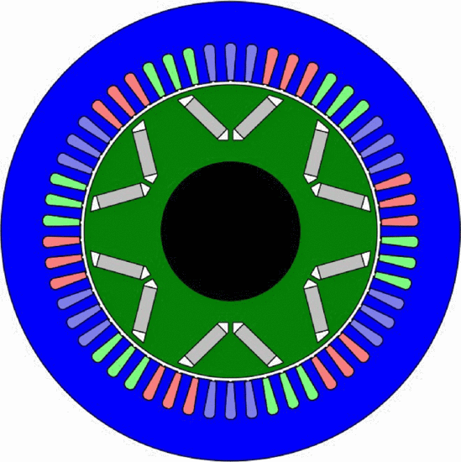
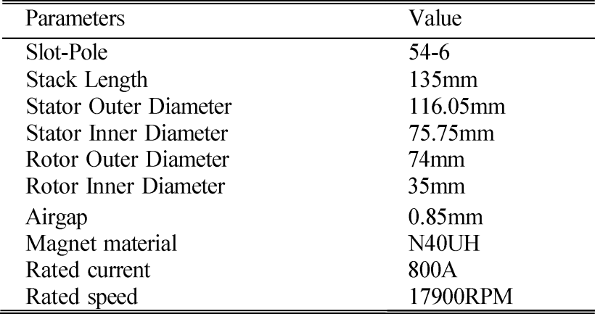
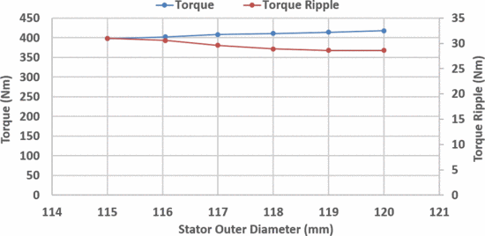
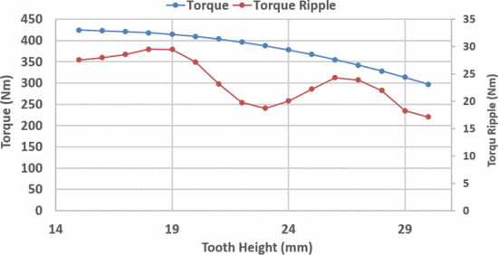
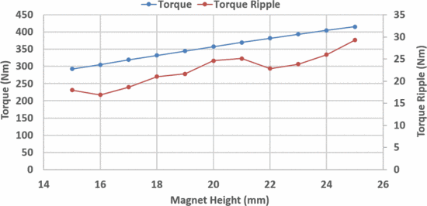
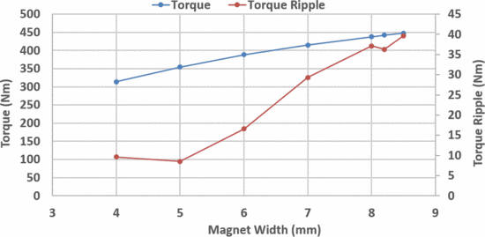
Contd..
Paper 3. Design and Optimization of Interior Permanent Magnet (IPM) Motor for Electric Vehicle Applications
Fig . 10
Fig . 11
Fig . 12
Fig . 13
Fig .14
Observation from this paper- a. Various geometry parameters such as magnet dimension, machine diameter and stator teeth height are analyzed to compare overall torque, power, and torque ripples in order to select the best design parameters and their ranges b. Two designs A and B were obtained for two objective functions and the corresponding torque ripples values of the design A and B were later reduced by 32% and 77% Reference -L. Balasubramanian, N. A. Bhuiyan, A. Javied, A. A. Fahmy, F. Belblidia and J. Sienz, "Design and Optimization of Interior Permanent Magnet (IPM) Motor for Electric Vehicle Applications," in CES Transactions on Electrical Machines and Systems, vol. 7, no. 2, pp. 202-209, June 2023, doi: 10.30941/CESTEMS.2023.00021.
keywords: {Torque;Permanent magnet motors;Synchronous motors;Optimization;Magnetic flux;Mathematical models;Magnetic analysis;Electric vehicles;IPM motor;Magnet grade;Optimization;Permanent magnet motor;Torque ripple},
Fig .15
8

Slide 9
Contd..
Inference from the above papers- 1. For low power EV application output power is nearly 5 kw in most of case. 2. Dc link voltage generally use 72 or 48 volt in EV applications. 3. Output frequency is generally depend on number of pole and speed. 4.Genrally we consider v shape and modified v shape IPMSM. 5. Design is iterative process so initially using formula we calculate geometry and then we do iterative tuning of parameter to achieve our goal using FEA
9

Slide 10
Work done so far
Project design requirement
TABLE 2. MOTOR RATING AND OTHER SPECIFICATION
Parameter | Value | Unit
Rated speed | 1800 | rpm
Rated power | 5 | kW
Rated Torque | 27 | Nm
DC link voltage | 72 | V
Line voltage | 45 | V
Maximum torque | 29.21 | Nm
Maximum power | 6.05 | kW
Power factor | 0.95 | ----
**Here we consider worst case and done overdesign of 10% on the rated values then we get maximum values of torque and power Reference- P. Verma, H. Misra and B. Singh Rajpurohit, "Design and Analysis of Interior PMSM for Low Power EV Applications in Hilly Terrain," 2022 IEEE 10th Power India International Conference (PIICON), New Delhi, India, 2022, pp. 1-6, doi: 10.1109/PIICON56320.2022.10045199. keywords: {Permanent magnet machines;Magnetic flux;Analytical models;Torque;Design methodology;Electric vehicles;Synchronous motors;Electric vehicle;Interior Permanent Magnet Synchronous Machine (IPMSM);Machine Design;NdFeB},
10

Slide 11
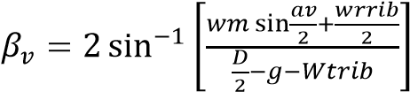




Contd..
Flow chart for design of IPMSM
Specify Require Motor Rating : output power , rated speed , rated torque ,dc link voltage
Select design constant
(current density, magnetic loading, fill factor and stacking factor)
Select materials
(magnet , core ,winding and insulation)
Select tuning variable
(air gap , aspect ratio, Magnet depth and width, magnet bending angle )
Calculation of geometry
$$D^{2}L=\frac{P_{out}}{GRps}$$
,
Ar=$\frac{L_{STK} }{Tp}$
Wst = $\frac{\text{Bgp}∗\text{π}\text{×3.14×}\text{Dis}}{\text{Btp}\text{×}\text{Qs}\text{ ×}\text{Ks}\text{ )}}$
$$\frac{\text{Bgp}\text{×}\text{π}\text{×}\text{Dis}}{Bc\text{P}\text{×}\text{Ks}}$$
,
,
Db=
,
Check slot geometry
Validate considered design constraint in analytical model through FEA
If all condition follow then design is good proceed to further transient analysis
If transient analysis performance is adequate then proceed design to fabrication else repeat the design process by making suitable correction
Fig . 16
Reference book -uha Pyrhonen and Tapani Jokinen and Val eria Hrabovcova , Design of Rotating Electrical Machines , 2008 John Wiley & Sons, Ltd
11

Slide 12
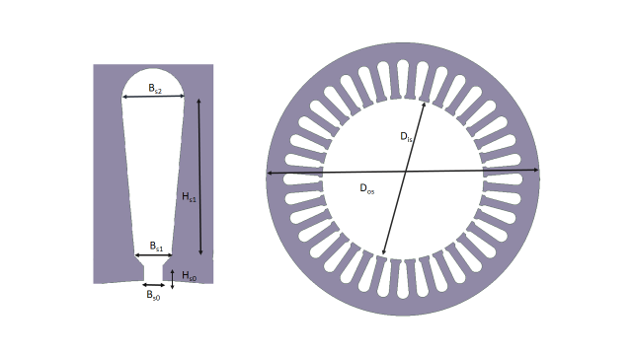
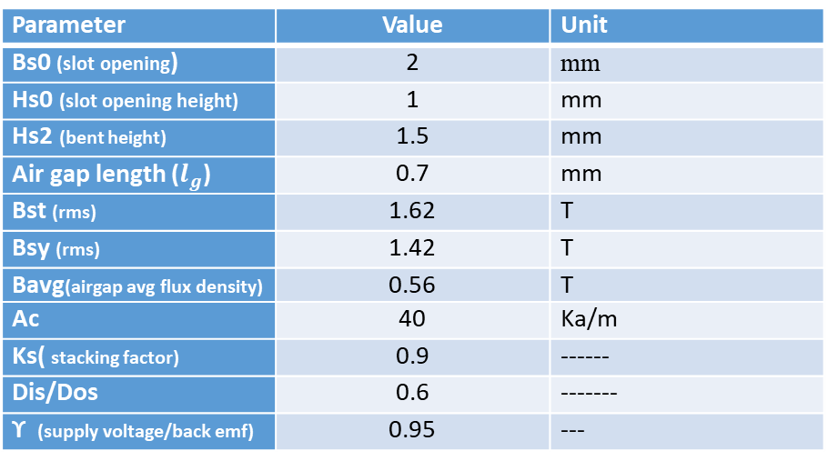

Contd..
TABLE 3. INITIAL ASSUMPION
Parameter | Value | Unit
Bs0 (slot opening) | 2 | mm
Hs0 (slot opening height) | 1 | mm
Hs2 (bent height) | 1.5 | mm
Air gap length ($l_{g}$) | 0.7 | mm
Bst (rms) | 1.62 | T
Bsy (rms) | 1.42 | T
Bavg(airgap avg flux density) | 0.56 | T
Ac | 40 | Ka/m
Ks( stacking factor) | 0.9 | ------
Dis/Dos | 0.6 | -------
ϒ (supply voltage/back emf) | 0.95 | ---
$$H_{s2}$$
Fig . 17
Stator geometry
**Reference-V. Anjuru, S. C. Patil and R. S. W, "Design of IPMSM using FEA in Ansys Maxwell," 2023 Innovations in Power and Advanced Computing Technologies (i-PACT), Kuala Lumpur, Malaysia, 2023, pp. 1-6, doi: 10.1109/i-PACT58649.2023.10434518. keywords: {Analytical models;Torque;Magnetostatics;Simulation;Magnetostatic waves;Software;Finite element analysis;nsys Maxwell;Electric vehicle FEA;IPMSM;Modelling;MATLAB},
TABLE 4. STATOR GEOMETRY VALUE CALCULATED
TABLE 5. ROTOR GEOMETRY VALUE CALCULATED
Parameter | Initial guess | New Value | Unit
Wm(width of magnet) | 12 | 14.2 | mm
Dm (depth of magnet) | 3 | 4 | mm
Lm (length of magnet) | 140 | 140 | mm
Kl (leakage factor) | 0.9 | 0.87 | ---
Wrrib (width of rib) | 2 | 1 | mm
Magnet bent (angle) | 170 | 172 | degree
Shaft diameter | 50 | 50 | mm
Parameter | Value | Unit
Wst(width of stator teeth) | 4.21 | mm
Db(back iron width) | 9.2 | mm
Dos(Outer diameter ) | 150 | mm
Dis(Inner diameter) | 88.5 | mm
L (stack length) | 140 | mm
Bs1 | 3.9 | mm
Hs1(slot depth) | 19.5 | mm
12

Slide 13
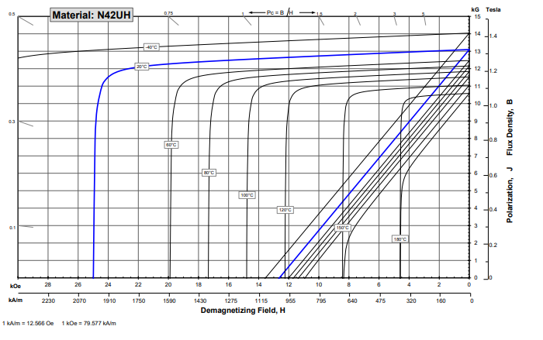
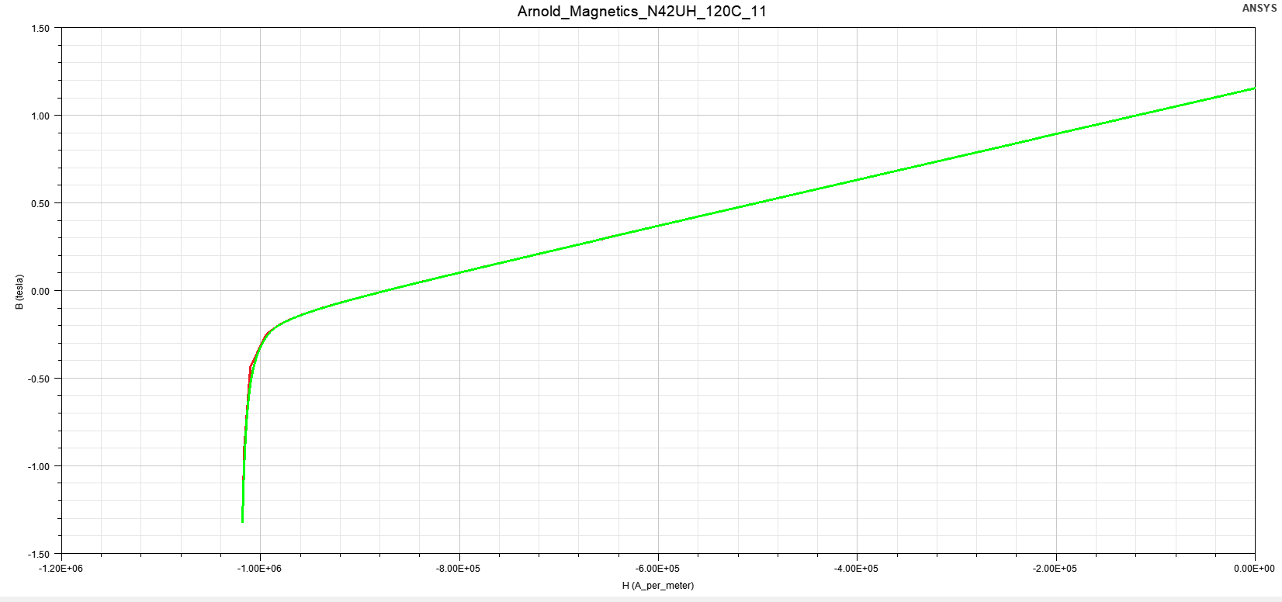
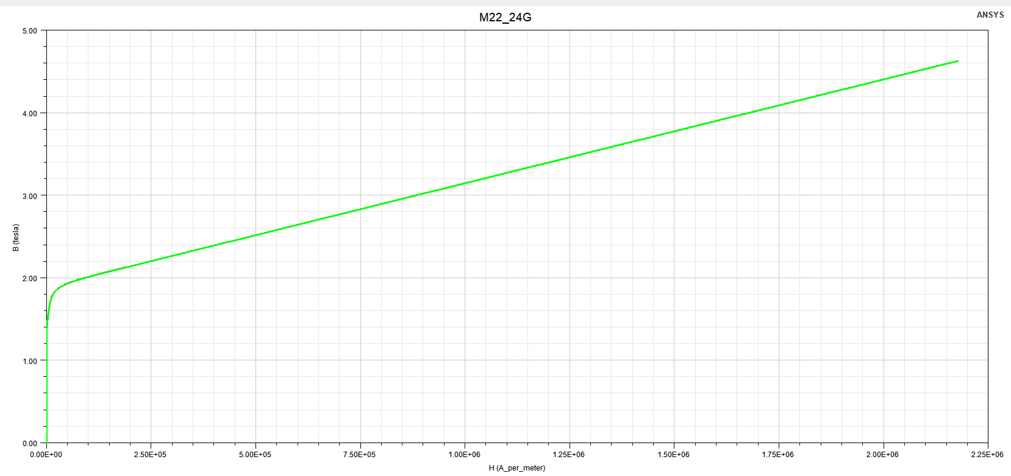
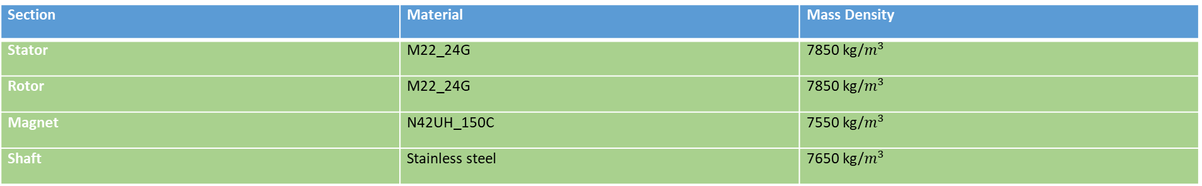
Contd..
Calculation validation – As*$K_{SF}$> Ac*$\left(\frac{2∗m∗{Nph}_{ }}{Q_{s}}\right)$ , here $K_{SF}$is the slot-fill factor, Qs is the total number of slots & As is an area of the slot Dos > Dis + 2*(Hs0+Hs1+Hs2+Db)
Material selection and there magnetic curve – Table . 6 Material used in design
Section | Material | Mass Density
Stator | M22_24G | 7850 kg/$m^{3}$
Rotor | M22_24G | 7850 kg/$m^{3}$
Magnet | N42UH_150C | 7550 kg/$m^{3}$
Shaft | Stainless steel | 7650 kg/$m^{3}$
Reference- V. Anjuru, S. C. Patil and R. S. W, "Design of IPMSM using FEA in Ansys Maxwell," 2023 Innovations in Power and Advanced Computing Technologies (i-PACT), Kuala Lumpur, Malaysia, 2023, pp. 1-6, doi: 10.1109/i-PACT58649.2023.10434518. keywords: {Analytical models;Torque;Magnetostatics;Simulation;Magnetostatic waves;Software;Finite element analysis;nsys Maxwell;Electric vehicle FEA;IPMSM;Modelling;MATLAB},
13

Slide 14
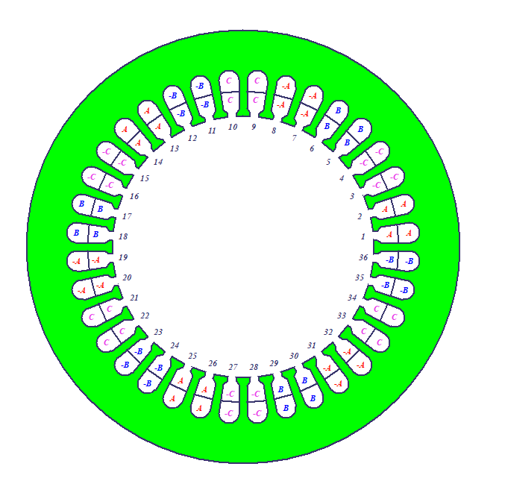
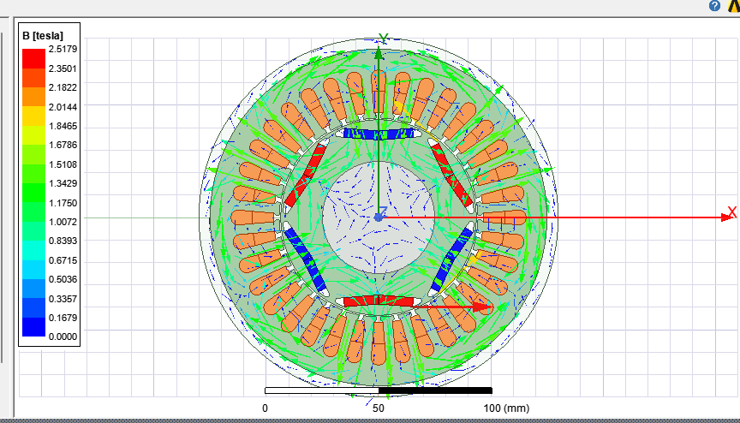
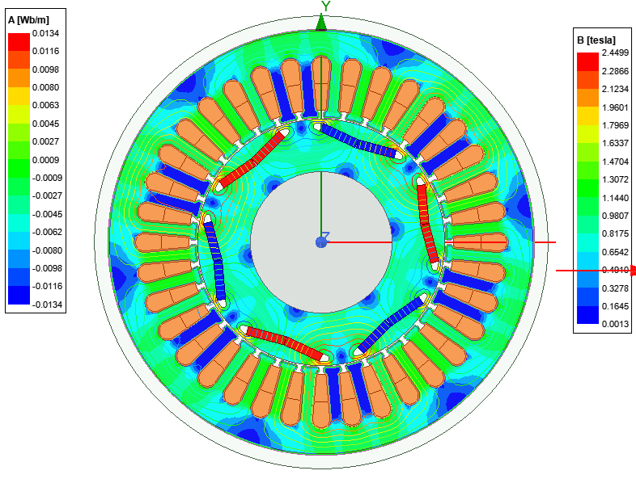
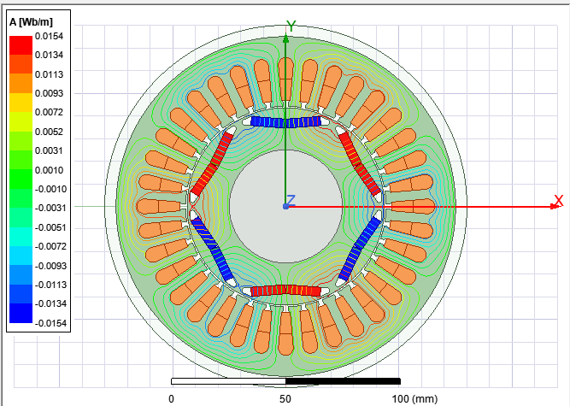
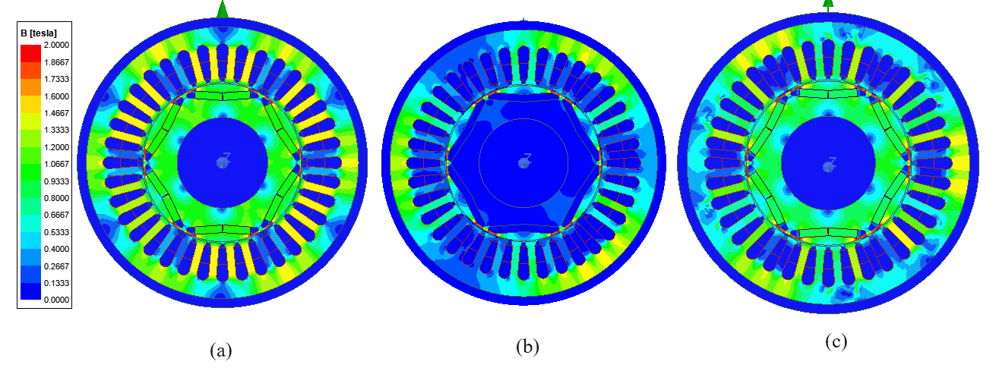
Contd..
Fig . 18 winding diagram
Fig. 20 magnetic field line with strength
Fig . 19 magnetic field vector
Fig . 21 magnetic field line
Fig . 22 magnetic field strength at different time instant
14

Slide 15
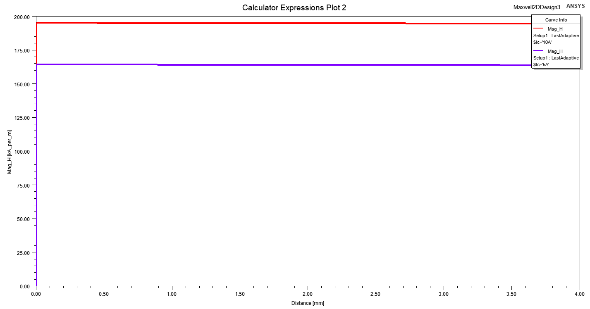
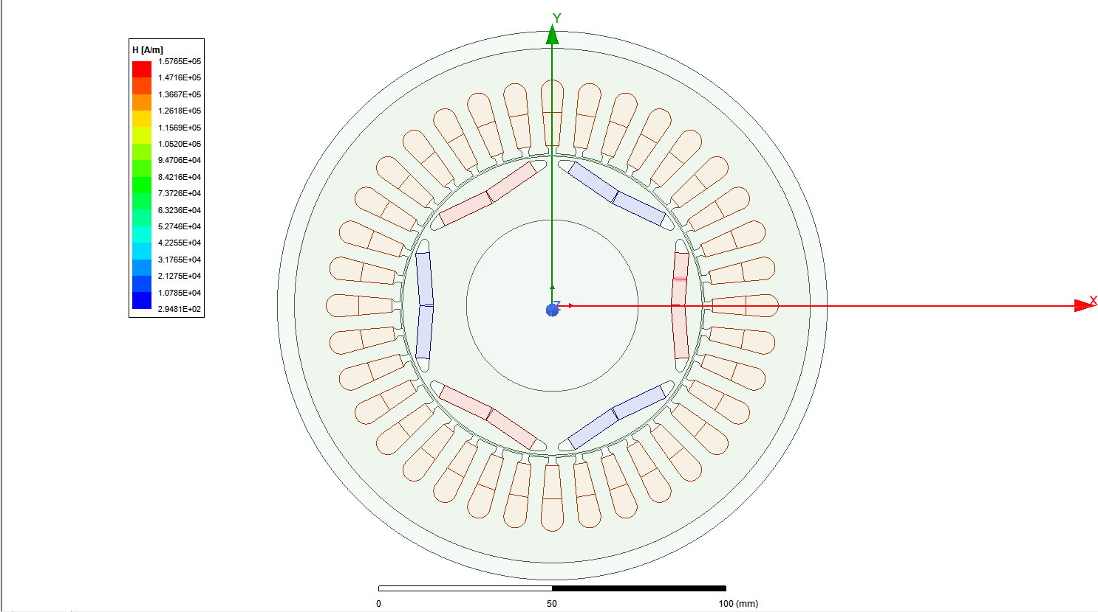
Contd..
Demagnetization study of magnet -----
Fig. 23
Fig . 24
Observation from demagnetization study:-- 1. It observe that magnetic field strength at surface of magnet is 160 ka/m under rated condition ie at 85 amp 2. If we take 10% more then rated current which is worst case than then magnetic field strength at magnet surface is 200ka/m and from demagnetisation curve of magnet in next page it can observe that for worst case if temperature may raise to 180 degree Celsius then also our magnet will not get demagnetize.
15

Slide 16
Contd..
Demagnetization curve of Magnet
Worst case operating point when temperature raise to 180deg Celsius
Fig . 25
**Source - https://www.arnoldmagnetics.com/wp-content/uploads/2017/11/N42UH-151021.pdf
16

Slide 17
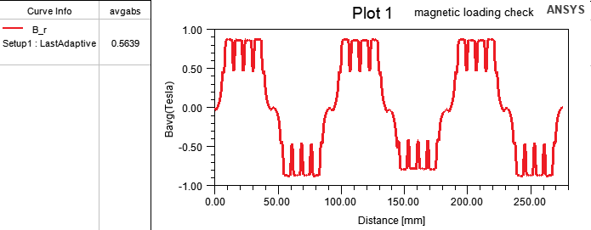
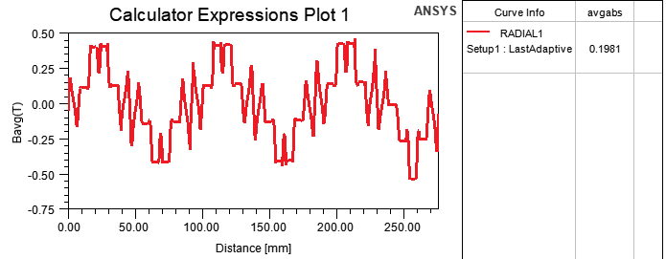
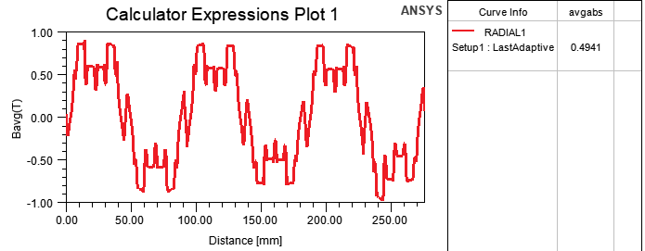
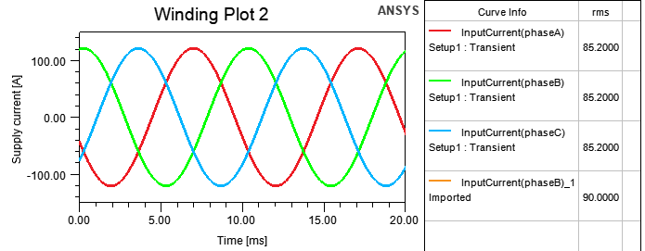
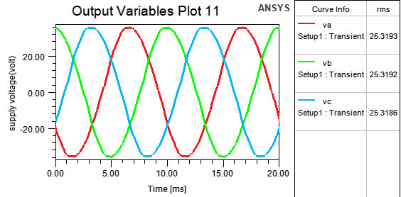
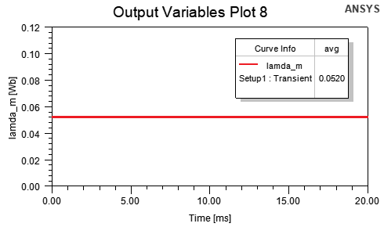
Fig. 26 air gap flux density due to magnet only
Fig .27 air gap flux density due armature current only
Fig .28 air gap flux density due to both
Fig .29 Supply current
Fig . 30 Supply voltage
Fig. 31 flux linkage
17

Slide 18
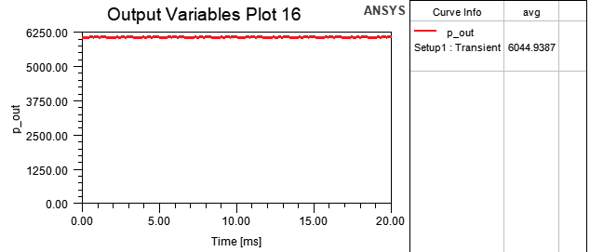
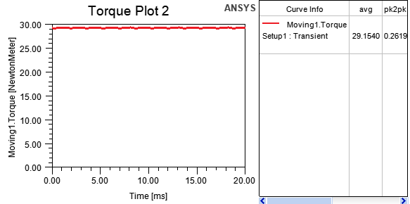
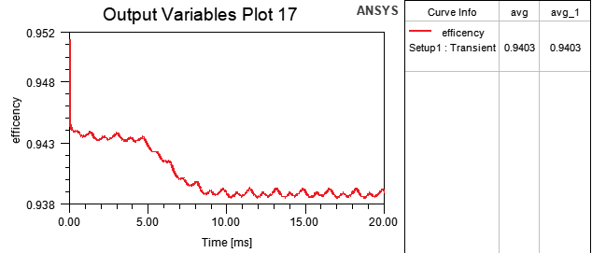
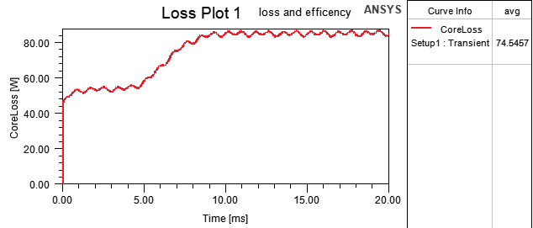
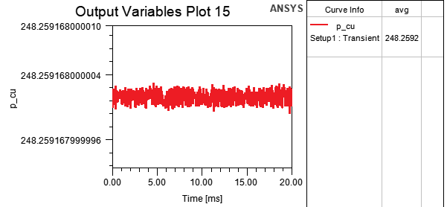
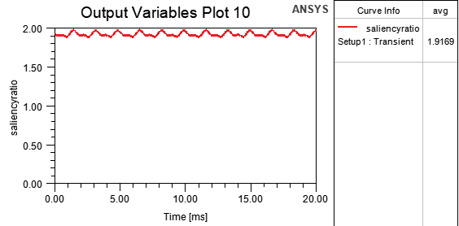
Contd..
Fig. 32 Efficency
Fig. 33 Output power
Fig . 34 output torque
Fig . 35 core loss
Fig . 36 copper loss
Fig . 37 saliency ratio
18

Slide 19
Contd..
A comparison of results is shown in Table
Table 6.
Parameter | Analytical | Simulated | Unit | Error (%)
 | 0.56 | 0.563 | Tesla | 1.25
Supply voltage (Rms) | 25.98 | 25.4 | Volt | 2.23
Torque | 29.21 | 29.14 | N-m | 0.239
Power Factor | 0.95 | 0.97 | -- | 2
Output Power | 6.05 | 6.044 | Kw | 0.1
Conclusion of work done – 1.Comprehensive methodology for designing an Interior Permanent Magnet Synchronous Motor (IPMSM) using Finite Element Analysis (FEA) and an analytical method . 2.The detailed design considerations and methodologies discussed in this study have focused on various geometrical parameters essential for optimizing the motor's performance. 3.A 5kW IPMSM was designed and analyzed using FEA to validate the effectiveness of the proposed design methodology. The results from the FEA were compared with the assumed design constants derived from the analytical model. This comparison confirmed the accuracy and reliability of the analytical model.
19

Slide 20
Future presentation --- 1. Different characteristics of motor like torque vs. speed , power vs. speed , efficiency vs. speed , power factor vs. speed , saliency ratio etc. to be calculated. 2. Next main objective is to find such rotor configuration which give maximum saliency for this we are going to design different IPMSM of v shaped rotor and compare there saliency . 3. Next Optimization study is done on new modified motor with considering different objectives. 4. Thermal analysis of IPMSM. 5. Structural analysis of IPMSM.
20

Slide 21
Thank You!

