Slide 1
Find your NGO
How to Find Your NGO that is trustworthy, and suits your interests and values!

Slide 2
Motivation
I want to donate to an NGO that supports children in need.
The NGO should …
… operate worldwide.
… have at least 10 years of experience.
… be trustworthy.
?

Slide 3
Mocks

Slide 4
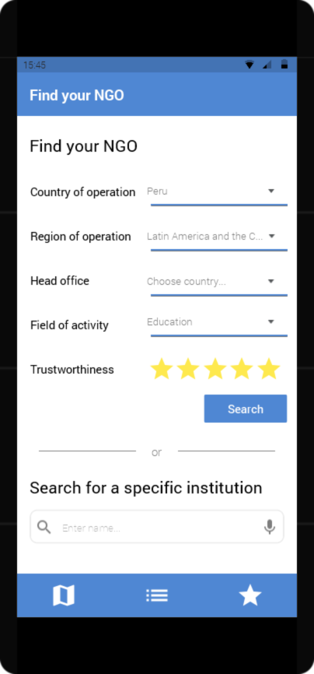
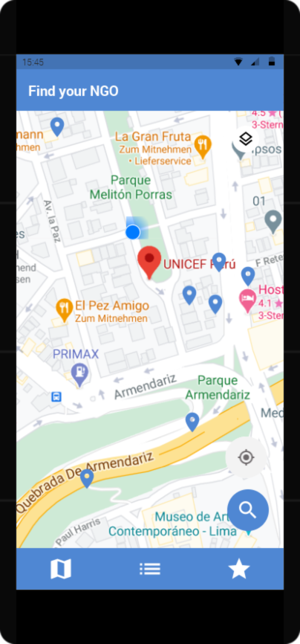
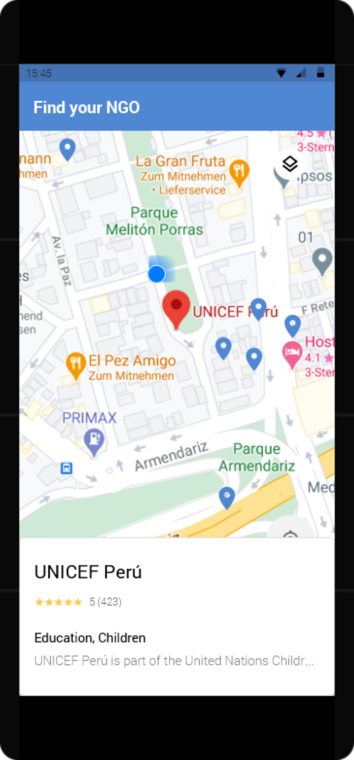
NGO Location & Search
* part of MVP
Find your NGO by means of its location
Find your NGO using relevant search criteria

Slide 5
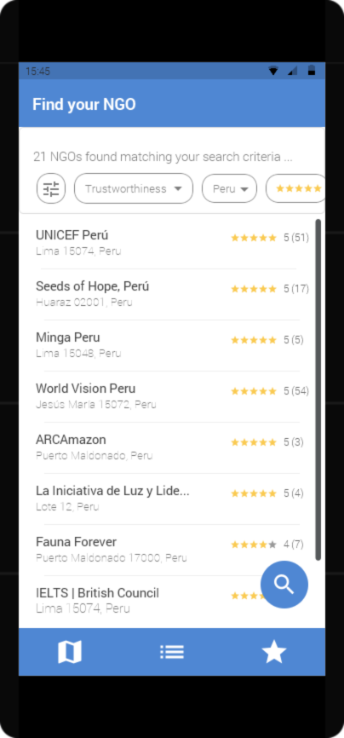
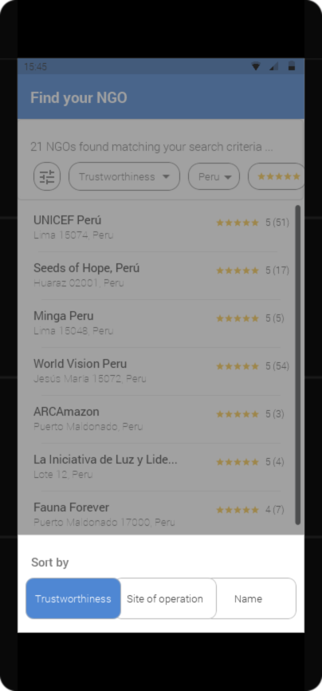
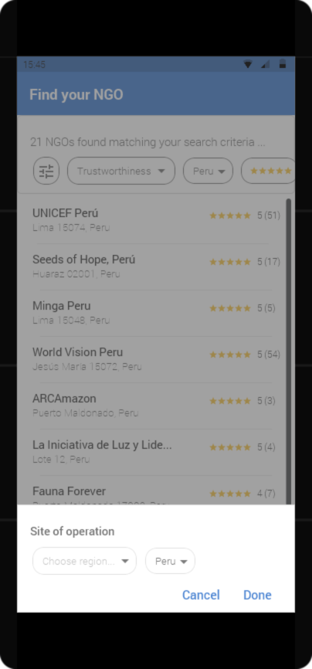
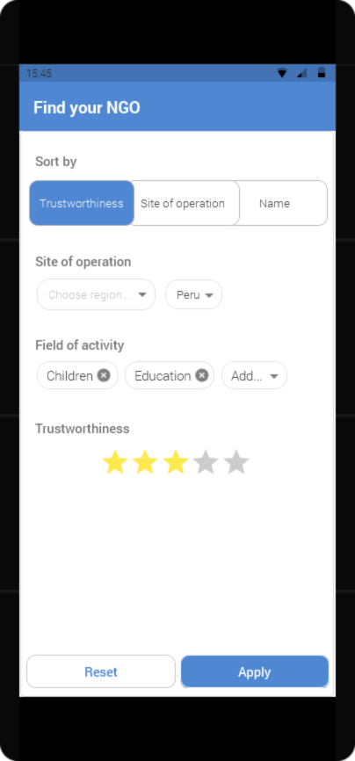
NGO Overview with sorting and filtering
* part of MVP
Find your NGO by filtering search results
Find your NGO by sorting the search results

Slide 6
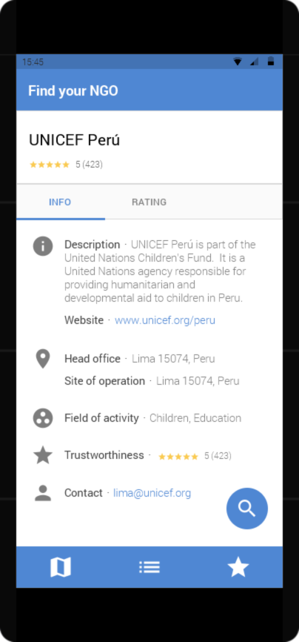
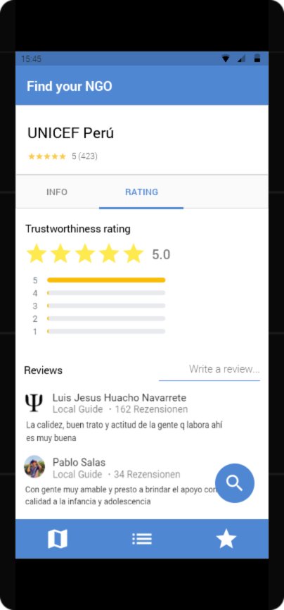
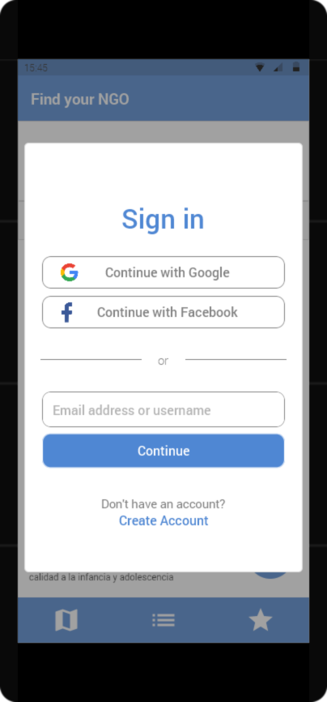
NGO Details with rating and login
Rate your NGO by its trustworthiness and leave a comment about your experience
Sign in to rate your NGO
Find your NGO by examining detailed information and ratings

Slide 7
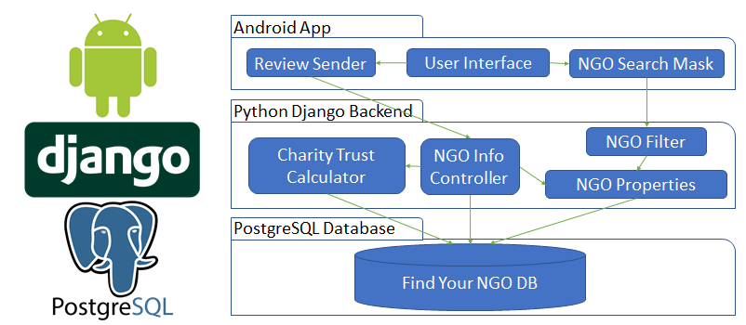
TechStack

