Slide 1
1. Random Boolean Function Generators
3. Boolean Function Analysis
2. Random Boolean Network Generators
4. Boolean Network Analysis
5. Ensemble experiments

Slide 2
1. Random Boolean Function Generators
2. Random Boolean Network Generators
5. Ensemble experiments
3. Boolean Function Analysis
4. Boolean Network Analysis

Slide 3
1. Random Boolean Function Generators
random_non_degenerated_function(n)
random_k_canalizing_function(n, k)
random_NCF(n, layer_structure)
…
2. Random Boolean Network Generators
Generates a random Boolean network of defined size, degree distribution, canalizing depth or layer structure, bias, …
5. Ensemble experiments
3. Boolean Function Analysis
is_monotonic() get_symmetry_groups()
is_degenerated() get_sensitivity()
Is_k_canalizing() get_layer_structure()
Is_kset_canalizing() get_canalizing_strength()
…
4. Boolean Network Analysis
get_attractors_synchronous()
get_steady_states_asynchronous()
get_attractors_and_robustness_measures_
synchronous()
…

Slide 4
1. Random Boolean Function Generators
random_non_degenerated_function(n)
random_k_canalizing_function(n, k)
random_NCF(n, layer_structure)
…
2. Random Boolean Network Generators
Generate random Boolean networks of defined size, degree distribution, canalizing depth or layer structure, bias, …
5. Ensemble experiments
Build reproducible pipelines for systematic studies
Systematically vary parameters and study network properties across ensembles
3. Boolean Function Analysis
is_monotonic() get_symmetry_groups()
is_degenerated() get_sensitivity()
Is_k_canalizing() get_layer_structure()
Is_kset_canalizing() get_canalizing_strength()
…
4. Boolean Network Analysis
get_steady_states_asynchronous()
get_Derrida_values()
get_attractors_and_robustness_measures_
synchronous()
…

Slide 5
1. Random Boolean Function Generators
random_non_degenerated_function(n)
random_k_canalizing_function(n, k)
random_NCF(n, layer_structure)
…
2. Random Boolean Network Generators
Generate random Boolean networks of defined size, degree distribution, canalizing depth or layer structure, bias, …
class BooleanNetwork
Interoperable with PyBoolNet, CANA
5. Ensemble experiments
Build reproducible pipelines for systematic studies:
vary parameters and study network properties across ensembles
3. Boolean Function Analysis
is_monotonic() get_symmetry_groups()
is_degenerated() get_sensitivity()
Is_k_canalizing() get_layer_structure()
Is_kset_canalizing() get_canalizing_strength()
…
4. Boolean Network Analysis
get_steady_states_asynchronous()
get_Derrida_values()
get_attractors_and_robustness_measures_
synchronous()
…

Slide 6
class BooleanFunction
class BooleanNetwork
1. Random Boolean Function Generators
random_non_degenerated_function(n, bias)
random_k_canalizing_function(n, k)
random_NCF(n, layer_structure)
…
2. Random Boolean Network Generators
Generate random Boolean networks of defined size, degree distribution, canalizing depth or layer structure, bias, …
5. Ensemble experiments
Build reproducible pipelines for systematic studies:
vary parameters and study function and network properties across ensembles
6. Interoperability
Export/Import → CANA, PyBoolNet, …
3. Boolean Function Analysis
is_monotonic() get_symmetry_groups()
is_degenerated() get_sensitivity()
Is_k_canalizing() get_layer_structure()
Is_kset_canalizing() get_canalizing_strength()
…
4. Boolean Network Analysis
get_steady_states_asynchronous()
get_Derrida_values()
get_attractors_and_robustness_measures_
synchronous()
…

Slide 7
class BooleanFunction
class BooleanNetwork
Random Boolean Function Generators
random_non_degenerate_function(n, bias)
random_k_canalizing_function(n, k)
random_NCF(n, layer_structure)
…
Random Boolean Network Generators
Generate random Boolean networks of defined size, degree distribution, canalizing depth, layer structure, bias, …
Ensemble Experiments
Build reproducible pipelines for systematic studies:
vary parameters and study function and network properties across ensembles
Interoperability
Export/Import → CANA, PyBoolNet, …
Boolean Function Analysis
is_monotonic() get_symmetry_groups()
is_degenerate() get_average_sensitivity()
Is_k_canalizing() get_layer_structure()
Is_kset_canalizing() get_canalizing_strength()
…
Boolean Network Analysis
get_steady_states_asynchronous()
get_attractors_and_robustness_synchronous()
get_types_of_regulation()
get_ffls()
…

Slide 8
class BooleanFunction
class BooleanNetwork
Random Boolean Function Generators
Sample functions with prescribed structural features uniformly at random
Random Boolean Network Generators
Generate random Boolean networks of defined size, degree distribution, canalizing properties, bias, …
Ensemble Experiments
Systematic analysis of
Interoperability
Export/Import → CANA, PyBoolNet, …
Boolean Function Analysis canalization; collective canalization; symmetry; sensitivity; degeneracy; …
Boolean Network Analysis
attractors under synchronous & asynchronous update; network motifs; stability & robustness; …

Slide 9
User Input
Network parameters
Constraints on topology
Constraints on functions
Optional: Network for null model matching
Scientific advances through ensemble experiments
Compare 5000+ Boolean regulatory functions from published bio models with random functions to reveal design principles
Explore the impact of function-level and topological parameters on network dynamics
Validate the significance of features in biological networks by comparison to ensemble of matched null models
Generation
Random Boolean Function Generators Generate functions with prescribed features: canalizing depth, layer structure, bias, …
Random Boolean Network Generators Generate networks with controlled function-level and topological properties: degree distribution, wiring diagram, preserved bias and/or canalizing properties, …
Analysis
Function-level metrics canalization, redundancy, symmetry, sensitivity, monotonicity, …
Structural network-level metrics recurring motifs, modularity, …
Network dynamics metrics attractors, stability to perturbation, …

Slide 10
User Input
Network parameters
Constraints on topology
Constraints on functions
Optional: Boolean network for null model matching
Generation
Random Boolean Function Generators Sample functions uniformly with prescribed canalizing depth, layer structure, bias, …
Random Boolean Network Generators Generate networks with controlled topology and function-level constraints: degree distribution or specific wiring diagram, bias, canalizing properties, …
Ensemble experiments
Function-level characterization (Fig 2A) Compare 5,000+ biological Boolean functions with constraint-matched random ensembles to uncover structural design principles
Parameter space exploration (Fig 2B) Systematically quantify how function-level and topological parameters shape network dynamics
Null model hypothesis testing (Fig 2C) Assess the statistical significance of structural and dynamical features in biological networks using ensembles of matched null models
Analysis
Function-level metrics canalization, redundancy, symmetry, sensitivity, monotonicity, …
Structural network-level metrics recurring motifs, modularity, …
Network dynamics metrics attractors, stability to perturbation, …
Notes:
Original submission

Slide 11
User Input
Random network design Specify network size, topological constraints (in-degree distribution, self-loops, strong connectivity, …), functional constraints (canalizing depth, layer structure, bias, …)
Biological network for matched null models Decide whether to preserve full wiring diagram, in- and/or out-degree distribution, canalizing depth, bias, …
Controlled Generation
Boolean Function Generators Function-uniform sampling under constraints: canalizing depth, layer structure, bias, ...
Boolean Network Generators Controlled topology and update-rule ensembles: degree distribution, function-level constraints
Matched null-model generators Preserve selected biological features while randomizing remaining network properties
Ensemble-based investigations
Function-level characterization (Fig. 3A) Compare 5,000+ biological Boolean functions with constraint-matched random ensembles to uncover structural design principles
Parameter space exploration (Fig. 3B) Systematically quantify how functional and topological parameters shape network dynamics and robustness
Null model hypothesis testing (Fig. 3C) Assess the statistical significance of structural and dynamical features in biological networks using ensembles of matched null models
refine constraints
Analysis
Function-level analysis canalization, collective canalization, redundancy, symmetry, sensitivity, monotonicity, …
Network structure analysis feedback and feed-forward loops, modularity, …
Dynamical analysis attractors, full trajectories, basin entropy, Derrida values, coherence, perturbation fragility, …
Notes:
New for revision

Slide 12
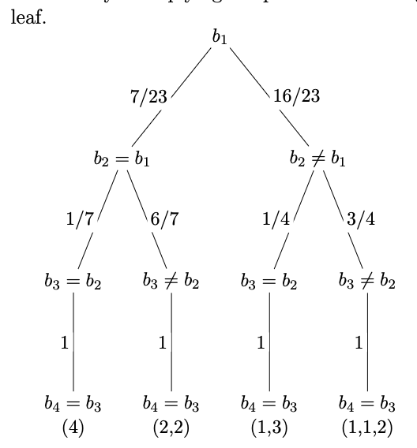
m=3
s=2
s=1
m=2
s=3
m=1

Slide 13
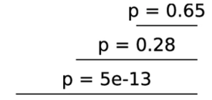
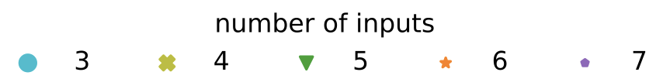
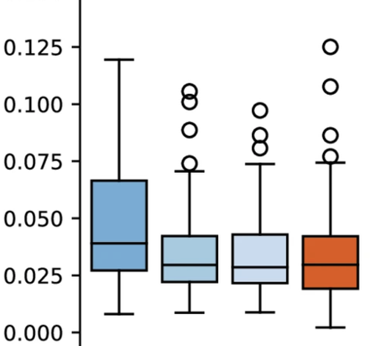
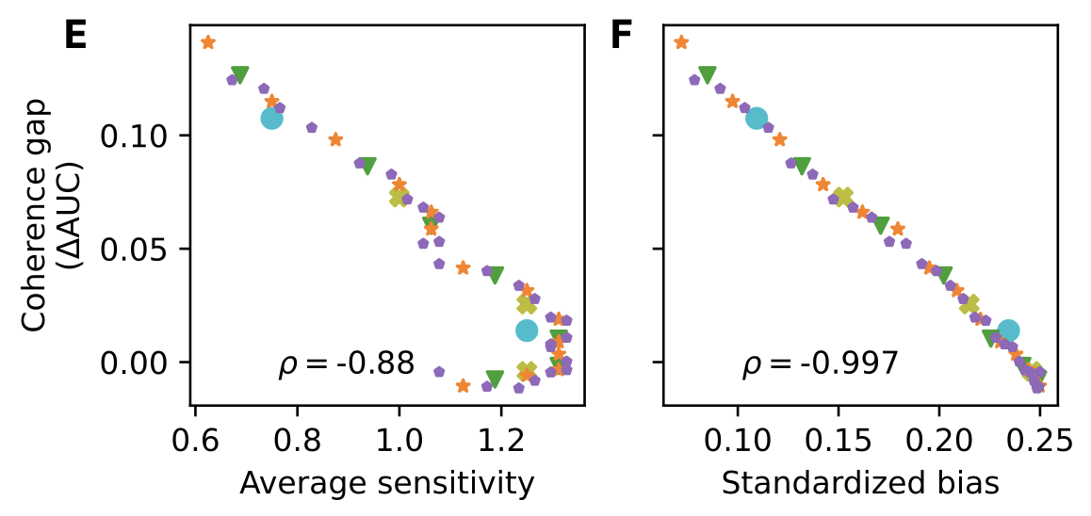
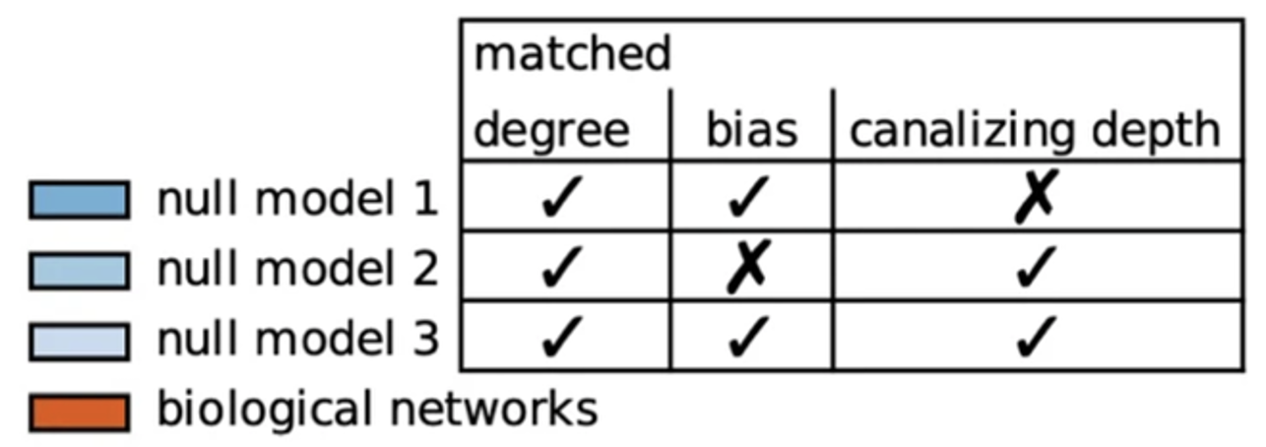
A
Function-level characterization
B
Parameter space exploration
C
Null model hypothesis testing
Network degree
biological networks
First-order approximation error
expectation (random functions)

Slide 14
A
Function-level characterization
B
Parameter space exploration
C
Null model hypothesis testing
constant in-degree
biological networks
First-order approximation error
expectation (random functions)

Slide 15
Extract and analyze Boolean functions to identify anomalies/design principles
Load 122 published biological models
Generate a large ensemble of random Boolean functions
Extract >5000 regulatory rules
Analyze the abundance of canalization
Statistical analysis yields finding: bio networks are massively enriched for nested canalizing functions

Slide 16
