Slide 1
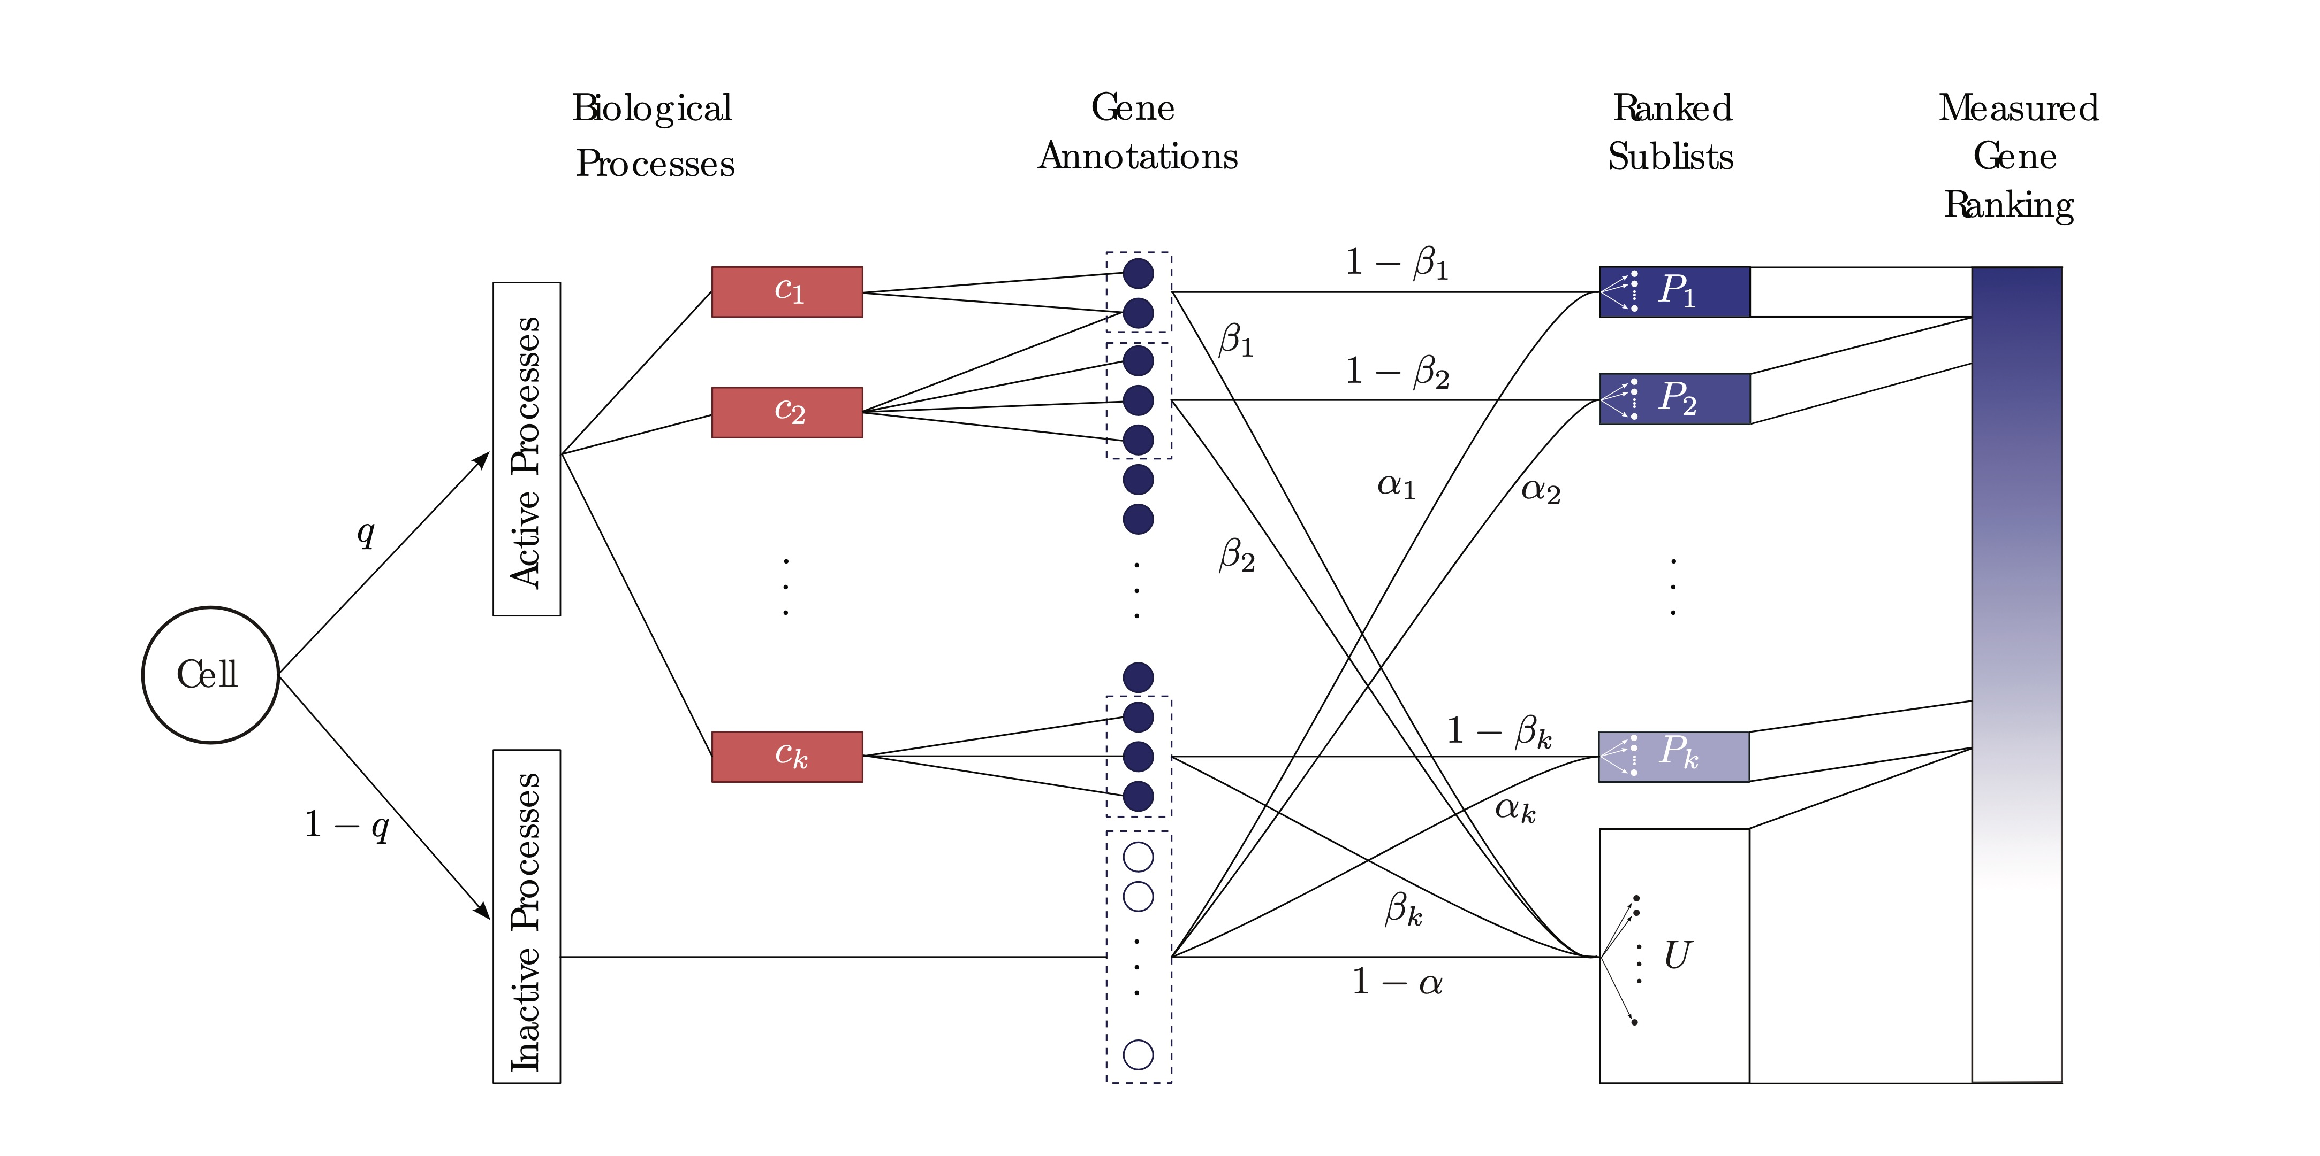








P₁
w₁
P₂
w₂
1 - β
$$⋮$$
$$⋮$$
$$\tilde{P}$$
β
α
$$⋮$$
$$⋮$$
T
P_{k}
w_{k}
$$\tilde{U}$$
1 - α

Slide 2





P₁
w₁
P₂
w₂
1 - β
$$⋮$$
$$⋮$$
C
$$\tilde{P}$$
β
α
$$⋮$$
$$⋮$$
T
P_{k}
w_{k}
c_{m}
$$\tilde{U}$$
1 - α
T - C

Slide 4
P₁
w₁
P₂
w₂
1 - β
$$⋮$$
$$⋮$$
$$\tilde{P}$$
β
α
$$⋮$$
$$⋮$$
T
P_{k}
w_{k}
$$\tilde{U}$$
1 - α

Slide 5








Likelihood contribution
P_{i}$∈$ EP
P_{i}$∈$ NP
P₁
w₁
1- βw₁
$>$
αw₁
P₂
w₂
1- βw₂
$>$
αw₂
$$⋮$$
$$⋮$$
P
$$⋮$$
$$⋮$$
P_{k}
w_{k}
1- βw_{k}
$>$
αw_{k}
U

Slide 6







C
xxxx
P₁
w₁
xxxx
P₂
w₂
1 - β
$$⋮$$
$$⋮$$
$$\tilde{P}$$
β
$$𝒞$$
α
$$⋮$$
$$⋮$$
$$\tilde{U}$$
P_{k}
w_{k}
1 - α
$𝒞$ - C

Slide 8
Hidden state
Genes annotated to activated processes
Observed gene ranking
P₁
w₁
P₂
w₂
1 – β
$$⋮$$
$$⋮$$
Activated Processes
P
q
$$⋮$$
$$⋮$$
β
α
w_{k}
Cell
P_{k}
1 – q
Inactive Processes
1 – α
U
Genes not annotated to activated processes

Slide 9





Observed gene ranking
Likelihood contribution
g$∈$ EP_{i}
g$∈$ NP_{i}
P₁
w₁
1- βw₁ $>$αw₁
P₂
w₂
1- βw₂ $>\text{α}\text{w}\text{2}$
$$⋮$$
$$⋮$$
$$⋮$$
$$⋮$$
P_{k}
w_{k}
1- βw_{k} $>$ αw_{k}

