Slide 2
A
B

Slide 3
A
D
B
E
C

Slide 4
f(x₁,x₂,x₃) = x₁ OR (x₂ AND x₃)
x₃
x₂
A
x₁ | x₂ | x₃ | f
0 | 0 | 0 | 0
0 | 0 | 1 | 0
0 | 1 | 0 | 0
0 | 1 | 1 | 1
1 | 0 | 0 | 1
1 | 0 | 1 | 1
1 | 1 | 0 | 1
1 | 1 | 1 | 1
B
1
x₁
1
0
0,1,1
1
1,1,1
0,0,1
1,0,1
0
1
0
0,1,0
1
1,1,0
0,0,0
1,0,0
C
1st layer
x₁
x₁
1
0
1
0
D
x₁ | x₂ | x₃ | f
0 | 0 | # | 0
0 | # | 0 | 0
1 | # | # | 1
# | 1 | 1 | 1
2nd layer
1
x₂
1
x₃
0
1
0
1
0
x₃
0
x₂
0
1
1
0
0
1
1
0

Slide 5
x₃
x₂
A
x₁ | x₂ | x₃ | f
0 | 0 | 0 | 0
0 | 0 | 1 | 0
0 | 1 | 0 | 0
0 | 1 | 1 | 1
1 | 0 | 0 | 1
1 | 0 | 1 | 1
1 | 1 | 0 | 1
1 | 1 | 1 | 1
B
1
x₁
1
0
0,1,1
1
1,1,1
0,0,1
1,0,1
0
1
0
0,1,0
1
1,1,0
0,0,0
1,0,0
C
1st layer
x₁
x₁
1
0
1
0
D
x₁ | x₂ | x₃ | f
0 | 0 | # | 0
0 | # | 0 | 0
1 | # | # | 1
# | 1 | 1 | 1
2nd layer
1
x₂
1
x₃
0
1
0
1
0
x₃
0
x₂
0
1
1
0
0
1
1
0

Slide 6
A
x₁(t) | x₂(t) | x₁(t+1) | x₂(t+1)
0 | 0 | 0 | 0
0 | 1 | 1 | 0
1 | 0 | 0 | 1
1 | 1 | 1 | 1
B
C
0,1
1,1
D
0,1
1,1
x₁
x₂
0,0
1,0
0,0
1,0

Slide 7
z
y
A
x | y | z | f
0 | 0 | 0 | 0
0 | 0 | 1 | 0
0 | 1 | 0 | 0
0 | 1 | 1 | 1
1 | 0 | 0 | 1
1 | 0 | 1 | 1
1 | 1 | 0 | 1
1 | 1 | 1 | 1
B
1
x
1
0
0,1,1
1
1,1,1
0,0,1
1,0,1
0
1
0
0,1,0
1
1,1,0
0,0,0
1,0,0
C
1st layer
x
x
1
0
1
0
D
x | y | z | f
0 | 0 | # | 0
0 | # | 0 | 0
1 | # | # | 1
# | 1 | 1 | 1
1
1
2nd layer
y
y
0
1
0
1
0
z
0
z
0
1
1
0
0
1
1
0

Slide 8
A
x₁ | x₂ | f | g
0 | 0 | 0 | 0
0 | 1 | 0 | 0
0 | 2 | 1 | 1
1 | 0 | 0 | 0
1 | 1 | 0 | 1
1 | 2 | 1 | 1
2 | 0 | 2 | 2
2 | 1 | 2 | 2
2 | 2 | 2 | 2
B
x₁
2
0,1
2
x₂
2
0,1
1
0
C
x₁
x₁
2
0,1
2
0,1
2
x₂
2
x₂
2
0,1
0
1,2
1
x₁
0
x₂
0
1
2
1
0
x₂
1
x₁
0
1
1
0
0
1
1
0

Slide 9
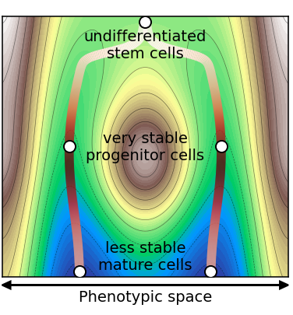
low
Canalization and absolute bias
high

