Slide 1
A
B
B
C
E
C
D

Slide 2
A
C
E
B
D
F
Notes:
Delay = 5

Slide 3
A
C
B
D

Slide 4
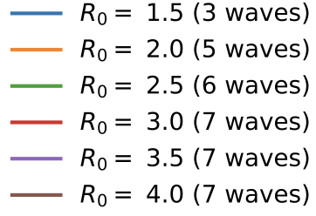
A
B
C

Slide 5
A
C
E
B
D
F

Slide 6
A
D
B
E
C
F

Slide 7
(a)
(b)

