Slide 1
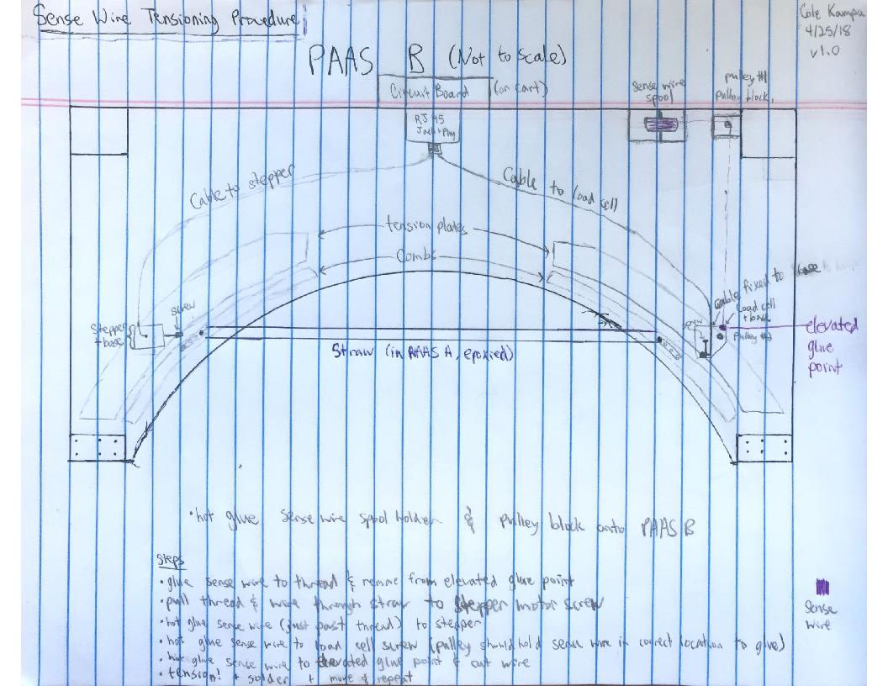
Gold: sense wire
Red: thread
Green: hot glue

