Slide 1
Functional Neuroimaging
NEUROSCI 382 / PSY 303
Thursday, Aug 25, 2026
Week 1
Introduction and Chapters 1 & 2

Slide 2
Class Outline
Perkins LINK 088, Classroom 4
Thursdays 3:05 – 5:45 PM
2 consecutive periods with ~10 min break
2 parts:
lecture (reading assignments)
lab (hands-on data analysis)

Slide 3
Class Outline
1st half of the semester:
physics of MRI and fMRI
physiological basis of the BOLD signal
Midterm I
2nd half of the semester:
study design
data analysis
clinical applications
Midterm II

Slide 4
Group projects
Groups of ~4 students
design your own research study
program experimental design
run study (two 2-hour scanning sessions, i.e. 2 participants)
normally $640/hour!
analyze data
Project presentation & Results presentation (10-15 mins each)
Write-up (~3000 words)

Slide 5
The class is on Canvas
Read the syllabus!
Lab materials posted in Files
Lecture PDF posted after class in Files

Slide 6
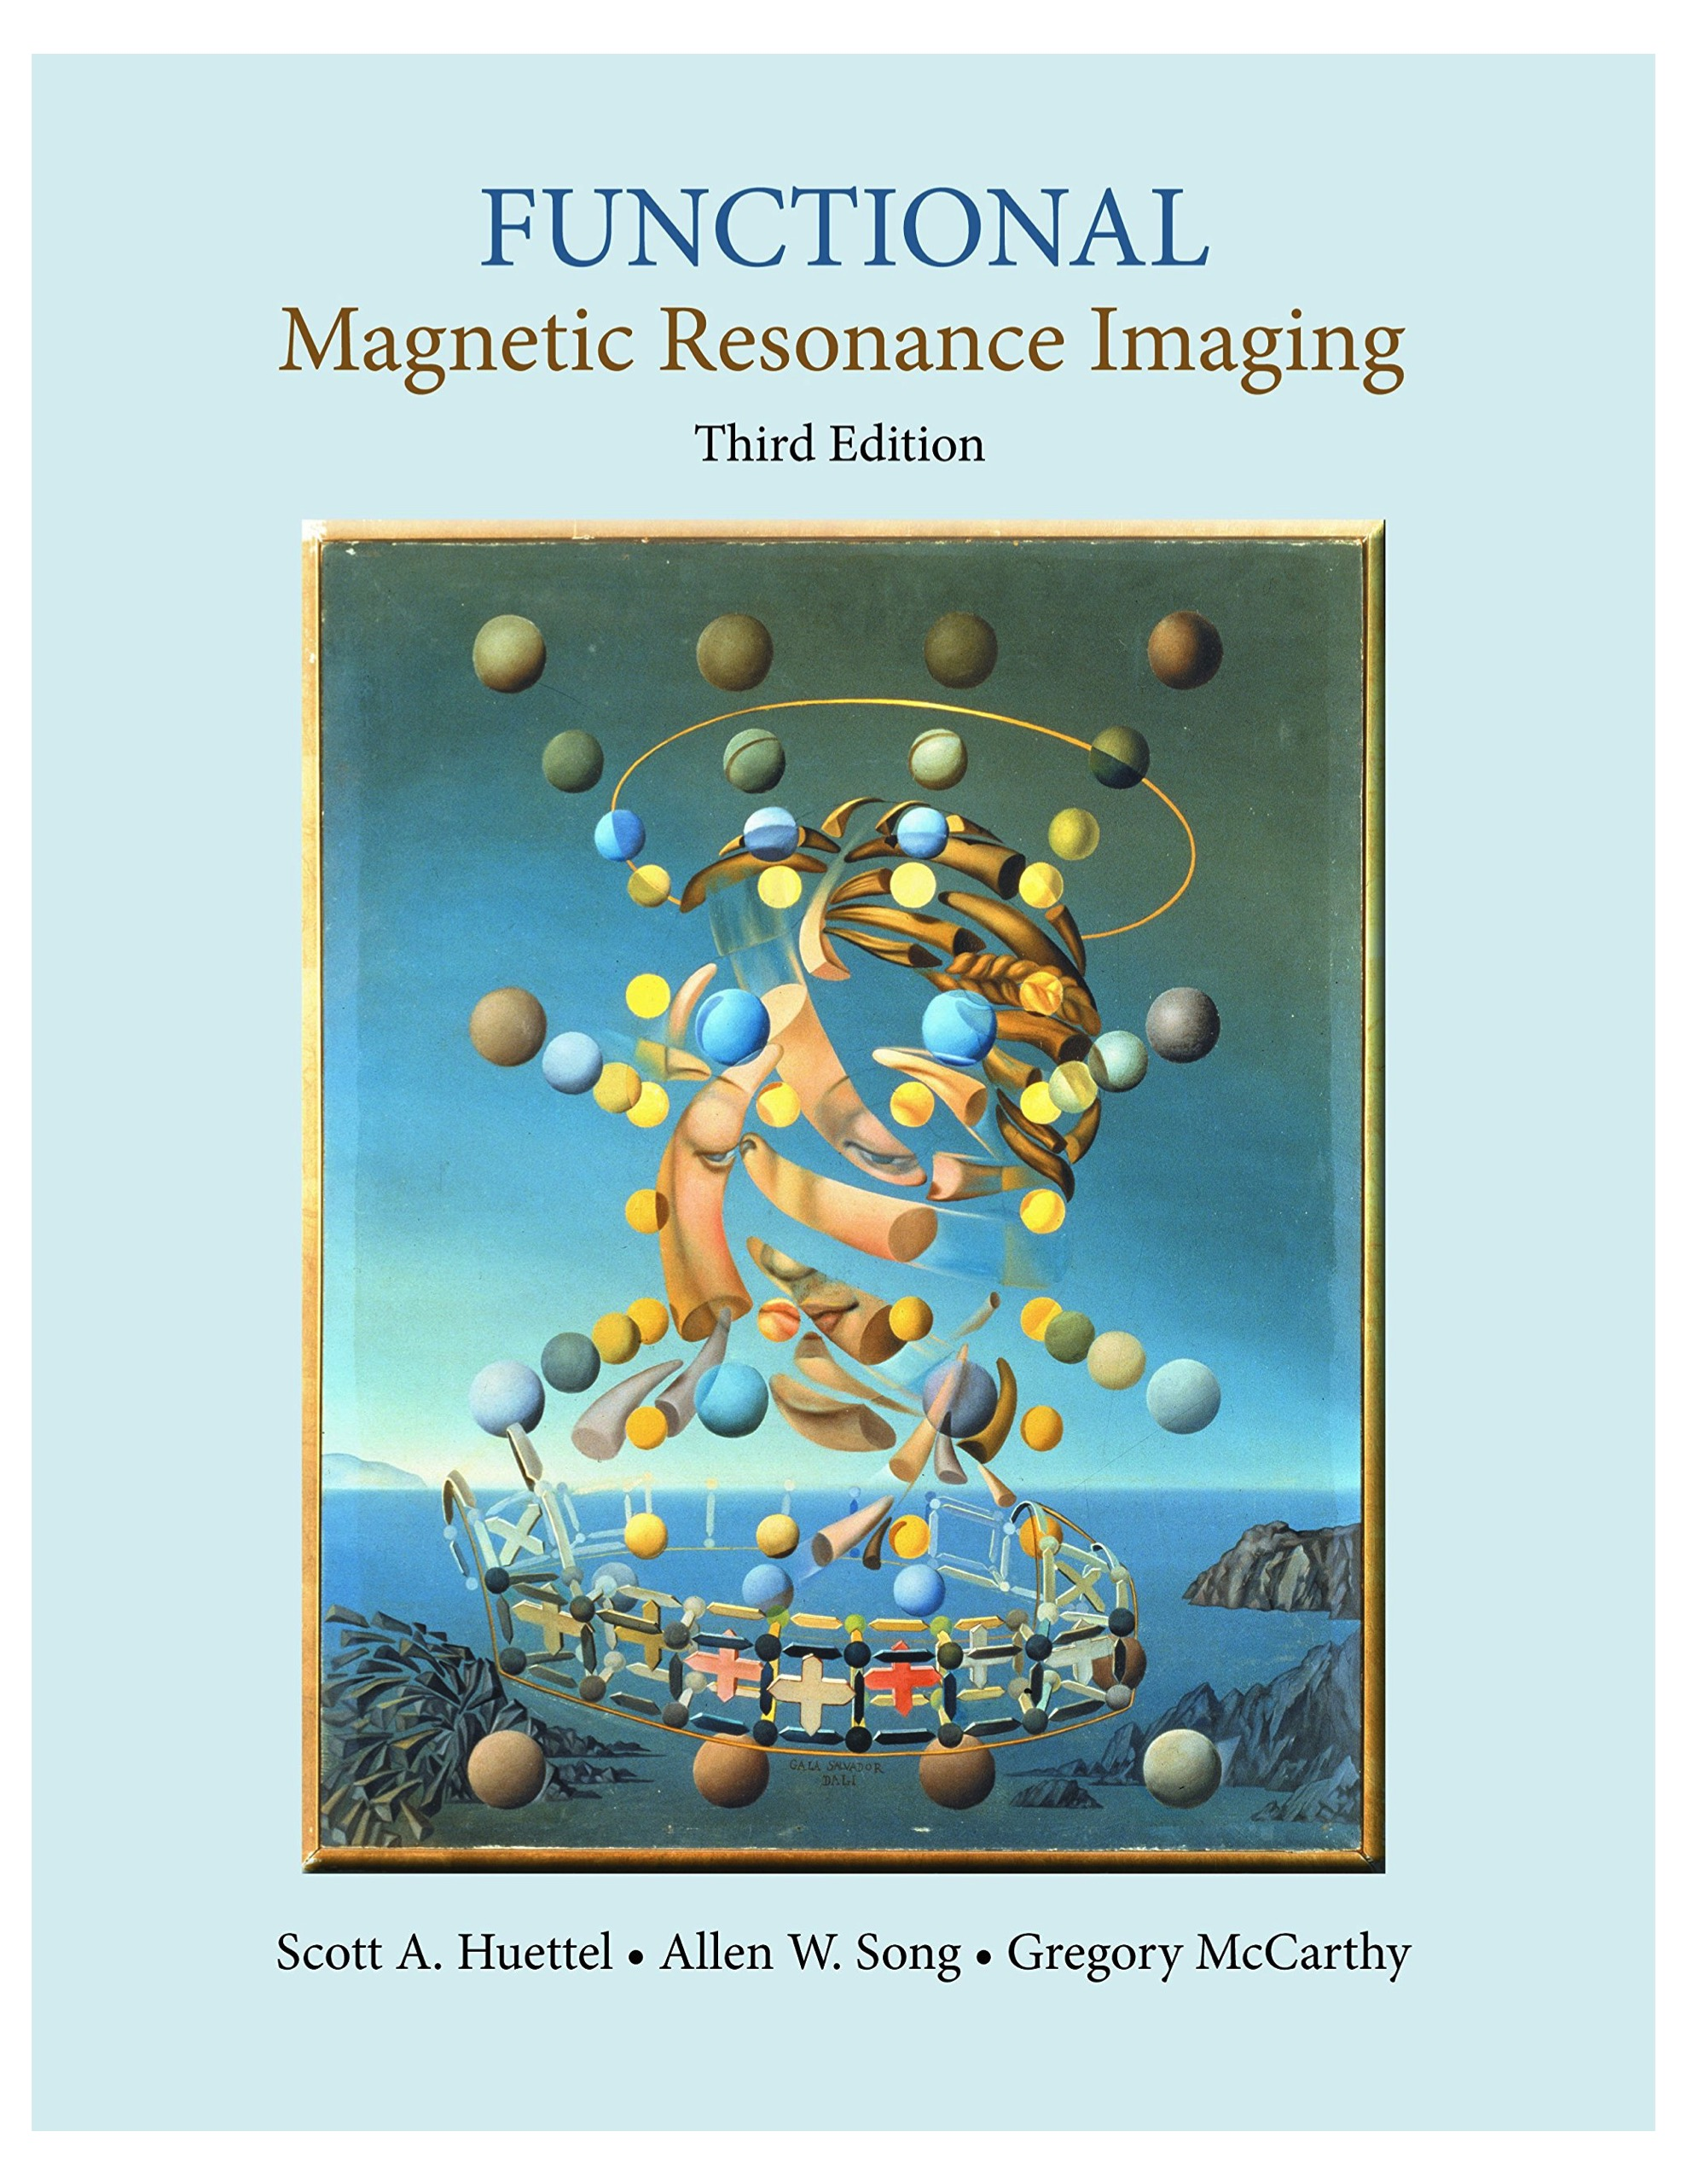
Textbook

Slide 7
Reading
Reading assignments typically for lecture part
they can be long and dense – plan your time wisely
get together with a study partner!!

Slide 8
Use of electronic devices
This is a ‘no tech’ classroom
no electronic devices (laptops, iPads, phones, etc.) are allowed during lectures
this helps you and your fellow students
if you need to use a laptop etc. for note taking, or use an electronic device for another reason, please get in touch with me so we can discuss this

Slide 9
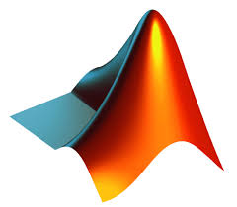
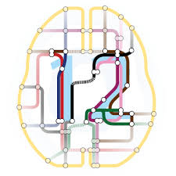
Software
→ bring your laptop to class!
By next class, download:
via Duke OIT software:
Matlab (2026b, or earlier)
No toolboxes necessary!
via the internet:
Statistical Parametric Mapping (SPM):
https://www.fil.ion.ucl.ac.uk/spm/docs/installation/
Latest version is SPM25

Slide 10
Grading
30% Midterm I
30% Midterm II
30% Project
10% Labs

Slide 11
Questions?

Slide 12
1. What is fMRI?
What fMRI is NOT!

Slide 13
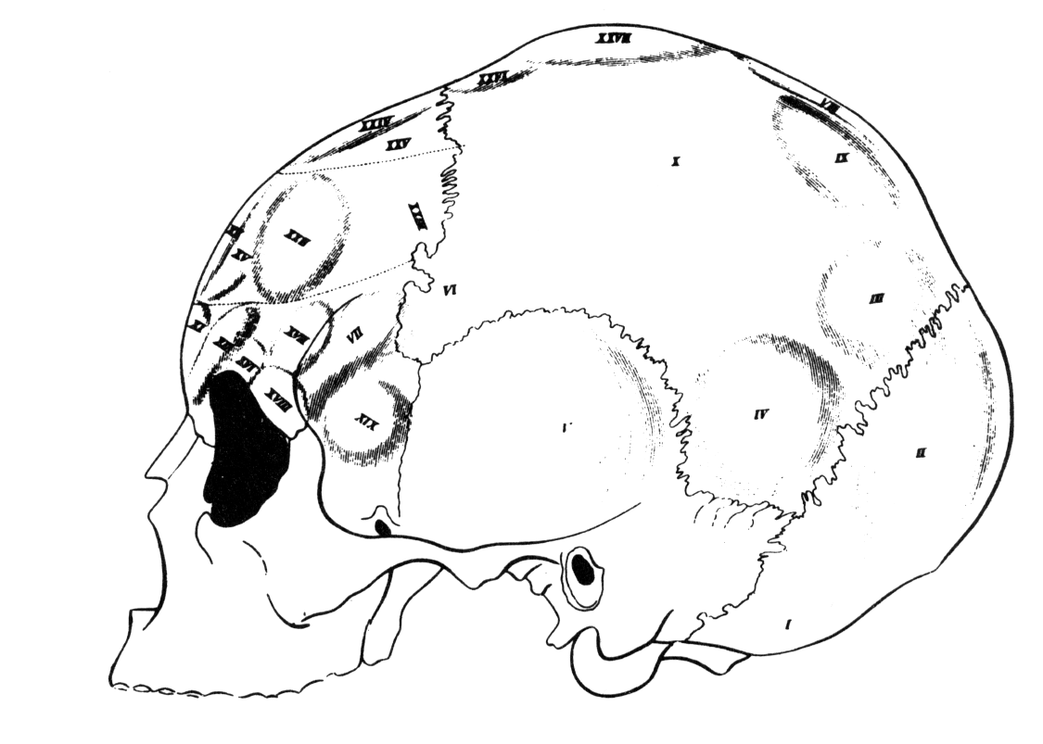
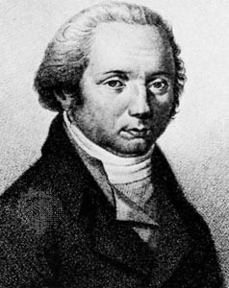
fMRI is not bumpology
Phrenology (“Study of mental science”) claimed that bumps on the skull reflected exaggerated functions/traits
it lacked any mechanism underlying its claims
it used anecdotal, rather than scientific, evidence
nevertheless, one of its central ideas persisted:
Localization of Function
from Gall (c. 1810)
Franz Joseph Gall (1758-1828)

Slide 14
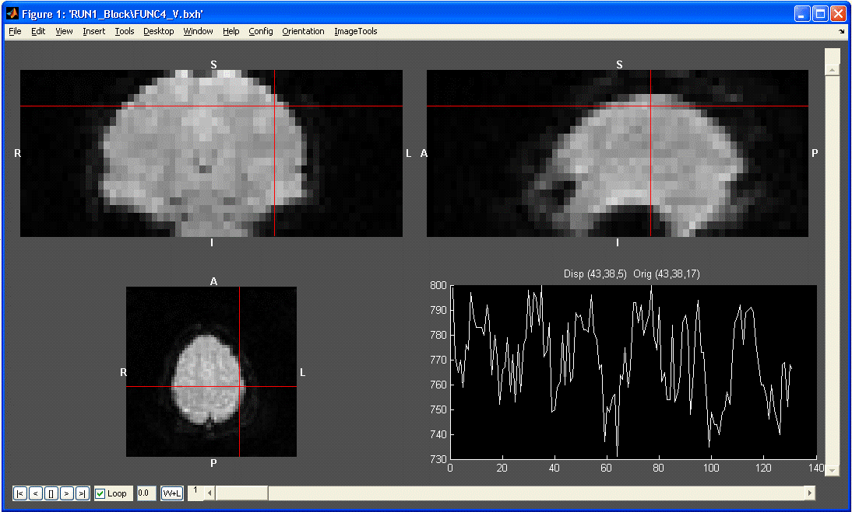
fMRI is not mind-reading
(Though we are getting closer…)
This is not a thought.
This is not a thought.
This is not an anti-thought.

Slide 15
fMRI is not a simple one-to-one
It’s not enough just to show ‘activation’ in a brain region to know its function:
Insula
Interoception
Emotional processing
Disgust
Empathy
Social norm violations
Consciousness
Smoking
Phonological & language processing
Attention

Slide 16
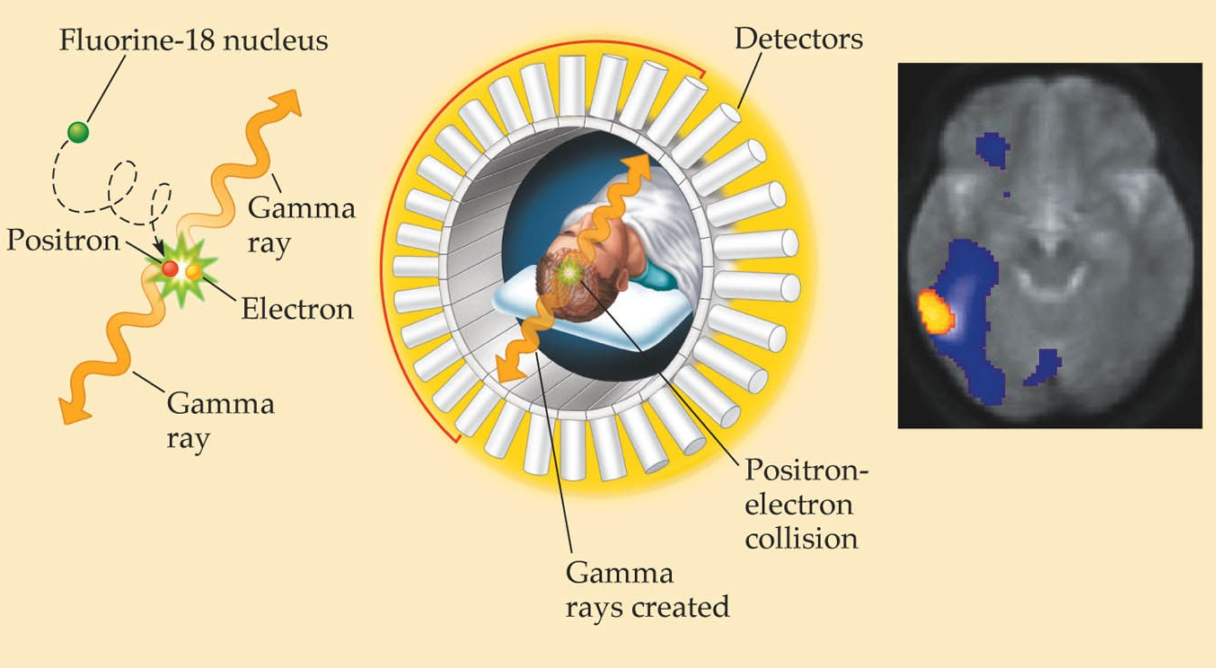
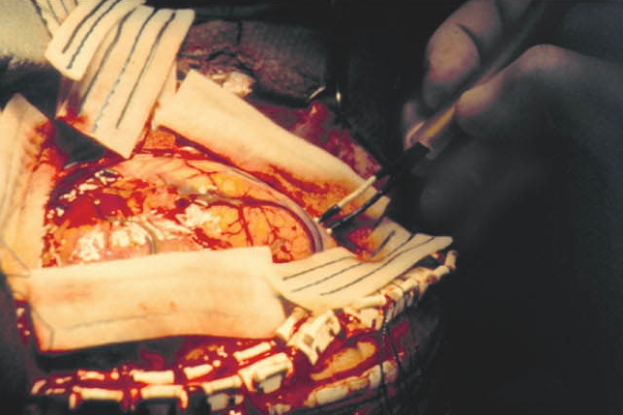
fMRI is not invasive
Positron Emission Tomography (PET)
Intracranial Stimulation / Recording

Slide 17
fMRI is…
… a technique for measuring metabolic correlates of neural activity
uses a standard MRI scanner
acquires a series of images via clever manipulations of magnetic fields / magnetic gradients
measures changes in blood oxygenation levels over time
uses non-invasive, non-ionizing radiation (radio frequencies) to perturb atomic nuclei (e.g. H)
can be repeated many times; can be used for a wide range of participants
combines good spatial and reasonable temporal resolution

Slide 18
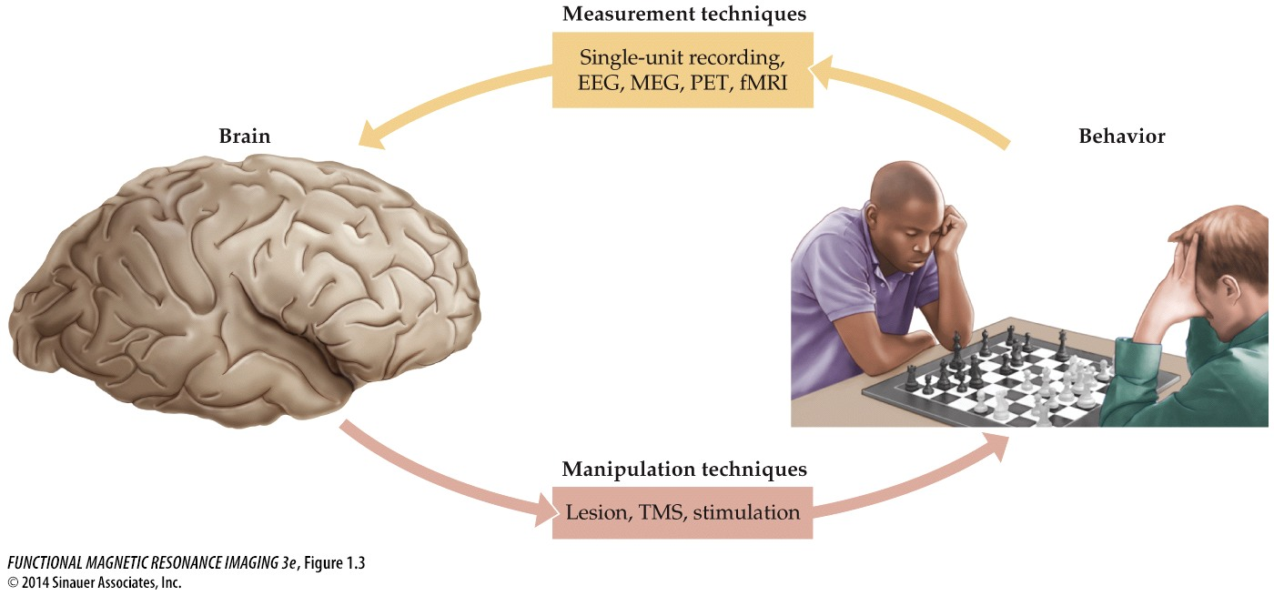
fMRI is a Measurement Technique…

Slide 19
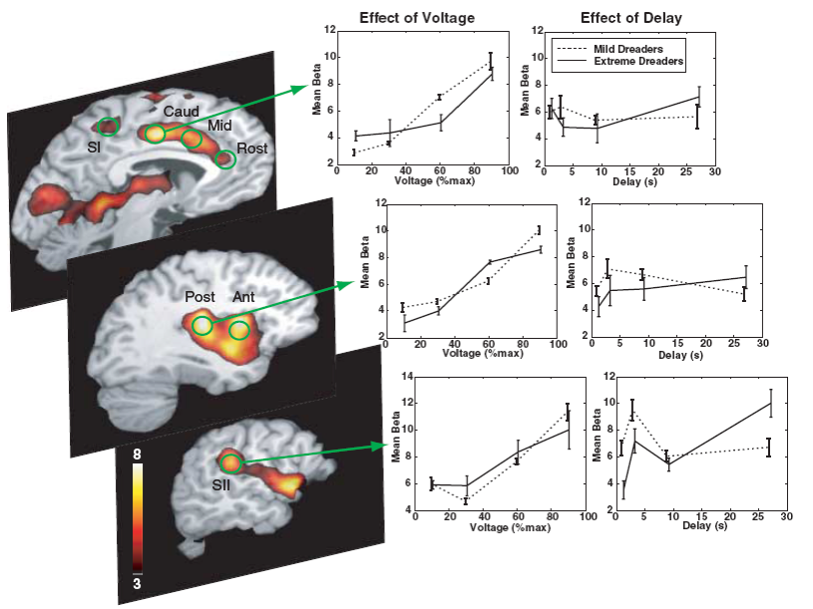
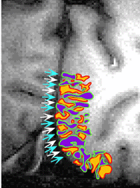
… that provides information about a wide range of topics…
From bone-dry psychophysics… (ocular dominance columns)
… to existential feelings. (the dread of an upcoming shock)
Cheng, Waggoner, & Tanaka (2001) Neuron
Berns et al. (2006) Science

Slide 20
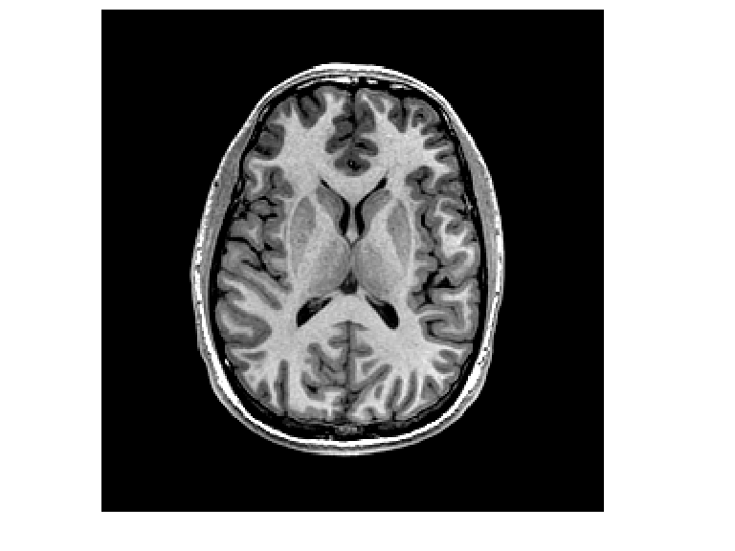
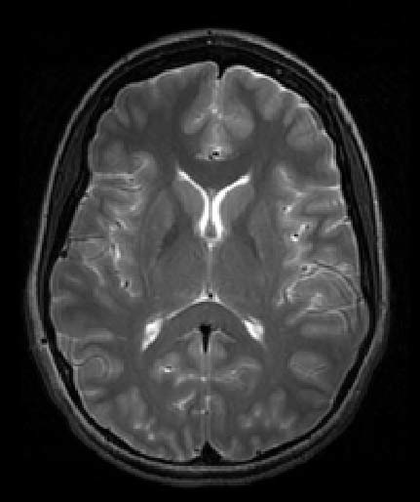

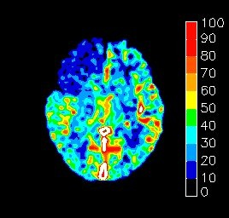
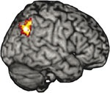
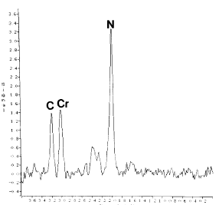
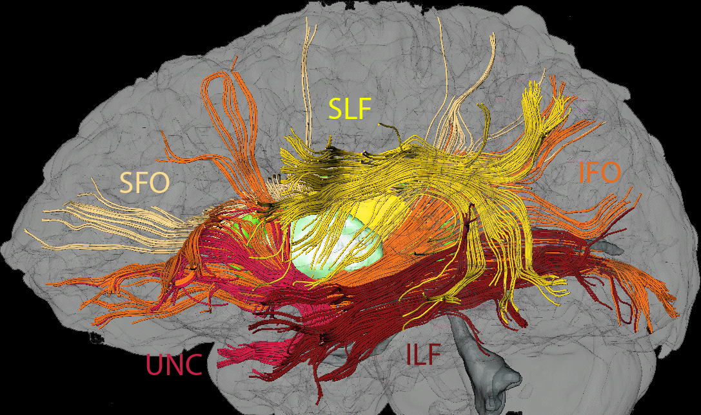
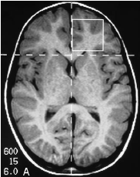
… using many Types of MR Imaging
Anatomical Imaging
Functional Imaging
Perfusion
Anatomical Imaging (MRI)
Functional Imaging (fMRI)
Perfusion
T1 weighted
T2 weighted
T1-weighted
T2-weighted
Spectroscopy
Diffusion Tensor Imaging
Spectroscopy
Diffusion Tensor Imaging (DTI)
(anatomical image illustrating MRS region)
Notes:
C= choline
Cr =creatine
N = N-acetyl aspartate

Slide 21
2. Key Concepts

Slide 22
Contrast & Resolution
Contrast
anatomical contrast
functional contrast
Resolution
spatial resolution
temporal resolution
functional resolution

Slide 23
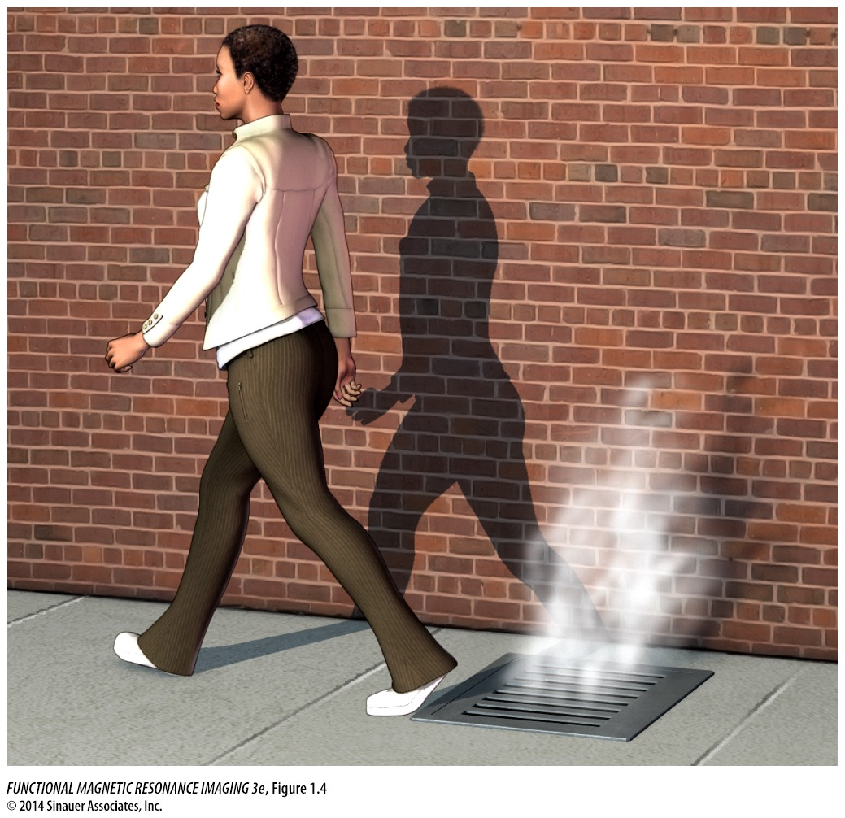
Contrast: Conceptual Overview
In vision: contrast is based on the opacity of an object to visible light rays
→ darkness of shadow indicates the opacity of the object

Slide 24
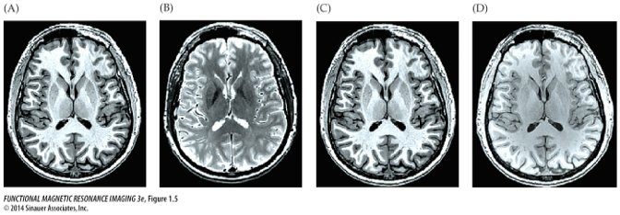
Contrast: Anatomical Contrast
T1
T2
T1
T1
A&B → The quantity being measured: “What?”
intrinsic tissue properties (e.g., longitudinal relaxation time: 'T1 contrast'; Chapters 3&4)
C&D → An intensity difference between quantities: “How much?”
“high contrast” if sensitive to small differences (resulting in an overall large intensity range)
Contrast-to-noise ratio (CNR): The magnitude of the intensity difference between quantities divided by (relative to) the overall variability in their measurements
Notes:
In MRI, the term contrast is used in two main ways:

Slide 25
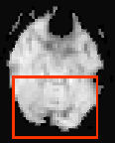

Contrast: Functional Contrast
3) In fMRI, a statistical comparison between two (or more) experimental conditions.
→ Is there a statistically significant difference?
CNR is critical for fMRI: How confidently can we decide whether a given brain region is (significantly) ‘active' or not?
(unfortunately, CNR in fMRI is rather low…)
Notes:
In fMRI, there is a third usage of the term contrast:

Slide 26
Contrast & Resolution
Contrast
anatomical contrast
functional contrast
Resolution
spatial resolution
temporal resolution
functional resolution

Slide 27
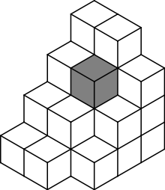
Resolution: Spatial Resolution
Voxels
Voxel (3-D volume element): A small rectangular prism that is the basic sampling unit of (f)MRI.
Typical anatomical (MRI) voxel edge size: 0.5-1 mm (e.g., 1 mm X 1 mm X 1mm voxel).
Typical functional (fMRI) voxel edge size: 2-4 mm.

Slide 28
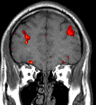
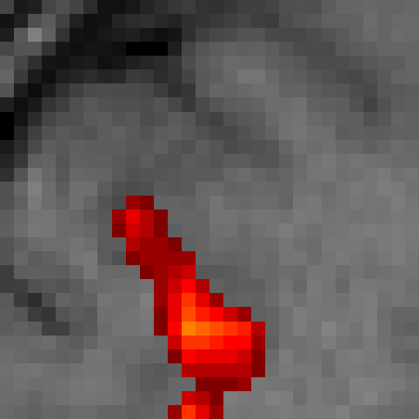
Resolution: Spatial Resolution
Voxels
(in 2D rendition)
Voxel (3-D volume element): A small rectangular prism that is the basic sampling unit of (f)MRI.
Typical anatomical (MRI) voxel edge size: 0.5-1 mm (e.g., 1 mm X 1 mm X 1mm voxel).
Typical functional (fMRI) voxel edge size: 2-4 mm.

Slide 29
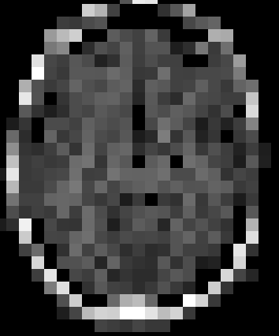
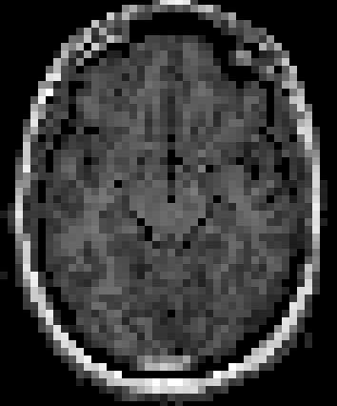
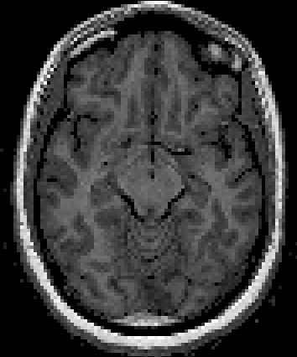
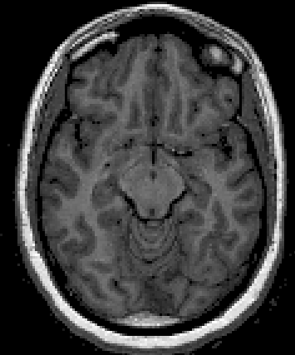
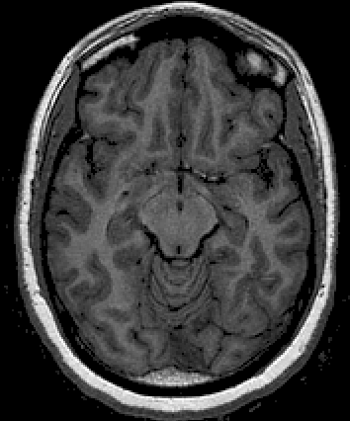
Spatial Resolution: 2D Examples
8mm
4mm
2mm
1.5mm
1mm
→ The smaller the voxels, the higher the anatomical resolution

Slide 30
Resolution: Temporal Resolution
Determining factors:
Sampling rate – usually repetition time (TR)
Dependent variable – usually BOLD response
BOLD response is sluggish, taking 1-3 seconds to rise above baseline and 4-6 seconds to peak
Experimental design
Many fMRI studies have an effective temporal resolution on the order of ~1-3 seconds (sic!)
with specialized designs and data acquisition, this can in some cases be improved to a few 100ms (very rare…)

Slide 31
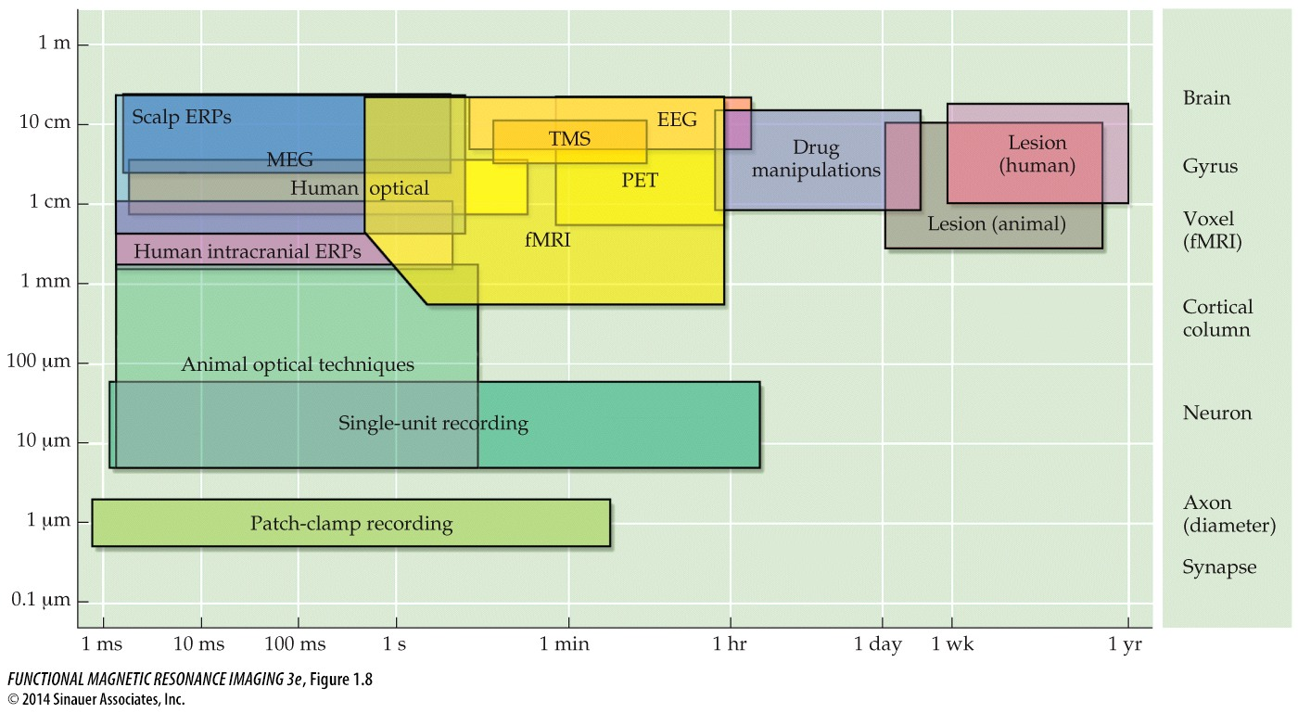
Resolution: Comparison
spatial resolution
anatomical resolution
temporal resolution

Slide 32
Resolution: Functional Resolution
The ability of a measurement technique to identify the relation between underlying neuronal activity and a cognitive or behavioral phenomenon.
basically: the ability to measure what we want to measure…
Functional resolution is limited by both:
the intrinsic properties of our brain measure (here: hemodynamics in response to neural activity), and
our ability to manipulate the experimental design to allow variation in the phenomenon of interest.

Slide 33
Contrast & Resolution
Contrast
anatomical contrast
functional contrast
Resolution
spatial resolution
temporal resolution
functional resolution

Slide 34
3. History of fMRI

Slide 35
Timeline of MR Imaging
1972 – Damadian patents idea for large NMR scanner to detect malignant tissue.
1924 - Pauli suggests that nuclear particles have angular momentum (spin) and magnetic moment.
1937 – Rabi measures magnetic moment of nucleus. Coins “magnetic resonance”.
1985 – Insurance reimbursements for MRI exams begin.
1973 – Lauterbur publishes method for generating images using NMR gradients.
MRI scanners become clinically prevalent and mainstay at hospitals.
→ purified gases
1944 – Rabi wins Nobel prize in Physics.
M
NMR becomes MRI
1920
1930
1940
1950
1960
1970
1980
1990
2000
1952 – Purcell and Bloch share Nobel prize in Physics.
1973 – Mansfield independently publishes gradient approach to MR.
1990 – Ogawa and colleagues create functional images using endogenous, blood-oxygenation contrast.
→ bulk matter
1946 – Purcell shows that matter absorbs energy at a resonant frequency.
1975 – Ernst develops 2D-Fourier transform for MR.
1946 – Bloch demonstrates that nuclear precession can be measured in detector coils.
Notes:
M: nuclei have magnetic properties
R: nuclei have resonant frequency
Magnetic moment: related to magnitude of the magnetic field, as well as the direction

Slide 36
Timeline of MR Imaging
1972 – Damadian patents idea for large NMR scanner to detect malignant tissue.
1924 - Pauli suggests that nuclear particles have angular momentum (spin) and magnetic moment.
1937 – Rabi measures magnetic moment of nucleus. Coins “magnetic resonance”.
1985 – Insurance reimbursements for MRI exams begin.
1973 – Lauterbur publishes method for generating images using NMR gradients.
MRI scanners become clinically prevalent and mainstay at hospitals.
→ purified gases
1944 – Rabi wins Nobel prize in Physics.
M
R
NMR becomes MRI
1920
1930
1940
1950
1960
1970
1980
1990
2000
1952 – Purcell and Bloch share Nobel prize in Physics.
1973 – Mansfield independently publishes gradient approach to MR.
1990 – Ogawa and colleagues create functional images using endogenous, blood-oxygenation contrast.
→ bulk matter
1946 – Purcell shows that matter absorbs energy at a resonant frequency.
1975 – Ernst develops 2D-Fourier transform for MR.
1946 – Bloch demonstrates that nuclear precession can be measured in detector coils.
Notes:
M: nuclei have magnetic properties
R: nuclei have resonant frequency

Slide 37
Early Uses of NMR
Most early NMR was used for chemical analysis of entire, homogeneous (tissue) samples
no spatial information / no ‘images’
no medical applications
1971 – Damadian publishes and patents idea for using NMR to distinguish healthy and malignant tissues
“Tumor detection by nuclear magnetic resonance”, Science
shows relaxation time differences in the two tissues
no image formation method proposed (other than, a few years later, moving person voxel by voxel! See “Indomitable”)
BUT: first medical application

Slide 38
Early Uses of NMR
Formation of Images (1973):
Lauterbur describes projection method for creating NMR images using magnetic gradients
Mansfield independently describes similar approach, and subsequently develops echo-planar imaging (EPI; much(!!) faster)

Slide 39
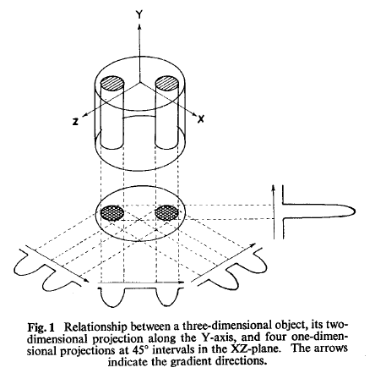
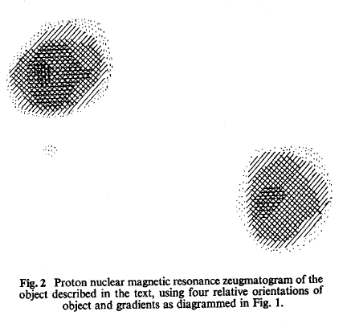
The First NMR Image
2-D projection method: 4 magnetic gradients at 45˚ intervals
The very first MR image!
Lauterbur, P.C. (1973). Image formation by induced local interaction: Examples employing nuclear magnetic resonance. Nature, 242, 190-191.
Notes:
2-D projection can be derived from several 1-D measurements
zeugmatography: that which is used for joining

Slide 40
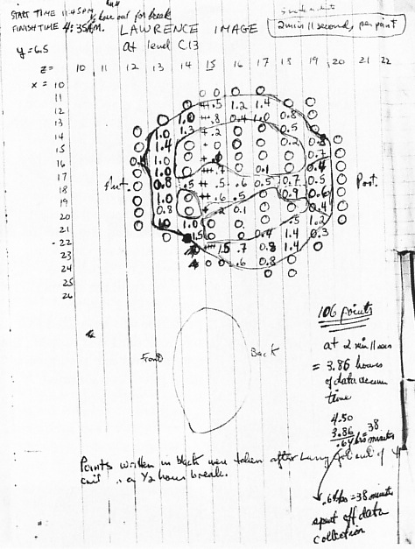
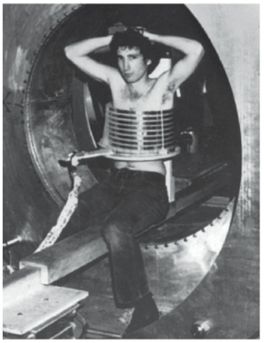
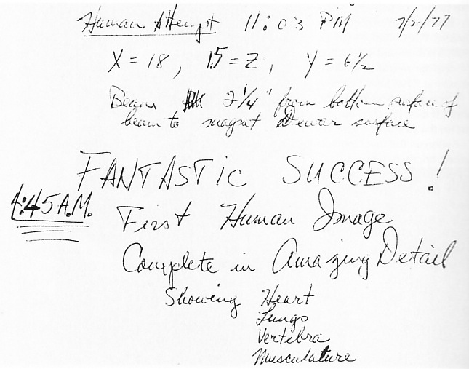
Early Human MR Images (Damadian)

Slide 41
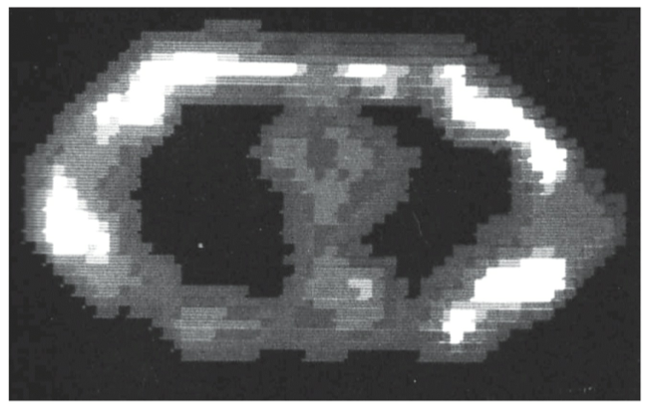
First human NMR image
Mink5 Image – Damadian (1977)

Slide 42
Timeline of MR Imaging
1972 – Damadian patents idea for large NMR scanner to detect malignant tissue.
1924 - Pauli suggests that nuclear particles have angular momentum (spin) and magnetic moment.
1937 – Rabi measures magnetic moment of nucleus. Coins “magnetic resonance”.
1985 – Insurance reimbursements for MRI exams begin.
1973 – Lauterbur publishes method for generating images using NMR gradients.
MRI scanners become clinically prevalent and mainstay at hospitals.
1944 – Rabi wins Nobel prize in Physics.
M
R
I
NMR becomes MRI
1920
1930
1940
1950
1960
1970
1980
1990
2000
1952 – Purcell and Bloch share Nobel prize in Physics.
1973 – Mansfield independently publishes gradient approach to MR.
1990 – Ogawa and colleagues create functional images using endogenous, blood-oxygenation contrast.
1946 – Purcell shows that matter absorbs energy at a resonant frequency.
1975 – Ernst develops 2D-Fourier transform for MR.
1946 – Bloch demonstrates that nuclear precession can be measured in detector coils.

Slide 43
Advantages of MRI
high-resolution images that can visualize a variety of tissues (bones, soft tissue, etc.) in the same image
does not require ionizing radiation (different from x-rays, CT scans)
can obtain images in any plane through the body

Slide 44
Timeline of MR Imaging
1972 – Damadian patents idea for large NMR scanner to detect malignant tissue.
1924 - Pauli suggests that nuclear particles have angular momentum (spin) and magnetic moment.
1937 – Rabi measures magnetic moment of nucleus. Coins “magnetic resonance”.
1985 – Insurance reimbursements for MRI exams begin.
1973 – Lauterbur publishes method for generating images using NMR gradients.
MRI scanners become clinically prevalent and mainstay at hospitals.
1944 – Rabi wins Nobel prize in Physics.
M
R
I
NMR becomes MRI
f
1920
1930
1940
1950
1960
1970
1980
1990
2000
1952 – Purcell and Bloch share Nobel prize in Physics.
1973 – Mansfield independently publishes gradient approach to MR.
1990 – Ogawa and colleagues create functional images using endogenous, blood-oxygenation contrast.
1946 – Purcell shows that matter absorbs energy at a resonant frequency.
1975 – Ernst develops 2D-Fourier transform for MR.
1946 – Bloch demonstrates that nuclear precession can be measured in detector coils.

Slide 45
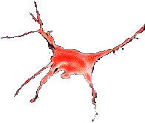
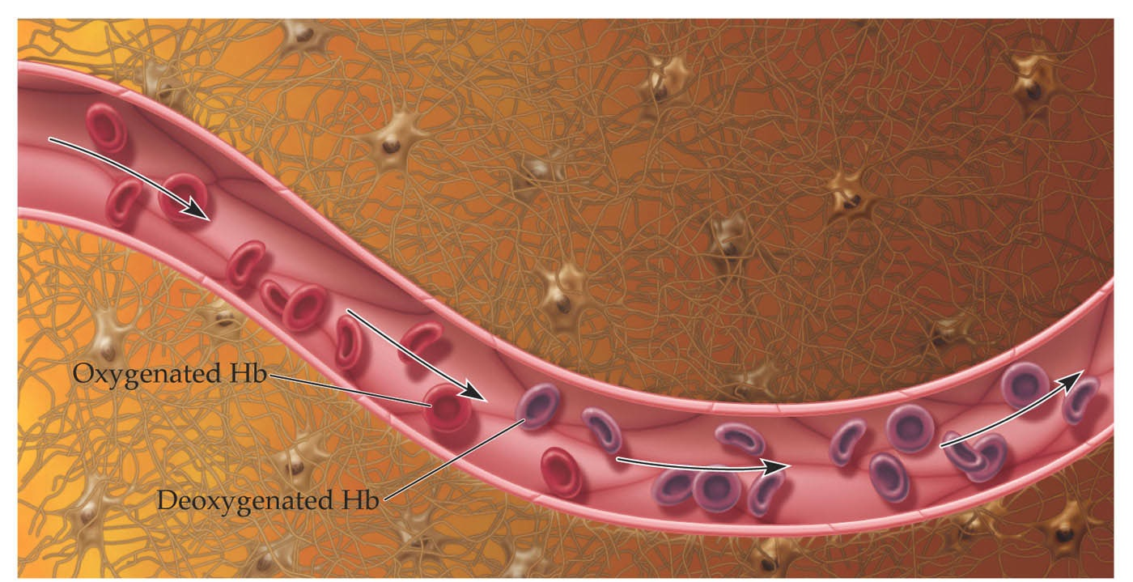
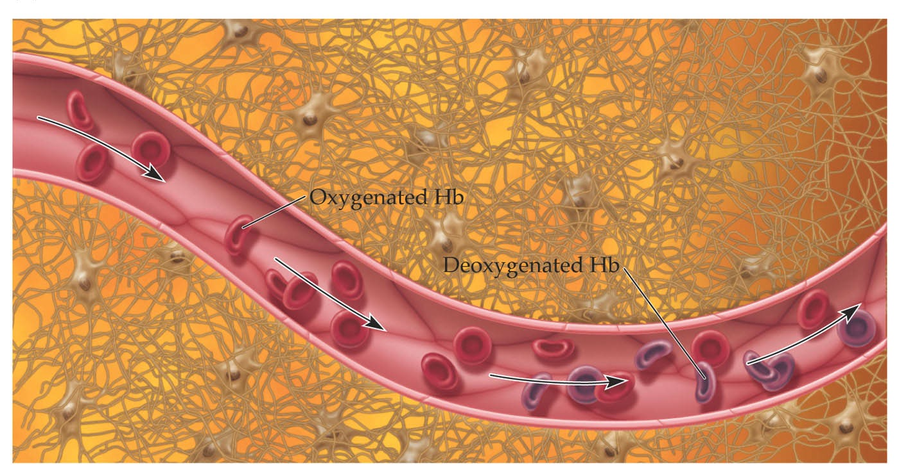
Physiology (BOLD Contrast)
Blood-Oxygenation-Level Dependent contrast
Oxy-Hb & deoxy-Hb have different magnetic properties
(see chapters 6&7)
Notes:
oxygenated blood stronger signal (diamagnetic, less perturbation of magnetic field) than deoxygenated blood (paramagnetic)!

Slide 46
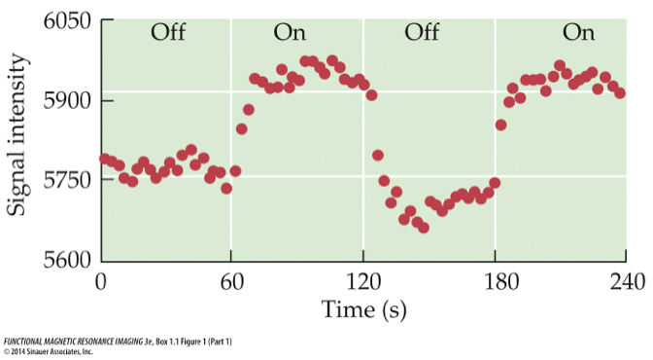
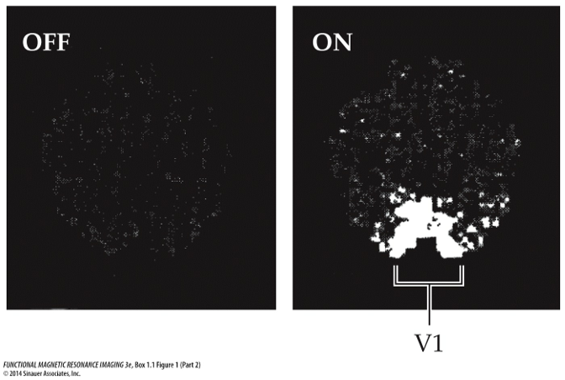
Using fMRI to Study Brain Function
Simple visual stimulation paradigm (Kwong et al., 1992)
→ functional changes over time!
Beginning of a success story…

Slide 47
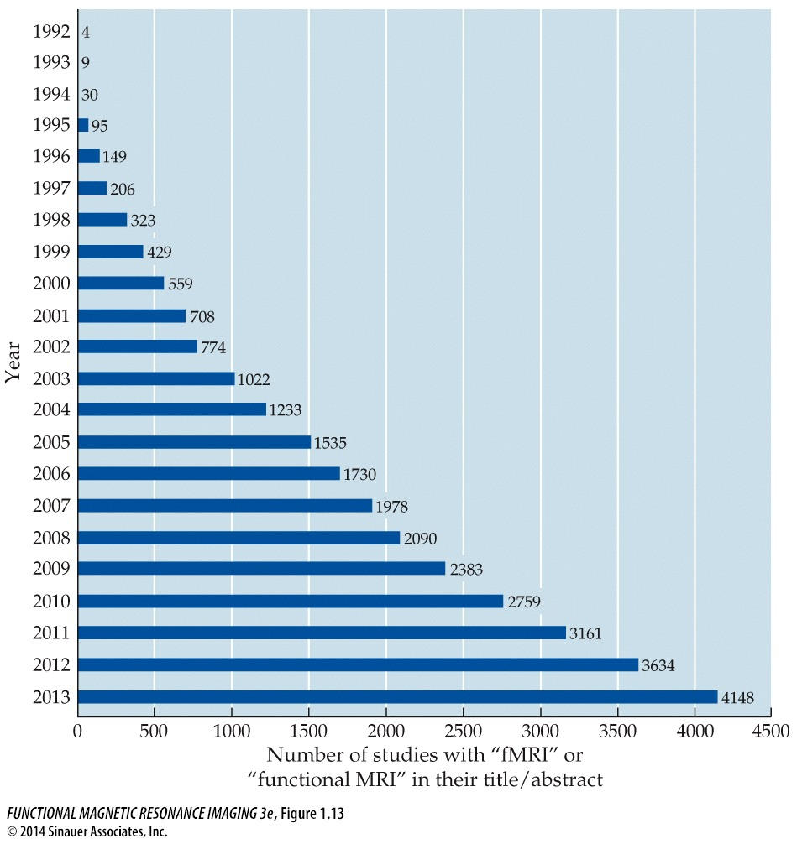
Growth in fMRI: Published Studies

Slide 48
4. MRI Scanners

Slide 49
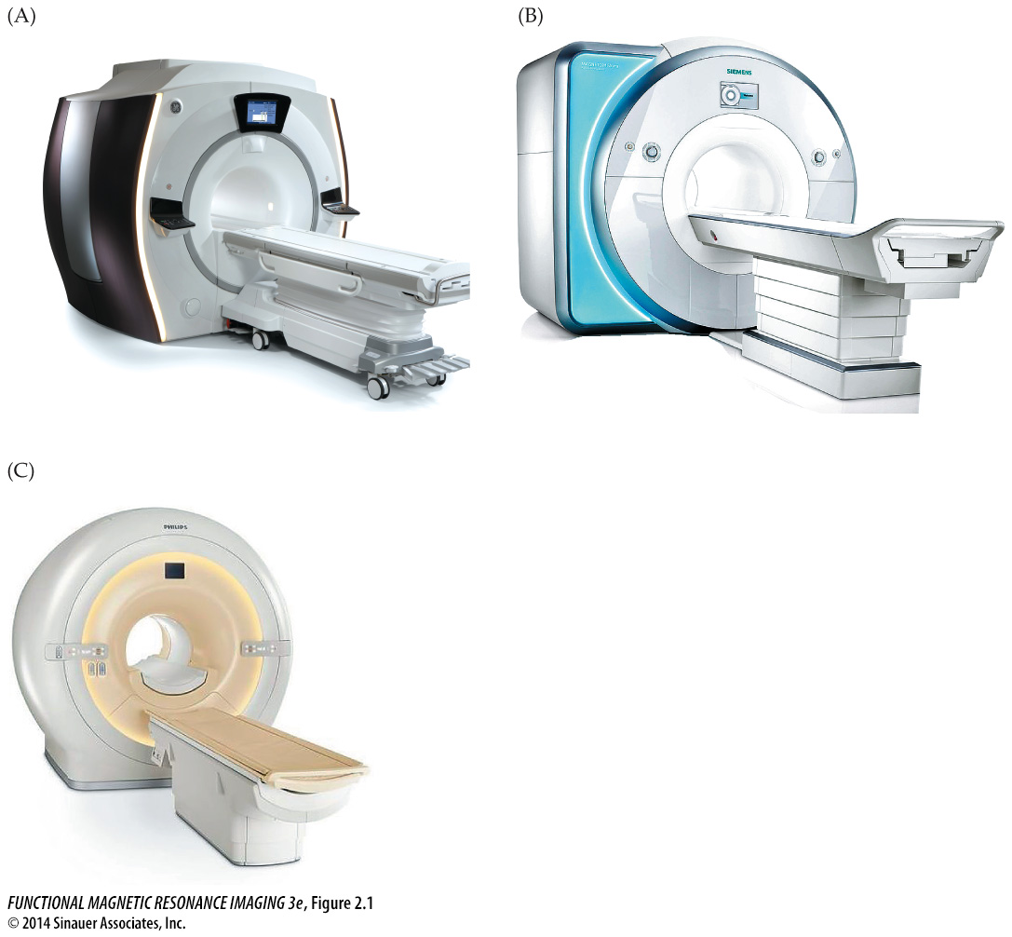
Slight variations - same principle
GE
Siemens
Philips

Slide 50
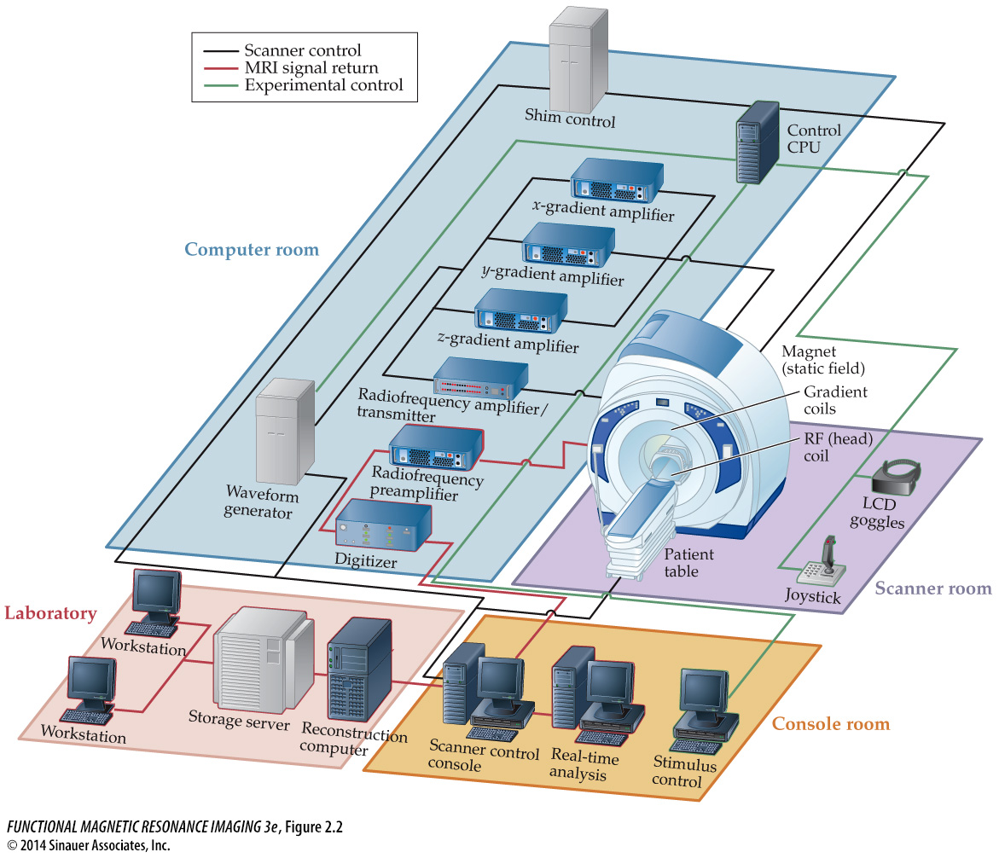
MRI scanner setup

Slide 51
Main Components of a Scanner
Magnetic: Static Magnetic Field Coils
Resonance: Radiofrequency Coil
Imaging: Gradient Magnetic Field Coils
Others:
Shimming Coils
Data transfer and storage computers
Physiological monitoring, stimulus presentation, and behavioral recording hardware

Slide 52
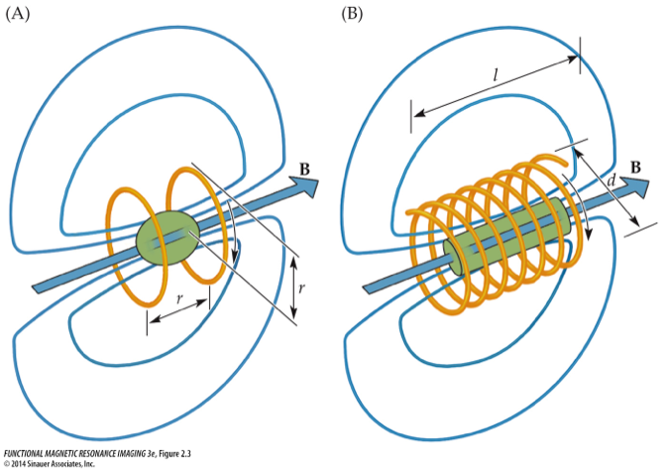
1. Magnetic: Static Field Coils
19th century: electrical current-carrying wire induces perpendicular magnetic field → Electromagnets
magnetic field strength is proportional to current strength
2 important aspects for MRI: homogeneity & field strength
Helmholtz pair
Solenoid
Area of max.
uniformity
if l >> d, highly homogeneous
B₀: Right-hand
thumb rule
Modern MRI:
Combination of both

Slide 53
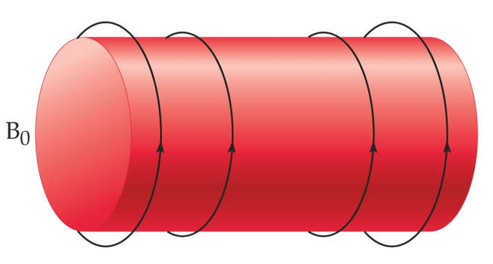
1. Magnetic: Static Field Coils
19th century: electrical current-carrying wire induces perpendicular magnetic field → Electromagnets
magnetic field strength is proportional to current strength
2 important aspects for MRI: homogeneity & field strength
MRI scanners contain dense parallel coilings of wires, which generate the large, static, main magnetic field (B₀, e.g. 3T).
The magnet is always on!!!

Slide 54
2. Resonance: Radiofrequency Coils
Strong magnetic field itself does not produce the MR signal!
instead: electromagnetic coils send & receive oscillating electromagnetic fields
at the resonant frequency of atomic nuclei
typically in radio frequency range (MHz) in large B₀’s
turned on very briefly!
Sequence of events:
atomic nuclei align with static magnetic field B₀
excitation at resonant frequency using radiofrequency coils
absorption of radiofrequency pulse energy by atomic nuclei
release of absorbed energy after cessation of RF pulse
emitted energy is received by RF coils
→ Raw MR signal!

Slide 55
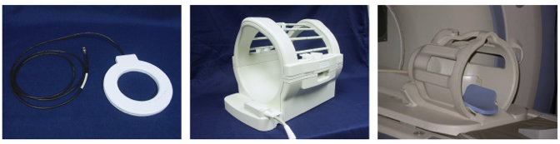
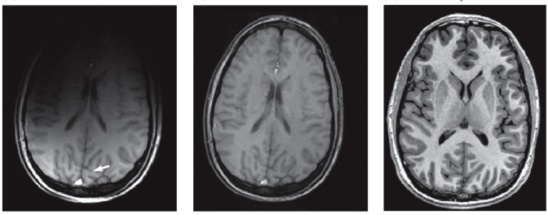
RF (Head) Coil Types
Surface Coil
Volume Coil
Phase-Array Coil
received signal intensity is inversely proportional to distance from object

Slide 56
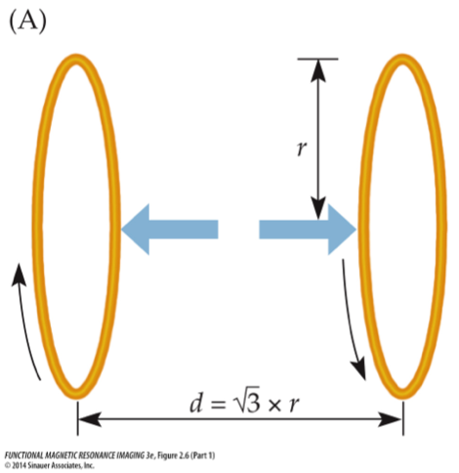
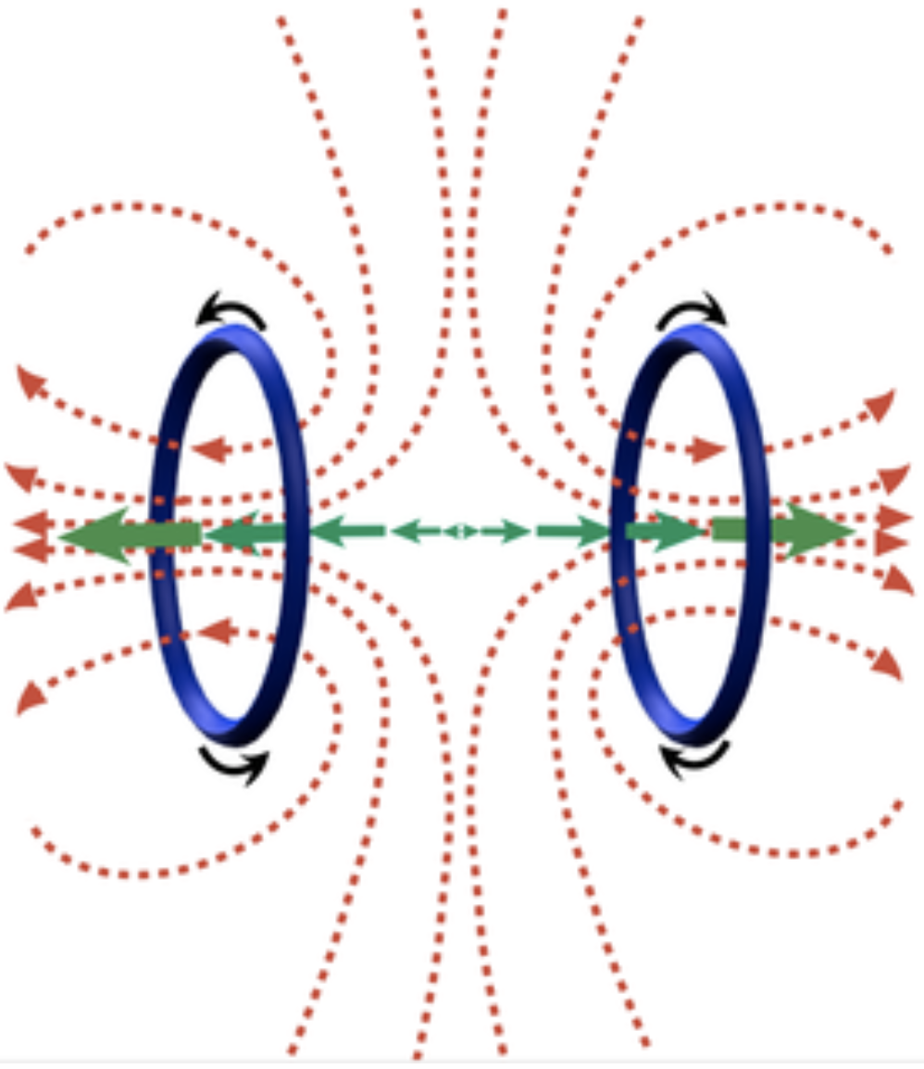

3. Imaging: Gradient Coils
3 Gradient coils produce orthogonal magnetic gradients in x, y, and z dimensions
z-Gradient (longitudinal gradient, along B₀):
Maxwell pair
z-gradient
Notes:
http://mri-q.com/how-do-z-gradients-work.html

Slide 57


x- & y-Gradient Coils
x- and y-gradients (transverse gradients)
produce gradients perpendicular to B₀ and z-Gradient
Golay pair
Golay pair
G_{y}
Notes:
http://mri-q.com/x--and-y--gradients.html

Slide 58


Gradient Coils
Gradient coils produce linear magnetic gradients
the resonance frequency of atomic nuclei depends on strength of external magnetic field
received RF signal becomes spatially dependent!
typically turned on briefly after RF pulse
Three gradient coils are used, one in each of the 3 cardinal axes relative to the main magnetic field B₀.
These allow the spatial encoding of the MR signal.

Slide 59
5. MRI Safety

Slide 60
MRI is a non-invasive technique
MRI itself is not harmful
the magnetic field strengths (1.5T, 3T) that are in common use today have no known long-term negative effects on biological tissues
it is therefore considered a ‘non-invasive’ technique
Erhard et al. (1995) study…
45% reported ‘unusual sensations’ in 4T scanner
(scanner had been powered down - no B₀!)

Slide 61
MRI safety - external objects
Hospital Nightmare
Boy, 6, Killed in Freak MRI Accident July 31, 2001 — A 6-year-old boy died after undergoing an MRI exam at a New York-area hospital when the machine's powerful magnetic field jerked a metal oxygen tank across the room, crushing the child's head. …
ABCNews.com

Slide 62

B0 in action

Slide 63
Component – Safety Concerns
Each main component of a scanner has a specific associated safety risk
Main Magnet
Projectile Effects
Translation
Torsion
Gradients
effect of a gradient is a function of: ΔB/Δt
gradient switching can generate small electric current (don’t cross hands/legs)
peripheral nerve stimulation
interfere with medical devices
RF coils
SAR (amount of electromagnetic energy absorbed by the body over time)
Tissue heating, burns
Metal wires – refocusing pulse

Slide 64


Safety questionnaire

Slide 65
Questions?

