Slide 1
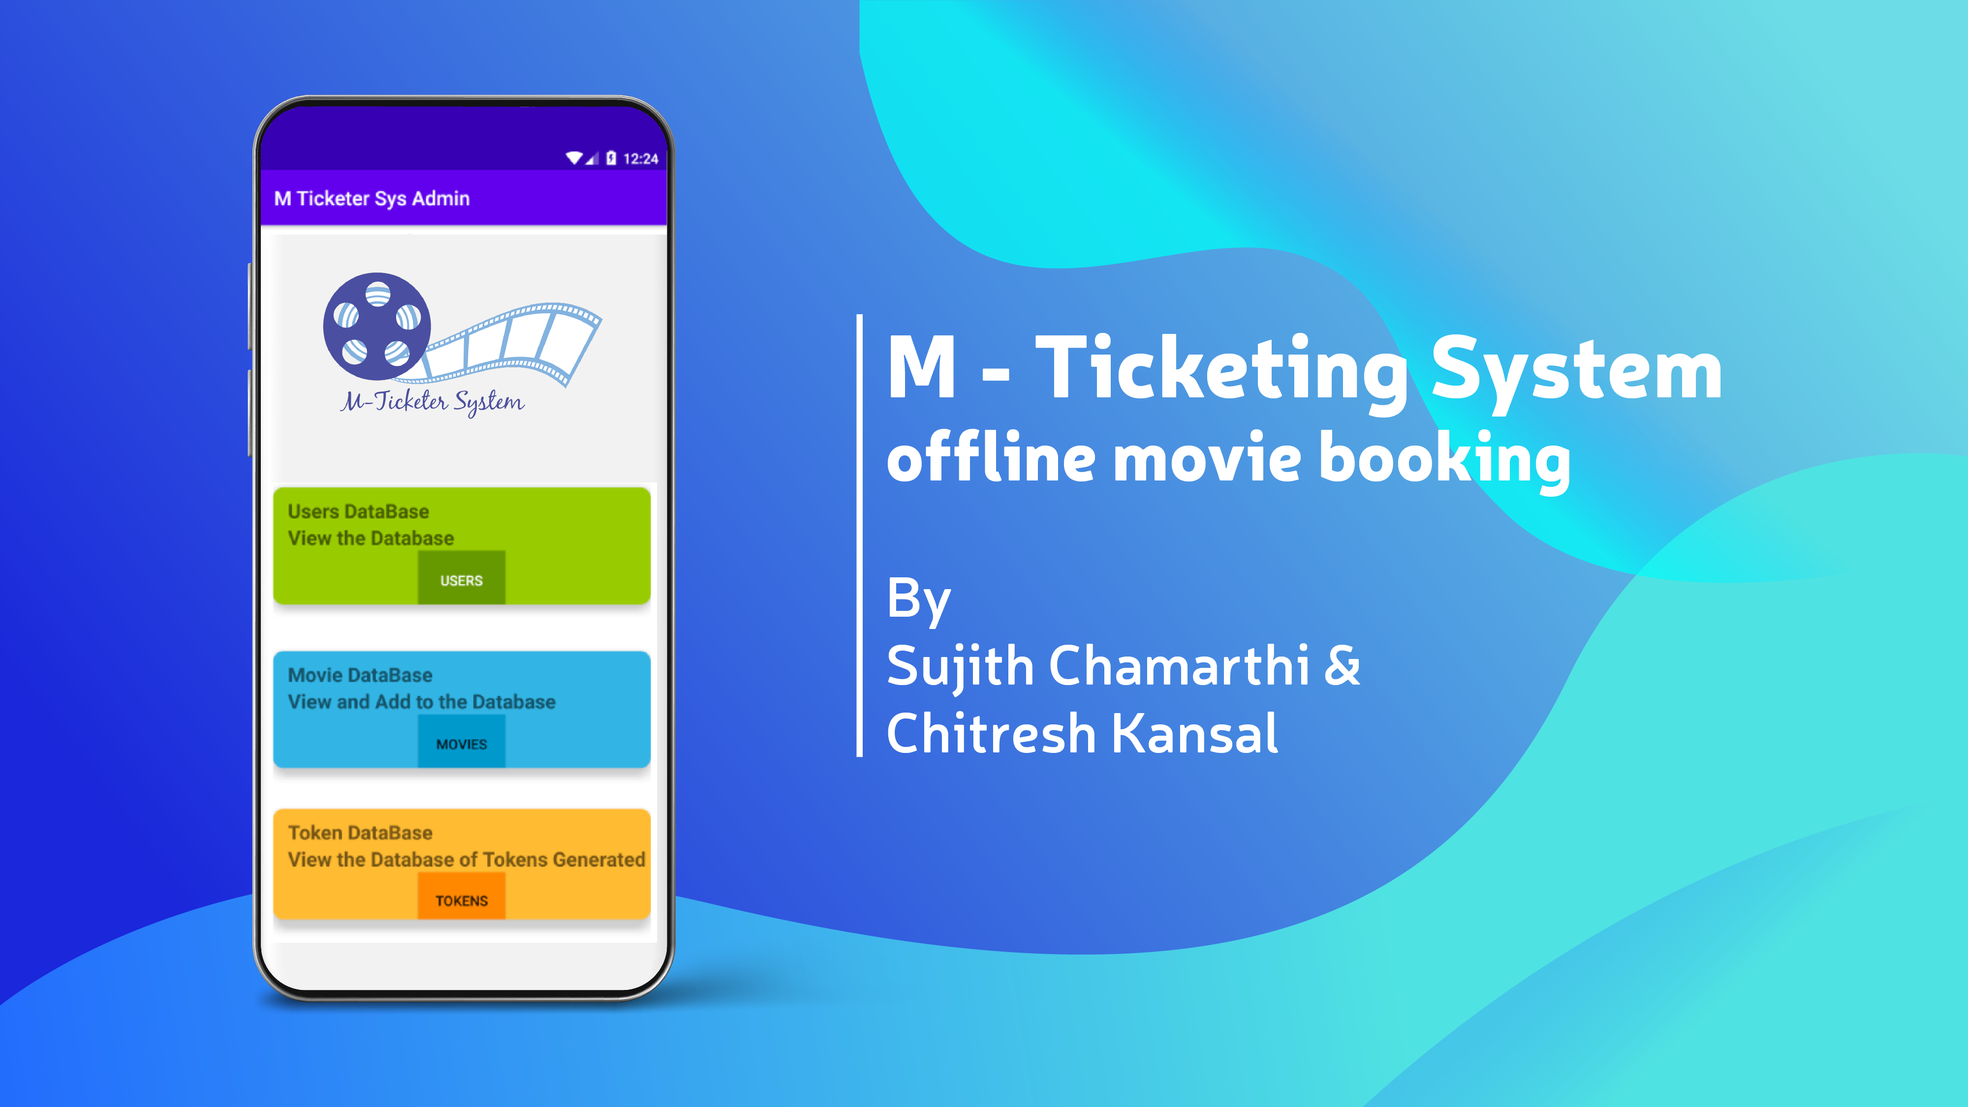

Slide 2

AIM
In the market several online movie ticket platforms exist but there is almost no offline booking platforms, there are many instances where users get inconsistent or no internet at times which prevents them from booking tickets we plan on capturing these users.
So, the aim of this project is to develop a ticketing system that allows users to book tickets remotely without the use of any internet connection.

Slide 3
Project Objective
An easy to use app that helps admin to manage the user info, theatre info.
A system in which user can request movie info, and additional services all through the default sms app.
A well defined token system where a unique token is generated after the successful booking which is shared to the theatre and user.

Slide 4
Motivation
There are still many places in the country that don’t get internet connection and the only way to reserve your movie tickets is to stand in big lines in front of the box office.
To eliminate this problem there should be no dependence on an active internet connection. The only other efficient way is through a message based system as it only requires a basic cell connection.

Slide 5






Admin App
Automatically detects msg from user
Checks if any incorrect format of msg is used and calls suitable database
Automated reply is sent back
Text Msg is received by the default messaging app,
This Broadcasts the msg to all apps .
Token Id & User
Info sent
Token Id or
Error msg Sent
Back
User DataBase
Movie DataBase
Token DataBase

Slide 6

It sends the user info
if user is new it registers the new user.
Else if already registered it returns the area code
User DataBase
Admin App
Return Area Code of User
The Movie Code and number of seats required are sent
Send Area Code of User
Return Movie data according to Area Code of User
If seats are less the msg request for updating number of seats is sent
It checks if User has sent correct Movie code and if it is in correct format.
If the format is incorrect the user is guided by sending a msg of correct format
If there is no error in msg and number of seats required are present
Movie code , User Id and number of seats is sent
Movie DataBase
if the msg sent by the user is of the correct format , then it is passed to the User DataBase
If not it sends error msg back to user
Movie code is sent and number of seats are updated in movie DataBase
Generated Token Id is sent to both user (with required instructions) and movie Theater
Token DataBase

Slide 7
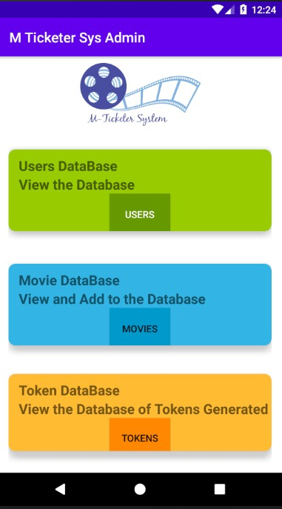
User DataBase
Movie DataBase
Token DataBase

Slide 8
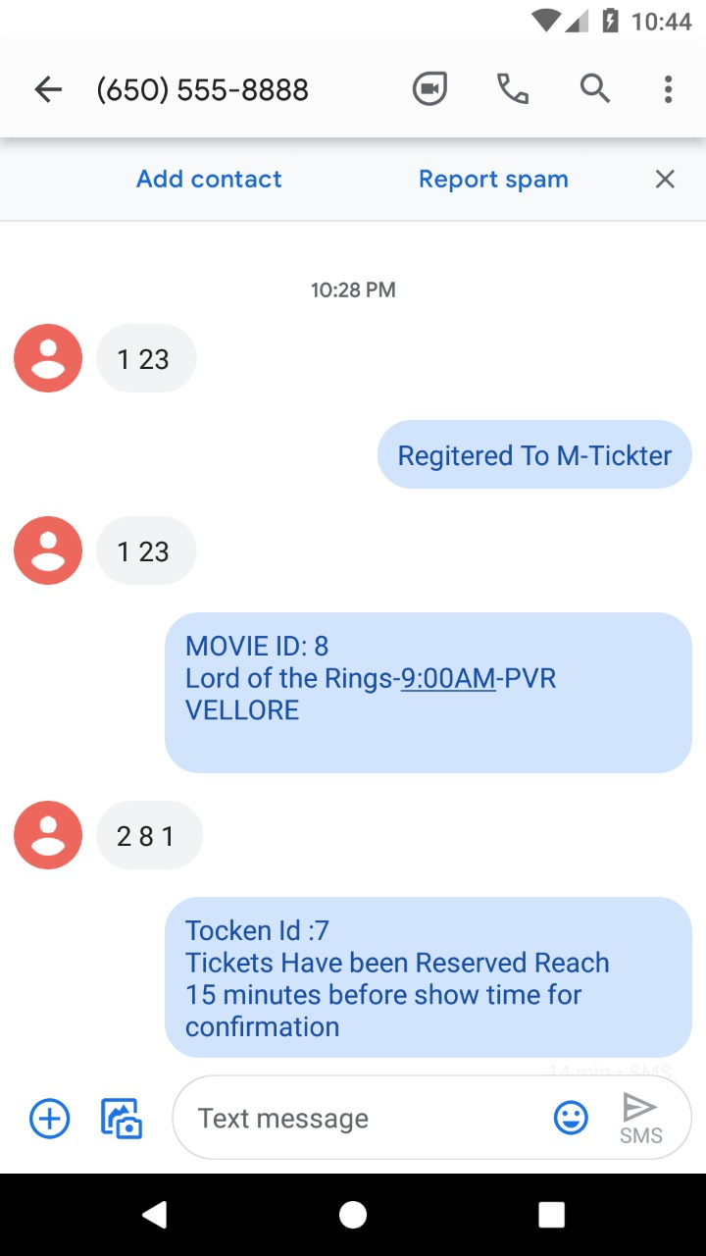
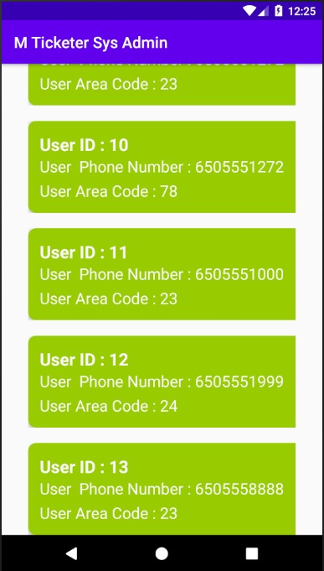
User Database
Saving new data in
Database

Slide 9
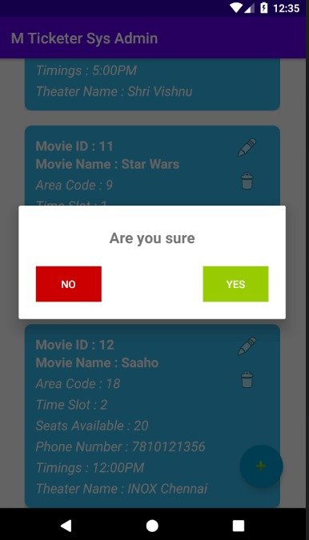
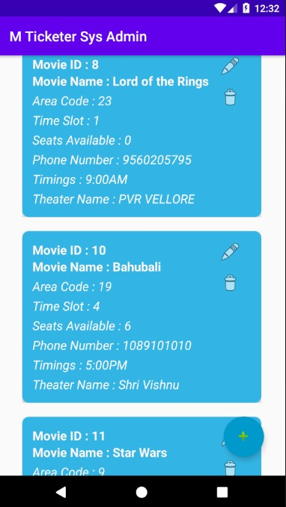
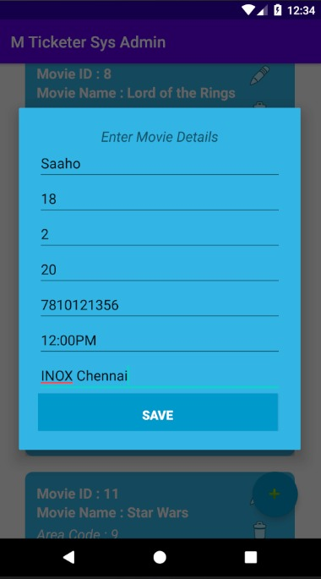
Movie DataBase
Deletion
Addition of details

Slide 10
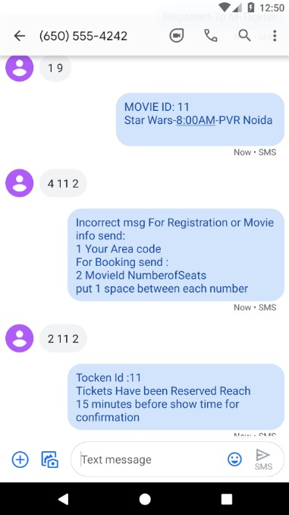
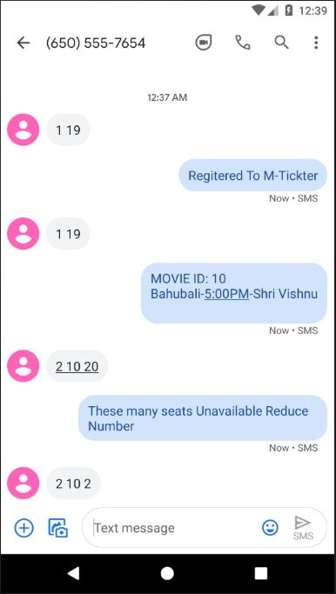
Error msg sent to user for
sending wrong code or format
Error msg due to unavailability
Of seats

Slide 11
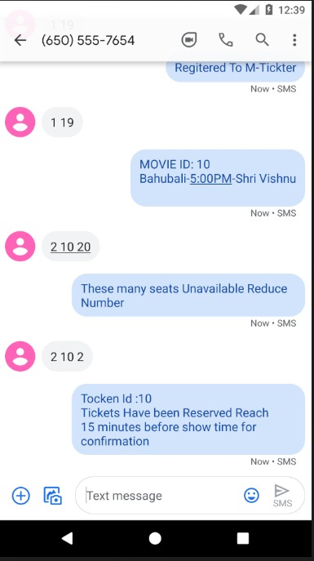
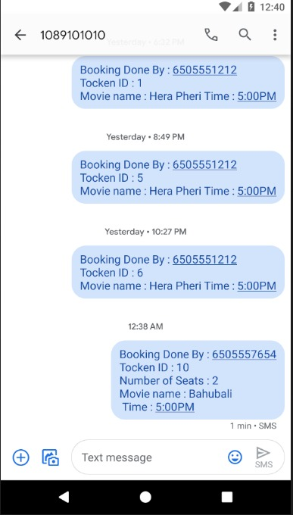
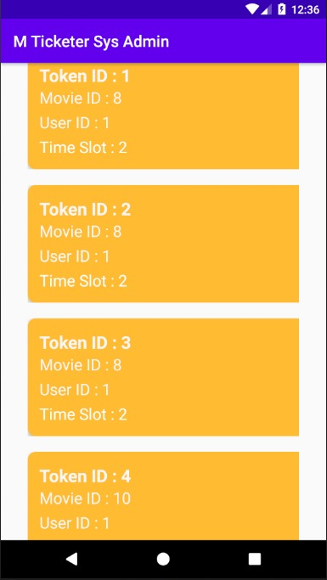
Ticket successfully booked
By user
Ticket confirmation sent to
Movie theatre
Token DataBase

Slide 12
Conclusion
There are still many places in the country where there is no 3G/4G services even if there is ,it is sometimes limited by its speed. So, there is some unmet demand for a ticketing system that has the potential to reach remote corners of the country. This potential can be realized, through M-Ticketer system, the SMS based mobile ticketing system. It is an innovation that clearly dominates its rivals on virtually all dimensions. It is faster and most importantly network independent. It has been designed in a very user friendly way. In developing markets, M-ticketer will allow people to use ticket booking services in a more efficient way and sometimes the only way.

Slide 13
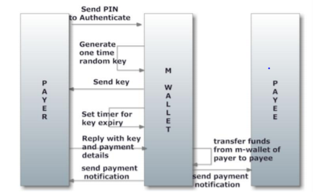
Future development
Payment is a major problem when it comes to offline mode of ticket booking. So, in the future we intend to implement an SMS based payment system.
M-Wallet will be integrated in the existing m-ticker system. It provides a mobile payment system that will be available on all mobile devices that support basic features like text messaging, yet be secure from spoofing of mobile numbers and replay attacks. M-Wallet transactions are totally based on text messages and provide mobile apps only for added convenience. A user specified PIN allows only authorized access. Mobile number spoofing and replay attacks is eliminated as each transaction is protected with a unique one time key sent to the user’s registered mobile number.

