Slide 1
GTL RALLY GPS APPLICATION· APPLICATION OVERVIEW FOR FIA REVIEW
RALLY GPS
Supplementary live tracking and stage-flag safety tool
for the Cyprus Rally organiser and race control.
PREPARED FOR
EVENT
DOCUMENT DATE
STATUS
FIA/NATIONAL — event safety / operations review
Cyprus Rally
September 2026
Software application briefing
1 / 15

Slide 2
01 / PURPOSE
Purpose and scope
WHAT RALLY GPS IS
• Live GPS from competing crews’ smartphones to race control.
• Authenticated HQ map, plus Google Earth Pro live KML.
• Per-event KMZ: road, special stages, and control pins.
• GREEN FLAG / RED FLAG for cars currently on that special stage.
• Stopped-crew OK / SOS confirmation on stage.
2 / 15

Slide 3
02 / ARCHITECTURE
System overview
1 DRIVER DEVICE
2 RALLY GPS SERVER
3 RACE CONTROL HQ
4 GOOGLE EARTH PRO
• Android application or HTTPS web page.
• Sends GPS and crew actions (OK / SOS / flag ack).
• Receives live fixes and offline batches.
• Binds each car to the LIVE rally KMZ.
• Stores flags and SOS.
• Authenticated dashboard.
• Full-screen map beside sidebar.
• Cars as numbers; stage flags.
• Network Link KML.
• Refresh every 2 seconds.
• Same live rally feed.
REFRESH AND LIVE STATE
• HQ map polls cars about every 2 seconds. Driver devices poll stage-flag state about every 2 seconds (web) or 2 seconds (Android).
• A car is LIVE while tracking and a fix has been received within 3 minutes; otherwise HQ shows last GPS / no signal.
3 / 15

Slide 4
03 / EVENT DATA
Rally and route binding
NAMED EVENT
LIFECYCLE
ONE LIVE RALLY
• HQ creates a rally with name and dates.
• Cyprus Rally is a distinct event, not a global route.
• draft → LIVE → ended.
• Cars are drawn on the map only while a rally is LIVE.
• Going live snapshots and ends any other live rally.
• HQ is bound to a single course.
PER-RALLY KMZ
GO LIVE AGAIN
CLEAR / REPLACE
• KMZ/KML is uploaded for the selected rally only.
• Other events keep their own roads, stages, and pins.
• An ended rally can be set live again to review the stored snapshot.
• HQ can clear or replace that rally’s route without affecting other events.
4 / 15

Slide 5
04 / TRACKING
Live tracking and car display
RACE CONTROL MAP
MARKER COLOUR
• Cars appear as competition numbers (no live trail clutter).
• Click a number: name, motion, speed (km/h), section, OK/SOS.
• Green = moving (~4 km/h+); blue = stopped; red = SOS.
• List: LIVE · NO SIGNAL / LAST GPS · STOPPED.
• Trails are not drawn live by default; HQ may show one route or download GPX.
• “Refresh lost cars” holds last GPS and requests reconnect.
• Green — moving (speed above ~1.2 m/s / ~4 km/h).
• Blue — on course but not moving.
• Red — crew has declared RED SOS.
GOOGLE EARTH PRO
• HQ downloads a session-bound Network Link KML.
• Earth refreshes every 2 seconds. Route colours: blue road, red stage.
5 / 15

Slide 6
05 / ROUTE
Stages, road sections, and time controls
KMZ COLOUR RULE
PLACEMARKS
HQ TABS
• Red line = special stage.
• Blue line = road / liaison.
• HQ can reclassify a path after upload.
• TC, Start, Finish, Stop, Refueling.
• Google Earth-style icons on the map and live KML.
• Optional PNG replace per icon type, per rally.
• All · Stages · Road · Time controls.
• Counts shown per tab.
• Click a section to fit it on the map.
HOW A CAR IS BOUND TO A SECTION
• The server matches the latest GPS fix to the LIVE rally KMZ.
• Special stage if within about 80 m of a stage line (or inside a stage polygon); road if within about 120 m. If both are close, the stage wins.
• The driver screen shows that KMZ stage name and switches to stage mode. This is KMZ proximity, not an official start/finish beam.
Rally GPS · Cyprus Rally · For FIA review
6 / 15

Slide 7
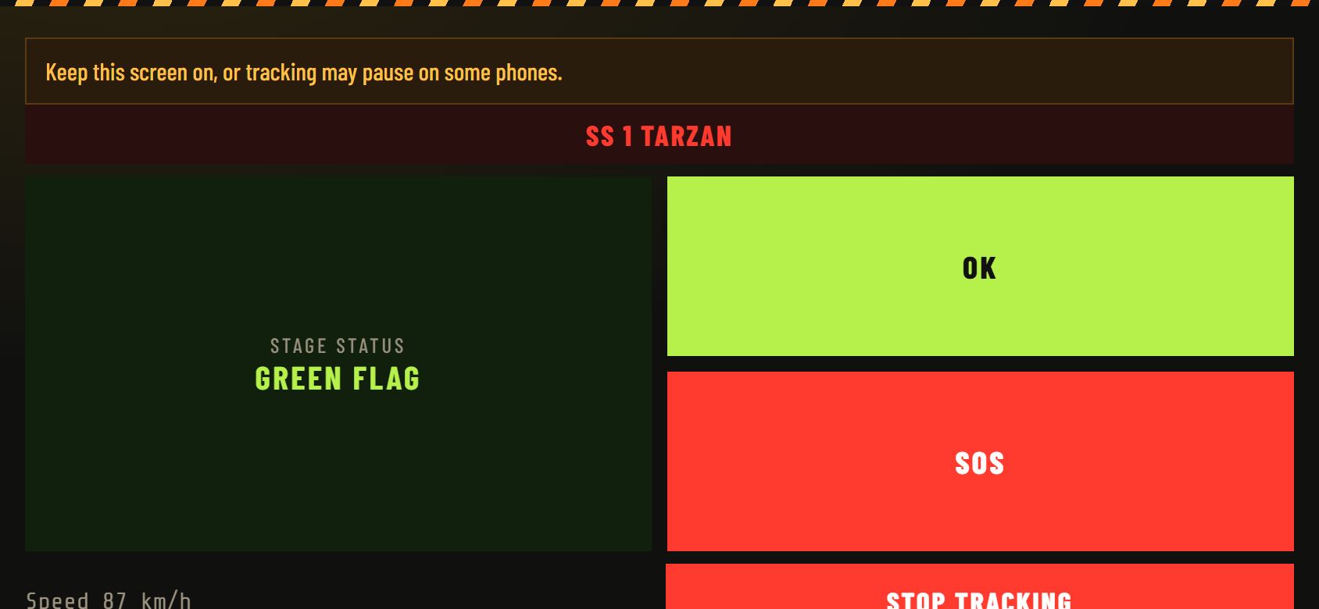
06 / DRIVER
Stage mode — GREEN FLAG
ON-STAGE DISPLAY
• Stage name from the event KMZ.
• STAGE STATUS: GREEN FLAG while that stage is not red-flagged.
• Large OK and SOS controls.
• Speed readout.
• Stop tracking remains available.
• Web driver: keep the screen on unless the Android application is used.
Rally GPS · Cyprus Rally · For FIA review
7 / 15

Slide 8
07 / SAFETY
RED FLAG procedure
1 HQ
2 SERVER
• On the Stages list, race control sets Red flag for that special stage only. Roads cannot be red-flagged.
• The flag and a timestamp are stored on that stage. Only cars currently detected on that stage inherit RED FLAG.
3 CARS
4 CREW
• Devices receive flag state on GPS ping and on poll (web ~2 s, Android ~2 s) when connected.
• Those cars get a full-screen RED FLAG, looping alarm, and must tap OK / CONFIRMED.
5 HQ
6 CLEAR
• The car list shows RED FLAG WAITING until acknowledgement, then RED FLAG ACKED.
• Green flag returns the stage to normal. A later red flag is a new event (new timestamp).
Rally GPS · Cyprus Rally · For FIA review
8 / 15

Slide 9
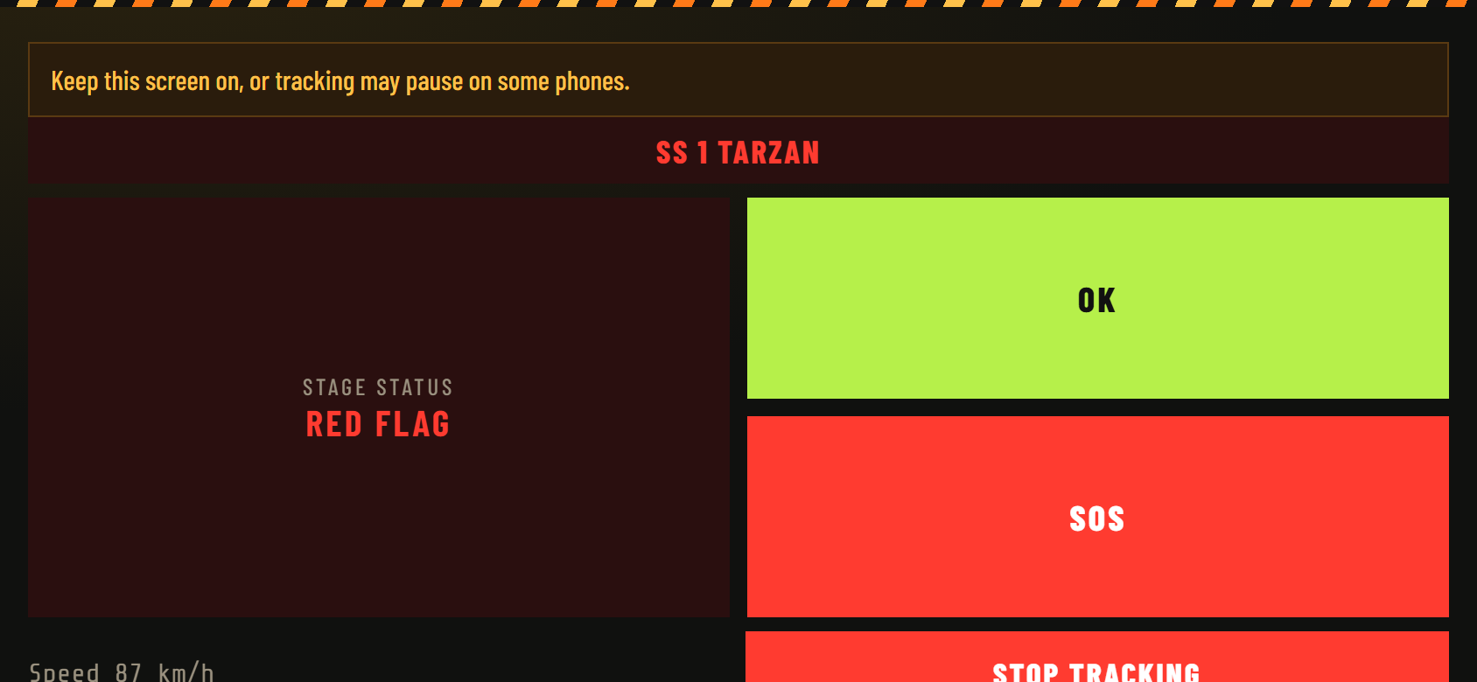

08 / CREW CONFIRMATION
RED FLAG — display and acknowledgement
Stage panel after HQ red-flags that stage.
Full-screen alert until OK / CONFIRMED.
CREW-FACING BEHAVIOUR (AS IMPLEMENTED)
• Full-screen RED FLAG overlay with flashing treatment and a looping alarm. Message: “Stage stopped. Confirm the crew has seen this red flag.”
• Shown only to cars currently ON that red-flagged special stage, until they acknowledge. After ack, the panel stays RED FLAG while HQ keeps the stage red.
• If the device is offline, the flag arrives on the next successful poll/ping; GPS continues to queue locally.
Rally GPS · Cyprus Rally · For FIA review
9 / 15

Slide 10
09 / SAFETY
Stopped-crew and SOS procedure
AUTOMATIC PROMPT ON STAGE
WHAT RACE CONTROL SEES
• On a special stage, if speed stays below ~4 km/h for more than 20 seconds, STOPPED ON STAGE appears.
• GREEN OK — both crew OK. RED SOS — need help.
• Manual OK / SOS are also available in stage mode.
• An unacknowledged RED FLAG overlay takes priority over this prompt.
• GREEN OK or RED SOS on the car list.
• SOS forces the map marker red.
• Crew status is tied to the current stage and clears when the car leaves it.
• This does not replace official SOS boards, radio, medical, or rescue.
Rally GPS · Cyprus Rally · For FIA review
10 / 15

