Slide 1
Comparative effectiveness of ACE inhibitors vs. angiotensin receptor blockers to prevent or delay dementia: a target trial emulation using US electronic health records
Causal inference workshop Marie-Laure Charpignon June 10, 2026
Notes:
Good morning everyone! My name is Marie. I recently started as a junior professor chair in the PEPITES team led by Professor Florence Tubach.
Today, I would like to share with you about two applications of causal inference in clinical medicine and public health.
This first presentation is about the comparative effectiveness of hypertension medications for dementia prevention and an application of the target trial emulation framework using electronic health records data from the United States.
Let us aim for a 50-min overview, after which I’d appreciate hearing from you and discussing more together!
Feel free to interrupt at any time.

Slide 2
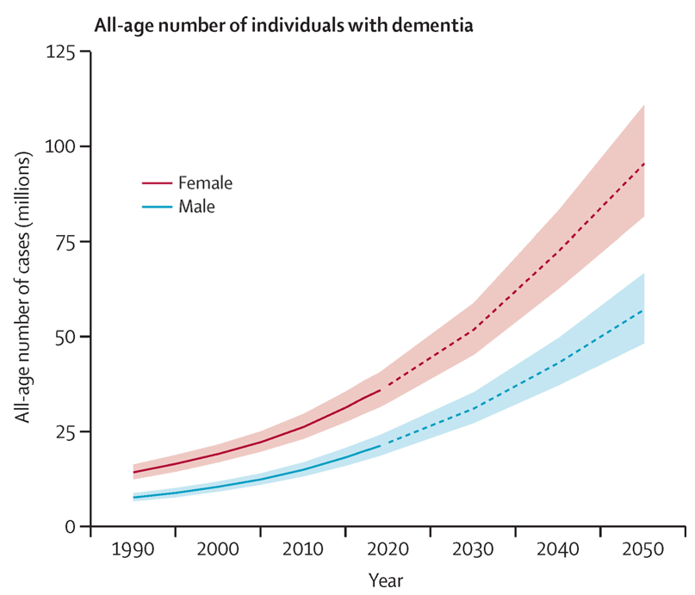
Motivation: the growing burden of dementia
55 million people affected by dementia globally.
Expected increase of 1.4-fold by 2030 and 2.5-fold by 2050.
Modest cognitive benefits of Leqembi, but serious risks (e.g., >10% brain edema or hemorrhage).
Sources: 2022 Alzheimer's disease facts and figures, Global Burden of Disease Study 2019, van Dyck et al. (NEJM, 2022)
Notes:
This research is motivated by the global burden of dementia.
Over 55 million people worldwide are currently affected, and this number will more than double by 2050.
Although the recent release of Leqembi by Eisai and Biogen brings some hope, the cognitive benefits after 18 months of treatment are modest and adverse effects are substantial.

Slide 3
Leqembi targets primarily patients with early-stage Alzheimer’s disease, but what about delaying the onset of dementia?
Notes:
Moreover, Leqembi targets primarily patients with early-stage Alzheimer’s disease, so what if instead we are interested in delaying the onset of dementia?

Slide 4
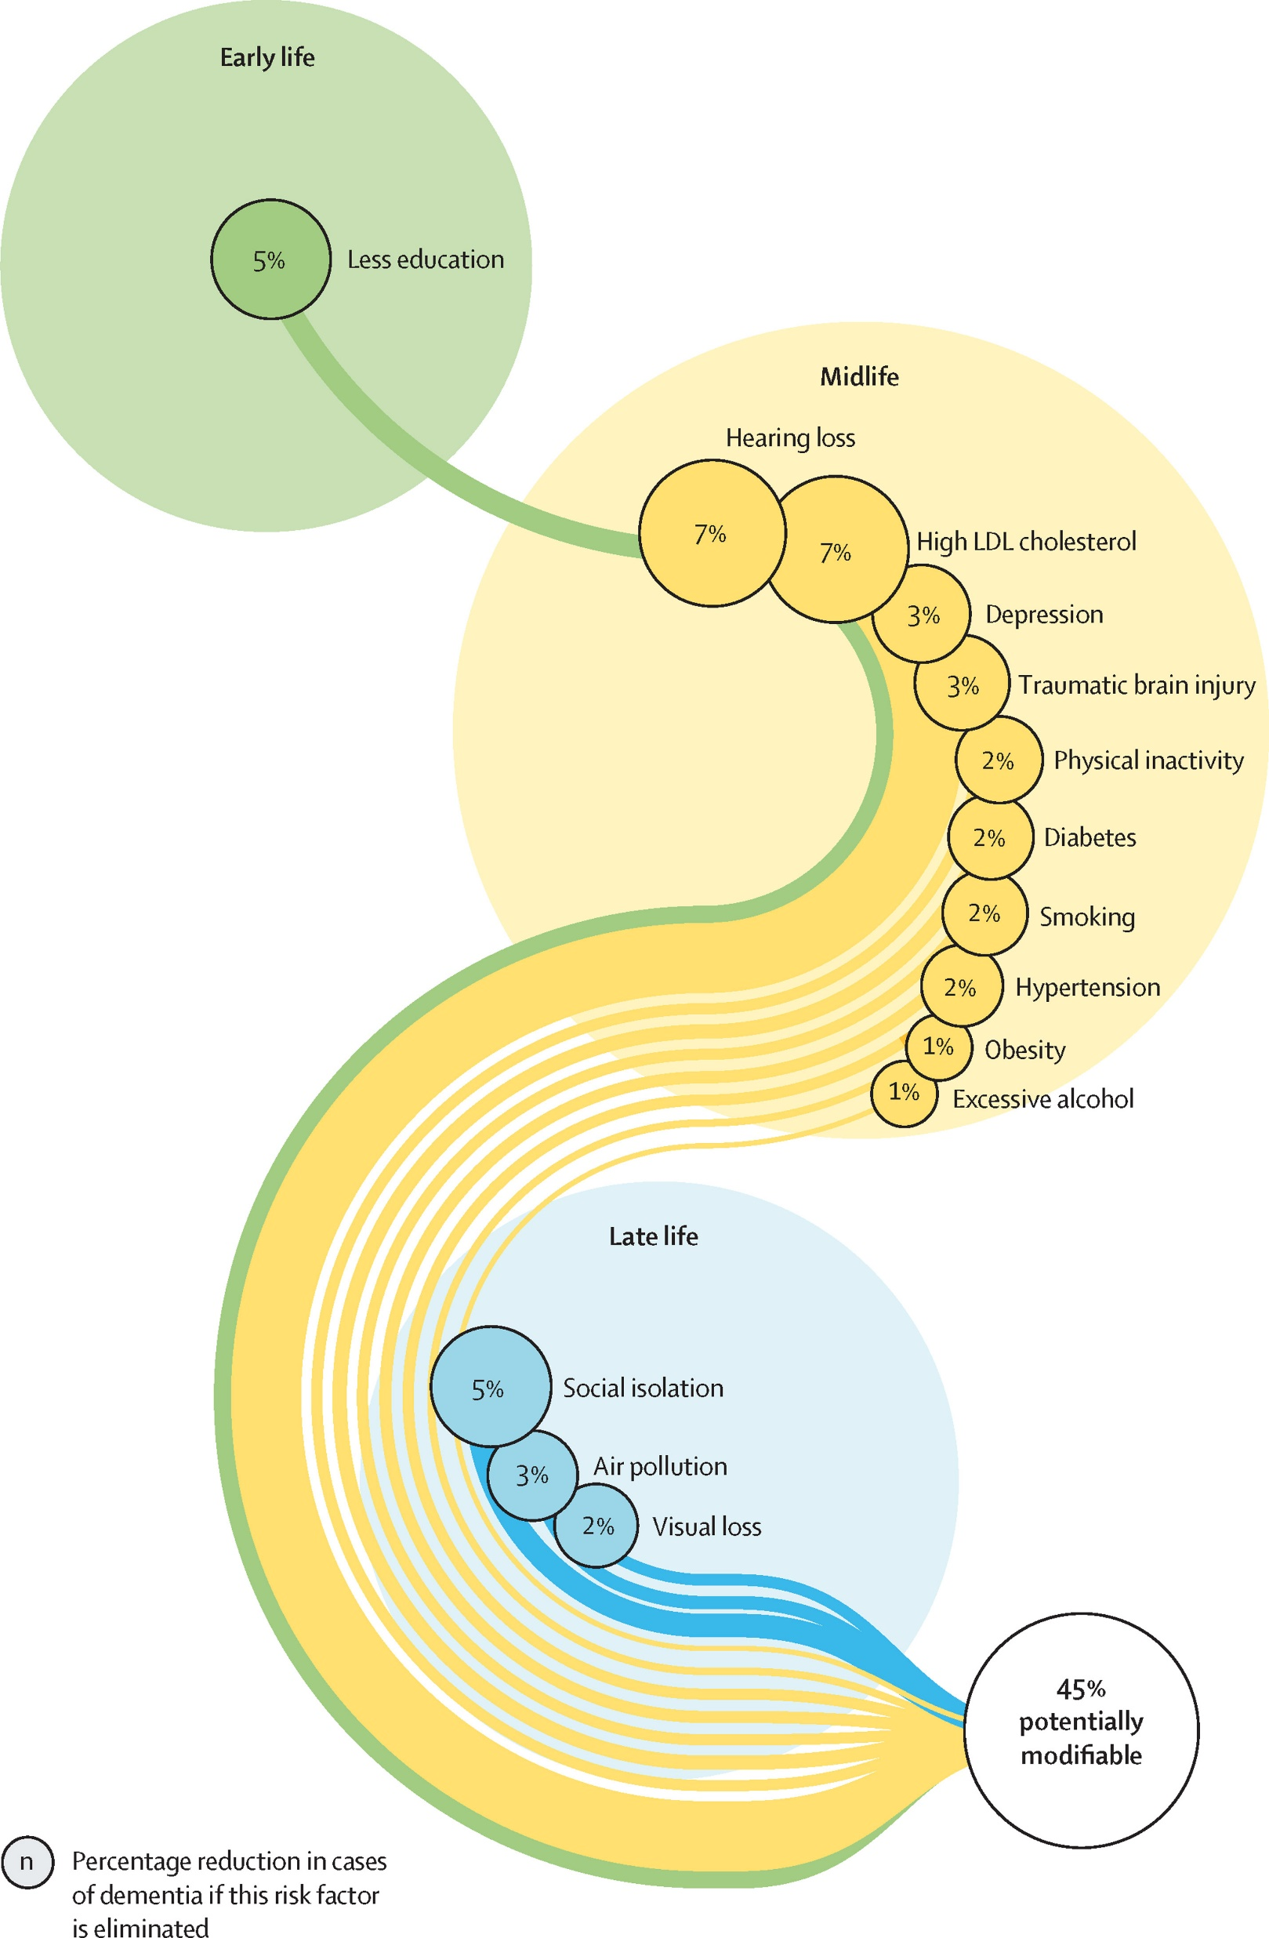
Hypertension: an opportunity for drug repurposing against dementia
45% of dementia risk attributable to modifiable risk factors.
For 5 out of 14 modifiable risk factors, pharmaceutical interventions are available:
Hypertension (2%)
High LDL cholesterol (7%)
Depression (3%)
Type 2 diabetes (2%)
Obesity (1%)
Hypertension
Affects 45% of the US adult population aged 18+
Associated with a 42% higher risk of dementia if untreated and 13% if treated
Sources: Lennon et al. (JAMA Network Open, 2023), Cholerton et al. (Diabetes Spectrum, 2016)
Notes:
To address this question, the decomposition of dementia risk over the life course – from early life, to midlife, to late life – can be helpful. In particular to identify opportunities to repurpose existing drugs that could delay or prevent dementia.
To date, 45% of dementia risk has been attributed to modifiable risk factors. 5 out of 14 factors map to pharmaceutical interventions – including hypercholesterolemia, depression, type 2 diabetes, obesity, and hypertension.
Hypertension, specifically, affects 45% of US adults. It is associated with a 42% higher risk of dementia if untreated and still 13% if treated, relative to healthy controls.

Slide 5
Could certain antihypertensives have the added benefit of delaying the onset of dementia?
Notes:
Given this decomposition, you may wonder whether all antihypertensives are equal or whether some may have the added benefit of delaying the onset of dementia?

Slide 6

Notes:
Back in 2022, a group in the UK conducted a Mendelian randomization interrogating the role of the ACE gene, which has long been implicated in Alzheimer’s disease – a subtype of dementia.

Slide 7
Step 1 Mine genetic epidemiology studies to identify gene variants related to dementia risk
Mendelian randomization of the ACE gene
Association | Directionality | Relation
ACE expression vs SBP | + | ACE ~ SBP
ACE expression vs AD risk | - | ACE ~ AD
Predicted SBP vs AD risk
Co-localization analyses identified a gene variant for three traits (chr. 17, rs4291).
Directionality of the associations:
Lower ACE expression, lower SBP
Lower ACE, higher risk of AD
No association btw predicted SBP and AD risk
7
Notes:
The authors identified a gene variant common to three traits: (1) expression of ACE in the cerebral cortex, (2) systolic blood pressure, and (3) AD risk.
Lower ACE expression was associated with lower SBP, but it was also associated with a greater risk of AD.
However, when the authors used other gene variants – from previous Genome-Wide Association Studies – to predict blood pressure, they did not find any association with AD risk.

Slide 8
Step 1 Mine genetic epidemiology studies to identify gene variants related to dementia risk
Mendelian randomization of the ACE gene
Association | Directionality | Relation
ACE expression vs SBP | + | ACE ~ SBP
ACE expression vs AD risk | - | ACE ~ AD
Predicted SBP vs AD risk
Co-localization analyses identified a gene variant for three traits (chr. 17, rs4291).
Directionality of the associations points to a possibly direct, rather than mediated, link between ACE and AD.
8
Notes:
This result suggests that there might be a direct relation between cortical ACE expression and AD risk, one that is not mediated by the control of blood pressure.

Slide 9


Variant of the ACE gene: chr. 17, rs4291
Drug class mimicking the effect of this variant: ACE inhibitors
Notes:
Now, to go from genetics to pharmacoepidemiology, the next logical step was to find a drug class that would mimic the effect of this gene variant – namely, ACE inhibitors.

Slide 10

How to emulate a target trial, using medical records, to interrogate the hypothesis that ACEi initiation may have a detrimental effect on dementia?
10
Notes:
To interrogate the hypothesis that ACE inhibitors may have a detrimental effect on dementia, I emulated a target trial using medical records. For this, we first needed to find an active comparator – i.e., another drug class used to treat hypertension that could serve as a control arm because using a placebo arm would not be clinically meaningful and could introduce confounding bias.

Slide 11
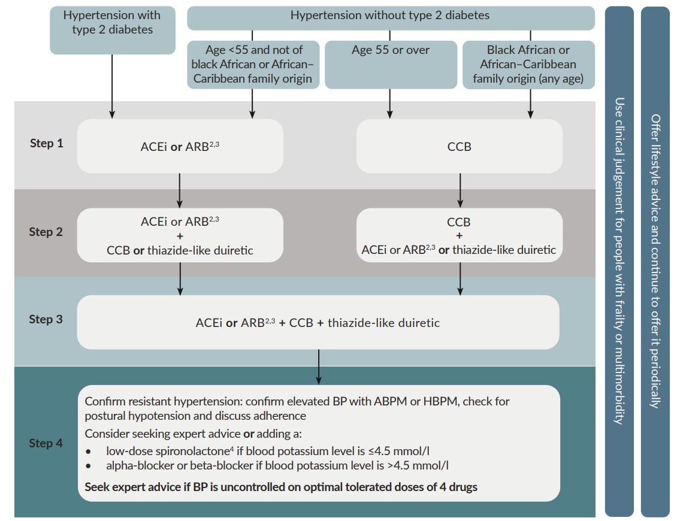
Step 2
Derive a relevant, active comparator drug (class) from clinical guidelines
Choice of antihypertensive drug
Source: NICE hypertension guidelines (2019)
11
Notes:
For this, I used clinical prescription guidelines and talked with General Practitioners and cardiologists to identify a recommended alternative to the class of ACE inhibitors.

Slide 12
Step 2
Derive a relevant, active comparator drug (class) from clinical guidelines
Choice of antihypertensive drug
Angiotensin receptor blockers (ARB) appear as a natural active comparator for ACE inhibitors.
Source: NICE hypertension guidelines (2019)
12
Notes:
When looking at the decision tree that underlies prescribing choices, Angiotensin Receptor Blockers or ARBs, in short, appear as a natural alternative treatment, among patients with underlying type 2 diabetes or patients diagnosed with hypertension before age 55 who are not of Black origin.

Slide 13
Step 2
Derive a relevant, active comparator drug (class) from clinical guidelines
Choice of antihypertensive drug
Angiotensin receptor blockers (ARB) appear as a natural active comparator for ACE inhibitors.
These two drug classes involve distinct mechanisms of action, making their comparison biologically relevant.
Source: NICE hypertension guidelines (2019)
13
Notes:
Because these two drug classes involve distinct mechanisms of action (namely, inhibition vs. receptor blocking), it is relevant not only clinically but also biologically to emulate a trial contrasting the two arms.

Slide 14
Causal question of interest
Step 3
Emulate a target trial using EHR data
What is the effect of initiating an ACEi rather than an ARB on memory loss, mild cognitive impairment, or dementia among hypertensive adults aged 50 and over?
14
Notes:
Given this motivation, we formulated our causal question as follows: “What is the effect of receiving an initial prescription for an ACEi rather than an ARB on memory loss, mild cognitive impairment, or dementia among hypertensive adults aged 50 and over?” Here, I chose a composite outcome because of delays in MCI/dementia diagnosis and heterogeneity in disease recording across patients.

Slide 15
ACEi vs. ARB target trial specification & emulation
The target trial protocol comprises 7 components:
Eligibility criteria
Treatment strategies
Treatment assignment
Outcome definition
Follow-up definition
Causal contrasts
Statistical analysis
15
Notes:
To answer this causal question, we then specify the protocol of a hypothetical target trial, which includes 7 key components.

Slide 16
ACEi vs. ARB target trial specification & emulation
The hypothetical target trial includes 6 main inclusion/exclusion criteria:
Age 50 or over.
No prior outpatient prescription of any ACEi or ARB.
Prior diagnosis of hypertension.
No prior diagnosis of dementia in any setting.
No prior prescription of any dementia-related drugs in any setting.
Prior history of 1+ year within the EHR system.
Eligibility criteria
Treatment strategies
Treatment assignment
Outcome definition
Follow-up definition
Causal contrasts
Statistical analysis
16
Notes:
The first consists in specifying trial eligibility criteria.
In our case, 6 main inclusion/exclusion criteria were considered. Let me highlight 3 for you.

Slide 17
ACEi vs. ARB target trial specification & emulation
The hypothetical target trial includes 6 main inclusion/exclusion criteria:
Age 50 or over.
No prior outpatient prescription of any ACEi or ARB.
Prior diagnosis of hypertension.
No prior diagnosis of dementia in any setting.
No prior prescription of any dementia-related drugs in any setting.
Prior history of 1+ year within the EHR system.
Eligibility criteria
Treatment strategies
Treatment assignment
Outcome definition
Follow-up definition
Causal contrasts
Statistical analysis
17
Notes:
We focused on patients aged 50 and over at baseline to target the preclinical phase of MCI/dementia.
We required a prior diagnosis of hypertension to limit confounding by indication because ACE inhibitors can also be prescribed for heart failure.
And finally, we imposed at least 12 months of presence in the considered EHR system to mitigate the extent of missing data.

Slide 18
ACEi vs. ARB target trial specification & emulation
Eligibility criteria
Treatment strategies
Treatment assignment
Outcome definition
Follow-up definition
Causal contrasts
Statistical analysis
Initiation of 1 of the 2 following treatment strategies:
Immediate treatment with an ACE inhibitor (ACEi)
Immediate treatment with an angiotensin receptor blocker (ARB)
18
Notes:
In terms of treatment strategies, we contrasted the initiation of an ACEi with that of an ARB in an outpatient setting – which is an important consideration.

Slide 19
ACEi vs. ARB target trial specification & emulation
Emulated randomization by balancing baseline confounders via overlap weighting:
Sociodemographics: age, sex, educational attainment, social vulnerability
Comorbidities: prior history of type 2 diabetes, stroke, cardiovascular disease, cancer
Healthcare and temporal factors: presence of primary care physician, time since enrollment in EHR system
Eligibility criteria
Treatment strategies
Treatment assignment
Outcome definition
Follow-up definition
Causal contrasts
Statistical analysis
19
Notes:
The next step of the protocol consists in specifying treatment assignment.
While we can’t achieve randomization, we can emulate it by balancing baseline confounders between the two arms using overlap weighting – a choice that I’ll justify further in step 7.
Specifically, we accounted for socio-demographics, comorbidities, as well as healthcare and temporal factors, which may affect both the preference of physicians for a certain drug class and the recording of MCI/dementia in the EHR.

Slide 20
ACEi vs. ARB target trial specification & emulation
Two mutually-exclusive, competing events
Incidence of memory loss, mild cognitive impairment, or dementia.
Death prior to such an event.
Outcome ascertainment
Diagnosis codes and drug prescriptions.
Death information internal to the healthcare system, supplemented by linkage to the national death index and state-level vital records.
Eligibility criteria
Treatment strategies
Treatment assignment
Outcome definition
Follow-up definition
Causal contrasts
Statistical analysis
20
Notes:
So, with this consideration in mind, let us now move on to the specification of the fourth component of our target trial.
We define two mutually-exclusive, competing events.
The composite outcome of memory loss, mild cognitive impairment, or dementia incidence, broadly defined.
Death prior to such an event.
The occurrence of these competing outcomes is ascertained through dementia-related diagnosis codes and drug prescriptions as well as death information internal to the considered healthcare system, complemented by linkage to the national death index and state-level vital records.

Slide 21
ACEi vs. ARB target trial specification & emulation
Eligibility criteria
Treatment strategies
Treatment assignment
Outcome definition
Follow-up definition
Causal contrasts
Statistical analysis
For each patient, the follow-up starts at treatment initiation (a.k.a. baseline or time 0) and ends at the first of the following dates:
Dementia onset
Death prior to dementia
Loss to follow-up
Administrative end of study
21
Notes:
Now that we have specified our two mutually-exclusive competing outcomes of interest, we are ready to define follow-up.
For each patient, I start the clock when they initiate their treatment and stop the clock at either the date of dementia onset, the date of death, their last visit, or the administrative end of our study, whichever occurs first.

Slide 22



Five representative patient scenarios
Loss to follow-up
Dementia onset
Death
#1
#2
Patient Number
#3
#4
#5
Treatment initiation (a.k.a. baseline or time 0)
Max. follow-up (e.g., 10 years)
22
Notes:
To illustrate this more concretely, let us consider five representative patient scenarios encountered in the EHR and look at their timeline, from treatment initiation onwards.

Slide 23
Five representative patient scenarios
Loss to follow-up
Dementia onset
Death
#1
#2
Patient Number
#3
#4
#5
Treatment initiation (a.k.a. baseline or time 0)
Max. follow-up (e.g., 10 years)
23
Notes:
Patient 1 did not have any event and kept coming for visits regularly, until the end of the study.

Slide 24
Five representative patient scenarios
Loss to follow-up
Dementia onset
Death
#1
#2
Patient Number
#3
#4
#5
Treatment initiation (a.k.a. baseline or time 0)
Max. follow-up (e.g., 10 years)
24
Notes:
Patient 2 was lost to follow up before the end and we do not know what happened to them after their last visit.

Slide 25
Five representative patient scenarios
Loss to follow-up
Dementia onset
Death
#1
#2
Patient Number
#3
#4
#5
Treatment initiation (a.k.a. baseline or time 0)
Max. follow-up (e.g., 10 years)
25
Notes:
Patient 3 had a record indicative of dementia-like symptoms during the study period.

Slide 26
Five representative patient scenarios
Loss to follow-up
Dementia onset
Death
#1
#2
Patient Number
#3
#4
#5
Treatment initiation (a.k.a. baseline or time 0)
Max. follow-up (e.g., 10 years)
26
Notes:
Patient 4 died during follow-up, without any record of dementia in their electronic health record.

Slide 27
Five representative patient scenarios
Loss to follow-up
Dementia onset
Death
#1
#2
Patient Number
#3
#4
#5
Treatment initiation (a.k.a. baseline or time 0)
Max. follow-up (e.g., 10 years)
27
Notes:
Finally, patient 5 first had a record indicative of dementia symptoms and then died before the end of our study.

Slide 28
Five representative patient scenarios
Loss to follow-up
Dementia onset
Death
#1
#2
Patient Number
#3
#4
#5
Treatment initiation (a.k.a. baseline or time 0)
Max. follow-up (e.g., 10 years)
28
Notes:
Since our causal question pertains to delaying the onset of dementia rather than the progression from dementia onset to death, for patient 5 we focus solely on the first segment, i.e., the time from treatment initiation until dementia onset.

Slide 29
How to capture these different scenarios statistically?
29
Notes:
So, how do we capture these different scenarios statistically?

Slide 30
Multi-state model representation
State 1: Alive, dementia
At treatment initiation All patients are in state 0.
From treatment initiation onwards Patients can either go through state 1 before ultimately reaching state 2 or move directly to state 2.
State 0: Alive, no dementia
State 2: Dead
Illness-death model, with 3 states
30
Notes:
A multi-state representation using the illness-death model can be helpful. It comprises 3 states. At initiation, all patients are in state 0 (i.e., alive and without any record of dementia in their chart). From there, they can either move to state 1 first or move directly to state 2, which is absorbing.

Slide 31
Multi-state model representation
State 1: Alive, dementia
At treatment initiation
1. Which path the patient will take is unknown.
2. Two latent time-to-event variables can be defined.
State 0: Alive, no dementia
State 2: Dead
Illness-death model, with 3 states
31
Notes:
However, which path each patient will take is generally unknown at initiation. In this context, we can define two latent time-to-event variables.

Slide 32
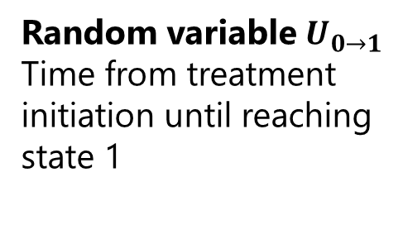
Multi-state model representation
State 1: Alive, dementia
Random variable $U_{0→1}$ Time from treatment initiation until reaching state 1
State 0: Alive, no dementia
State 2: Dead
Illness-death model, with 3 states
32
Notes:
The first variable, U(0->1), represents the time from initiation to state 1. Note that it could be infinity if the patient never experiences dementia in their lifetime.

Slide 33
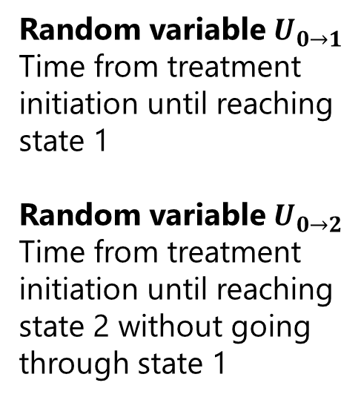
Multi-state model representation
State 1: Alive, dementia
Random variable $U_{0→1}$ Time from treatment initiation until reaching state 1
Random variable $U_{0→2}$
Time from treatment initiation until reaching state 2 without going through state 1
State 0: Alive, no dementia
State 2: Dead
Illness-death model, with 3 states
33
Notes:
The second variable, U(0->2), represents the time from initiation to death without dementia.

Slide 34
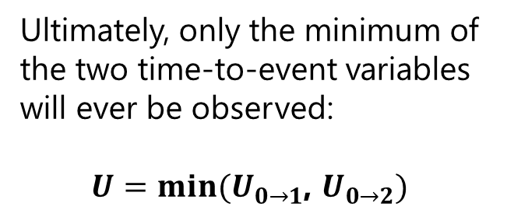
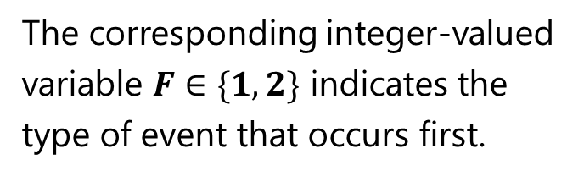
Multi-state model representation
State 1: Alive, dementia
Ultimately, only the minimum of the two time-to-event variables will ever be observed:
$U=min⁡(U_{0→1}$, $U_{0→2})$
State 0: Alive, no dementia
State 2: Dead
The corresponding integer-valued variable $F∈\{1,2\}$ indicates the type of event that occurs first.
Illness-death model, with 3 states
34
Notes:
Ultimately, each patient will take only one path: either 0-1-2 or 0-2. Only the minimum of the two time-to-event variables will be observed. We denote it by U and the variable F, which takes value in {1, 2}, indicates the type of event that occurs first.

Slide 35
What is the nature of observations made in the EHR?
35
Notes:
This approach would be valid if we had data until death for all patients. But what do we observe in EHR databases?

Slide 36


Observed transitions
State 1: Alive, dementia
$$U=U_{0→2}, F=2$$
State 0: Alive, no dementia
State 0: Alive, no dementia
State 2: Dead
$$U=U_{0→1}, F=1$$
36
Notes:
For some patients, we do observe actual transitions. For example, they may go from 0 to 1.
Or they may go directly from 0 to 2.

Slide 37
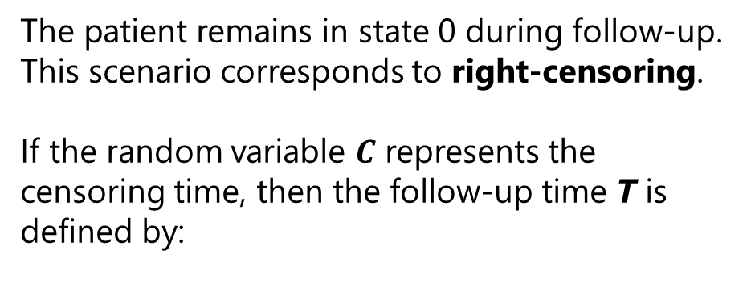
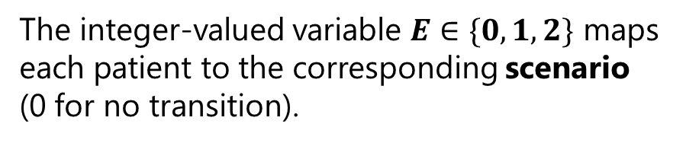
No observed transition
The patient remains in state 0 during follow-up.
This scenario corresponds to right-censoring.
If the random variable $C$ represents the censoring time, then the follow-up time T is defined by:
State 1: Alive, dementia
State 0: Alive, no dementia
$$T=\min\left(U,C\right)=min⁡(U_{0→1},U_{0→2},C)$$
State 2: Dead
The integer-valued variable $E∈\{0,1,2\}$ maps each patient to the corresponding scenario (0 for no transition).
37
Notes:
But the patient may also remain in state 0 during follow-up and be right-censored. Thus, their follow-up time T is defined as the minimum between U and C. We use the variable E taking value in {0, 1, 2} to indicate the corresponding scenario.

Slide 38



Summary of notations
State 1: Alive, dementia
State 0: Alive, no dementia
State 0: Alive, no dementia
State 0: Alive, no dementia
State 2: Dead
$$T=U=U_{0→1}$$
$$E=F=1$$
$$T=U=U_{0→2}$$
$$E=F=2$$
$$T=C$$
$$E=0$$
38
Notes:
To recap, observations encountered in the EHR can be of three types. In the first two scenarios, the follow-up time T is equal to the realized time to the first event, U. And in the third, T is equal to the censoring time C.

Slide 39
All quantities considered so far are based on observed data!
39
Notes:
So far, we’ve talked about observed quantities. But in a target trial emulation, we aim to answer “what-if” questions, requiring the definition of hypothetical or counterfactual worlds.

Slide 40
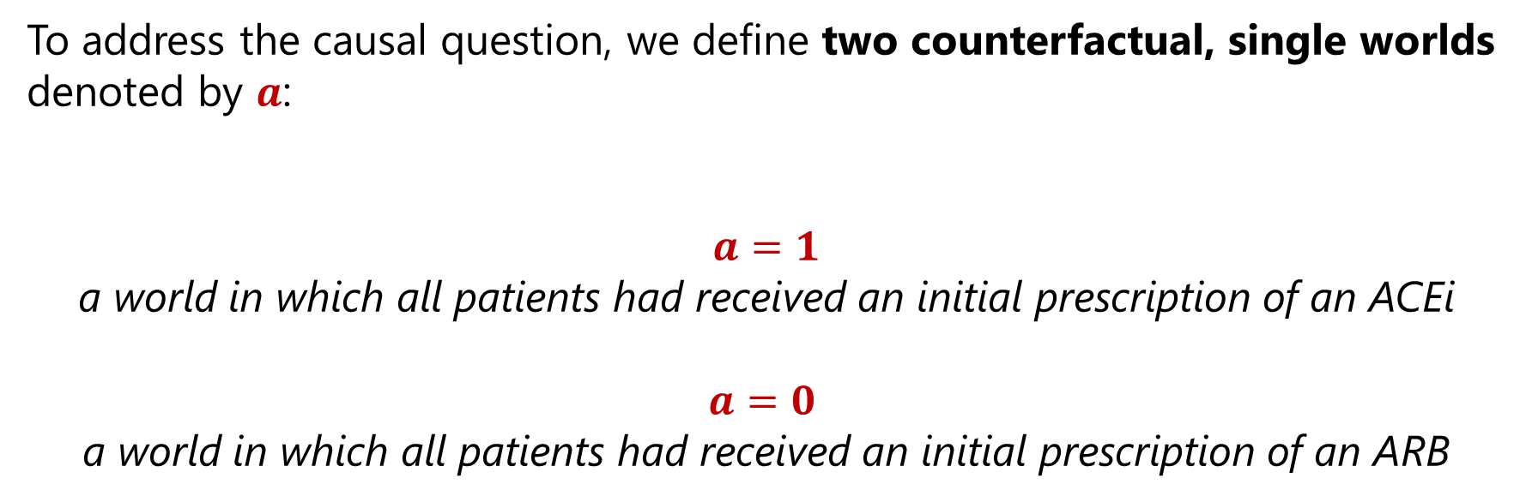
Definition of counterfactual worlds
To address the causal question, we define two counterfactual, single worlds denoted by $a$:
$a=1$ a world in which all patients had received an initial prescription of an ACEi
$$a=0$$ a world in which all patients had received an initial prescription of an ARB
40
Notes:
In our case, what are the counterfactual worlds?
Well, patients eligible to enter the target trial could have been prescribed an ACEi (a=1) or an ARB (a=0).

Slide 41
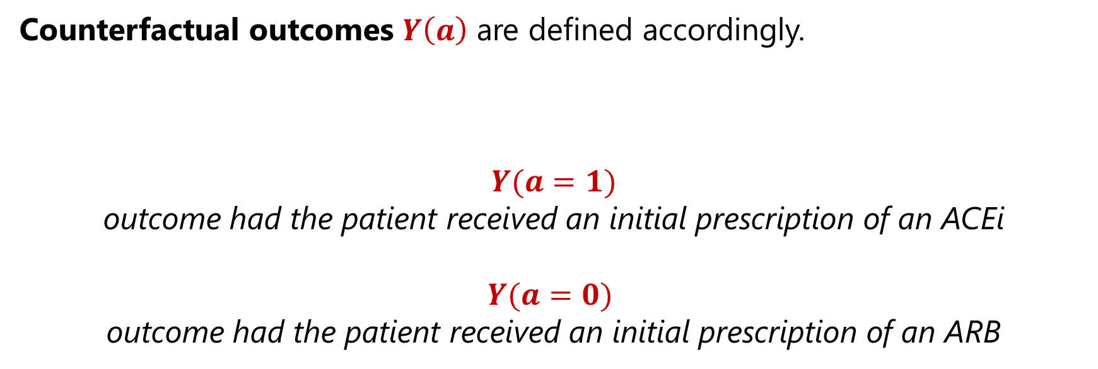
Definition of potential outcomes
Counterfactual outcomes $Y\left(a\right)$ are defined accordingly.
$Y(a=1)$ outcome had the patient received an initial prescription of an ACEi
$$Y(a=0)$$ outcome had the patient received an initial prescription of an ARB
41
Notes:
Upon entering the trial, a patient’s potential outcomes are defined in both worlds, although ultimately only one will be realized, depending on the assigned treatment strategy.

Slide 42
What are the potential outcomes of interest in our setting?
42
Notes:
So, let us now combine the multi-state model setup with the concept of counterfactual worlds to define the potential outcomes of interest!

Slide 43
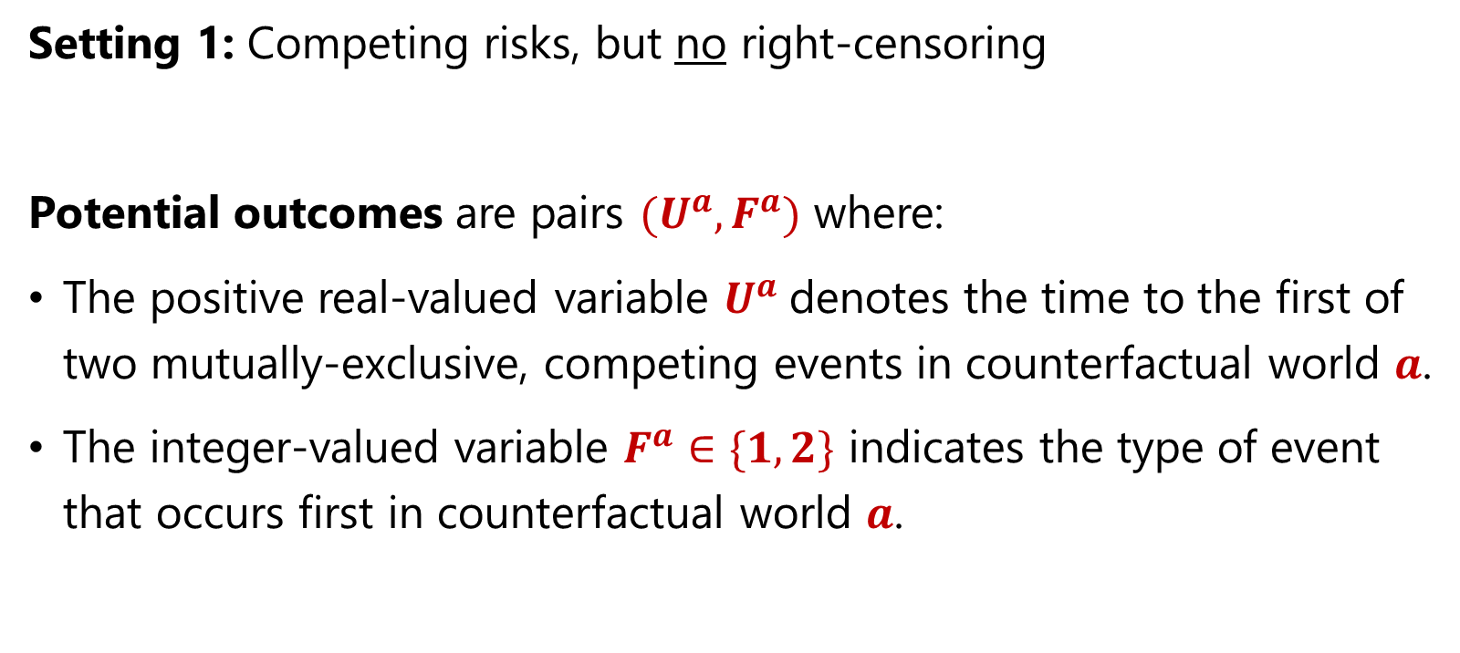
Potential outcomes under no right-censoring
Setting 1: Competing risks, but no right-censoring
Potential outcomes are pairs ${(U}^{a},F^{a})$ where:
The positive real-valued variable $U^{a}$denotes the time to the first of two mutually-exclusive, competing events in counterfactual world $a$.
The integer-valued variable $F^{a}∈\{1,2\}$ indicates the type of event that occurs first in counterfactual world $a$.
43
Notes:
In the absence of right-censoring, potential outcomes would be tuples of the form (Ua, Fa) where Ua denotes the time to the first event in counterfactual world a and Fa is the corresponding indicator.

Slide 44
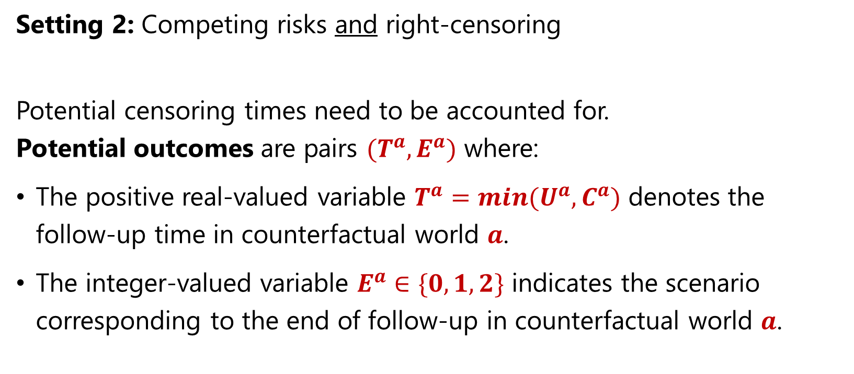
Potential outcomes under right-censoring
Setting 2: Competing risks and right-censoring
Potential censoring times need to be accounted for. Potential outcomes are pairs ${(T}^{a},E^{a})$ where:
The positive real-valued variable $T^{a}=min{(U}^{a},C^{a})$ denotes the follow-up time in counterfactual world $a$.
The integer-valued variable $E^{a}∈\{0,1,2\}$ indicates the scenario corresponding to the end of follow-up in counterfactual world $a$.
44
Notes:
With right censoring, potential outcomes become tuples of the form (Ta, Ea) where Ta denotes the follow-up time in counterfactual world a and Ea reflects whether the clock stopped because of an event (1 or 2) or because of censoring (0).

Slide 45
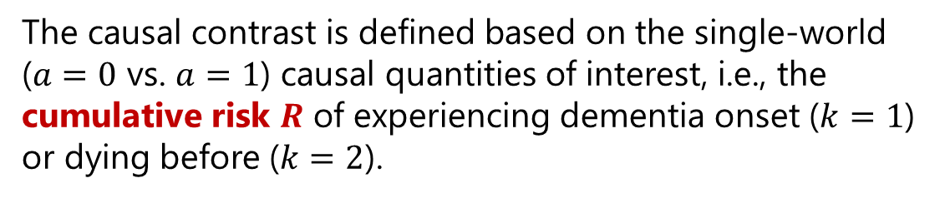
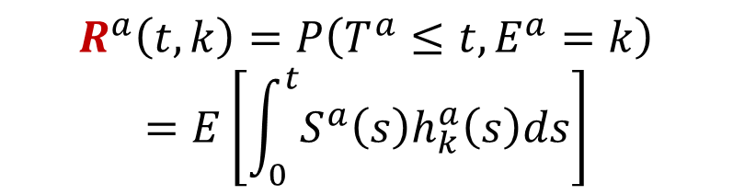
ACEi vs. ARB target trial specification & emulation
The causal contrast is defined based on the single-world ($a=0$ vs. $a=1$) causal quantities of interest, i.e., the cumulative risk $R$ of experiencing dementia onset ($k=1$) or dying before ($k=2$).
Eligibility criteria
Treatment strategies
Treatment assignment
Outcome definition
Follow-up definition
Causal contrasts
Statistical analysis
$$R^{a}\left(t,k\right)=P\left(T^{a}≤t, E^{a}=k\right)$$
$$=E\left[\int_{0}^{t}{S^{a}\left(s\right)h_{k}^{a}\left(s\right)ds}\right]$$
45
Notes:
Now, to compare the distribution of outcomes in the two arms, we shall define our causal contrasts, i.e., the quantities that summarize the risk of experiencing a particular type of event by a given time.
Our core metric of interest is the probability of experiencing an event of type k by a time t, in counterfactual world a.
It is given by the following cumulative incidence or risk function, denoted by R. Let me unpack this for you.

Slide 46
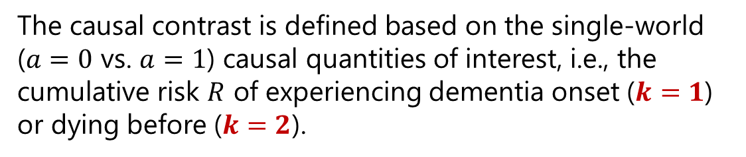
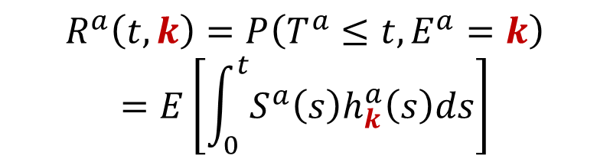
ACEi vs. ARB target trial specification & emulation
The causal contrast is defined based on the single-world ($a=0$ vs. $a=1$) causal quantities of interest, i.e., the cumulative risk $R$ of experiencing dementia onset ($k=1$) or dying before ($k=2$).
Eligibility criteria
Treatment strategies
Treatment assignment
Outcome definition
Follow-up definition
Causal contrasts
Statistical analysis
$$R^{a}\left(t,k\right)=P\left(T^{a}≤t, E^{a}=k\right)$$
$$=E\left[\int_{0}^{t}{S^{a}\left(s\right)h_{k}^{a}\left(s\right)ds}\right]$$
46
Notes:
There is one risk function R for each type of event (k=1 or k=2).

Slide 47
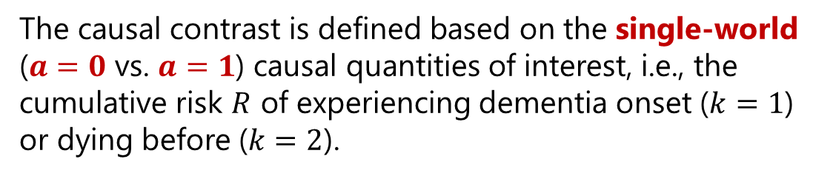
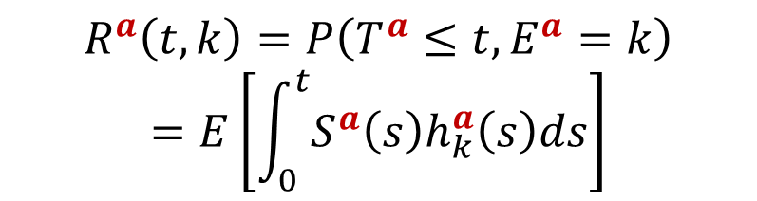
ACEi vs. ARB target trial specification & emulation
The causal contrast is defined based on the single-world ($a=0$ vs. $a=1$) causal quantities of interest, i.e., the cumulative risk $R$ of experiencing dementia onset ($k=1$) or dying before ($k=2$).
Eligibility criteria
Treatment strategies
Treatment assignment
Outcome definition
Follow-up definition
Causal contrasts
Statistical analysis
$$R^{a}\left(t,k\right)=P\left(T^{a}≤t, E^{a}=k\right)$$
$$=E\left[\int_{0}^{t}{S^{a}\left(s\right)h_{k}^{a}\left(s\right)ds}\right]$$
47
Notes:
Given a type of event k, there is one risk function R in each counterfactual world (a=0 or a=1).

Slide 48
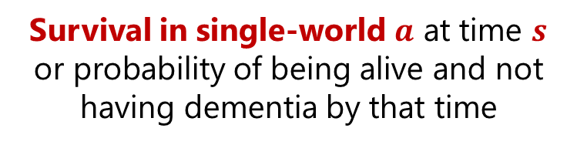
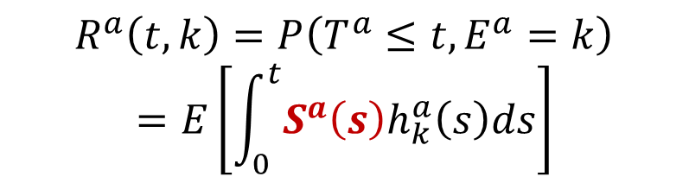
ACEi vs. ARB target trial specification & emulation
The causal contrast is defined based on the single-world ($a=0$ vs. $a=1$) causal quantities of interest, i.e., the cumulative risk $R$ of experiencing dementia onset ($k=1$) or dying before ($k=2$).
Eligibility criteria
Treatment strategies
Treatment assignment
Outcome definition
Follow-up definition
Causal contrasts
Statistical analysis
$$R^{a}\left(t,k\right)=P\left(T^{a}≤t, E^{a}=k\right)$$
$$=E\left[\int_{0}^{t}{S^{a}\left(s\right)h_{k}^{a}\left(s\right)ds}\right]$$
Survival in single-world $a$ at time $s$ or probability of being alive and not having dementia by that time
48
Notes:
In counterfactual world a, the cumulative risk of experiencing an event of type k by time t is defined as the average, in the overall population, of an integral between time 0 and time t that involves two functions.
First: S(a) – The survival function in counterfactual world a, which corresponds to the probability of being alive and not having dementia (i.e., still being in state 0 if you remember our multi-state model setup).

Slide 49
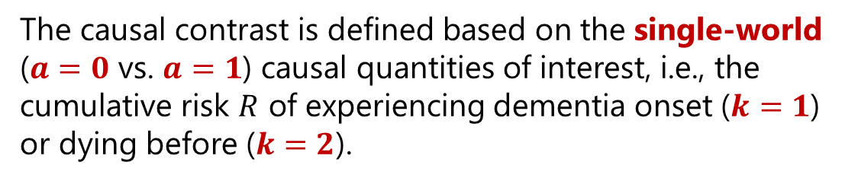

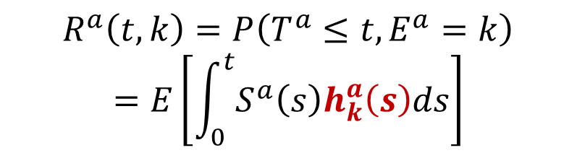
ACEi vs. ARB target trial specification & emulation
The causal contrast is defined based on the single-world ($a=0$ vs. $a=1$) causal quantities of interest, i.e., the cumulative risk $R$ of experiencing dementia onset ($k=1$) or dying before ($k=2$).
Eligibility criteria
Treatment strategies
Treatment assignment
Outcome definition
Follow-up definition
Causal contrasts
Statistical analysis
$$R^{a}\left(t,k\right)=P\left(T^{a}≤t, E^{a}=k\right)$$
$$=E\left[\int_{0}^{t}{S^{a}\left(s\right)h_{k}^{a}\left(s\right)ds}\right]$$
Cause-specific hazard in single-world $a$ of experiencing event $k$ at time $s$
49
Notes:
Second: The cause- or event-specific hazard function in counterfactual world a, which corresponds to the instantaneous rate of occurrence of event k in that world.

Slide 50
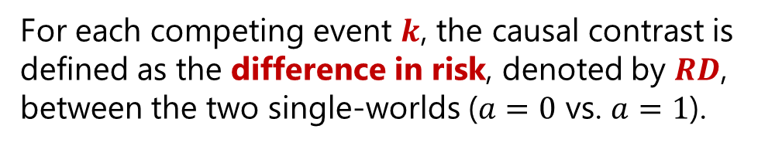
ACEi vs. ARB target trial specification & emulation
For each competing event $k$, the causal contrast is defined as the difference in risk, denoted by $RD$, between the two single-worlds ($a=0$ vs. $a=1$).
Eligibility criteria
Treatment strategies
Treatment assignment
Outcome definition
Follow-up definition
Causal contrasts
Statistical analysis
$$t↦{RD\left(t,k\right)=R}^{a=1}\left(t,k\right)−R^{a=0}\left(t,k\right)$$
We chose risk differences as the causal contrasts to facilitate clinical interpretability.
50
Notes:
For each competing event k, we define as our causal contrast the difference between these two risk functions.
I chose risk differences to facilitate clinical interpretability. But using the core risk metrics, it is possible to define other causal contrasts, such as risk ratios.

Slide 51
In observational data, the treatment and control arms are often not balanced. How to handle this statistically to estimate the effects of treatment on competing risks?
51
Notes:
However, in observational data, the treatment and control arms are often not balanced: e.g., there may be a greater share of women or a greater share of patients with type 2 diabetes in one arm than in the other. So, we can’t calculate simple averages and take the difference. So, what should we do to estimate the effects of treatment on competing risks in an unbiased way?

Slide 52
ACEi vs. ARB target trial specification & emulation
Eligibility criteria
Treatment strategies
Treatment assignment
Outcome definition
Follow-up definition
Causal contrasts
Statistical analysis
Assumptions
Choice of weights
Estimation
H1: Conditional exchangeability
H2: Positivity
H3: Conditionally independent censoring
H4: Stable Unit Treatment Value Assumption (SUTVA)
52
Notes:
To identify this risk difference using observational data, we need to make 4 assumptions. Some, like positivity, can be partially verified, but others like conditional exchangeability fundamentally cannot.

Slide 53
ACEi vs. ARB target trial specification & emulation
Eligibility criteria
Treatment strategies
Treatment assignment
Outcome definition
Follow-up definition
Causal contrasts
Statistical analysis
Assumptions
Choice of weights
Estimation
H1: Conditional exchangeability
H2: Positivity
H3: Conditionally independent censoring
H4: Stable Unit Treatment Value Assumption (SUTVA)
53
Notes:
I will briefly comment on the first two assumptions.

Slide 54

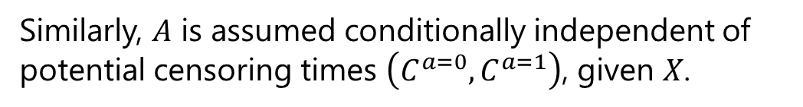
ACEi vs. ARB target trial specification & emulation
H1: Conditional exchangeability
The treatment assignment 𝐴 is assumed conditionally independent of potential outcomes $\left(U^{a=0},U^{a=1}\right)$, given baseline covariates 𝑋.
Eligibility criteria
Treatment strategies
Treatment assignment
Outcome definition
Follow-up definition
Causal contrasts
Statistical analysis
Assumptions
Choice of weights
Estimation
$$A⊥\left(U^{a=0},U^{a=1}\right) | X$$
Similarly, 𝐴 is assumed conditionally independent of potential censoring times $\left(C^{a=0},C^{a=1}\right)$, given 𝑋.
$$A⊥\left(C^{a=0},C^{a=1}\right) | X$$
54
Notes:
Conditional exchangeability is two-fold:
We assume that the assigned treatment A is conditionally independent of the potential time-to-event outcomes U(a), given baseline covariates X.
And similarly, we assume that A is conditionally independent of the potential censoring times, given X.

Slide 55

ACEi vs. ARB target trial specification & emulation
H2: Positivity
For any set of covariates $X = x$present in the population, there is a nonzero probability of being assigned to any arm $a$.
Eligibility criteria
Treatment strategies
Treatment assignment
Outcome definition
Follow-up definition
Causal contrasts
Statistical analysis
Assumptions
Choice of weights
Estimation
$$0<P\left(A=a \right| X=x)<1$$
55
Notes:
What does positivity tell us? That for any set of covariates that appears at least once in the study population, there should be a nonzero probability of being assigned to any arm.
Now, for the sake of time, I won’t cover identification assumptions in detail today, but you can find them in the slides that will be shared later.

Slide 56
ACEi vs. ARB target trial specification & emulation
Eligibility criteria
Treatment strategies
Treatment assignment
Outcome definition
Follow-up definition
Causal contrasts
Statistical analysis
Assumptions
Choice of weights
Estimation
56
Notes:
Now that we have listed the 4 assumptions needed to identify the risk difference, let us discuss how we manage to rebalance the two arms.

Slide 57
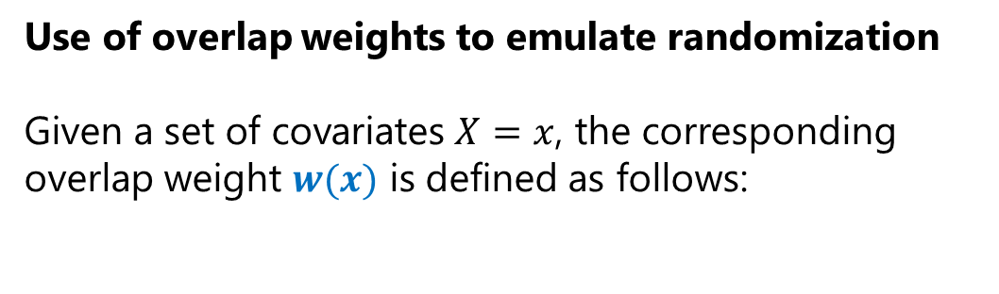
ACEi vs. ARB target trial specification & emulation
Use of overlap weights to emulate randomization
Given a set of covariates $X=x$, the corresponding overlap weight $w(x)$ is defined as follows:
Eligibility criteria
Treatment strategies
Treatment assignment
Outcome definition
Follow-up definition
Causal contrasts
Statistical analysis
Assumptions
Choice of weights
Estimation
57
Notes:
To emulate baseline randomization, we use overlap weights, which allow us to keep every eligible patient in the target trial while approximating the intuitive setting of many-to-many matching. So, how are we going to define these weights? Let me build some intuition.

Slide 58

ACEi vs. ARB target trial specification & emulation
Use of overlap weights to emulate randomization
Given a set of covariates $X=x$, the corresponding overlap weight $w(x)$ is defined as follows:
Eligibility criteria
Treatment strategies
Treatment assignment
Outcome definition
Follow-up definition
Causal contrasts
Statistical analysis
Assumptions
Choice of weights
Estimation
$x$ (e.g., age)
58
Notes:
Let us consider that we have only one patient characteristic, for example: age at treatment initation.

Slide 59
ACEi vs. ARB target trial specification & emulation
Use of overlap weights to emulate randomization
Given a set of covariates $X=x$, the corresponding overlap weight $w(x)$ is defined as follows:
Eligibility criteria
Treatment strategies
Treatment assignment
Outcome definition
Follow-up definition
Causal contrasts
Statistical analysis
Assumptions
Choice of weights
Estimation
Propensity score
$x$ (e.g., age)
59
Notes:
And we are going to look at the patient’s probability of being assigned to the treatment arm, as a function of their age.

Slide 60
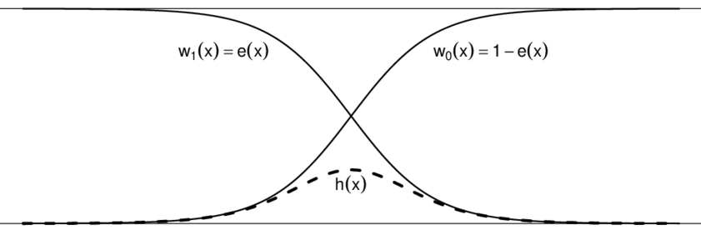


ACEi vs. ARB target trial specification & emulation
Use of overlap weights to emulate randomization
Given a set of covariates $X=x$, the corresponding overlap weight $w(x)$ is defined as follows:
Eligibility criteria
Treatment strategies
Treatment assignment
Outcome definition
Follow-up definition
Causal contrasts
Statistical analysis
Assumptions
Choice of weights
Estimation
Propensity score
$$P(A=1|X=x)$$
$$P(A=0|X=x)$$
$x$ (e.g., age)
60
Notes:
Now, let us imagine that the propensity score function looks like this.

Slide 61
ACEi vs. ARB target trial specification & emulation
Use of overlap weights to emulate randomization
Given a set of covariates $X=x$, the corresponding overlap weight $w(x)$ is defined as follows:
Eligibility criteria
Treatment strategies
Treatment assignment
Outcome definition
Follow-up definition
Causal contrasts
Statistical analysis
Assumptions
Choice of weights
Estimation
Propensity score
$$P(A=1|X=x)$$
$$P(A=0|X=x)$$
$x$ (e.g., age)
61
Notes:
For patients at the tails – who were either quite young or quite old when starting their treatment – it was almost certain which drug class (1 or 0) they would receive, making it hard to find a close match in the opposite arm. So, we would not get rid of these patients completely, but we would want to assign them a small weight.

Slide 62
ACEi vs. ARB target trial specification & emulation
Use of overlap weights to emulate randomization
Given a set of covariates $X=x$, the corresponding overlap weight $w(x)$ is defined as follows:
Eligibility criteria
Treatment strategies
Treatment assignment
Outcome definition
Follow-up definition
Causal contrasts
Statistical analysis
Assumptions
Choice of weights
Estimation
Propensity score
$$P(A=1|X=x)$$
$$P(A=0|X=x)$$
$x$ (e.g., age)
62
Notes:
Conversely, patients in the middle of the age distribution had a decent chance to be assigned to either arm. We want to give these patients a larger weight because they best represent the case of a randomized trial in which patients have a similar probability of being assigned to treatment or control.

Slide 63

ACEi vs. ARB target trial specification & emulation
Use of overlap weights to emulate randomization
Given a set of covariates $X=x$, the corresponding overlap weight $w(x)$ is defined as follows:
Eligibility criteria
Treatment strategies
Treatment assignment
Outcome definition
Follow-up definition
Causal contrasts
Statistical analysis
Assumptions
Choice of weights
Estimation
$$w\left(x\right)=AP\left(A=0 | X=x\right)+(1−A)P(A=1|X=x)$$
Propensity score
$$P(A=1|X=x)$$
$$P(A=0|X=x)$$
$$x$$
63
Notes:
We can achieve this goal by giving more importance to patients in the overlap region. This approach applies in multiple dimensions as well, considering not only age, but also sex, social vulnerability etc.

Slide 64
Why using overlap weights?
64
Notes:
So, why would we use overlap rather than other weighting schemes?

Slide 65
ACEi vs. ARB target trial specification & emulation
Statistical advantages
Overlap weights are bounded.
If propensity scores are estimated by maximum likelihood with a logistic regression, then equality of covariate means is achieved.
The nonparametric estimator for the ATO has minimum variance among all WATE estimators with balancing weights.
Eligibility criteria
Treatment strategies
Treatment assignment
Outcome definition
Follow-up definition
Causal contrasts
Statistical analysis
Assumptions
Choice of weights
Estimation
ATO: average treatment effect in the overlap population, WATE: weighted average treatment effect
Sources: Li, Morgan, and Zaslavsky (JASA, 2017) & Li, Thomas, and Li (AJE, 2018)
65
Notes:
On one hand, overlap weights have several statistical advantages.
First, they are bounded, which helps avoid the arbitrary removal of patients at the tails, who have extreme propensity scores.
Second, if propensity scores are estimated by maximum likelihood with a logistic regression, then equality of covariate means is achieved.
And third, the nonparametric estimator for the ATO has minimum variance among all WATE estimators with balancing weights, which can help in terms of precision.

Slide 66
ACEi vs. ARB target trial specification & emulation
Clinical relevance
The overlap-weighted population corresponds to patients in clinical equipoise, whose covariates could appear with high probability in any arm.
The ATO may be more generalizable than other effect measures.
Eligibility criteria
Treatment strategies
Treatment assignment
Outcome definition
Follow-up definition
Causal contrasts
Statistical analysis
Assumptions
Choice of weights
Estimation
ATO: average treatment effect in the overlap population
Source: Thomas, Li, and Pencina (JAMA, 2020)
66
Notes:
On the other hand, beyond their statistical properties, overlap weights are also relevant clinically.
1. Indeed, the overlap-weighted population corresponds to patients in clinical equipoise, whose covariates could be found with high probability in any arm.
2. The ATO is also thought to be a more transportable quantity than others, i.e., it can be more easily generalized to other populations of interest.

Slide 67
ACEi vs. ARB target trial specification & emulation
Eligibility criteria
Treatment strategies
Treatment assignment
Outcome definition
Follow-up definition
Causal contrasts
Statistical analysis
Assumptions
Choice of weights
Estimation
The statistical estimation procedure involves 4 steps.
In what follows, we assume proportional hazards, but it can be relaxed.
67
Notes:
So, now that we have listed our key assumptions and made the decision to use overlap weights, let me walk you through the statistical estimation procedure, which involves 4 steps. In what follows, I’ll assume proportional hazards for simplicity, but it can be relaxed. In fact, we did so in this application and implemented both versions, as you’ll see in the results shortly.

Slide 68
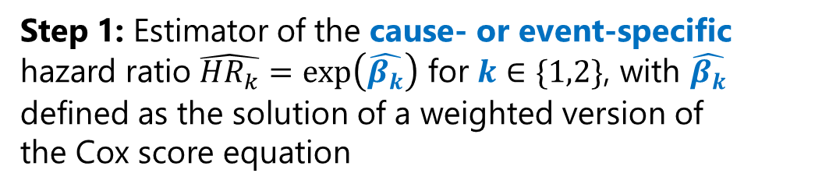
ACEi vs. ARB target trial specification & emulation
Step 1: Estimator of the cause- or event-specific hazard ratio $\hat{{HR}_{k}}=\exp\left(\hat{β_{k}}\right)$ for $k∈\{1,2\}$, with $\hat{β_{k}}$ defined as the solution of a weighted version of the Cox score equation
Eligibility criteria
Treatment strategies
Treatment assignment
Outcome definition
Follow-up definition
Causal contrasts
Statistical analysis
Assumptions
Choice of weights
Estimation
68
Notes:
Assuming that the hazards in each arm are proportional to each other over time, step 1 consists in estimating a single metric – the hazard ratio – to summarize whether one average one arm is better or worse than the other. There is a hazard ratio for each event type k.

Slide 69
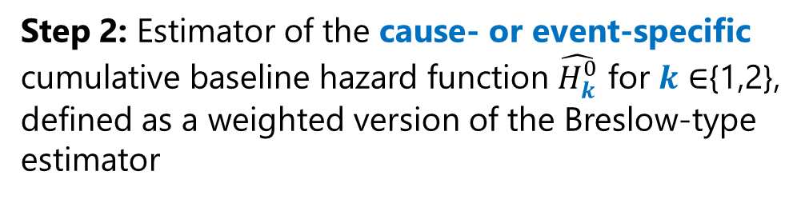
ACEi vs. ARB target trial specification & emulation
Step 1: Estimator of the cause- or event-specific hazard ratio $\hat{{HR}_{k}}=\exp\left(\hat{β_{k}}\right)$ for $k∈\{1,2\}$, with $\hat{β_{k}}$ defined as the solution of a weighted version of the Cox score equation
Eligibility criteria
Treatment strategies
Treatment assignment
Outcome definition
Follow-up definition
Causal contrasts
Statistical analysis
Assumptions
Choice of weights
Estimation
Step 2: Estimator of the cause- or event-specific cumulative baseline hazard function $\hat{H_{k}^{0}}$ for 𝒌 ∈{1,2}, defined as a weighted version of the Breslow-type estimator
69
Notes:
Then, in step 2, we use a weighted version of the Breslow-type estimator to derive the cumulative baseline hazard function.

Slide 70
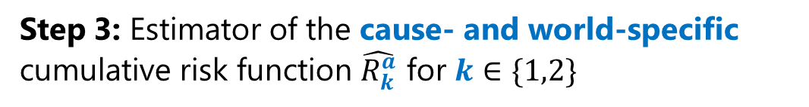
ACEi vs. ARB target trial specification & emulation
Step 1: Estimator of the cause- or event-specific hazard ratio $\hat{{HR}_{k}}=\exp\left(\hat{β_{k}}\right)$ for $k∈\{1,2\}$, with $\hat{β_{k}}$ defined as the solution of a weighted version of the Cox score equation
Eligibility criteria
Treatment strategies
Treatment assignment
Outcome definition
Follow-up definition
Causal contrasts
Statistical analysis
Assumptions
Choice of weights
Estimation
Step 2: Estimator of the cause- or event-specific cumulative baseline hazard function $\hat{H_{k}^{0}}$ for 𝒌 ∈{1,2}, defined as a weighted version of the Breslow-type estimator
Step 3: Estimator of the cause- and world-specific cumulative risk function $\hat{R_{k}^{a}}$ for $k∈\{1,2\}$
70
Notes:
From there, in step 3, we can obtain an estimator of the cumulative risk function, for each event type k and in each counterfactual world a.

Slide 71
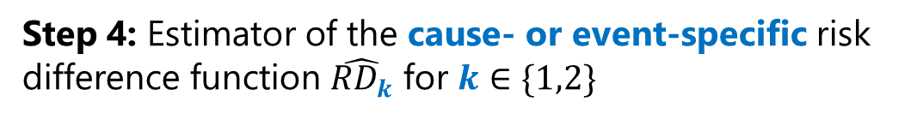
ACEi vs. ARB target trial specification & emulation
Step 1: Estimator of the cause- or event-specific hazard ratio $\hat{{HR}_{k}}=\exp\left(\hat{β_{k}}\right)$ for $k∈\{1,2\}$, with $\hat{β_{k}}$ defined as the solution of a weighted version of the Cox score equation
Eligibility criteria
Treatment strategies
Treatment assignment
Outcome definition
Follow-up definition
Causal contrasts
Statistical analysis
Assumptions
Choice of weights
Estimation
Step 2: Estimator of the cause- or event-specific cumulative baseline hazard function $\hat{H_{k}^{0}}$ for 𝒌 ∈{1,2}, defined as a weighted version of the Breslow-type estimator
Step 3: Estimator of the cause- and world-specific cumulative risk function $\hat{R_{k}^{a}}$ for $k∈\{1,2\}$
Step 4: Estimator of the cause- or event-specific risk difference function $\hat{{RD}_{k}}$ for $k∈\{1,2\}$
71
Notes:
And finally, in step 4, we can compute the difference between the two estimators to derive the relative risk of experiencing an event of type k over time.

Slide 72
What did we learn from applying this target trial emulation approach to real-world EHR data?
72
Notes:
This concludes the statistical estimation procedure and the overview of the 7 components of the target trial.
By now, I am sure you would like to see how the target trial emulation approach plays out in practice!

Slide 73

Data overview
1. Data source
Research Patient Data Registry at an academic healthcare system on the US East Coast.
73
Notes:
In this study, we used data from Mass General Brigham, an academic healthcare system comprising two main hospitals in Boston and 33 clinics in Massachusetts.

Slide 74

Data overview
1. Data source
2. Study period
Research Patient Data Registry at an academic healthcare system on the US East Coast.
Outpatient prescription orders made between January 1, 2010, and January 31, 2020.
74
Notes:
We considered outpatient prescriptions made between January 2010 and the end of January 2020 – before the COVID-19 pandemic, which induced shifts in both mortality and dementia diagnosis rates. A challenge that we need to address and that I would like to discuss with you during the Q&A!

Slide 75

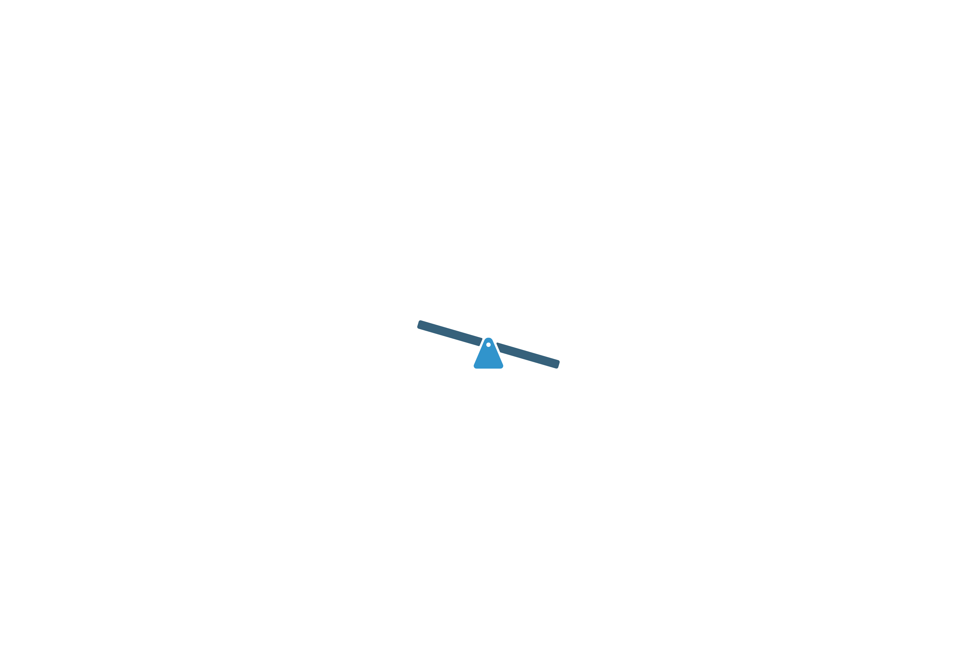
Data overview
1. Data source
2. Study period
3. Cohort size and arm split
25,507 hypertensive patients aged 50+
Uneven split between original arms
Research Patient Data Registry at an academic healthcare system on the US East Coast.
Outpatient prescription orders made between January 1, 2010, and January 31, 2020.
ARB initiators
25.2%
ACEi initiators
74.8%
75
Notes:
After applying the eligibility criteria, we obtained a cohort of about 25k patients. The initial split between the two arms was not 50/50 as in a typical randomized controlled trial but the imbalance was still reasonable – with about 25% of patients in one arm and 75% in the other.

Slide 76
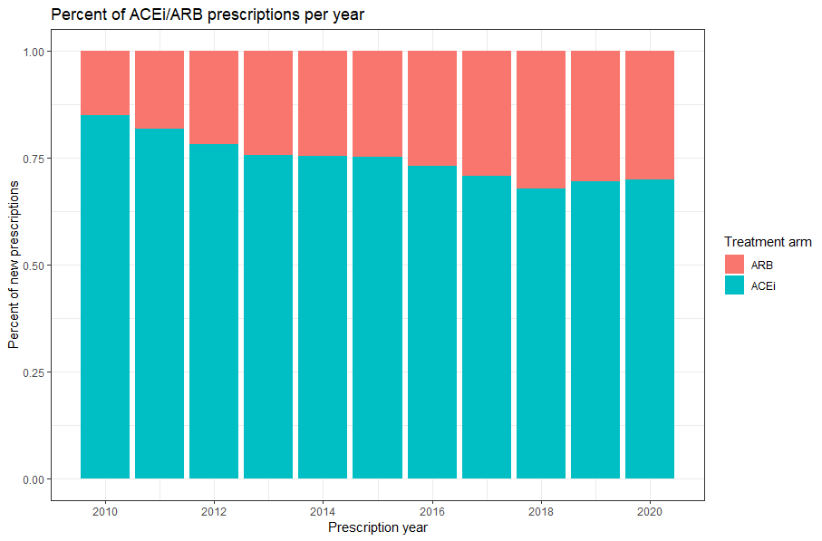
Temporal patterns of ACEi/ARB drug prescriptions
Arm
Percent of new prescriptions
ARB
ACEi
2010
2020
Prescription year
Notes:
This imbalance between the two arms can be explained in part by the later approval, in 2010, of the generic version of losartan (the most common drug from the ARB class).
With ARBs becoming less costly, physicians modified their prescribing preferences and progressively adopted this drug class.
Given such a temporal pattern, we included interaction terms in the logistic regression model for the propensity score to achieve balance in covariate means with respect to each calendar year of prescription.

Slide 77
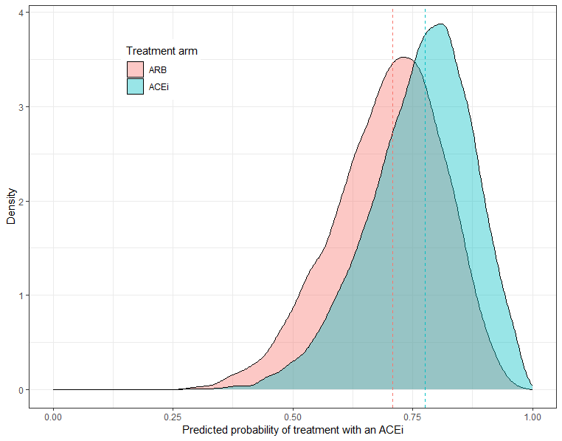
Assessment of overlap between arms
Arm
ARB
ACEi
Density
Large overlap between the two arms, enabling us to proceed with the target trial internally
Estimated probability of treatment with an ACEi
Notes:
The stratified distribution of the estimated propensity scores suggests a large overlap between the two arms, giving us confidence about the internal validity of our target trial emulation.

Slide 78
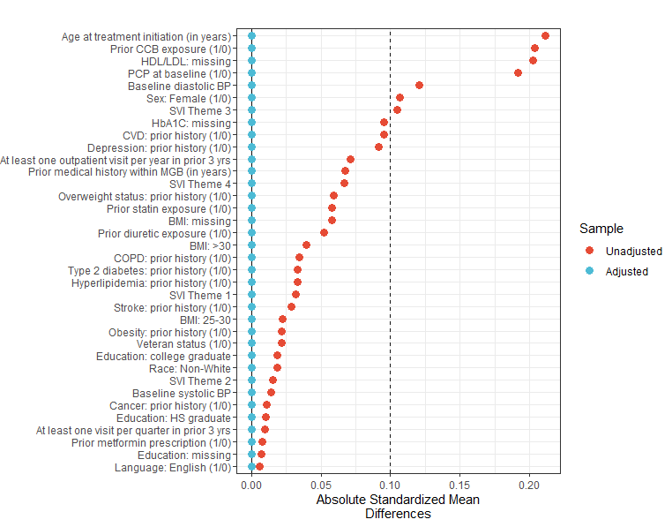
Assessment of covariate balance
Main differences before weighting: age, prior exposure to calcium channel blockers (CCB), presence of a primary care physician (PCP), etc.
Unweighted
Overlap-weighted
Absolute standardized mean differences
Notes:
By visualizing differences in absolute standardized means along measured covariates, it appears that ACEi and ARB initiators initially differed with respect to age at treatment iniation, sex, and prior history of CCB prescriptions, but were otherwise quite similar.

Slide 79
Assessment of covariate balance
Main differences before weighting: age, prior exposure to calcium channel blockers (CCB), presence of a primary care physician (PCP), etc.
Elimination of measured confounding bias after weighting the contribution of each patient.
Unweighted
Overlap-weighted
Absolute standardized mean differences
Notes:
And such initial differences were reduced to zero, on average, after applying overlap weights.

Slide 80
How do the two arms compare after balancing and accounting for competing death?
Notes:
From there, how do the two arms compare after balancing and accounting for competing death?

Slide 81
First metric: hazard ratio (HR), time-independent
HR < 1: ACEi better than ARB initiation HR = 1: no difference
HR > 1: ACEi worse than ARB initiation
Notes:
We considered two metrics. First, we estimated cause-specific hazard ratios, one for each event type.
Here, a HR above 1 would indicate that ACEi initiation may be more detrimental than ARB initiation, on average across all time points.

Slide 82
Estimated hazard ratios suggest a detrimental effect of ACEi initiation w.r.t. MCI/dementia onset, relative to ARB initiation
Event type | Hazard Ratio
MCI/dementia onset | HR = 1.10 95% CI = [1.01 – 1.21]
HR < 1: ACEi better than ARB initiation HR = 1: no difference HR > 1: ACEi worse than ARB initiation
Notes:
Our target trial emulation suggests that ACE inhibitor initiation may not be as good as ARB initiation, with a HR of about 1.10.

Slide 83
Estimated hazard ratios suggest no difference between ACEi and ARB initiation w.r.t. competing death
Event type | Hazard Ratio
Dementia onset | HR = 1.10 95% CI = [1.01 – 1.21]
Death before dementia | HR = 1.05 95% CI = [0.94 – 1.16]
HR < 1: ACEi better than ARB initiation HR = 1: no difference
HR > 1: ACEi worse than ARB initiation
Notes:
But we did not find evidence of a difference for the competing risk of death.
Now, while the HR is often used in comparative effectiveness research, it may not be as useful as a risk measure.

Slide 84
Second metric: cumulative risk, time-dependent
Probability of an event of a certain type occurring by time t
Notes:
Which constitutes our main metric of interest because it is more relevant in clinical practice.
For example, physicians and patients may want to ask: what is the probability of experiencing dementia onset five years after treatment initiation?
So, let us now have a look at the results together!

Slide 85
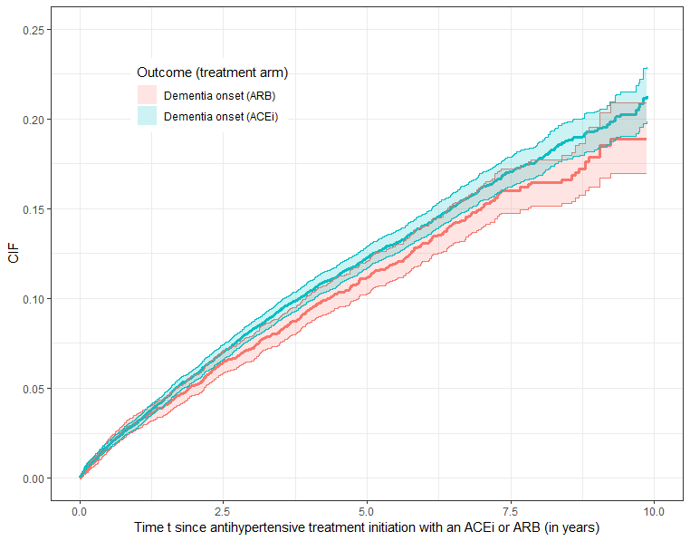
1pp higher 5-year risk of MCI/dementia onset among ACEi vs. ARB initiators
Risk of MCI/dementia onset
Arm
ARB
When not assuming proportional hazards, risk differences were estimated to:
Year 5 1.12pp (0.048 to 2.19)
Year 10 2.36pp (-0.45 to 4.68)
ACEi
Probability of event by time t
*95% CIs obtained via Bayesian bootstrap (500 iterations)
Time since antihypertensive treatment initiation (in years)
Notes:
This figure represents the estimated risk of dementia during follow-up, from baseline up to a maximum of 10 years, had all patients received one drug class (ACEi, in blue) or the other (ARB, in pink).
While accounting for the competing risk of death, we found that treatment initiation with an ACEi was associated with a greater risk of dementia, but that the risk difference with ARB initiation was small, at about 1pp five years after baseline.
By year 10, confidence intervals were wider. Thus, larger study cohorts are needed to quantify the extent of differences in dementia risk between the two groups with greater precision.

Slide 86
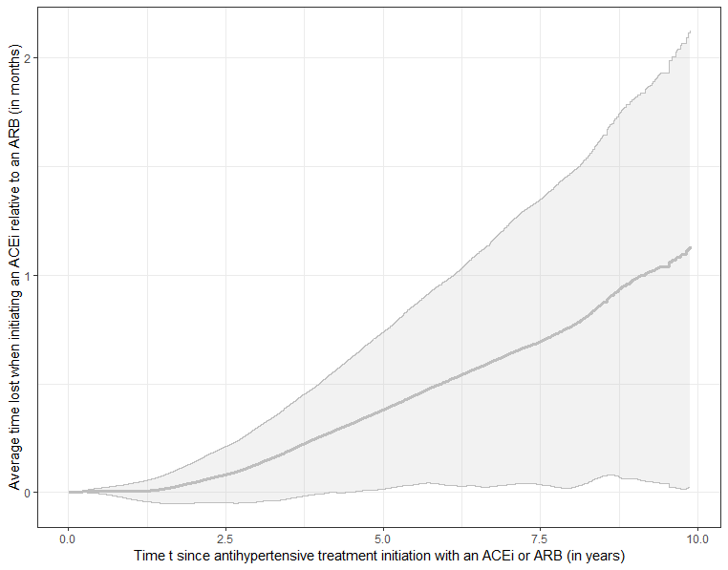
Up to 4 months of MCI/dementia-free time lost under ACEi vs. ARB initiation
Clinical impact Estimated risk differences can be translated into an average dementia-free time loss.
Overall: up to 2 months
Among men: up to 4 months
Average time lost when initiating an ACEi vs an ARB (in months)
Time since antihypertensive treatment initiation (in years)
Notes:
You may ask yourself: what is the clinical impact of such a risk difference?
To answer this question, we can quantify how much dementia-free time on average was lost when initiating an ACEi rather than an ARB. In the overlap-weighted population, we found that ACEi initiators lost up to 2 months on average, over a 10-year period. And this difference was more pronounced among men, at about 4 months on average.

Slide 87
Potential public health implications & work needed
Small effect at the individual level Estimated loss of <6 MCI/dementia-free months, over a 10-year period, among people initiating an ACEi vs an ARB
Potentially important implications at the population level 55 million US adults prescribed an ACEi for chronic hypertension
Replications in larger EHR systems and mechanistic studies are needed to stress-test the results of this single-center target trial emulation.
Notes:
To conclude, I would argue that, while the estimated effect of ACEi initiation may not be clinically significant at the individual level, the population-level implications may be important, given that 55 million US adults are currently taking these medications on a daily basis to reduce their blood pressure.
Therefore, more work is needed to replicate this study in larger healthcare systems, identify subgroups with a larger time loss, and conduct mechanistic studies to gain a better understanding of these drugs’ actions on brain cells.

Slide 88
Limitations
Potential for residual confounding (e.g., lifestyle factors).
Absence of linkage to claims data to check medication dispensing and adherence.
Measurement errors affecting the definition and timing of dementia outcomes.
Lack of representativity of the considered patient population and implications for generalizability outside the Mass General Brigham healthcare system.
Notes:
As with any observational study, our research has several limitations, which I can go over in more detail during the Q&A. Briefly:
Despite using overlap weights to maximize clinical equipoise, balance could be obtained only with respect to measured confounders but other potential confounders such as lifestyle factors remain unmeasured.
We did not have access to linked claims data to assess medication dispensing and adherence.
Measurement errors certainly affect the definition and timing of dementia-related outcomes.
The considered patient population is not fully representative of US adults suffering from hypertension, which hinders our ability to generalize results outside the MGB healthcare system.

Slide 89
Next steps
Identify subgroups of patients least/most affected.
Conduct a per-protocol analysis in EHR linked with claims data.
Understand the potential mediating role played by blood pressure control.
Implement multi-arm target trials by drug class and brain penetrance.
Contrast with other inferential strategies (e.g., physician prescribing preferences as instrumental variables).
Develop a framework to federate target trial emulations across healthcare systems and extend to other drug classes.
Notes:
This work prompted several follow-up questions to investigate next, which I would like to discuss with you during the Q&A!
-------------------------------------------------------------------------------------------------------------------------------------------------
These include estimating heterogeneous treatment effects, exploring the potential role of blood pressure as a mediator, implementing alternative strategies for inference such as the use of physician preferences as instrumental variables, and federating target trial emulations across healthcare systems and countries to extend this research to other drug classes that are commonly prescribed.

Slide 90









Acknowledgements
US
Munther Dahleh (MIT)
Caroline Uhler (MIT, Broad)
Anthony Philippakis (Broad)
Deborah Blacker (HSPH, MGB)
Mark Albers (HMS, MGB)
Sudeshna Das (HMS, MGB)
Colin Magdamo (HMS)
Max Sunog (MGB)
UK, Imperial
Ioanna Tzoulaki
Youssef Hbid
Bowen Su
Israel, Haifa
Bella Lagun
Notes:
With that, I’d like to thank and acknowledge my mentors and collaborators.

Slide 91
Thanks for your attention! Any questions? Feel free to reach out: mlaurecc@gmail.com
Notes:
Thanks very much for your attention! And if you are interested or have suggestions for improvement, feel free to reach out!
I’d be happy to answer any questions you may have.

Slide 92
Next steps
Identify subgroups of patients least/most affected.
Conduct a per-protocol analysis in EHR linked with claims data.
Understand the potential mediating role played by blood pressure control.
Implement multi-arm target trials by drug class and brain penetrance.
Contrast with other inferential strategies (e.g., physician prescribing preferences as instrumental variables).
Develop a framework to federate target trial emulations across healthcare systems and extend to other drug classes.
Notes:
This work prompted several follow-up questions to investigate next, which I will leave up here for you to read and would love to discuss during the Q&A!
These include estimating heterogeneous treatment effects, exploring the potential role of blood pressure as a mediator, implementing alternative strategies for inference such as the use of physician preferences as instrumental variables, and federating target trial emulations across healthcare systems and countries to extend this research to other drug classes.

Slide 93
Target trial specification & emulation
Eligibility criteria
Treatment strategies
Treatment assignment
Outcome definition
Follow-up definition
Causal contrasts
Statistical analysis
93
Notes:
Now, to compare the distribution of outcomes in the two arms, we shall define our causal contrasts, i.e., the quantities that summarize the risk of experiencing a particular type of event by a given time.

Slide 94
Target trial specification & emulation
The causal contrast is defined based on the single-world ($a=0$ vs. $a=1$) causal quantities of interest, i.e., the cumulative risk $R$ of experiencing dementia onset ($k=1$) or dying before ($k=2$).
Eligibility criteria
Treatment strategies
Treatment assignment
Outcome definition
Follow-up definition
Causal contrasts
Statistical analysis
94
Notes:
Our core metric of interest is the probability of experiencing an event of a particular type k by a certain point in time t, in counterfactual world a.

Slide 95

Target trial specification & emulation
H1: Conditional exchangeability
H2: Positivity
H3: Conditionally independent censoring
The potential right-censoring times $C^{a}$ are conditionally independent of the potential outcome pairs, given baseline covariates 𝑋. I.e., for any arm a:
$$C^{a}⊥{(U}^{a},F^{a}) | X$$
Eligibility criteria
Treatment strategies
Treatment assignment
Outcome definition
Follow-up definition
Causal contrasts
Statistical analysis
Assumptions
Choice of weights
Estimation
95
Notes:
Similar to the first assumption, the third cannot be verified.
It states that the potential censoring times C(a) are conditionally independent of the potential outcome pairs, given baseline covariates X.
In our case, we reasoned that making this assumption was reasonable since we included the patient’s prior healthcare utilization as part of the covariate set X.

Slide 96
Target trial specification & emulation
H1: Conditional exchangeability
H2: Positivity
H3: Conditionally independent censoring
H4: Stable Unit Treatment Value Assumption (SUTVA)
Eligibility criteria
Treatment strategies
Treatment assignment
Outcome definition
Follow-up definition
Causal contrasts
Statistical analysis
Assumptions
Choice of weights
Estimation
96
Notes:
Finally, the last assumption, which is common in causal inference, is called SUTVA or Stable Unit Treatment Value Assumption. It is two-fold.

Slide 97
Target trial specification & emulation
H1: Conditional exchangeability
H2: Positivity
H3: Conditionally independent censoring
H4: Stable Unit Treatment Value Assumption (SUTVA)
No interference: The potential outcomes of any given patient do not vary with the treatments assigned to other patients.
Eligibility criteria
Treatment strategies
Treatment assignment
Outcome definition
Follow-up definition
Causal contrasts
Statistical analysis
Assumptions
Choice of weights
Estimation
97
Notes:
1. We assume that there is no interference, i.e., the potential outcomes of any given patient do not vary with the treatments assigned to other patients.

Slide 98
Target trial specification & emulation
H1: Conditional exchangeability
H2: Positivity
H3: Conditionally independent censoring
H4: Stable Unit Treatment Value Assumption (SUTVA)
No interference: The potential outcomes of any given patient do not vary with the treatments assigned to other patients.
Consistency: For each patient, there are no different versions of each treatment that lead to different potential outcomes.
Eligibility criteria
Treatment strategies
Treatment assignment
Outcome definition
Follow-up definition
Causal contrasts
Statistical analysis
Assumptions
Choice of weights
Estimation
98
Notes:
2. We assume consistency, i.e., there is only one version of each treatment and the manner in which it was assigned does not affect the patient’s potential outcomes.

Slide 99

Target trial specification & emulation
Step 1: Estimator of the cause- or event-specific hazard ratio $\hat{{HR}_{k}}=\exp\left(\hat{β_{k}}\right)$
Eligibility criteria
Treatment strategies
Treatment assignment
Outcome definition
Follow-up definition
Causal contrasts
Statistical analysis
Assumptions
Choice of weights
Estimation
99
Notes:
Assuming that the hazards in each arm are proportional to each other over time, step 1 consists in estimating a single metric – the hazard ratio – to summarize whether one average one arm is better or worse than the other. There is a hazard ratio for each event type k. [Cox 1972 to cite]

Slide 100
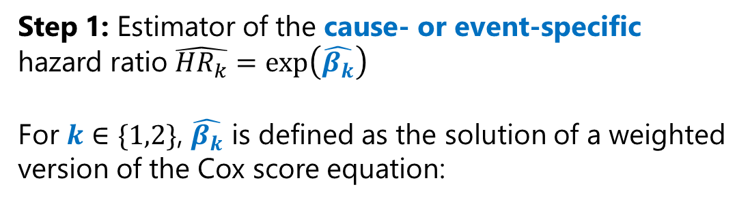
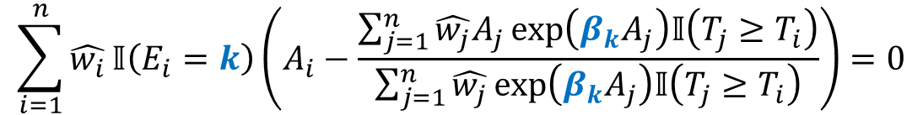
Target trial specification & emulation
Step 1: Estimator of the cause- or event-specific hazard ratio $\hat{{HR}_{k}}=\exp\left(\hat{β_{k}}\right)$
For $k∈\{1,2\}$, $\hat{β_{k}}$ is defined as the solution of a weighted version of the Cox score equation:
Eligibility criteria
Treatment strategies
Treatment assignment
Outcome definition
Follow-up definition
Causal contrasts
Statistical analysis
Assumptions
Choice of weights
Estimation
$$\sum_{i=1}^{n}{\hat{w_{i}}}𝕀\left(E_{i}=k\right)\left(A_{i}−\frac{\sum_{j=1}^{n}{\hat{w_{j}}A_{j}}exp⁡\left(β_{k}A_{j}\right)𝕀\left(T_{j}≥T_{i}\right)}{\sum_{j=1}^{n}{\hat{w_{j}}}exp⁡\left(β_{k}A_{j}\right)𝕀\left(T_{j}≥T_{i}\right)}\right)=0$$
100
Notes:
To estimate this quantity, we go back to the score equation derived by Cox in 1972, using a partial log-likelihood and taking its first derivative with respect to beta…

Slide 101
Target trial specification & emulation
Step 1: Estimator of the cause- or event-specific hazard ratio $\hat{{HR}_{k}}=\exp\left(\hat{β_{k}}\right)$
For $k∈\{1,2\}$, $\hat{β_{k}}$ is defined as the solution of a weighted version of the Cox score equation:
Eligibility criteria
Treatment strategies
Treatment assignment
Outcome definition
Follow-up definition
Causal contrasts
Statistical analysis
Assumptions
Choice of weights
Estimation
$$\sum_{i=1}^{n}{\hat{w_{i}}}𝕀\left(E_{i}=k\right)\left(A_{i}−\frac{\sum_{j=1}^{n}{\hat{w_{j}}A_{j}}exp⁡\left(β_{k}A_{j}\right)𝕀\left(T_{j}≥T_{i}\right)}{\sum_{j=1}^{n}{\hat{w_{j}}}exp⁡\left(β_{k}A_{j}\right)𝕀\left(T_{j}≥T_{i}\right)}\right)=0$$
Weights
101
Notes:
…except that here we are introducing overlap weights (one for each of the n patients). This idea is similar to that of downweighting or upweighting certain samples in the loss function in machine learning.

Slide 102
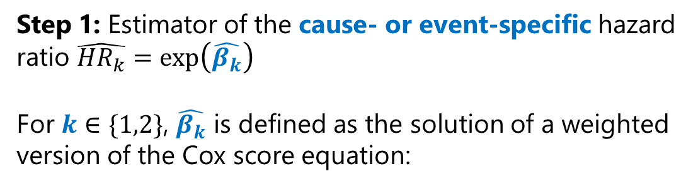
Target trial specification & emulation
Step 1: Estimator of the cause- or event-specific hazard ratio $\hat{{HR}_{k}}=\exp\left(\hat{β_{k}}\right)$
For $k∈\{1,2\}$, $\hat{β_{k}}$ is defined as the solution of a weighted version of the Cox score equation:
Eligibility criteria
Treatment strategies
Treatment assignment
Outcome definition
Follow-up definition
Causal contrasts
Statistical analysis
Assumptions
Choice of weights
Estimation
$$\sum_{i=1}^{n}{\hat{w_{i}}}𝕀\left(E_{i}=k\right)\left(A_{i}−\frac{\sum_{j=1}^{n}{\hat{w_{j}}A_{j}}exp⁡\left(β_{k}A_{j}\right)𝕀\left(T_{j}≥T_{i}\right)}{\sum_{j=1}^{n}{\hat{w_{j}}}exp⁡\left(β_{k}A_{j}\right)𝕀\left(T_{j}≥T_{i}\right)}\right)=0$$
Events
102
Notes:
We learn the effect of the treatment using data from patients who experienced an event of type k.

Slide 103
Target trial specification & emulation
Step 1: Estimator of the cause- or event-specific hazard ratio $\hat{{HR}_{k}}=\exp\left(\hat{β_{k}}\right)$
For $k∈\{1,2\}$, $\hat{β_{k}}$ is defined as the solution of a weighted version of the Cox score equation:
Eligibility criteria
Treatment strategies
Treatment assignment
Outcome definition
Follow-up definition
Causal contrasts
Statistical analysis
Assumptions
Choice of weights
Estimation
$$\sum_{i=1}^{n}{\hat{w_{i}}}𝕀\left(E_{i}=k\right)\left(A_{i}−\frac{\sum_{j=1}^{n}{\hat{w_{j}}A_{j}}exp⁡\left(β_{k}A_{j}\right)𝕀\left(T_{j}≥T_{i}\right)}{\sum_{j=1}^{n}{\hat{w_{j}}}exp⁡\left(β_{k}A_{j}\right)𝕀\left(T_{j}≥T_{i}\right)}\right)=0$$
Treatments
103
Notes:
This weighted equation involves the treatment that these patients actually received.

Slide 104
Target trial specification & emulation
Step 1: Estimator of the cause- or event-specific hazard ratio $\hat{{HR}_{k}}=\exp\left(\hat{β_{k}}\right)$
For $k∈\{1,2\}$, $\hat{β_{k}}$ is defined as the solution of a weighted version of the Cox score equation:
Eligibility criteria
Treatment strategies
Treatment assignment
Outcome definition
Follow-up definition
Causal contrasts
Statistical analysis
Assumptions
Choice of weights
Estimation
$$\sum_{i=1}^{n}{\hat{w_{i}}}𝕀\left(E_{i}=k\right)\left(A_{i}−\frac{\sum_{j=1}^{n}{\hat{w_{j}}A_{j}}exp⁡\left(β_{k}A_{j}\right)𝕀\left(T_{j}≥T_{i}\right)}{\sum_{j=1}^{n}{\hat{w_{j}}}exp⁡\left(β_{k}A_{j}\right)𝕀\left(T_{j}≥T_{i}\right)}\right)=0$$
Follow-up times
104
Notes:
And for how long patients were followed up, relative to each other.
That is for step 1!

Slide 105

Target trial specification & emulation
Step 2: Estimator of the cause- or event-specific cumulative baseline hazard function $\hat{H_{k}^{0}}$
Eligibility criteria
Treatment strategies
Treatment assignment
Outcome definition
Follow-up definition
Causal contrasts
Statistical analysis
Assumptions
Choice of weights
Estimation
105
Notes:
Now that we have an estimator for the cause-specific hazard ratio – the proportional coefficient between the ACEi and ARB arm – we need to find an estimator for the cumulative baseline hazard (under the PH assumption, it corresponds to the cumulative hazard in the control arm). [Andersen 2012]

Slide 106
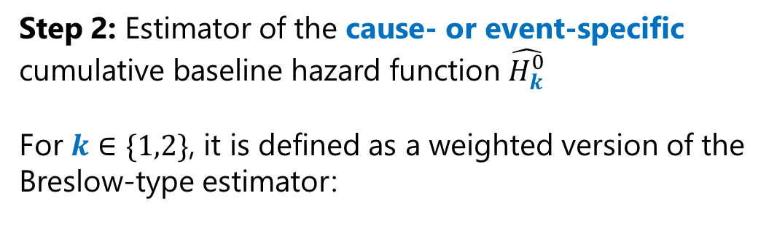
Target trial specification & emulation
Step 2: Estimator of the cause- or event-specific cumulative baseline hazard function $\hat{H_{k}^{0}}$
For $k∈\{1,2\}$, it is defined as a weighted version of the Breslow-type estimator:
Eligibility criteria
Treatment strategies
Treatment assignment
Outcome definition
Follow-up definition
Causal contrasts
Statistical analysis
Assumptions
Choice of weights
Estimation
106
Notes:
For this, we use a weighted version of the Breslow-type estimator… [Andersen 2012]

Slide 107

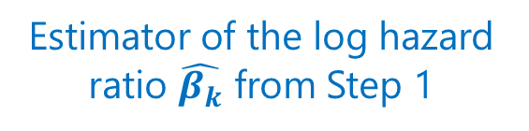
Target trial specification & emulation
Step 2: Estimator of the cause- or event-specific cumulative baseline hazard function $\hat{H_{k}^{0}}$
For $k∈\{1,2\}$, it is defined as a weighted version of the Breslow-type estimator:
$$∀ t>0: \hat{H_{k}^{0}}\left(t\right)=\sum_{\{i:{ E}_{i}=k,T_{i}≤t\}}{\frac{\hat{w_{i}}}{\sum_{j=1}^{n}{\hat{w_{j}}exp⁡\left(\hat{β_{k}}A_{j}\right)𝕀\left(T_{j}≥T_{i}\right)}}}$$
Eligibility criteria
Treatment strategies
Treatment assignment
Outcome definition
Follow-up definition
Causal contrasts
Statistical analysis
Assumptions
Choice of weights
Estimation
Estimator of the log hazard ratio $\hat{β_{k}}$ from Step 1
107
Notes:
…in which we plug in the estimator of beta_k established in the previous step.

Slide 108
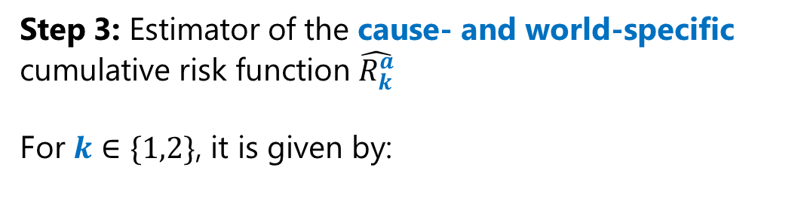
Target trial specification & emulation
Step 3: Estimator of the cause- and world-specific cumulative risk function $\hat{R_{k}^{a}}$
For $k∈\{1,2\}$, it is given by:
Eligibility criteria
Treatment strategies
Treatment assignment
Outcome definition
Follow-up definition
Causal contrasts
Statistical analysis
Assumptions
Choice of weights
Estimation
108
Notes:
Then, we are ready to estimate the cumulative risk function for each event type k and in each counterfactual world a.

Slide 109


Target trial specification & emulation
Step 3: Estimator of the cause- and world-specific cumulative risk function $\hat{R_{k}^{a}}$
For $k∈\{1,2\}$, it is given by:
$$∀ t>0: \hat{R_{k}^{a}}\left(t\right)=\sum_{\{i:{ E}_{i}=k,T_{i}≤t\}}{\frac{\hat{w_{i}}\exp\left(−\hat{H_{1}^{0}}\left(T_{i}\right)\exp\left(\hat{β_{1}}a\right)−\hat{H_{2}^{0}}\left(T_{i}\right)\exp\left(\hat{β_{2}}a\right)\right)}{\sum_{j=1}^{n}{\hat{w_{j}}exp⁡\left(\hat{β_{k}}A_{j}\right)𝕀\left(T_{j}≥T_{i}\right)}}}$$
Eligibility criteria
Treatment strategies
Treatment assignment
Outcome definition
Follow-up definition
Causal contrasts
Statistical analysis
Assumptions
Choice of weights
Estimation
Plug-in estimator of the survival function $S^{a}$
109
Notes:
The term at the numerator is a plug-in estimator of the survival function S in the counterfactual world a, evaluated at the follow-up times T(i) of patients who had an event of type k.

Slide 110

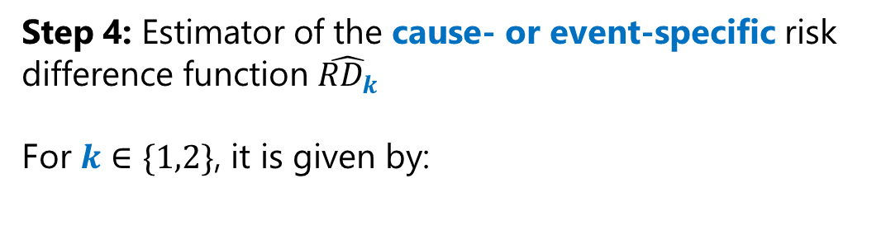
Target trial specification & emulation
Step 4: Estimator of the cause- or event-specific risk difference function $\hat{{RD}_{k}}$
For $k∈\{1,2\}$, it is given by:
$∀t>0: \hat{{RD}_{k}}\left(t\right)=\hat{R_{k}^{1}}(t)−$ $\hat{R_{k}^{0}}(t)$
Eligibility criteria
Treatment strategies
Treatment assignment
Outcome definition
Follow-up definition
Causal contrasts
Statistical analysis
Assumptions
Choice of weights
Estimation
110
Notes:
Now that we have an estimator of the cumulative risk in each counterfactual world a, we can compute the difference between the two estimators to obtain a measure of the relative risk of experiencing an event of each type over time.

