Slide 1
Emulation of the ACORN RCT using observational data from a large integrated health system in California
Causal inference workshop
Marie-Laure Charpignon
June 10, 2026
1

Slide 2
Sepsis in short
Sepsis is the body's extreme response to an infection.
Multiple sources of infection exist:
Gastro-intestinal
Pulmonary
Skin
Urinary, etc.
Sepsis cases are caused by:
Mostly bacterial infections
Yet viral and fungal infections also possible
2
Notes:
This work is about sepsis. Sepsis is when your body responds to an infection in an extreme manner. There are multiple sources of infection, which complicates diagnosis.
It can be gastrointestinal, pulmonary, dermatological, or genito-urinary.
Sepsis cases, for the most part, are due to bacterial infections, but they can also result from influenza.

Slide 3
Key figures on sepsis
In the US, 1.7M people experience sepsis every year, with 87% of cases originating outside the hospital.
Over 350k people die during their stay or in a hospice, making sepsis the third most common cause of death in US hospitals.
Sepsis care costs $62B to US hospitals annually.
3
Notes:
I have compiled a key figures on sepsis to tell you why it matters. In the U.S., every single year, about 1.7 million people experience sepsis, and 87 percent of these infections originate outside of the hospital.
The remainder would be a nosocomial infection coming from hospital settings. And out of these 1.7 million patients, about 350 die either during their hospital stay or after they are discharged to a hospice, which represents a mortality rate of about 21%. And that makes sepsis the third most common cause of death in U.S. hospitals.
From an economic standpoint, sepsis care requires skilled nursing and costs about $62 billion annually.

Slide 4
Sepsis diagnosis and treatment bring challenges
Sepsis may be challenging to diagnose as symptoms are shared with many other conditions (e.g., fever, elevated HR, low BP).
Key treatments include:
IV fluid resuscitation
Vasopressors
Antibiotics
Yet physicians face trade-offs when ordering antibiotics:
Treat rapidly as the risk of death increases by 4-9% per hour of delay
Cover a broad range of bacteria while waiting for culture results
Avoid neurological and life-threatening side effects
Mitigate the development of antimicrobial resistance
4
Notes:
In addition to these key figures that underscore the importance of sepsis, I want to emphasize that it is challenging to diagnose this condition and it is also challenging to treat it. It's not because we don't have solutions, it's just because timing is
difficult and differential diagnosis too.
So first, sepsis is challenging to diagnose. Why? Because when people arrive at the ED or ICU, they actually present symptoms that are shared with many other conditions, i.e., they are non-specific. For example: fever, elevated heart rate, low blood pressure, etc. could all be associated with other conditions.
We have key treatments, including intravenous fluid resuscitation, vasopressors, and antibiotics,
which is going to be the focus of this talk. But when it comes to ordering antibiotics, physicians
have several tradeoffs to consider. First, physicians need to treat people rapidly.
Why? Because for every hour that you delay treatment, the risk of death increases by up to 10%.
Then physicians do not know yet, at the time the patient presents, which bacteria are responsible for the infection. So, they need to cover a broad range of bacteria because they haven't received the results from microbiology. They also want to monitor side effects because these antibiotics can neurological and renal damage. That is why safety concerns are real and are going to be the focus today. And of course, as you all know, antimicrobial resistance is growing, and so you don't want to over-prescribe antibiotics when it’s not necessary. In sum, there are many tradeoffs to consider when it comes to sepsis care.

Slide 5
Opportunity to inform decision-making in sepsis care
New sepsis guidelines since November 2021:
Treat with antibiotics within 1 hour versus 3 hours previously
CDC initiative to support sepsis care since August 2023:
73% of hospitals have a sepsis committee
55% of those have program leaders with dedicated time to evaluate sepsis protocols in real-world settings
5
Notes:
Now, the role I think we have as researchers is to inform decision-making for sepsis care. Why? Because recent changes in guidelines and new initiatives really give a role to causal inference. The first realization, during the COVID-19 pandemic, was that we needed to treat more rapidly.
The recommendation is now to treat within 1 hour rather than 3 hours. Later in this presentation, you'll see that in the trial, they do manage to hit that one-hour limit. In observational data, we don't, and we will be able to discuss that.
In addition, the CDC now has a special initiative on sepsis protocols and their evaluation in the real world. And more than 70% of hospitals have what they call a dedicated sepsis committee.
And out of these, 55% have dedicated time for program leaders to evaluate how sepsis protocols are followed and how it associates or not with differential effectiveness and monitoring of side effects among sepsis patients.
So, I think we have this opportunity to inform decision-making in sepsis care.

Slide 6
Clinical equipoise re: efficacy, uncertainty re: safety
Antibiotics ordered before identification of the responsible pathogen
Among patients at risk for infection with resistant gram-negative bacteria (e.g., Escherichia coli), two antibiotics are highly prescribed:
Cefepime (cephalosporin class)
Zosyn (penicillin and beta-lactamase inhibitor class)
Clinical equipoise regarding their effectiveness
But uncertainty about renal and neurological side effects
First large safety RCT conducted in 2021-2022 at a single site, Vanderbilt University Medical Center (Tennessee)
6
Notes:
Now, what do we know? And what is it that we don't know?
The first thing you need to remember is that antibiotics are ordered before the responsible pathogen has been identified.

Slide 7
The ACORN RCT in brief
Settings
2511 adults, with a median age of 58
Simple 1:1 randomization without stratification, using software integrated in the EHR system to facilitate antibiotic ordering
14-day outcome assessment window
Findings
No evidence of a differential risk of acute kidney injury (AKI) or death between Zosyn and cefepime ordering
Evidence of an increased risk of neurological dysfunction with cefepime versus Zosyn ordering
7

Slide 8
Our study
Aim
Emulate a target trial with the same inclusion/exclusion criteria as the ACORN RCT – replicating the same design, retrospectively
Clinical setting
Kaiser Permanente Northern California (KPNC), integrated healthcare delivery system with over 4.5M patients
Observational period
Longer than the original RCT, spanning 2014-2024
8

Slide 9
Objective: to assess generalizability of RCT results
Multiple aspects of generalizability
To a more diverse population of US adults
Across multiple sites
Beyond the pandemic period
Characteristics of hospitalized patients are likely to differ during the pandemic due to heightened COVID-19 transmission
Younger age at admission
Different comorbidity profile
Treatment effects may vary by subgroup and geography
Heterogeneity in vaccination coverage
Local variation in treatment resistance against certain infections
9
Notes:
Framing of our first manuscript.

Slide 10
Our causal question
What is the effect of receiving an antibiotic order of Zosyn first rather than cefepime first on renal and neurological outcomes among adults aged 18+ admitted to the ED or ICU with sepsis or suspected infection?
10
Notes:
Our causal question was: “What is the effect of receiving an antibiotic order of zosyn first rather than cefepime first on renal and neurological outcomes among adults aged 18+ admitted to the ED or ICU because of confirmed or suspected sepsis?”

Slide 11
Target trial specification & emulation
Eligibility criteria
Treatment strategies
Treatment assignment
Outcome definition
Follow-up definition
Causal contrasts
Statistical analysis
11
Notes:
To answer this causal question, we shall now specify the protocol of a hypothetical randomized trial. The protocol includes 7 key components.

Slide 12
Target trial specification & emulation
The hypothetical target trial includes 6 main inclusion/exclusion criteria:
Age ≥18 at admission between January 1, 2014, and December 31, 2024.
Admitted through the ED or to the ICU.
No inpatient or outpatient prescription of more than one dose of Zosyn or cefepime in the 7 days preceding admission.
No allergy to cephalosporins or penicillins ever documented in the EHR.
No contraindication to Zosyn or cefepime ever documented in the EHR.
Not incarcerated.
Eligibility criteria
Treatment strategies
Treatment assignment
Outcome definition
Follow-up definition
Causal contrasts
Statistical analysis
12
Notes:
The first step of the protocol consists in specifying the criteria that determine eligibility to enter the target trial. In the context of our antibiotic TTE, 6 main inclusion/exclusion criteria are considered.

Slide 13
Target trial specification & emulation
Initiation of 1 of the 2 following strategies:
Inpatient prescription order for Zosyn or Cefepime made in the ED or ICU and within 12 hours of presentation to the facility
Treatment administration, dosing, and continuation decisions after the initial prescription order are left to the discretion of the clinical team.
Eligibility criteria
Treatment strategies
Treatment assignment
Outcome definition
Follow-up definition
Causal contrasts
Statistical analysis
13
Notes:
Next, the definition of our treatment strategies follows directly from the causal question.
Specifically, we considered the initiation of the two following strategies:
Either receiving an inpatient prescription order for zosyn in the 12 hours following ED or ICU admission
Or receiving the same type of order, but for cefepime
Of note, we are interested the intention-to-treat effect. Therefore, treatment administration, dosing, and continuation decisions after the initial prescription order was made are left to the discretion of the clinical team.

Slide 14
Target trial specification & emulation
Emulated randomization
By balancing baseline confounders, including:
Admission-related factors: ED/ICU, care order
Suspected infection site and type
Risk scores: Charlson comorbidity index, SOFA
Comorbidities: diabetes, CVD
Socio-demographics: age, sex, race, ethnicity
Prior healthcare utilization: # of ED visits
Prior dispensed prescriptions: anticoagulants
Renal function: prior RRT history
Neurological status: coma, delirium
Other concurrent treatments: mechanical ventilation
Eligibility criteria
Treatment strategies
Treatment assignment
Outcome definition
Follow-up definition
Causal contrasts
Statistical analysis
14
Notes:
In the emulated version of the target trial, we can not achieve perfect randomization, but we can emulate it -- precisely by balancing baseline confounders between the two arms.

Slide 15
Target trial specification & emulation
Eligibility criteria
Treatment strategies
Treatment assignment
Outcome definition
Follow-up definition
Causal contrasts
Statistical analysis
In both
Physicians and patients are aware of the assigned treatment because we can emulate only a pragmatic trial!
Sources: Ford & Norrie (NEJM, 2016), NIA (2017)
15
Notes:
Importantly, in both the hypothetical target trial and its emulated version, physicians and patients would be aware of the assigned treatment because we can only emulate a pragmatic trial that will be conducted in real-world clinical practice settings rather than in controlled settings.

Slide 16
Target trial specification & emulation
Primary outcome: Incident AKI or death, defined as an ordinal outcome between 0 and 4 (with 4 = death)
Secondary outcomes:
All-cause death
Coma
Delirium
Eligibility criteria
Treatment strategies
Treatment assignment
Outcome definition
Follow-up definition
Causal contrasts
Statistical analysis
16

Slide 17
Assessment of renal function
Pre-illness:
Lowest creatinine between 12 months and 24 hours before first antibiotic order
On-study:
Highest creatinine from enrollment to 14 days after first antibiotic order
Peri-enrollment:
Closest creatinine 24 hours before or 6 hours after first antibiotic order

Slide 18
Definition of acute kidney injury (AKI)
AKI definition: based on Kidney Disease Improving Global Outcomes (KDIGO) criteria
Uses creatinine values, renal replacement treatment (RRT) and death
Baseline value: lowest creatinine from pre-illness and peri-enrollment
Incident AKI stage | Definition
0 | Creatinine increased by <1.5 times baseline and increased by <0.3 mg/dL, no new RRT
1 | Creatinine increased by 1.5–1.9 times baseline or increased by ≥0.3 mg/dL
2 | Creatinine increased by 2.0–2.9 times baseline
3 | Creatinine increased by ≥3.0 times baseline or increase to ≥4.0 mg/dL or new RRT
4 | Death

Slide 19
Target trial specification & emulation
Eligibility criteria
Treatment strategies
Treatment assignment
Outcome definition
Follow-up definition
Causal contrasts
Statistical analysis
Clock start:
First study antibiotic order
Clock end:
14 days after
19

Slide 20
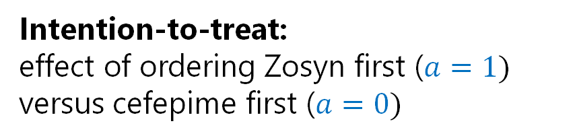
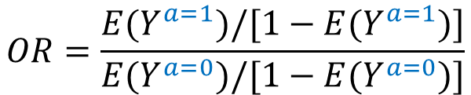
Target trial specification & emulation
Eligibility criteria
Treatment strategies
Treatment assignment
Outcome definition
Follow-up definition
Causal contrasts
Statistical analysis
Intention-to-treat: effect of ordering Zosyn first ($a=1)$
versus cefepime first ($a=0)$
$$OR=\frac{E(Y^{a=1})/[1−{E(Y}^{a=1})]}{E(Y^{a=0})/[1−E(Y^{a=0})]}$$
20

Slide 21
Handling repeat hospitalizations
4 options
Consider each hospitalization as independent
Select only the first hospitalization for each patient
Perform B bootstrap iterations
If the patient has 1 hosp., then always include it
If the patient has >1 hosp., then sample one at random
Keep all, report clustered standard errors

Slide 22
Target trial specification & emulation
Eligibility criteria
Treatment strategies
Treatment assignment
Outcome definition
Follow-up definition
Causal contrasts
Statistical analysis
Binary outcome models
Effect measures for primary and secondary outcomes estimated via TMLE using ‘glmnet’ and ‘xgboost’ as learners
Clustered standard errors
By patient ID
By patient ID x facility ID
Sensitivity analysis for primary outcome
Proportional odds model (as in the RCT)
22

Slide 23
Preliminary results

Slide 24
Consort diagram
Hospitalizations for sepsis or susp. infection
01/01/2014 to 12/31/2024
n=673,381
Exclude
n=503,059
- Received study antibiotic in prior 7 days (n=30)
- Prior allergy to study antibiotic (n=6,615)
- No study antibiotic order within 12 hours of arr. (n=480,366)
- Study antibiotic administration without an order (n=118)
- Study antibiotic order outside ED or ICU (n=15,930)
First study antibiotic order
within 12 hours of arrival
n=170,322
Zosyn
n=143,495
Cefepime
n=26,827

Slide 25
Repeat hospitalizations
122,336 unique patients
22.6% have 2+ hospitalizations
14.5% have 2
4.4% have 3
3.6% have 4+

Slide 26
Baseline covariates
115 covariates, grouped into 10 themes
Admission-related factors (p=6)
Suspected infection site and type (p=9)
Risk scores (p=4)
Comorbidities (p=19 + 1)
Socio-demographics and temporal factor (p=9 + 1)
Prior healthcare utilization (p=14)
Prior dispensed prescriptions (p=40)
Renal function (p=4 + 2)
Neurological status (p=3)
Other concurrent treatments (p=3)

Slide 27
Baseline covariates with missing data
4 covariates affected, spanning 3 themes
Comorbidities: 1/19 BMI (<0.1% missing)
Socio-demographics: 1/9 Neighborhood deprivation index or NDI (0.6% missing)
Renal function: 2/4 Pre-illness creatinine (8.9% missing) Peri-enrollment creatinine (0.2% missing)
Mean imputation
Overall and stratified by treatment arm
Four binary indicators for missingness

Slide 28
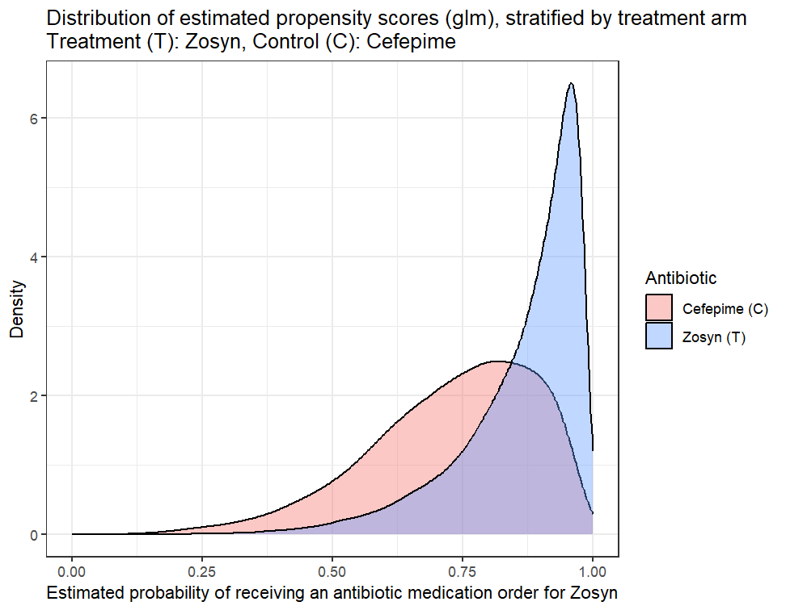
Visual assessment of overlap (1)
Propensity scores estimated with a non-regularized logistic regression, using ‘glm’

Slide 29
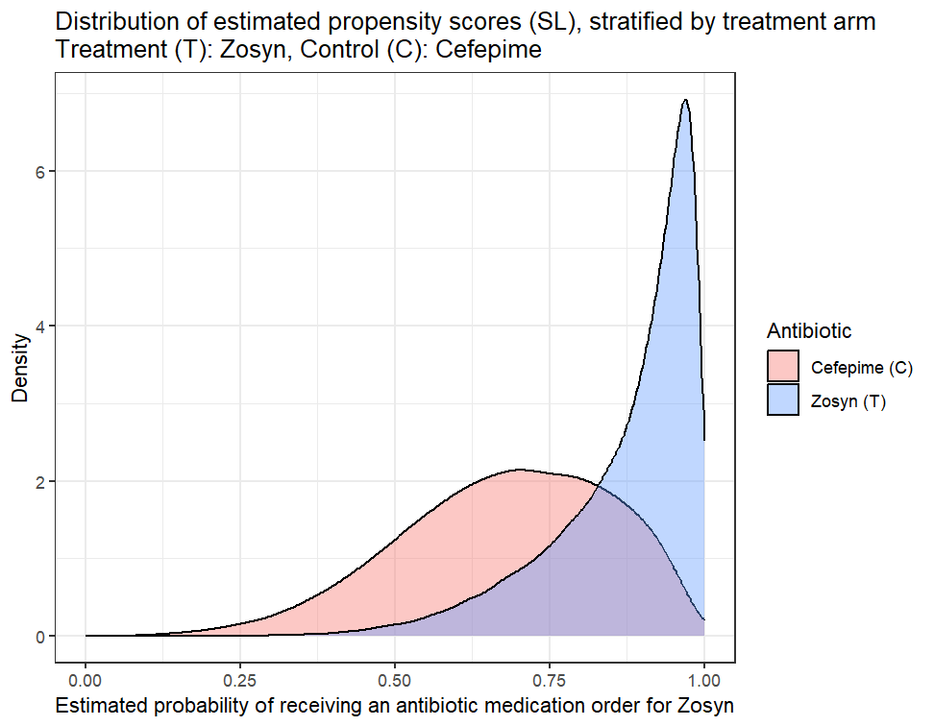
Visual assessment of overlap (2)
Propensity scores estimated with SuperLearner, using ‘glmnet’ and ‘xgboost’ as learners

Slide 30
Summary of covariate imbalance at baseline
24/115 covariates lacked balance, spanning 6/10 themes
Prior healthcare utilization: 13/14
Risk scores: 3/4
Socio-demographics and temporal factor: 3/10
Suspected infection site and type: 1/9
Comorbidities: 2/20
Prior dispensed prescriptions: 2/40
Admission-related characteristics: 0/6
Renal function: 0/6
Neurological status: 0/3
Other concurrent treatments: 0/3

Slide 31
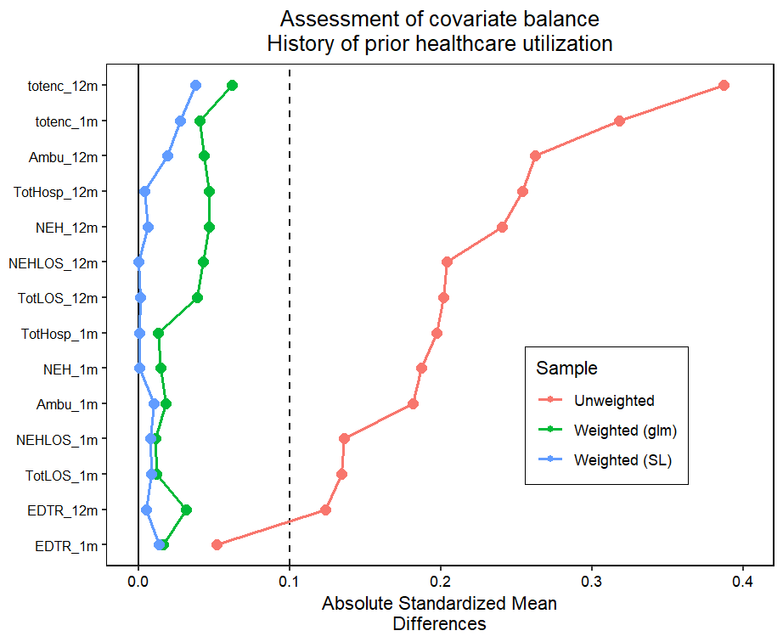
Greater healthcare utilization in the prior month and year among cefepime patients.
Totenc: total encounters, NEH: non-elective hospitalizations, EDTR: ED visits, LOS: length of stay

Slide 32
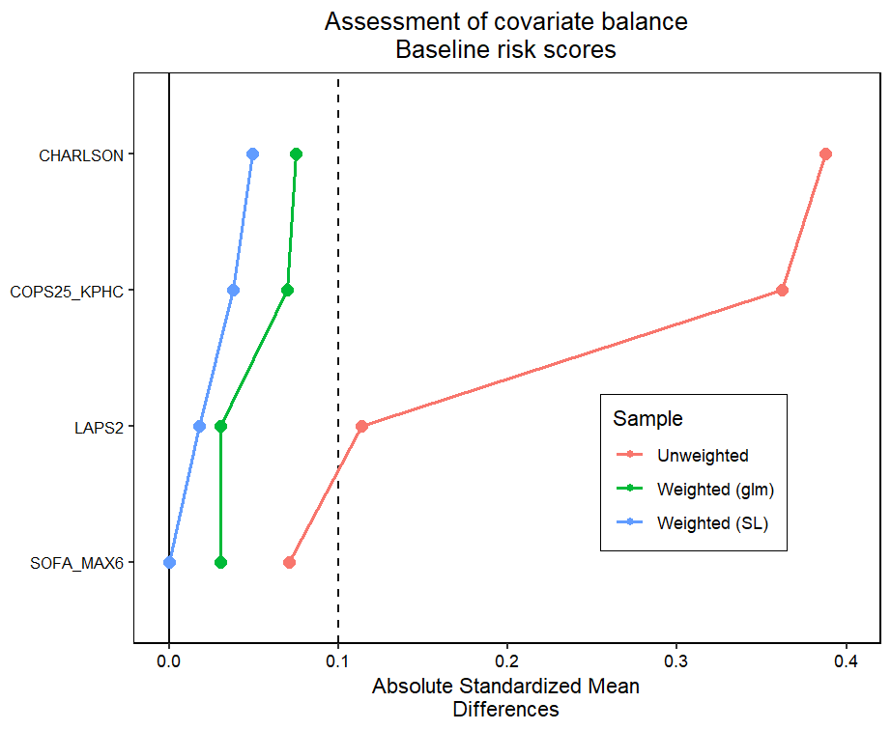
Cefepime patients were sicker at baseline than Zosyn patients, on average.

Slide 33
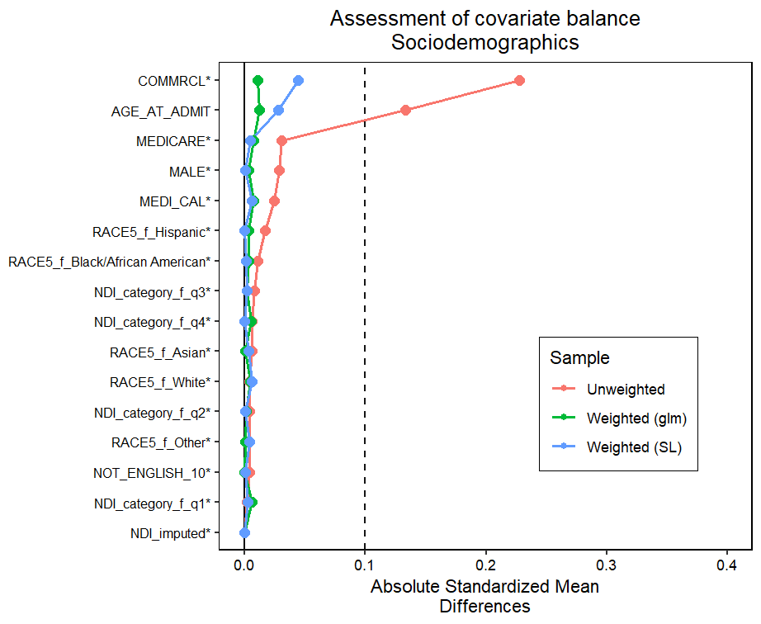
Zosyn patients were more likely to have a commercial insurance.
Cefepime patients were slightly older than Zosyn patients, on average.

Slide 34
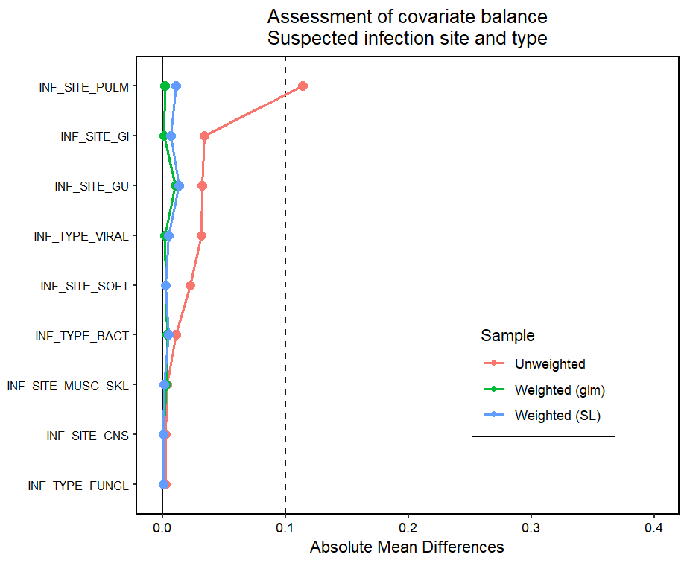
Cefepime patients were more likely to have a pulmonary infection.

Slide 35
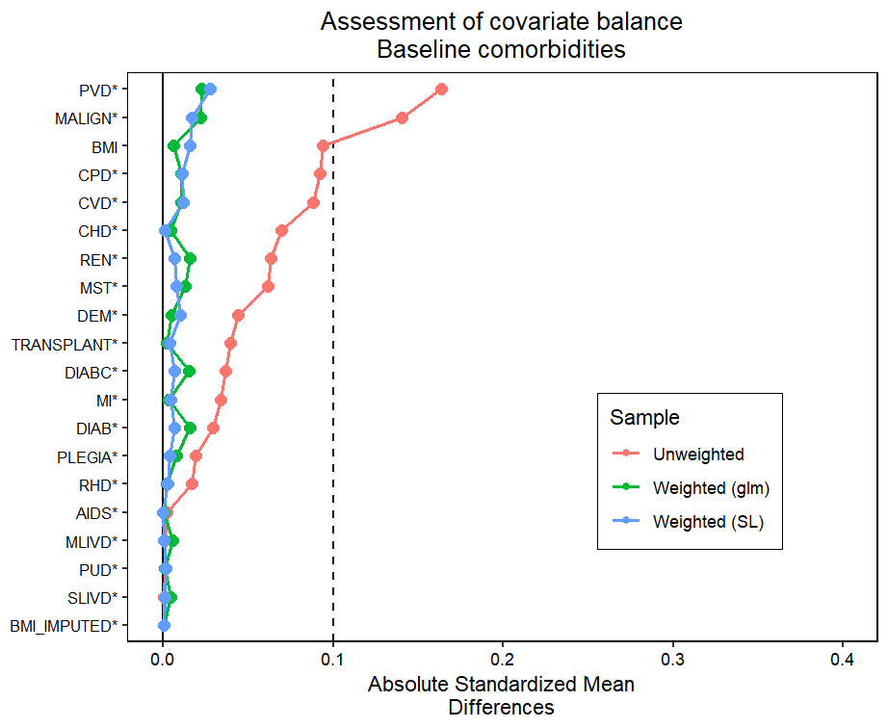
Cefepime patients were more likely to have a prior history of:
Peripheral vascular disease
Cancer

Slide 36
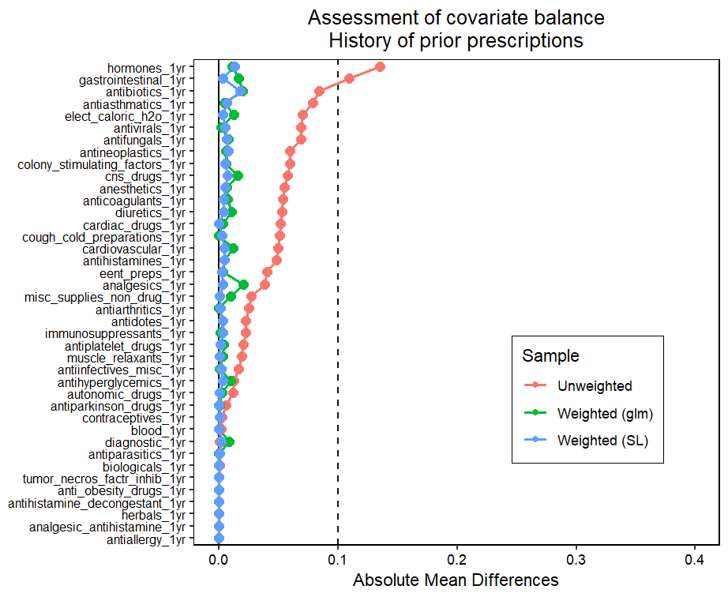
Cefepime patients were more likely to have filled a prescription of the following in prior year:
Hormonal treatments
GI drugs

Slide 37
Primary outcome

Slide 38
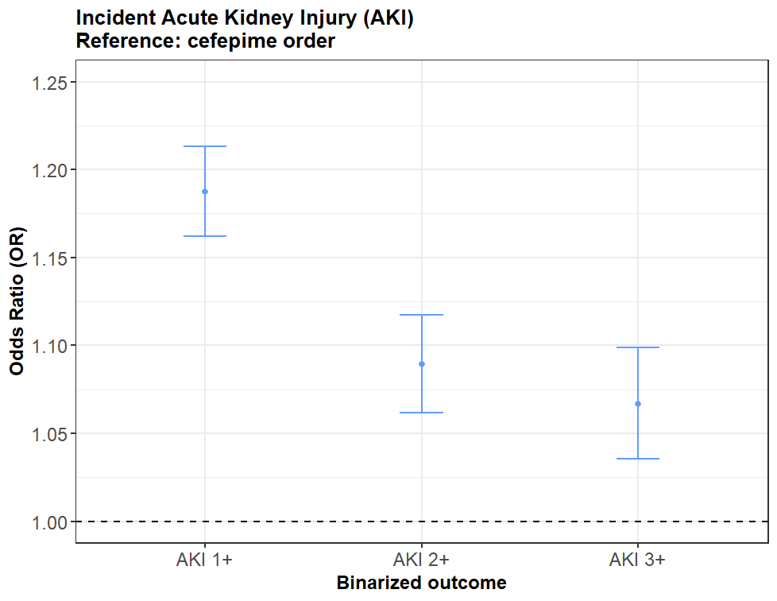
Results suggest a detrimental effect of Zosyn ordering, relative to cefepime, across AKI levels.
OR: ITT effect of ordering Zosyn first versus cefepime first
Notes:
95% CIs are clustered by patient identifier. I also tried clustering by the tuple patient identifier x facility identifier. The results were almost identical.

Slide 39
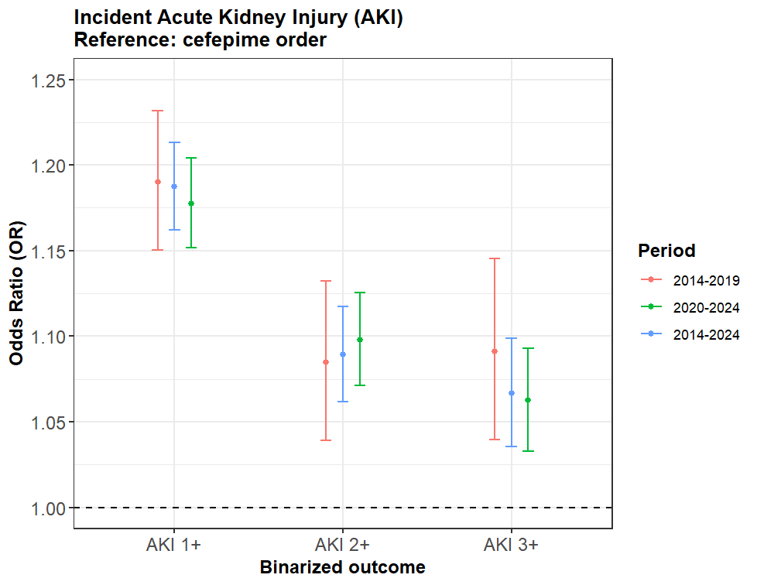
Estimated effect seems to hold across time periods, both before and after the pandemic.
OR: ITT effect of ordering Zosyn first versus cefepime first
Notes:
95% CIs are clustered by patient identifier. I also tried clustering by the tuple patient identifier x facility identifier. The results were almost identical.

Slide 40
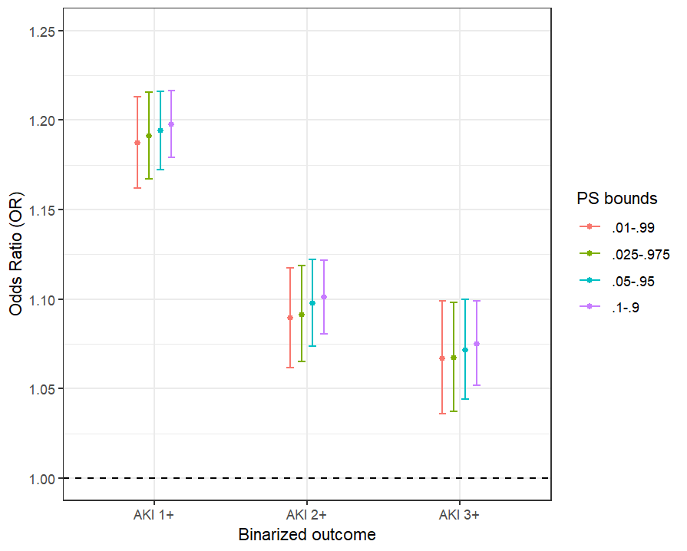
Estimated effect seems robust to the truncation of estimated propensity scores.
OR: ITT effect of ordering Zosyn first versus cefepime first

Slide 41
If assuming proportional odds model, as in the RCT
PO model
Single OR for ITT effect on AKI of ordering Zosyn first versus cefepime first
Distinct intercept for each AKI stage transition
So far, weighting but no further adjustment in outcome model
Without bootstrap procedure
Propensity scores learnt via ‘glm’ OR = 1.10 (95% CI: 1.07-1.13)
Propensity scores learnt via SuperLearner with ‘glmnet’ and ‘xgboost’ OR = 1.13 (95% CI: 1.10-1.16)
With bootstrap procedure
As a next step!

Slide 42
Secondary outcomes

Slide 43
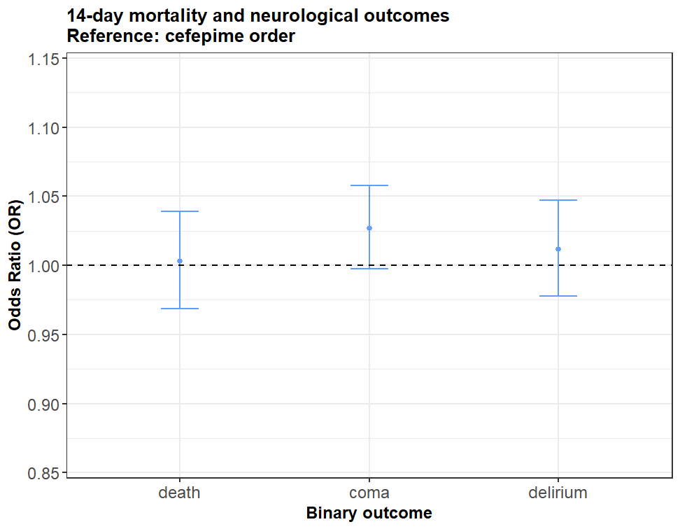
No evidence of a differential effect of Zosyn vs cefepime ordering for death or neurological function.
OR: ITT effect of ordering Zosyn first versus cefepime first
Notes:
95% CIs are clustered by patient identifier. I also tried clustering by the tuple patient identifier x facility identifier. The results were almost identical.

Slide 44
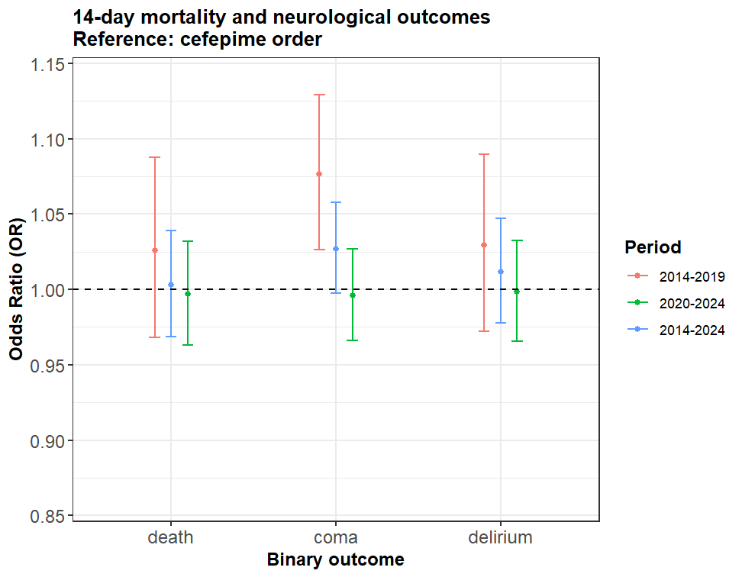
Variation by period in the estimated effect of Zosyn vs cefepime ordering on coma during follow-up.
OR: ITT effect of ordering Zosyn first versus cefepime first
Notes:
95% CIs are clustered by patient identifier. I also tried clustering by the tuple patient identifier x facility identifier. The results were almost identical.

Slide 45
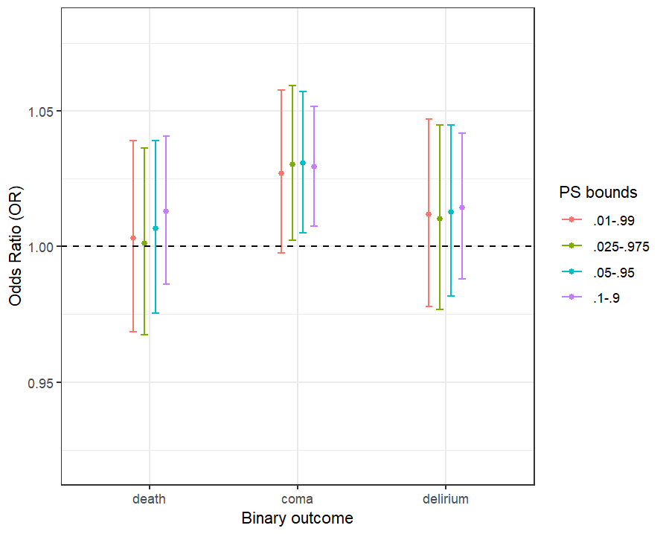
Variation by period in the estimated effect of Zosyn vs cefepime ordering on coma during follow-up.
OR: ITT effect of ordering Zosyn first versus cefepime first
Notes:
95% CIs are clustered by patient identifier. I also tried clustering by the tuple patient identifier x facility identifier. The results were almost identical.

Slide 46
Takeaways
Primary AKI outcome
Results differ from RCT but align with prior observational studies
Suggesting a detrimental effect of ordering Zosyn first versus cefepime first
Secondary outcomes
Death: aligned with RCT, no evidence of a difference
Coma: variation by period
Delirium: different from RCT, no evidence of a difference
Challenges of emulating a critical care RCT in real-world EHR data

Slide 47
Next steps

Slide 48
Research directions to discuss with the group
Discovery of subgroups with heterogeneous treatment effects
Replication in open critical care databases (e.g., MIMIC, eICU) and locally within AP-HP
Federation of target trial emulations
Per-protocol analysis accounting for antibiotic sequence
Comparison with VUMC RCT data and fusion if possible
Use of physician prescribing preferences as candidate IVs
Extension to pediatric population

Slide 49
 | Target trial cohort |  | RCT cohort
Covariate | Cefepime (n=26827) | Zosyn (n=143495) | Cefepime (n=1214) | Zosyn (n=1297)
Age, median (IQR) [min-max] | 71 (60-80) [18-108] | 69 (57-80) [18-113] | 57 (42 to 68) | 59 (44 to 69) [n=1296]
Race and ethnicity, No./total (%)
Hispanic | 4775 (17.8%) | 28002 (19.5%) | 59/1186 (5.0%) | 73/1264 (5.8%)
Non-Hispanic Asian | 3563 (13.3%) | 18213 (12.7%) | Category collapsed with 'Other'.
Non-Hispanic Black | 2610 (9.7%) | 12372 (8.6%) | 190/1186 (16.0%) | 209/1264 (16.5%)
Non-Hispanic White | 14458 (53.9%) | 76720 (53.5%) | 913/1186 (77.0%) | 950/1264 (75.2%)
Other | 1421 (5.3%) | 8188 (5.7%) | 24/1186 (2.0%) | 32/1264 (2.5%)
Hours from hospital presentation to order, median (IQR) [min-max] | 2.18 (1.05-4.05) [0-12] | 2.10 (1.05-3.8) [0-12] | 1.3 (0.5 to 3.7) | 1.1 (0.4 to 3.2)
Location at order, No. (%)
ED | 26229 (97.8%) | 139753 (97.4%) | 1135 (93.5%) | 1243 (95.8%)
ICU | 598 (2.2%) | 3742 (2.6%) | 79 (6.5%) | 54 (4.2%)
CCI, median (IQR) [min-max] | 6 (3-8) [0-20] | 4 (2-7) [0-21] | 4 (2 to 7) [n = 1191] | 4 (2 to 6) [n = 1276]
CKD, No./total (%) | 11372 (42.4%) | 51741 (36.1%) | 243/1191 (20.4%) | 259/1276 (20.3%)
Prior receipt of RRT | 3158 (11.8%) | 14438 (10.1%) | 78 (6.4%) | 67 (5.2%)
Notes:
On average, patients in the RCT cohort were about 10 years younger than patients in the target trial cohort.

Slide 50
 | Target trial cohort |  | RCT cohort
Covariate | Cefepime (n=26827) | Zosyn (n=143495) | Cefepime (n=1214) | Zosyn (n=1297)
Age, median (IQR) [min-max] | 71 (60-80) [18-108] | 69 (57-80) [18-113] | 57 (42 to 68) | 59 (44 to 69) [n=1296]
Race and ethnicity, No./total (%)
Hispanic | 4775 (17.8%) | 28002 (19.5%) | 59/1186 (5.0%) | 73/1264 (5.8%)
Non-Hispanic Asian | 3563 (13.3%) | 18213 (12.7%) | Category collapsed with 'Other'.
Non-Hispanic Black | 2610 (9.7%) | 12372 (8.6%) | 190/1186 (16.0%) | 209/1264 (16.5%)
Non-Hispanic White | 14458 (53.9%) | 76720 (53.5%) | 913/1186 (77.0%) | 950/1264 (75.2%)
Other | 1421 (5.3%) | 8188 (5.7%) | 24/1186 (2.0%) | 32/1264 (2.5%)
Hours from hospital presentation to order, median (IQR) [min-max] | 2.18 (1.05-4.05) [0-12] | 2.10 (1.05-3.8) [0-12] | 1.3 (0.5 to 3.7) | 1.1 (0.4 to 3.2)
Location at order, No. (%)
ED | 26229 (97.8%) | 139753 (97.4%) | 1135 (93.5%) | 1243 (95.8%)
ICU | 598 (2.2%) | 3742 (2.6%) | 79 (6.5%) | 54 (4.2%)
CCI, median (IQR) [min-max] | 6 (3-8) [0-20] | 4 (2-7) [0-21] | 4 (2 to 7) [n = 1191] | 4 (2 to 6) [n = 1276]
CKD, No./total (%) | 11372 (42.4%) | 51741 (36.1%) | 243/1191 (20.4%) | 259/1276 (20.3%)
Prior receipt of RRT | 3158 (11.8%) | 14438 (10.1%) | 78 (6.4%) | 67 (5.2%)
Notes:
There was greater racial and ethnic diversity in the target trial cohort than in the RCT cohort.

Slide 51
 | Target trial cohort |  | RCT cohort
Covariate | Cefepime (n=26827) | Zosyn (n=143495) | Cefepime (n=1214) | Zosyn (n=1297)
Age, median (IQR) [min-max] | 71 (60-80) [18-108] | 69 (57-80) [18-113] | 57 (42 to 68) | 59 (44 to 69) [n=1296]
Race and ethnicity, No./total (%)
Hispanic | 4775 (17.8%) | 28002 (19.5%) | 59/1186 (5.0%) | 73/1264 (5.8%)
Non-Hispanic Asian | 3563 (13.3%) | 18213 (12.7%) | Category collapsed with 'Other'.
Non-Hispanic Black | 2610 (9.7%) | 12372 (8.6%) | 190/1186 (16.0%) | 209/1264 (16.5%)
Non-Hispanic White | 14458 (53.9%) | 76720 (53.5%) | 913/1186 (77.0%) | 950/1264 (75.2%)
Other | 1421 (5.3%) | 8188 (5.7%) | 24/1186 (2.0%) | 32/1264 (2.5%)
Hours from hospital presentation to order, median (IQR) [min-max] | 2.18 (1.05-4.05) [0-12] | 2.10 (1.05-3.8) [0-12] | 1.3 (0.5 to 3.7) | 1.1 (0.4 to 3.2)
Location at order, No. (%)
ED | 26229 (97.8%) | 139753 (97.4%) | 1135 (93.5%) | 1243 (95.8%)
ICU | 598 (2.2%) | 3742 (2.6%) | 79 (6.5%) | 54 (4.2%)
CCI, median (IQR) [min-max] | 6 (3-8) [0-20] | 4 (2-7) [0-21] | 4 (2 to 7) [n = 1191] | 4 (2 to 6) [n = 1276]
CKD, No./total (%) | 11372 (42.4%) | 51741 (36.1%) | 243/1191 (20.4%) | 259/1276 (20.3%)
Prior receipt of RRT | 3158 (11.8%) | 14438 (10.1%) | 78 (6.4%) | 67 (5.2%)
Notes:
On average, the time delay between hospital presentation and antibiotic ordering was larger in the target trial cohort than in the RCT cohort.

Slide 52
 | Target trial cohort |  | RCT cohort
Covariate | Cefepime (n=26827) | Zosyn (n=143495) | Cefepime (n=1214) | Zosyn (n=1297)
Age, median (IQR) [min-max] | 71 (60-80) [18-108] | 69 (57-80) [18-113] | 57 (42 to 68) | 59 (44 to 69) [n=1296]
Race and ethnicity, No./total (%)
Hispanic | 4775 (17.8%) | 28002 (19.5%) | 59/1186 (5.0%) | 73/1264 (5.8%)
Non-Hispanic Asian | 3563 (13.3%) | 18213 (12.7%) | Category collapsed with 'Other'.
Non-Hispanic Black | 2610 (9.7%) | 12372 (8.6%) | 190/1186 (16.0%) | 209/1264 (16.5%)
Non-Hispanic White | 14458 (53.9%) | 76720 (53.5%) | 913/1186 (77.0%) | 950/1264 (75.2%)
Other | 1421 (5.3%) | 8188 (5.7%) | 24/1186 (2.0%) | 32/1264 (2.5%)
Hours from hospital presentation to order, median (IQR) [min-max] | 2.18 (1.05-4.05) [0-12] | 2.10 (1.05-3.8) [0-12] | 1.3 (0.5 to 3.7) | 1.1 (0.4 to 3.2)
Location at order, No. (%)
ED | 26229 (97.8%) | 139753 (97.4%) | 1135 (93.5%) | 1243 (95.8%)
ICU | 598 (2.2%) | 3742 (2.6%) | 79 (6.5%) | 54 (4.2%)
CCI, median (IQR) [min-max] | 6 (3-8) [0-20] | 4 (2-7) [0-21] | 4 (2 to 7) [n = 1191] | 4 (2 to 6) [n = 1276]
CKD, No./total (%) | 11372 (42.4%) | 51741 (36.1%) | 243/1191 (20.4%) | 259/1276 (20.3%)
Prior receipt of RRT | 3158 (11.8%) | 14438 (10.1%) | 78 (6.4%) | 67 (5.2%)
Notes:
At the time of antibiotic ordering, an even smaller share of the target trial cohort was in the ICU, relative to the RCT cohort.

Slide 53
 | Target trial cohort |  | RCT cohort
Covariate | Cefepime (n=26827) | Zosyn (n=143495) | Cefepime (n=1214) | Zosyn (n=1297)
Age, median (IQR) [min-max] | 71 (60-80) [18-108] | 69 (57-80) [18-113] | 57 (42 to 68) | 59 (44 to 69) [n=1296]
Race and ethnicity, No./total (%)
Hispanic | 4775 (17.8%) | 28002 (19.5%) | 59/1186 (5.0%) | 73/1264 (5.8%)
Non-Hispanic Asian | 3563 (13.3%) | 18213 (12.7%) | Category collapsed with 'Other'.
Non-Hispanic Black | 2610 (9.7%) | 12372 (8.6%) | 190/1186 (16.0%) | 209/1264 (16.5%)
Non-Hispanic White | 14458 (53.9%) | 76720 (53.5%) | 913/1186 (77.0%) | 950/1264 (75.2%)
Other | 1421 (5.3%) | 8188 (5.7%) | 24/1186 (2.0%) | 32/1264 (2.5%)
Hours from hospital presentation to order, median (IQR) [min-max] | 2.18 (1.05-4.05) [0-12] | 2.10 (1.05-3.8) [0-12] | 1.3 (0.5 to 3.7) | 1.1 (0.4 to 3.2)
Location at order, No. (%)
ED | 26229 (97.8%) | 139753 (97.4%) | 1135 (93.5%) | 1243 (95.8%)
ICU | 598 (2.2%) | 3742 (2.6%) | 79 (6.5%) | 54 (4.2%)
CCI, median (IQR) [min-max] | 6 (3-8) [0-20] | 4 (2-7) [0-21] | 4 (2 to 7) [n = 1191] | 4 (2 to 6) [n = 1276]
CKD, No./total (%) | 11372 (42.4%) | 51741 (36.1%) | 243/1191 (20.4%) | 259/1276 (20.3%)
Prior receipt of RRT | 3158 (11.8%) | 14438 (10.1%) | 78 (6.4%) | 67 (5.2%)
Notes:
The cefepime arm is more comorbid in the target trial cohort than in the RCT cohort.

Slide 54
 | Target trial cohort |  | RCT cohort
Covariate | Cefepime (n=26827) | Zosyn (n=143495) | Cefepime (n=1214) | Zosyn (n=1297)
Age, median (IQR) [min-max] | 71 (60-80) [18-108] | 69 (57-80) [18-113] | 57 (42 to 68) | 59 (44 to 69) [n=1296]
Race and ethnicity, No./total (%)
Hispanic | 4775 (17.8%) | 28002 (19.5%) | 59/1186 (5.0%) | 73/1264 (5.8%)
Non-Hispanic Asian | 3563 (13.3%) | 18213 (12.7%) | Category collapsed with 'Other'.
Non-Hispanic Black | 2610 (9.7%) | 12372 (8.6%) | 190/1186 (16.0%) | 209/1264 (16.5%)
Non-Hispanic White | 14458 (53.9%) | 76720 (53.5%) | 913/1186 (77.0%) | 950/1264 (75.2%)
Other | 1421 (5.3%) | 8188 (5.7%) | 24/1186 (2.0%) | 32/1264 (2.5%)
Hours from hospital presentation to order, median (IQR) [min-max] | 2.18 (1.05-4.05) [0-12] | 2.10 (1.05-3.8) [0-12] | 1.3 (0.5 to 3.7) | 1.1 (0.4 to 3.2)
Location at order, No. (%)
ED | 26229 (97.8%) | 139753 (97.4%) | 1135 (93.5%) | 1243 (95.8%)
ICU | 598 (2.2%) | 3742 (2.6%) | 79 (6.5%) | 54 (4.2%)
CCI, median (IQR) [min-max] | 6 (3-8) [0-20] | 4 (2-7) [0-21] | 4 (2 to 7) [n = 1191] | 4 (2 to 6) [n = 1276]
CKD, No./total (%) | 11372 (42.4%) | 51741 (36.1%) | 243/1191 (20.4%) | 259/1276 (20.3%)
Prior receipt of RRT | 3158 (11.8%) | 14438 (10.1%) | 78 (6.4%) | 67 (5.2%)
Notes:
- At baseline, the share of patients with renal disease was much larger in the target trial cohort than in the RCT cohort. - Similarly, the share of patients who had already received renal replacement therapy was larger in the target trial cohort than in the RCT cohort.

Slide 55
Thank you! Any questions? Feel free to reach out: mlaurecc@gmail.com

Slide 56
Material for discussion

Slide 57
Antibiotic ordering versus administration
Generally, antibiotic orders of Zosyn and cefepime result in a subsequent administration during the follow-up period.
Zosyn orders that do not yield an administration within 14 days: 0.7%
Cefepime orders that do not yield an administration within 14 days: 1.6%
57

Slide 58
Preliminary assessment of leakage between arms
Subsequent cefepime administration among Zosyn patients: 5.3%
Subsequent Zosyn administration among cefepime patients: 15.2%
58

Slide 59
Studying the potential synergistic effect of vancomycin, another antibiotic?
Vancomycin administration within 14 days may occur.
Among Zosyn patients: 17.6%
Among cefepime patients: 17.7%
59

Slide 60
How to use natural variation of antibiotic order across repeated hospitalizations?
Always Zosyn: 68.8%
Always cefepime: 6.3%
Variation: 24.9%
60

