Slide 1

House price Prediction
Chanpreet Kaur
Sai Kiran Mohal Sukumaran
Amrutha Bollineni

Slide 2
Content
Introduction
Overview
Algorithms Used
Models
Future Outcomes
Conclusion
References

Slide 3
Introduction
• The most crucial aspects of real estate is house price forecasting. This literature makes an effort to extract useful information from varied data.
• Machine learning techniques are used to examine historical real estate transactions in the United States in order to create models that are helpful to home buyers and sellers.
• Experiments also show that the Multiple AI models based on mean squared error measurement and accuracy are considered as the competitive strategy, which reveals the significant disparity between home prices in the most costly and most inexpensive suburbs in the United States.

Slide 4

Overview
• Predicting the property price and whether a specific user will be qualified for a loan depends greatly on the capacity to properly categorize observations.
• To forecast the specifics of the property price, we employed Lasso Regression, which is used to forecast home prices.

Slide 5
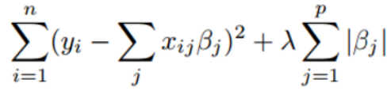
Algorithms used
Lasso Regression: This sort of predictive analysis is frequently employed. Shrinkage is used in the linear regression method known as lasso regression. Data will be shrunk toward the mean, which is beneficial when dealing with specific values or parameters or when there is multicollinearity.
The cost function is represented by
Here λ is called turning factor or shrinkage factor • When λ=0 then all variables are equivalent, or no shrinkage is needed

Slide 6
Tools
We are using Python and Jupyter notebooks for the competition.
Libraries: These are frameworks in python to handle commonly required tasks.
Pandas — For handling structured data
Scikit Learn — For machine learning
NumPy — For linear algebra and mathematics
Seaborn — For data visualization

Slide 7
Model- House pricing Prediction
•House pricing depends on multiple factors like the Home size and usable space, condition of the house, location whether it is urban, semi urban or rural and the facilities it is going to provide like kitchen, number of bedrooms and garden.
•Also factors like whether it is near the road, does the house has pool and Utilities will influence the sales price of the house.
•We use Lasso Regression model to predict the prices of houses.
•Here the data is unrefined so we need to clean the data which is also called as data preprocessing.
•For this we need to deal with the missing values or null values then we need to deal with the string values like “Sale Condition”.

Slide 8
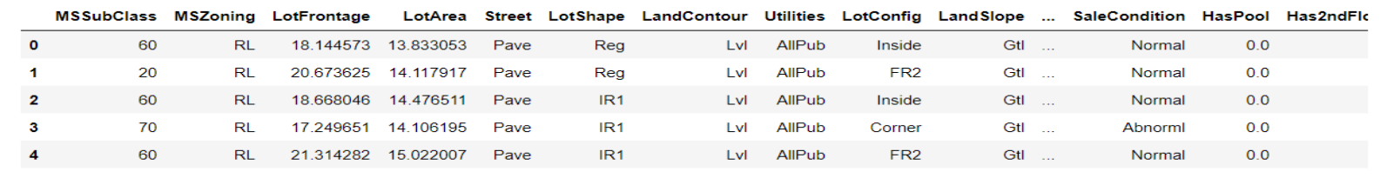
House Pricing Prediction(contd)
• We will give weights based on strings since we prefer normal conditions to abnormal ones and want to make sure that all of the data is useful for data analysis.
• We can use matplot and seaborn to create a more effective graphical representation of the data so that it makes more sense.
• As soon as we have data from both the train and the test, we merge them and preprocess them. Then split the information by 75 to 25.
• To determine the association between the variables and compare the results of the train dataset, we utilized lasso regression in the last phase. From there, we calculated the model's rmes.

Slide 9
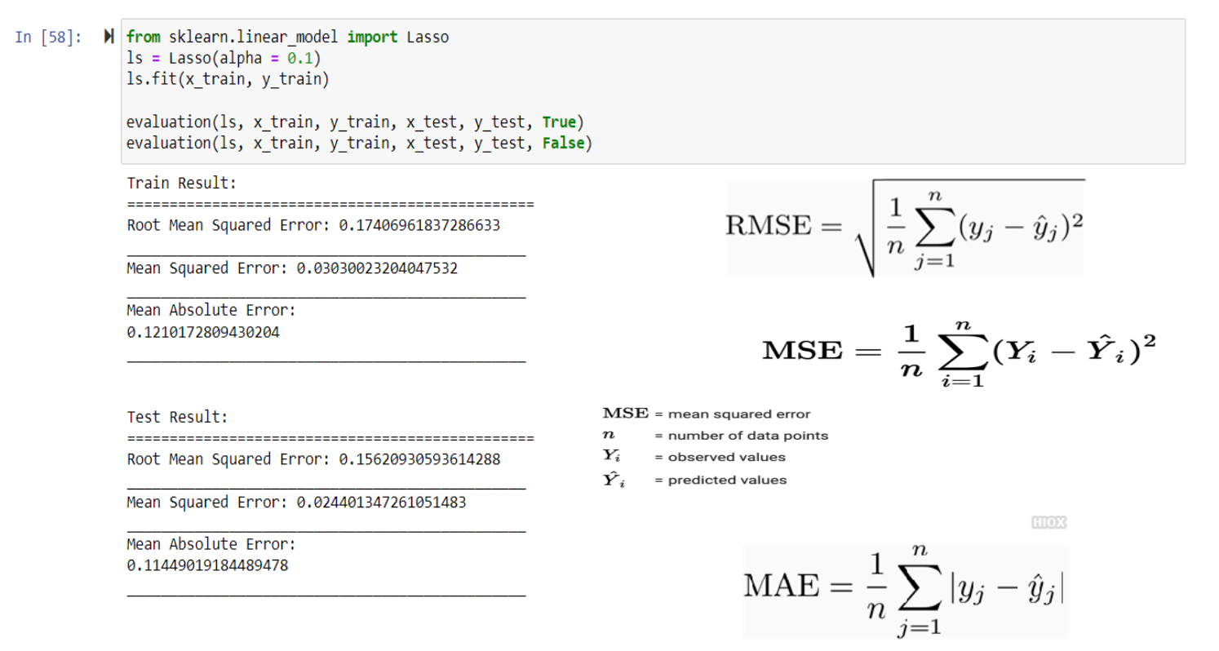

Slide 10
Future Outcomes
By utilizing the model, the end user is able to forecast the sale price of their home..
Utilizing them allows us to save time and money. By gathering additional data and altering the model's data feed, we may further enhance the model's accuracy and ability to forecast increasingly complex circumstances.
We can even include additional distributed processing and storage systems to sell our product on a larger scale.

Slide 11
Conclusion
• We may get the conclusion that the continuous dependent variable "Sales price" can be predicted using lasso regression.
• We can decrease the time complexity by employing these models, and we may further enhance this in the future by updating the model and making more sophisticated predictions.

Slide 12

References
R. A. Fisher, Statistical methods for research workers, In Breakthroughs in statistics (1992), 66–70.
• Franz Fuerst and George Matysiak, Analysing the performance of nonlisted real estate funds: a panel data analysis, Applied Economics 45 (2013), no. 14, 1777– 1788. • Richard J Herring and Susan M Wachter, Real estate booms and banking busts: An international perspective, The Wharton School Research Paper (1999), no. 99 -27
Data source: • https://www.kaggle.com/datasets/house-price-prediction?select=train.csv
• https://www.kaggle.com/datasets/house-loan-data-analysis?select=loan_data.csv

Slide 13

GitHub
https://github.com/ckaur1Unh/ArtificialIntelligence_HomeMortgagePrediction/blob/main/finalPPT.pptx

Slide 14

Thank You

