Slide 1

House Loan and Mortgage Prediction
Chanpreet Kaur
Sai Kiran Mohal Sukumaran
Amrutha Bollineni

Slide 2
Content
Introduction
Overview
Algorithms Used
Models
Future Outcomes
Conclusion
References

Slide 3
Introduction
• The two most crucial aspects of real estate are house price forecasting and mortgage approval forecasting. This literature makes an effort to extract useful information from varied data.
• Machine learning techniques are used to examine historical real estate transactions in the United States in order to create models that are helpful to home buyers and sellers.
• Experiments also show that the Multiple AI models based on mean squared error measurement and accuracy are considered as the competitive strategy, which reveals the significant disparity between home prices in the most costly and most inexpensive suburbs in the United States.

Slide 4

Overview
• Predicting the property price and whether a specific user will be qualified for a loan depends greatly on the capacity to properly categorize observations.
• To forecast the specifics of the property price and the approval of the mortgage, we employed two models. They are :
Lasso Regression, which is used to forecast home prices.
Random Forest Classifier, which is employed to forecast mortgage acceptance.

Slide 5
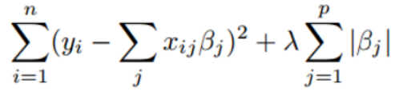
Algorithms used
Lasso Regression: This sort of predictive analysis is frequently employed. Shrinkage is used in the linear regression method known as lasso regression. Data will be shrunk toward the mean, which is beneficial when dealing with specific values or parameters or when there is multicollinearity.
The cost function is represented by
Here λ is called turning factor or shrinkage factor • When λ=0 then all variables are equivalent, or no shrinkage is needed

Slide 6
Algorithms used (contd)
• Random Forest Classifier - Regression and classification issues are solved using the random forest classifier, a machine learning approach.
• It is a procedure that combines a number of classifiers to offer answers to challenging issues.
• The decision trees that make up a random forest algorithm are many. It determines the result based on the predictions made by the decision trees. • It makes predictions by averaging or averaging out the output from different trees. The accuracy of the result grows as the number of trees increases.

Slide 7
Model- House pricing Prediction
•House pricing depends on multiple factors like the Home size and usable space, condition of the house, location whether it is urban, semi urban or rural and the facilities it is going to provide like kitchen, number of bedrooms and garden.
•Also factors like whether it is near the road, does the house has pool and Utilities will influence the sales price of the house.
•We use Lasso Regression model to predict the prices of houses.
•Here the data is unrefined so we need to clean the data which is also called as data preprocessing.
•For this we need to deal with the missing values or null values then we need to deal with the string values like “Sale Condition”.

Slide 8
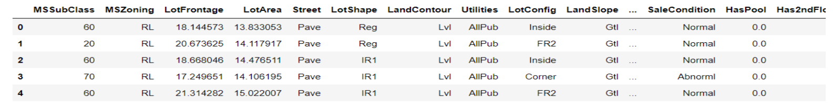
House Pricing Prediction(contd)
• We will give weights based on strings since we prefer normal conditions to abnormal ones and want to make sure that all of the data is useful for data analysis.
• We can use matplot and seaborn to create a more effective graphical representation of the data so that it makes more sense.
• As soon as we have data from both the train and the test, we merge them and preprocess them. Then split the information by 75 to 25.
• To determine the association between the variables and compare the results of the train dataset, we utilized lasso regression in the last phase. From there, we calculated the model's rmes.

Slide 9
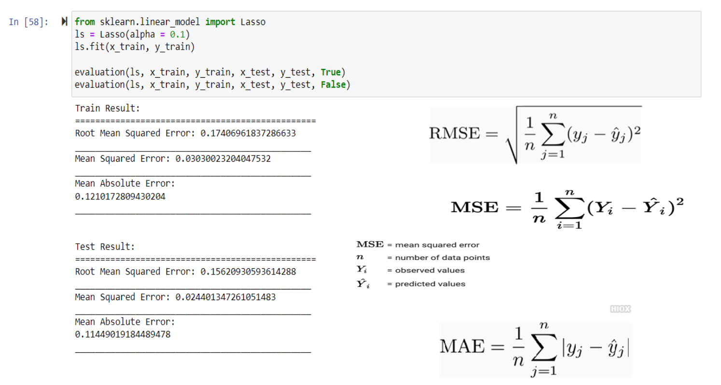

Slide 10
Model- Mortgage Approval Prediction
• The mortgage status is affected by a number of factors, including the applicant's gender, education level, self-employment status, dependents, and marital status.
• It's also important to consider the applicant's income, the loan amount, the location of the property, and their credit history to determine whether they qualify for a loan or not.
• This approach uses a random forest model to forecast whether a mortgage application will be granted or denied.
• To load the data set with information on gender employment dependents and credit history for this model, we import the relevant packages.
• We can create useful graphs out of the data using seaborn and matplotlib.
• In order to create a single data type, we may handle missing values by assigning fake values as string values.

Slide 11
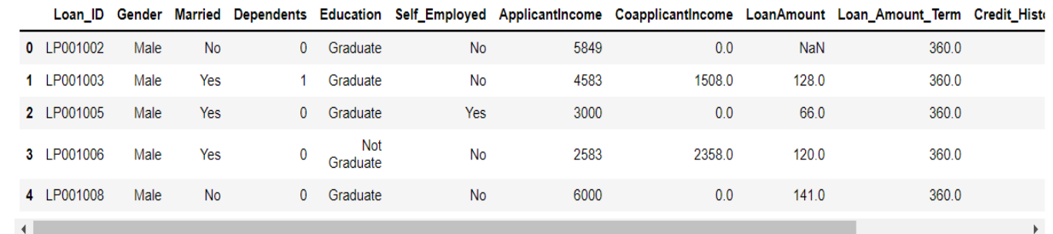
The dataset may also be split in two, with the ratio of train to test being 80-20, and the accuracy of the train and test models can be predicted using a random forest classifier.

Slide 12
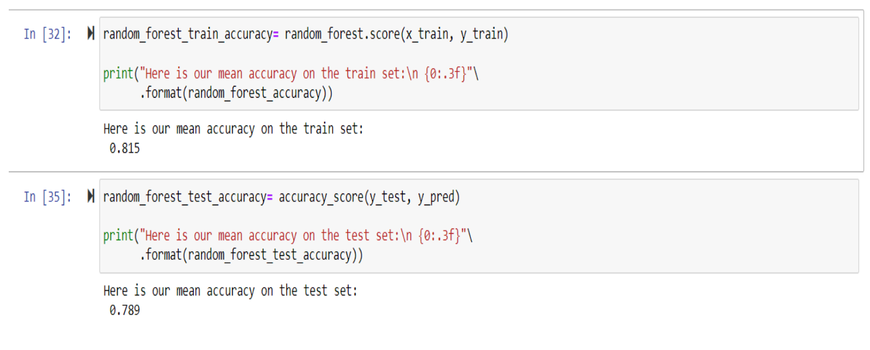
Accuracy scores for random forest classifier are

Slide 13
Tools
We are using Python and Jupyter notebooks for the competition.
Libraries: These are frameworks in python to handle commonly required tasks.
Pandas — For handling structured data
Scikit Learn — For machine learning
NumPy — For linear algebra and mathematics
Seaborn — For data visualization

Slide 14
Future Outcomes
By utilizing these two models, the end user is able to forecast the sale price of their home as well as whether or not their loan application will be accepted.
Utilizing them allows us to save time and money. By gathering additional data and altering the model's data feed, we may further enhance the model's accuracy and ability to forecast increasingly complex circumstances.
We can even include additional distributed processing and storage systems to sell our product on a larger scale.

Slide 15
Conclusion
• We may get the conclusion that the continuous dependent variable "Sales price" can be predicted using lasso regression.
• In contrast, the random forest classifier will produce better results even if it uses more storage capacity while creating decision trees.
• We can decrease the time complexity by employing these models, and we may further enhance this in the future by updating the model and making more sophisticated predictions.

Slide 16

References
R. A. Fisher, Statistical methods for research workers, In Breakthroughs in statistics (1992), 66–70.
• Franz Fuerst and George Matysiak, Analysing the performance of nonlisted real estate funds: a panel data analysis, Applied Economics 45 (2013), no. 14, 1777– 1788. • Richard J Herring and Susan M Wachter, Real estate booms and banking busts: An international perspective, The Wharton School Research Paper (1999), no. 99 -27
Data source: • https://www.kaggle.com/datasets/house-price-prediction?select=train.csv
• https://www.kaggle.com/datasets/house-loan-data-analysis?select=loan_data.csv

Slide 17

Thank You

