Slide 1
Digital Portfolio
STUDENT NAME: KAVIYA C
REGISTER NO AND NMID: 24132231802522027&
6E99D83701A37B48DF0438616F1629D7
DEPARTMENT: B.SC COMPUTERSCIENCE
COLLEGE: COLLEGE/ UNIVERSITY: Dr.M.G.R GOVT. ARTS & SCIENCE COLLEGE FOR WOMEN /ANNAMALAI UNIVERSITY

Slide 2
PROJECT TITLE
SOFTWARE DEVELOPER PORTFOLIO

Slide 3


AGENDA
Problem Statement
Project Overview
End Users
Tools and Technologies
Portfolio design and Layout
Features and Functionality
Results and Screenshots
Conclusion
Github Link
3/21/2024 Annual Review

Slide 4
PROBLEM STATEMENT
1. Identify the Issue: Clearly describe the problem or challenge.
2. Impact: Explain the impact of the problem on users, business, or operations.
3. Goals: Define the desired outcome or solution.
4. Constraints: Outline any limitations or constraints.
Example:
"Current manual process for tracking inventory is time-consuming, prone to errors, and leads to stock discrepancies. Develop an automated inventory management system to improve accuracy, efficiency, and reduce costs."

Slide 5

PROJECT OVERVIEW
A structured process of conceiving, designing, programming, testing, and maintaining applications, frameworks, or other software components.
Planning & Analysis: Define goals, requirements, and feasibility. Design: Create system architecture, UI/UX wireframes, and database schemas. Implementation (Coding): Write code using chosen technologies and frameworks. Testing: Ensure quality through unit, integration, and user acceptance testing (

Slide 6

WHO ARE THE END USERS?
1. Consumers: Individuals using mobile apps, games, or productivity software. 2. Business users: Employees using software for tasks like accounting, project management, or customer relationship management. 3. Organizations: Companies, non-profits, or government agencies using custom-built software solutions. 4. MInternal stakeholders: Employees within a company using internal tools or systems.

Slide 7

TOOLS AND TECHNIQUES
Tools:
1. Git (Version Control)
2. Visual Studio (IDE)
3. Jira (Agile Management)
4. Slack (Collaboration)
5. JUnit (Testing)
Techniques:
1. Agile Development
2. Test-Driven Development (TDD)
3. Continuous Integration/Continuous Deployment (CI/CD)

Slide 8
POTFOLIO DESIGN AND LAYOUT
Portfolio Design: 1. Projects: Showcase projects with descriptions and links. 2. Skills: List technical skills. 3. Experience: Highlight relevant experience. 4. Contact: Include contact info.Software Development
Layout:
1. Home: Introduction and overview
2. Projects: Showcase projects with descriptions and links
3. Skills: List technical skills and proficiencies
4. About: Brief bio and experience
5. Contact: Contact information and social media links
Keep it clean, simple, and easy to navigate!
8

Slide 9
FEATURES AND FUNCTIONALITY
Features and Functionality : 1. Modularity: Break down code into reusable modules. 2. Scalability: Design for growth and increased traffic. 3. Security: Implement robust security measures. 4. User Experience (UX): Create intuitive and user-friendly interfaces. 5. Testing and Debugging: Ensure thorough testing and debugging. 6. Integration: Seamlessly integrate with other systems and tools. 7. Performance Optimization: Optimize for speed and efficiency. 8. Data Management: Effectively manage and store data.

Slide 10
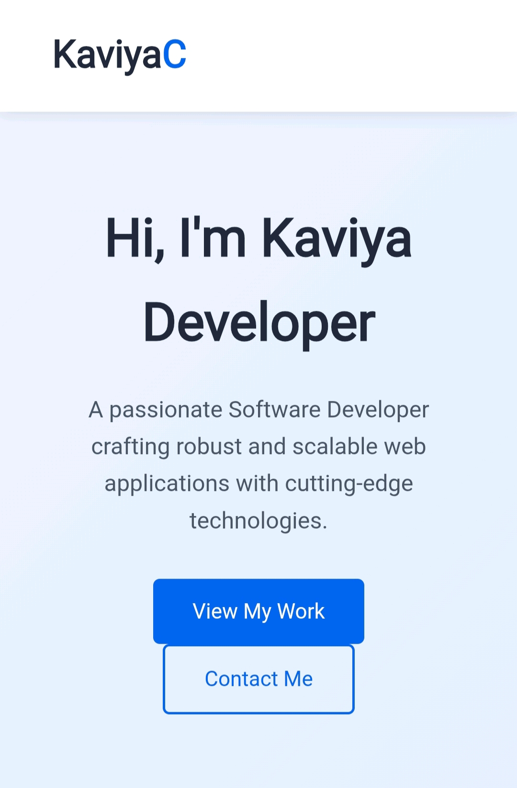

RESULTS AND SCREENSHOTS
3/21/2024 Annual Review
10

Slide 11
CONCLUSION
1. Summary: Recap key points. 2. Key Takeaways: Highlight important concepts. 3. Future Scope: Discuss future trends and opportunities. 4. Call to Action: Encourage further learning or collaboration. Example: "Software development is a dynamic field requiring continuous learning and innovation. Stay updated with emerging technologies and best practices to excel in this field."
11

