Slide 1
AIOps RHEL8 & Windows Production-Safe CVE Patching
Architecture & Flow

Slide 2
What does the Customer Want ?
Automated, production-safe critical CVE patching that scales without risk.
The Core Ask:
Patch only when it matters
Apply updates only when there are critical CVEs—not every minor update, not on a fixed schedule regardless of risk.
CVE = Common Vulnerabilities and Exposures.
Stay production-safe
Limit patching to security-related updates. No feature updates, no optional packages, no changes that could introduce breaking behavior.
Remove manual effort
No more ad-hoc scripts, inconsistent pre-patch scans, or manual decisions about when to patch.
Use structured, reliable data
Base patch decisions on authoritative CVE data (severity, affected packages, IDs), not raw command output or custom scripts.
Scale across the fleet
Support RHEL8 and Windows across many instances without manual per-instance work.

Slide 3
Success Criteria
Outcome | Description
Security | Critical CVEs are patched in a timely way
Stability | Only security updates are applied; production risk is minimized
Automation | Patching runs on a schedule with minimal human intervention
Visibility | Patch decisions are traceable; reports exist for audit and troubleshooting
Consistency | Same process for RHEL and Windows, driven by a single workflow
What “Done” Looks Like
Critical vulnerabilities are identified automatically from a trusted source (Inspector).
An AI-driven decision determines whether patching is needed based on severity and context.
When needed, only security updates are applied—CVE-related patches only.
RHEL8 and Windows instances are patched in parallel.
Each run leaves an audit trail and local reports for compliance and debugging.
The entire flow is automated, repeatable, and deployable via Infrastructure as Code.

Slide 4
Production-Safe CVE Patching with AWS Lambda, Inspector, and Bedrock
Automated CVE patching for RHEL8 and Windows servers
Uses Amazon Inspector v2 for vulnerability scanning
Uses Bedrock (Amazon Nova 2 Lite) for AI-driven patch decisions
Orchestrated by Step Functions, triggered by EventBridge
CVE-only patching – security updates only, production-safe

Slide 5
Guardrails for Patching RHEL8 and Windows Hosts
Circuit-Breaker (CVE Block After Reboot Failure).
CVE Analysis (Bedrock)
Pre-Patch AMI
Dry-Run Mode
Maintenance Window
Instance Exclusion (PatchExcluded Tag)
SSM Agent Health Pre-Check
Canary / Phased Rollout
Batched Patching
Failure Detection (Within Run)
Patch Scope (RHEL – Security Only)
Patch Baseline (Windows – CVE Only)
Reboot Behavior (Windows)
Workflow Failure Notification (SNS)

Slide 7
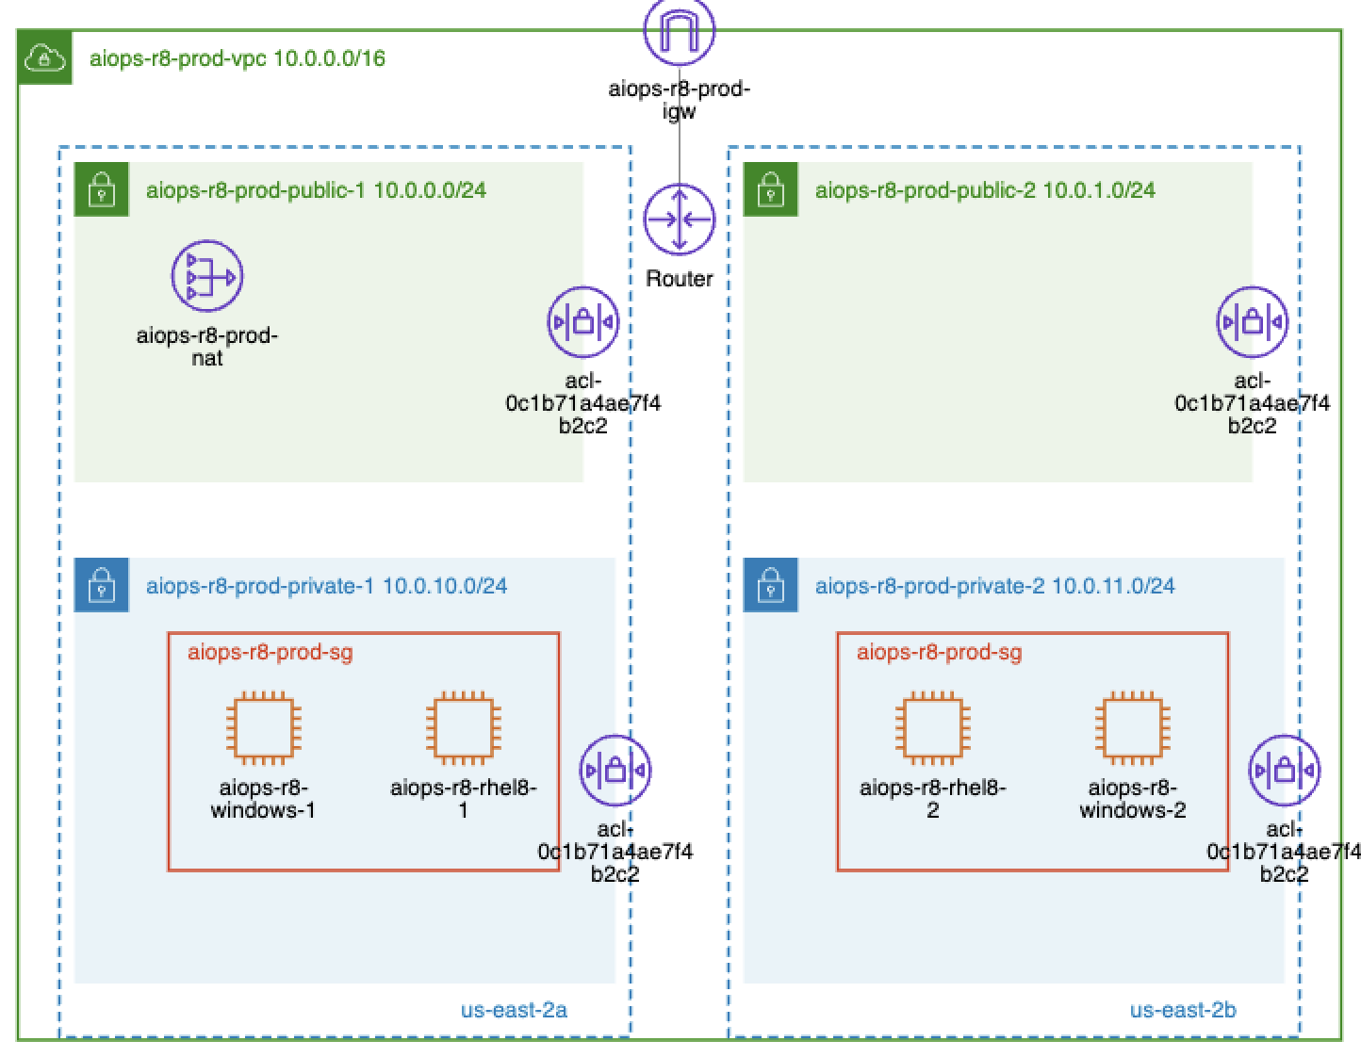
Current Architecture

Slide 8
Amazon Inspector - Workflow
1. SCHEDULE (EventBridge)
│ cron(0 2 ? * 3#2 *) → 2:00 AM UTC on 2nd Tuesday (after Patch Tuesday)
▼
2. DISCOVER INSTANCES (Lambda)
│ Instance Discovery Lambda: by tags (Role=patch-target) or static Terraform IDs
│ Excludes PatchExcluded=true
▼
3. CHECK SSM AGENT HEALTH (Lambda)
│ Filters out instances not in SSM Managed state; sends SNS alert if any excluded
▼
4. FETCH INSPECTOR FINDINGS (Lambda)
│ Inspector Findings Lambda fetches CVE findings from Amazon Inspector v2
▼
5. ANALYZE (Lambda + Bedrock)
│ Lambda sends Inspector findings to Bedrock; model analyzes CVEs
│ Returns has_critical_cves flag + recommendations
▼
6. CHECK MAINTENANCE WINDOW
│ If outside window → Skip (enabled by default)
▼
7. PREPARE BATCHES + APPLY (Map over batches)
│ Per batch: Patch → Wait 180s → CheckFailure → continue or abort
│ Batched patching stops within same run if instance fails to reboot
│ Canary: first batch uses canary_batch_size, then remaining batches
▼
8. POST-PATCH (Parallel, via Lambda → SSM)
│ SSM Runner Lambda verifies patches on RHEL8 and Windows
▼
9. COMPLETE

Slide 9
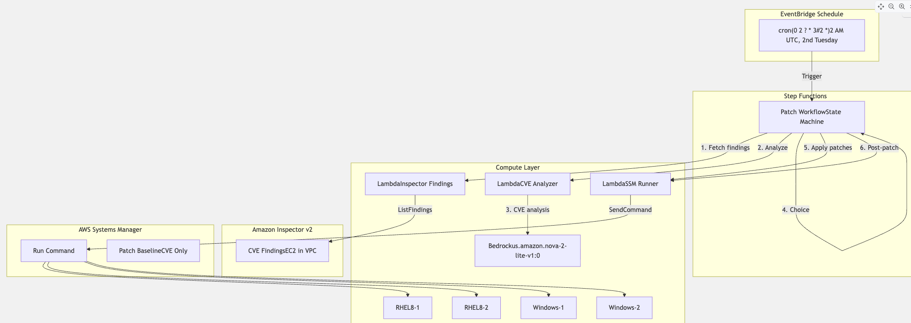

Slide 10
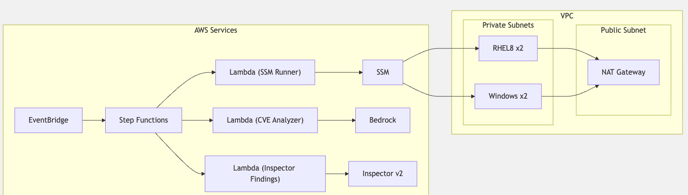

Slide 11
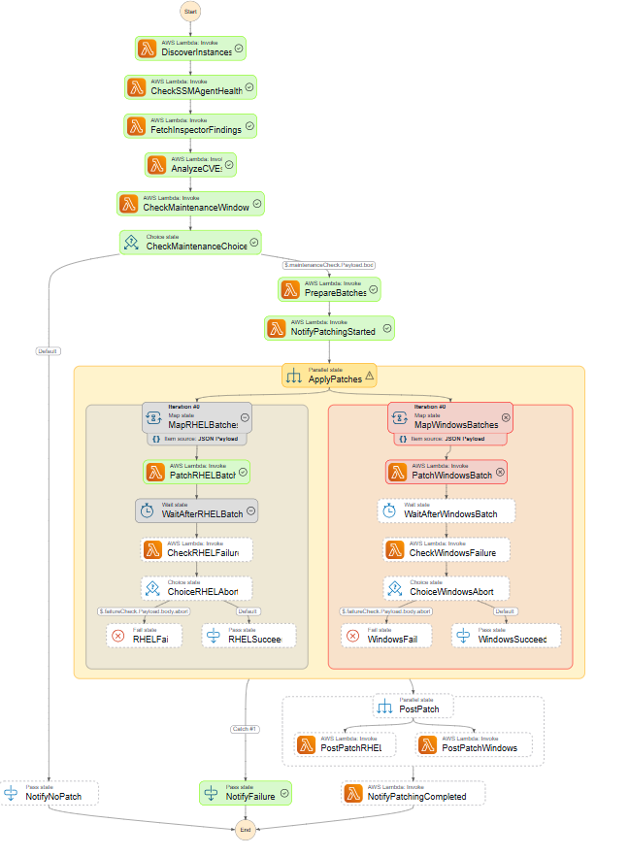

Slide 12
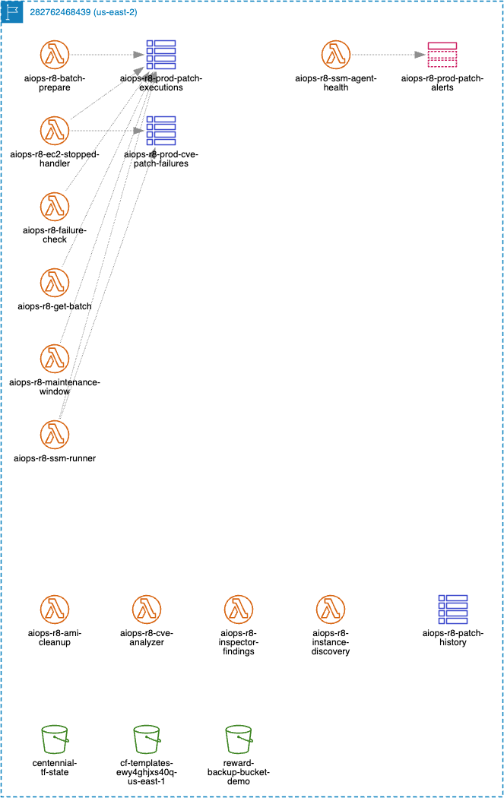
Serverless View

Slide 13
Lambda Functions
All Lambda functions used in the aiops-r8 patch workflow.
# | Lambda Function | One-liner
1 | instance-discovery | Discovers EC2 instances by tags (e.g. Role=patch-target) in the VPC for dynamic fleets.
2 | inspector-findings | Fetches Amazon Inspector v2 CVE findings for EC2 instances.
3 | cve-analyzer | Uses Bedrock to analyze CVEs and decide if critical patches are needed.
4 | ssm-runner | Runs SSM commands for patching, checks blocked CVEs, creates pre-patch AMIs, and records executions.
5 | ssm-agent-health | Verifies instances are SSM-managed and online before patching; filters out unhealthy instances.
6 | batch-prepare | Splits instance IDs into batches and prepares patch context for RHEL and Windows.
7 | get-batch | Returns the batch at the given index for the batched patching loop.
8 | failure-check | Checks if any recently patched instance has stopped before proceeding to the next batch.
9 | maintenance-window | Checks if the current time is within the configured maintenance window.
10 | ec2-stopped-handler | Circuit-breaker: when an instance stops, checks if it was recently patched and records CVEs to block future patches.
11 | ami-cleanup | Deregisters old pre-patch AMIs and deletes snapshots beyond the retention period.
12 | sfn-failure-notifier | Sends an SNS alert when the patch workflow Step Functions execution fails, aborts, or times out.

Slide 14
