Slide 1
Materials Data in Action

Slide 2
Predicting the formation of binary compounds using machine learning
5 September 2019
Chris Borg, Research Scientist

Slide 3
Agenda
0. Is this a good problem for ML?
Data preparation
Modeling
Classification with random forest
Model quality metrics
Compare to DFT
Model performance vs. “ground-truth”
Further considerations
Notes:
https://citrination.com/datasets/181017/show_search?searchMatchOption=fuzzyMatch

Slide 4
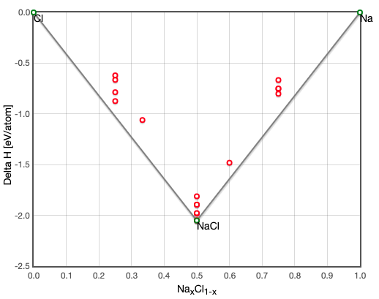
Task: Predict the stability of binary compounds
Typically, chemists use thermodynamics to determine the relative stability of a binary (AB) compound.
stabilityVec: [1, 0, 0, 0, 0, 1, 1, 0, 0, 0, 1]
1 = stable
0 = unstable
Na, NaCl, Na2Cl3, Cl
Task: build a machine learning model in Python to predict the full stability vector
http://oqmd.org/materials/composition/NaCl
Notes:
https://citrination.com/datasets/181017/show_search?searchMatchOption=fuzzyMatch
delH = enthalpy of formation.

Slide 5
Is this a reasonable problem for ML to solve?
Machine learning (ML): A set of data-driven algorithms that discern patterns from high-dimensional spaces.
High-dimensional input space: chemical composition (can be mapped to 100s of physically meaningful features)
Binary output: stable/unstable labels for 68k compositions (82 elements, 2572 AB combinations)
Validation / ”ground-truth”: DFT calculated enthalpies of formation
Notes:
(i.e. do we believe our output of interest in controlled by more than 3 variables?)

Slide 6
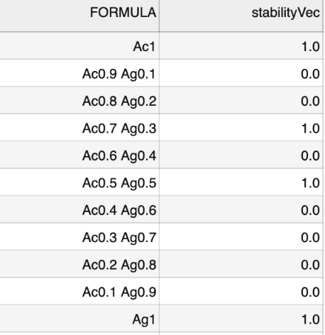


Preparing dataset
Input:
Output:
Inputs:
Output:
…
2572 rows, 99 columns: element A, element B, stability vector, 48 features per element (A, B)
Each row is now a single composition (input) and stability classification (output)
Notes:
https://citrination.com/datasets/181017/show_search?searchMatchOption=fuzzyMatch

Slide 7
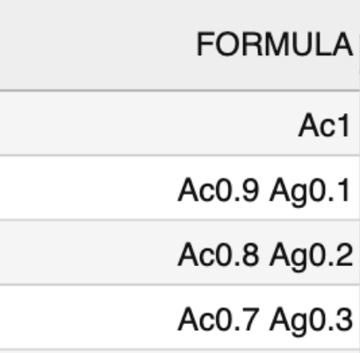
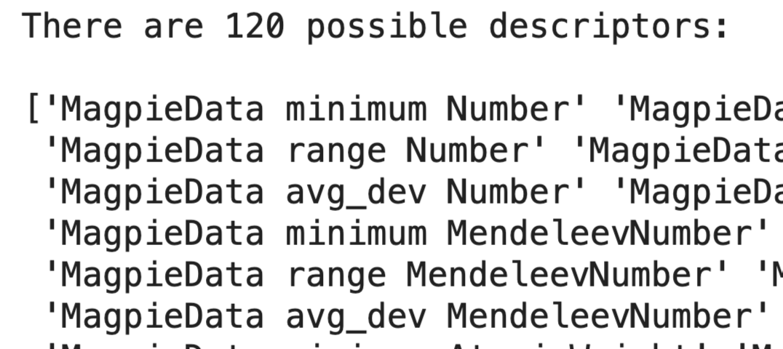
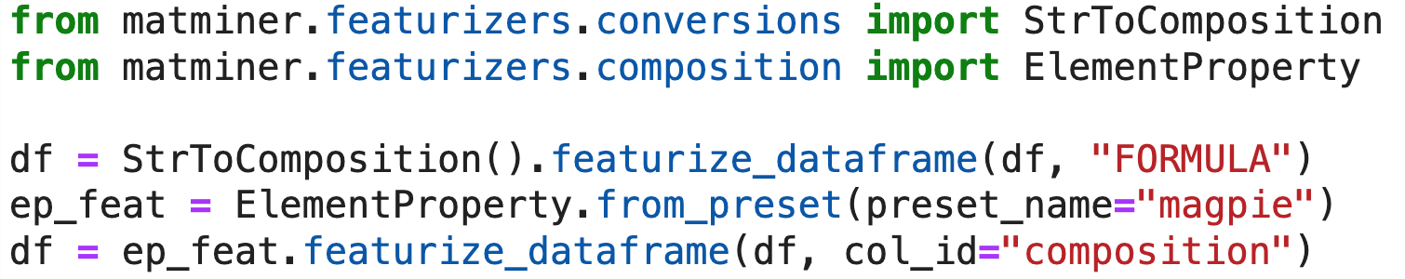
Deriving physically-informed features
Notes:
https://citrination.com/datasets/181017/show_search?searchMatchOption=fuzzyMatch

Slide 8
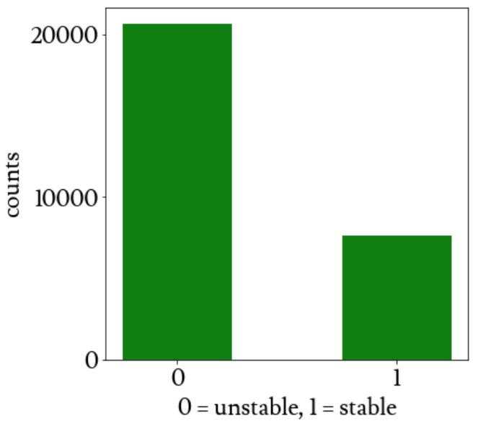
Choosing an estimator
Establishing a baseline:
20655 unstable binaries
random guess = 0.5
”intuition” = 0.82
Random forest
5144 stable monatomic
2493 stable binaries
Interpretable (ranked feature importance)
Can capture non-linear correlations
Notes:
https://citrination.com/data_views/11942/predict

Slide 9
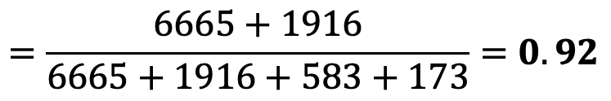
Evaluating predictions
 | N (predicted) | P (predicted)
N (actual) | TN = 6665 | FP = 173
P (actual) | FN = 583 | TP = 1916
Accuracy
$$=\frac{6665+1916}{6665+1916+583+173}=0.92$$
F1 score = 0.84
3-fold CV avg. accuracy = 0.963
10-fold CV avg. accuracy = 0.967
Notes:
# precision: What proportion of positive identifications was actually correct?
precision = tp/(tp+fp)
# recall: What proportion of actual positives was identified correctly?
recall = tp/(tp+fn)
2 * (precision * recall) / (precision + recall)

Slide 10
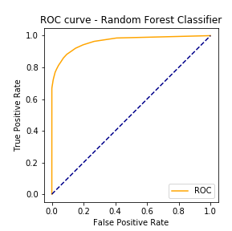
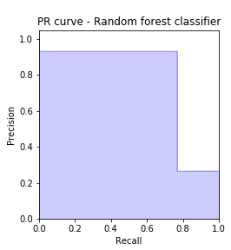
Graphical model accuracy metrics
AP = 0.78
AUROC = 0.96
Typically, an ROC curve is a good measure of the ability of a binary classifier.
However this is an overly optimistic view due to the large class imbalance between stable and unstable compounds. PR curve better captures the classification ability of the model.
Notes:
https://citrination.com/data_views/11942/predict

Slide 11
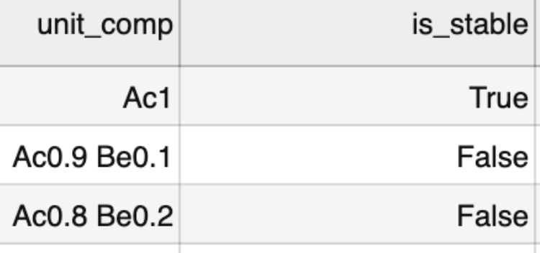
Comparing against DFT
 | N (predicted) | P (predicted)
N (actual) | TN = 6230 | FP = 218
P (actual) | FN = 196 | TP = 97
Added DFT calculated stability to test data.
While accuracy is high, FP is more than 2x TP.
If a researcher were to attempt synthesis of predicted compounds, they may likely succeed 50% of the time.
Accuracy = 0.94
F1 score = 0.32
Notes:
https://citrination.com/data_views/11942/predict
GS = dft volume per atom

Slide 12
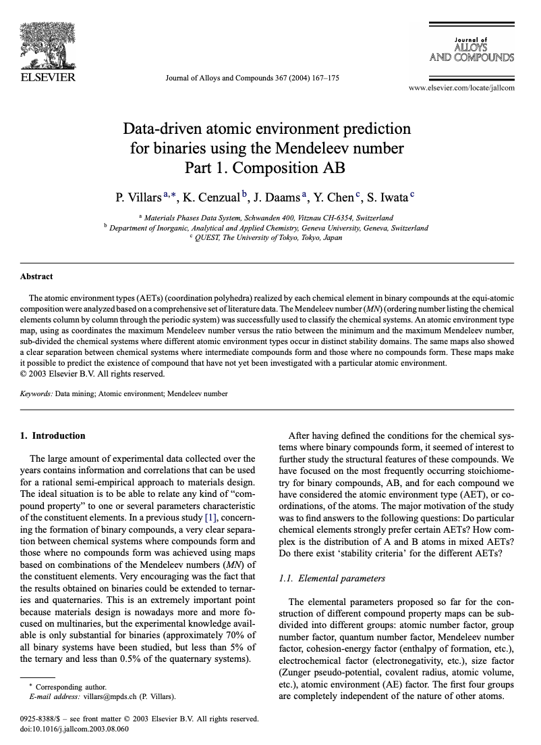
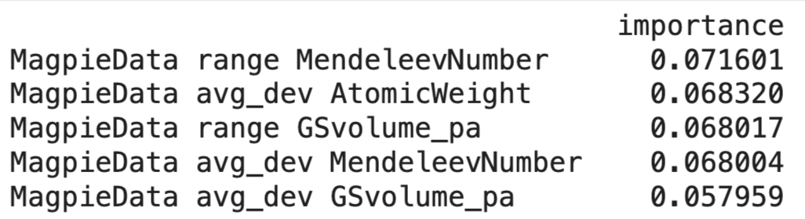
Important features
“The Mendeleev number (MN) (ordering number listing the chemical elements column by column through the periodic system) was successfully used to classify the chemical systems”
Notes:
https://citrination.com/data_views/11942/predict
GS = dft volume per atom

Slide 13
Conclusions
The random forest model trained on the given data is able to discern, above a baseline, between stable and unstable compounds.
However, the class imbalance (low number of stable compounds) skews our perspective on the model’s classification ability (as shown in the comparison to DFT)
This imbalance causes an equivalent number of false positives and false negatives and could be address through re-samples (super- or sub- sampling)
Notes:
https://citrination.com/data_views/11942/predict
GS = dft volume per atom

Slide 14
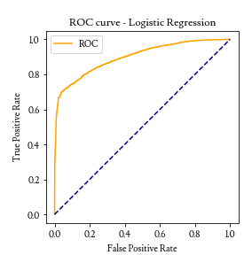
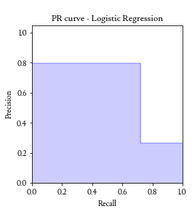
Logistic regression results
Held out test set
DFT-labeled test_data.csv
 | N (predicted) | P (predicted)
N (actual) | TN = 6395 | FP = 443
P (actual) | FN = 681 | TP = 1818
 | N (predicted) | P (predicted)
N (actual) | TN = 6046 | FP = 402
P (actual) | FN = 199 | TP = 94
AUROC = 0.913
AP = 0.65
Accuracy = 0.88
F1_score = 0.76
Accuracy = 0.911
F1_score = 0.24
Notes:
https://citrination.com/data_views/11942/predict
GS = dft volume per atom

Slide 15
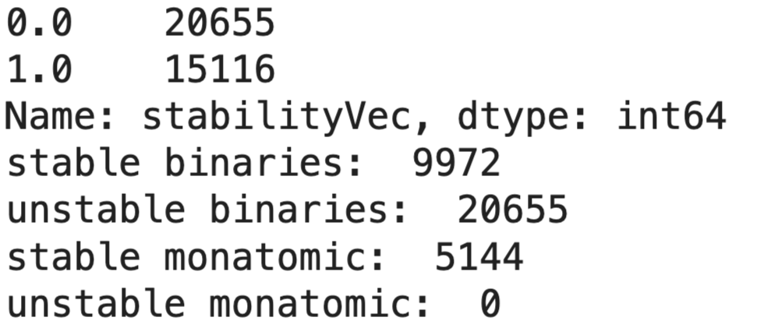
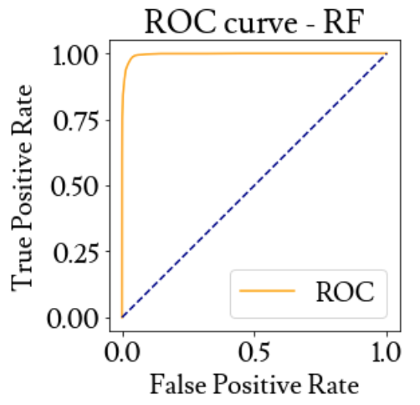
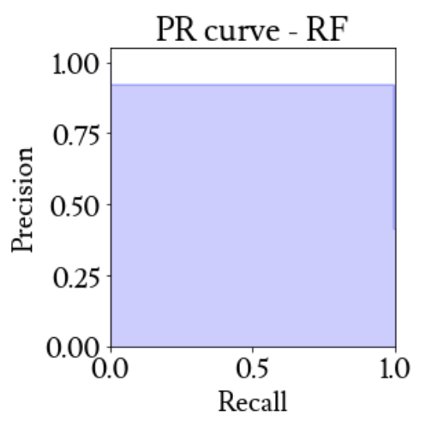
rf supersampled
Held out test set
DFT-labeled test_data.csv
AUROC = 0.996
 | N (predicted) | P (predicted)
N (actual) | TN = 6483 | FP = 412
P (actual) | FN = 29 | TP = 4881
 | N (predicted) | P (predicted)
N (actual) | TN = 5897 | FP = 551
P (actual) | FN = 126 | TP = 167
AP = 0.92
Accuracy = 0.96
F1_score = 0.96
Accuracy = 0.9
F1_score = 0.33
Notes:
https://citrination.com/data_views/11942/predict
GS = dft volume per atom

Slide 16
Further considerations
Investigate design space, low F1 score could be due to inability to extrapolate
Feature engineering
More data
Notes:
https://citrination.com/data_views/11942/predict
GS = dft volume per atom

Slide 17

THANK YOU!

Slide 18
Tuning rf hyperparameters
n_estimators = 3 | N (predicted) | P (predicted)
N (actual) | TN = 6500 | FP = 338
P (actual) | FN = 539 | TP = 1960
n_estimators = 10 | N (predicted) | P (predicted)
N (actual) | TN = 6665 | FP = 173
P (actual) | FN = 583 | TP = 1916
n_estimators = 20 | N (predicted) | P (predicted)
N (actual) | TN = 6697 | FP = 141
P (actual) | FN = 578 | TP = 1921
test_size = 0.1 | N (predicted) | P (predicted)
N (actual) | TN = 2002 | FP = 50
P (actual) | FN = 160 | TP = 618
test_size = 0.25 | N (predicted) | P (predicted)
N (actual) | TN = 5126 | FP = 102
P (actual) | FN = 405 | TP = 1440
test_size = 0.33 | N (predicted) | P (predicted)
N (actual) | TN = 6665 | FP = 173
P (actual) | FN = 583 | TP = 1916
Notes:
https://citrination.com/data_views/11942/predict

Slide 19
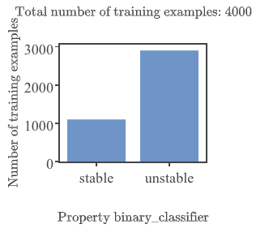
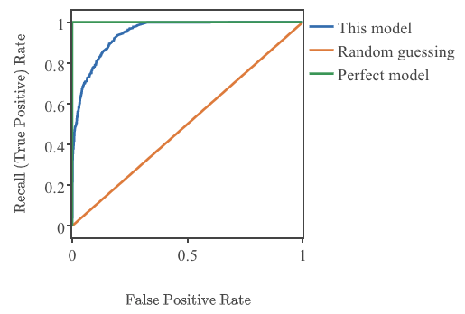
Binary classification on Citrination
AUROC = 0.948
Random subset of data (Citrination limit = 4k rows)
Notes:
https://citrination.com/datasets/181017/show_search?searchMatchOption=fuzzyMatch

Slide 20
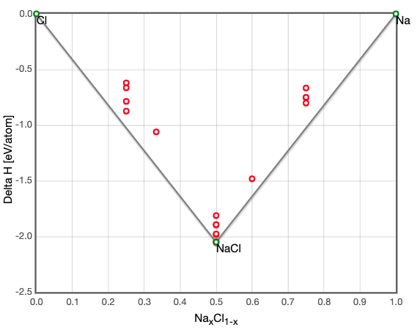
Test case: Na, Cl
Predicted: [1, 0, 0, 0, 0, 0, 0, 0, 0, 0, 1]
Actual: [1, 0, 0, 0, 0, 1, 1, 0, 0, 0, 1]
compound | stable | unstable
Na | 1 | 0
Na0.9 | 0.14 | 0.86
Na0.8 | 0.22 | 0.78
Na0.7 | 0.25 | 0.75
Na0.6 | 0.31 | 0.69
Na0.5 | 0.35 | 0.65
Na0.4 | 0.21 | 0.79
Na0.3 | 0.13 | 0.87
Na0.2 | 0.07 | 0.93
Na0.1 | 0.05 | 0.95
Cl | 1 | 0
Conclusion: No better than random, worse than intuition
http://oqmd.org/materials/composition/NaCl
Notes:
https://citrination.com/data_views/11942/predict

