Slide 1
Materials Data in Action

Slide 2
Predicting the formation of binary compounds using machine learning
5 September 2019
Chris Borg, Research Scientist

Slide 3
Agenda
0. Is this a good problem for ML?
Data preparation
Modeling
Classification with random forest
Model quality metrics
Compare to DFT
Model performance vs. “ground-truth”
Further considerations
Notes:
https://citrination.com/datasets/181017/show_search?searchMatchOption=fuzzyMatch

Slide 4
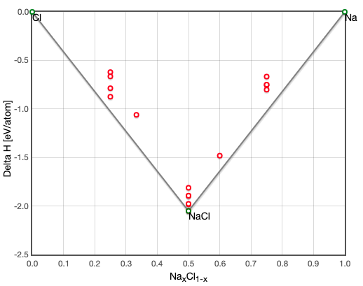
Task: Predict the stability of binary compounds
Typically thermodynamics allows us to calculate the relative stability of a compound. Instead of using standard equations, we can use data of known compounds to predict stability.
stabilityVec: [1, 0, 0, 0, 0, 1, 1, 0, 0, 0, 1]
1 = stable
0 = unstable
Na, NaCl, Na2Cl3, Cl
Task: build a machine learning model in python to predict the full stability vector
http://oqmd.org/materials/composition/NaCl
Notes:
https://citrination.com/datasets/181017/show_search?searchMatchOption=fuzzyMatch
delH = enthalpy of formation.

Slide 5
Is this a reasonable problem for ML to solve?
Machine learning: A set of data-driven algorithms that discern patterns from high-dimensional spaces.
High-dimensional input space: chemical composition (can be mapped to 100s of physically meaningful features)
Binary output: stable/unstable labels for 68k compositions (82 elements, 2572 AB combinations)
Validation / ”ground-truth”: DFT calculated enthalpies of formation
Notes:
(i.e. do we believe our output of interest in controlled by more than 3 variables?)

Slide 6
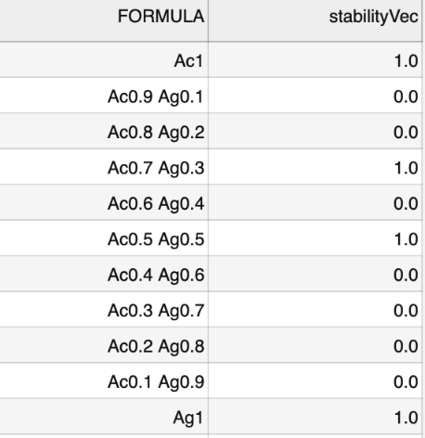


Preparing dataset
Input:
Output:
Inputs:
Output:
…
2572 rows, 99 columns: element A, element B, stability vector, 48 features per element (A, B)
Each row is now a single composition (input) and stability classification (output)
Notes:
https://citrination.com/datasets/181017/show_search?searchMatchOption=fuzzyMatch

Slide 7
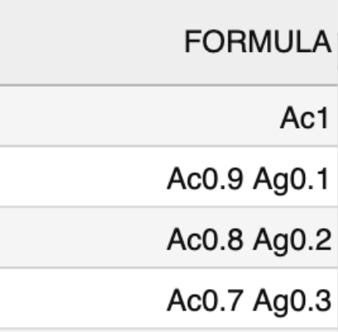
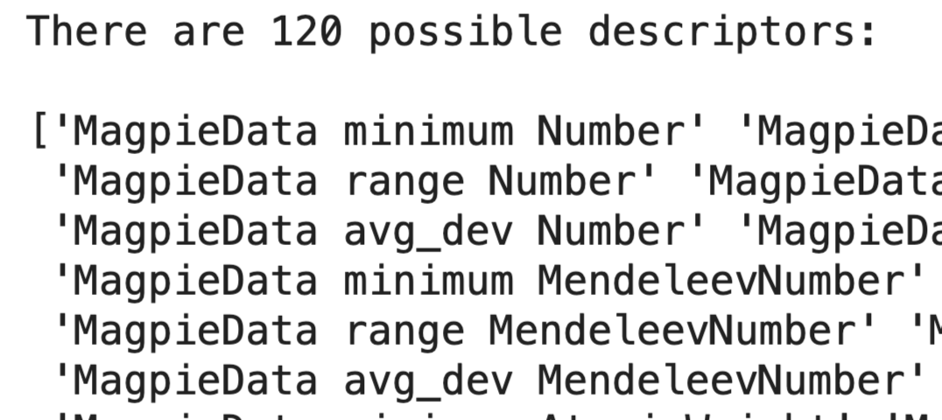
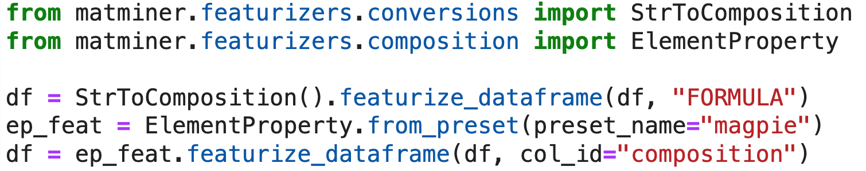
Deriving physically-informed features
Notes:
https://citrination.com/datasets/181017/show_search?searchMatchOption=fuzzyMatch

Slide 8
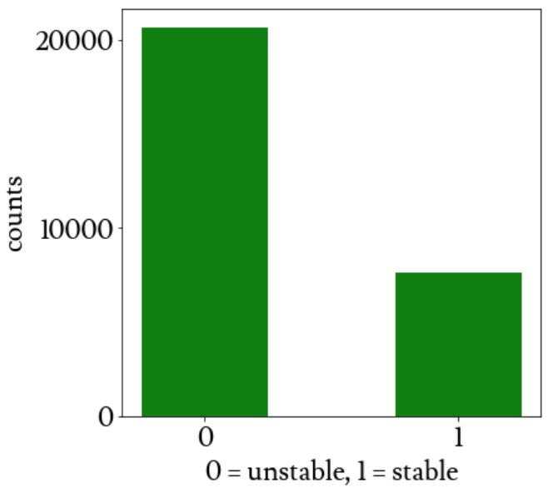
Choosing the right estimator
20655 unstable binaries
Random forest
5144 stable monatomic
2493 stable binaries
Interpretable (can yield subset of important features)
Can capture non-linear correlations
Notes:
https://citrination.com/data_views/11942/predict

Slide 9
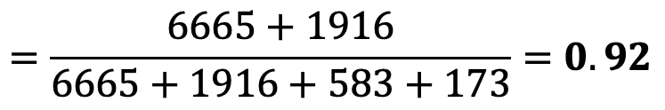
Evaluating predictions
 | N (predicted) | P (predicted)
N (actual) | TN = 6665 | FP = 173
P (actual) | FN = 583 | TP = 1916
Accuracy
$$=\frac{6665+1916}{6665+1916+583+173}=0.92$$
F1 = 2 * (precision * recall) / (precision + recall) = 0.842
3-fold CV avg. accuracy = 0.963
10-fold CV avg. accuracy = 0.967
Notes:
# precision: What proportion of positive identifications was actually correct?
precision = tp/(tp+fp)
# recall: What proportion of actual positives was identified correctly?
recall = tp/(tp+fn)

Slide 10
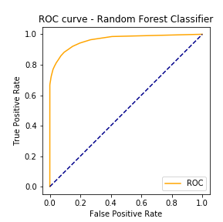
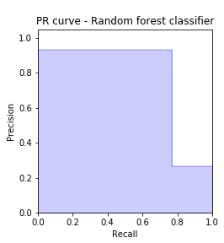
Evaluating predictions
AP = 0.78
AUROC = 0.96
Typically, an ROC curve is a good measure of the ability of a binary classifier.
However this is an overly optimistic view due to the large class imbalance between stable and unstable compounds. PR curve better captures the classification ability of the model.
Notes:
https://citrination.com/data_views/11942/predict

Slide 11
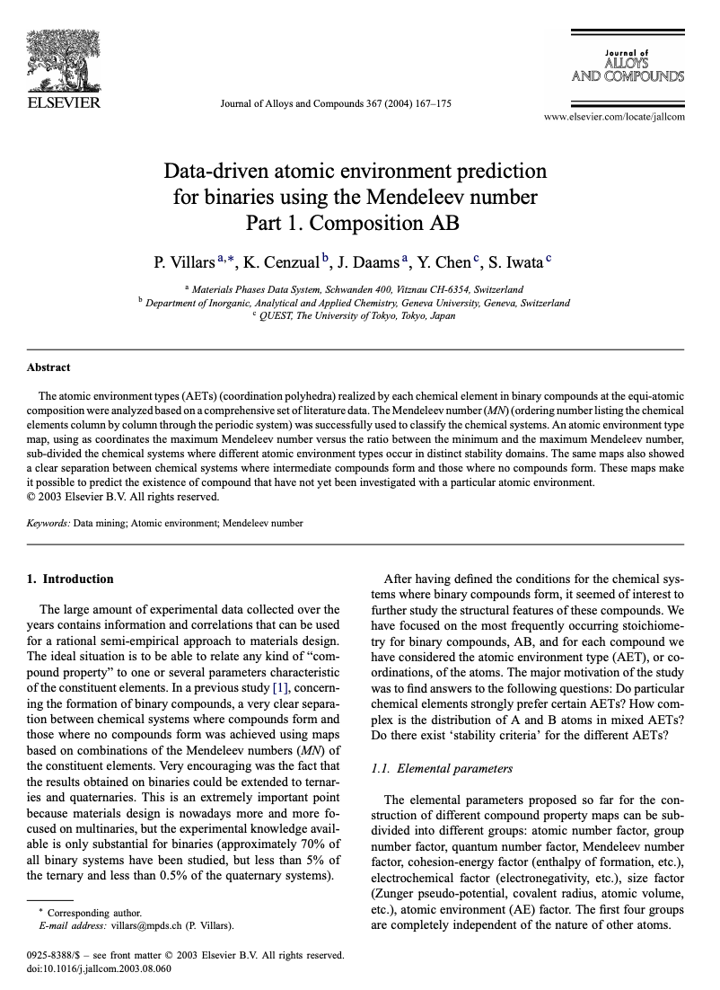
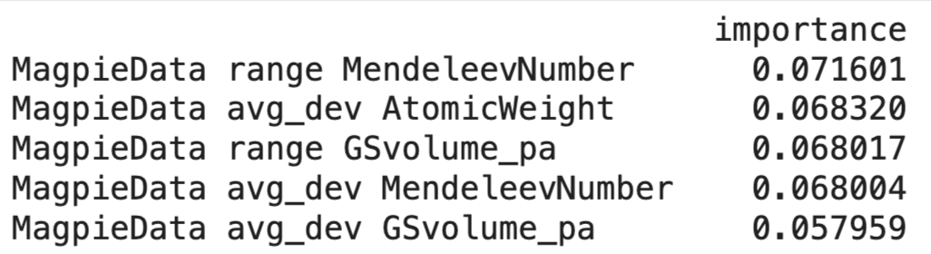
Important features
“The Mendeleev number (MN) (ordering number listing the chemical elements column by column through the periodic system) was successfully used to classify the chemical systems”
Notes:
https://citrination.com/data_views/11942/predict
GS = dft volume per atom

Slide 12
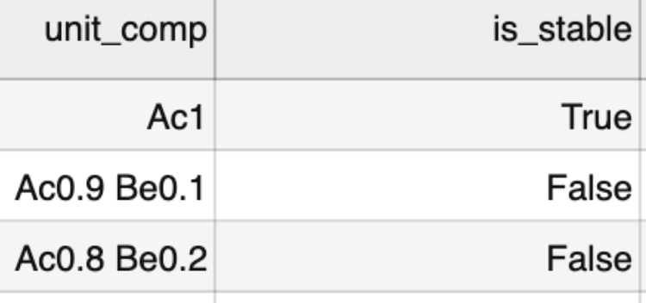
Comparing against DFT
 | N (predicted) | P (predicted)
N (actual) | TN = 6230 | FP = 218
P (actual) | FN = 196 | TP = 97
Added DFT calculated stability to test data.
While accuracy is high, FP is more than 2x TP.
If a researcher were to attempt synthesis of predicted compounds, they may likely succeed 50% of the time.
Accuracy = 0.94
F1 score = 0.32
Notes:
https://citrination.com/data_views/11942/predict
GS = dft volume per atom

Slide 13
Conclusions
The random forest model trained on the given data is able to discern, above a baseline, between stable and unstable compounds.
However, the class imbalance (low number of stable compounds) skews our perspective on the model’s classification ability (as shown in the comparison to DFT)
This imbalance causes an equivalent number of false positives and false negatives and could be address through re-samples (super- or sub- sampling)
Notes:
https://citrination.com/data_views/11942/predict
GS = dft volume per atom

Slide 14

THANK YOU!

Slide 15
Tuning rf hyperparameters
n_estimators = 3 | N (predicted) | P (predicted)
N (actual) | TN = 6500 | FP = 338
P (actual) | FN = 539 | TP = 1960
n_estimators = 10 | N (predicted) | P (predicted)
N (actual) | TN = 6665 | FP = 173
P (actual) | FN = 583 | TP = 1916
n_estimators = 20 | N (predicted) | P (predicted)
N (actual) | TN = 6697 | FP = 141
P (actual) | FN = 578 | TP = 1921
test_size = 0.1 | N (predicted) | P (predicted)
N (actual) | TN = 2002 | FP = 50
P (actual) | FN = 160 | TP = 618
test_size = 0.25 | N (predicted) | P (predicted)
N (actual) | TN = 5126 | FP = 102
P (actual) | FN = 405 | TP = 1440
test_size = 0.33 | N (predicted) | P (predicted)
N (actual) | TN = 6665 | FP = 173
P (actual) | FN = 583 | TP = 1916
Notes:
https://citrination.com/data_views/11942/predict

Slide 16
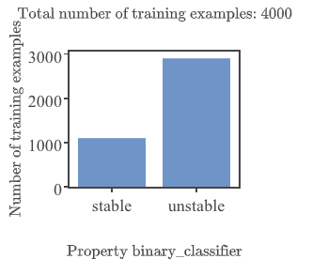
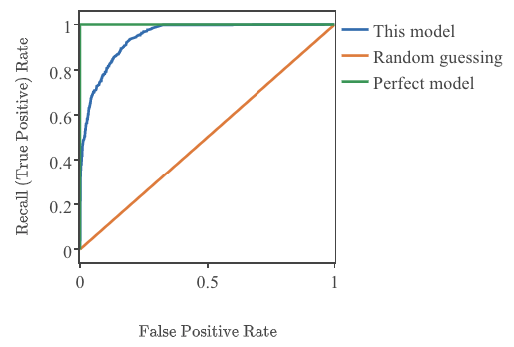
Binary classification on Citrination
AUROC = 0.948
Random subset of data (Citrination limit = 4k rows)
Notes:
https://citrination.com/datasets/181017/show_search?searchMatchOption=fuzzyMatch

Slide 17
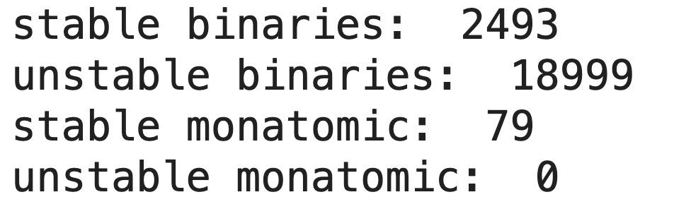
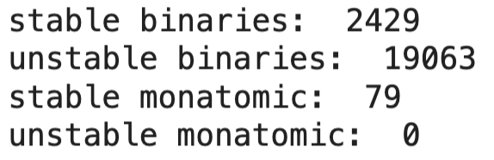
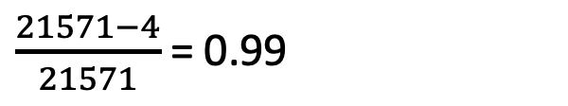
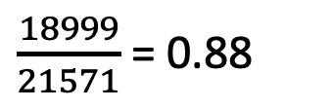
Baseline accuracy
Classifying all binaries as unstable = 88%
$\frac{18999}{21571}$ = 0.88
$\frac{21571−4}{21571}$ = 0.99
Random forest
Notes:
https://citrination.com/datasets/181017/show_search?searchMatchOption=fuzzyMatch

Slide 18
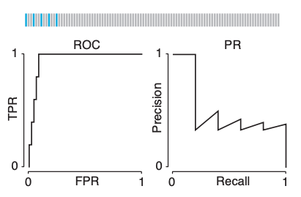
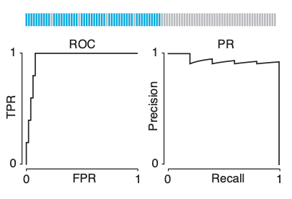
Addressing class imbalance
Lever, J., Krzywinski, M., & Altman, N. (2016). Points of significance: classification evaluation.
Notes:
https://citrination.com/datasets/181017/show_search?searchMatchOption=fuzzyMatch

Slide 19
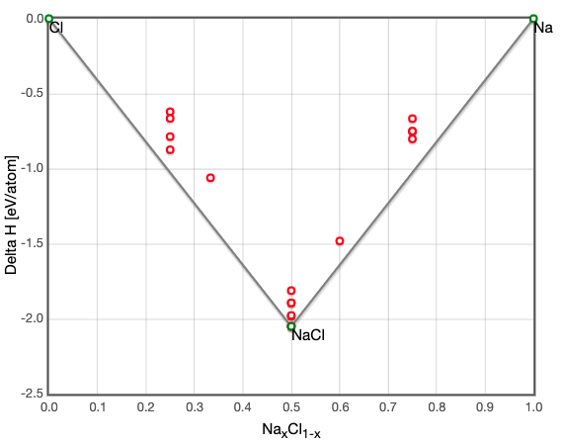
Test case: Na, Cl
Predicted: [1, 0, 0, 0, 0, 0, 0, 0, 0, 0, 1]
Actual: [1, 0, 0, 0, 0, 1, 1, 0, 0, 0, 1]
compound | stable | unstable
Na | 1 | 0
Na0.9 | 0.14 | 0.86
Na0.8 | 0.22 | 0.78
Na0.7 | 0.25 | 0.75
Na0.6 | 0.31 | 0.69
Na0.5 | 0.35 | 0.65
Na0.4 | 0.21 | 0.79
Na0.3 | 0.13 | 0.87
Na0.2 | 0.07 | 0.93
Na0.1 | 0.05 | 0.95
Cl | 1 | 0
Conclusion: No better than random, worse than intuition
http://oqmd.org/materials/composition/NaCl
Notes:
https://citrination.com/data_views/11942/predict

Slide 20
Assess model quality
Cross-validation
Compare to “ground-truth”
Notes:
https://citrination.com/data_views/11942/predict

Slide 21
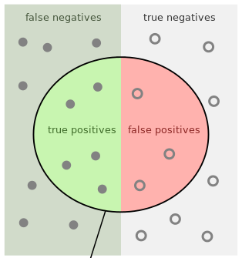

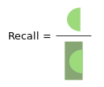
Binary classification
Predicted | Actual | label
Stable (1) | Stable (1) | True Positive (TP)
Unstable (0) | Unstable (0) | True Negative (TN)
Stable (1) | Unstable (0) | False Negative (FN)
Unstable (0) | Stable (1) | False Positive (FP)
4 possible outcomes: TP, FP, TN, FN
Notes:
https://citrination.com/data_views/11942/predict

Slide 22
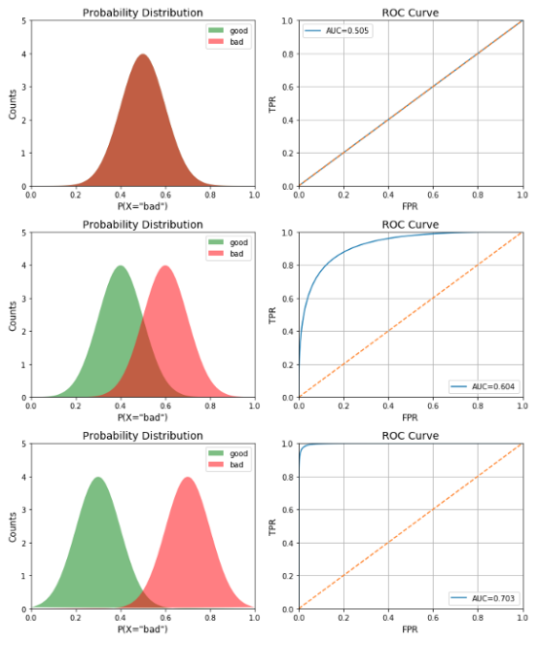
Binary classification
Notes:
https://towardsdatascience.com/receiver-operating-characteristic-curves-demystified-in-python-bd531a4364d0

