Slide 1
Materials Data in Action

Slide 2
Predicting the formation of binary compounds using machine learning
5 September 2019
Chris Borg, Research Scientist

Slide 3
Agenda
0. Is this a good problem for ML?
Data preparation
Breakout stability vector
Featurize with magpie
Modeling
Model quality
Further considerations
Notes:
https://citrination.com/datasets/181017/show_search?searchMatchOption=fuzzyMatch

Slide 4
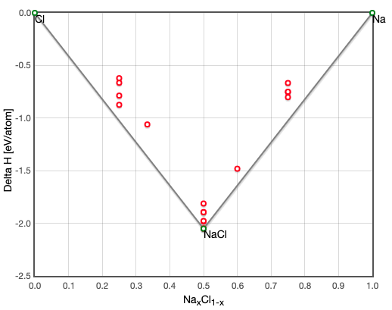
Task: Predict the stability of binary compounds
stabilityVec: [1, 0, 0, 0, 0, 1, 1, 0, 0, 0, 1]
1 = stable
0 = unstable
NaCl, Na2Cl3
Task: build a machine learning model in python to predict the full stability vector
http://oqmd.org/materials/composition/NaCl
Notes:
https://citrination.com/datasets/181017/show_search?searchMatchOption=fuzzyMatch

Slide 5
Is this a reasonable problem for ML to solve?
Machine learning: A set of data-driven algorithms that discern patterns from high-dimensional spaces.
High-dimensional input space: chemical composition (can be mapped to 100s of physically meaningful features)
Binary output: stable/unstable labels for 68k compositions (82 elements, 2572 AB combinations)
Validation / ”ground-truth”: DFT calculated enthalpies of formation
Notes:
(i.e. do we believe our output of interest in controlled by more than 3 variables?)

Slide 6
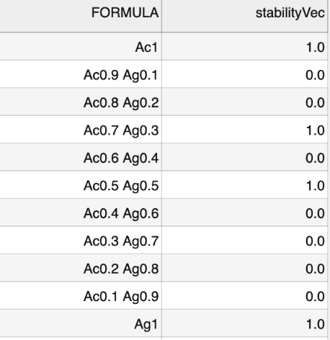


Preparing dataset
Input:
Output:
Inputs:
Output:
…
2572 rows, 99 columns: element A, element B, stability vector, 48 features per element (A, B)
Each row is now a single composition (input) and stability classification (output)
Notes:
https://citrination.com/datasets/181017/show_search?searchMatchOption=fuzzyMatch

Slide 7
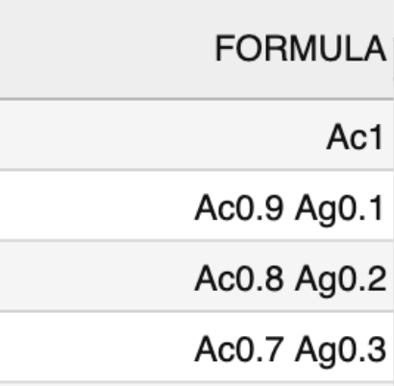
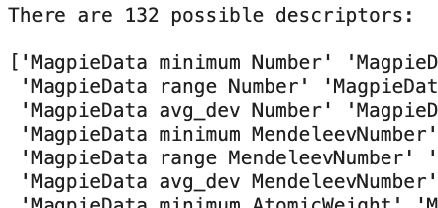
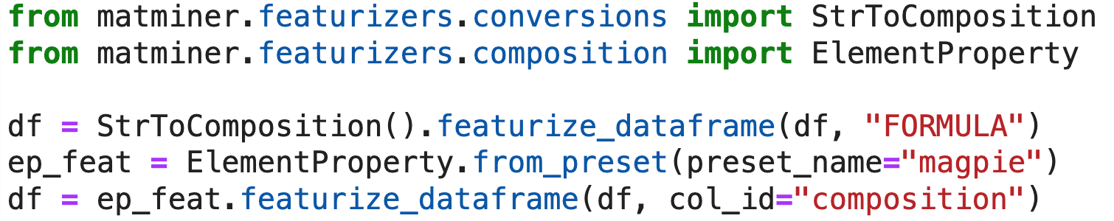
Deriving physically-informed features
Notes:
https://citrination.com/datasets/181017/show_search?searchMatchOption=fuzzyMatch

Slide 8
Given features
Discrete:
Continuous: Atomic volume, atomic weight, boiling,
A. Quick classifier on Citrination
B. Perform modeling in .ipynb
Notes:
https://citrination.com/datasets/181017/show_search?searchMatchOption=fuzzyMatch

Slide 9
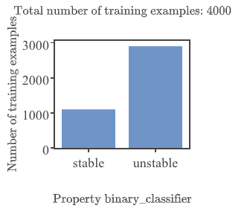
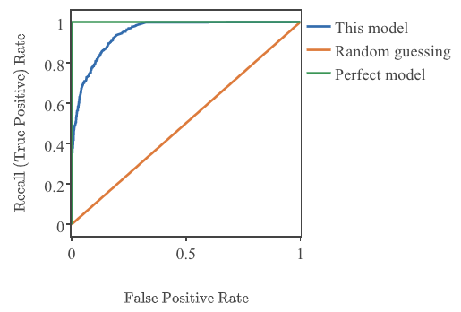
A. Binary classification on Citrination
AUROC = 0.948
Random subset of data (Citrination limit = 4k rows)
Notes:
https://citrination.com/datasets/181017/show_search?searchMatchOption=fuzzyMatch

Slide 10
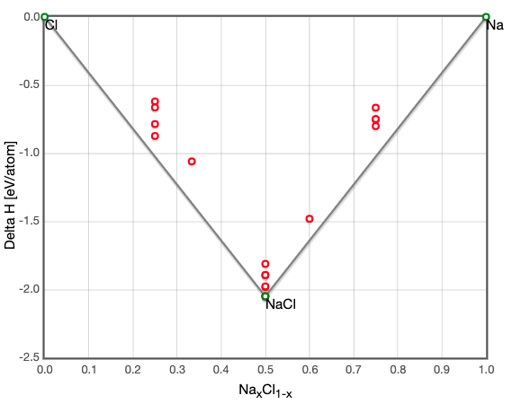
Test case: Na, Cl
Predicted: [1, 0, 0, 0, 0, 0, 0, 0, 0, 0, 1]
Actual: [1, 0, 0, 0, 0, 1, 1, 0, 0, 0, 1]
compound | stable | unstable
Na | 1 | 0
Na0.9 | 0.14 | 0.86
Na0.8 | 0.22 | 0.78
Na0.7 | 0.25 | 0.75
Na0.6 | 0.31 | 0.69
Na0.5 | 0.35 | 0.65
Na0.4 | 0.21 | 0.79
Na0.3 | 0.13 | 0.87
Na0.2 | 0.07 | 0.93
Na0.1 | 0.05 | 0.95
Cl | 1 | 0
Conclusion: No better than random, worse than intuition
http://oqmd.org/materials/composition/NaCl
Notes:
https://citrination.com/data_views/11942/predict

Slide 11
Choosing a machine learning algorithm
Classification:
1. Random forest
2. Logistic regression
Notes:
https://citrination.com/data_views/11942/predict

Slide 12
Important features
Can we acquire some physically meaningful insights from our featurization method?
Notes:
https://citrination.com/data_views/11942/predict

Slide 13
Assess model quality
Cross-validation
Compare to “ground-truth”
Notes:
https://citrination.com/data_views/11942/predict

Slide 14
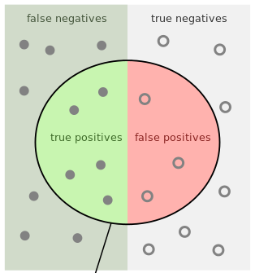

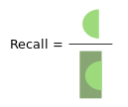
Binary classification
Predicted | Actual | label
Stable (1) | Stable (1) | True Positive (TP)
Unstable (0) | Unstable (0) | True Negative (TN)
Stable (1) | Unstable (0) | False Negative (FN)
Unstable (0) | Stable (1) | False Positive (FP)
4 possible outcomes: TP, FP, TN, FN
Notes:
https://citrination.com/data_views/11942/predict

Slide 15
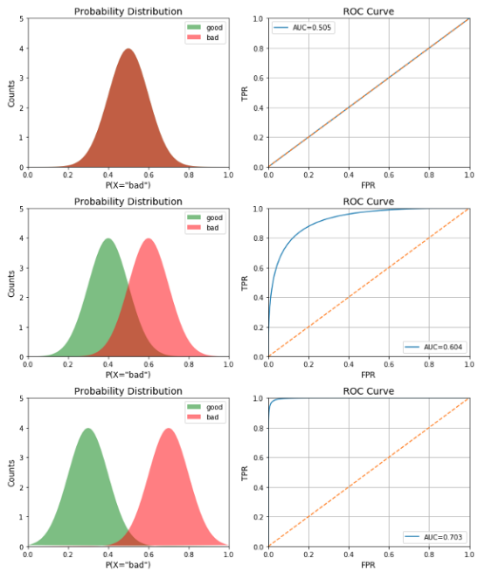
Binary classification
Notes:
https://towardsdatascience.com/receiver-operating-characteristic-curves-demystified-in-python-bd531a4364d0

