Slide 1

Final year project smart shoe rack
Name : chong kheng chen
Matrik number : 03det22f1043
Class : det5c
Penyelia : puan habsah bt hussain

Slide 2

Title : smart shoe --------rack
Subtitle : an Intelligent Storage Solution for Organized Footwear Management

Slide 3
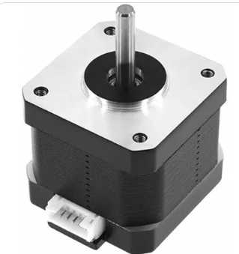

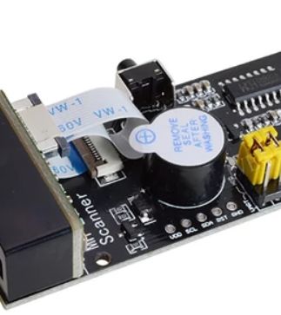
introduction
In this project, we present an innovative smart shoe rack system that automates the process of shoe storage and retrieval. The system is designed to:
Scan barcodes Attached to shoes, making it easy to identify and manage individual pairs.
Utilize blynk, an iot platform, to allow remote control of the system. Users can effortlessly select which shoe to retrieve through A mobile application.
The movement of the shoe rack is controlled by stepper motors that navigate in x, y, and z directions, ensuring the selected shoe is accurately retrieved and brought down to the user.
This smart system offers a more efficient, organized, and user-friendly way to manage personal footwear.

Slide 4
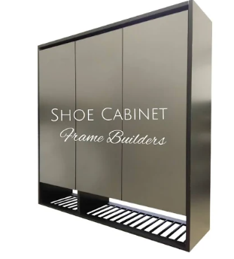
Problem statement
Traditional shoe cabinets have several limitations:
Limited storage capacity and inefficient space usage.
Difficulty in sorting and retrieving shoes, especially by style, size, or color.
Hygiene and safety concerns due to disorganized shoe placement, leading to potential falling hazards.
Manual stock management in stores is time-consuming and error-prone, often resulting in inventory issues (overstock or out-of-stock).
Existing smart shoe cabinets are expensive with limited functionality, focusing mainly on basic automation like opening doors. They fail to address the need for a smart, customizable, and efficient shoe storage system.
This project aims to create a smart shoe rack that automatically selects, organizes, and tracks shoes, providing a space-optimized, user-friendly, and iot-integrated solution.

Slide 5
Objectives
User-Friendly Interface: Provide a mobile app (via Blynk) that allows users to remotely control and retrieve shoes from the storage system.
Modular Design: Develop a customizable shoe storage system with a unified and expandable structure, allowing users to adjust modules based on space and needs.
Automation: Automate the process of shoe storage and retrieval using a 3x3 grid system with 2 active compartments.
Barcode Integration: Implement a barcode scanner for efficient shoe identification and placement.
IoT Control: Utilize IoT technology via Blynk for remote operation, enhancing user convenience.

Slide 6
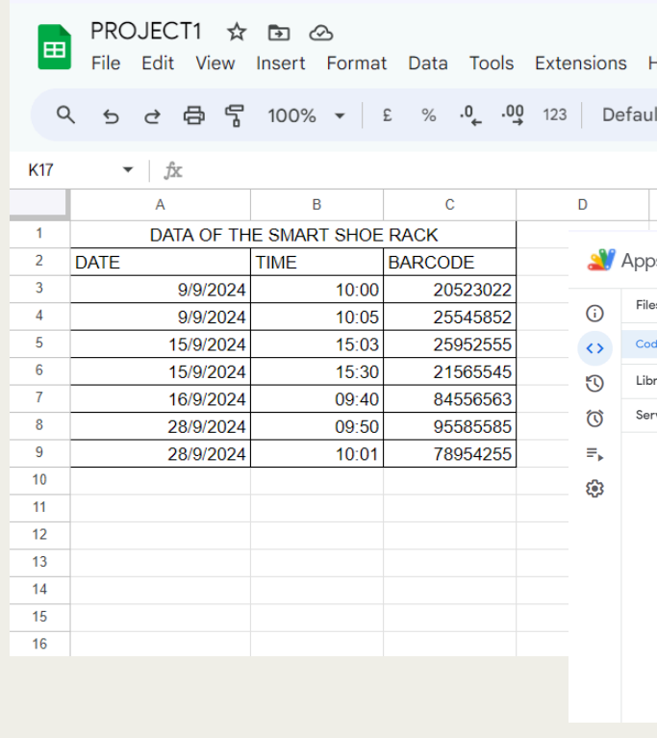
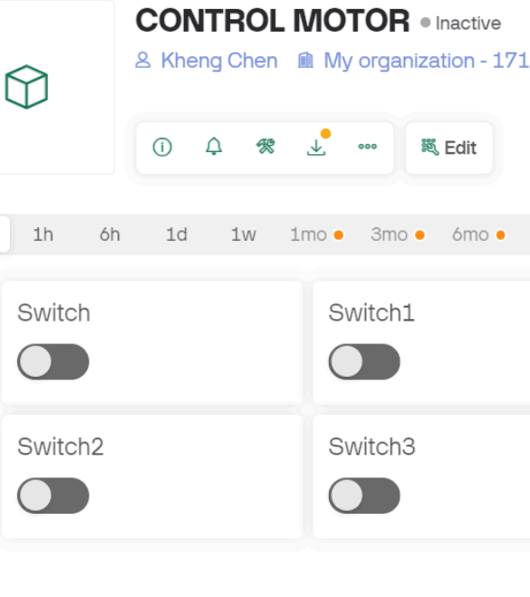
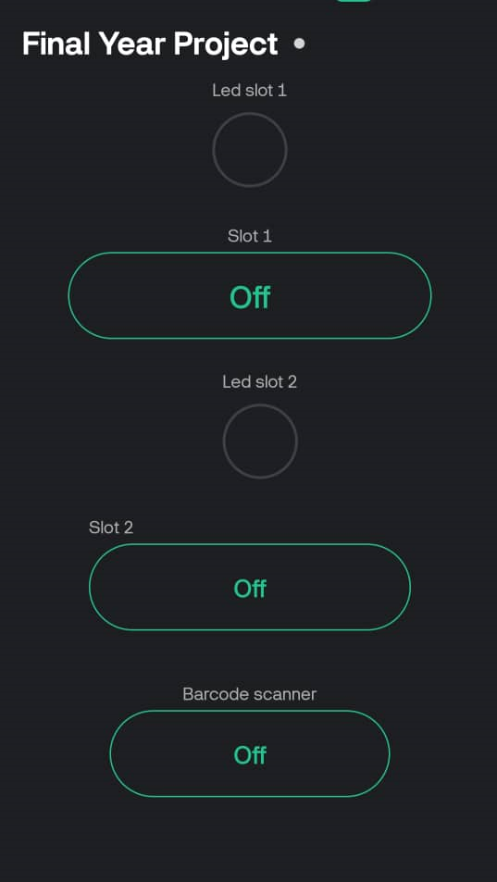
Scope
Focus on a 5-compartment system using a 3x3 grid.
Utilization of stepper motors (X, Y, Z axes) for compartment navigation.
Use of ESP32 and A4988 drivers to control motor movement.
Integration of trigger switches for homing (0,0,0) axis detection.
Blynk integration for remote control via mobile devices.

Slide 7
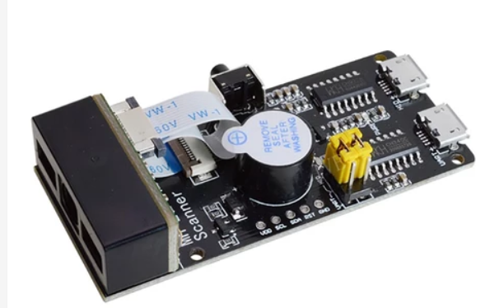
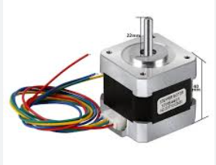
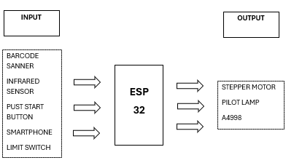
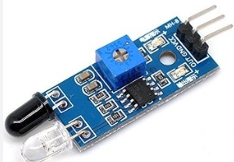
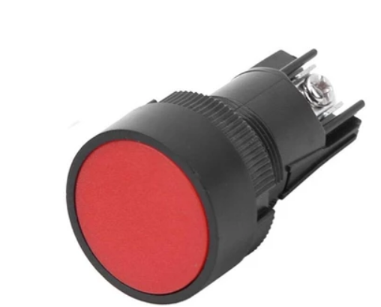
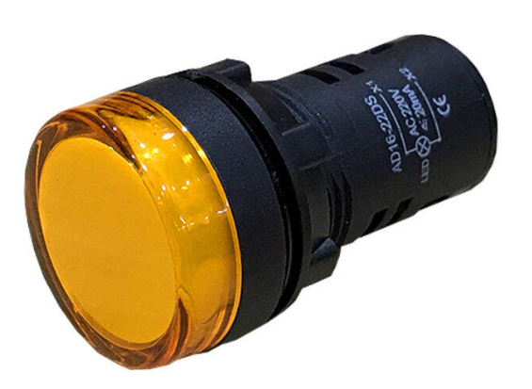

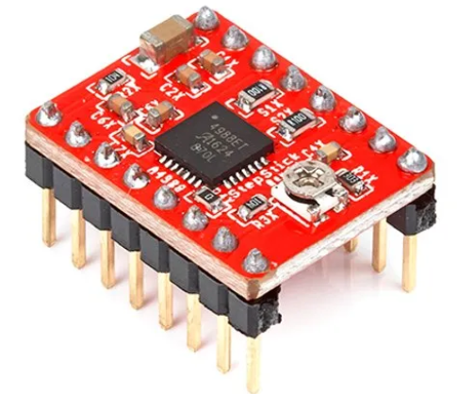
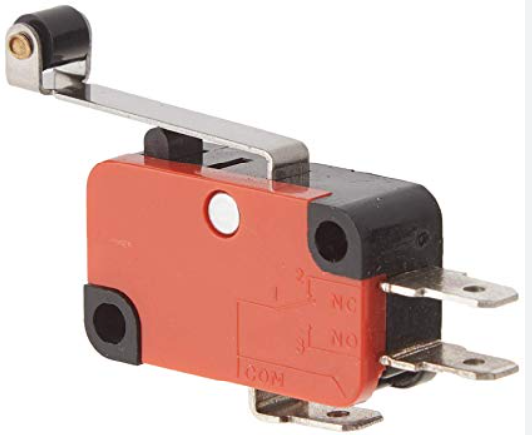
Block Diagram

Slide 8
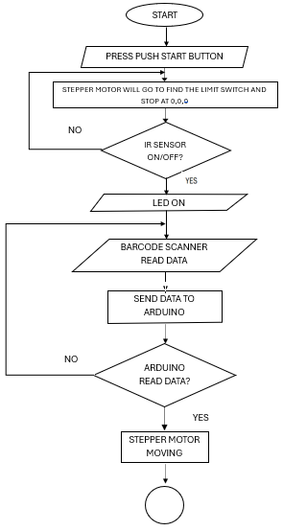
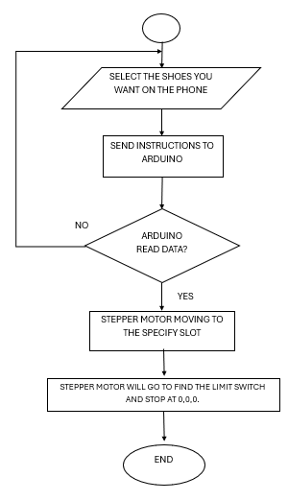
Flow chart
Output
Input

Slide 9
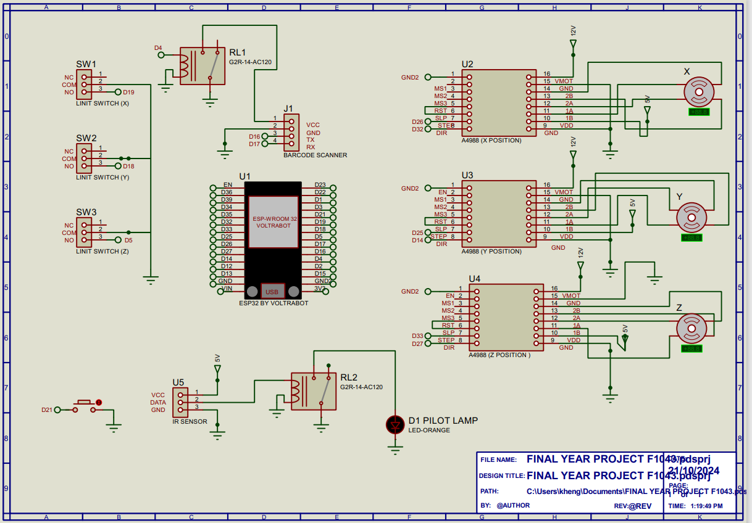
Circuit Diagram

Slide 10
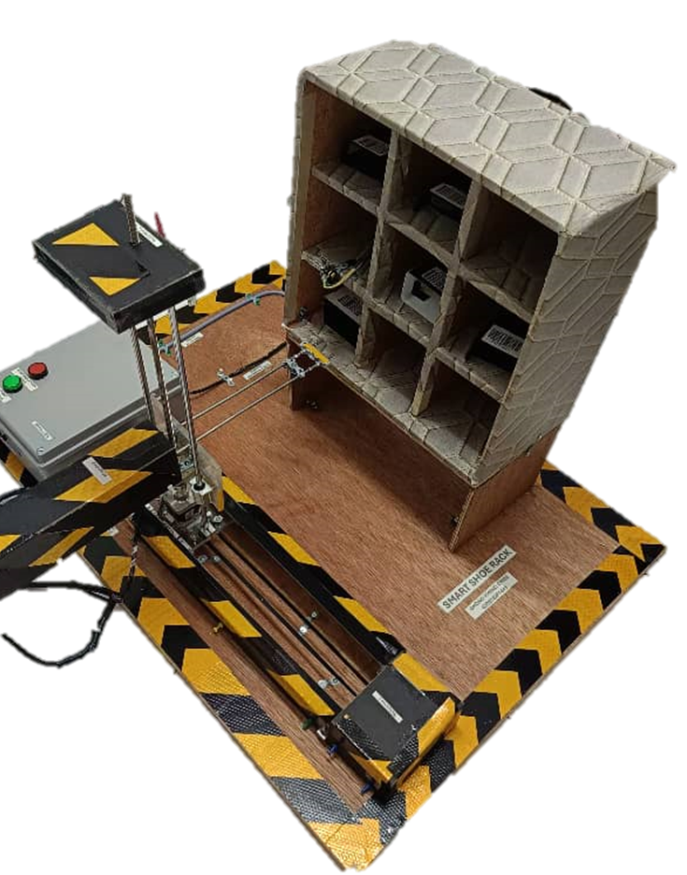
Circuit operation
1. Press the PUSH START BUTTON first.
2. The STEPPER will return to the 0, 0, 0 position to find the limit switch.
3. Then see if the pilot lamp is off, which means the IR sensor has detected a shoebox at 0, 0, 0.
4. Then we can select the button on the BLYNK side or the barcode scanner side to scan the barcode.
5. The stepper motor will take the shoebox to the specified position.
6. If we want to take the shoebox off, we can control it on blynk.
7. The stepper motor will go to the specified position and take the shoebox to 0, 0, 0.

Slide 11
conclusion
In summary, the smart shoe rack system addresses the prevalent issues associated with traditional shoe storage solutions. By integrating advanced technology, this project provides :
Enhanced organization: the automated shoe retrieval and storage system effectively maximizes space and ensures easy access to shoes, minimizing clutter.
User convenience: with a user-friendly interface via blynk, users can control the shoe rack remotely and retrieve their shoes effortlessly.
Efficient inventory management: the integration of a barcode scanner and google sheets allows for accurate tracking and management of shoe inventory, reducing the likelihood of errors.
Customizable design: the modular structure of the shoe rack caters to diverse user needs, allowing for expansion and personalization based on available space.
Overall, this innovative solution not only improves the efficiency of shoe storage but also enhances user experience, making it an ideal choice for both households and retail environments. Future developments may include additional features like voice control and integration with other smart home devices, further elevating the functionality of the system.

Slide 12
Recommendations
Advanced drivers: use improved motor drivers for better performance.
Camera integration: add a camera for automatic compartment location.
Upgraded motors: implement high-quality stepper motors for reliability.
Better rails: utilize superior rails for smoother and quieter operation.
Expanded capacity: design for a larger grid to hold more shoes.
Enhanced barcode scanner: improve scanner accuracy for quicker identification.
Voice control: integrate voice control for hands-free operation.
Commercial applications: explore uses in smart homes and retail environments.

Slide 13
THANK YOU !!!

