Slide 1
Collections

Slide 2
What are Collections
Group of Objects treated as a single Object.
Java provides supports for manipulating collections in the form of
Collection Interfaces
Collection Classes
Collection interfaces provide basic functionalities whereas collection classes provides their concrete implementation

Slide 3
Collection Classes
Collection classes are standard classes that implement collection interfaces
Some Collection Classes are abstract and some classes are concrete and can be used as it is.
Important Collection Classes:
AbstractCollection
AbstractList
AbstractSequentialList
LinkedList
ArrayList
AbstractSet
HasSet
LinkedHashSet
TreeSet

Slide 4
Partial View of Collection’s Framework
<< interface >>
Collection
<< Abstract Classes >>
AbstractCollection
List
Set
<< interface >>
AbstractList
Sorted Set
<< interface >>
ArrayList
AbstractSequentialList
LinkedList
Concrete Classes

Slide 5
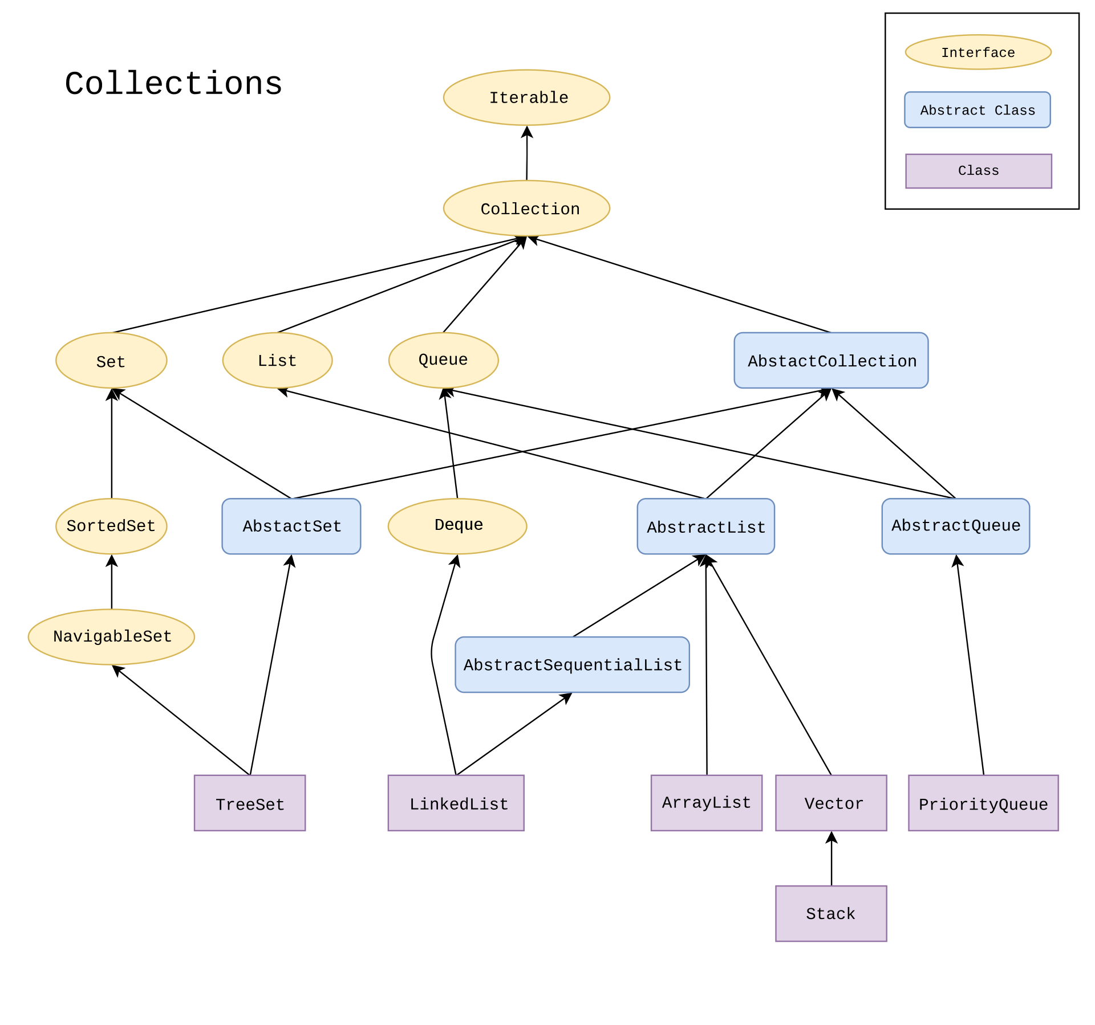

Slide 6
ArrayList
Growable Array implementation of List interface.
Insertion order is preserved.
Duplicate elements are allowed.
Multiple null elements of insertion are allowed.
Default initial capacity of an ArrayList is 10.
The capacity grows with the below formula, once ArrayList reaches its max capacity.
newCapacity= (oldCapacity * 3)/2 + 1
When to use?
If elements are to be retrieved frequently. Because ArrayList implements RandomAccess Interface
When not to use?
If elements are added/removed at specific positions frequently

Slide 7
ArrayList - Example
import java.util.*;
class Test{
public static void main(String args[]){
ArrayList<Integer> al1 = new ArrayList<Integer>();
al1.add(20);
al1.add(9);
ArrayList<Integer> al2 = new ArrayList<Integer>();
al2.add(22);
al2.add(53);
al1.addAll(al2);
Collections.sort(al1);
System.out.println(al1);
System.out.println(al1.get(3));}
}
Output:
[9, 20, 22, 53]
53

Slide 8
LinkedList - Methods
Constructor/Method | Description
List list = new LinkedList(); | It creates an empty linked list.
public boolean add(E e); | It adds the specified element at the end of the list.
public void addFirst(E e); | It adds the specified element in the beginning of the list.
public void addLast(E e); | It adds the specified element to the end of the list
public E removeFirst(); | It removes and returns the first element from the list.
public E removeLast(); | It removes and returns the last element from the list.
public E getFirst(); | It returns the first element from the list.
public E getLast(); | It returns the last element from the list.

Slide 9
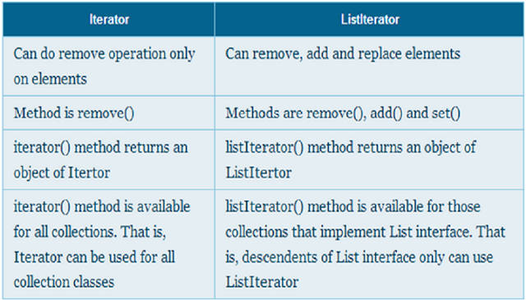
Iterator vs. ListIterator

Slide 10
Stack
Stack is child class of Vector
Stack class in java represents LIFO (Last in First Out) stack of objects.
Method | Description
public E push(E item); | Pushes the item on top of the stack
public synchronized E pop(); | Removes the item at the top of the stack and returns that item
public synchronized E peek(); | Returns the item at the top of the stack
public boolean empty(); | Checks whether stack is empty or not
public synchronized int search(Object o); | Returns the position of an object in the stack.

Slide 11
Set Interface

Slide 12
Set Interface
The set interface is an unordered collection of objects in which duplicate values cannot be stored.
The Java Set does not provide control over the position of insertion or deletion of elements.
Basically, Set is implemented by HashSet, LinkedHashSet or TreeSet (sorted representation).

Slide 13
HashSet
Implements Set Interface.
Underlying data structure for HashSet is hashtable.
As it implements the Set Interface, duplicate values are not allowed.
Objects that you insert in HashSet are not guaranteed to be inserted in same order. Objects are inserted based on their hash code.
NULL elements are allowed in HashSet.
Execution time of add(), contains(), remove(), size() is constant even for large sets.

Slide 14
HashSet - Example
HashSet<Integer> set = new HashSet<Integer>();
set.add(12);
set.add(63);
set.add(34);
set.add(45);
set.add(12);
Iterator<Integer> iterator = set.iterator();
System.out.print("Set data: ");
while (iterator.hasNext()) {
System.out.print(iterator.next() + " ");
}
Output:
Set data: 34 12 45 63

Slide 15
List Iterator
List Iterator is used to traverse forward and backward directions
Method | Description
boolean hasNext() | This method return true if the list iterator has more elements when traversing the list in the forward direction.
Object next() | This method return the next element in the list and advances the cursor position.
boolean hasPrevious() | This method return true if this list iterator has more elements when traversing the list in the reverse direction.
Object previous() | This method return the previous element in the list and moves the cursor position backwards.

Slide 16
List Iterator - Example
Output:
Forward Traversal
20
9
22
53
Backward Traversal
53
22
9
20
ArrayList<Integer> al = new ArrayList<Integer>();
al.add(20);
al.add(9);
al.add(22);
al.add(53);
ListIterator<Integer> itr=al.listIterator();
System.out.println("Forward Traversal");
while(itr.hasNext()) {
System.out.println(itr.next());
}
System.out.println("Backward Traversal");
while(itr.hasPrevious()) {
System.out.println(itr.previous());
}
Question: What happens if the backward traversal happens before the forward?

Slide 17
Review Question
Find the output
Compilation Error
Runtime Error
[Sachin, Rahul, 10]
[Sachin, Rahul, 10]
ArrayList al = new ArrayList();
al.add("Sachin");
al.add("Rahul");
al.add(10);
String s[] = new String[3];
for(int i=0;i<3;i++)
s[i] = (String)al.get(i);
System.out.println(al);
System.out.println(Arrays.toString(s));
Note:
No compilation error because add(Object o) method in the ArrayList class
Runtime Error because integer object is type case to String
Solution:
Generics

Slide 18
Wildcard in Generics
abstract class Shape{
final double pi = 3.14;
double area;
abstract void draw();
}
class Rectangle extends Shape{
Rectangle(int l,int b){
area = l*b; }
void draw(){System.out.println("Area of Rect:"+area);}
}
class Circle extends Shape{
Circle(int r){
area = pi*r*r; }
void draw(){System.out.println("Area of circle:"+area);}
}

Slide 19
Wildcard in Generics
class test{
//creating a method that accepts only child class of Shape
public static void drawShapes(List<? extends Shape> lists){
for(Shape s:lists){
s.draw();}
}
public static void main(String args[]){
List<Rectangle> list1=new ArrayList<Rectangle>();
list1.add(new Rectangle(3,5));
List<Circle> list2=new ArrayList<Circle>();
list2.add(new Circle(2));
list2.add(new Circle(5));
drawShapes(list1);
drawShapes(list2);
}}
Output:
Area of Rect:15.0
Area of circle:12.56
Area of circle:78.5

Slide 20
Wildcard in Generics
class test{
public static void main(String[] args) {
List<Integer> list1= Arrays.asList(1,2,3);
List<Number> list2=Arrays.asList(1.1,2.2,3.3);
List<Double> list3=Arrays.asList(1.1,2.2,3.3);
List<String> list4=Arrays.asList("s","j","r");
printlist(list1);
printlist(list2);
printlist(list3);
printlist(list4);
}
private static void printlist(List<Number> list) {
System.out.println(list);}
}
Output:
list1, list3, list4 – compilation error
Type not applicable for the arguements

Slide 21
Wildcard in Generics
class test{
public static void main(String[] args) {
List<Integer> list1= Arrays.asList(1,2,3);
List<Number> list2=Arrays.asList(1.1,2.2,3.3);
List<Double> list3=Arrays.asList(1.1,2.2,3.3);
List<String> list4=Arrays.asList("s","j","r");
printlist(list1);
printlist(list2);
printlist(list3);
printlist(list4);
}
private static void printlist(List<?> list) {
System.out.println(list);
}
}
Output:
[1, 2, 3]
[1.1, 2.2, 3.3]
[1.1, 2.2, 3.3]
[s, j, r]

Slide 22
Upper Bounded Wildcard
class test{
public static void main(String[] args) {
List<Integer> list1= Arrays.asList(1,2,3);
List<Number> list2=Arrays.asList(1.1,2.2,3.3);
List<Double> list3=Arrays.asList(1.1,2.2,3.3);
List<String> list4=Arrays.asList("s","j","r");
printlist(list1);
printlist(list2);
printlist(list3);
printlist(list4);
}
private static void printlist(List<? extends Number> list){
System.out.println(list);}
}
Output:
list4 – compilation error
Type not applicable for the arguements

Slide 23
Lower Bounded Wildcard
class test{
public static void main(String[] args) {
List<Integer> list1= Arrays.asList(1,2,3);
List<Number> list2=Arrays.asList(1.1,2.2,3.3);
List<Double> list3=Arrays.asList(1.1,2.2,3.3);
printlist(list1);
printlist(list2);
printlist(list3);
}
private static void printlist(List<? super Integer> list) {
System.out.println(list);
}
}
Output:
list3 – compilation error
Type not applicable for the arguements

Slide 24
Comparable Interface

Slide 25
Comparable Interface
It is used to order the objects of user-defined class.
It is found in java.lang package and contains only one method named compareTo(Object)
Elements can be sorted based on single data member eg: account number, name or age.
We can sort the elements of:
String objects
Wrapper class objects
User-defined class objects

Slide 26
Comparable-Example
import java.util.*;
class Account implements Comparable<Account>{
int acc;
String name;
float amt;
Account(int acc,String name,float amt){
this.acc = acc;
this.name = name;
this.amt = amt; }
public int compareTo(Account ac){
if(amt==ac.amt)
return 0;
else if(amt>ac.amt)
return 1;
else
return -1; }
public String toString() {
return "Acc. No.: "+acc+" Name: "+name+" Amount: "+amt;}
}

Slide 27
Comparable-Example
class Test{
public static void main(String[] args) {
List<Account> al = new ArrayList<Account>();
al.add(new Account(111,"Ankit",5000));
al.add(new Account(112,"Ashok",4000));
al.add(new Account(123,“Ryan",5000));
Collections.sort(al);
for(Account a:al)
System.out.println(a);
}
}

Slide 28
Comparator
Interface

Slide 29
Comparator Interface
Used to order user defined class
This interface is found in java.util package and contains 2 methods
compare(Object obj1,Object obj2)
equals(Object element)
It provides multiple sorting sequence
Elements can be sorted based on any data member

Slide 30
Comparator - Example
import java.util.*;
class Account{
int acc;
String name;
float amt;
Account(int acc,String name,float amt){
this.acc = acc;
this.name = name;
this.amt = amt; }
public String toString() {
return "Acc. No.: "+acc+" Name: "+name+" Amount: "+amt;}
}

Slide 31
Comparator - Example
class AmtCmp implements Comparator<Account>{
public int compare(Account a1,Account a2){
if(a1.amt == a2.amt)
return 0;
else if(a1.amt>a2.amt)
return 1;
else
return -1; }
}

Slide 32
Comparator - Example
class AccCmp implements Comparator<Account>{
public int compare(Account a1,Account a2){
if(a1.acc == a2.acc)
return 0;
else if(a1.acc>a2.acc)
return 1;
else
return -1; }
}

Slide 33
Comparator - Example
class test {
public static void main(String[] args) {
List<Account> al = new ArrayList<Account>();
al.add(new Account(123,"Ankit",5000));
al.add(new Account(112,"Ashok",4000));
al.add(new Account(111,"Ryan",5000));
System.out.println("Comparison on Amount");
Collections.sort(al,new AmtCmp());
for(Account a:al)
System.out.println(a);
System.out.println("Comparison on Acc. No.");
Collections.sort(al,new AccCmp());
for(Account a:al)
System.out.println(a); }
}

Slide 34
Overriding Equals method
class Account implements Comparator<Account>{
int acc;
String name;
float amt;
Account(int acc,String name,float amt){
this.acc = acc;
this.name = name;
this.amt = amt; }
public boolean equals(Account a1) {
if (a1 == null)
return false;
if(this.acc != a1.acc)
return false;
if(this.amt != a1.amt)
return false;
if(!(a1.name.equals(this.name)))
return false;
return true;}

Slide 35
Overriding Equals method
public String toString() {
return "Acc. No.: "+acc+" Name: "+name+" Amount: "+amt;}
public int compare(Account arg0, Account arg1) {
// TODO Auto-generated method stub
return 0;}
}
class test {
public static void main(String[] args) {
List<Account> al = new ArrayList<Account>();
al.add(new Account(111,"Ryan",5000));
al.add(new Account(112,"Ryan",5000));
al.add(new Account(111,"Ryan",5000));
System.out.println(al.get(0).equals(al.get(2)));
System.out.println(al.get(0).equals(al.get(1))); }
}

Slide 36
Bounds in Generics (Comparator)
public class test {
public static void main(String[] args) {
System.out.printf("Max of %d, %d and %d is %d\n\n",
3, 4, 5, maximum( 3, 4, 5 ));
System.out.printf("Max of %.1f,%.1f and %.1f is %.1f\n\n",
6.6, 8.8, 7.7, maximum( 6.6, 8.8, 7.7 ));
System.out.printf("Max of %s,%s and %s is %s\n\n",
"s", "j", "r", maximum( "s", "j", "r" ));
}
public static <T extends Comparable<T>> T maximum(T x, T y, T z) {
T max = x;
if(y.compareTo(max) > 0) {
max = y; }
if(z.compareTo(max) > 0) {
max = z; }
return max; }
}
Output:
Max of 3, 4 and 5 is 5
Max of 6.6,8.8 and 7.7 is 8.8
Max of s,j and r is s

Slide 37
Multiple Bounds in Generics
public class test {
public static void main(String[] args) {
System.out.printf("Max of %d, %d and %d is %d\n\n",
3, 4, 5, maximum( 3, 4, 5 ));
System.out.printf("Max of %.1f,%.1f and %.1f is %.1f\n\n",
6.6, 8.8, 7.7, maximum( 6.6, 8.8, 7.7 ));
System.out.printf("Max of %s,%s and %s is %s\n\n",
"s", "j", "r", maximum( "s", "j", "r" ));
}
public static <T extends Number & Comparable<T>> T maximum(T x, T y, T z) {
T max = x;
if(y.compareTo(max) > 0) {
max = y; }
if(z.compareTo(max) > 0) {
max = z; }
return max; } }
Error:
The method maximum(T, T, T) in the type test is not applicable for the arguments (String, String, String)

