Slide 1
Object Oriented Programming CS F213 Amit Dua
Slide material from book “Head First Design Patterns”

Slide 2
Decorator Design pattern

Slide 3
Topics to be covered
Decorator Design pattern
Simple Factory Design pattern

Slide 4
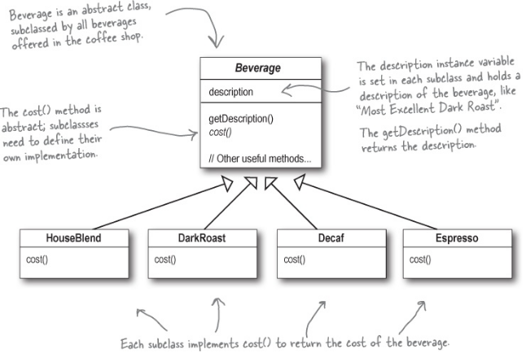
Starbuzz coffee

Slide 5
Problem
Every coffee can be served with milk, soy, mocha, caramel
Solution??

Slide 6
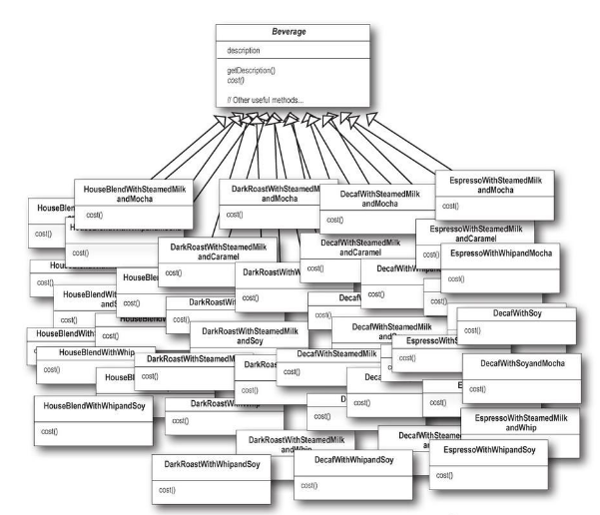

Slide 7


Slide 8
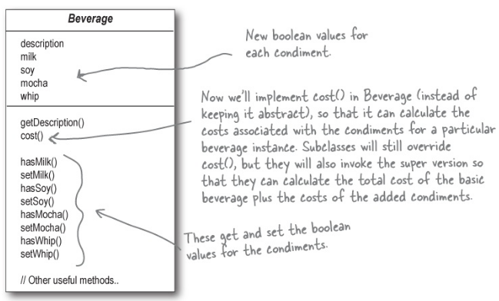

Slide 9
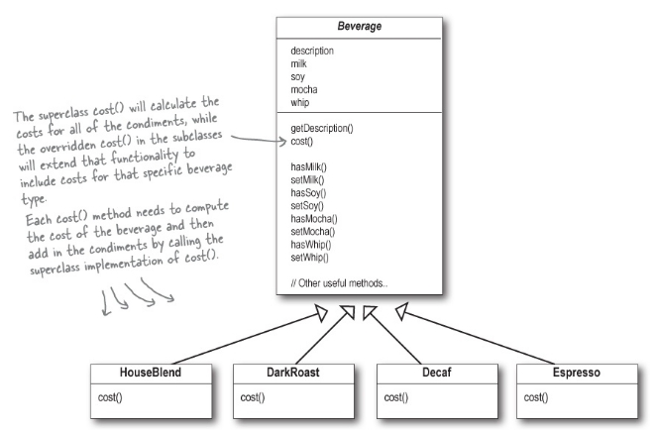
Double mocha
Change the cost of whip

Slide 10
Implementation
public class Beverage {
public double cost() {
float condimentCost = 0.0;
if (hasMilk()) { condimentCost += milkCost; }
if (hasSoy()) { condimentCost += soyCost; }
if (hasMocha()) { condimentCost += mochaCost; }
if (hasWhip()) { condimentCost += whipCost; }
return condimentCost; } }
public class DarkRoast extends Beverage {
public DarkRoast() {
description = "Most Excellent Dark Roast"; }
public double cost() { return 1.99 + super.cost(); } }

Slide 11
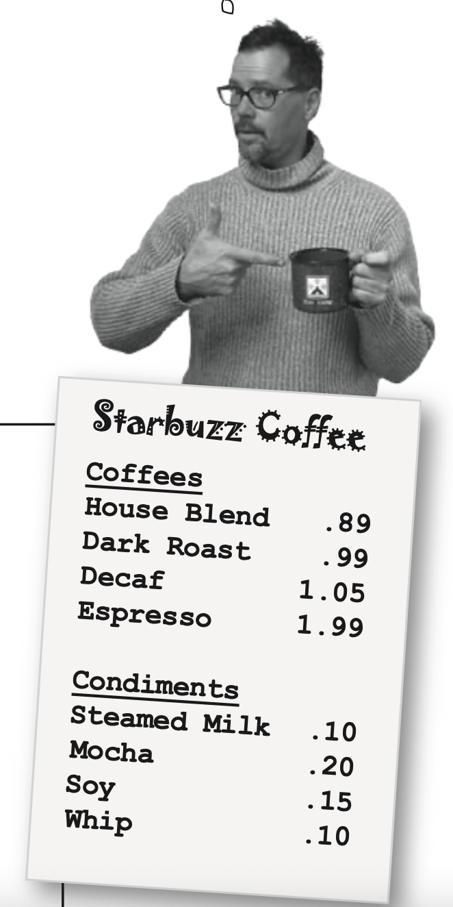

Slide 12
Problems
Price changes for condiments will force us to alter existing code.
New condiments will force us to add new methods and alter the cost method in the superclass.
We may have new beverages. For some of these beverages (iced tea?), the condiments may not be appropriate, yet the Tea subclass will still inherit methods like hasWhip().
What if a customer wants a double mocha?

Slide 13
Solution (dark roast with mocha with whip)
Decorate
Take a DarkRoast object
Decorate it with a Mocha object
Decorate it with a Whip object
Call the cost() method and rely on delegation to add on the condiment costs

Slide 14
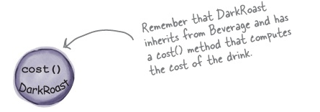
DarkRoast with Mocha and Whip

Slide 15
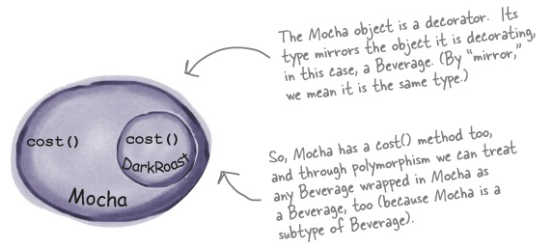
create a Mocha object and wrap it around the DarkRoast

Slide 16
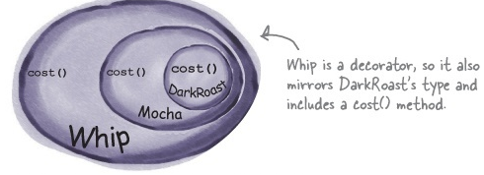
create a Whip decorator and wrap Mocha with it.

Slide 17
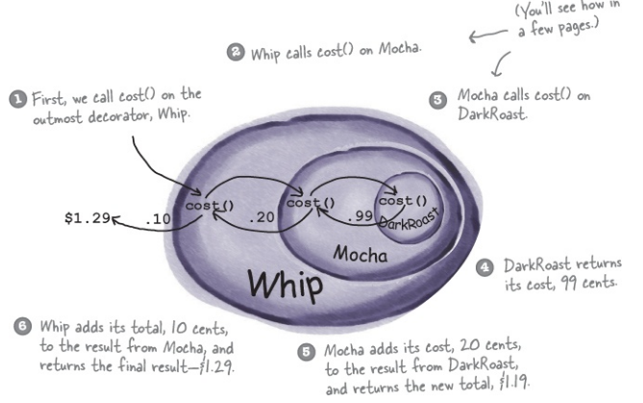
DarkRoast with mocha and whip

Slide 18
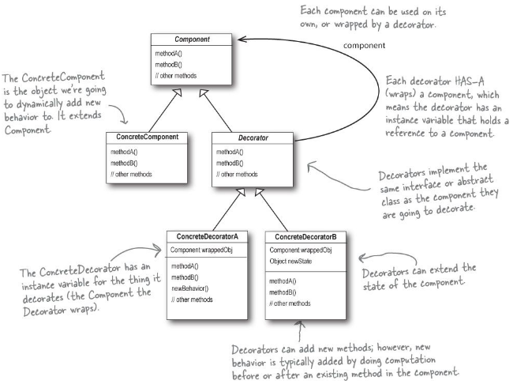
Questions

Slide 19
Decorator pattern
The Decorator Pattern attaches additional responsibilities to an object dynamically. Decorators provide a flexible alternative to subclassing for extending functionality.

Slide 20
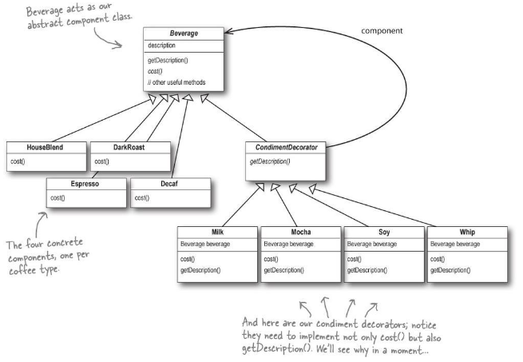

Slide 21
Points for decorator
we’re using inheritance to achieve the type matching, but we aren’t using inheritance to get behavior.
When we compose a decorator with a component, we are adding new behavior. We are acquiring new behavior not by inheriting it from a superclass, but by composing objects together.
because we are using object composition, we get a whole lot more flexibility about how to mix and match condiments and beverages.

Slide 22
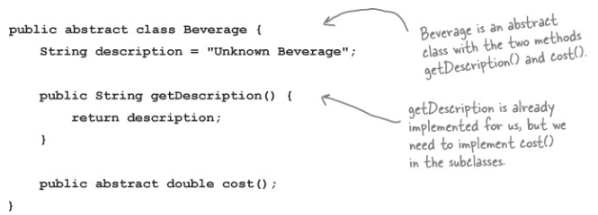
Beverage

Slide 23
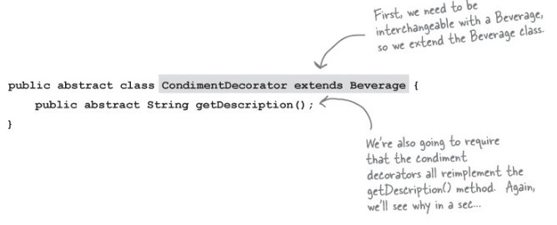

Slide 24
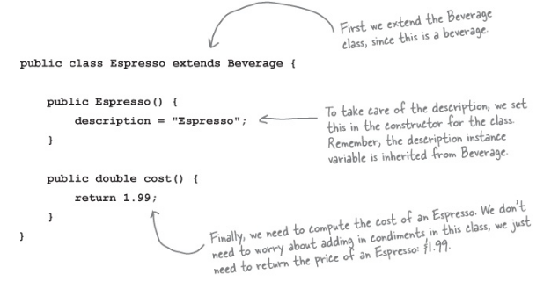

Slide 25
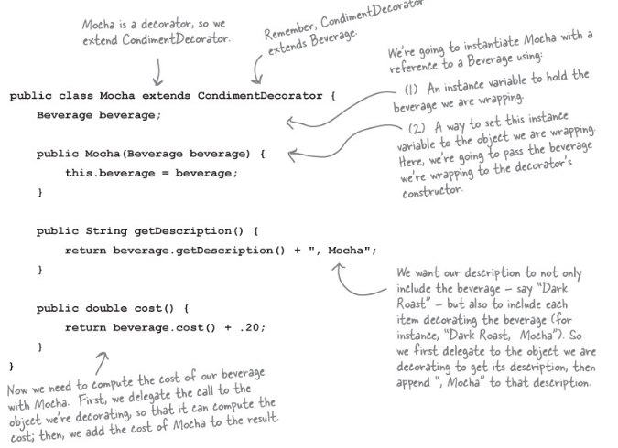

Slide 26
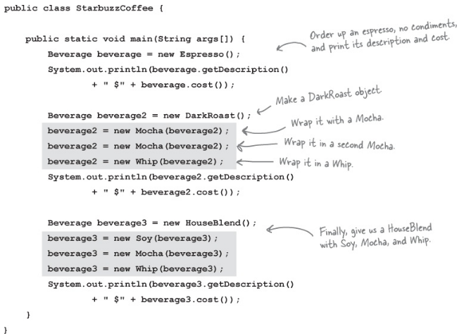

Slide 28
Questions

Slide 29
Simple Factory Design pattern

Slide 30
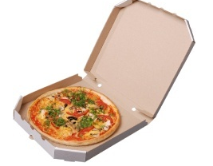
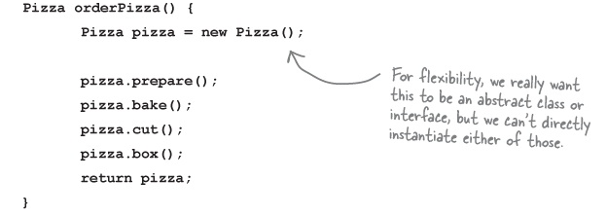
Pizza

Slide 31
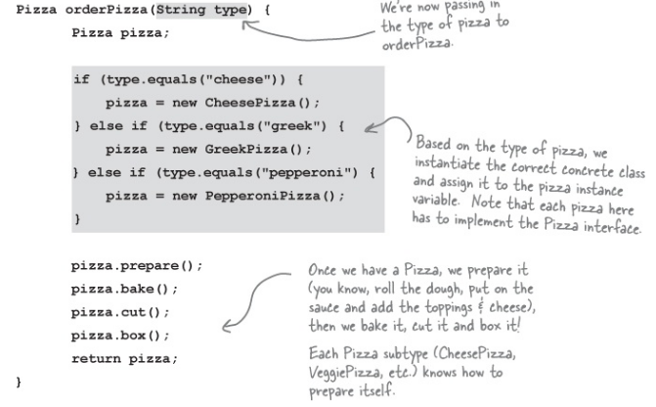

Slide 32
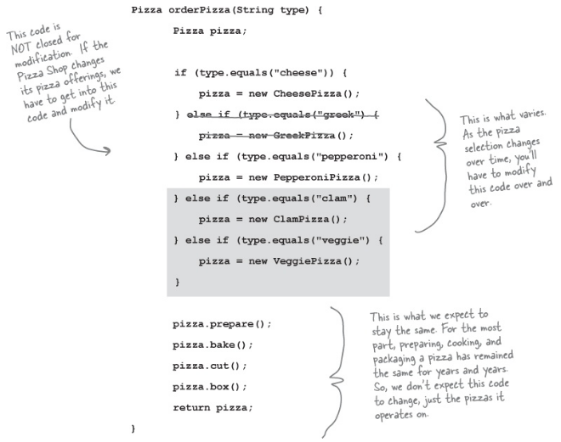
New situation violates ‘Open for extension closed for modification’

Slide 33
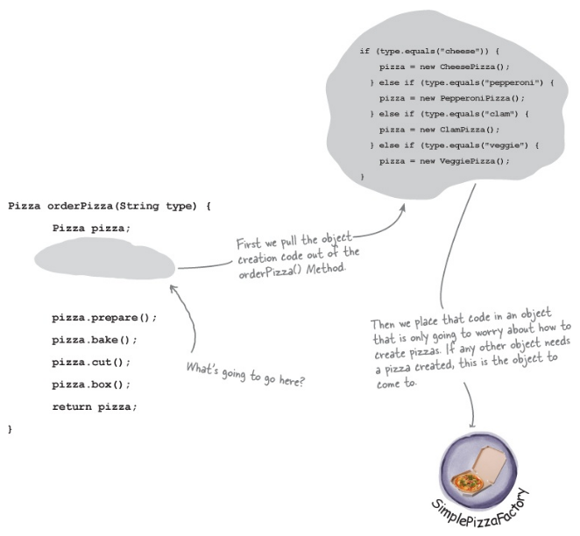

Slide 34
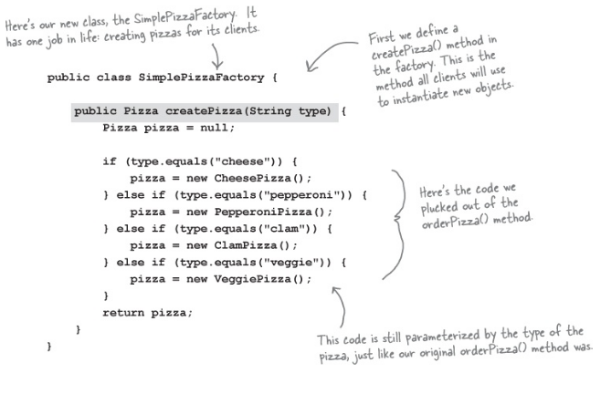

Slide 35
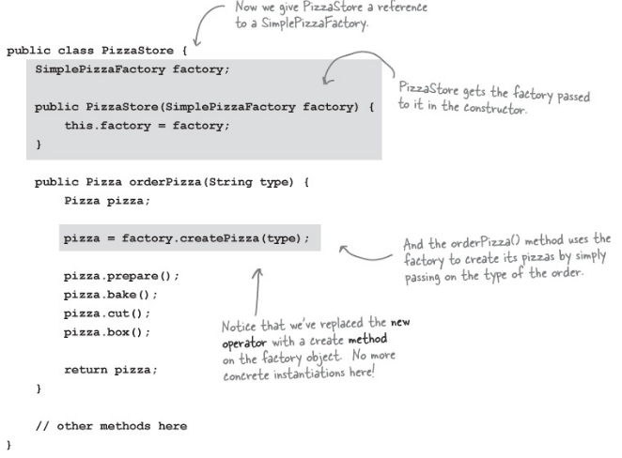

Slide 36
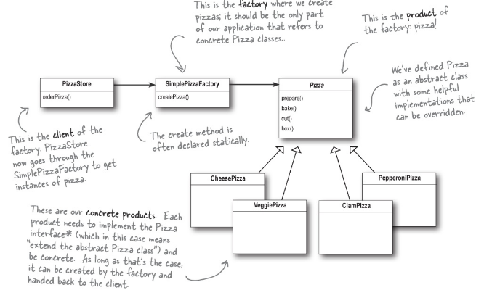

Slide 37
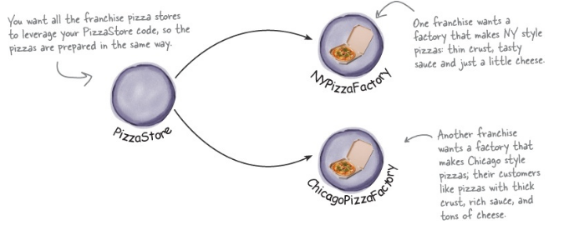

Slide 38
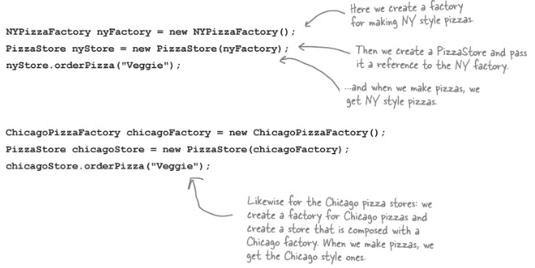

Slide 39
Simple Factory Pattern

