Slide 1
How did NBA positions and roles change over time?
Chirag Kashyap
STA 141B

Slide 2
Difference between role and Position
Position is a label that tells what the player does to help his team
Example: Steph Curry is a guard
Example: Andre Iguodala is a wing
Role is a label that implies how important a player is to a team
Example: Steph Curry’s role on the team is being a superstar
Example: Andre Iguodala’s role on the team is being a 6th man

Slide 3
Why does this matter?
The NBA game has changed over the years
Widespread usage of 3 point shot
Decrease in Turnovers
Decrease in Offensive rebounding
A cluster analysis of player’s position and role allows us to
Predict how the league will continue to evolve
Predict success of teams dependent on the clusters their players belong to

Slide 4
Preliminary Methods
Scraping Data From basketball-reference.com
BeautifulSoup to scrape
Used Requests_Cache to limit unnecessary requesting
K-Means Cluster Analysis
Principal Component Analysis
Euclidean Distance
Silhouette Analysis of various Ks

Slide 5
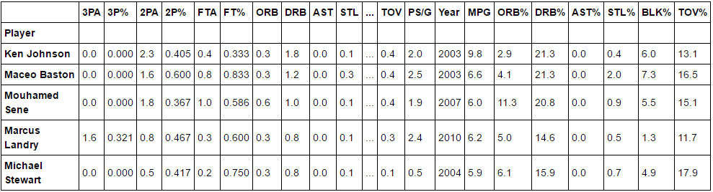
Example of Data

Slide 6
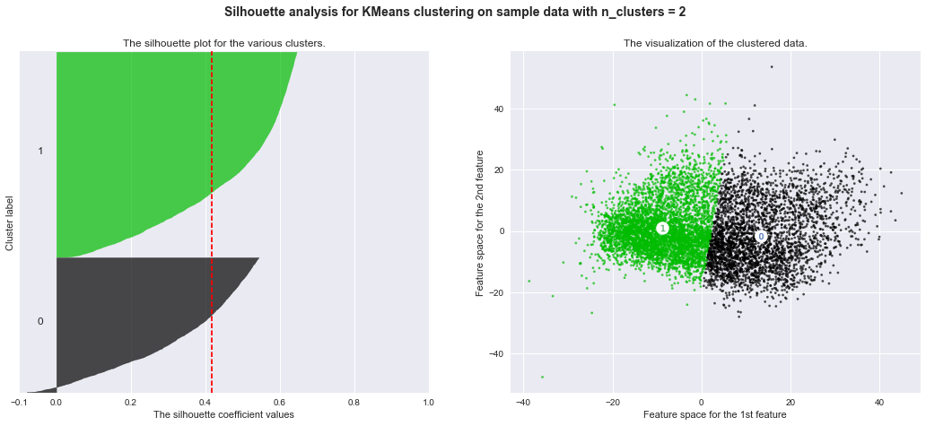
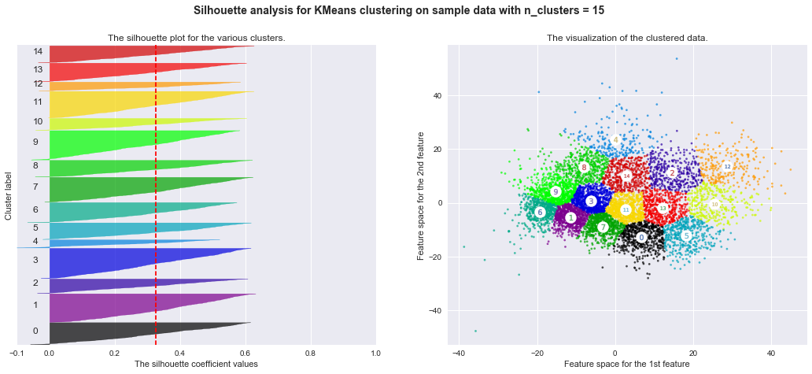
Preliminary results: role

Slide 7
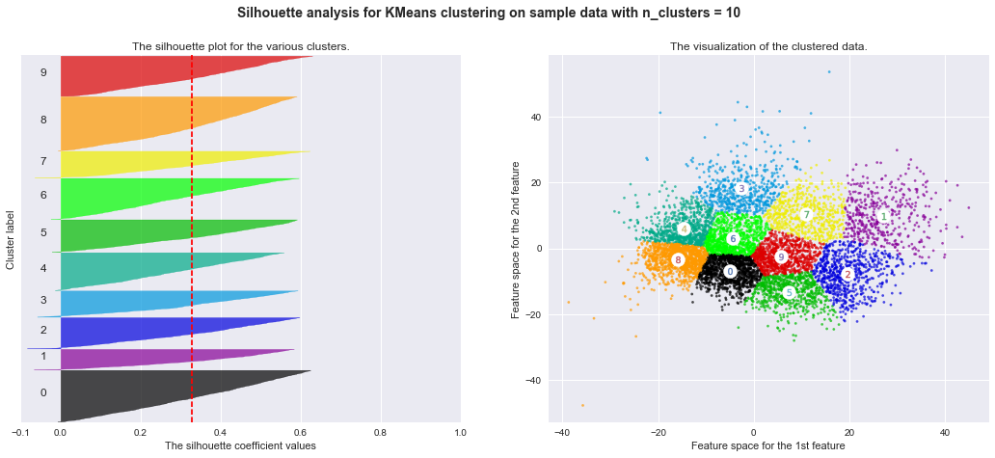
Preliminary Results: role

Slide 8
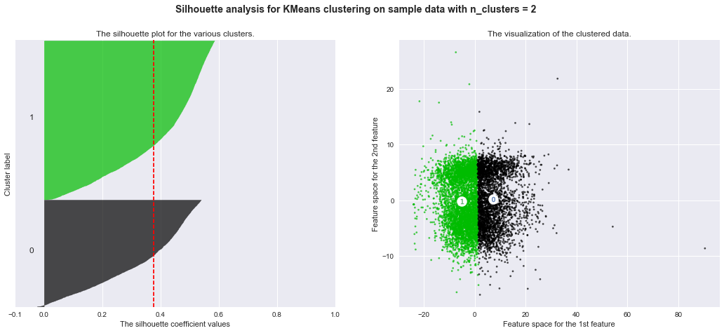
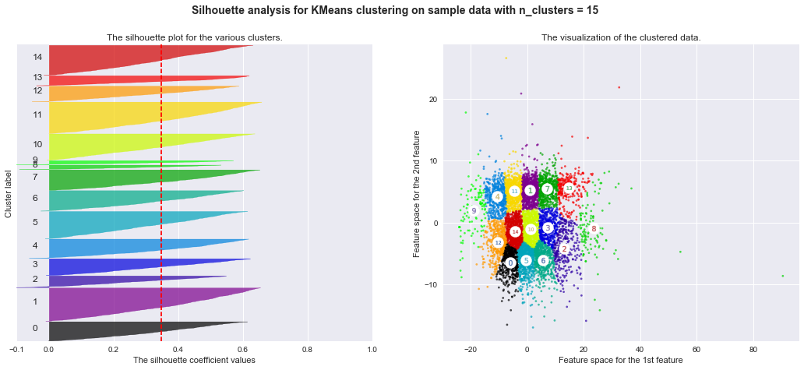
Preliminary Results: Position

Slide 9
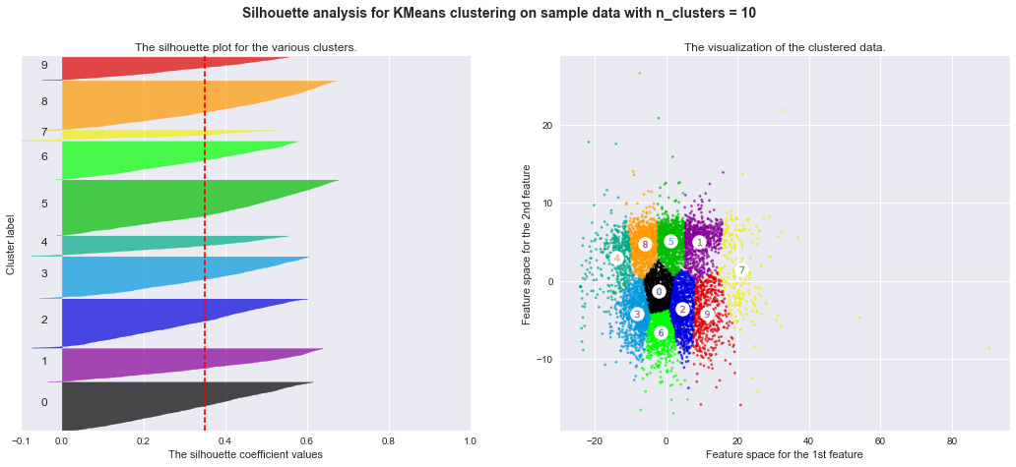
Preliminary Results: Position

Slide 10
TO do List
Compare K-Means results with other types of cluster analysis
Re-do cluster analysis for each NBA season
Determine amount of clusters
Make sure clusters make sense
Label clusters based off of prior knowledge
Predict future percentages of each cluster in NBA

