Slide 1
DLIP 2022-1
Exercise Posture Assistance System
한동대학교 기계제어공학부
21700421 ChangMin An
21700433 JiWoo Yang

Slide 2
Introduction
Technique
Evaluation
Contents

Slide 3
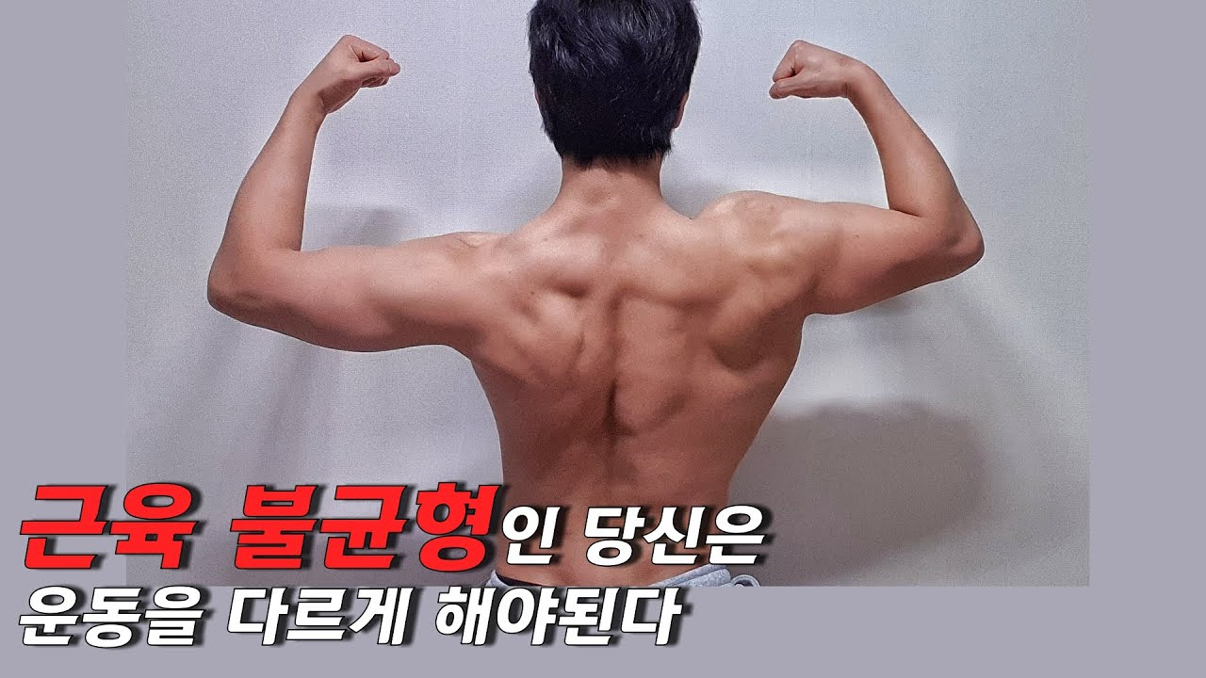
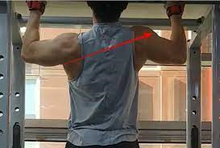
Introduction
Problem & Solution

Slide 4
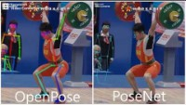
Technique
Deep Learning Model for Pose Estimation

Slide 5
Evaluation
Evaluation
Deep-Learning Model | Set up level of difficulty
 | Accuracy of model
 | Speed
Additional Learning | Precision, Accuracy, Recall
Application | Utilization
 | Accuracy of Command
 | Algorithm

