Slide 1

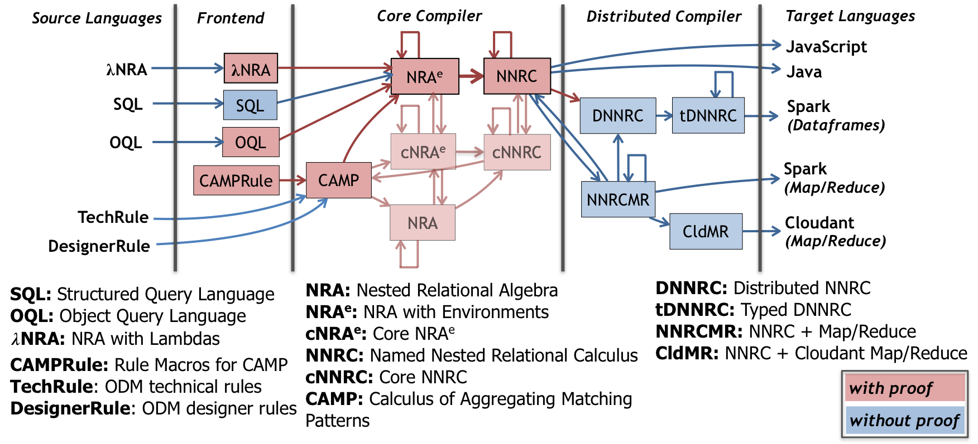

Q*cert
A platform for specifying and verifying query compilers
J. Auerbach, M. Hirzel, L. Mandel, A. Shinnar, J. Siméon
IBM Research
Challenges?
Precise Language Semantics
Long Compilation Pipeline
Query Optimizer
What for?
Correctness guarantees
New Languages (e.g., DSLs)
Education
How?
Formal Specification
Mechanized Proof
Code Extraction
Compilation Pipeline
–
Functional Rewrite
Algebraic Equivalence
Lemma select_union_distr q₀ q₁ q₂ :
𝛔⟨ q₀ ⟩(q₁ ∪ q₂) ≡ 𝛔⟨ q₀ ⟩(q₁) ∪ 𝛔⟨ q₀ ⟩(q₂).
Proof.
… (* proof omitted *)
Qed.
Definition select_union_distr_fun q :=
match q with
| NRAEnvSelect q0 (NRAEnvBinop AUnion q1 q2) =>
NRAEnvBinop AUnion
(NRAEnvSelect q0 q1) (NRAEnvSelect q0 q2)
| _ => q
end.
Correctness Proof
Property select_union_distr_fun_correctness q₀ q₁ q₂ :
select_union_distr_fun q ≡ q.
Proof.
Hint Rewrite select_union_distr : envmap_eqs.
prove_correctness q.
Qed.
Features
Nested Data Model with Objects
Type Checking
Aggregate Queries (includes TPC-H)
Configurable Optimizer
External Types and Functions
JSON Support
Compiler Extraction
https://querycert.github.io

