Slide 1

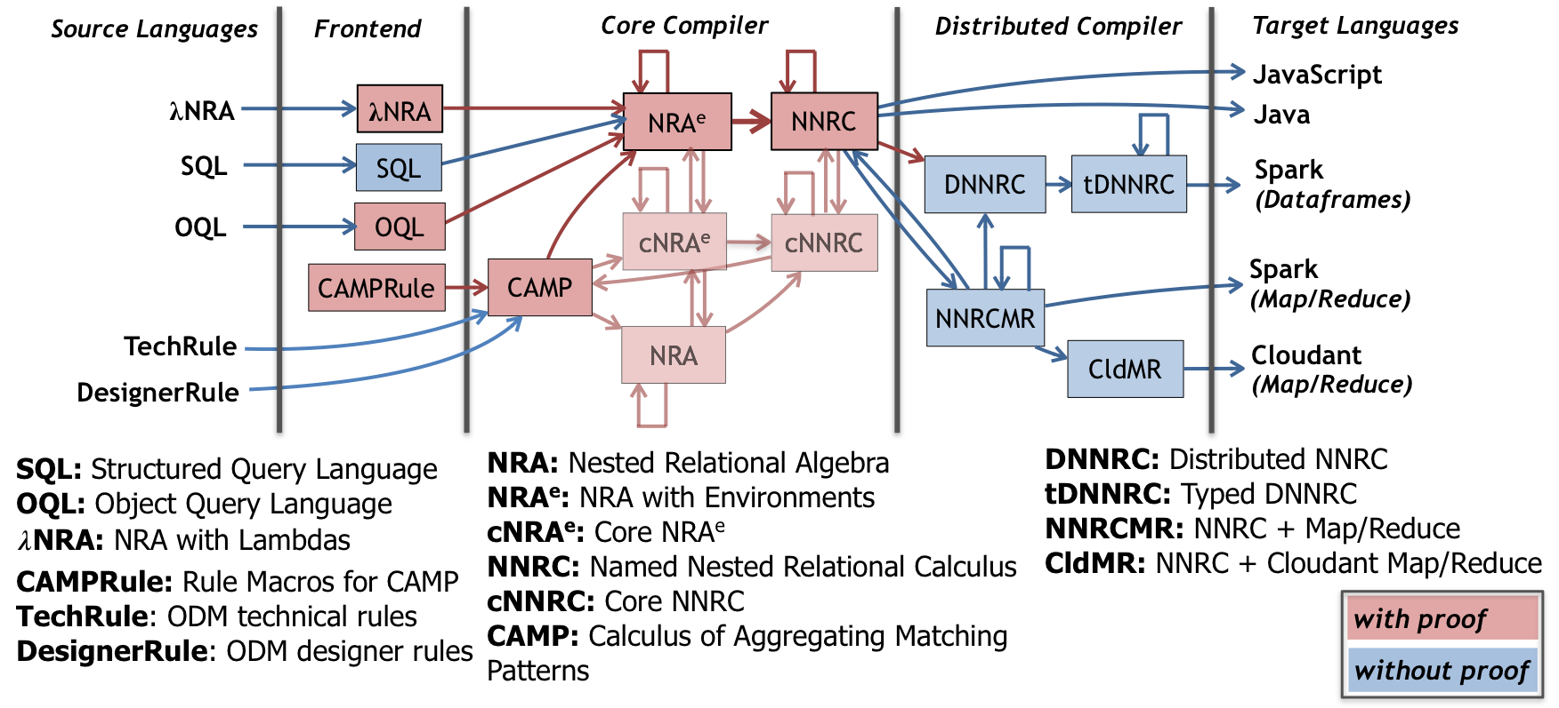

Q*cert
A Platform for Specifying and Verifying Query Compilers
J. Auerbach, M. Hirzel, L. Mandel, A. Shinnar, J. Siméon
IBM Research
Goals:
Verified Query Compiler
Multiple Sources & Targets
Extensibility
Applications:
New Languages (e.g., DSLs)
Designing New Optimizations
Education Platform
Approach:
Written in Coq (Proof Assistant)
Mechanized Correctness Proof
Compiler Extraction
Compilation Pipeline
–
Functional Rewrite
Algebraic Equivalence
Lemma select_union_distr q₀ q₁ q₂ :
𝛔⟨ q₀ ⟩(q₁ ∪ q₂) ≡ 𝛔⟨ q₀ ⟩(q₁) ∪ 𝛔⟨ q₀ ⟩(q₂).
Proof.
… (* proof omitted *)
Qed.
Definition select_union_distr_fun q :=
match q with
| NRAEnvSelect q0 (NRAEnvBinop AUnion q1 q2) =>
NRAEnvBinop AUnion
(NRAEnvSelect q0 q1) (NRAEnvSelect q0 q2)
| _ => q
end.
Correctness Proof
Property select_union_distr_fun_correctness q₀ q₁ q₂ :
select_union_distr_fun q ≡ q.
Proof.
Hint Rewrite select_union_distr : envmap_eqs.
prove_correctness q.
Qed.
Other Features
Configurable Optimizer
Nested Data Model with Objects
JSON Support
Aggregate Queries (supports TPC-H)
Type Checking
Foreign Types and Operations
Compiler Extraction
https://querycert.github.io

