Slide 1
Breaking Balls are like Kryptonite:
The Decline of Javy Baez
Chris Kellogg , DSC680-T302
Notes:
Background of the project

Slide 2
Javy Baez was one of the most exciting players in baseball (Rogers, 2018)
penchant for big hits
controlled aggression running the bases (Chicago Cubs, 2020)
stunning knack for tagging baserunners (Crazy for Baseball, 2017)
defensive wizardry; nicknamed “El Mago” (EduardoBeisbol, 2024)
Introduction
Notes:
Background of the project

Slide 3
Javy Baez was a fan favorite in Chicago
helped the Cubs break their World Series drought in 2016
played in 2 MLB all-star games (2018-2019)
finished 2nd in NL MVP voting in 2018
Time in Chicago ended disappointingly
turned down a 9-year, $180 million extension in early 2020 (Taylor, 2021)
traded to the New York Mets halfway through the 2021 season (Wikipedia)
Introduction
Notes:
Background of the project

Slide 4
Baez has performed poorly after signing a 6-year, $140 million contract in Detroit
contract has been called a “nightmare” (Petzold, 2021)
may end up being benched (Clark, 2025)
Can these struggles be explained by MLB pitchers throwing Javy Baez a higher percentage of breaking balls?
Problem Statement
Notes:
Background of the project

Slide 5
BAEZ may be able to make adjustments to the pitch mix and his swing
DETROIT TIGERS may get a better picture of how to proceed for the future
OPPONENTS may be able to adjust their game plans and approach to Baez
How is it useful?
Notes:
Background of the project

Slide 6
Season performance statistics
Baseball Reference
https://www.baseball-reference.com/players/b/baezja01.shtml
Pitch data
pybaseball API for Python
https://pypi.org/project/pybaseball/2.0.0/
Data Sources
Notes:
Background of the project

Slide 7
Narrowed data sets to full-time MLB seasons
Grouped and aggregated season pitch data based on pitch type
Calculated percentages of each pitch type thrown each season
Merged datasets for pitch mix and performance by season
Data Preparation
Notes:
Background of the project

Slide 8
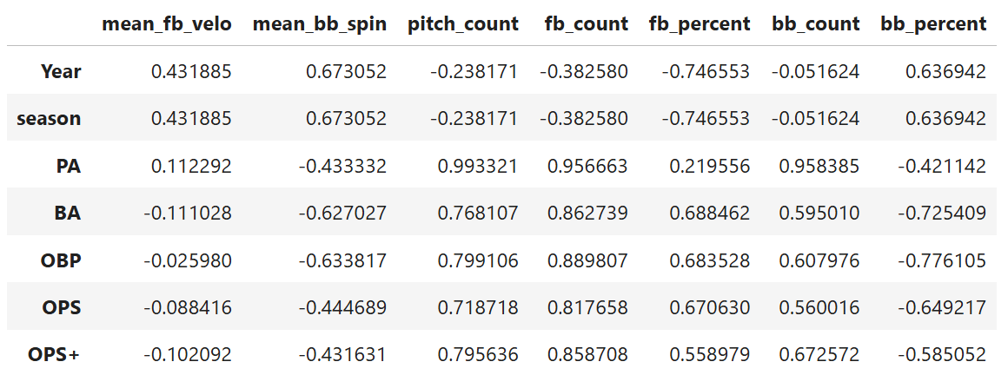
Looked for correlation between pitch data and offensive performance
Methods
Notes:
Background of the project

Slide 9
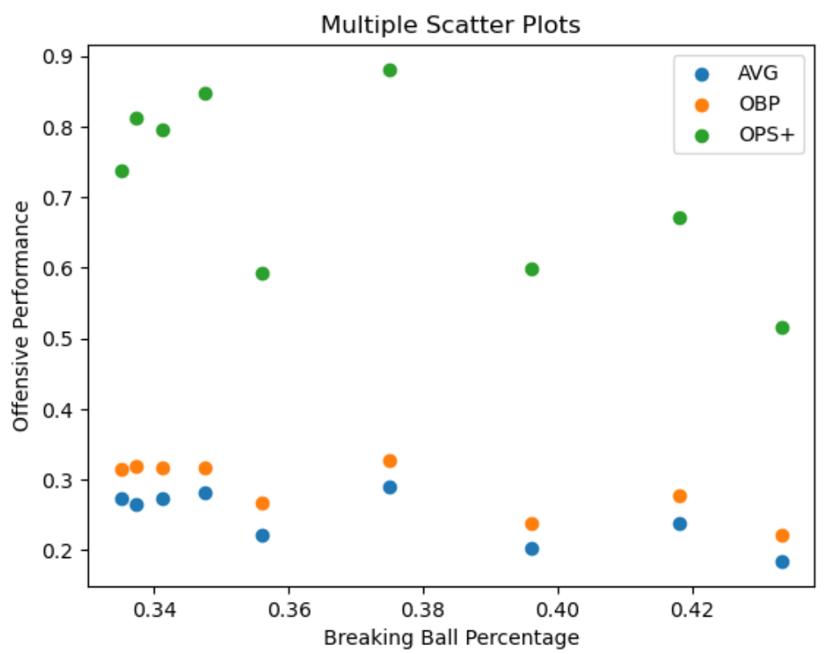
Looked for visual relationship between
breaking ball percentag and offensive performance
Methods
Notes:
Background of the project

Slide 10
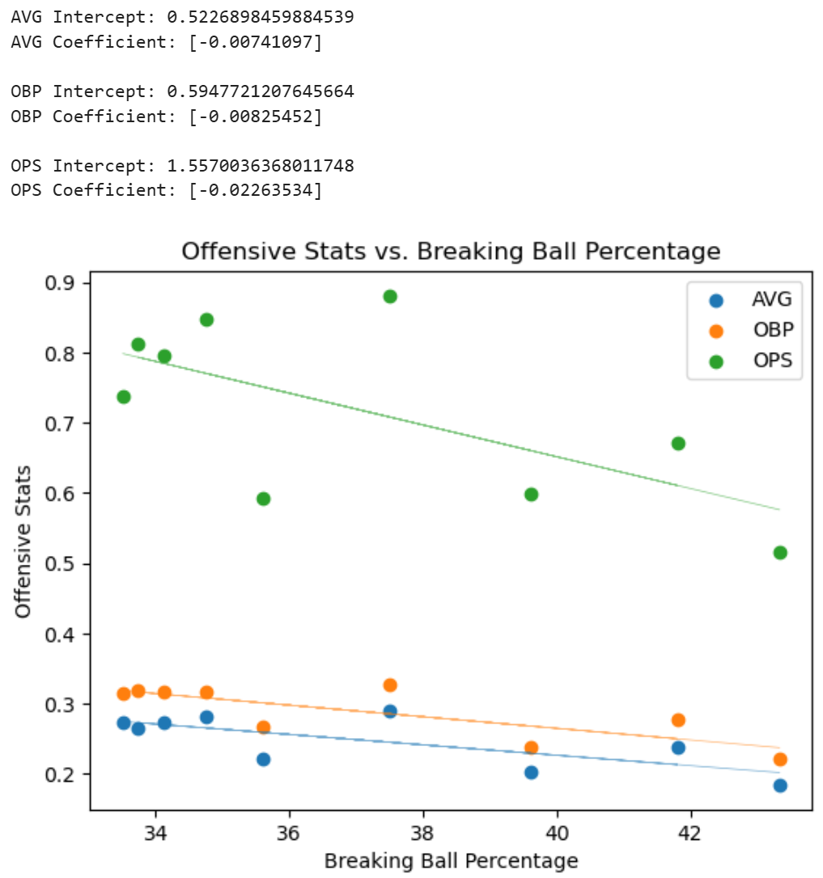
Fit linear regression to offensive performance based on breaking ball percentage
Model and Evaluation Method
Notes:
Background of the project

Slide 11
Baez loses .020 on his OPS for each percentage increase in breaking balls
Went from .800 (good) when he saw around 34% breaking balls (near MLB mean)
down to below .600 (awful) when he saw about 43% breaking balls
Results
Notes:
Background of the project

Slide 12
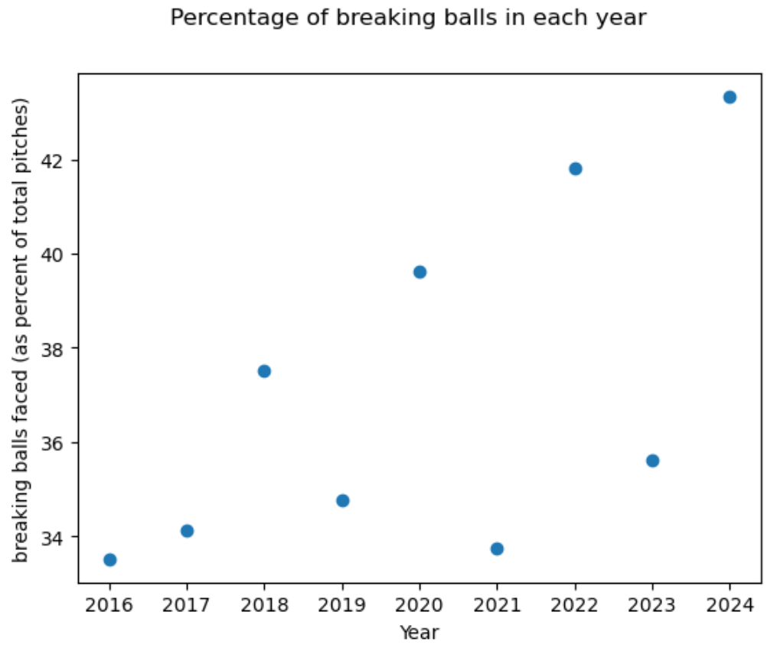
Pitchers have likely picked up on the pattern
percentage of breaking balls has generally gone up as time passes
Baez had his worst year in 2024, when he saw the most breaking pitches
Results
Notes:
Background of the project

Slide 13
Javy Baez is experiencing a decline in his offensive value because pitchers are throwing a higher percentage of breaking balls to him.
Baez is a world-class athlete and has had success before, but Detroit can’t afford to keep paying him if he doesn’t regain his offensive value.
Baez MUST adjust his swing decisions to account for the pitch mix.
Conclusion / Recommendation
Notes:
Background of the project

Slide 14
References
Javier Báez. (2025, February 6). In Wikipedia.
https://en.wikipedia.org/wiki/Javier_Báez
Moser, C. (2024, March 15). The Arbitration Brief. Salary Arbitration in Baseball Contracts.
https://thearbitrationbrief.com/2024/03/15/salary-arbitration-in-baseball-contracts/
Rogers, J. (2018, July 13). ESPN. Cubs All-Star Javier Baez is the most exciting player in baseball. https://www.espn.com/mlb/story/_/id/24080545/chicago-cubs-javier-baez-most-exciting-player-baseball
Chicago Cubs. (2020). Cubs Infielder Javy Báez's Magical Slides [Video]. Youtube. https://www.youtube.com/watch?v=upXHTI98fTg
References
Notes:
Background of the project

Slide 15
References
Crazy for Baseball. (2017). Javier Baez | Best Tags [Video]. Youtube.
https://www.youtube.com/watch?v=-Uiq2ORGqoc
EduardoBeisbol. (2025, February 6). Javier Báez "God Mode" Defensive Plays [Video]. Youtube.
https://www.youtube.com/watch?v=YDOn23uaLK4
Taylor, B. (2021, April 18). Bleacher Nation. Javy Báez Reportedly Turned Down a Cubs Extension Offer “in the Range of $180 Million” Before 2020.
https://sports.betmgm.com/en/blog/mlb/mlb-teams-highest-payrolls-2023-bm15/
Petzold, E. (2021, November 30). Detroit Free Press. Detroit Tigers to sign shortstop Javier Baez to 6-year, $140 million contract.
https://www.freep.com/story/sports/mlb/tigers/2021/11/30/detroit-tigers-javier-baez-contract/8804706002/
References
Notes:
Background of the project

Slide 16
References
Ziegler, N. (2024, October 14). Detroit Tigers on SI. Javier Baez Contract Has Become Nightmare for Detroit Tigers.
https://www.si.com/mlb/tigers/news/javier-baez-contract-has-become-nightmare-for-detroit-tigers
Clark, P. (2025, January 11). MotorcycleSports.net. Javier Baez’s Epic Fall from Astronomic Contract to Tigers’ Bench Warmer.
https://motorcyclesports.net/javier-baezs-epic-fall-from-astronomic-contract-to-tigers-bench-warmer/
References
Notes:
Background of the project

