Slide 1


?
Are electric vehicles (EVs)
and hybrid vehicles
better for the environment
than internal combustion engine (ICE) vehicles?
?

Slide 2

Even accounting for
generating the electricity,
EVs have half the carbon footprint
of comparable ICE cars.
EPA. (n.d.). Greenhouse Gas Emissions from Electric and Plug-In Hybrid Vehicles – Results.
https://www.fueleconomy.gov/feg/Find.do?year=2022&vehicleId=44211&zipCode=68122&action=bt3

Slide 3

EVs use about 90% of their stored energy
to move the car along the road.
ICE cars operate around 30% efficiency,
meaning about 70% of the fuel burned is wasted.
WiTricity. (2023, April 11). EV vs ICE: Surprising Differences in Efficiency, Cost, and Impact.
https://witricity.com/media/blog/ev-vs-ice-surprising-differences

Slide 4
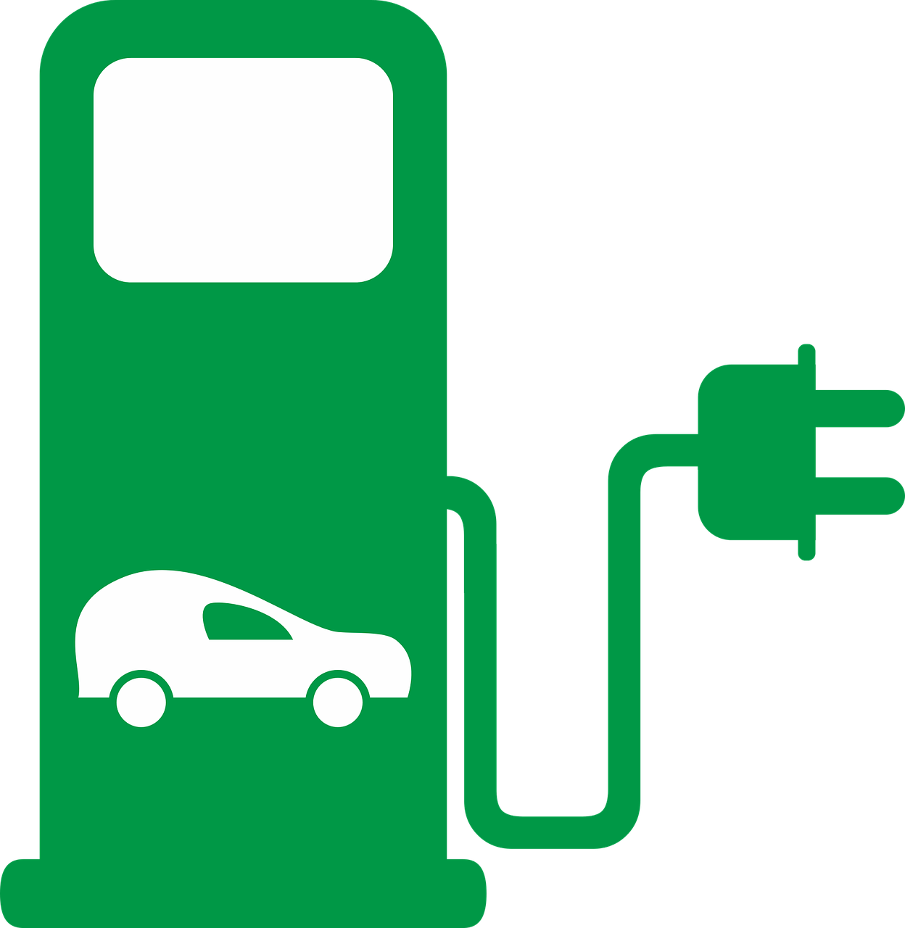

Charging stations and filling stations
have comparable water footprints.
Because EVs are more efficient,
operating an EV has
a smaller water footprint.
Noori, M., et al. (2015, May 30). Electric vehicle cost, emissions, and water footprint in the United States: Development of a regional optimization model. Energy. http://dx.doi.org/10.1016/j.energy.2015.05.152

Slide 5
Battery technology is advancing.
Current lithium collection methods have significant effects on groundwater.
New developments are making a
zinc batteries a viable replacement.
Zinc is far more readily available.
EVBox. (2023, May 4). Are electric car batteries bad for the environment?
https://blog.evbox.com/ev-battery-environmental-impact
Stelle, L. (2023, December 2). Scientists just made a massive breakthrough on an alternative to lithium-ion batteries: ‘These batteries are essential’. https://finance.yahoo.com/news/scientists-just-made-massive-breakthrough-121500329.htm

Slide 6
Conclusion:
Electric vehicles (EVs)
and hybrid vehicles
are better for the environment
than internal combustion engine (ICE) vehicles.

Slide 7
Over 70 countries have outlined plans
to reduce their overall environmental impact.
EVs will become more popular
as technology and policy make them
more affordable and attractive to consumers.
Electric vehicle. (2023, December 15). In Wikipedia.
https://en.wikipedia.org/w/index.php?title=Electric_vehicle&oldid=1190001619
Many graphics used in this presentation came from pixabay.com
and are used in accordance with their Content License.

