Slide 1
Is My Team Really Trying to Compete?
Using an MLB Team’s Opening Day Player Payroll
to Predict Playoff Expectation
Chris Kellogg , DSC630-T301
Notes:
Background of the project

Slide 2
MLB teams spend more money on player payrolls than any other expense
2024 Oakland A’s - $63 million
2024 New York Mets - $316 million
Opening Day payroll is the best chance for a planned strategy
Can’t predict under-performance or over-performance
Can’t predict injuries, regression, or development
We CAN predict the money that’s available on Opening Day
Introduction
Notes:
Background of the project

Slide 3
If an MLB team wants to make the playoffs, how much should the team expect to spend on its Opening Day player payroll?
Cuts, additions, promotions, trades, etc. not considered
Specifically looking at a spending threshold for playoff teams
Problem Statement
Notes:
Background of the project

Slide 4
OWNERS can set the baseball operations budget correctly
FRONT OFFICE can set targets for best impact from free agent dollars
PLAYERS and AGENTS would have a better idea of how much teams will spend
FANS have evidence that their team is genuinely trying to win
MEDIA can plan for which games are more likely to have playoff implications
How is it useful?
Notes:
Background of the project

Slide 5
Team standings
pybaseball API for Python
https://pypi.org/project/pybaseball/2.0.0/
Team payrolls
MLB Team Payrolls
https://www.stevetheump.com/Payrolls.htm
Data Sources
Notes:
Background of the project

Slide 6
Mapped team names to consistent team abbreviations
Standardized format for payroll numbers
Merged datasets for year-by-year payroll and “made playoffs” flag
Data Preparation
Notes:
Background of the project

Slide 7
Planned to use linear regression model to find the payroll threshold
Planned to use several evaluation methods
Mean squared error
Coefficient of determination
Model and Evaluation Method
Notes:
Background of the project

Slide 8
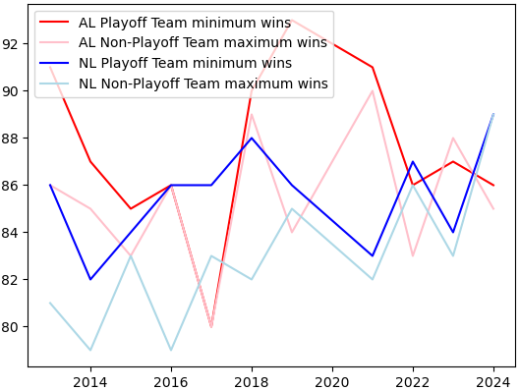
In most years, winning 88 games would be enough to make the playoffs
Threshold for playoff teams
Notes:
Background of the project

Slide 9
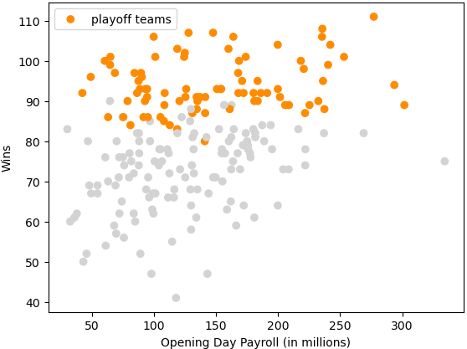
Wins vs Opening Day Payroll, seasons after 2016
Obviously no clear threshold
2022 Cleveland Indians made the playoffs at less than $50 million
2023 New York Mets missed the playoffs at over $330 million
Results
Notes:
Background of the project

Slide 10
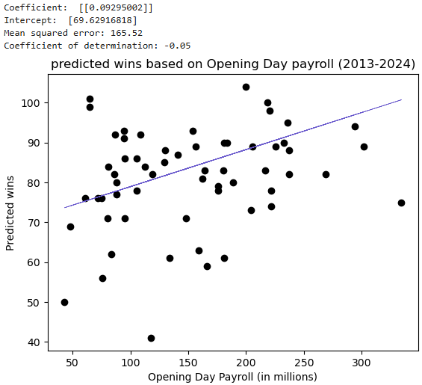
Linear Regression attempt
Mean squared error was large, indicated lots of big misses
Coefficient of determination indicates that the regression line is not
significantly more valuable than a horizontal line
Results
Notes:
Background of the project

Slide 11
Spending can overcome mistakes and sign more talent.
There is NO magic spending level to feel confident about getting into the playoffs.
The only reasonable recommendation, therefore, is for a team to make as much money as possible and then spend as much money on players as it can afford.
Conclusion / Recommendation
Notes:
Background of the project

Slide 12
References
Jackson, S. (2024, September 24). BetMGM. MLB Teams With Highest 2024 Payrolls: Mets on Top.
https://sports.betmgm.com/en/blog/mlb/mlb-teams-highest-payrolls-2023-bm15/
Gough, C. (2024, June 13). Statista. Major League Baseball average player salary 2003-2024.
https://www.statista.com/statistics/236213/mean-salaray-of-players-in-majpr-league-baseball/
Major League Baseball postseason. (2024, November 2). In Wikipedia. https://en.wikipedia.org/wiki/Major_League_Baseball_postseason
Timeline of Major League Baseball. (2024, November 8). In Wikipedia. https://en.wikipedia.org/wiki/Timeline_of_Major_League_Baseball
References
Notes:
Background of the project

