Slide 1
MVP or TJS?
Using pitch data
to predict elbow injuries in MLB pitchers
Chris Kellogg
Notes:
Background of the project

Slide 2
MLB teams spend a tremendous amount of money paying players
The 10 highest-paid contracts in 2025 will pay players over $420 million
Starting pitchers account for about 35% of the top 100 contracts
Most MLB player contracts are guaranteed
The team must continue to pay the player if he gets injured
The only relief is typically if another team is willing to assume the contract
Introduction
Notes:
Background of the project

Slide 3
MLB pitchers are extremely susceptible to injury
Repeated high effort overhand throws can damage elbow ligaments
Over 35% of active MLB pitchers in 2023 had undergone elbow surgery
MLB teams lose money when their pitchers are injured
A surgically repaired elbow ligament can take 9 months to heal
MLB pitchers often require over a year to regain enough strength and stamina
Introduction
Notes:
Background of the project

Slide 4
Are there patterns in readily available pitch data that indicate that a pitcher might be at a higher risk for elbow injuries?
Pitch counts
Velocity on fastballs
Spin rates on breaking balls
Higher effort (average velocity/spin compared to maximums)
Problem Statement
Notes:
Background of the project

Slide 5
Pitch data
pybaseball API for Python
https://pypi.org/project/pybaseball/2.0.0/
Surgery information
Tommy John Surgery List (@MLBPlayerAnalys)
https://docs.google.com/spreadsheets/d/1gQujXQQGOVNaiuwSN680Hq-FDVsCwvN-3AazykOBON0/
Data Sources
Notes:
Background of the project

Slide 6
Aggregated pitch data for count/mean/max/effort calculations
Joined pitch data and surgery info based on MLB Advanced Media ID
Labeled each season with whether UCL reconstruction followed within 12 months
Data Preparation
Notes:
Background of the project

Slide 7
Planned to use logistic regression model to classify seasons
Planned prelimary evaluation with confusion matrix
Model and Evaluation Method
Notes:
Background of the project

Slide 8
Split the 400 seasons into testing and training subsets
Randomly assigned 75% of seasons to the training set
The remaining 100 seasons were classified by the regression model
Logistic Regression
Notes:
Background of the project

Slide 9
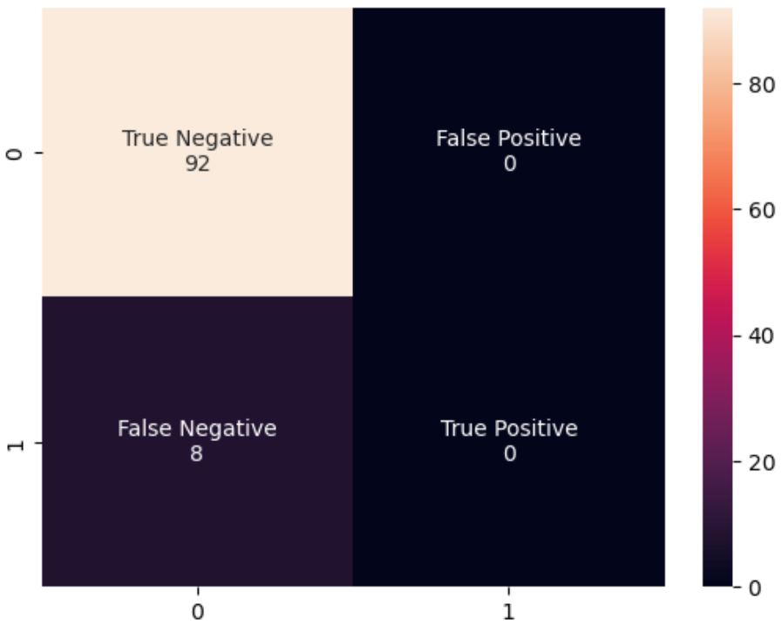
The confusion matrix indicates 92% accuracy, but…
All of the correct classifications are True Negatives
All of the incorrect classifications are False Negatives
The model ONLY indicated Negative classifications
Confusion Matrix
Notes:
Background of the project

Slide 10
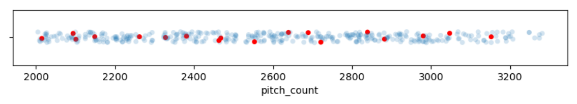
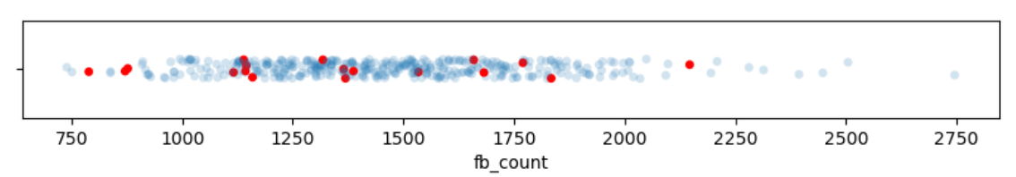
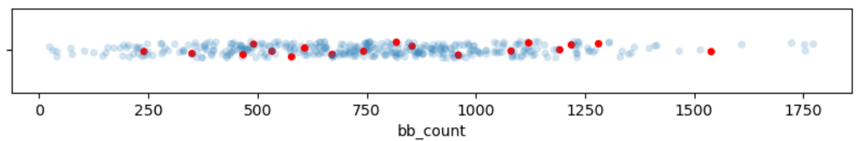
Distribution of potential Pitch Count features
Total pitches thrown
Fastballs thrown
Breaking balls thrown
Pitch Count Distribution
Notes:
Background of the project

Slide 11
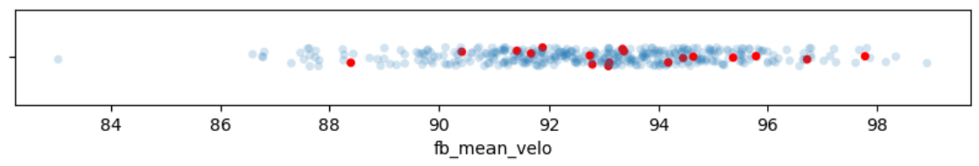
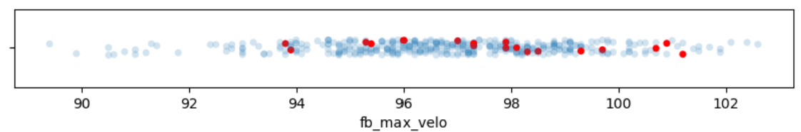
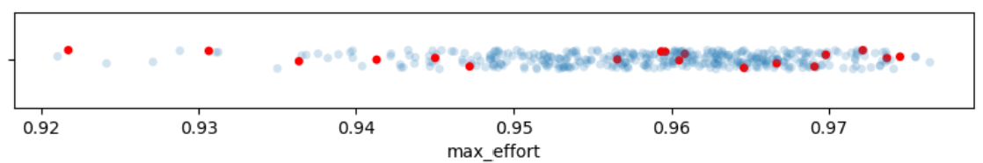
Distribution of potential Fastball Attribute features
Mean fastball velocity
Maximum fastball velocity
Max effort (expressed as mean/maximum fastball velocities)
Fastball Distribution
Notes:
Background of the project

Slide 12
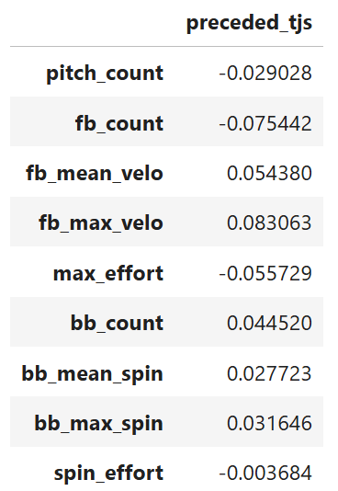
Feature correlation with the target class
None of the features show any significant correlation
The chosen features appear unlikely to offer any predictive value
Correlation
Notes:
Background of the project

Slide 13
The features that I collected and aggregated as part of this project did not provide
any correlation or predictive value for the target class.
Perhaps setting the limit at 2000-pitch MLB seasons was too restrictive, or perhaps the aggregation of all “fastballs” and “breaking balls” was not granular enough.
Conclusion
Notes:
Background of the project

Slide 14
Despite the disappointing lack of conclusion in this project, it seems likely that there is some kind of value to be found in pitch data as a predictor of future reconstructive elbow surgery.
I think the most reasonable recommendation I could make is that teams, organizations, coaches, and pitchers continue to educate themselves on the risk of injury and ways to avoid increased risk and look for data that helps identify the risk.
Recommendation
Notes:
Background of the project

Slide 15
References (1 of 2)
Spotrac. (viewed 2025, January 4). Spotrac. MLB Salary Rankings.
https://www.spotrac.com/mlb/rankings/player/_/year/2025/sort/cap_total
Wikipedia. (viewed 2025, January 4). Ulnar collateral ligament reconstruction. https://en.wikipedia.org/wiki/Ulnar_collateral_ligament_reconstruction
Berg, S. (2024, July 12). AMA. What doctors wish patients knew about Tommy John surgery.
https://www.ama-assn.org/delivering-care/public-health/what-doctors-wish-patients-knew-about-tommy-john-surgery
References
Notes:
Background of the project

Slide 16
References (2 of 2)
Johns Hopkins Medicine. (viewed 2025, January 4). Tommy John Surgery (Ulnar Collateral Ligament Reconstruction).
https://en.wikipedia.org/wiki/Major_League_Baseball_postseason
MLB. (viewed 2025, January 4). Competitive Balance Tax.
https://www.mlb.com/glossary/transactions/competitive-balance-tax
NBC Sports. (2024, December 17). MLB study: Velocity, max efforts likely causing pitching injuries; rule changes should be considered.
https://www.nbcsports.com/mlb/news/mlb-study-velocity-max-efforts-likely-causing-pitching-injuries-rule-changes-should-be-considered
References
Notes:
Background of the project

