Slide 1
Elite Metric Regroup
Defining Tasker supply quality tiers — a methodology walkthrough
Synthetic recreation · no proprietary data · shapes & findings reproduced for presentation

Slide 2
Finding a metric for "good"
1
Which Taskers perform well…
Start from raw performance.
2
…at our business objectives…
Invoice volume, revenue volume, and close rate.
3
…relative to their peers?
Compared to other Taskers in the same metro-category (metcat).
The unit of analysis becomes a Tasker within a metcat — every metric is computed relative to local peers.
Synthetic data — not real Taskrabbit data
2

Slide 3
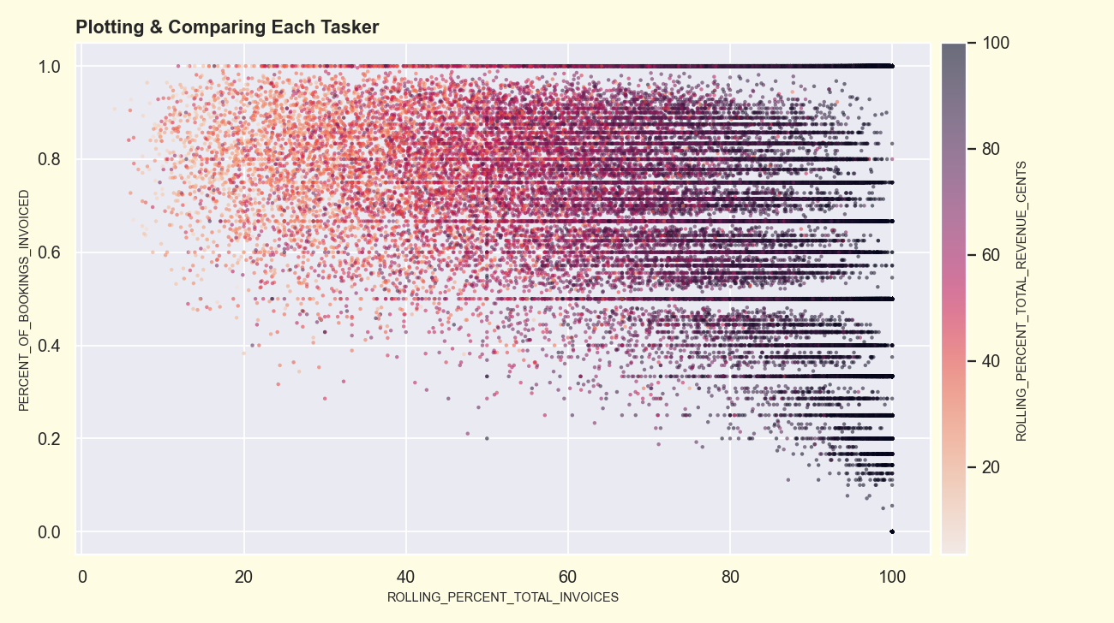
Plotting & comparing each Tasker
x = rolling cumulative % of metcat invoices (top contributors at left) · y = close rate · hue = rolling % of revenue.
Synthetic data — not real Taskrabbit data
3

Slide 4
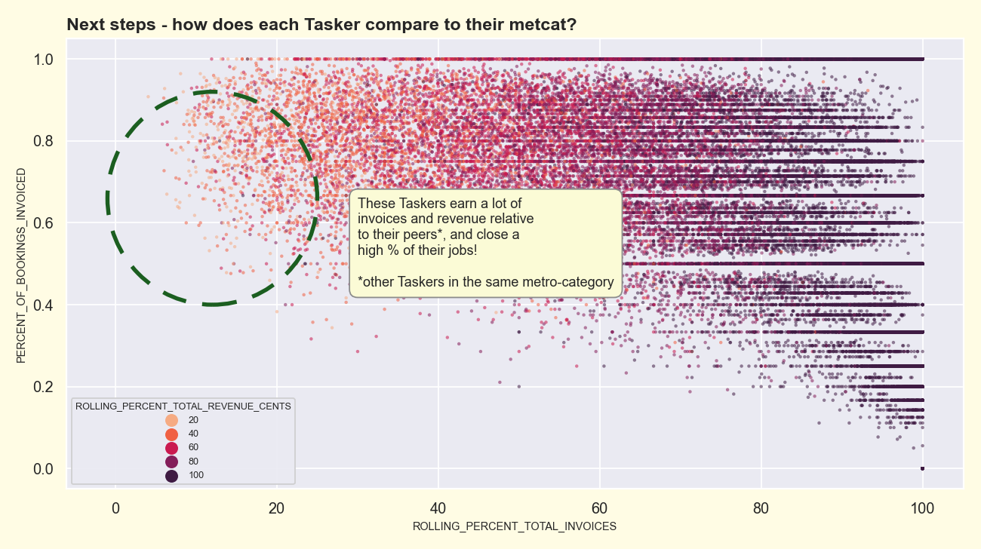
How does each Tasker compare to their metcat?
Top-left: high volume AND high close rate relative to peers — our intuitive 'good' Taskers.
Synthetic data — not real Taskrabbit data
4

Slide 5
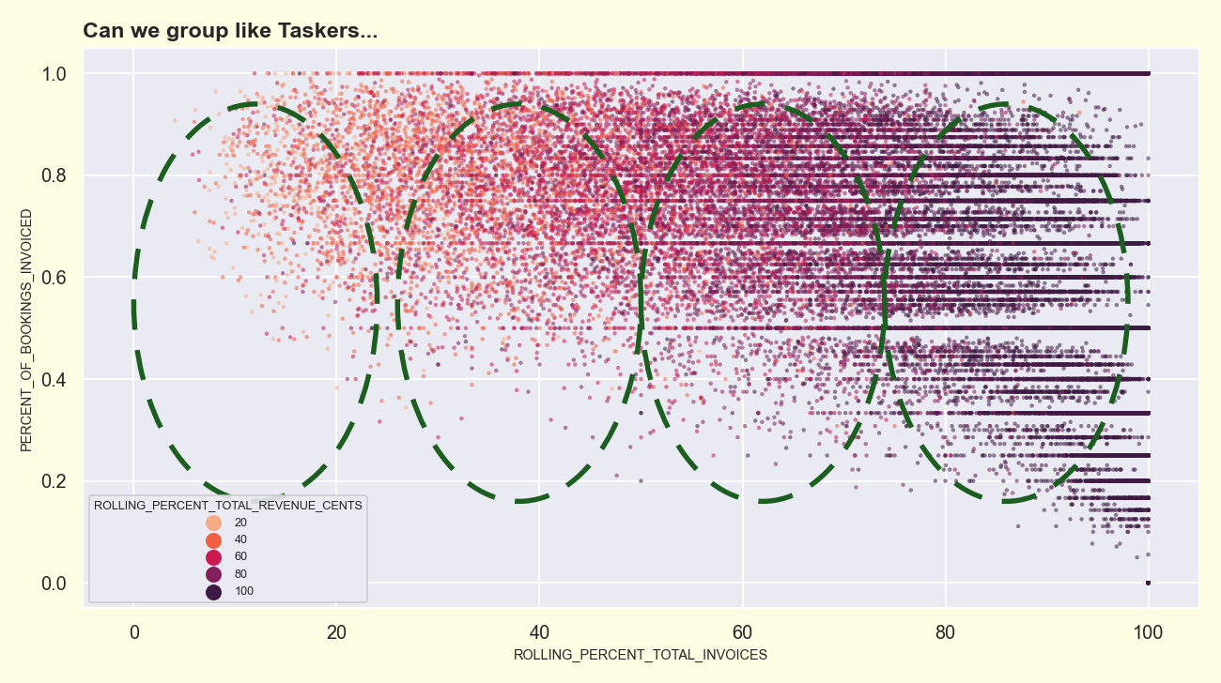
Can we group like Taskers…
The shape suggests natural groupings along the volume axis — but where exactly are the cut points?
Synthetic data — not real Taskrabbit data
5

Slide 6
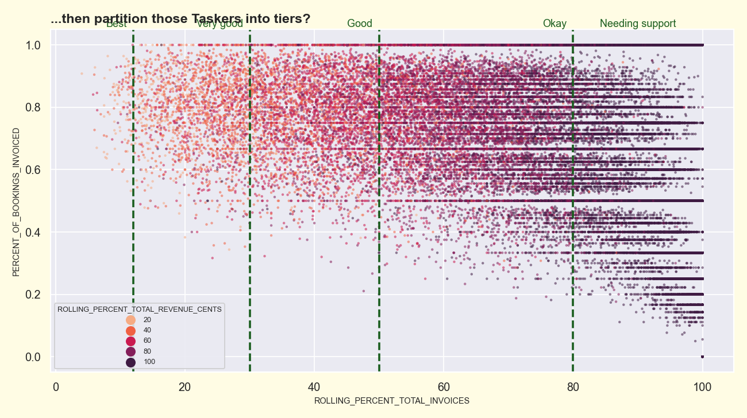
…then partition them into tiers?
Eyeballing tiers is fast, but it's biased and not reproducible. Can we do better?
Synthetic data — not real Taskrabbit data
6

Slide 7
Two ways to partition
Visual inspection
Unsupervised learning
“eyeball it”
k-means clustering
Pro: Quick to do once
Pro: Iterative discovery of hidden patterns
Con: Not iterable; human bias
Con: Very dependent on a few inputs
Synthetic data — not real Taskrabbit data
7

Slide 8
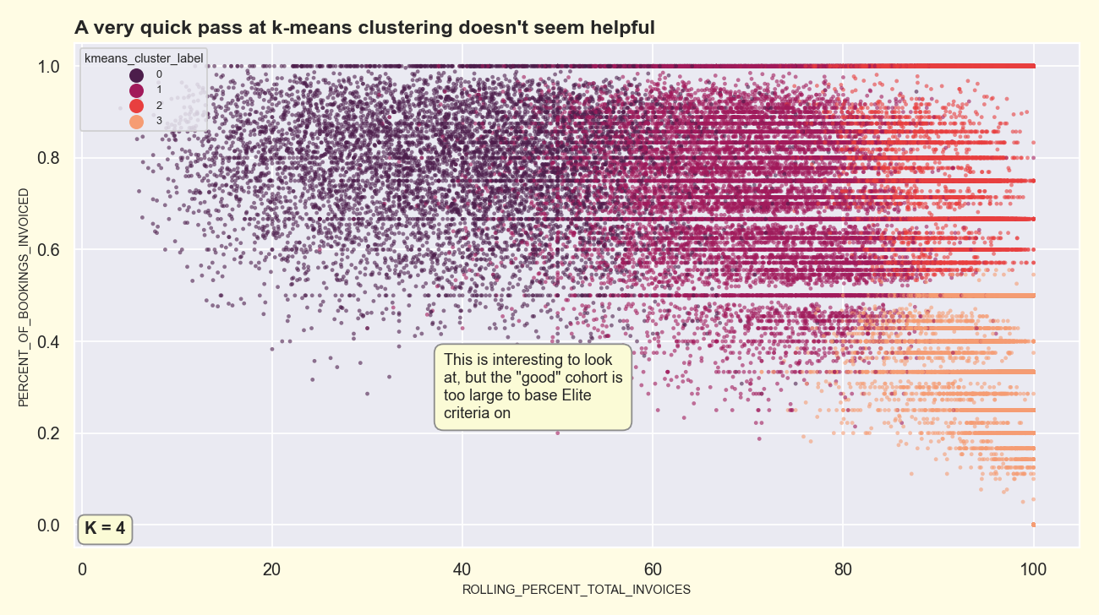
A quick pass at k-means doesn't seem helpful
Clustering on {close rate, rolling invoices, rolling revenue} just re-discovers the volume axis → vertical stripes.
Synthetic data — not real Taskrabbit data
8

Slide 9
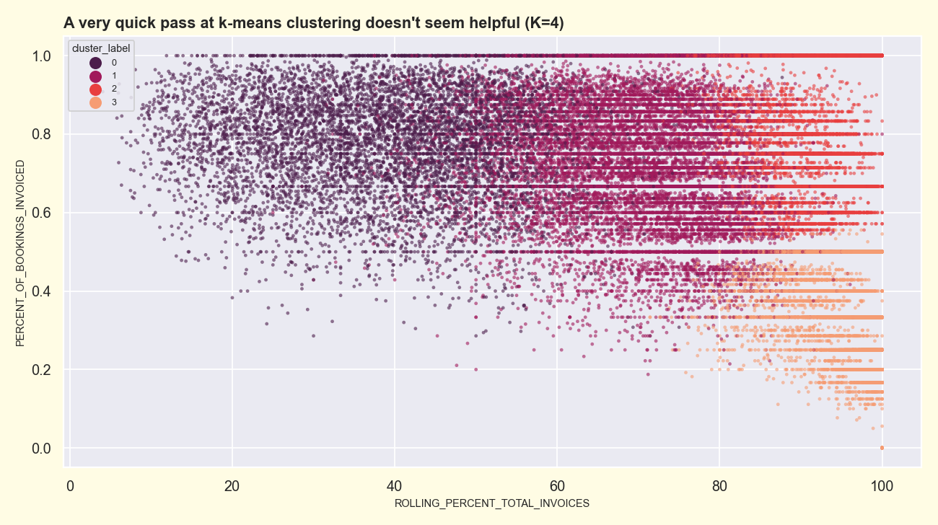
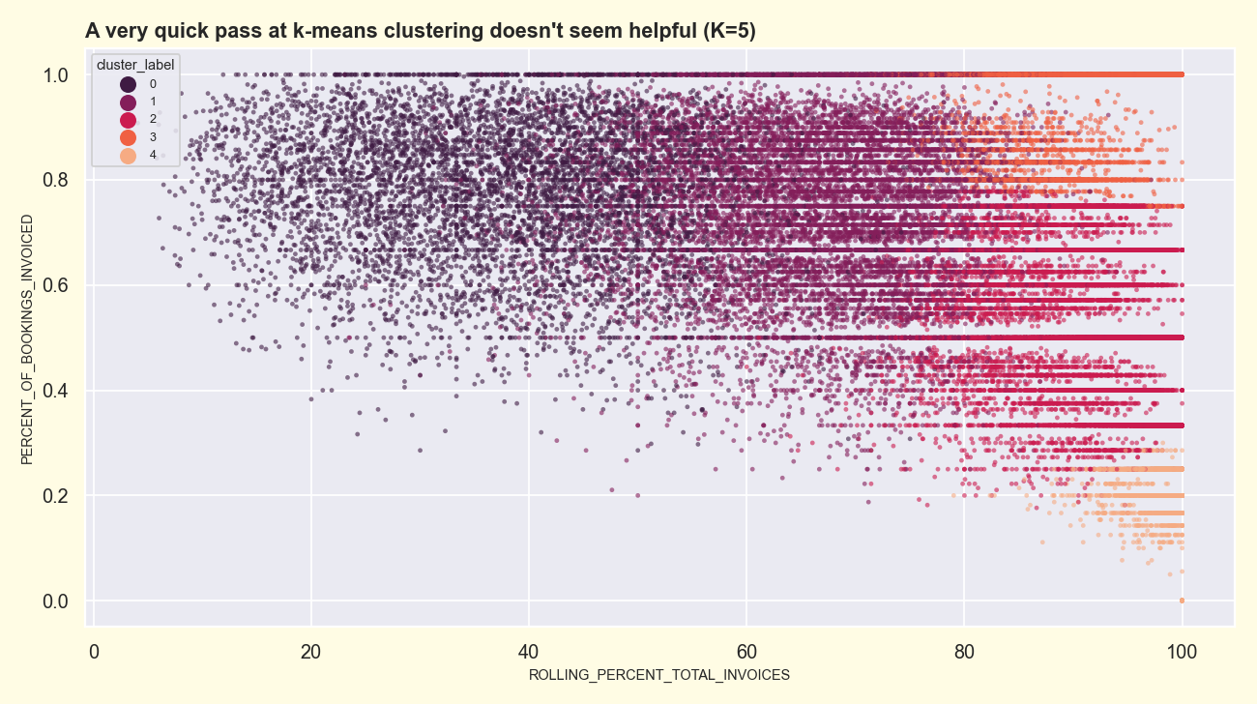
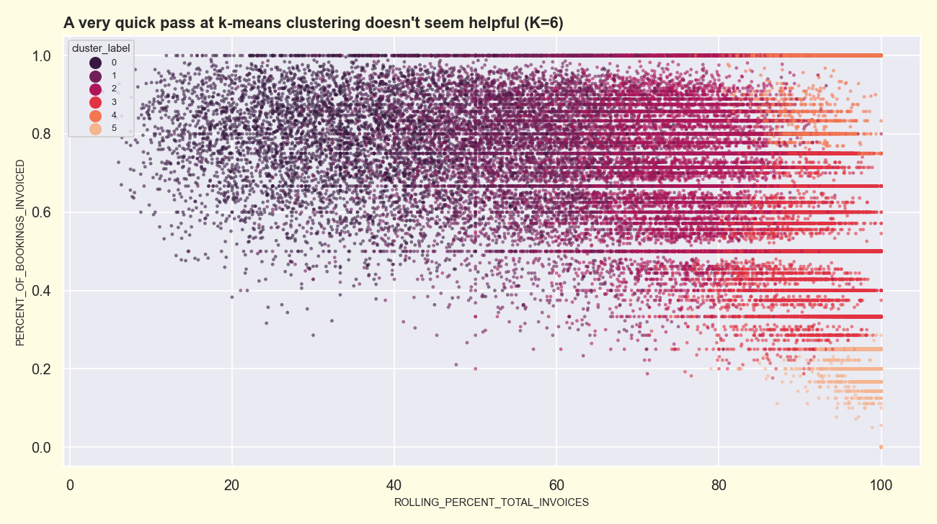
…and adding clusters doesn't fix it
K = 4
K = 5
K = 6
Whatever k we pick, the clusters stratify on volume alone and the 'good' cohort stays too large to base an Elite program on.
Synthetic data — not real Taskrabbit data
9

Slide 10
The fix: add a behavioral floor
Tasker-fault cancellations are an axis that is genuinely independent of volume. Feeding the clustering one orthogonal feature — instead of three collinear volume features — is what turns a useless partition into a defensible tiering.

Slide 11
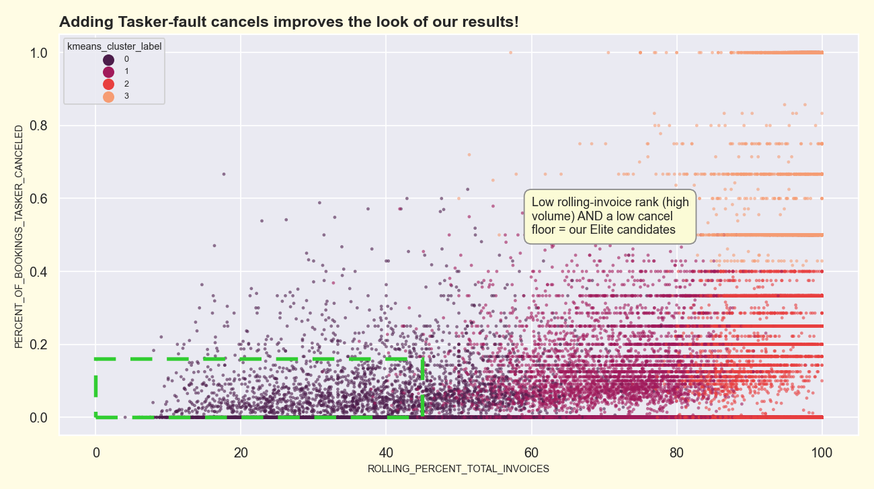
Adding tasker-fault cancels improves the results
Now y = cancel rate. Elite candidates = high volume (low rolling rank) AND a low cancel floor.
Synthetic data — not real Taskrabbit data
11

Slide 12
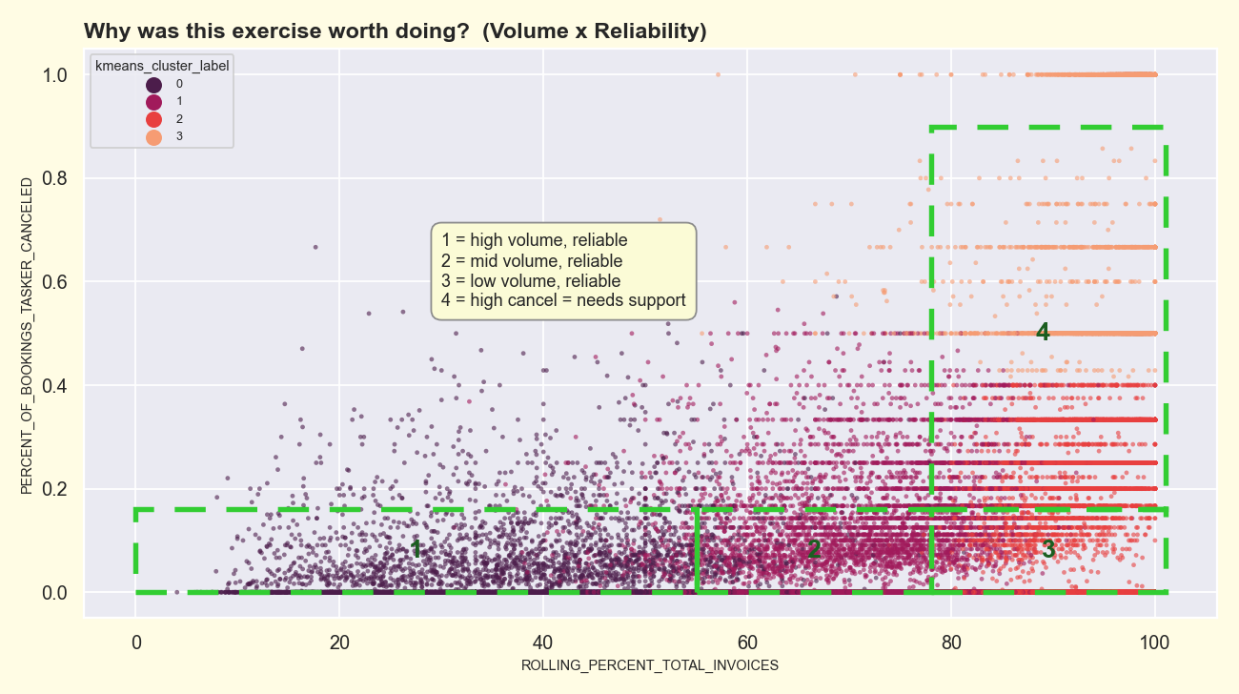
Why it was worth doing: Volume × Reliability
k=4 now resolves into four interpretable cohorts — three volume bands at low cancel, plus a high-cancel 'needs support' group.
Synthetic data — not real Taskrabbit data
12

Slide 13
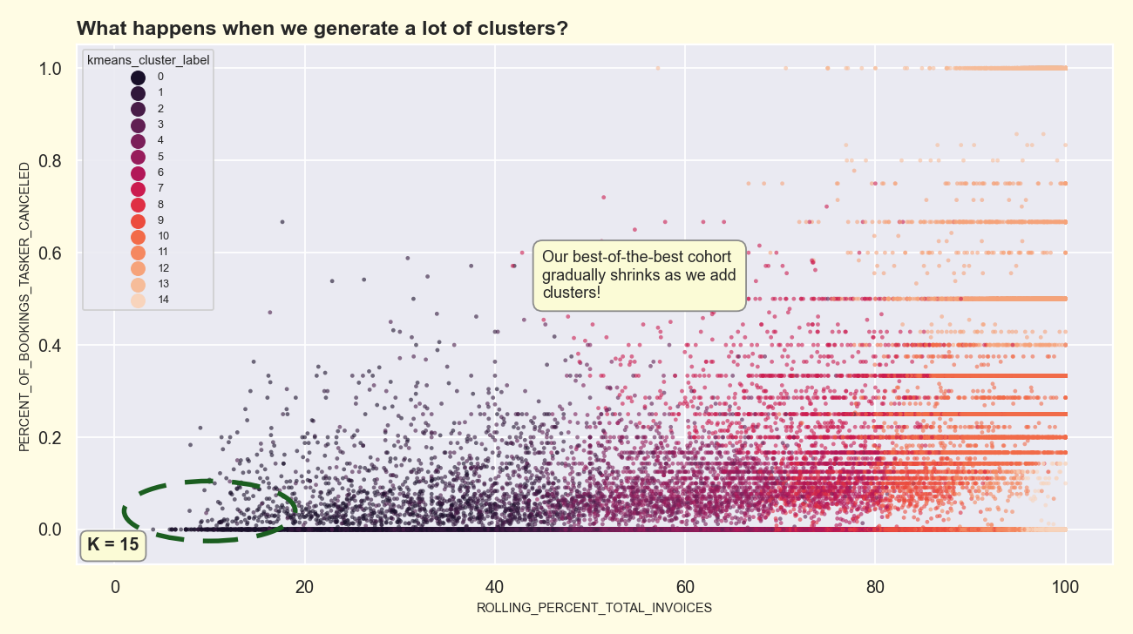
What happens at a high cluster count?
Push k to 15 and the best-of-the-best cohort progressively shrinks — 'how elite' is a choice of k.
Synthetic data — not real Taskrabbit data
13

Slide 14
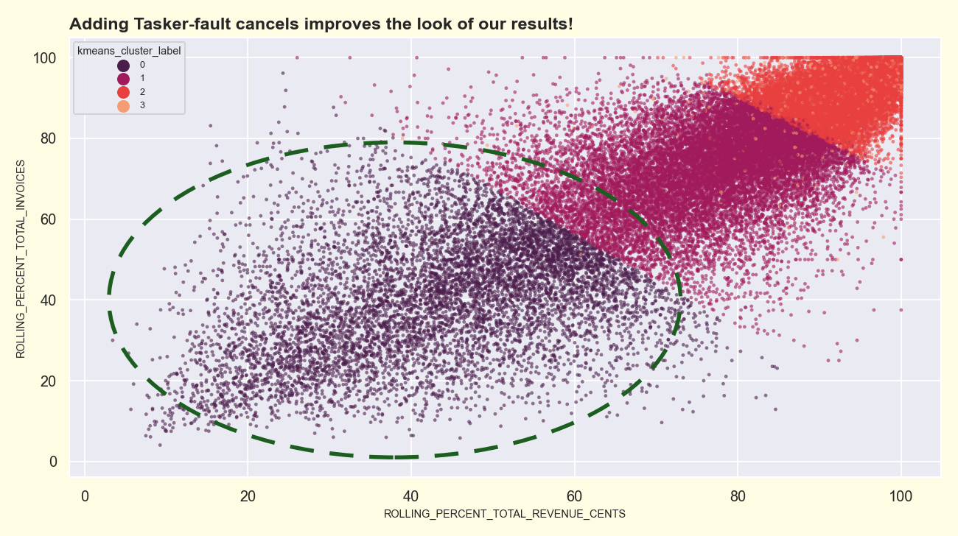
Cohorts hold up across feature pairs
Rolling invoices vs rolling revenue: the same cohorts tile cleanly along the diagonal.
Synthetic data — not real Taskrabbit data
14

Slide 15
Resulting US Tasker quality tiers
Tier | Taskers | % supply | Monthly revenue | Monthly invoices | Cancel %
Cohort 1 — Elite | 1,400 | 2.4% | $580 | 12.9 | 2.6%
Cohort 1 — Total | 6,069 | 10.4% | $416 | 9.4 | 3.1%
Cohort 2 | 12,533 | 21.4% | $141 | 3.5 | 4.1%
Cohort 3 | 35,916 | 61.3% | $22 | 0.6 | 2.0%
Cohort 4 — needs support | 4,053 | 6.9% | $11 | 0.3 | 80.3%
Reproduces the deck's tiering: cohort split ≈ 10 / 21 / 61 / 7% (deck 11 / 23 / 58 / 8) and Elite ≈ 13 invoices / $580 (deck 12 / $530).
Synthetic data — not real Taskrabbit data
15

Slide 16
Did we pick the right model?
Clustering has no ground-truth accuracy, so we pressure-tested the choice with the conventional toolkit: internal validity, resample stability, and business recovery — across eight unsupervised methods.

Slide 17
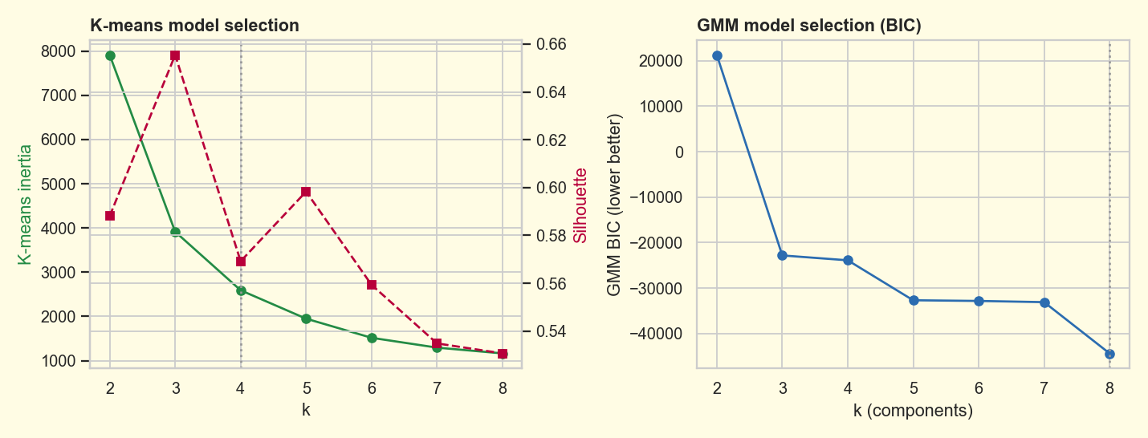
No k is statistically "correct" — so k=4 is a business call
Elbow is smooth, silhouette flat, GMM BIC never bottoms: the supply is a continuum. k=4 is chosen for legibility; the question is which method renders it best.
Synthetic data — not real Taskrabbit data
16

Slide 18
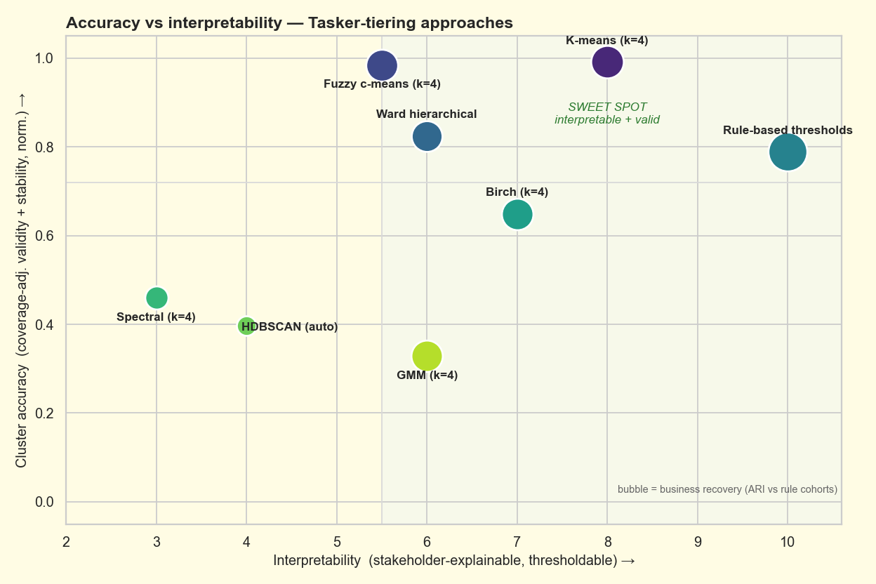
Accuracy vs interpretability across eight methods
K-means is the sweet spot — top validity + stability AND interpretable. HDBSCAN only looks clean because it drops ~70% of Taskers as noise; fuzzy c-means ≈ k-means but flags boundary cases.
Synthetic data — not real Taskrabbit data
17

Slide 19
What happened after rollout
Shareable result: 1.5× as many Taskers met the Elite cancellation bar as before — broad downward pressure on tasker-fault cancellation. Each avoided cancellation is a booking that now completes: +1 invoice at $135.

Slide 20
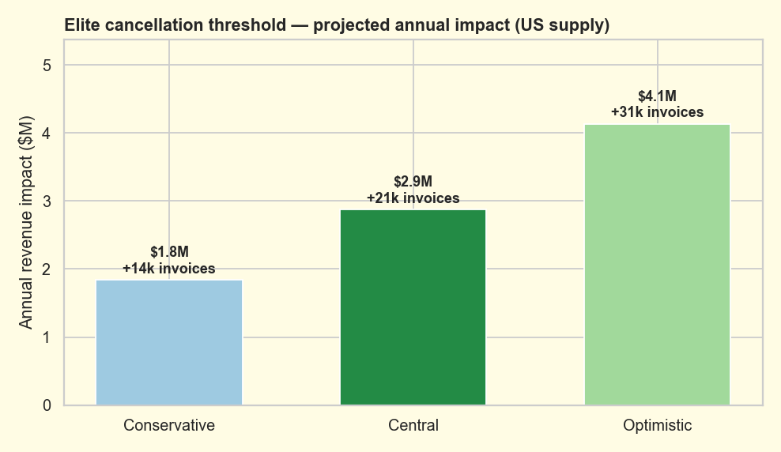
Projected annual impact of the cancellation floor
Central case: ~+$2.9M/yr and ~+21k invoices (a ~1.4% lift), plausible range $1.8M–$4.1M. Direct recovered-invoice channel only — reliability-driven retention upside is unmodeled.
Synthetic data — not real Taskrabbit data
18

Slide 21
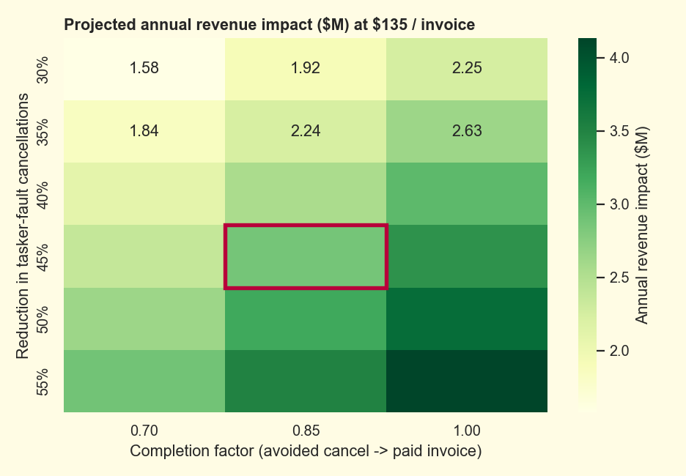
Impact is a range, not a point
Revenue as a function of the two uncertain levers — cancellation reduction and the completion factor. The honest deliverable is the grid, with the central cell highlighted.
Synthetic data — not real Taskrabbit data
19

Slide 22
What this shows
Frame 'good' as performance relative to local peers (metcat), not absolute counts.
Naive k-means on collinear volume features just re-finds volume — too coarse to act on.
One orthogonal behavioral feature (tasker-fault cancels) unlocks a Volume × Reliability tiering.
Pressure-tested it: k-means is the most valid + stable of eight methods, and stays interpretable.
Post-rollout: 1.5× more Taskers held the cancellation bar → ~+$2.9M/yr, ~+21k invoices (central).
Methodology recreated on fully synthetic data — no Taskrabbit data used.

