Slide 1
Predicting General Health for Women
DAT7
Corinne Fukayama

Slide 2
Recap:
Main Question: can we predict an adult woman’s general health based on existing structural disadvantages such as race and socioeconomic status (SES)?
Can we predict the CHANGE in a woman’s general health over time based on existing structural disadvantages?
Features:
Structural disadvantages (Race and Income)
Demographic info (Education, age, etc)
Mediating variables (Discrimination, Stress, Hostility)
Outcome: Allostatic Load
“wear and tear” on the body as a function of repeated exposure to stress on the body
The Study of Women’s Health Across the Nation
Notes:
So as a recap: I’m studying whether we can predict an adult woman’s general health based on a couple different categories of variables and whether or not we can predict the change over time as well.
This is something that’s become important as precision medicine becomes more relevant, since that’s looking at not just your genes but your environment and lifestyle to tailor a specific treatment plan.
So the features were divided into three categories, and I tried to use different combinations of these based on what I wanted to test. The outcome was “allostatic load”, which is an attempt to scientifically represent the “wear and tear” on the body as a function of repeated exposure to stress. They do this using a composite function based on a variety of biomarker scores, and the biomarkers used depends on the study and what information gets collected in the study.
I got my data through the SWAN health data set, which is publicly available.

Slide 3
Data Processing
Baseline, Visit 1 (+ 2 years),
Visit 6 (+ 8 years)
Missing values
Automatically dropped Null values for ETHNIC and INCOME
Average of the visit prior and visit after
Average of Baseline, Visits 1-7
Average of that field
Future work: set specific inclusion criteria to essentially drop all null values
Notes:
So since there is a lot of data and I didn’t really have a lot of time, I used three data sets: their baseline set, visit 1, and visit 6. The Baseline data set is the most complete set since the information was collected at the beginning of the study. Visit 1 was the next “most” complete.
From the Baseline and Visit 1 set I processed all of the feature and outcome variables, and from Visit 6 I processed only the outcome variables because I wanted to measure the change in health within the next X years depending on your factors this present day.
The biggest trouble I ran into was null values, everywhere.
It doesn’t seem like a lot, but my code for data cleaning was four times as long as my modeling code.

Slide 4
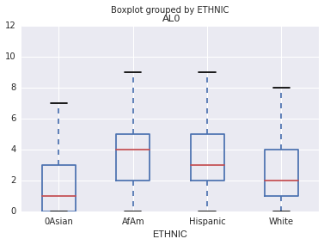
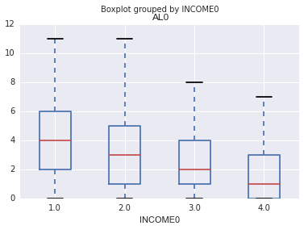
Data Exploration - Baseline

Slide 5
Correlation – Baseline

Slide 6
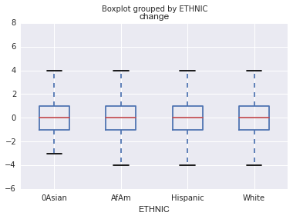
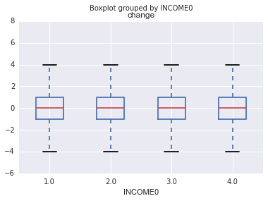
Data Exploration – Change in AL

Slide 7
Correlation - Change

Slide 8
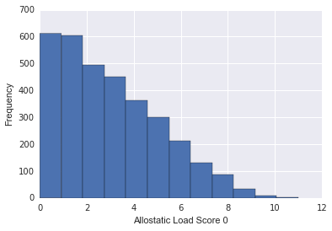
Allostatic Load Distribution

Slide 9
Modeling
Models Used:
Linear Regression (cross validation)
Decision Tree
Three data sets
TTS on baseline data
TTS on visit 01 data
Train on baseline data, test on visit 01 data
Combination of categories of features used

Slide 10
Feature Selection and Accuracy

Slide 11
Feature Selection and Accuracy
Feature Importance (Top 5) with No Age
Race_AfAm | 0.380468
DEGREE | 0.214427
Race_White | 0.126726
Race_Hispanic | 0.085282
hostility | 0.064437
Feature Importance (Top 5) with No Menopause Stat
Race_AfAm | 0.365383
DEGREE | 0.179249
Race_White | 0.121701
AGE1 | 0.101342
hostility | 0.084312

Slide 12
Things to consider…
Testing same model but different imputation methods
How to control for medication?
Community-based sampling

