Slide 1
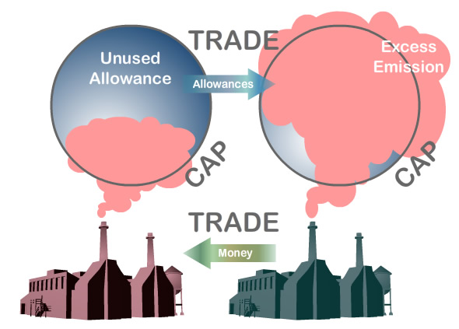
Project 1: Web Scraping RGGI entities verified data. What is Carbon Cap and Trade?

Slide 2
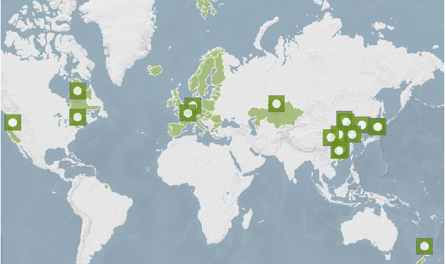
Where are the main markets?
RGGI

Slide 3
- RGGI or Regional Greenhouse Gas Initiative. - 9 States: Connecticut, Delaware, Maine, Maryland, Massachusetts, New Hampshire, New York, Rhode Island, Vermont. - It covers the power sector which is prox. 25% of all CO2 emissions. Goal is to reduce emissions to 75Mt by 2020. - The RGGI has so far delivered. 2010 150Mt – 2014 92Mt - New EPA Clean Power Plan could see new states joining the RGGI.
Quick facts on the RGGI:

Slide 4
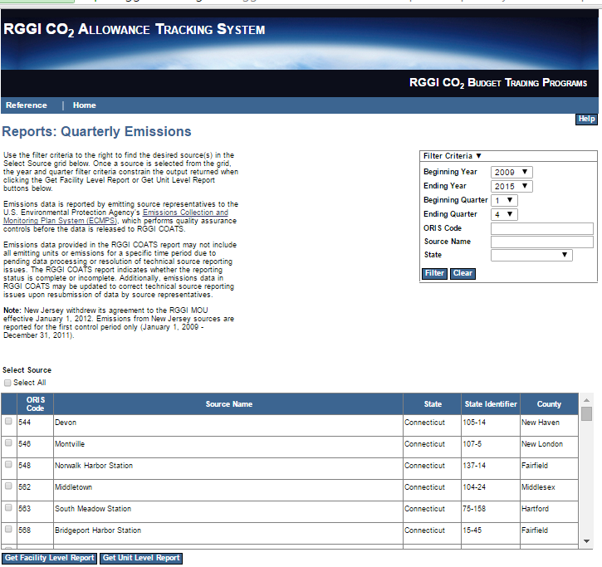
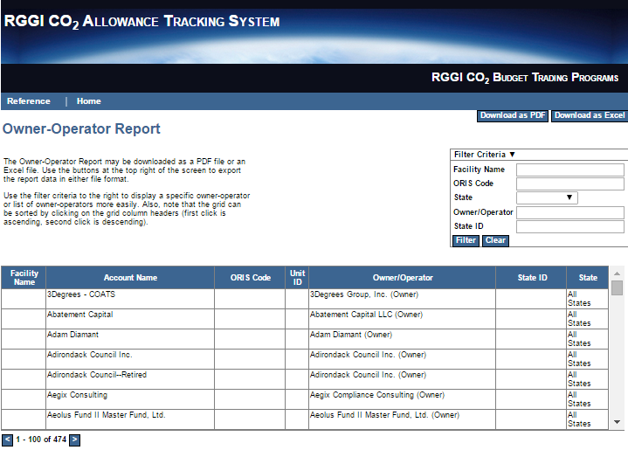
RGGI-COATS.ORG
Quarterly Emissions Table:
Owner Operator Table:

