Slide 1
CSCI4430 Data Communication and Computer Networks
Tutorial 5 – Introduction on project mTCP protocol

Slide 2
REVISION On Multi Thread Programming

Slide 3
Race Condition
Memory
Variable X
Value = 10
Thread 1
Thread 2
Add 10 to Variable X
Minus 10 from Variable X
Is value of X ALWAYS equals to 10 after both thread 1 and thread 2 is executed?
NO!!!!!!!!!!!!!!!
Adapted from Mole Wong’s CSCI3150 Lecture Notes

Slide 4
Race Condition
Memory
Variable X
Value = 10
Thread 1
Thread 2
State
Stand-by
Register A
Value = 0
State
Stand-by
Register A
Value = 0
1. | Load variable X to register A
2. | Add 10 to register A
3. | Write register A to variable X
1. | Load variable X to register A
2. | Minus 10 from register A
3. | Write register A to variable X
Add 10 to Variable X
Minus 10 from Variable X
Adapted from Mole Wong’s CSCI3150 Lecture Notes

Slide 5
Race Condition
Memory
Variable X
Value = 10
Thread 1
Thread 2
State
Active
Register A
Value = 10
State
Stand-by
Register A
Value = 0
1. | Load variable X to register A
2. | Add 10 to register A
3. | Write register A to variable X
1. | Load variable X to register A
2. | Minus 10 from register A
3. | Write register A to variable X
Add 10 to Variable X
Minus 10 from Variable X
Adapted from Mole Wong’s CSCI3150 Lecture Notes

Slide 6
Race Condition
Memory
Variable X
Value = 10
Thread 1
Thread 2
State
Active
Register A
Value = 20
State
Stand-by
Register A
Value = 0
1. | Load variable X to register A
2. | Add 10 to register A
3. | Write register A to variable X
1. | Load variable X to register A
2. | Minus 10 from register A
3. | Write register A to variable X
Add 10 to Variable X
Minus 10 from Variable X
Adapted from Mole Wong’s CSCI3150 Lecture Notes

Slide 7
Race Condition
Memory
Variable X
Value = 10
Thread 1
Thread 2
State
Stand-by
Register A
Value = 20
State
Active
Register A
Value = 10
1. | Load variable X to register A
2. | Add 10 to register A
3. | Write register A to variable X
1. | Load variable X to register A
2. | Minus 10 from register A
3. | Write register A to variable X
Add 10 to Variable X
Minus 10 from Variable X
Adapted from Mole Wong’s CSCI3150 Lecture Notes

Slide 8
Race Condition
Memory
Variable X
Value = 10
Thread 1
Thread 2
State
Stand-by
Register A
Value = 20
State
Active
Register A
Value = 0
1. | Load variable X to register A
2. | Add 10 to register A
3. | Write register A to variable X
1. | Load variable X to register A
2. | Minus 10 from register A
3. | Write register A to variable X
Add 10 to Variable X
Minus 10 from Variable X
Adapted from Mole Wong’s CSCI3150 Lecture Notes

Slide 9
Race Condition
Memory
Variable X
Value = 0
Thread 1
Thread 2
State
Stand-by
Register A
Value = 20
State
Active
Register A
Value = 0
1. | Load variable X to register A
2. | Add 10 to register A
3. | Write register A to variable X
1. | Load variable X to register A
2. | Minus 10 from register A
3. | Write register A to variable X
Add 10 to Variable X
Minus 10 from Variable X
Adapted from Mole Wong’s CSCI3150 Lecture Notes

Slide 10
Race Condition
Memory
Variable X
Value = 20
Thread 1
Thread 2
State
Active
Register A
Value = 20
State
Stand-by
Register A
Value = 0
1. | Load variable X to register A
2. | Add 10 to register A
3. | Write register A to variable X
1. | Load variable X to register A
2. | Minus 10 from register A
3. | Write register A to variable X
Add 10 to Variable X
Minus 10 from Variable X
Adapted from Mole Wong’s CSCI3150 Lecture Notes

Slide 11
Race Condition
Memory
Variable X
Value = 20
Thread 1
Thread 2
State
Active
Register A
Value = 20
State
Stand-by
Register A
Value = 0
1. | Load variable X to register A
2. | Add 10 to register A
3. | Write register A to variable X
1. | Load variable X to register A
2. | Minus 10 from register A
3. | Write register A to variable X
Add 10 to Variable X
Minus 10 from Variable X
Clearly, if a variable is shared between more than threads, it should NOT be accessed directly
Adapted from Mole Wong’s CSCI3150 Lecture Notes

Slide 12
Race Condition
Memory
Variable X
Value = 20
Thread 1
Thread 2
State
Active
Register A
Value = 20
State
Stand-by
Register A
Value = 0
1. | Load variable X to register A
2. | Add 10 to register A
3. | Write register A to variable X
1. | Load variable X to register A
2. | Minus 10 from register A
3. | Write register A to variable X
Add 10 to Variable X
Minus 10 from Variable X
Use pthread_mutex to create critical section to prevent Race Condition
Adapted from Mole Wong’s CSCI3150 Lecture Notes

Slide 13
Critical Session
Thread
Program Code
Use pthread_mutex_lock() to lock a COMMON pthread_mutex()
Section Entry
Critical Section
Access memory shared by a number of thread
Section Exit
Use pthread_mutex_unlock() to unlock a COMMON pthread_mutex()
Program Code
Adapted from Mole Wong’s CSCI3150 Lecture Notes

Slide 14
How does a pthread_mutex work
What would happen when a number of threads try to access the shared memory?
Each of them will call the pthread_mutex_lock() to lock a COMMON pthread_mutex
The first thread calling pthread_mutex_lock() will not be blocked.
Meanwhile, other thread will be blocked.
When the first thread release the pthread_mutex, other threads will “compete” to lock the pthread_mutex again
Critical section should be short, fast and efficient such that every thread will not be blocked for too long

Slide 15
Project Overview

Slide 16
Project Overview
Implement a library such that a client program can send file to a server program through mTCP protocol.
mTCP protocol is a “reliable” data transfer protocol:
It establishes connection with 3-way handshake
It closes connection with 4-way handshake
When server receive a data packet from client, the client will sent acknowledgement packet back to client
If client doesn’t receive acknowledgement packet within a specific timeout, packet will be assumed to be lost and resent.

Slide 17
Data Flow

Slide 18
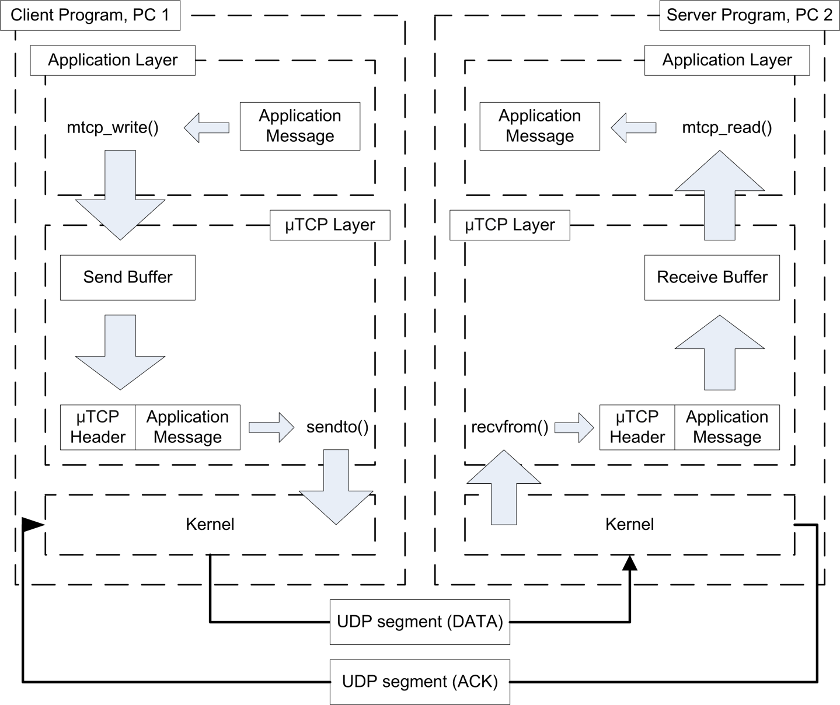
Data Flow
The connection between client and server is unidirectional
Client CAN send data to server.
Server CANNOT send data to client.

Slide 19
Data Flow
The client and server are already implemented in the skeleton code

Slide 20
Data Flow
You are REQUIRED TO FINISH the implementation of this library

Slide 21
Overview on Skeleton Code

Slide 22
Overview on Skeleton Code (Client)
client.c
The code of a complete client program
It can only send a file to a server
All the network connection is handled by mTCP library
mtcp_client.c
The code of mTCP library for client side.
It is only a skeleton code
You are free to add global variables and functions
You are strongly recommended not to change the name and the arguments of the given function.

Slide 23
Overview on Skeleton Code (Server)
server.c
The code of a complete client program
It can only send a file to a server
All the network connection is handled by mTCP library
mtcp_server.c
The code of mTCP library for client side.
It is only a skeleton code
You are free to add global variables and functions
You are strongly recommended not to change the name and the arguments of the given function.

Slide 24
mTCP Protocol Packet

Slide 25
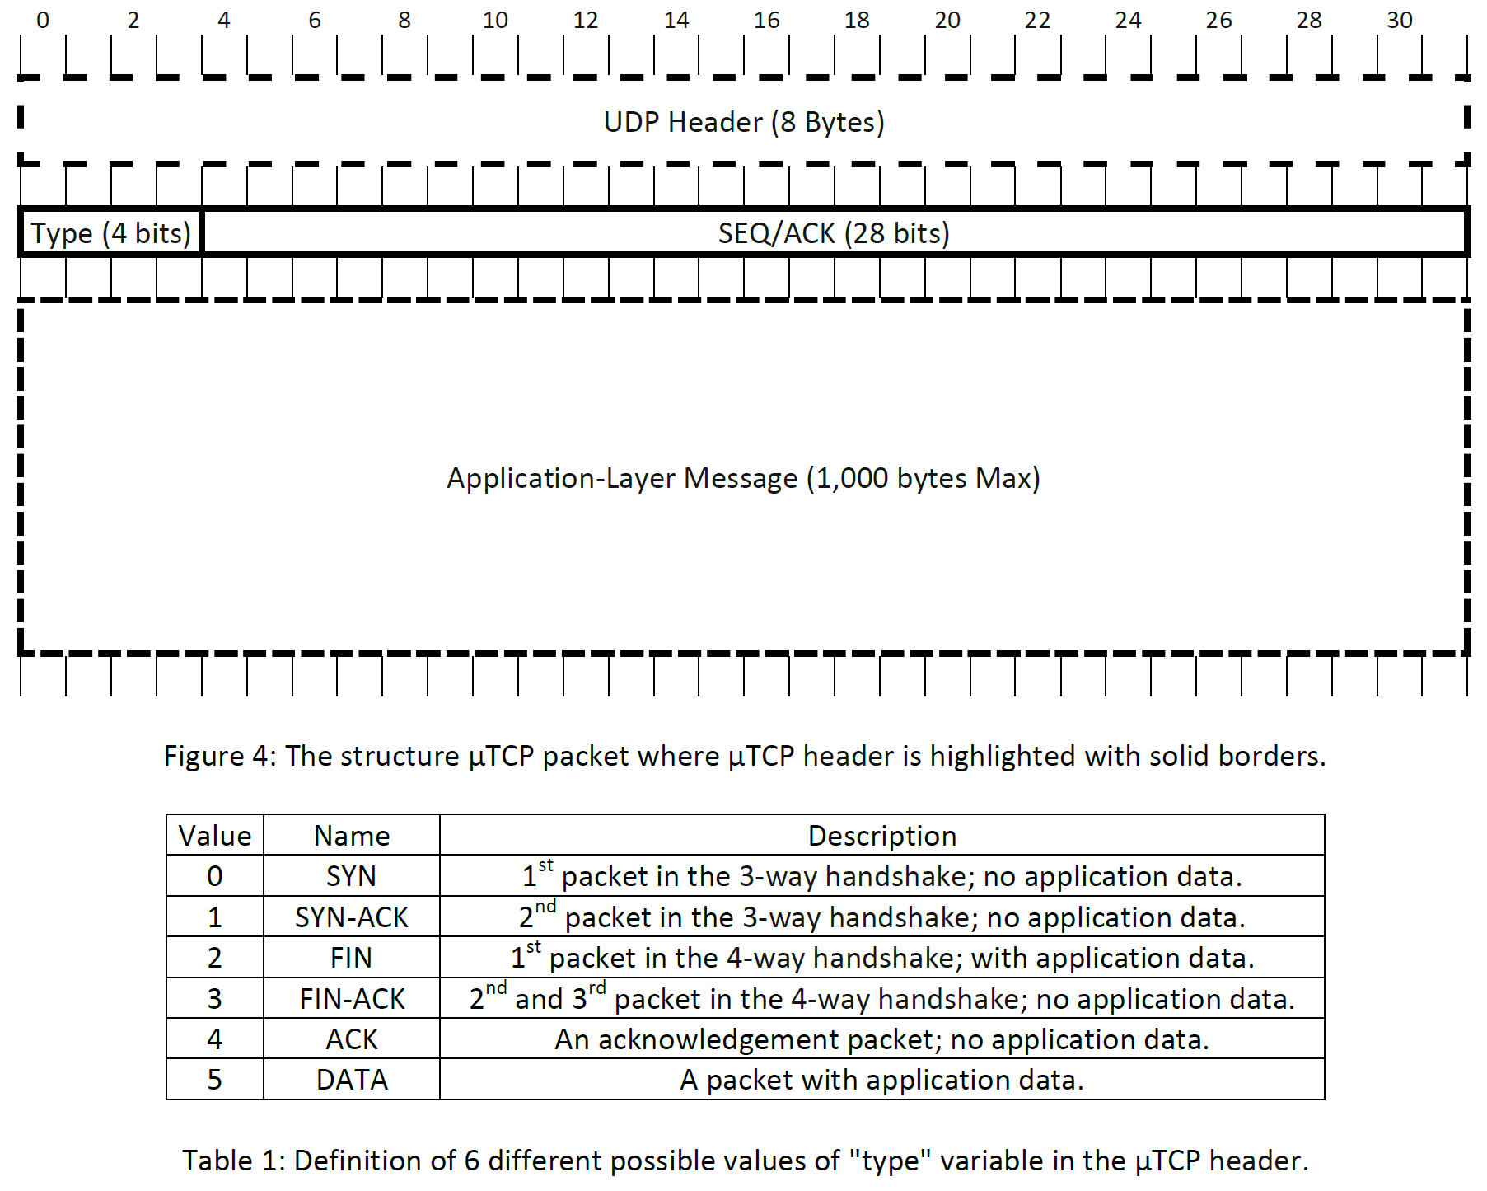
mTCP Protocol Packet

Slide 26
mTCP Protocol Packet
A UDP Packet

Slide 27
mTCP Protocol Packet
mTCP Header

Slide 28
Thread Activity OverView

Slide 29
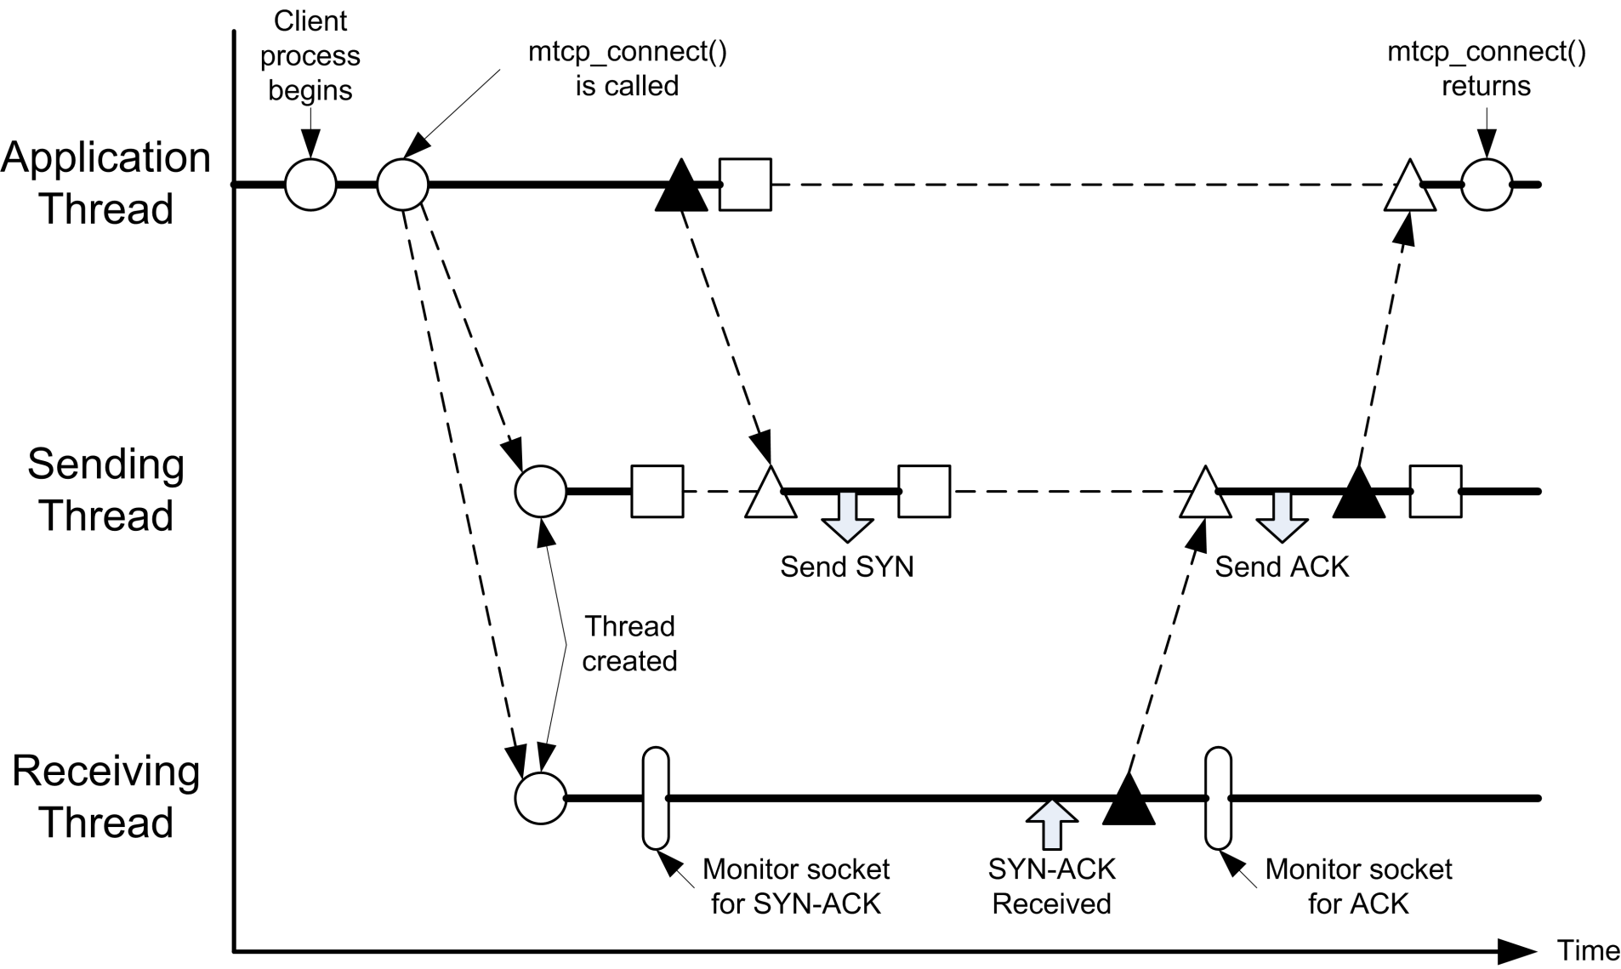
Thread Interaction Diagram of Client
1. Create and start sending thread and receiving Thread
Thread Interaction during 3-way Handshake

Slide 30
Thread Interaction Diagram of Client
2. Wake up sending thread
Thread Interaction during 3-way Handshake

Slide 31
Thread Interaction Diagram of Client
3. After woken up by application thread, send a SYN packet to server
Thread Interaction during 3-way Handshake

Slide 32
Thread Interaction Diagram of Client
4. After receiving the SYN-ACK packet, it will wake up the sending thread
Thread Interaction during 3-way Handshake

Slide 33
Thread Interaction Diagram of Client
5. After woken up by the receiving thread, the sending thread will send a ACK packet to the server
Thread Interaction during 3-way Handshake

Slide 34
Thread Interaction Diagram of Client
6. After woken up by the sending thread, the mtcp_connect() running on the application thread will be returned.
Thread Interaction during 3-way Handshake

Slide 35
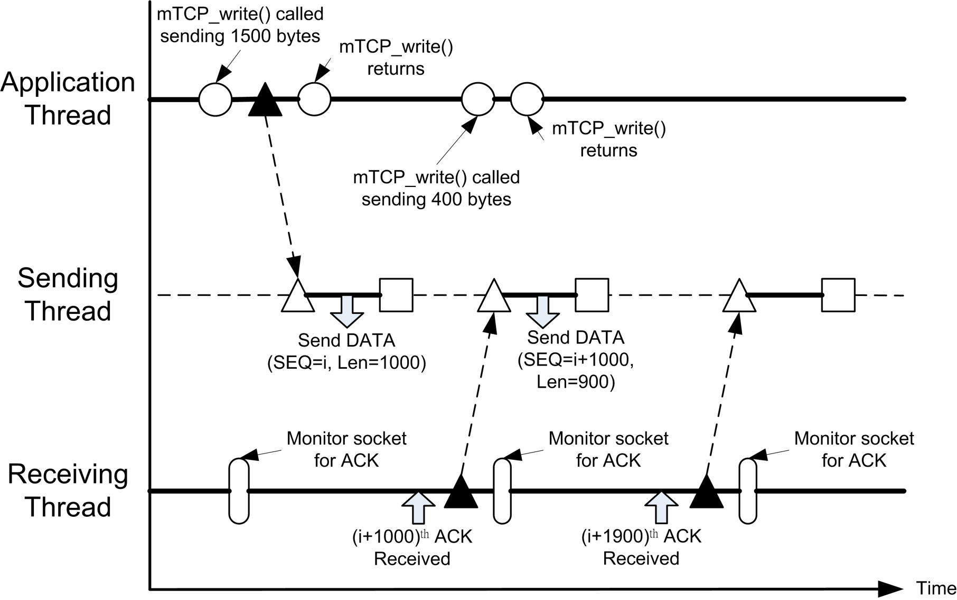
Thread Interaction Diagram of Client
Application thread write data to mTCP internal buffer. If sending thread is sleeping, send a signal to wake it up
(Note: This function return automatically)
Thread Interaction during data transmission

Slide 36
Thread Interaction Diagram of Client
2. Sending data packet out
Thread Interaction during data transmission

Slide 37
Thread Interaction Diagram of Client
3. Receive acknowledgement packet and wake up sending thread
Thread Interaction during data transmission

Slide 38
Thread Interaction Diagram of Client
4. The sending thread send the remaining 900 byte
Thread Interaction during data transmission

Slide 39
Thread Interaction Diagram of Client
5. Receive acknowledgement packet and wake up sending thread
Thread Interaction during data transmission

Slide 40
Thread Interaction Diagram of Client
6. Sending thread has no data to send now. It goes back to sleep again.
Thread Interaction during data transmission

Slide 41
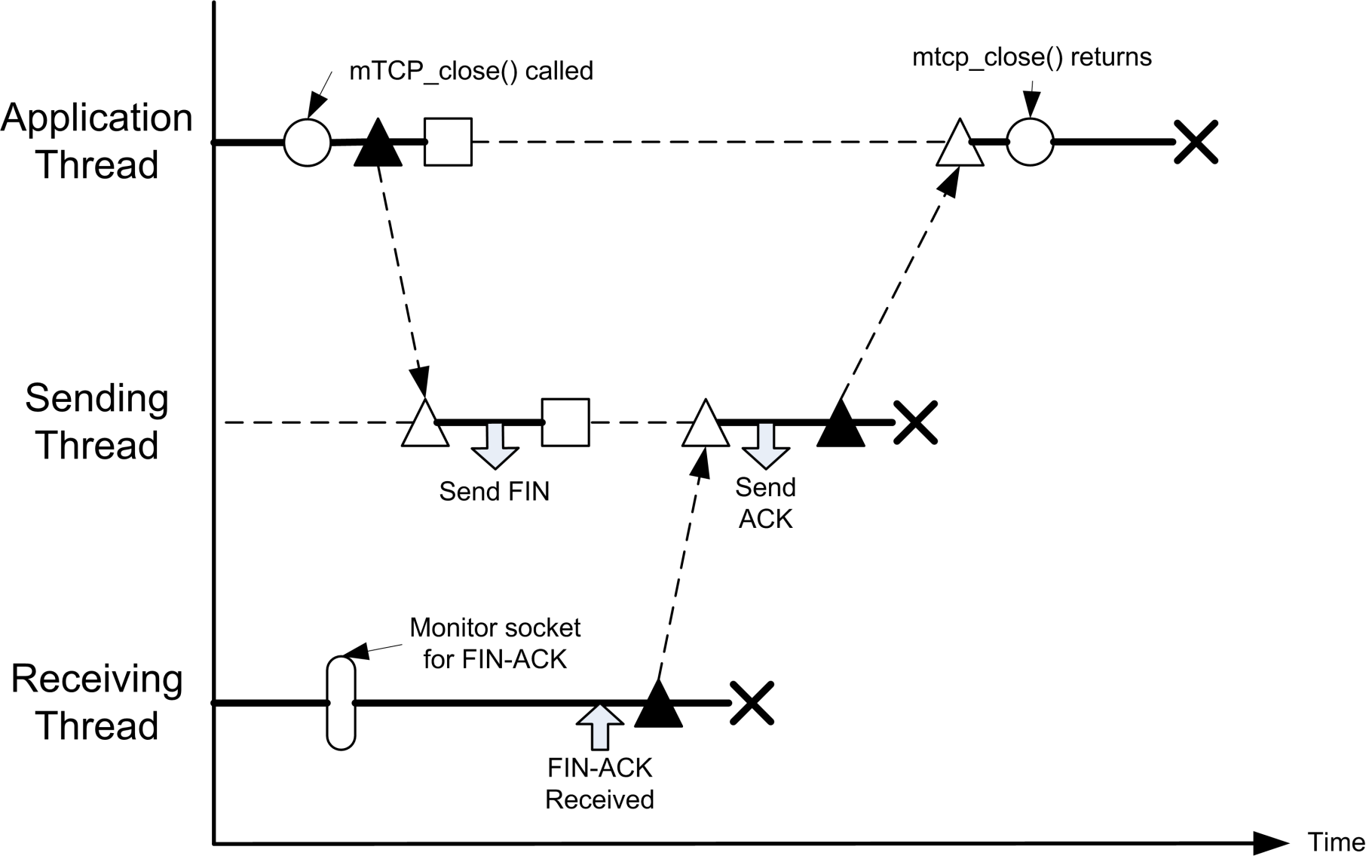
Thread Interaction Diagram of Client
Application thread calls the mtcp_close() to initiate 4 way handshake and wake up sending thread
Thread Interaction during closing connection

Slide 42
Thread Interaction Diagram of Client
2. Send FIN packet out, then sleep
Thread Interaction during closing connection

Slide 43
Thread Interaction Diagram of Client
2. After receive the FIN-ACK packet, wake up sending thread and terminate itself
Thread Interaction during closing connection

Slide 44
Thread Interaction Diagram of Client
3. After sending ACK packet, terminate itself and wake up application thread
Thread Interaction during closing connection

Slide 45
Thread Interaction Diagram of Client
4. Return the function after 4 way handshake is completed
Thread Interaction during closing connection

Slide 46
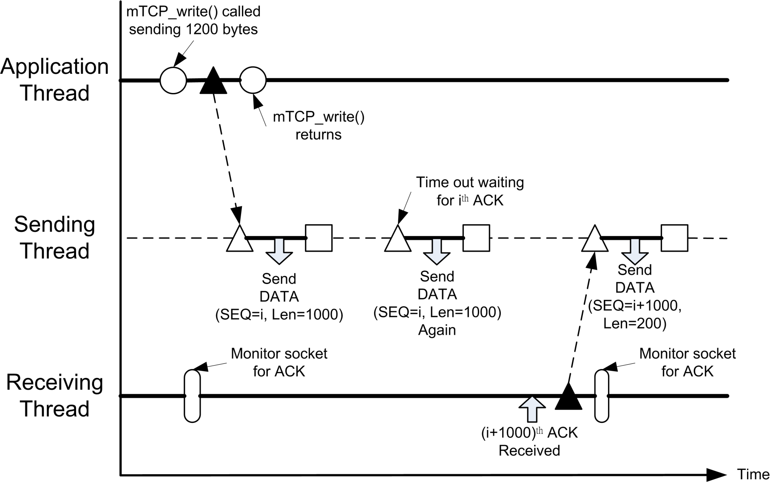
Thread Interaction Diagram of Client
Application thread write data to mTCP internal buffer. If sending thread is sleeping, send a signal to wake it up
(Note: This function return automatically)
Thread Interaction during data transmission with packet loss

Slide 47
Thread Interaction Diagram of Client
2. Sending data packet out
Thread Interaction during data transmission with packet loss

Slide 48
Thread Interaction Diagram of Client
3. No acknowledge is received by the receiving thread, sending thread resend the last DATA packet
Thread Interaction during data transmission with packet loss

Slide 49
Thread Interaction Diagram of Client
4. Receive acknowledgement packet and wake up sending thread
Thread Interaction during data transmission with packet loss

Slide 50
Thread Interaction Diagram of Client
6. The sending thread send the remaining 200 byte
Thread Interaction during data transmission with packet loss

