Slide 1
CSCI4430 Data Communication and Computer Networks
Tutorial 6 – Introduction on project mTCP protocol (II)

Slide 2
Thread Activity OverView

Slide 3
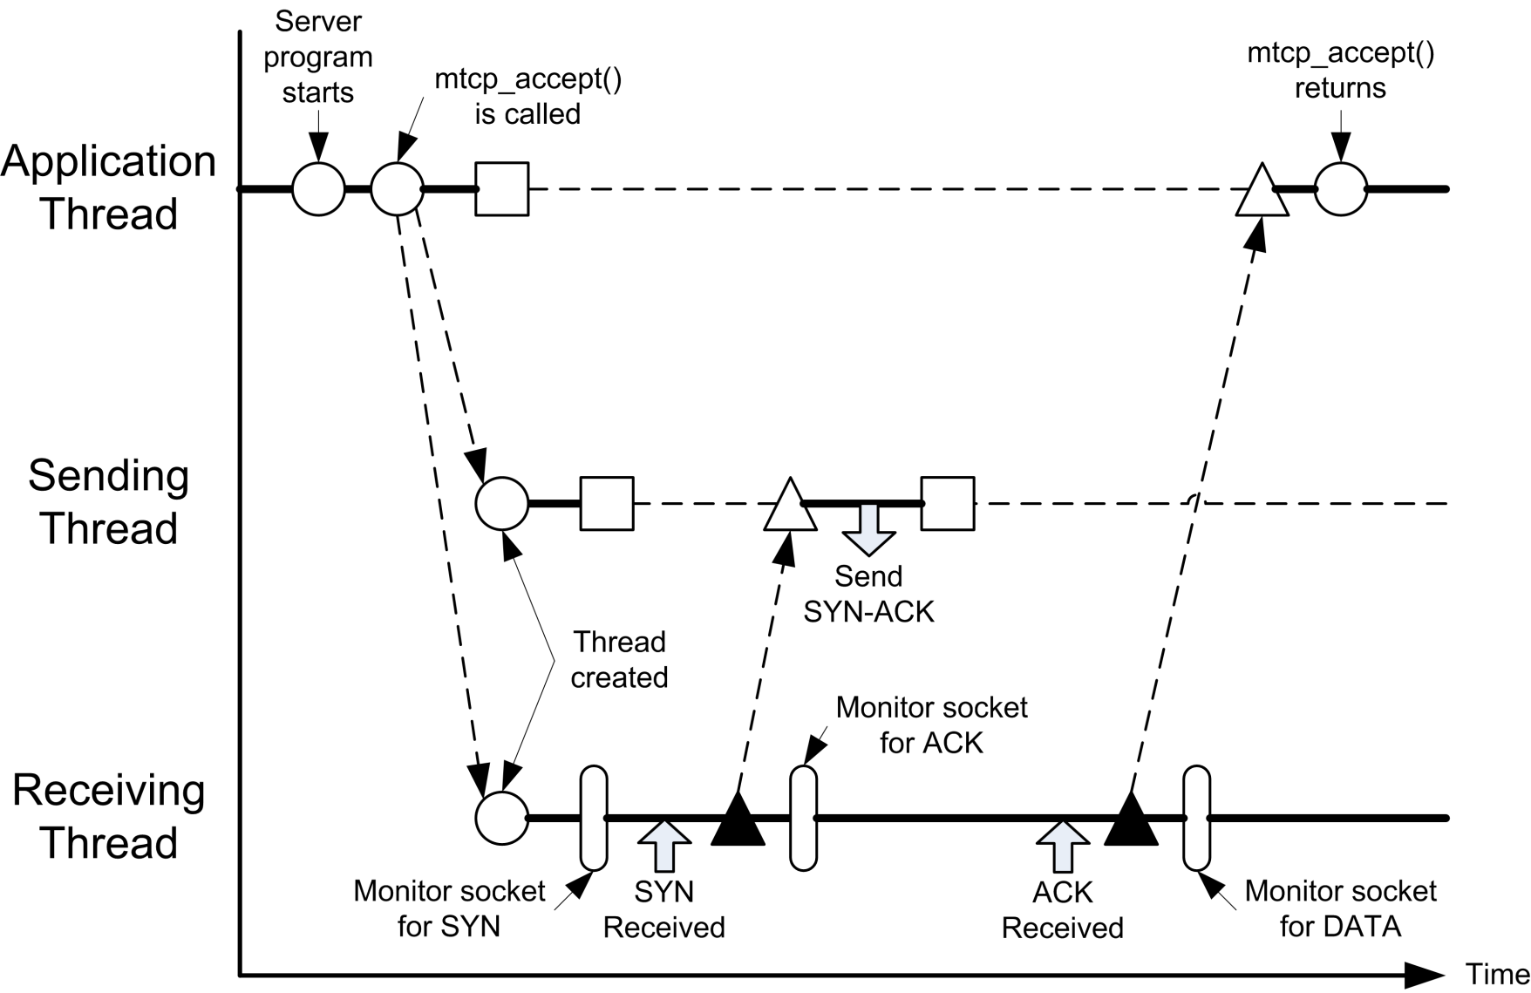
Thread Interaction Diagram of Server
1. Create and start sending thread and receiving thread
Thread Interaction during establishing connection (3-way Handshake)

Slide 4
Thread Interaction Diagram of Server
2. Application thread will be blocked until the connection is established
Thread Interaction during data transmission

Slide 5
Thread Interaction Diagram of Server
3. After receiving the SYN packet, it will wake up the sending thread to send the SYN-ACK packet
Thread Interaction during establishing connection (3-way Handshake)

Slide 6
Thread Interaction Diagram of Server
4. After woken up by application thread, send a SYN-ACK packet to server
Thread Interaction during establishing connection (3-way Handshake)

Slide 7
Thread Interaction Diagram of Server
5. After receiving ACK packet, the receive thread wake up the application thread
Thread Interaction during establishing connection (3-way Handshake)

Slide 8
Thread Interaction Diagram of Server
6. After woken up by the sending thread, the mtcp_appect() running on the application thread will be returned.
Thread Interaction during establishing connection (3-way Handshake)

Slide 9
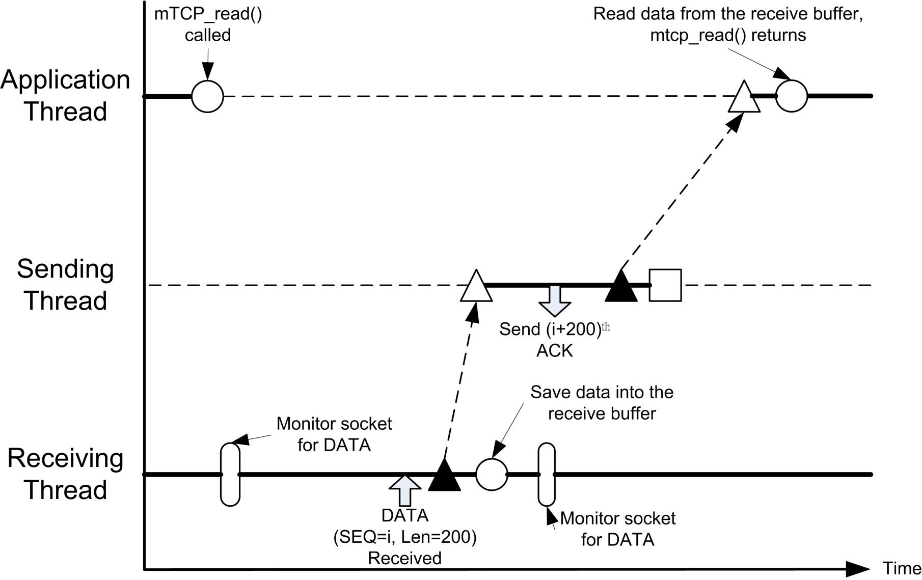
Thread Interaction Diagram of Server
Application thread read data to mTCP internal buffer. If the buffer is empty, it blocks until there is a packet received
Thread Interaction during data transmission

Slide 10
Thread Interaction Diagram of Server
2. Receive DATA packet, write the data to the buffer and wake up sending thread
Thread Interaction during data transmission

Slide 11
Thread Interaction Diagram of Server
2. Sending ACK packet out
Thread Interaction during data transmission

Slide 12
Thread Interaction Diagram of Server
3. After the sending thread send out the ACK packet, it wakes up the application thread
Thread Interaction during data transmission

Slide 13
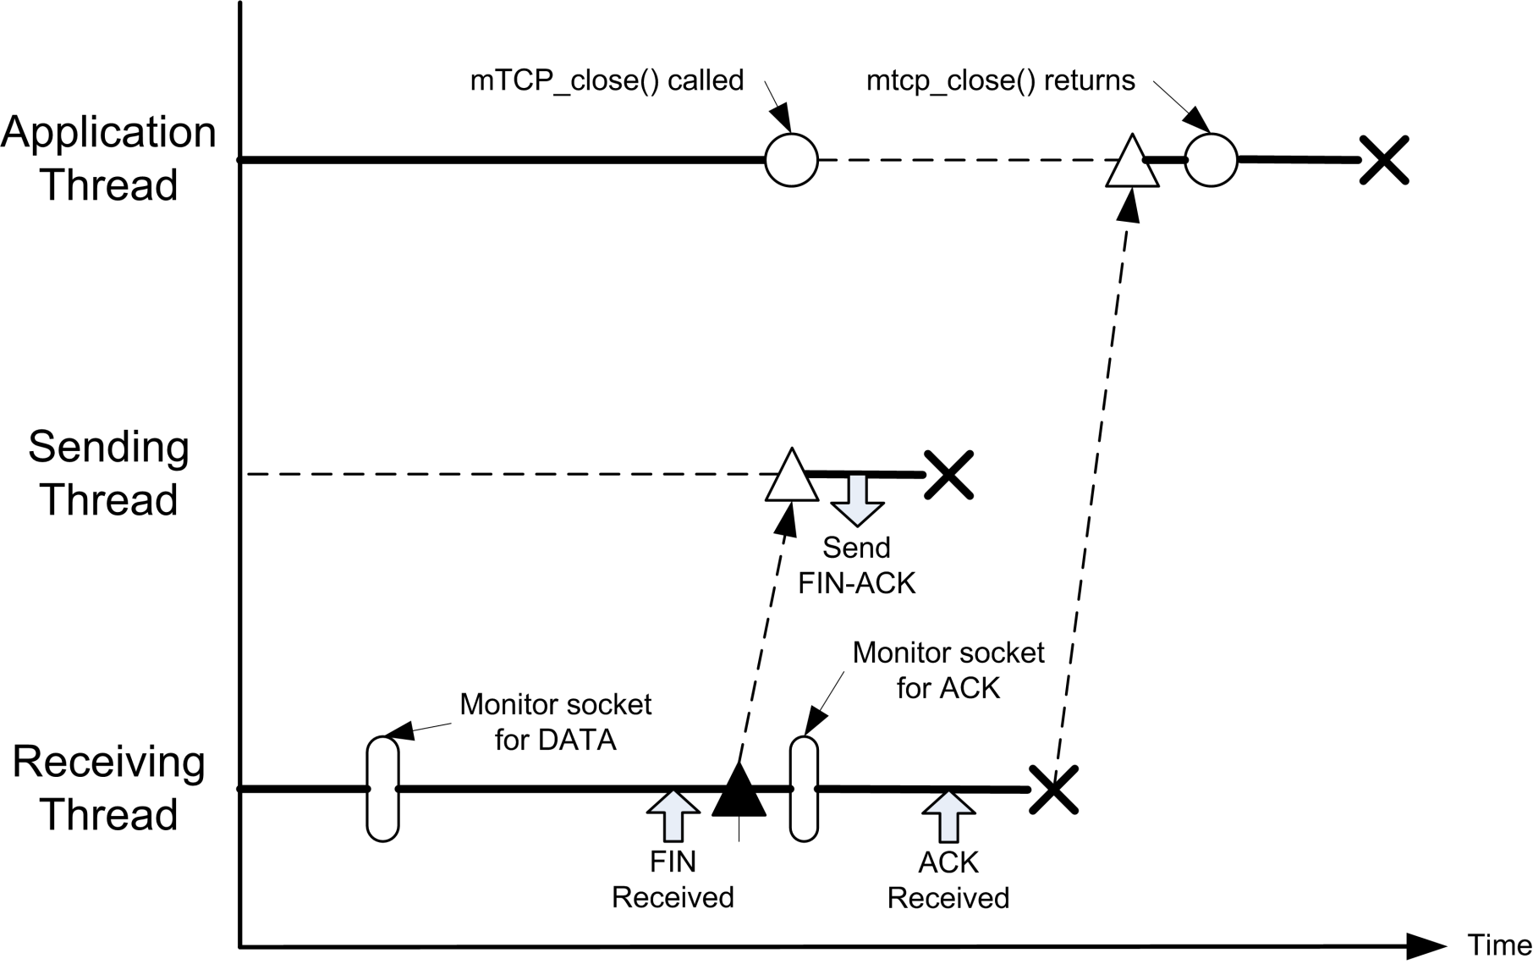
Thread Interaction Diagram of Server
Application thread will be blocked until the 4 way handshake has completed
Thread Interaction during closing connection (4-way Handshake)

Slide 14
Thread Interaction Diagram of Server
2. After receive the FIN packet, wake up sending thread to send FIN-ACK Packet
Thread Interaction during closing connection (4-way Handshake)

Slide 15
Thread Interaction Diagram of Server
3. Send FIN-ACK packet out, then terminate itself
Thread Interaction during closing connection (4-way Handshake)

Slide 16
Thread Interaction Diagram of Server
4. After receive the ACK packet, 4 way handshake is completed, wake up application thread and terminate itself
Thread Interaction during closing connection (4-way Handshake)

Slide 17
Thread Interaction Diagram of Server
5. Return the function after 4 way handshake is completed
Thread Interaction during closing connection (4-way Handshake)

Slide 18
Thread Flow Diagram (Client)

Slide 19
Flow Diagram of Sending Thread (Client)
Connection state:
During 3-way handshake
Data transmission
During 4-way handshake
Last packet received:
SYN-ACK
ACK
FIN-ACK
Sequence Number
Thread Start
Since time out of retransmission is 1s
Sleep for 1 Second
It should be done under critical section
Check & update state
Send packet
During 3-way handshake:
1. Send SYN
2. Send ACK after receiving SYN-ACK
During data transmission:
1. Send/Retransmit DATA
During 4-way handshake
1. Send FIN
2. Send ACK after receiving FIN-ACK
Is 4-Way handshake finished?
If no ACK is received, the state is not change and same DATA packet will be sent automatically
Thread Stop

Slide 20
Flow Diagram of Receiving Thread (Client)
Connection state:
During 3-way handshake
Data transmission
During 4-way handshake
Last packet sent:
SYN
ACK
DATA
FIN
Sequence Number
Thread Start
Monitor Socket
It should be done under critical section
Check & update state
Is 4-Way handshake finished?
Thread Stop

Slide 21
Thread Flow Diagram (Server)

Slide 22
Flow Diagram of Sending Thread (Server)
Connection state:
During 3-way handshake
Data transmission
During 4-way handshake
Last packet received:
SYN
DATA
FIN
ACK
Sequence Number
Thread Start
Sleep
It should be done under critical section
Check & update state
Send packet
During 3-way handshake:
1. Send SYN-ACK after receiving SYN
During data transmission:
1. Send ACK after receiving DATA
During 4-way handshake
1. Send FIN-ACK after receiving FIN
Is 4-Way handshake finished?
Thread Stop

Slide 23
Flow Diagram of Receiving Thread (Server)
Thread Start
Connection state:
During 3-way handshake
Data transmission
During 4-way handshake
Last packet sent:
SYN-ACK
ACK
FIN-ACK
Sequence Number
(If a DATA packet is received, the content of the data should be written to the buffer)
Monitor Socket
It should be done under critical section
Check & update state
Is 4-Way handshake finished?
Thread Stop

Slide 24
Additional pThread Function Call

Slide 25
Additional pThread Function Call
Make a thread sleep a certain period of time
Make a thread sleep indefinitely
Wait function call for thread
int pthread_cond_timedwait(pthread_cond_t *cond, pthread_mutex_t *mutex, const struct timespec *abstime)
int pthread_cond_wait(pthread_cond_t *cond, pthread_mutex_t *mutex)
int pthread_cond_signal(pthread_cond_t *cond)

Slide 26
Additional pThread Function Call
It will periodically:
Unlock the mutex
Check if signal is updated
Lock the mutex back again
Sleep for a fraction of time
Sample Code for making a thread sleep:
pthread_mutex_lock(&sig_mutex);
pthread_cond_timedwait(&sig,&sig_mutex, &timeNow);
pthread_mutex_unlock(&sig_mutex);
Sample Code for waking up a thread:
pthread_mutex_lock(&sig_mutex);
pthread_cond_signal(&sig);
pthread_mutex_unlock(&sig_mutex);
Must be in critical section
Signal and mutex are shared

