Slide 1
LipiLens
Ancient Scripts. New Possibilities.
AI-assisted transcription of historical Modi manuscripts — with a measured answer to whether image restoration actually helps.
Chirayu Khot
Kolhapur Institute of Technology, Kolhapur · (+ 3 co-authors & faculty mentor — TBD)

Slide 2
01 · PROBLEM
Millions of pages no machine can read
• Modi script: Maharashtra's administrative script, 13th c. to mid-20th c. — land, court and personal records survive only in Modi.
• Readers are disappearing, pages are degrading: faded ink, stains, skew, bad photography.
• No mature OCR exists for Modi. Vision-language models + LoRA adapters can draft transliterations — but a fluent draft can be entirely wrong.
• Two questions: can we build a trustworthy human-in-the-loop pipeline, and does classical restoration help or hurt the model?
LipiLens · Kolhapur Institute of Technology, Kolhapur
2

Slide 3
02 · SYSTEM
LipiLens: upload → restore → transcribe → verify
Upload
(photo)
Restore
(OpenCV, 7 configs)
Transcribe
(Qwen2.5-VL-3B + Modi LoRA)
Verify
(human, explicit)
Archive
+ search
→
→
→
→
• AI-authoritative use is structurally impossible: the AI draft is immutable; verification writes a separate field.
• Originals are never overwritten; every restoration config is versioned for reproducibility.
• Live demo: upload → compare slider → edit → verify → library.
LipiLens · Kolhapur Institute of Technology, Kolhapur
3

Slide 4
03 · EXPERIMENT
140 calls, 7 conditions, 20 pages
• Data: 50 real MoDeTrans pages (IIT Roorkee, MIT) with expert Devanagari ground truth; sweep on 20, refs 60–205 chars.
• Model: Qwen2.5-VL-3B + Modi LoRA (pinned revisions), official prompt, greedy decoding, Colab GPU.
• Conditions: original (control) · grayscale · denoised · enhanced (CLAHE) · binarized (Otsu) · deskewed · full restoration.
• Metrics: CER / WER vs ground truth; same model+prompt+decoding, only the input varies. Baseline n=50: CER 0.304.
LipiLens · Kolhapur Institute of Technology, Kolhapur
4

Slide 5
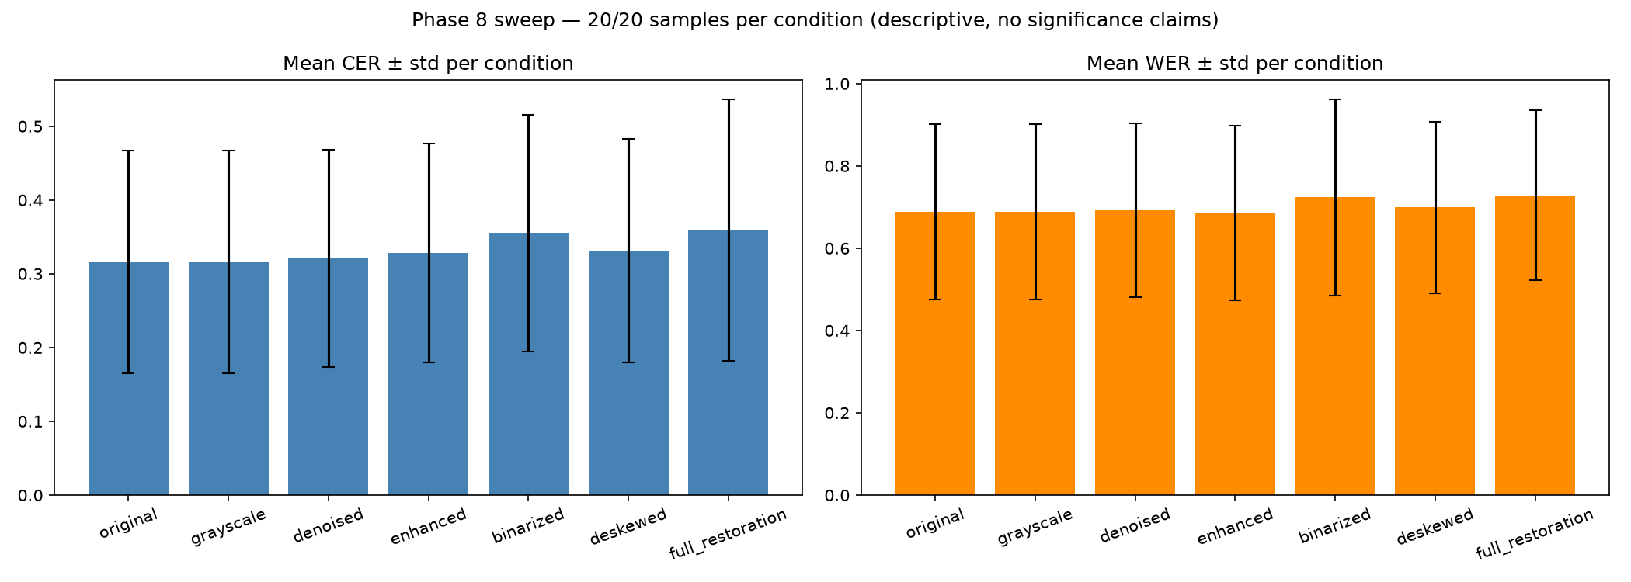
04 · RESULTS
On clean pages, send the original
• Grayscale = perfect no-op (20/20 ties: the control that validates the rig).
• Binarization hurts: 17/20 worse, +0.038 CER — thresholding erases faint strokes.
• Full pipeline worst overall: 0.359 — stacked neutral stages compound into harm.
• Denoise / enhance / deskew: neutral within noise.
• Honest bounds: n=20, descriptive only, possible train overlap, clean pages only.
LipiLens · Kolhapur Institute of Technology, Kolhapur
5

Slide 6
05 · TAKEAWAY
Default to the original. Verify everything.
• LipiLens works end-to-end and its study answers the question: preprocessing that destroys gray-level stroke detail hurts this VLM.
• Human verification is not a feature — it is the architecture (see: the fluent hallucination on MT-003).
• Next: degraded-manuscript robustness, larger ground-truth set, local-GPU path.
Thank you. Demo: upload → verify → library · Evidence: showcase/GROUND_TRUTH.md
LipiLens · Kolhapur Institute of Technology, Kolhapur
6

