Slide 1
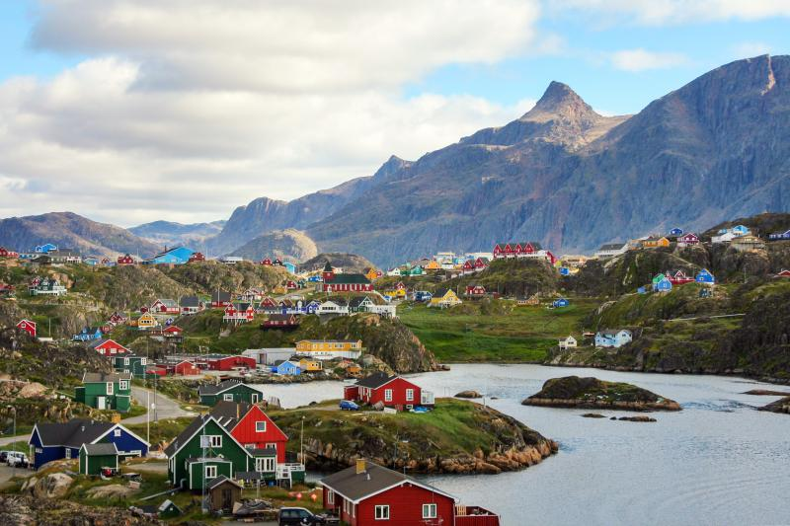
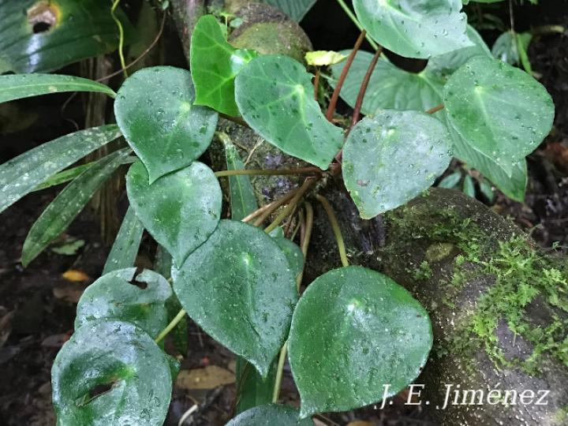
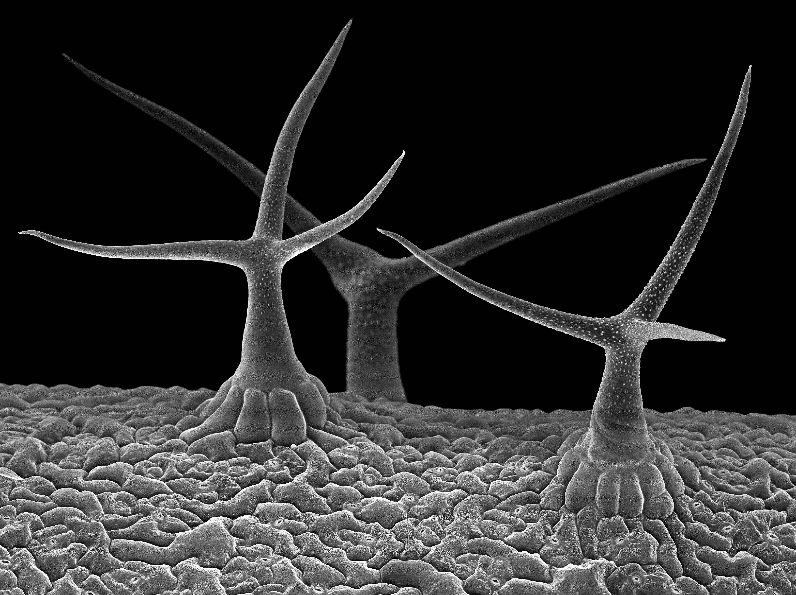
Greenland nest data Datasets/Greenland_nests.csv
Location data for Begonia conchifolia. Datasets/B_conch_loc.csv
Making bad formats better
Use:
Your note books (saved, annotated)
The cheatsheets
The pandas manual
Google advice
ChatGPT
Work as a group
Hairs per mm² on leaf surfaces Datasets/Leaves.csv

