Slide 1
Automated Question Type Coding
Gupte, A., Chawan, S., Thakur, H., Yashraj, S., Szojka, Z. A., Lyon, T. D. ,

Slide 2
Motivation
Importance of question type coding:
Widely used measure of interview quality (Lamb et al., 2018)
Broad open-ended questions (e.g., “Tell me everything that happened.”) are preferred because they elicit the most details and are least likely to lead to misinformation, followed by wh- questions (e.g., “Where was your mom?”) and option-posing questions (e.g., “Did you run away?”), which interviewers are trained to avoid
Benefits of automated question type coding:
Currently question type coding is performed manually – time-consuming and labor-intensive
Automated coding enables forensic interviewers and attorneys to obtain measures of interview quality quickly
Prior research:
Previous research relied on mock transcripts (with adults acting as child witnesses) to train models
Mixed results in terms of human-machine reliability

Slide 3
Our study - Data
First large language model trained on real data from forensic interviews and court transcripts
Sample: 349,033 utterances from 1,851 transcripts
Forensic interviews (California, 2004-2022): 1,435 (ages 3-17, M = 7.81)
Court trials (Los Angeles County Court, 1997-2001): 416 (ages 4-17, M = 11.85)
Manually question type coded by coders trained to achieve high reliability

Slide 4
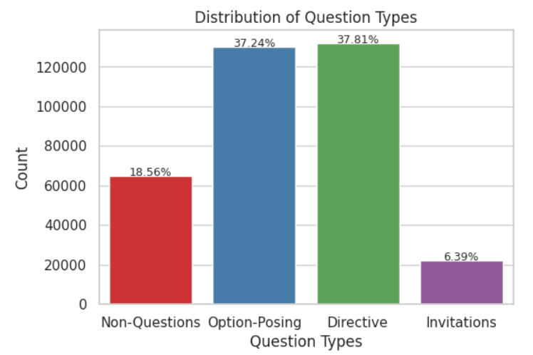
Problem
Our team’s first model was able to reliably distinguish between 3 types of questions
Non-questions (e.g., “Please sit down.”)
Option-posing questions: Yes/no and forced choice
Invitations & directives: Broad narrative prompts, wh- and how questions.
The current project aims to develop a 4-type model that can distinguish between invitations and directives
Invitations are recommended over directives, because they are broader and elicit more narrative information
Challenge: Invitations are used less frequently than other question types, especially at court, leading to an imbalanced question type distribution

Slide 5
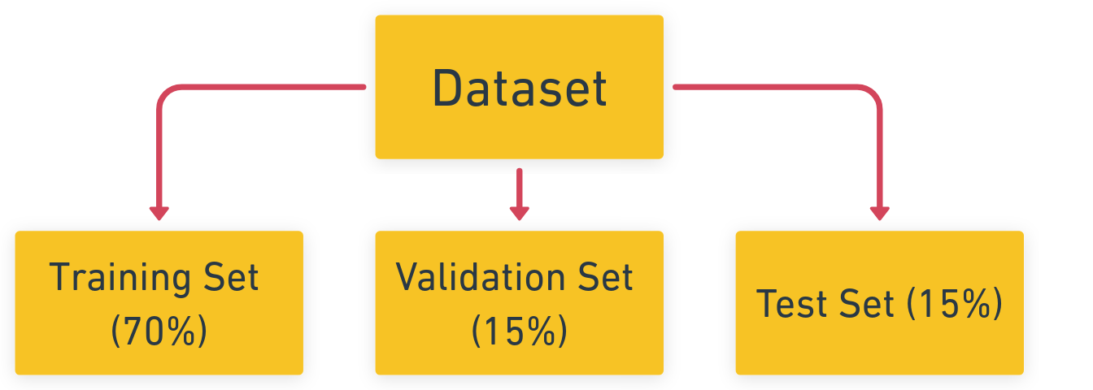
Approach
Addressing data imbalance:
Oversampled invitation examples to prevent bias
Robust training on a diverse dataset
Model selection and fine-tuning:
Used RoBERTa from Hugging Face as the pre-trained model
Fine-tuned the model on the oversampled dataset
Data split for training and evaluation:
Used the training set for model training
Validation set was used for performance assessment

Slide 6
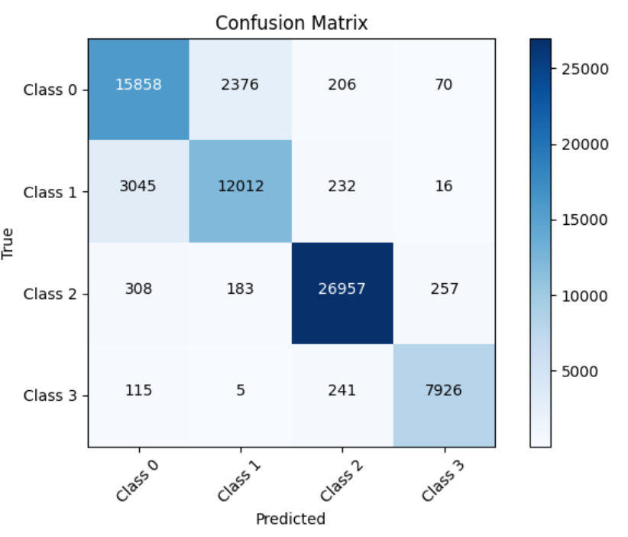
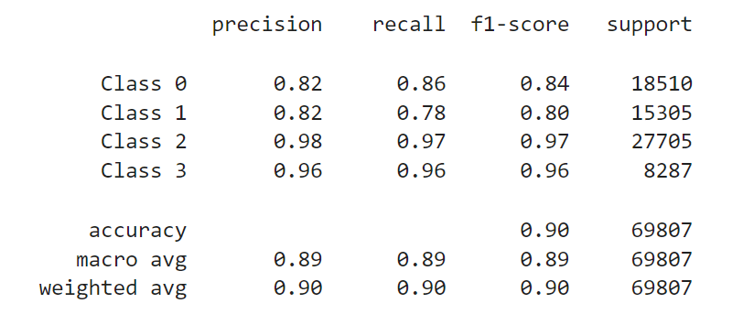
Results
High human-machine agreement:
82% for non-questions
82% for option-posing questions,
98% for wh-questions
96% for invitations

Slide 7
Discussion
Future work:
Differentiate between subtypes of option-posing questions
Yes-no questions (“Did you go home that night?”)
Forced choice questions (“Did you go home that night or did you stay with your sister?”)
Suggestive questions (“You went home that night, didn’t you?”)
Categorize children’s responses
Unelaborated (Q: “Did you go home that night?” A: “No.”)
Elaborated (Q: “Did you go home that night?” A: “No, I stayed with my sister.”)
Impact:
Automated coding saves time for interviewers, attorneys, and expert witnesses - aiming to incorporate transcription and develop instant feedback system

Slide 8
Thank You!

