Slide 1
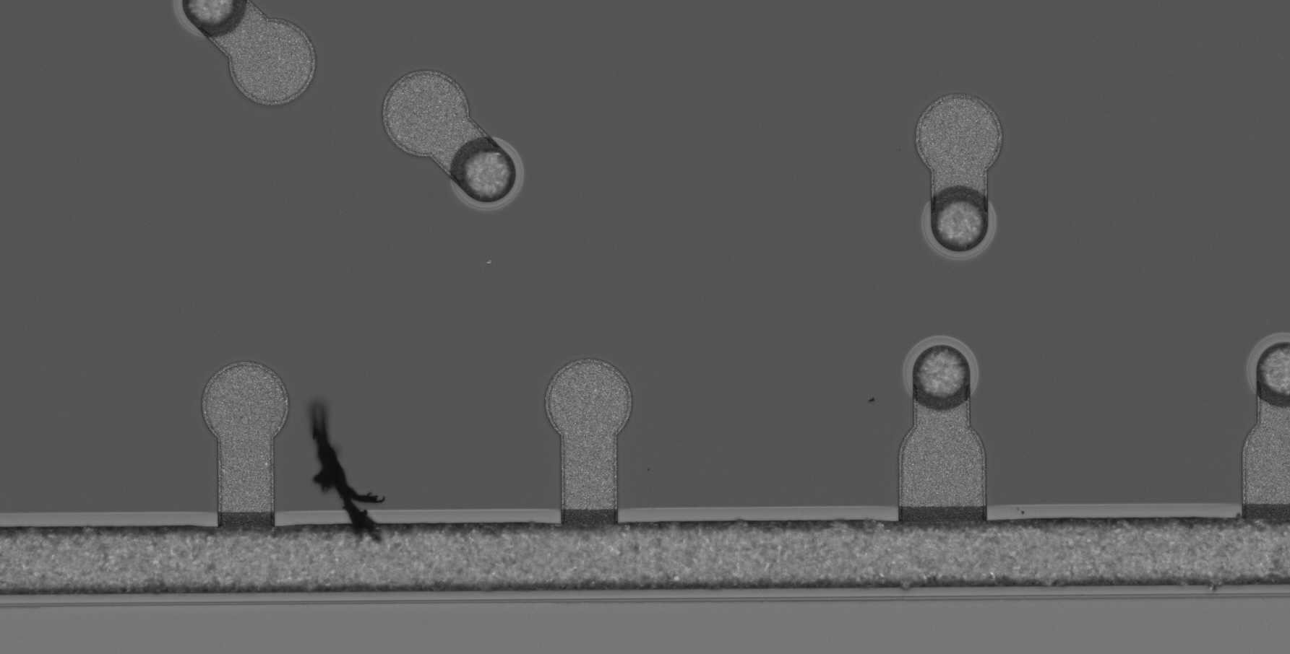

AI/ML assisted fault detection in foundry processed devices
Highly accurate fault detection in foundry produced microelectronics is crucial to ensuring quality of devices that leave the foundry
However, many current IC defect detection flows are human-centric and have potential to be a bottleneck in the foundry
Objective of this study is to find ways to leverage recent advances in AI/ML to enhance and accelerate the fault detection flow
Sample defect- foreign material in IC spanning multiple structures
Notes:
Hi, my name is Andy Rittenbach and I’d like to tell you a little bit about our project, AI/ML assisted fault detection in foundry processed devices. First, I would like to apologize for not being able to present in person. I am based out of the Arlington office of the Information Sciences Institute on the east coast, and I’m currently trying to get my four year old daughter to sleep. In this project we will be looking at ways to accelerate the defect detection flow of microelectronics produced at a foundry. Currently, most foundries use an image processing based approach that identifies potential defects in microelectronics by looking for variations in image contrast. If a chip is flagged as potentially having a defect, an engineer is brought in to look at the chip and to determine whether there actually is a defect. As you can imagine, this is a very time consuming and expensive process, and microelectronics manufacturers are looking for ways to reduce the time and costs, and to increase the accuracy of defect detection systems.

Slide 2
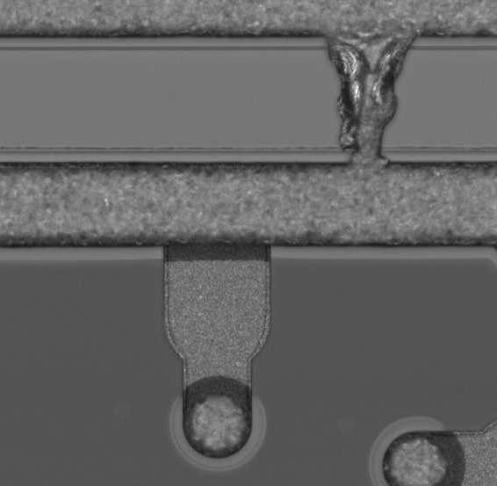
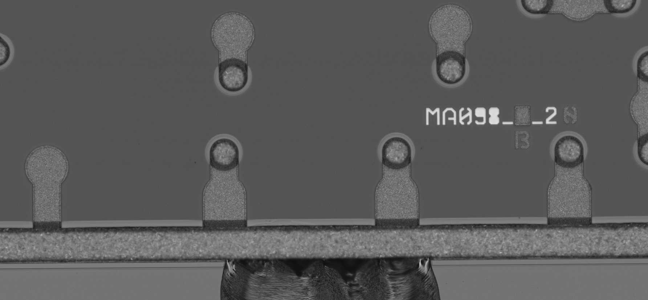
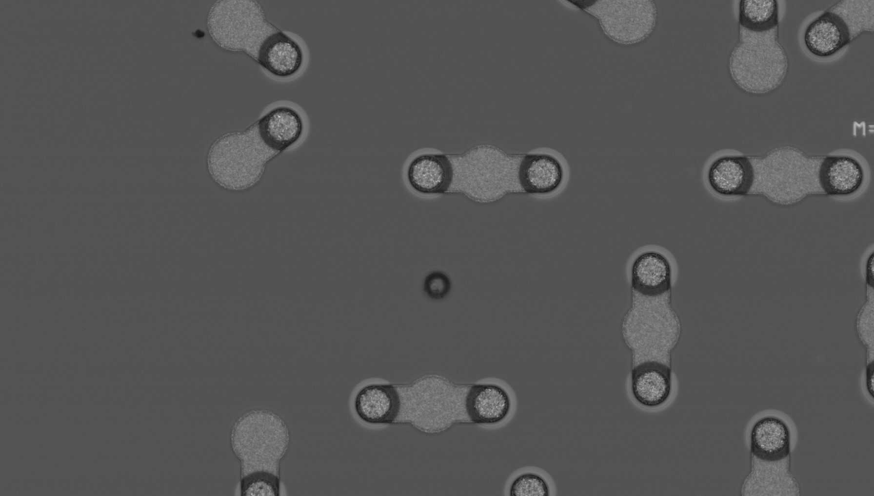
Challenge 1: Many different types of defects
Metal bridging
Foreign material
Chip out
Wafer pitting
Defects have many different shapes and sizes
Notes:
One challenge is that there are many different types of defects that can occur. I’ve highlighted a few of them here, but you can see that they all have very different shapes and sizes. Any viable defect detection model needs to be able to account for all of these types of defects, as well as many others.

Slide 3
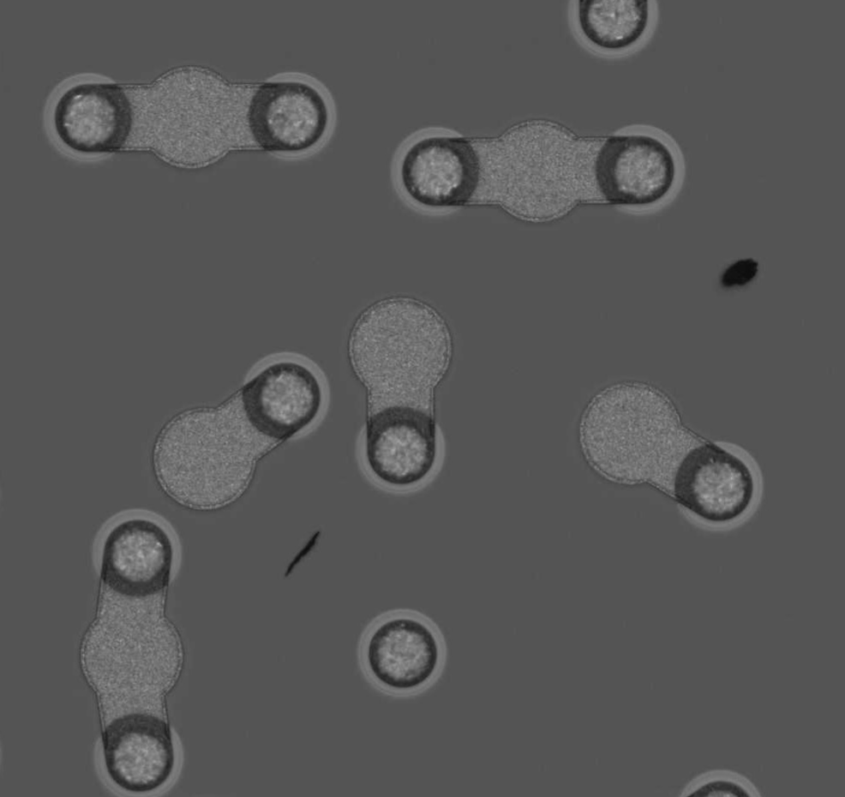
Challenge 2: Not all defects are show-stoppers
Foreign material crossing boundaries
Foreign material in IC wafer
Not all defects impact performance of IC, and some are considered acceptable
Notes:
Another challenge is that not all defects are show-stoppers. Here are two images of different chips with foreign material. In the chip on the left, the foreign material crosses multiple boundaries, which means that the chip must be discarded. However, the chip on the right has two pieces of foreign material that is only in the wafer of the chip. This is considered an acceptable defect, and the chip can still be used. Our defect detection approach needs to be able to take this feature of defects into account as well. Ideally, at the end of the project, we'll have a model that identifies chips as either defect free, having an acceptable defect, or having a rejectable defect.

Slide 4
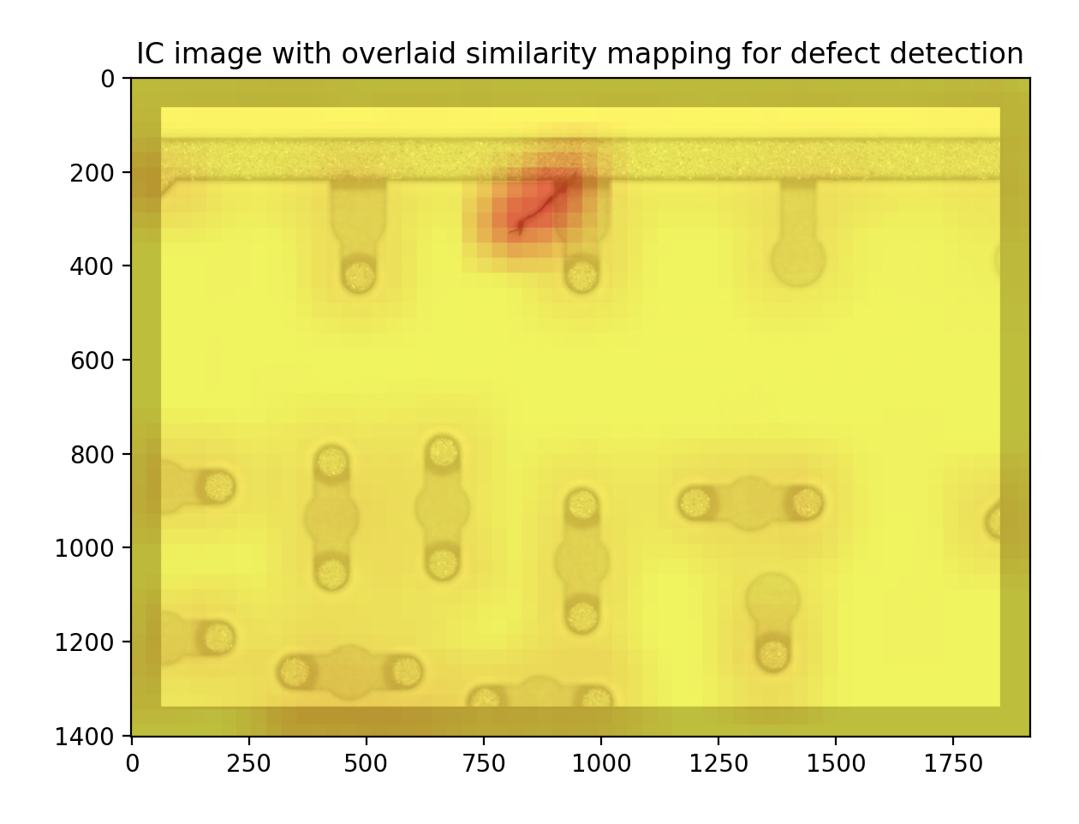
Project objectives
Due to large variety of types of defects, training a model to identify defects using a completely supervised based approach is not viable
Difficult to collect large training corpus with many samples of each type of defect
Want model to be able to identify when IC has a defect even when defect example was not included in data used to train model
Better approach is to train model that learns what IC should look like, and to recognize when there is a defect
Involves development of anomaly detection models
Stretch goal is to find a solution that makes use of pretrained feature extractors
Sample similarity mapping generated using deep image embeddings for defect detection
Notes:
Because there are so many different types of defects, a supervised approach where a model is trained using examples of each type of defect is not viable. This is because it is very difficult for the manufacturers at the microelectronics foundry to collect sufficient data samples of each type of defect. Our contact at the foundry told us that she has a book listing over 250 types of manufacturing defects, and there are many that she has never seen, so we’ll be working with an incomplete dataset for this project. Because of this, we need our model to be able to identify defects, even if the defect was not included in data used in our training dataset. Our goal for this project is to develop a model that learns what an integrated circuit should like, and to use this information to recognize when there is a defect. This is typically known as an anomaly detection problem. We’re also really interested in finding a solution that makes use entirely of pretrained feature extractors. For example, the heatmap shown on the right was generated through the use of deep image embeddings from a pretrained convolutional neural network followed by image similarity search.

Slide 5
Thank you!
If there are any questions, or if you have further interest, please reach out to:
Andy Rittenbach: arittenb@isi.edu
JP Walters: jwalters@isi.edu
Notes:
Thank you for your time, if you have any questions please feel free to reach out to me through my email or through the project Piazza page, and I’ll be happy to answer them. Thanks again.

