Slide 1
NAVER 영화('하울의움직이는성') 일반인 리뷰 크롤링
# NAVER 영화('하울의움직이는성') 일반인 리뷰 크롤링
library(rvest)
library(stringr)
library(dplyr)
library(xlsx)
setwd('D:/Workspace/R_Statistics/rcrawling')
trim <- function (x) gsub("^\\s+|\\s+$", "", x)
start_url <- 'https://movie.naver.com/movie/bi/mi/pointWriteFormList.nhn?code=39640&type=after&isActualPointWriteExecute=false&isMileageSubscriptionAlready=false&isMileageSubscriptionReject=false&'
page <- 'page='
#1page
url <- paste0(start_url, page, 1)
html <- read_html(url)
#코멘트 수를 통한 페이지 수 지정
#총 코멘트 수 11574
html %>%
html_node('.score_total') %>%
html_nodes('em') -> ems
pages <- ems[2] %>% html_text()
pages <- gsub(",", "", pages)
allpages <- ceiling(as.numeric(pages)/10)
#전체 리뷰 크롤링
df_all <- data.frame(score=c(), review=c(), writer=c(), time=c())
for (i in 1:allpages) {
url <- paste0(start_url, page, i)
html <- read_html(url)
html %>%
html_node('.score_result') %>%
html_nodes('li') -> lis
score <- c(); review <- c(); writer <- c(); time <- c()
for(li in lis) {
score <- c(score, html_node(li,'.star_score')%>%
html_text('em') %>%
trim())
li %>%
html_node('.score_reple') %>%
html_text('p') %>%
trim() -> tmp
idx <- str_locate(tmp, "\r")
review <- c(review, str_sub(tmp, 1, idx[1]-1))
tmp <- trim(str_sub(tmp, idx[1], -1))
idx <- str_locate(tmp, "\r")
writer <- c(writer, str_sub(tmp, 1, idx[1]-1))
tmp <- trim(str_sub(tmp, idx[1], -1))
idx <- str_locate(tmp, "\r")
time <- c(time, str_sub(tmp, 1, idx[1]-1))
}
review1 = data.frame(score=score, review=review, writer=writer, time=time)
df_all <- rbind.data.frame(df_all, review1)
}
head(df_all)

Slide 2
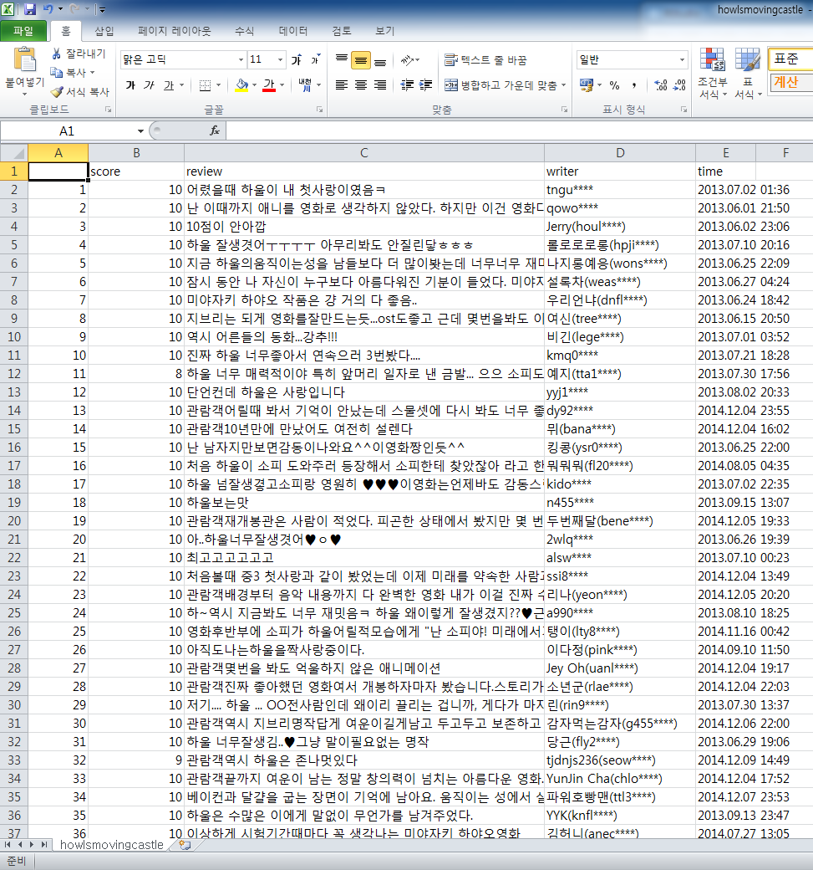
NAVER 영화('하울의움직이는성') 일반인 리뷰 크롤링
write.csv(df_all,'D:/Workspace/R_Statistics/rcrawling/howlsmovingcastle.csv')
write.xlsx(df_all,'D:/Workspace/R_Statistics/rcrawling/howlsmovingcastle2.xlsx',sheetName="하울의 움직이는 성")

Slide 3
NAVER 영화('하울의움직이는성') 일반인 리뷰 워드 클라우드
{r warning = FALSE}
library(wordcloud)
library(rJava)
library(KoNLP)
useSejongDic()
library(xlsx)
library(stringr)
library(RColorBrewer)
library(ggplot2)
library(dplyr)
data1 <- read.xlsx2('D:/Workspace/R_Statistics/rcrawling/howlsmovingcastle2.xlsx', 1)
head(data1)
data2 <- data1$review
head(data2)
write.table(data2, 'D:/Workspace/R_Statistics/rcrawling/howlsmovingcastle.txt',
sep=",",
row.names=FALSE,
col.names = FALSE,
quote=FALSE)
data3 <- readLines('D:/Workspace/R_Statistics/rcrawling/howlsmovingcastle.txt')
head(data3)
howl1 <- sapply(data3, extractNoun, USE.NAMES = F)
head(howl1)
howl2 <- unlist(howl1)
head(howl2, 10)
howl2 <- str_replace_all(howl2, "[^[:alpha:]]", "")
howl2 <- gsub('[ㄱ-ㅎ]','',howl2)
howl2 <- gsub('(ㅜ|ㅠ)+','',howl2)
howl2 <- gsub(" ", "", howl2)
txt <- readLines("howlsmovingcastle_gsub.txt")
txt
for(i in 1:length(txt)) {
howl2 <-gsub((txt[i]), "", howl2)
}
howl2 <- Filter(function(x) {nchar(x) >= 2}, howl2)
head(howl2,50)
write(unlist(howl2),"howlsmovingcastle2.txt")
howl3 <- read.table("howlsmovingcastle2.txt")
nrow(howl3)
wordcount<- table(howl3)
head(sort(wordcount, decreasing = T),100)
palete <- brewer.pal(8,"Set2")
wordcloud(names(wordcount), freq = wordcount, scale = c(5,1),
rot.per=0.25, min.freq = 5,
random.order = F, random.color = T, colors = palete)

Slide 4
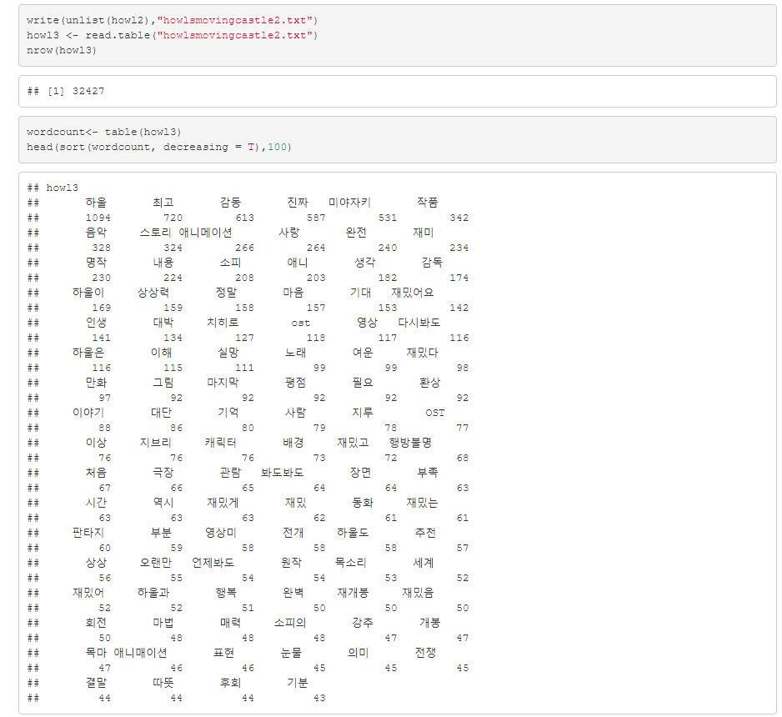

Slide 5
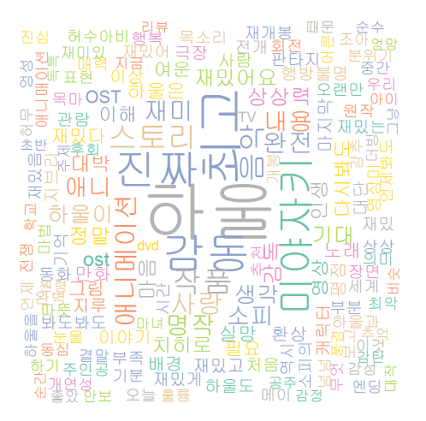
NAVER 영화('하울의움직이는성') 일반인 리뷰 워드 클라우드

Slide 6
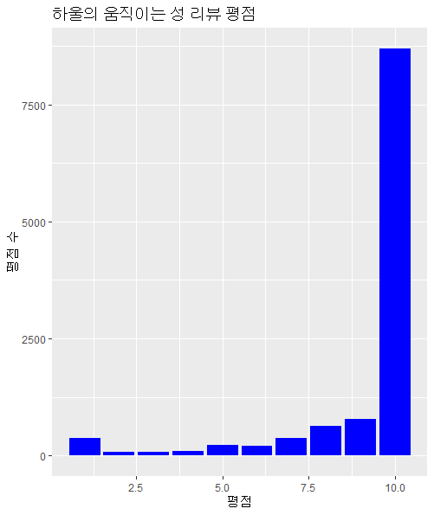
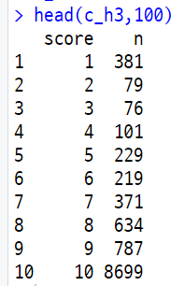
NAVER 영화('하울의움직이는성') 일반인 리뷰 평점 분석하기
library(ggplot2)
library(tidyr)
library(reshape2)
library(dplyr)
h1 <- read.csv('howlsmovingcastle.csv')
h_score <- melt(h1$score)
h_time <- melt(h1$time)
h2 <- cbind(h_score,h_time)
colnames(h2) <- c('score', 'time')
head(h2)
h2$score <- as.numeric(h2$score)
h2$time <- as.character(h2$time)
h2$time <- gsub("\\.","-",h2$time)
h2$time <- gsub(" ","/",h2$time)
h3 <- separate(h2, time, sep="/", into=c("date","time"))
head(h3)
ggplot(h3, aes(x=score)) + geom_bar(fill = 'blue') +
xlab("평점") + ylab("평점 수") +
ggtitle("하울의 움직이는 성 리뷰 평점")
c_h3<-as.data.frame(count(h3,score))
head(c_h3,100)

Slide 7
NAVER 영화('하울의움직이는성') 일반인 리뷰 평점 분석하기
#일자별 평점 분석하기
2004 . 12. 23 개봉 2014 .12. 04 재개봉.
d_score <- filter(h3, date>="2004-12-23" & date<="2005-01-23")
d_score14 <- filter(h3, date>="2014-12-04" & date<="2015-01-04")
head(d_score)
ggplot(data=d_score, aes(x=date, y=score, fill=score)) +
geom_bar(stat="identity")+
theme(axis.text.x=element_text(angle=45, hjust=1, vjust=1,
colour="black", size=8))
ggplot(data=d_score14, aes(x=date, y=score, fill=score)) +
geom_bar(stat="identity")+
theme(axis.text.x=element_text(angle=45, hjust=1, vjust=1,
colour="black", size=8))
#시간별 평점 분석하기
ggplot(data=d_score, aes(x=time, y=score, fill=score)) +
geom_bar(stat="identity")
ggplot(data=d_score14, aes(x=time, y=score, fill=score)) +
geom_bar(stat="identity")

Slide 8
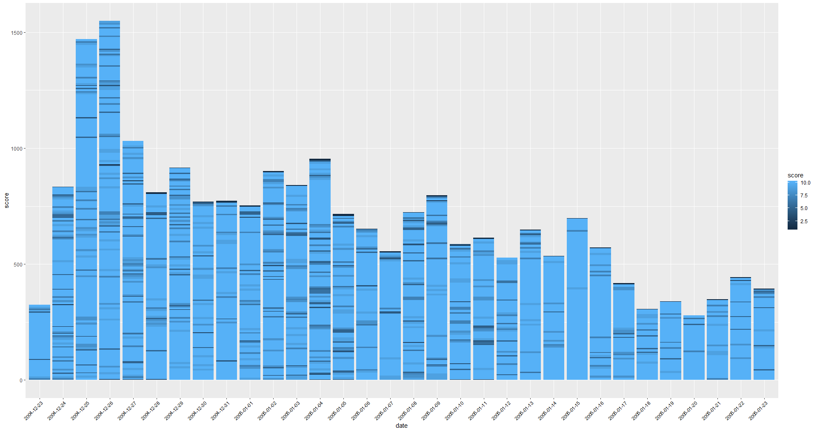
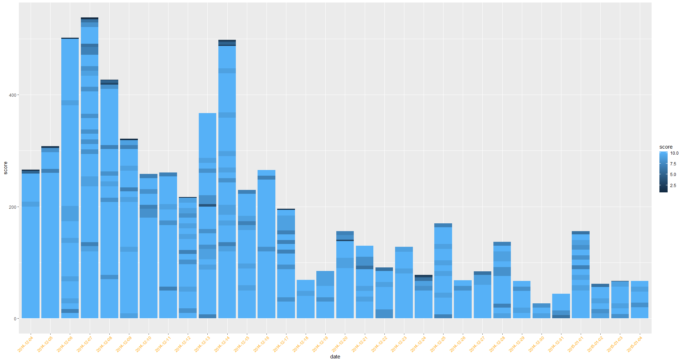

Slide 9
